Slide 1
Networking in Tungsten Fabric

Slide 2
Contents
Network Routing
What is EVPN?

Slide 3
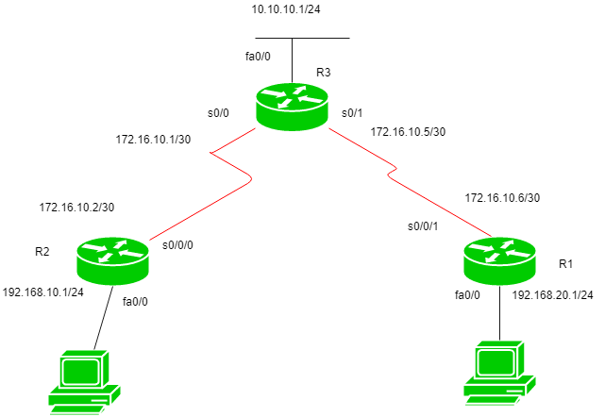
Network Routing
Routing
  Routing is a process which is performed by layer 3 (or network layer) devices in order to deliver the packet by choosing an optimal path from one network to another.
R2(config)#ip route 192.168.20.0 255.255.255.0 172.16.10.1
R2(config)#ip route 10.10.10.0 255.255.255.0 172.16.10.1
R2(config)#ip route 172.16.10.4 255.255.255.0 172.16.10.1

Slide 4
Network Routing
A basic routing table includes the following information:
  Destination: The IP address of the packet's final destination
  Next hop: The IP address to which the packet is forwarded
  Interface: The outgoing network interface the device should use when forwarding the packet to the next hop or final destination
  Metric: Assigns a cost to each available route so that the most cost-effective path can be chosen
  Routes: Includes directly-attached subnets, indirect subnets that are not attached to the device but can be accessed through one or more hops, and default routes to use for certain types of traffic or when information is lacking.
Routing tables can be maintained manually or dynamically.

Slide 5
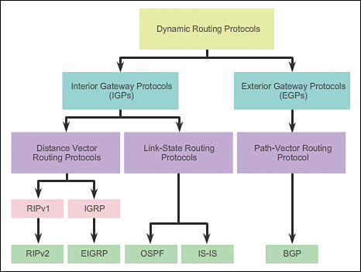
Network Routing
Type of routing protocols

Slide 6
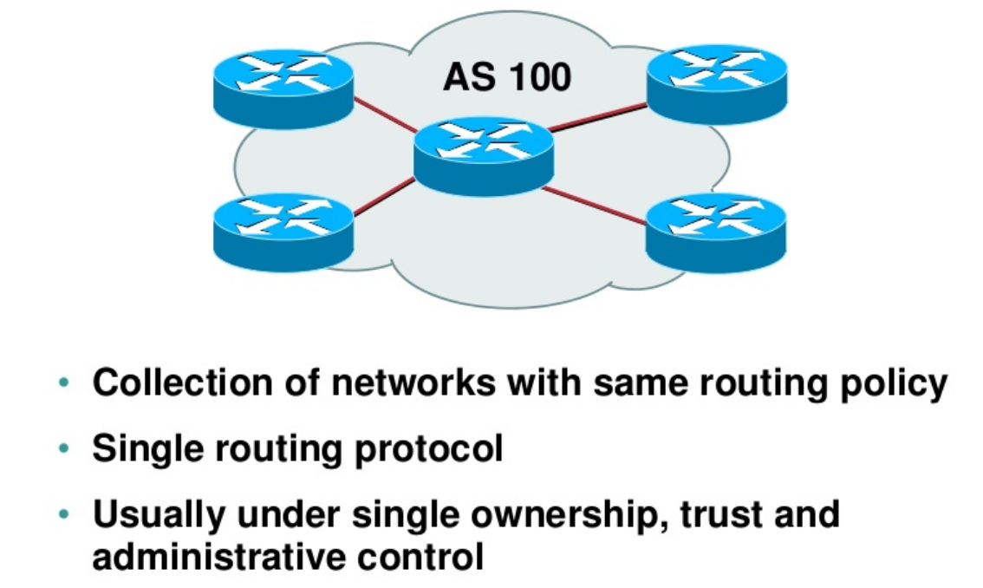
Network Routing
Autonomous System (AS)

Slide 7
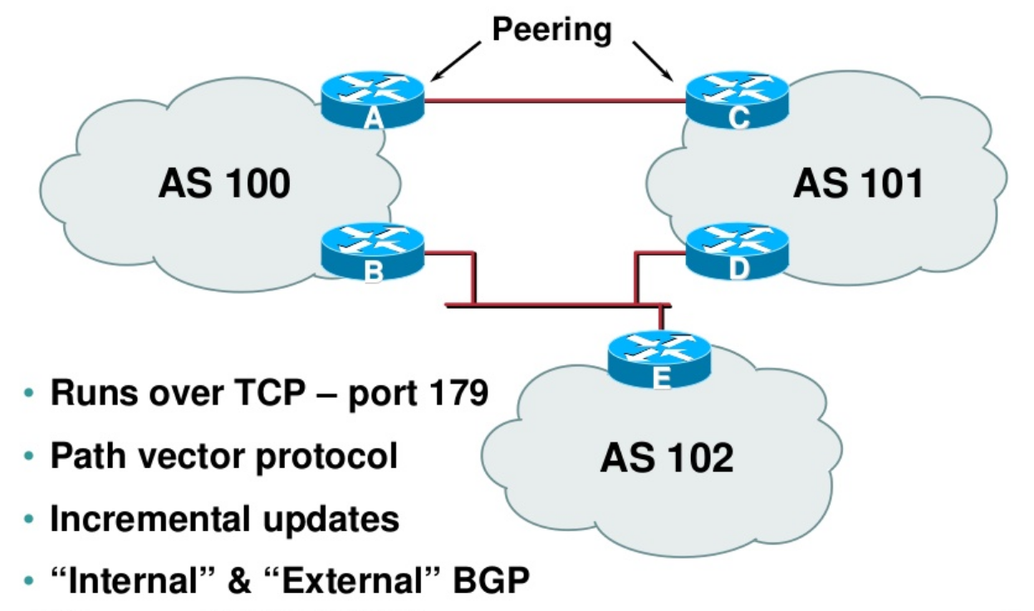
Network Routing
Autonomous System (AS)

Slide 8
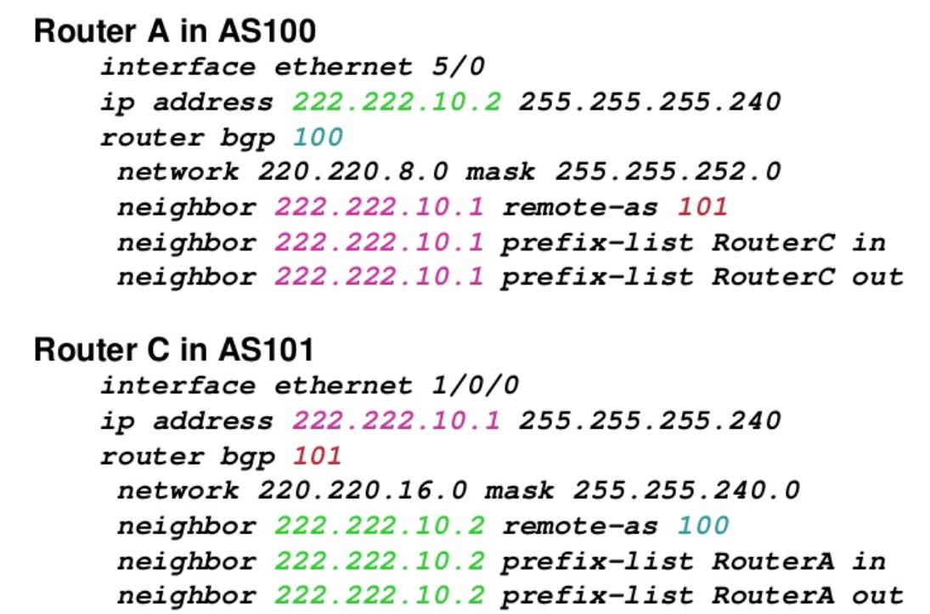
Network Routing
BGP

Slide 9
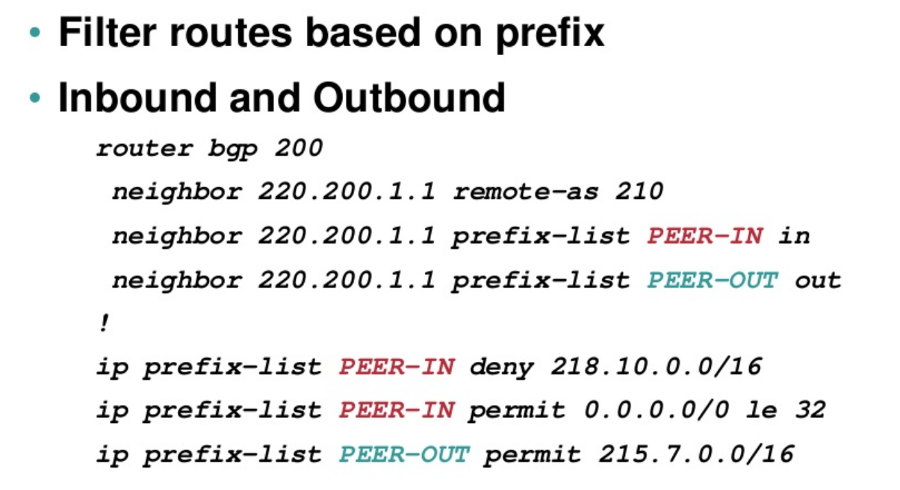
Network Routing
BGP

Slide 10
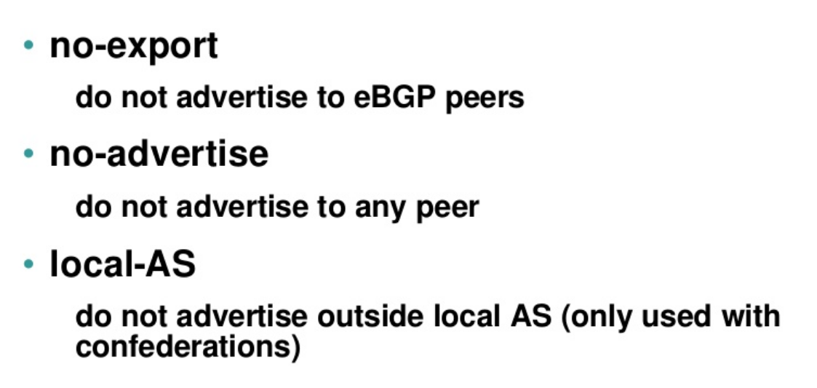
Network Routing
BGP - Wellknown Communities

Slide 11
Network Routing
BGP

Slide 12
Network Routing
VRF
  VRFs ( or VPN Routing and Forwarding instances or virtual Routing and Forwarding) are most commonly associated with MPLS service providers.
  In such networks, MPLS encapsulation is used to isolate individual customers' traffic and an independent routing table (VRF) is maintained for each customer.
  Most often, MP-BGP is employed to facilitate complex redistribution schemes to import and export routes to and from VRFs to provide Internet connectivity.

Slide 13
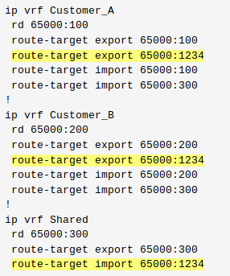
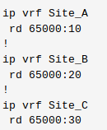
Network Routing
VRF
  Route distinguishers (RD) are used to maintain uniqueness among identical routes in different VRFs, route targets (RT) can be used to share routes among them.

Slide 14
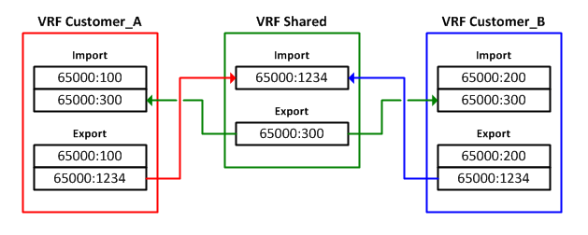
Network Routing
VRF

Slide 16
What is EVPN?
EVPN is a multi-tenant BGP-based control plane for layer-2 (bridging) and layer-3 (routing) VPNs. It’s the unifying L2+L3 equivalent of the traditional L3-only MPLS/VPN control plane.
EVPN provides a wide of range of services, such as E-LAN, E-Line, E-Tree, Layer 3 VPN, data center interconnect (DCI), DC overlay, and Integrated Routing and Bridging (IRB). These services were previously provided by disjointed technologies.
In theory you could use EVPN with almost any data-plane encapsulation (RFCs define extended BGP community values for MPLS, VXLAN, MPLS-over-GRE, MPLS-over-UDP, NVGRE…). In practice, it’s used with either MPLS or VXLAN.
EVPN replaces flood-and-learn behavior of traditional Ethernet bridges (or VPLS or simpler VXLAN implementations) with BGP control plane – MAC addresses are propagated as BGP prefixes within the EVPN address family.
EVPN implementations could use dynamic IP address discovery using DHCP reply snooping, ARP request snooping, or IP packet header gleaning, and advertise IP-to-MAC bindings in EVPN BGP updates.
You can use EVPN to implement end-to-end bridging, integrated bridging and routing, or routing-only fabrics.

Slide 17
Types of VPNs
A virtual private network (VPN) consists of two topological areas: the provider’s network and the customer’s network.
The customer’s network is commonly located at multiple physical sites and is also private (non-Internet). A customer site would typically consist of a group of routers or other networking equipment located at a single physical location.
The provider’s network, which runs across the public Internet infrastructure, consists of routers that provide VPN services to a customer’s network as well as routers that provide other services.

Slide 18
Layer 2 VPNs
Implementing a Layer 2 VPN on a router is similar to implementing a VPN using a Layer 2 technology such as ATM or Frame Relay. However, for a Layer 2 VPN on a router, traffic is forwarded to the router in Layer 2 format.
On a Layer 2 VPN, routing occurs on the customer’s routers, typically on the CE router. The PE router receiving the traffic sends it across the service provider’s network to the PE router connected to the receiving site. The PE routers do not need to store or process the customer’s routes; they only need to be configured to send data to the appropriate tunnel.

Slide 19
Layer 3 VPNs
In a Layer 3 VPN, the routing occurs on the service provider’s routers. Therefore, Layer 3 VPNs require more configuration on the part of the service provider, because the service provider’s PE routers must store and process the customer’s routes.

Slide 20
Understanding layer 3 VPNs
Virtual private networks (VPNs) are private networks that use a public network to connect two or more remote sites. Instead of dedicated connections between networks, VPNs use virtual connections routed (tunneled) through public networks that are typically service provider networks.
Layer 3 VPN operates at the Layer 3 level of the OSI model, the Network layer. The common routing information is shared across the provider's backbone using multiprotocol BGP (MP-BGP), and the VPN traffic is forwarded to the customer sites using MPLS (VxLAN, etc).

Slide 21
Components of layer 3 VPNs
CE devices - Customer Edge (CE) devices at the customer premises that connect to the provider’s network. Some models call these Customer Premises Equipment (CPE) devices.
Customer network - Customer sites with CE devices that belong to the VPN.
Provider network - The service provider backbone network running the MPLS backbone.
P devices -Provider (P) devices within the core of the provider’s network. Provider devices are not connected to any device at a customer site and are part of the tunnel between pairs of PE devices. Provider devices support label-switched path (LSP) functionality as part of the tunnel support, but do not support VPN functionality.
PE devices - Provider Edge (PE) devices within a service provider core network that connect directly to a CE device at the customer's site.
MP-BGP - PE devices use MP-BGP to distribute customer routes to the proper PE devices across the MPLS backbone.

Slide 22
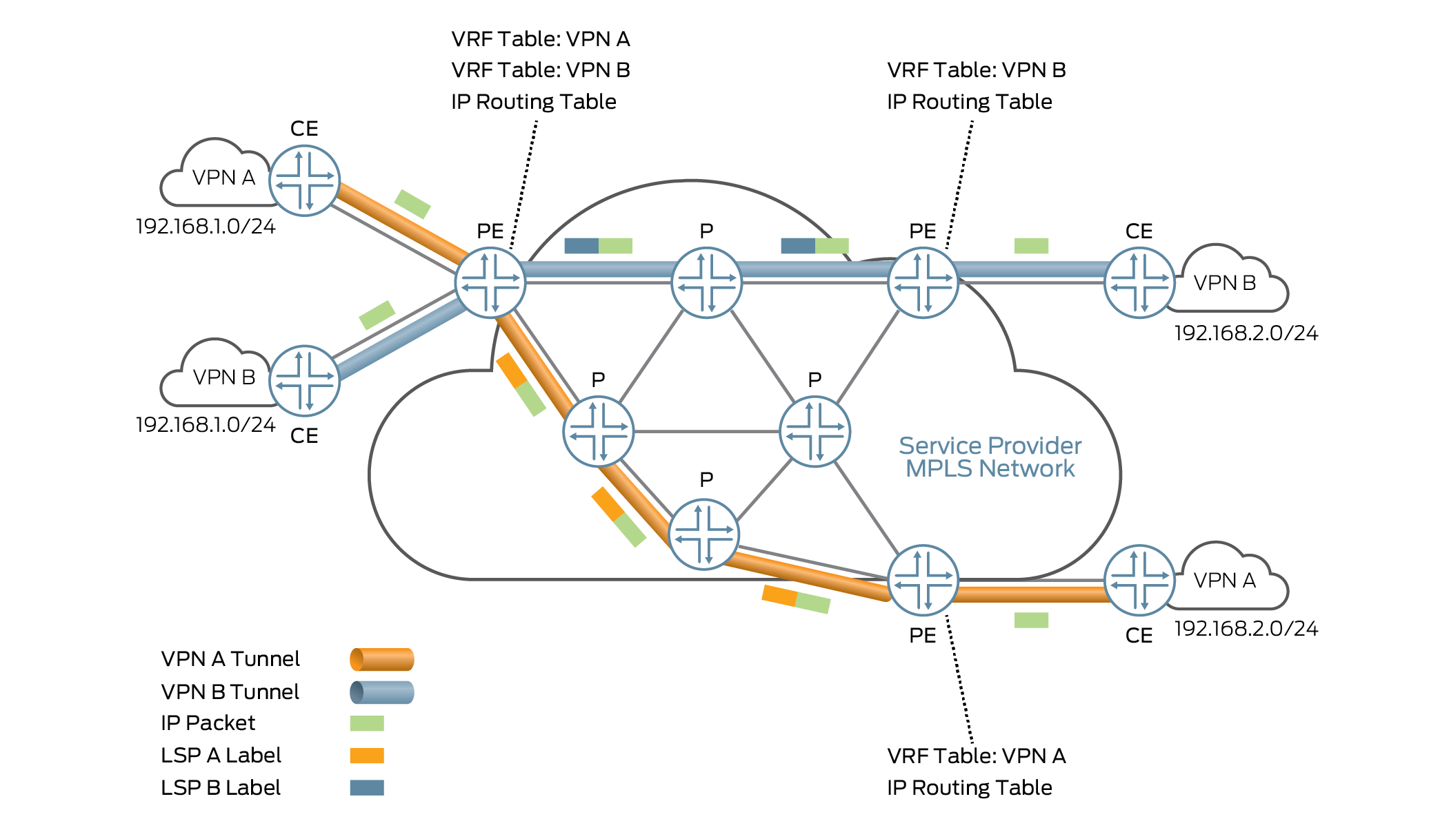
General Layer 3 VPN Architecture

Slide 23
What is EVPN?

