Slide 1
Networking in Tungsten Fabric SDN controller

Slide 2
Contents
Network Routing
What is EVPN?
Configuration example
Understanding Contrail Virtual Networks Use with EVPN-VXLAN

Slide 3
Network Routing

Slide 4
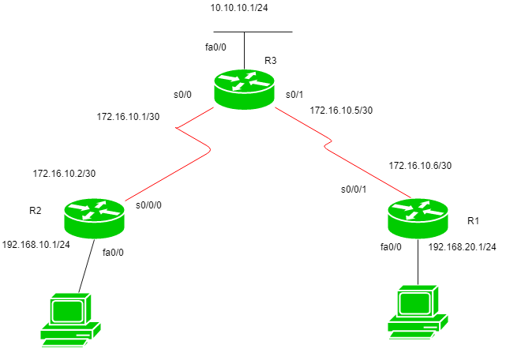
Network Routing
Routing
Routing is a process which is performed by layer 3 (or network layer) devices in order to deliver the packet by choosing an optimal path from one network to another.
R2(config)#ip route 192.168.20.0 255.255.255.0 172.16.10.1
R2(config)#ip route 10.10.10.0 255.255.255.0 172.16.10.1
R2(config)#ip route 172.16.10.4 255.255.255.0 172.16.10.1

Slide 5
Network Routing
A basic routing table includes the following information:
Destination: The IP address of the packet's final destination
Next hop: The IP address to which the packet is forwarded
Interface: The outgoing network interface the device should use when forwarding the packet to the next hop or final destination
Metric: Assigns a cost to each available route so that the most cost-effective path can be chosen
Routes: Includes directly-attached subnets, indirect subnets that are not attached to the device but can be accessed through one or more hops, and default routes to use for certain types of traffic or when information is lacking.
Routing tables can be maintained manually or dynamically.

Slide 6
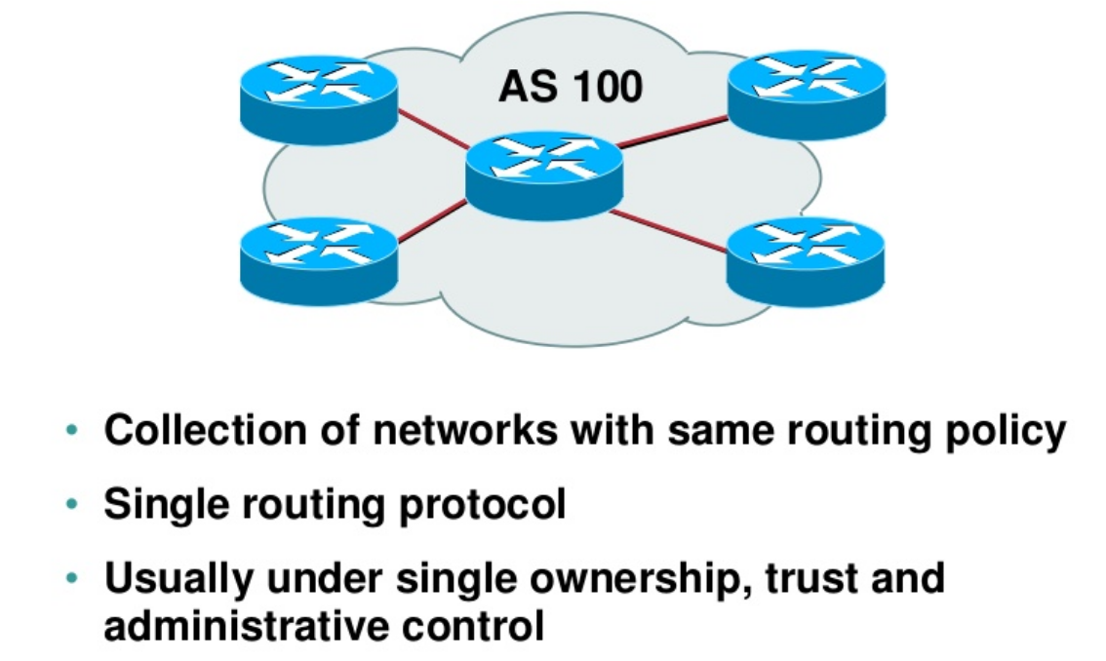
Network Routing
Autonomous System (AS)

Slide 7
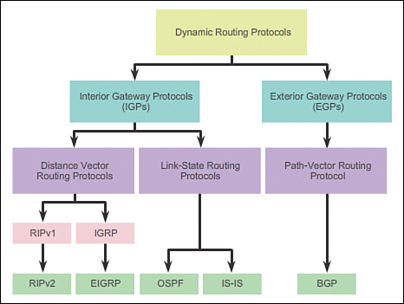
Network Routing
Type of routing protocols

Slide 8
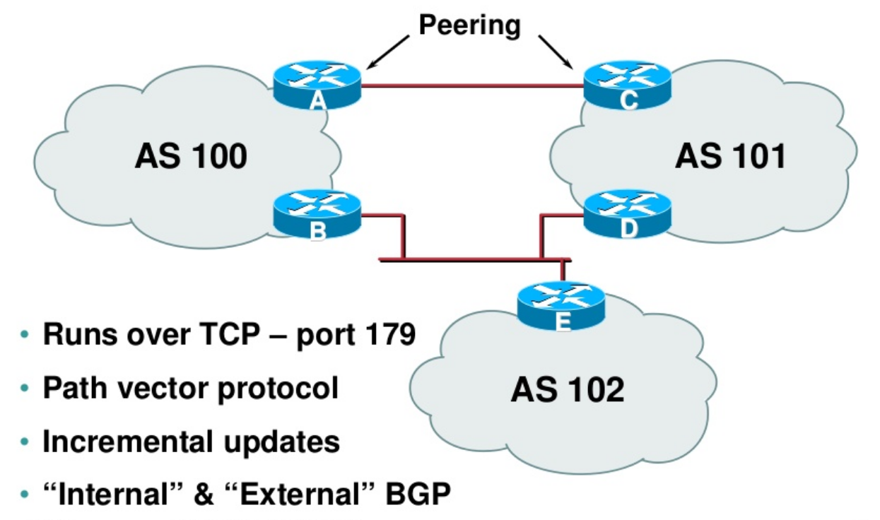
Network Routing - BGP
Autonomous System (AS)

Slide 9
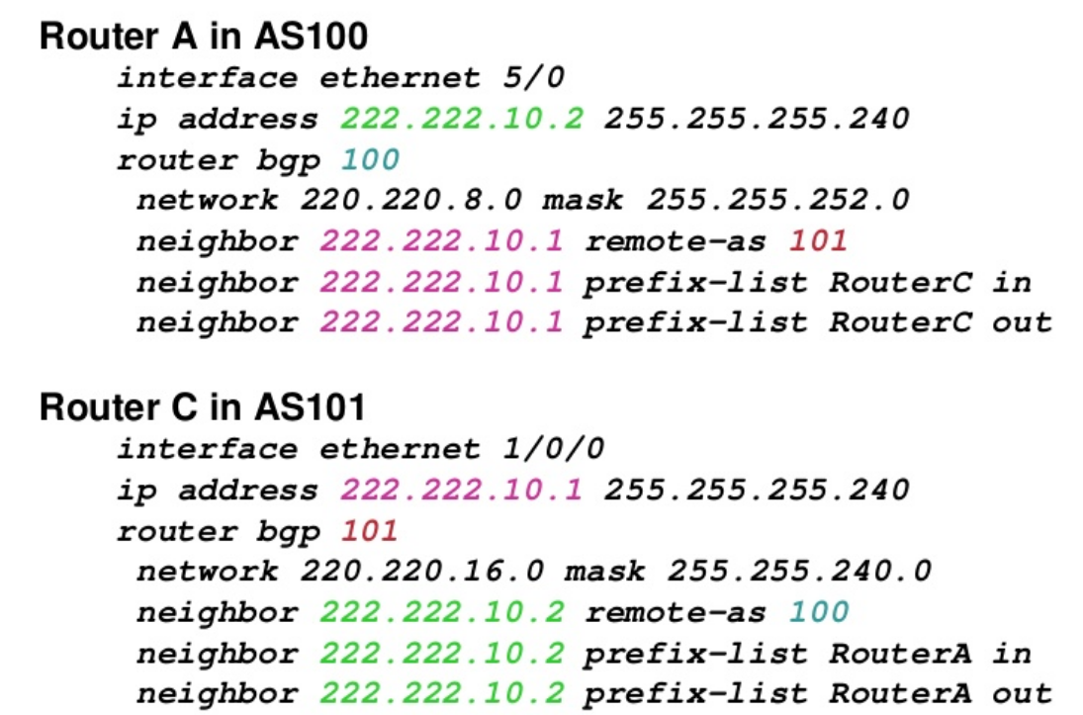
Network Routing
BGP

Slide 10
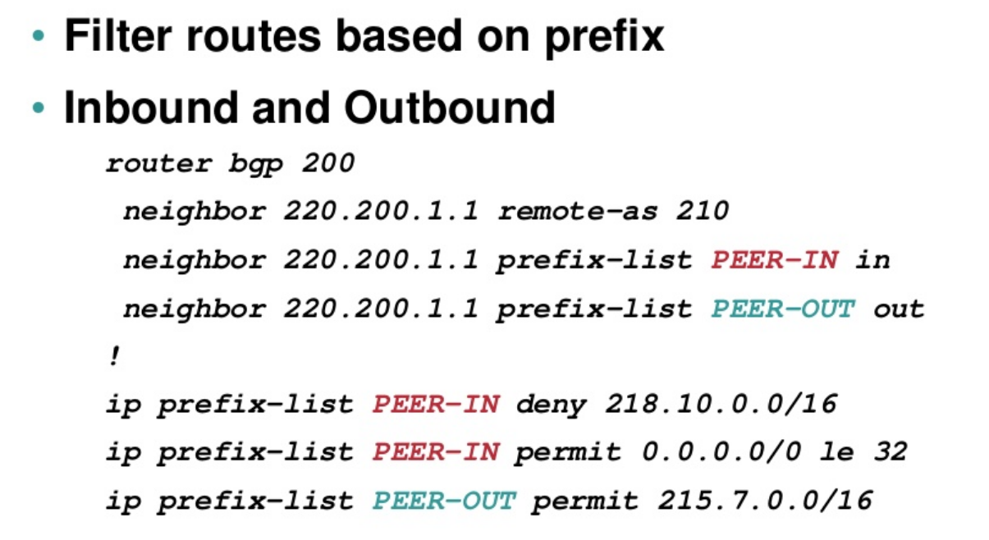
Network Routing
BGP

Slide 11
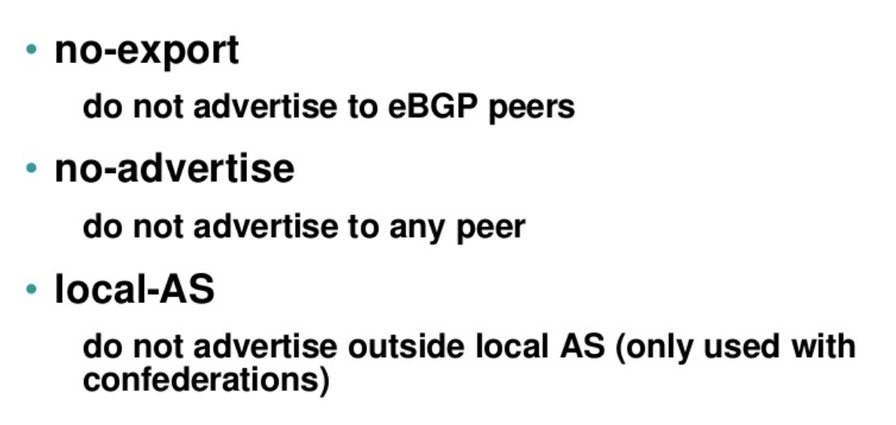
Network Routing
BGP - Wellknown Communities

Slide 12
Network Routing
BGP

Slide 13
Network Routing
VRF
VRFs (or VPN Routing and Forwarding instances or virtual Routing and Forwarding) are most commonly associated with MPLS service providers.
In such networks, MPLS encapsulation is used to isolate individual customers' traffic and an independent routing table (VRF) is maintained for each customer.
Most often, MP-BGP is employed to facilitate complex redistribution schemes to import and export routes to and from VRFs to provide Internet connectivity.

Slide 14
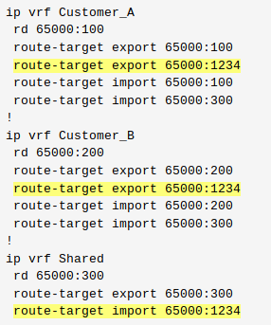
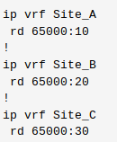
Network Routing
VRF
Route distinguishers (RD) are used to maintain uniqueness among identical routes in different VRFs, route targets (RT) can be used to share routes among them.

Slide 15
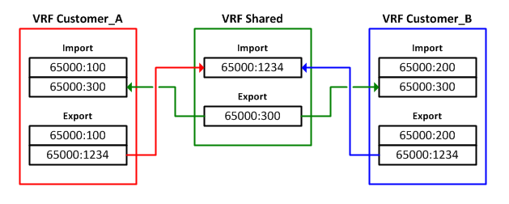
Network Routing
VRF

Slide 16
What is EVPN?

Slide 17
What is EVPN?
EVPN is a multi-tenant BGP-based control plane for layer-2 (bridging) and layer-3 (routing) VPNs. It’s the unifying L2+L3 equivalent of the traditional L3-only MPLS/VPN control plane.
EVPN provides a wide of range of services, such as E-LAN, E-Line, E-Tree, Layer 3 VPN, data center interconnect (DCI), DC overlay, and Integrated Routing and Bridging (IRB). These services were previously provided by disjointed technologies.
In theory you could use EVPN with almost any data-plane encapsulation (RFCs define extended BGP community values for MPLS, VXLAN, MPLS-over-GRE, MPLS-over-UDP, NVGRE…). In practice, it’s used with either MPLS or VXLAN.
EVPN replaces flood-and-learn behavior of traditional Ethernet bridges (or VPLS or simpler VXLAN implementations) with BGP control plane – MAC addresses are propagated as BGP prefixes within the EVPN address family.
EVPN implementations could use dynamic IP address discovery using DHCP reply snooping, ARP request snooping, or IP packet header gleaning, and advertise IP-to-MAC bindings in EVPN BGP updates.
You can use EVPN to implement end-to-end bridging, integrated bridging and routing, or routing-only fabrics.

Slide 18
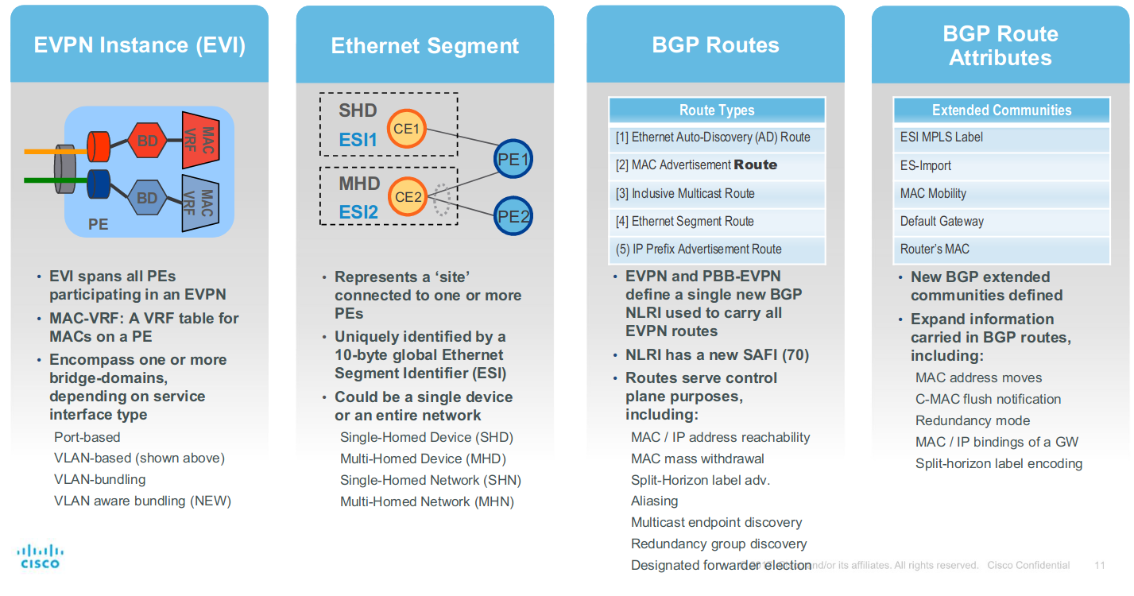
EVPN - Concept

Slide 19
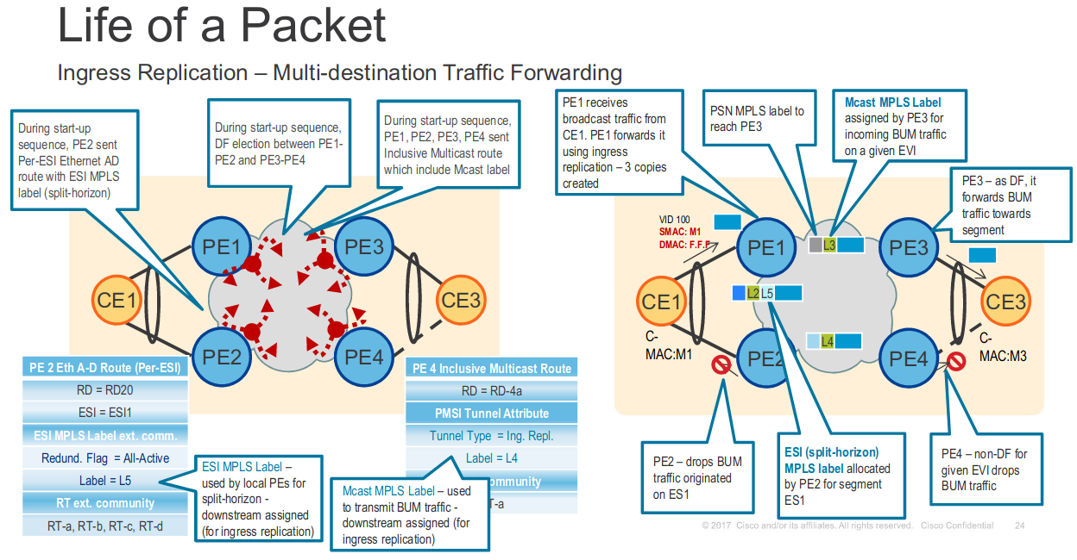

Slide 20
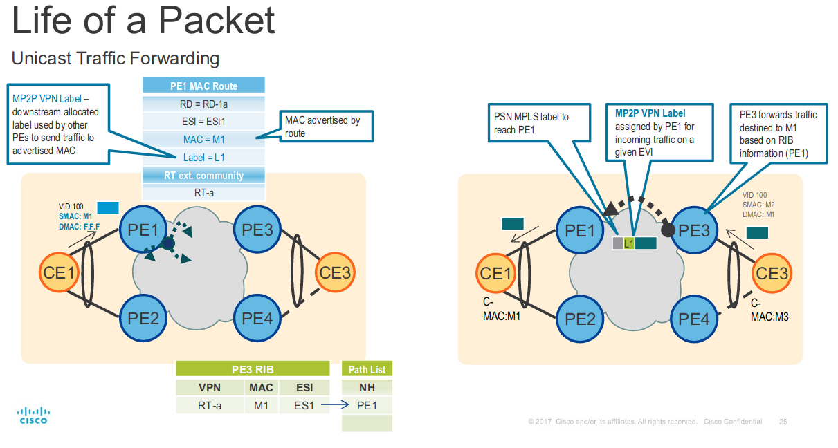
https://www.cisco.com/c/dam/m/en_us/network-intelligence/service-provider/digital-transformation/knowledge-network-webinars/pdfs/0420-epn-ckn.pdf

Slide 21
Types of VPNs
A virtual private network (VPN) consists of two topological areas: the provider’s network and the customer’s network.
The customer’s network is commonly located at multiple physical sites and is also private (non-Internet). A customer site would typically consist of a group of routers or other networking equipment located at a single physical location.
The provider’s network, which runs across the public Internet infrastructure, consists of routers that provide VPN services to a customer’s network as well as routers that provide other services.

Slide 22
Layer 2 VPNs
Implementing a Layer 2 VPN on a router is similar to implementing a VPN using a Layer 2 technology such as ATM or Frame Relay. However, for a Layer 2 VPN on a router, traffic is forwarded to the router in Layer 2 format.
On a Layer 2 VPN, routing occurs on the customer’s routers, typically on the CE router. The PE router receiving the traffic sends it across the service provider’s network to the PE router connected to the receiving site. The PE routers do not need to store or process the customer’s routes; they only need to be configured to send data to the appropriate tunnel.

Slide 23
Layer 3 VPNs
In a Layer 3 VPN, the routing occurs on the service provider’s routers. Therefore, Layer 3 VPNs require more configuration on the part of the service provider, because the service provider’s PE routers must store and process the customer’s routes.

Slide 24
Understanding layer 3 VPNs
Virtual private networks (VPNs) are private networks that use a public network to connect two or more remote sites. Instead of dedicated connections between networks, VPNs use virtual connections routed (tunneled) through public networks that are typically service provider networks.
Layer 3 VPN operates at the Layer 3 level of the OSI model, the Network layer. The common routing information is shared across the provider's backbone using multiprotocol BGP (MP-BGP), and the VPN traffic is forwarded to the customer sites using MPLS (VxLAN, etc).

Slide 25
Virtual-Router Routing Instances
A virtual-router routing instance, like a VPN routing and forwarding (VRF) routing instance, maintains separate routing and forwarding tables for each instance. However, many configuration steps required for VRF routing instances are not required for virtual-router routing instances.
However, you need to configure separate logical interfaces between each of the service provider routers participating in a virtual-router routing instance. You also need to configure separate logical interfaces between the service provider routers and the customer routers participating in each routing instance.

Slide 26
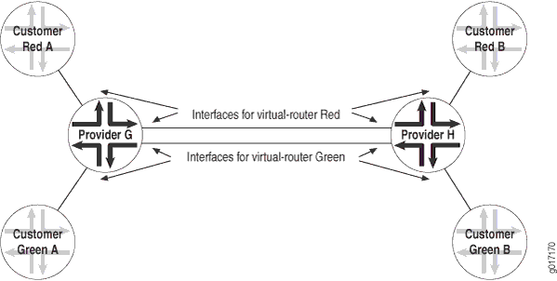
Virtual-Router Routing Instances

Slide 27
Components of layer 3 VPNs
CE devices - Customer Edge (CE) devices at the customer premises that connect to the provider’s network. Some models call these Customer Premises Equipment (CPE) devices.
Customer network - Customer sites with CE devices that belong to the VPN.
Provider network - The service provider backbone network running the MPLS backbone.
P devices -Provider (P) devices within the core of the provider’s network. Provider devices are not connected to any device at a customer site and are part of the tunnel between pairs of PE devices. Provider devices support label-switched path (LSP) functionality as part of the tunnel support, but do not support VPN functionality.
PE devices - Provider Edge (PE) devices within a service provider core network that connect directly to a CE device at the customer's site.
MP-BGP - PE devices use MP-BGP to distribute customer routes to the proper PE devices across the MPLS backbone.

Slide 28
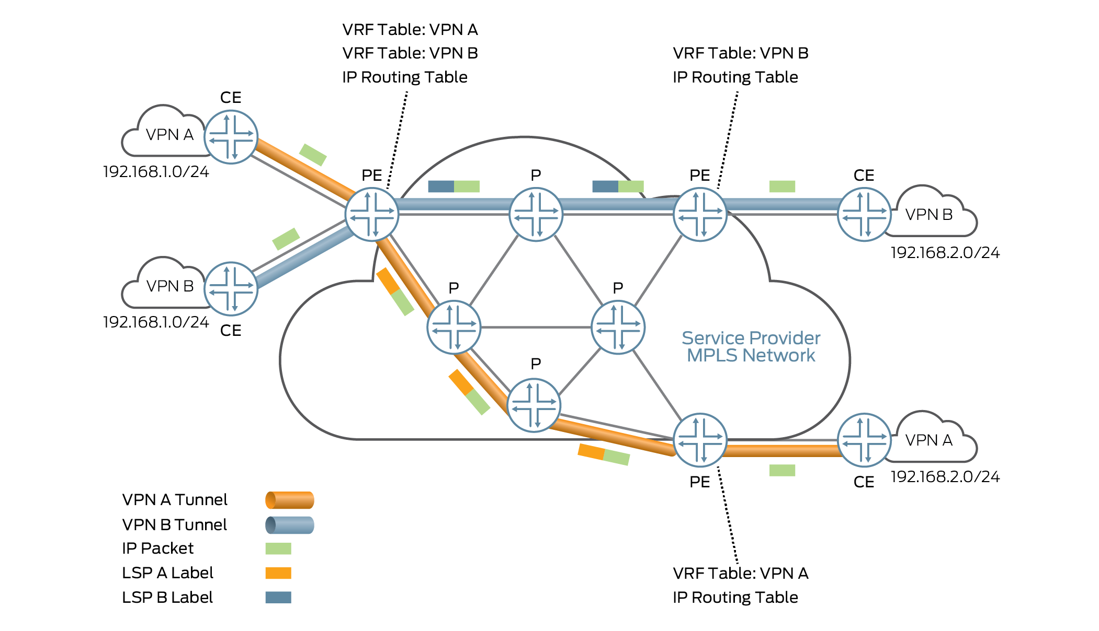
General Layer 3 VPN Architecture

Slide 29
Layer 3 VPN Terminology
IP routing table (also called the global routing table): This table contains service provider routes not included in a VRF. Provider devices need this table to be able to reach each other, while the VRF table is needed to reach all customer devices on a particular VPN.
Route Distinguisher: A 64-bit value prepended to an IP address. This unique tag helps identify the different customers’ routes as packets flow across the same service provider tunnel.
as-number:number
ip-address:number
Route Target (RT): A 64-bit value used to identify the final egress PE device for customer routes in a particular VRF to enable complex sharing of routes.
VPN-IPv4 routes: The PE devices export the VPN-IPv4 routes in IBGP sessions to the other provider devices. These routes are exchanged across the MPLS backbone using iBGP. When the outbound PE device receives the route, it strips off the route distinguisher and advertises the route to the connected CE devices, typically through standard BGP IPv4 route advertisements.
VRF: The virtual routing and forwarding (VRF) table distinguishes the routes for different customers, as well as customer routes from provider routes on the PE device

Slide 30
Understanding Layer 3 VPN Forwarding Through the Core
The PE routers in the provider’s core network are the only routers that are configured to support VPNs and hence are the only routers to have information about the VPNs. From the point of view of VPN functionality, the provider (P) routers in the core - those P routers that are not directly connected to CE routers - are merely routers along the tunnel between the ingress and egress PE routers.
When PE-router-to-PE router forwarding is tunneled over MPLS label-switched paths (LSPs), the MPLS packets have a two-level label stack:
Outer label - Label assigned to the address of the BGP next hop by the IGP next hop.
Inner label - Label that the BGP next hop assigned for the packet’s destination address.

Slide 31
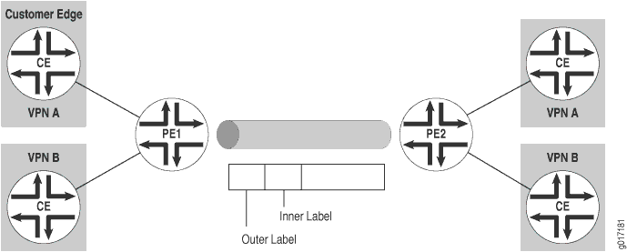
Understanding Layer 3 VPN Forwarding Through the Core

Slide 32
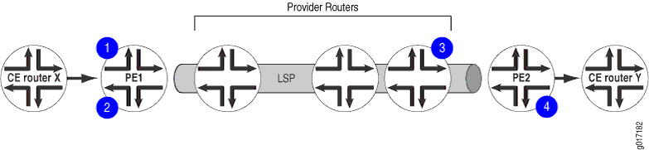
Understanding Layer 3 VPN Forwarding Through the Core
When CE Router X forwards a packet to Router PE1 with a destination of CE Router Y, the PE route identifies the BGP next hop to Router Y and assigns a label that corresponds to the BGP next hop and identifies the destination CE router. This label is the inner label.
Router PE1 then identifies the IGP route to the BGP next hop and assigns a second label that corresponds to the LSP of the BGP next hop. This label is the outer label.
The inner label remains the same as the packet traverses the LSP tunnel. The outer label is swapped at each hop along the LSP and is then popped by the penultimate hop router (the third P router).
Router PE2 pops the inner label from the route and forwards the packet to Router Y.

Slide 33
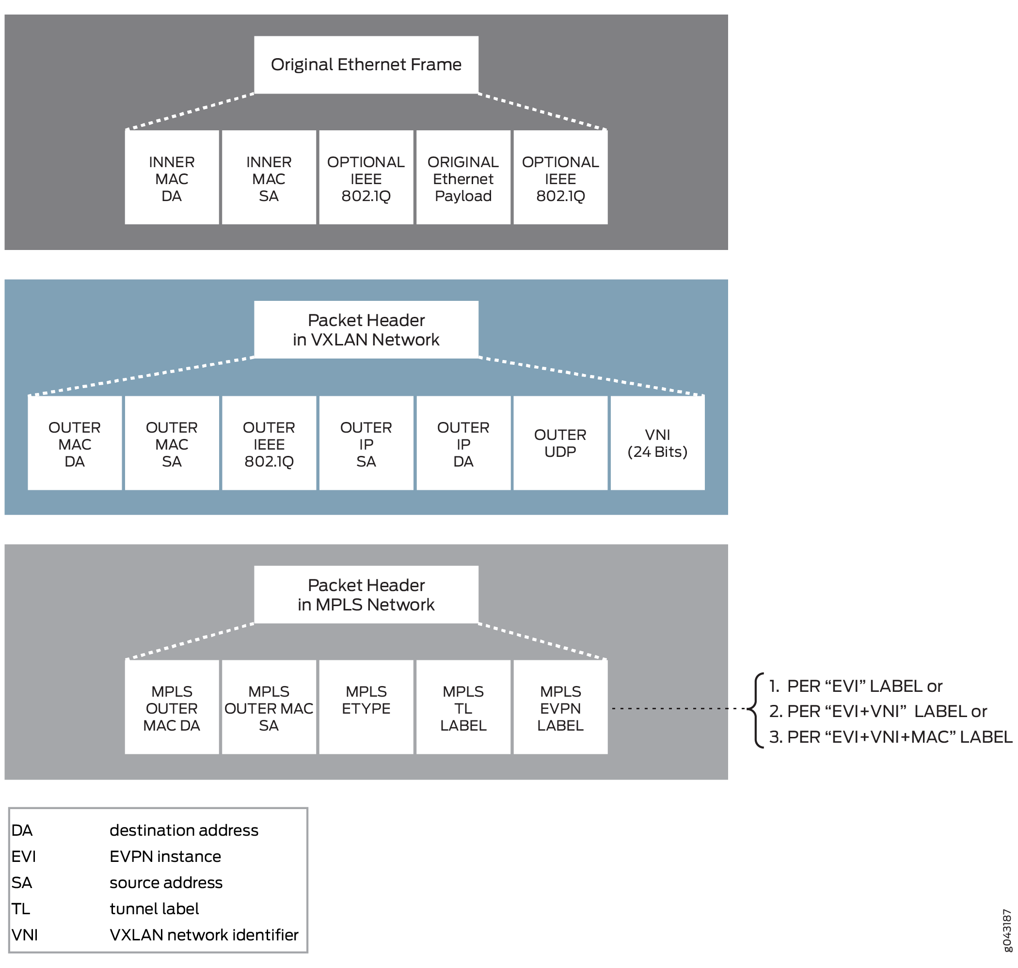
EVPN-VXLAN Packet Format

Slide 34
Understanding Layer 3 VPN Attributes
Route distribution within a VPN is controlled through BGP extended community attributes. RFC 4364 defines the following three attributes used by VPNs:
Target VPN—Identifies a set of sites within a VPN to which a provider edge (PE) router distributes routes. This attribute is also called the route target. The route target is used by the egress PE router to determine whether a received route is destined for a VPN that the router services.
VPN of origin—Identifies a set of sites and the corresponding route as having come from one of the sites in that set.
Site of origin—Uniquely identifies the set of routes that a PE router learned from a particular site. This attribute ensures that a route learned from a particular site through a particular PE-CE connection is not distributed back to the site through a different PE-CE connection.

Slide 35
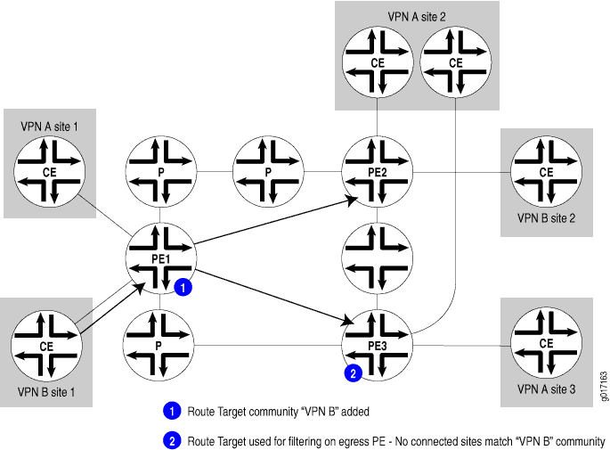
Understanding Layer 3 VPN Attributes

Slide 36
Configuration Example

Slide 37
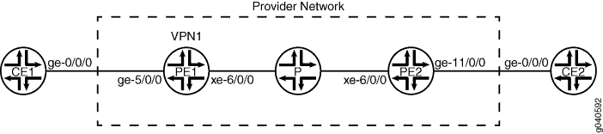
Configuring MPLS-Based Layer 2 VPNs
The following components must be added to the PE routing devices for an MPLS-based Layer 2 VPN:
BGP group with family l2vpn signaling
Routing instance using instance type l2vpn
The physical layer encapsulation type (ethernet) must be specified on the customer edge interface and the encapsulation type must also be specified in the configuration of the routing instance.

Slide 38
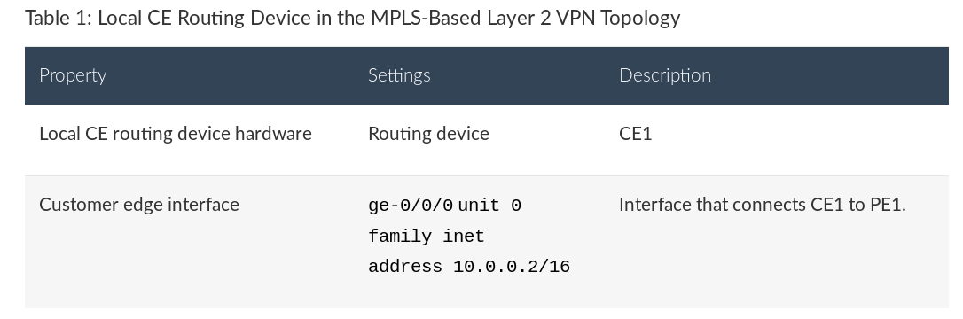
Configuring MPLS-Based Layer 2 VPNs

Slide 39
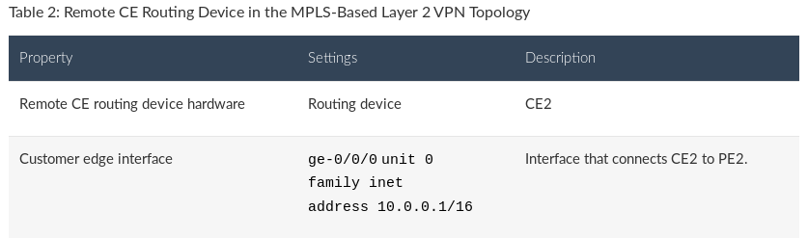
Configuring MPLS-Based Layer 2 VPNs

Slide 40
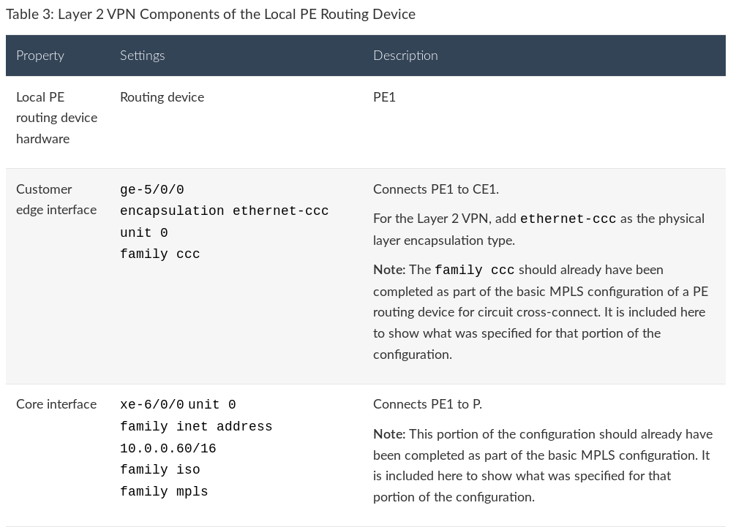
Configuring MPLS-Based Layer 2 VPNs

Slide 41
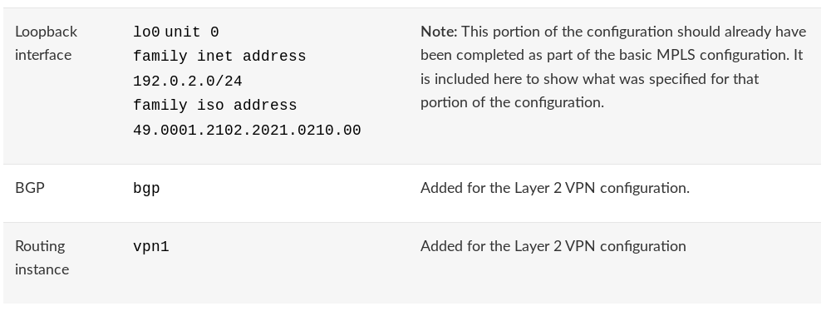
Configuring MPLS-Based Layer 2 VPNs
https://www.juniper.net/documentation/en_US/junos/topics/example/routing-protocol-is-is-security-configuring-cli.html

Slide 42
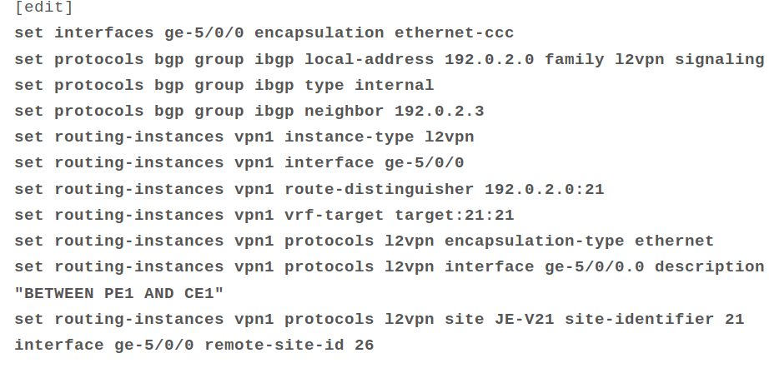
Configuring MPLS-Based Layer 2 VPNs

Slide 43
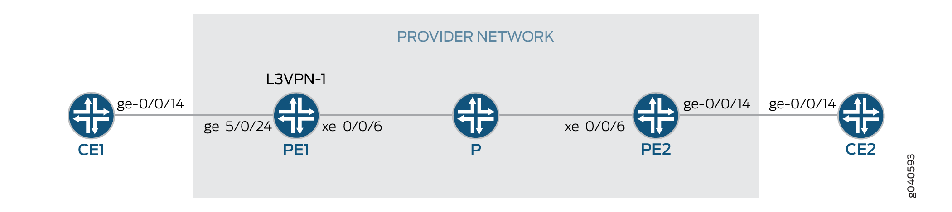
Configuring MPLS-Based Layer 3 VPNs
The following components must be added to the PE switches for an MPLS-based Layer 3 VPN:
BGP group with family inet-vpn unicast
Routing instance with instance type vrf

Slide 44
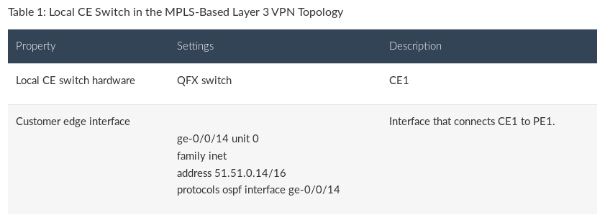
Configuring MPLS-Based Layer 3 VPNs

Slide 45
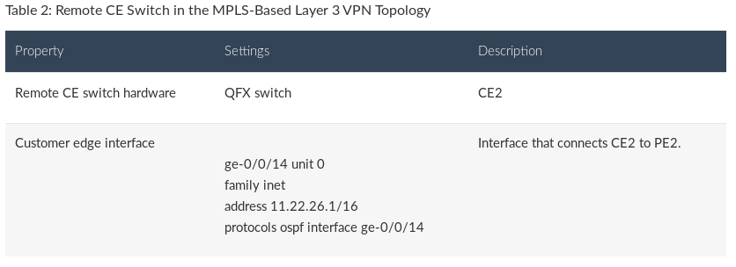
Configuring MPLS-Based Layer 3 VPNs

Slide 46
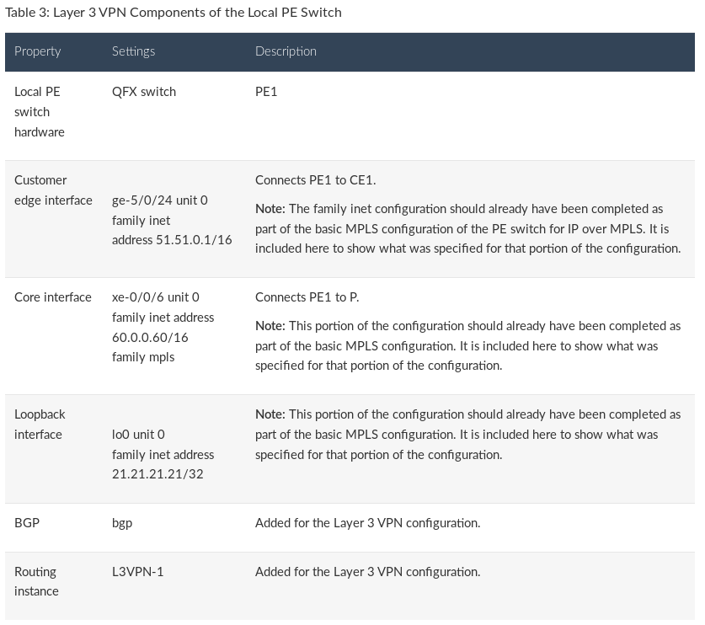

Slide 47
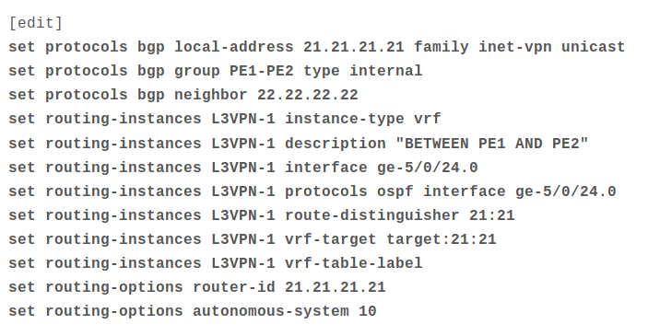
Configuring MPLS-Based Layer 3 VPNs

Slide 48
Understanding Contrail Virtual Networks Use with EVPN-VXLAN

Slide 49
Understanding Contrail Virtual Networks Use with EVPN-VXLAN
Juniper Networks Contrail virtualization software is a software-defined networking (SDN) solution that automates and orchestrates the creation of highly scalable virtual networks.
MX Series routers can use EVPN-VXLAN to provide both Layer 2 and Layer 3 connectivity for end stations within a Contrail virtual network (VN).
The Contrail software for virtual networks provides both Layer 2 and Layer 3 connectivity. With Contrail, Layer 3 routing is preferred over Layer 2 bridging whenever possible. Layer 3 routing is used through virtual routing and forwarding (VRF) tables between Contrail vRouters and physical MX Series routers.

Slide 50
Understanding Contrail Virtual Networks Use with EVPN-VXLAN
set protocols evpn vni-options vni 1 vrf-target target:10003:1
set protocols evpn vni-options vni 2 vrf-target target:10003:2
set protocols evpn encapsulation vxlan
set protocols evpn extended-vni-list all
set protocols evpn default-gateway no-gateway-community (For L3)
https://www.juniper.net/documentation/en_US/contrail5.0/topics/concept/using-device-manager-netconf-contrail.html

Slide 51
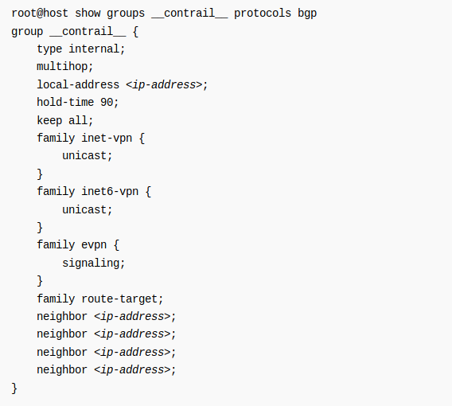
Understanding Contrail Virtual Networks Use with EVPN-VXLAN
https://www.juniper.net/documentation/en_US/contrail5.0/topics/concept/using-device-manager-netconf-contrail.html

Slide 52
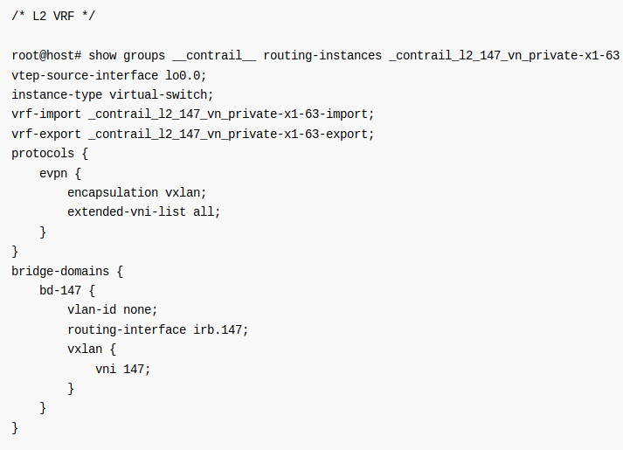
Extending the private network
https://www.juniper.net/documentation/en_US/junos/topics/task/configuration/evpn-vs-configuring.html

Slide 53
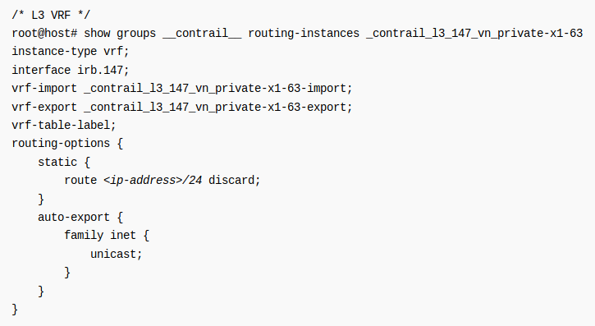
Extending the private network
https://www.juniper.net/documentation/en_US/contrail5.0/topics/concept/using-device-manager-netconf-contrail.html

Slide 54
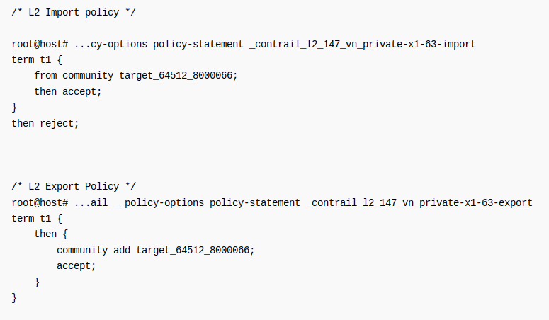
Extending the private network
https://www.juniper.net/documentation/en_US/contrail5.0/topics/concept/using-device-manager-netconf-contrail.html

Slide 55
Thank You

Slide 56
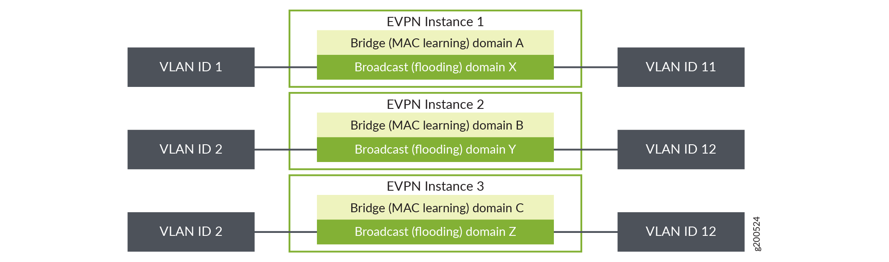
Back ups
VLAN Services for EVPN:
- https://www.juniper.net/documentation/en_US/junos/topics/concept/evpn-services-overview.html - https://www.juniper.net/documentation/en_US/junos/topics/topic-map/evpn-virtual-switch-configuring.html

Slide 57
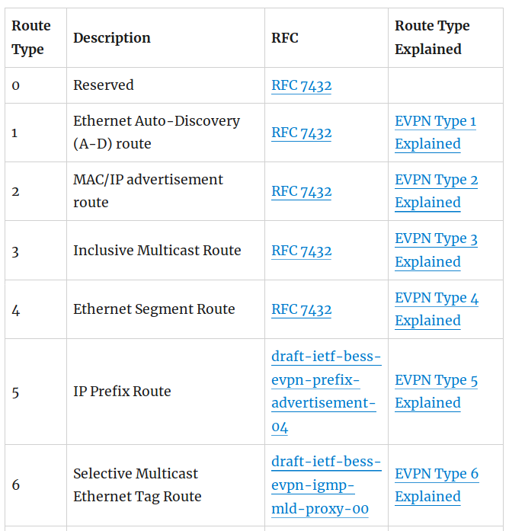
Back ups
EVPN Route Types:
- http://bgphelp.com/2017/05/22/evpn-route-types

Slide 58
Back ups
Cissco EVPN VxLAN L3:
- https://www.cisco.com/c/en/us/td/docs/ios-xml/ios/cether/configuration/xe-16/ce-xe-16-book/evpn-vxlan-l3.html

