Slide 1

Oriented Object Programming
Sales Management Program
Group Members:
Phan Nguyễn Huy Hoàng: ITITRG18006
Phan Hoàng Long ITITRG18019
Trần Nhất Đạt ITITIU18295

Slide 2
Briefly Description And Functions
This is the program helps users to manage business operations. It’s created by using Java programing language. The app includes these functions:
+ Storaging and handling the information of saling items(such as ID, Price,Type,… ) and customers(such as Name, Email,…)
+ Calculating and processing customer’s and item’s information and tranfering to the receipt.
+ Made it easy for managing inventory, import-export, items quantity, ...
+ Accurately manage revenue and profit.
Advantages of using sale management program:
Support sales managers and staff to keep track of the sales process.
Increasing efficiency in sales management.
Optimizing the time and quality of the staff.
Standardize the sales process in the business.

Slide 3
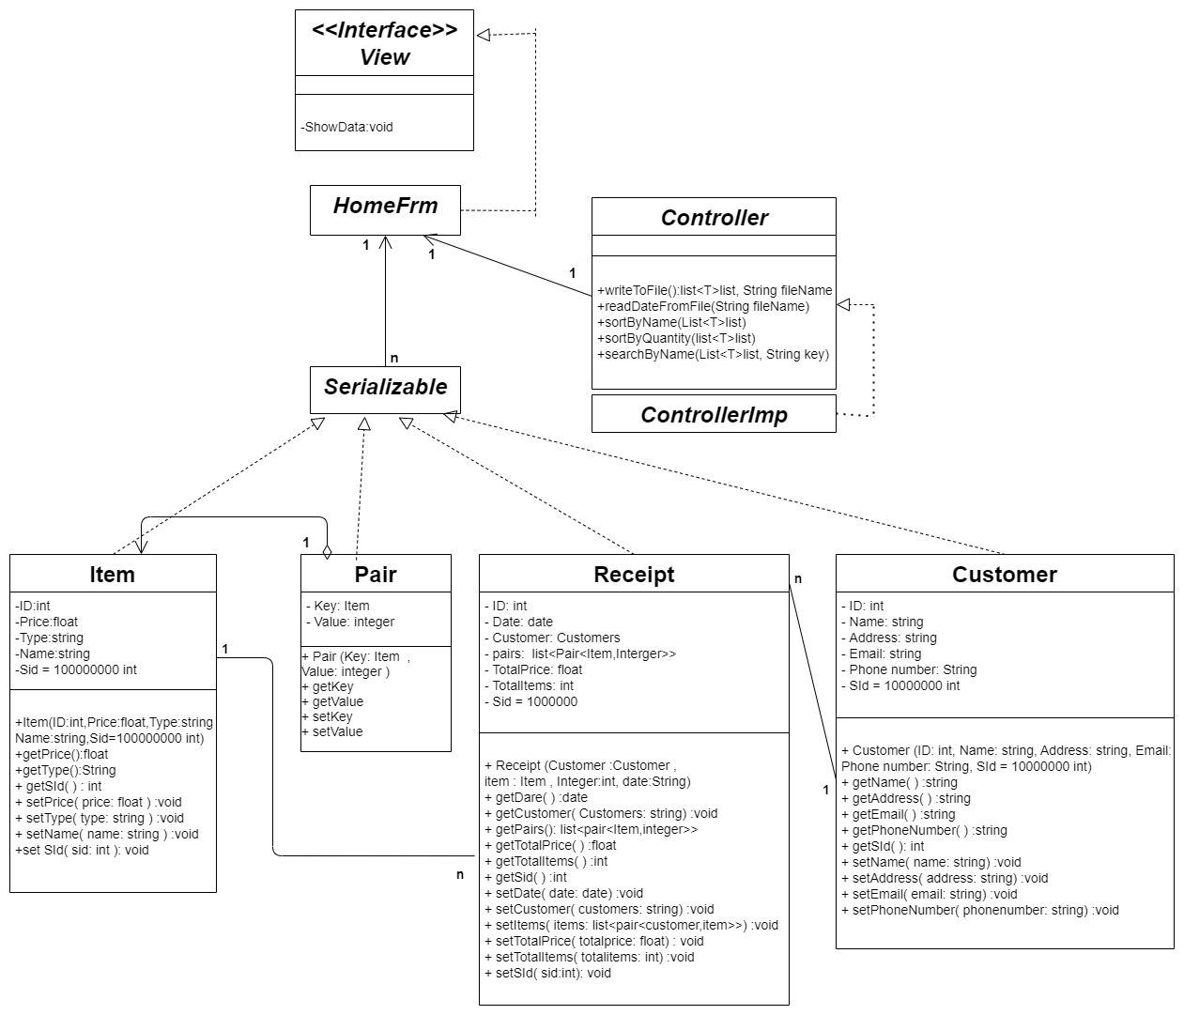
UML

Slide 4
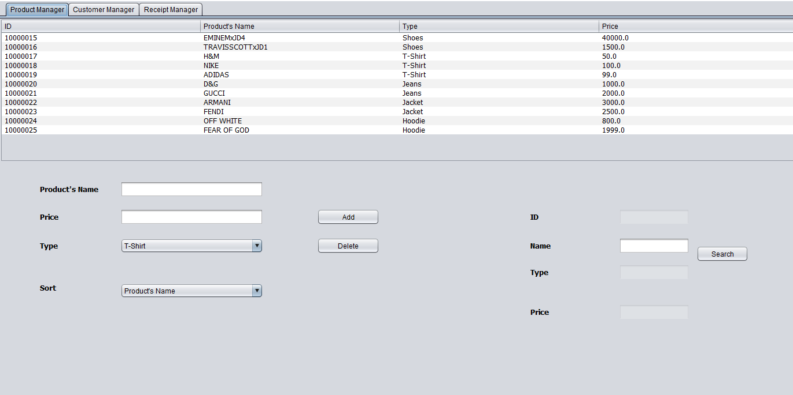
Application Gui

Slide 5
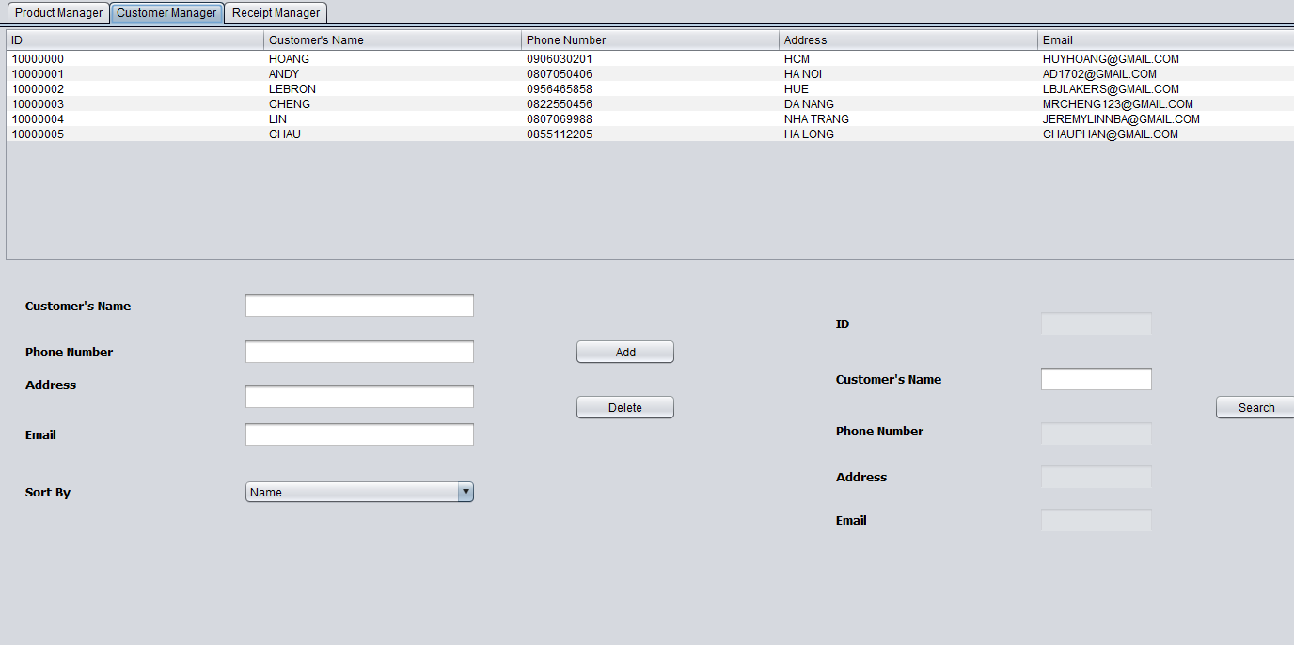
Application Gui

Slide 6
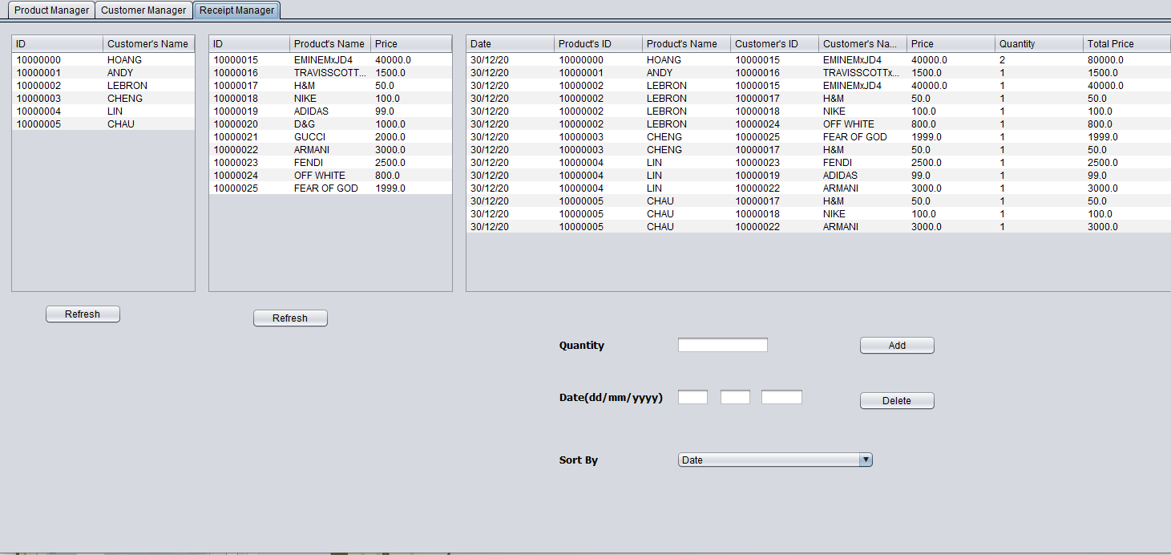
Application Gui

Slide 7
Thanks For Listening

