Slide 1
Team Introduction
INSTRUCTOR
Assoc. Prof. Dr. Truong Ninh Thuan
STUDENTS
Hoang Thi Tam K60CA Student ID: 15021603
Bui Manh Thang K60CA Student ID: 15021058
Nguyen Dang The K60CA Student ID: 15020912
Notes:
Hi everyone, it is our great honor to be here today to present our Object Oriented Analysis and Design Project. My name is The and our team consists of 3 members including me, Tam and Thang. Before begin our presentation, on behalf of my team, I want to say Thank you to Professor Truong Ninh Thuan, who had provided us with tons of valuable concepts and principals in this course.

Slide 2


Problem statement
Online shopping also known as "electronic retail" or "e-shopping" has seen an impressive development together with the growth of the Internet.
World Top Companies:
Amazon
Alibaba
eBay
Rakuten
...
Notes:
- As you know, Online shopping also known as "electronic retail" or "e-shopping" has seen an impressive development together with the growth of the Internet. Have you ever heard about Amazon and Alibaba, these are two of the world’s biggest electronic commerce companies. And the men behind these companies are now billionaires and their empires have created hundreds of thousands jobs for people worldwide.

Slide 3
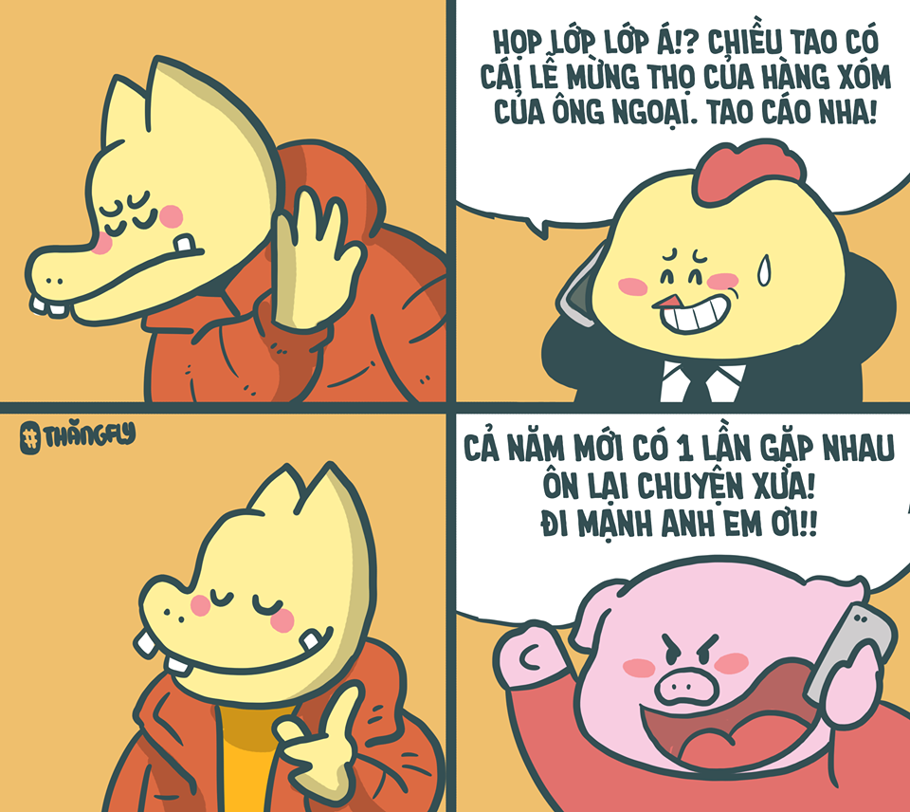


Remarkable Trend
Vietnam Top Companies:
Lazada
Tiki.vn
Sendo
...
Notes:
- Modern people now buy things with Browsers, not with shopping cart. And Vietnamese market does not stand aside with dozens of Online Retailers gaining more and more popularity everyday. As a result, systems have to be developed so that providers have a place to advertise and sell their products while consumers have a place to spend their money.

Slide 4

E-Commerce system
- Object Oriented Analysis and Design -
Notes:
- In our project, we analysed an E-commerce system call Tiki.vn. Have you ever buy something on Tiki. I guess the answer is Yes.

Slide 5

Tiki’s Information
Tiki.vn (founded in 3/2010) is a online system where Tiki company themself and providers (sellers) who have contracts with Tiki and consumers (buyers) can interact with each other.
Notes:
Here we give you some information about Tiki

Slide 6
Description
The system being developed is a web application which can be accessed by dozens of internet-connected devices like PC, smartphones, tablets and the like.
All types of users are Visitors, Customers, Providers and Administrators (Admins for short).

Slide 7
Glossary
Account - A record about a customer/administrator/provider containing information
Administrator - Ensure that the site is free of spam advertisements or abusive behaviours and operate the system.
Member - Providers, Customers have registered account on website Tiki.vn
Provider/Seller - Create showrooms to introduce, sell their products
Customer - Purchase products or using services on Tiki’s website
Visitor - Does not have an account.
Product - Goods or services provided by sellers through Tiki’s website.
Notes:
Here are the list of glossary we used in our analysis document. Let’s take a look at them.
(Đọc 3-4 cái đầu tiên)
Now that we have an overview of this system. Next, we will see the use-case diagram.

Slide 8
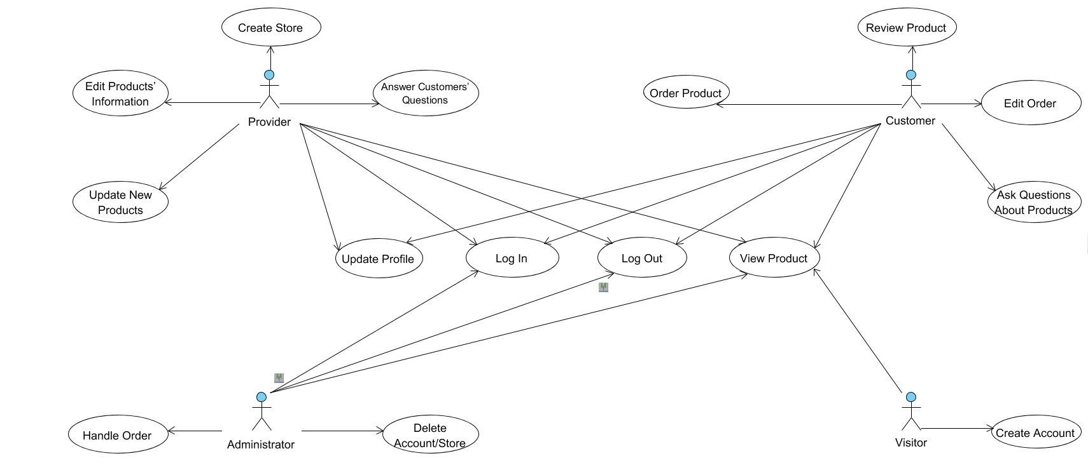
Use-case Diagram
Notes:
In this use-case diagram, we have tried to make it as simple as possible but still have full functions of the system.
It shows the relationship between the user and the different use cases in which the user is involved. 4 types of user are Provider, Customer, Admin and Visitor. Each type of user has their own sets of use-cases. As you can see here, for example: If you are a visitor, which means you have not have an account yet, you have limited access to some functions like Review, Order, and the like. But anyway, you still can view information of any product you like.

Slide 9
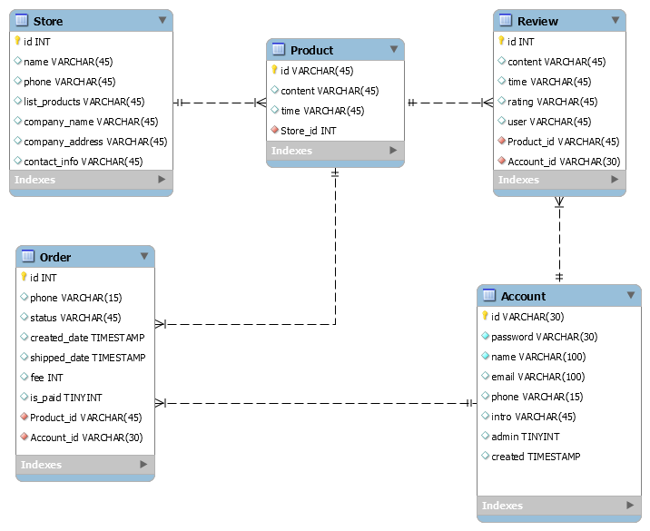
Database Design
Notes:
Next is the database design with main 5 entities and their primary keys, foreign keys and properties.
For example: In the Account entity, we can see it has it own ID to differentiate it with other Account. It also stores information like username, password, email, phone number, ... each field has their own data type and constraint.

Slide 10
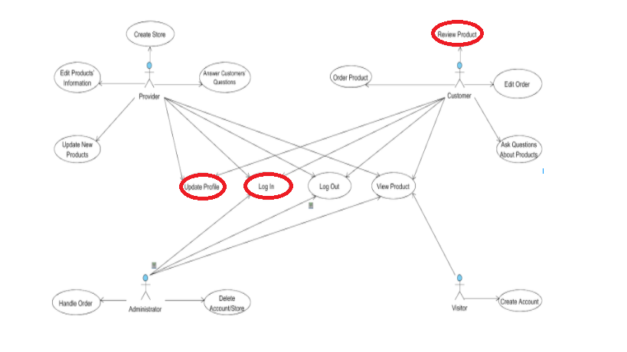
Use-case diagram
Notes:
Ok, let’s an even closer look at some use-case and see how it work.
We have chosen 3 use-cases to discuss, they are the ones that I have highlighted here. They are Login - Update Profile - Review Product.

Slide 11
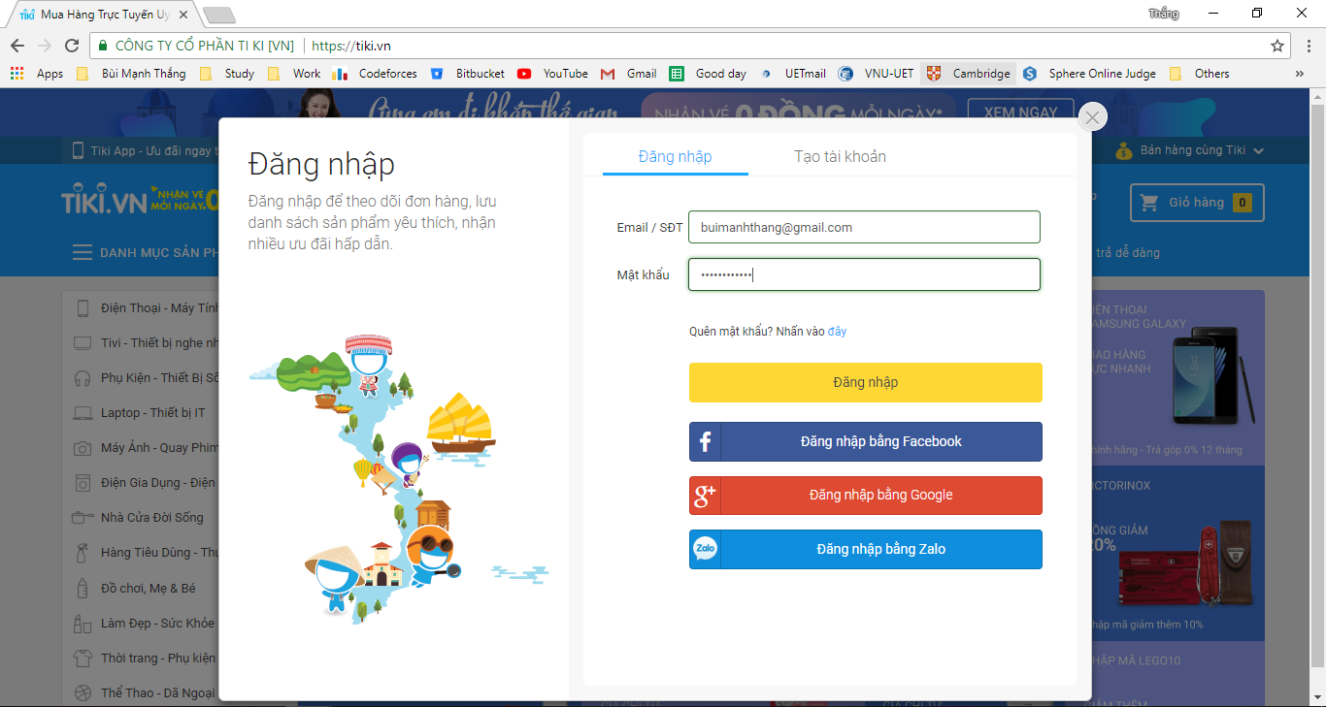
Log in
Let’s start shopping

Slide 12
Login - Use case model
Brief Description
This use case describes how a Customer, a Provider or an Administrator logs into the Website.

Slide 13
Login - Use case model
Flow of events
Basic flow
The actor enters his/her username and password.
The system validates the entered username and password and logs the actor into the system.

Slide 14
Login - Use case model
Flow of events: Alternative flow
Invalid/Error Information
If the actor enters an invalid or error username and/or password, the system displays an error message. The actor can choose to either return to the beginning of the Basic Flow or cancel the login, at which point the use case ends.
2. Missing Required Information
If any fields in the form are left empty, the system displays an error message. The actor can continue modifying the form or cancel the operation, at which point the use case ends.

Slide 15
Login - Use case model
Pre-condition
The system is in the login state and has the login screen displayed.

Slide 16
Login - Use case model
Post-condition
If the use case is successful, the actor is now logged into the system and the system then navigates to the previous window. Otherwise, the system state is unchanged.

Slide 17
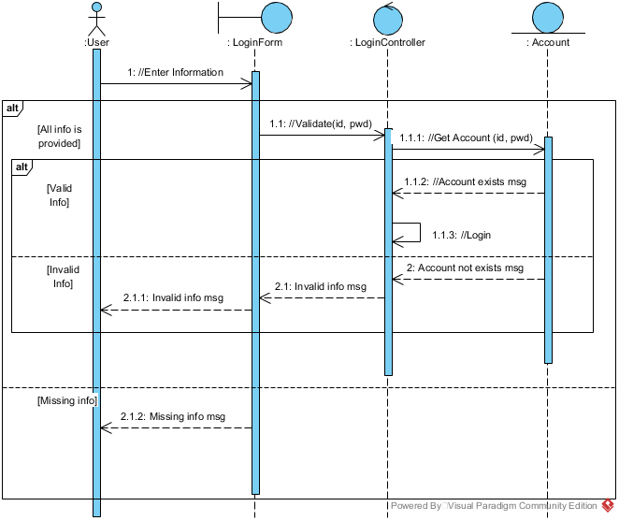
Login - Sequence Diagram

Slide 18
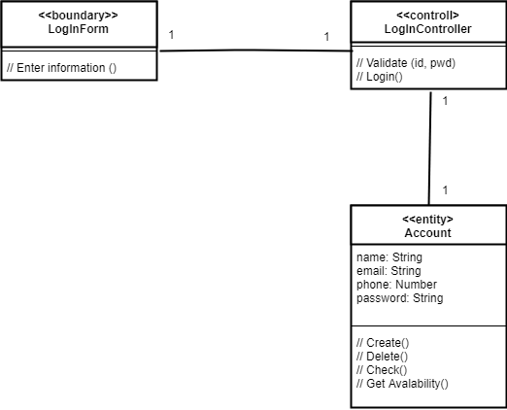
Login - View of participated classes

Slide 19
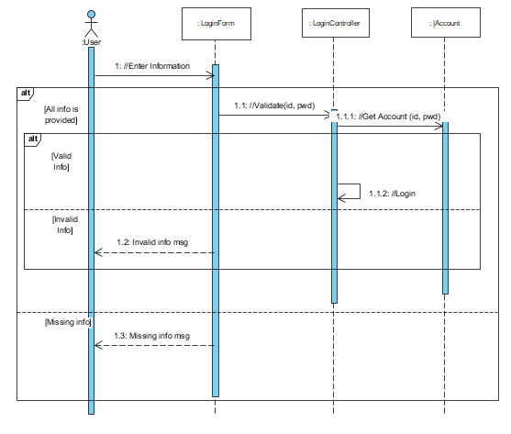
Login - Design sequence diagram

Slide 20
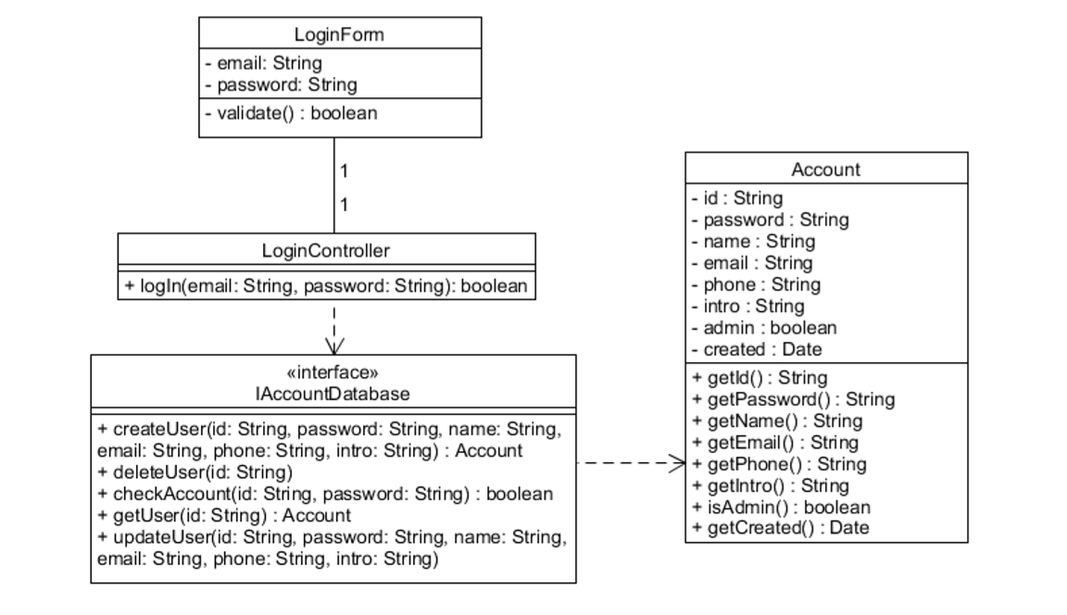
Login - Design VOPC

Slide 21
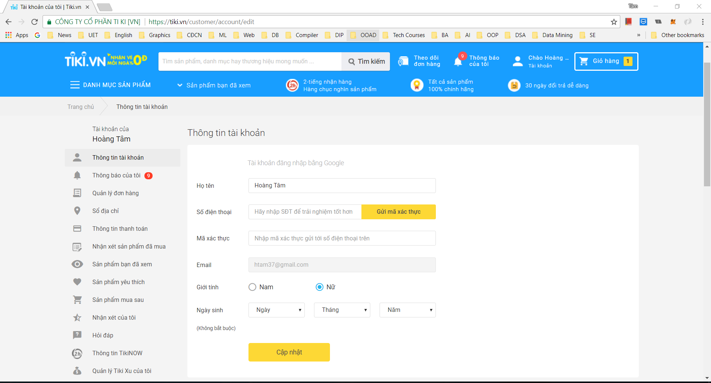
Update Profile
You have any wrong personal information?
Let change it!
Notes:
We are going to analysis and design about this common use-case of any website: Update Profile

Slide 22
Update Profile - Use case Model
Brief Description
This use case describes how an User updates his/her account in the system.

Slide 23
Update Profile - Use case Model
Flow of event
Basic flow:
1. The system displays the following information in editable fields and asks the User to make changes to their account:
Name
Password
Gender
Phone number /Email address (add not edit)
Date of Birth (optional)
2. Once the User provides the requested information, the system verifies that all required fields are specified, and updates the account’s information on the user database.

Slide 24
Update Profile - Use case Model
Flow of event
Alternative flow
Missing Information:
If any of the above fields (except for Date of birth) are not filled in, the system displays an error message. The actor can continue making changes to the registration form or cancel the registration, at which point the use case ends.
Notes:
Besides basic flow, we have alternative flow when having any missing infomation.

Slide 25
Update Profile - Use case Model
Pre-condition
The User must be logged into the system.
Notes:
It is clear to see that the user must be logged into the system. So, only Visitor has not ability to update profile.

Slide 26
Update Profile - Use case Model
Post-condition
If the use case was successful, the account’s information is updated. Otherwise, the system state remains unchanged.

Slide 27
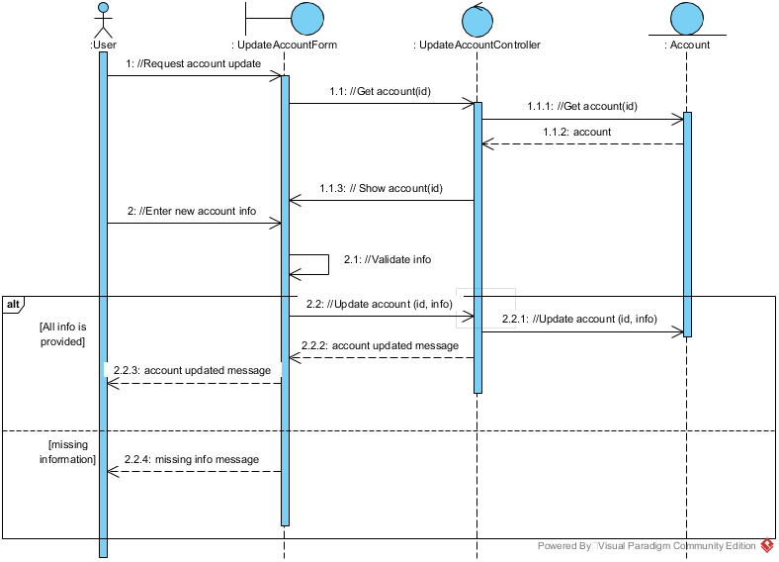
Update Profile - Sequence Diagram
Notes:
Use-case Realisation

Slide 28
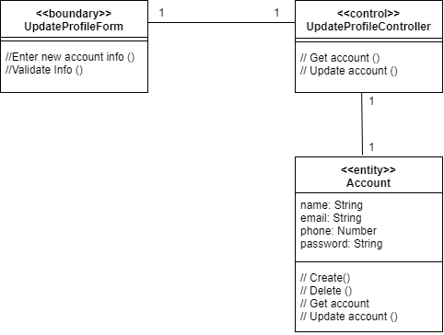
Update Profile - View of Participating Class
Notes:
Use-case Realisation

Slide 29
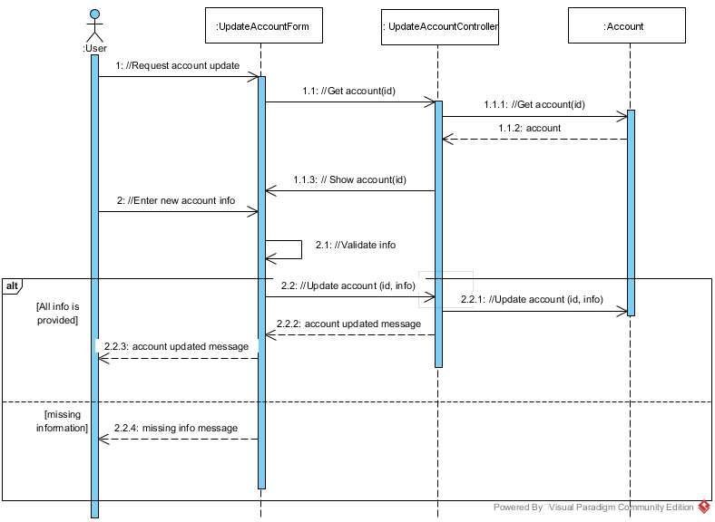
Update Profile - Design Sequence Diagram
Notes:
Use-case design

Slide 30
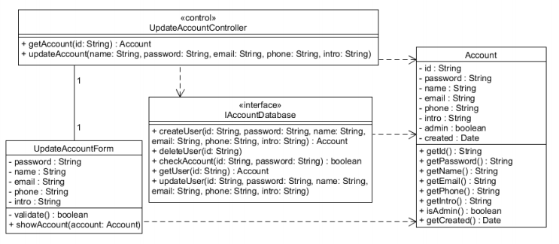
Update Profile - Design of VOPC
Notes:
Use-case design

Slide 31
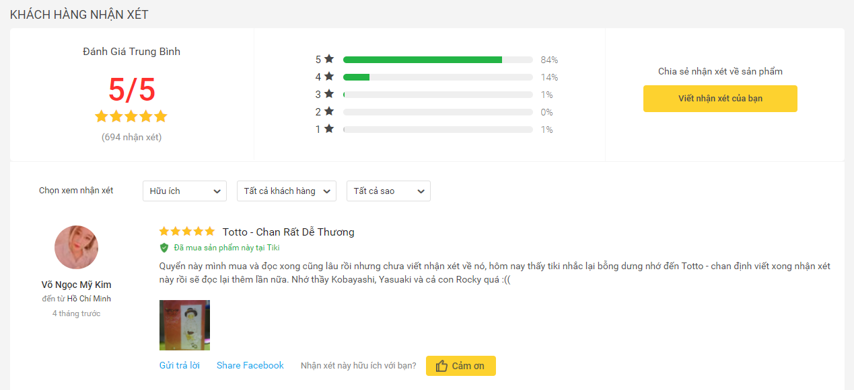
Review Product
Want to let others know how do you think about a product?
Notes:
After ordering and receiving your products, if you want to share with others about the product or about the providers’ services. This system will allow you to review product.
Let me describe the final View of this use-case.
As can be seen from the screen shot over here. You can do something like rate the product upto 5 stars, write some text to describe your thoughts about product. You even can give your comment a title and share your comment to your Facebook page. This comment area is kind of like a social network, other customers can like or reply to your comment. You can also filter comments to read based on information like rating, the number of likes or just view all of the comments.

Slide 32
Review Product
This use case allows a Customer to submit product’ reviews on the system.
Pre-conditions
The Customers must be logged onto the system before this use case begins.
Notes:
This is the Pre-conditions of this use-case.
The Customers must be logged onto the system before this use case begins.

Slide 33
Review Product - Basic Flow
1. Click on each product.
2. Click the “Write your review” button.
3. Choose the product rating by level 5*.
4. Write title of customer’s review.
5. Enter the review.
6. Add product’s photo. (optional)
7. Submit the review.
8. The review will be sent to the Admins
9. Display customer’s review based on the number of likes per comment.
Notes:
In current slide, you can see the steps involved in this use-case. In the first step, ...

Slide 34
Review Product - Special Requirements
Reviews should be written in Vietnamese with accents.
The review is not intended to promote the purchase of products between individuals, not to call for the purchase of products from other websites, or was posted on other websites, do not deliberately smear products for the reason personal.
Notes:
Here are some special requirements.
The first one is that the comments should be written in VNese.
The second one is that The review is not intended to promote the purchase of products between individuals, not to call for the purchase of products from other websites, or was posted on other websites, do not deliberately smear products for the reason personal. These kinds of comment can distort the truth about product, and inversely affect other customers’ thinking.
These comments are checked by Admin, they will read and decide whether they should be displayed or not.

Slide 35
Review Product
Post-conditions
If the use case was successful, reviews after being censored will be displayed below the product so that other customers have more information.
Notes:
This is the Post-conditions of this use-case:
If the use case was successful, reviews after being censored will be displayed below the product so that other customers have more information.

Slide 36
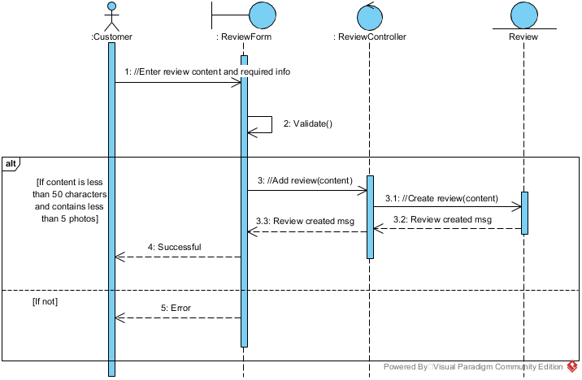
Review Product - Sequence Diagram
Notes:
Here you can see the Sequence Diagram.
Here in the front-end, the user enter the comment content. It will be checked to make sure that all information is filled. Them the front-end will send the content to the controller, then

Slide 37
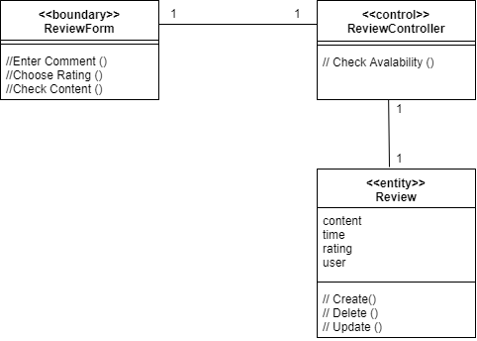
VOPC For Review Product Use-case
Notes:
VOPC = View of Participating Classes

Slide 38
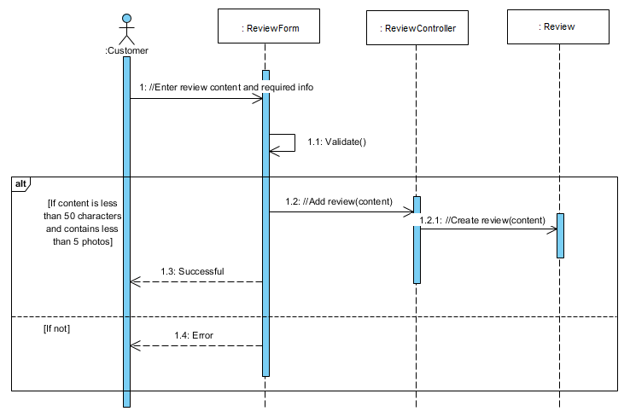
Review Product - Design Sequence Diagram

Slide 39
Use-case Diagram

Slide 40
Thank you for your attention
Any Questions?
Please don’t hesitate to contact Mr. BUI MANH THANG
thangbm@gmail.com

