Slide 1

SoICT 2024
Session 8B
AI Foundations and Big Data
December, 13th
BSRBF-KAN: A combination of B-splines and Radial Basis Functions in Kolmogorov-Arnold Networks
Author: Hoang-Thang Ta
Affiliate: Dalat University, Vietnam

Slide 2
Index
Introduction
Related works
Methodology: Kolmogorov-Arnold Representation Theorem, Kolmogorov-Arnold Networks, and Several KANs
Experiments: MNIST + Fashion-MNIST, Misclassification Analysis, Ablation Study
Limitation
Conclusion
Questions + Answers

Slide 3
1. Introduction
Kolmogorov-Arnold Networks (KANs) use learnable activation functions as "edges" to fit training data, as opposed to the fixed activation functions used as "nodes" in multi-layer perceptrons (MLPs).
KANs are based on the Kolmogorov-Arnold Representation Theorem. Multilayer Perceptrons (MLPs) are based on Universal Approximation Theory.
→ New research trends: novel KANs and integrating KANs with CNNs, RNNs, etc.

Slide 4
1. Introduction
Propose BSRBF-KAN combines B-splines and radial basis functions (RBFs) within Kolmogorov Arnold Networks (KAN) for improved data fitting.
BSRBF-KAN shows stability and better convergence compared to MLPs and other networks.
→ Inspire new mathematical function combinations for KAN design.

Slide 5
2. Related works
Hilbert’s 13th problem
concerns the solvability of the general 7th-degree polynomial function using continuous functions of only two variables
Kolmogorov-Arnold Representation Theorem (Vladimir Arnold, 1957)
demonstrating that a multivariate continuous function can be represented as a combination of single-variable functions and additions
Liu, Z., Wang, Y., Vaidya, S., Ruehle, F., Halverson, J., Soljačić, M., Hou, T.Y., Tegmark, M.: Kan: Kolmogorov-arnold networks. arXiv preprint arXiv:2404.19756 (2024)
Original KAN (LiuKAN, Spl-KAN), EfficientKAN, FastKAN, FasterKAN, Chebyshev KAN, etc.

Slide 6
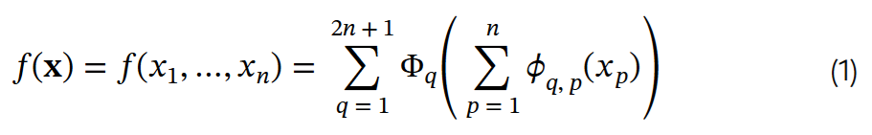
3. Methodology
Kolmogorov-Arnold Representation Theorem (KART -- Vladimir Arnold, 1957)
Any multivariate continuous function f defined on a bounded domain can be expressed using a finite number of continuous single-variable functions and additions
Given 𝐱 = x₁ , x₂ , . . , x_{n} consisting of n variables, a multivariate continuous function f(x) is represented by:

Slide 7
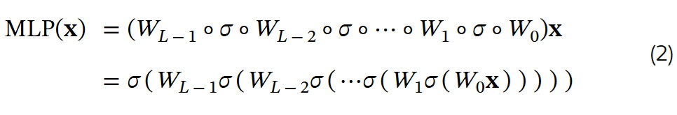
3. Methodology
Kolmogorov-Arnold Networks
An MLP characterized by affine transformations and non-linear functions.
From an input 𝐱, the network performs the composition of weight matrices by layers (from layer 0 to layer L-1 and the non-linearity (activation function) σ.

Slide 8
3. Methodology
Kolmogorov-Arnold Networks (based on KART)
In Equation 1, we must search proper Φ_{q} and ϕ_{q,p} to solve the problem. A general KAN network consisting of L layers takes 𝐱 to generate the output as:
which Φ_{l} is the function matrix of the l^{th} KAN layer or a set of pre-activations.

Slide 9
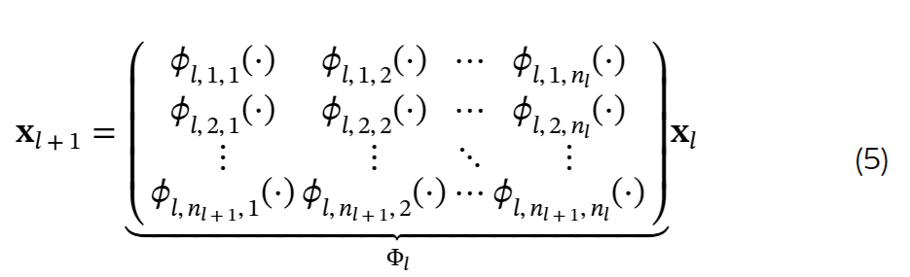
3. Methodology
Kolmogorov-Arnold Networks
The function matrix Φ_{l} can be represented as a matrix n_{l+1} × n_{l} of activations as:

Slide 10
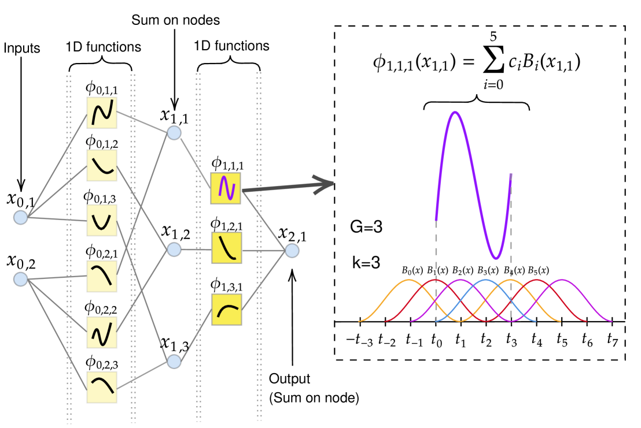
3. Methodology
Kolmogorov-Arnold Networks
Example: The structure of KAN(2,3,1)

Slide 11
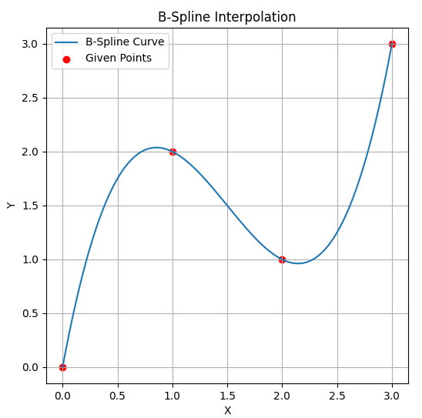
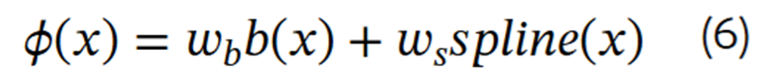
3. Methodology
Implementation of the current KANs
Original KAN (Spl-KAN, LiuKAN)
Liu, Z., Wang, Y., Vaidya, S., Ruehle, F., Halverson, J., Soljačić, M., Hou, T.Y., Tegmark, M.: Kan: Kolmogorov-arnold networks. arXiv preprint arXiv:2404.19756 (2024)
The residual activation function ϕ(x) as the sum of the base function and the spline function with their corresponding weight matrices w_{b} and w_{s}:
b(x) = silu(x) (activation functions)
spline(x) = linear combination of B-Splines

Slide 12

3. Methodology
Implementation of the current KANs
EfficientKAN
using B-splines followed by linear combination, reducing memory cost and simplifying computation.
https://github.com/Blealtan/efficient-kan
FastKAN
using GRBFs to approximate the 3-order B-spline and employing layer normalization to keep inputs within the RBFs’ domain. The RBF has the formula:
where r=‖x−c‖ is the distance between an input vector x and a center c, and ϵ > 0 controls the width of the Gaussian function.

Slide 13
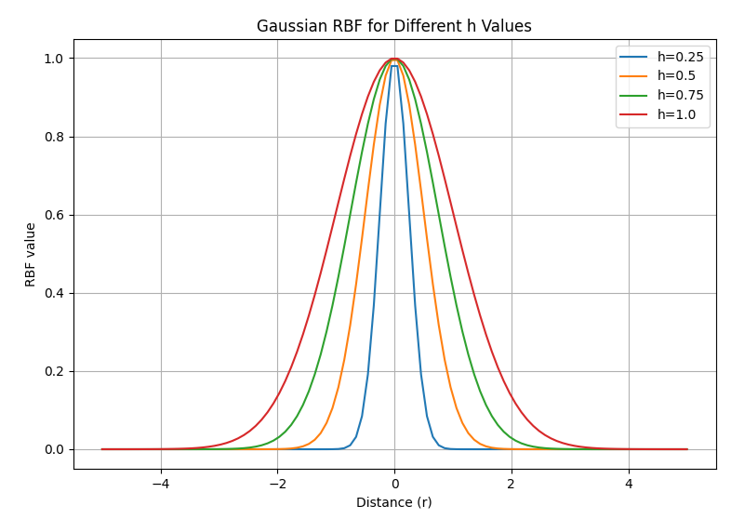

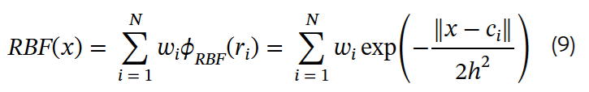
3. Methodology
Implementation of the current KANs
FastKAN
Li, Z.: Kolmogorov-arnold networks are radial basis function networks. arXiv preprint arXiv:2405.06721 (2024)
FastKAN uses a special form of RBFs, GRBFs where ϵ=0.5 and h controls the width of the Gaussian function:
The RBF network with N centers can be shown as:

Slide 14

3. Methodology
Implementation of the current KANs
FasterKAN
Li, Z.: Kolmogorov-arnold networks are radial basis function networks. arXiv preprint arXiv:2405.06721 (2024)
Use Reflectional Switch Activation Functions (RSWAFs), which are variants of RBFs:
GottliebKAN, which is based on Gottlieb polynomials
Teymoor Seydi, S.: Exploring the potential of polynomial basis functions in kolmogorov-arnold networks: A comparative study of different groups of polynomials. arXiv e-prints pp. arXiv–2406 (2024)

Slide 15
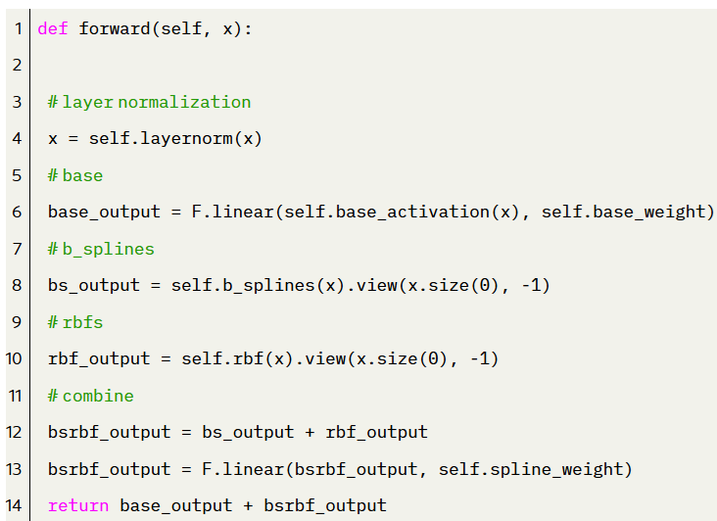
3. Methodology
Implementation of the current KANs
BSBRF-KAN
Combine B-splines and Gaussian RBFs for interpolation and approximation, ensures smoothness, continuity, and proper derivative handling.
From an input x, the BSRBF function is represented as:

Slide 16
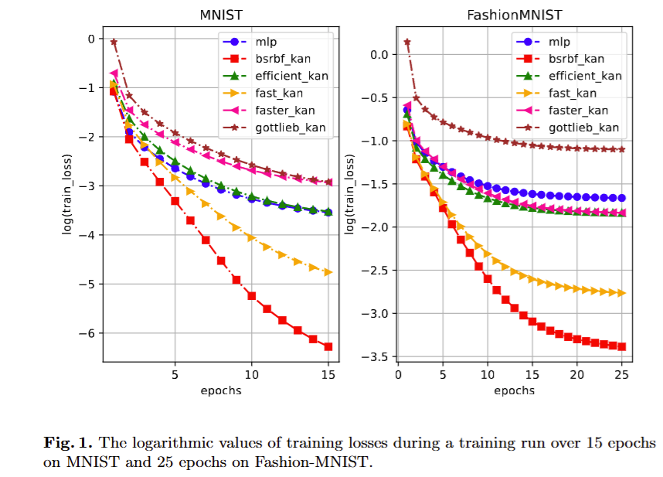
4. Experiments
Configuration + Model Losses
Each network was trained with 5 independent runs on MNIST (15 epochs) and Fashion-MNIST (25 epochs) using models structured as (784, 64, 10), and calculate the metric averages.
For GottliebKAN, we used (784, 64, 64, 10) to be similar to the original design.
Parameters: batch_size=64, learning_rate=1e-3, weight_decay=1e-4, gamma=0.8, optimize=AdamW, and loss=CrossEntropy.

Slide 17
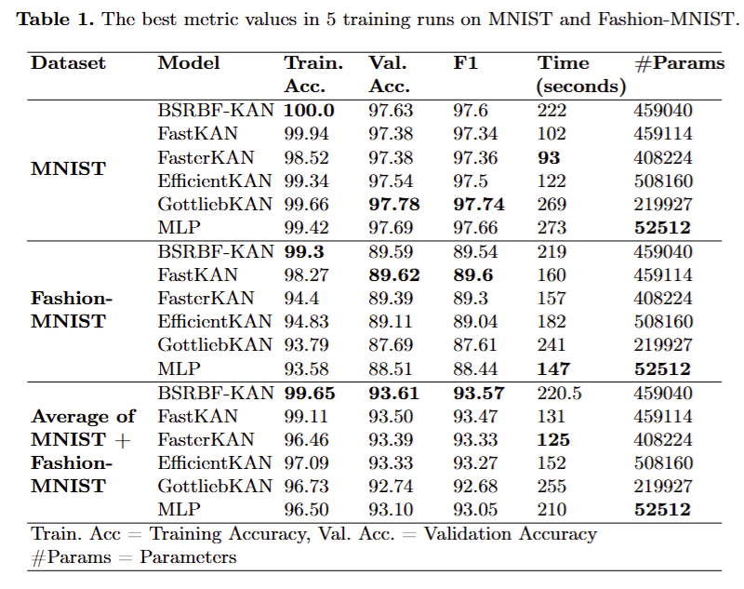
4. Experiments
The best metric values in 5 training runs

Slide 18
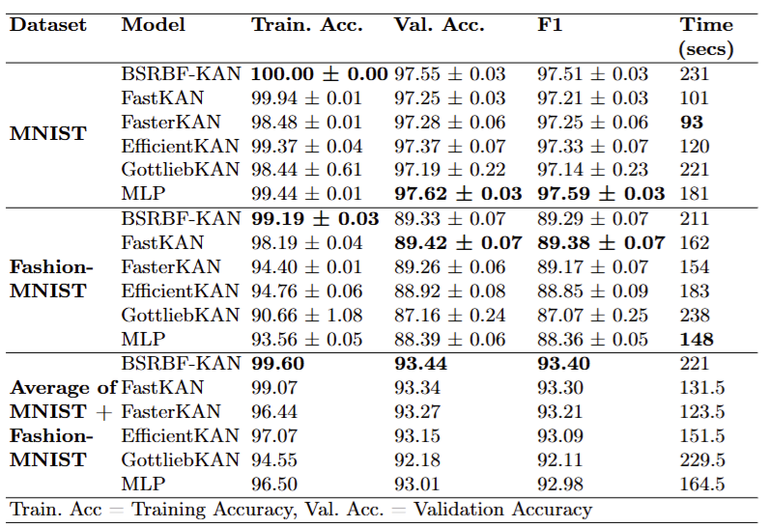
4. Experiments
The average metric values in 5 training runs

Slide 19
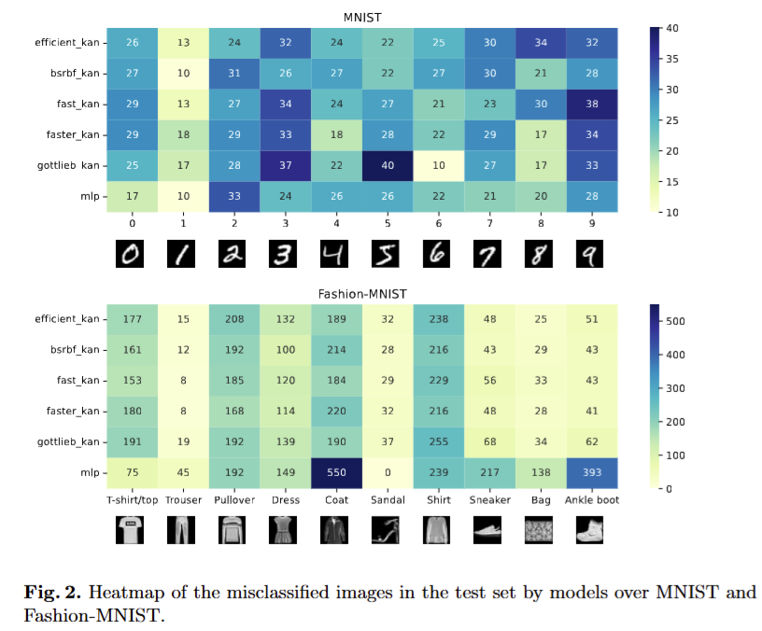
4. Experiments
Misclassification Analysis

Slide 20
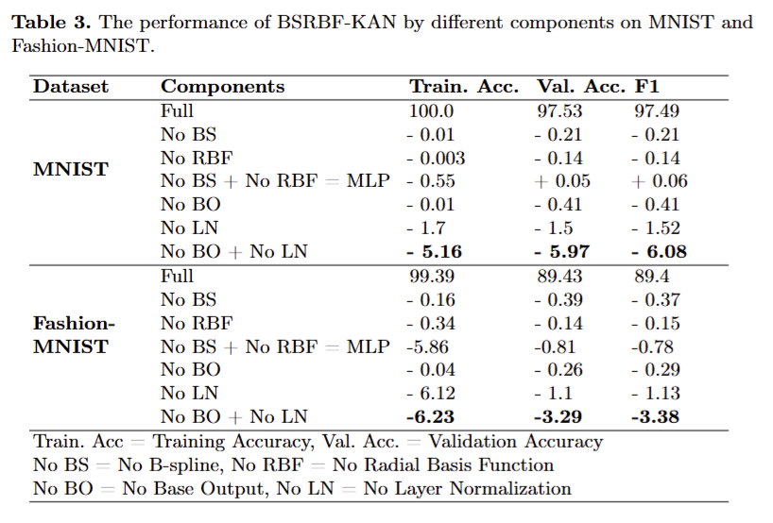
4. Experiments
Ablation Study

Slide 21
5. Limitations
Experiments were conducted simple datasets (MNIST and Fashion-MNIST)
The fairness of using the number of parameters (KANs vs. MLP)
Combining B-splines and Radial Basis Functions was chosen based on observed performance without a formalized mathematical justification or deep analyses.
Requirements:
Test more datasets and tasks
Design models with equal parameter counts for balanced comparisons
Explore the theoretical basis for function combinations through mathematical and qualitative analyses.

Slide 22
6. Conclusion + Future works
The paper introduces BSRBF-KAN, a new Kolmogorov Arnold Network combining B-splines and RBFs for training.
The focus was on understanding KAN combinations rather than optimizing hyperparameters.
BSRBF-KAN showed competitive performance and rapid convergence on MNIST and Fashion-MNIST,
high convergence could lead to overfitting, which can be mitigated.
Misclassification analysis and an ablation study were conducted to identify critical components.
Future work involves testing on more datasets and exploring KAN combinations to improve model performance.

Slide 23
7. Questions + Answers
SoICT 2024
Session 8B
AI Foundations and Big Data
December, 13th
Thank you for listening.
GitHub: https://github.com/hoangthangta/BSRBF_KAN

