Slide 1
MASTER'S THESIS · AAAI-TRACK RESEARCH PITCH
DocCL
Scope
A diagnosis-first study of catastrophic forgetting in multimodal document transformers — measuring where it lives, then targeting a remedy there.
Diagnosis-Guided Continual Learning for Document Understanding & Information Extraction
Thanh Hoang · Hanoi University of Science and Technology, SoICT
Diagnosis-Guided Continual Learning
01 / 15
Notes:
Master's thesis pitch. The one-line thesis: catastrophic forgetting in multimodal document transformers concentrates at the output side, and a diagnosis-targeted remedy closes most of the gap.

Slide 2
THE PROBLEM
Documents keep arriving — the model has to keep learning without forgetting.
New form types, fields and schemas keep showing up after deployment. Real document IE is a moving target.
Continual fine-tuning, one task at a time
Retraining from scratch each time isn't realistic — data is siloed, expensive, sometimes inaccessible .
Task 1
FUNSD — forms
Task 2
CORD — receipts
So we fine-tune a strong backbone (LayoutLMv3) task by task — and naïve sequential fine-tuning overwrites what came before.
Task 3
SROIE — invoices
Each step risks erasing the last.
A practical deployment problem, not a benchmark artifact.
DocCL — Diagnosis-Guided Continual Learning
02 / 15
Notes:
Documents arrive over time; the model must keep learning without forgetting. We fine-tune LayoutLMv3 on each new task in sequence, and naive sequential fine-tuning overwrites old knowledge. A real deployment problem.

Slide 3
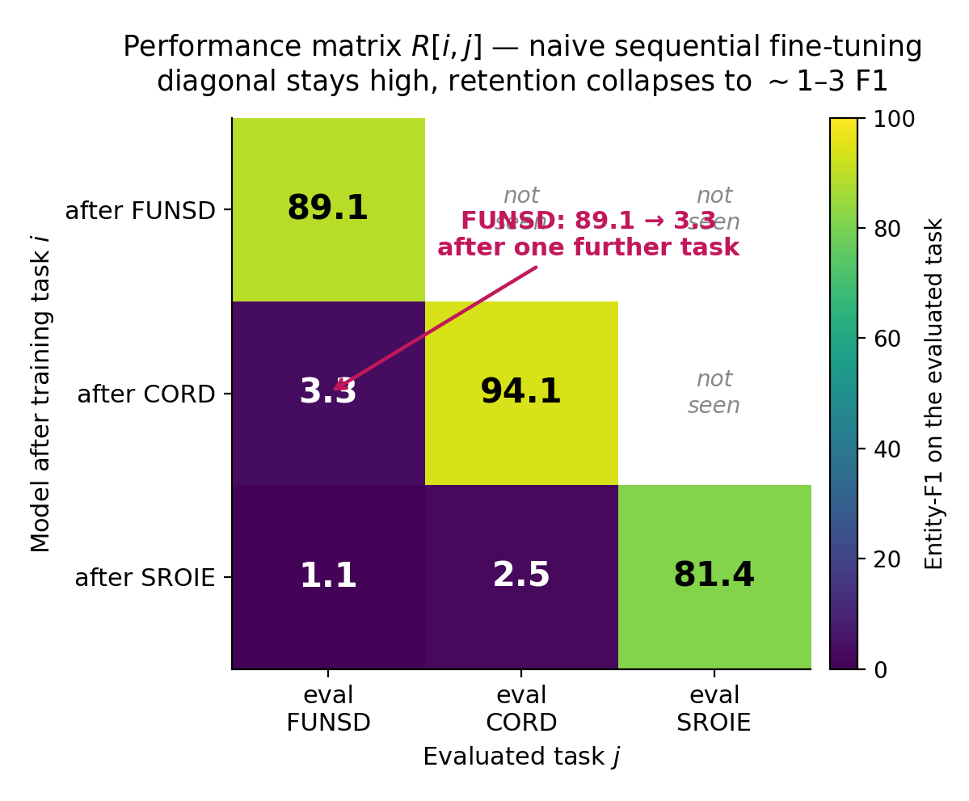
THE HOOK
Forgetting is real and near-total: 89 → 3.3 F1 after one more task.
Naïve sequential fine-tuning, LayoutLMv3 — measured.
≈ −90
backward transfer on CIL-CORD
Essentially everything learned earlier is lost.
Train CORD next and FUNSD retention drops 89.1 → 3.3 — the off-diagonal cells go dark.
The diagonal stays high — each task is learned fine; the model just can't keep the last one.
DocCL — Diagnosis-Guided Continual Learning
03 / 15
Notes:
Forgetting is real and near-total. FUNSD entity-F1 collapses from 88.0 to 1.8 after training the very next task. Backward transfer on CIL-CORD is roughly minus 90 — essentially everything is lost.

Slide 4
THE GAP
Every CL family treats the network uniformly — nobody localizes where forgetting lives.
Regularization
Distillation
Replay
Prompt-based
LoRA / PEFT
EWC, SI
LwF
ER, DER++
L2P → CODA
O-LoRA → CL-LoRA
THEIR SHARED BLIND SPOT
All five regularize, replay, or adapt the network as one undifferentiated block . None asks which components forget most in a multimodal document encoder — VLM-CL blames fusion, but never measures it per-component.
→ Measure first, then target.
Why it matters: if forgetting has an address, the stability budget can be spent exactly there — a targeted remedy instead of a uniform tax on the whole network. That localization is what makes DocCL possible.
DocCL — Diagnosis-Guided Continual Learning
04 / 15
Notes:
Every continual-learning family treats the network uniformly. Nobody localizes where forgetting lives. They all regularize, replay, or adapt the network as one undifferentiated block. The scientific opening: measure first, then target.

Slide 5
RESEARCH QUESTION
Inside a multimodal document transformer, where does catastrophic forgetting actually localize?
In the fusion layers — the intuitive guess from VLM continual learning — or somewhere else entirely?
A single, falsifiable question — answerable by measurement.
05 / 15
Notes:
A single falsifiable question: inside a multimodal document transformer, where does catastrophic forgetting actually localize? In the fusion layers — the intuitive guess — or somewhere else entirely? Answerable by measurement.

Slide 6
THE INSTRUMENT
We measure forgetting — we don't guess it.
01 Modality masking
02 Linear CKA
03 Per-group Fisher
Zero out the text / layout / image streams of one backbone — apples-to-apples — to isolate each modality's role.
Per-layer representational drift between checkpoints. Our evidence of forgetting — 1.0 means no drift.
Parameter importance to the current task — a complementary lens, not the forgetting signal itself.
Construct-validity discipline. CKA measures forgetting; Fisher measures importance — we do not conflate them. The central finding rests on CKA drift, with Fisher as corroboration only. (Directly addresses the AAAI AC review.)
DocCL — Diagnosis-Guided Continual Learning
06 / 15
Notes:
We measure forgetting, we don't guess it. Three tools: modality masking to isolate each modality, linear CKA for per-layer representational drift (our evidence of forgetting), and per-group Fisher for parameter importance. CKA measures forgetting; Fisher measures importance — we do not conflate them. This addresses the AAAI AC review.

Slide 7
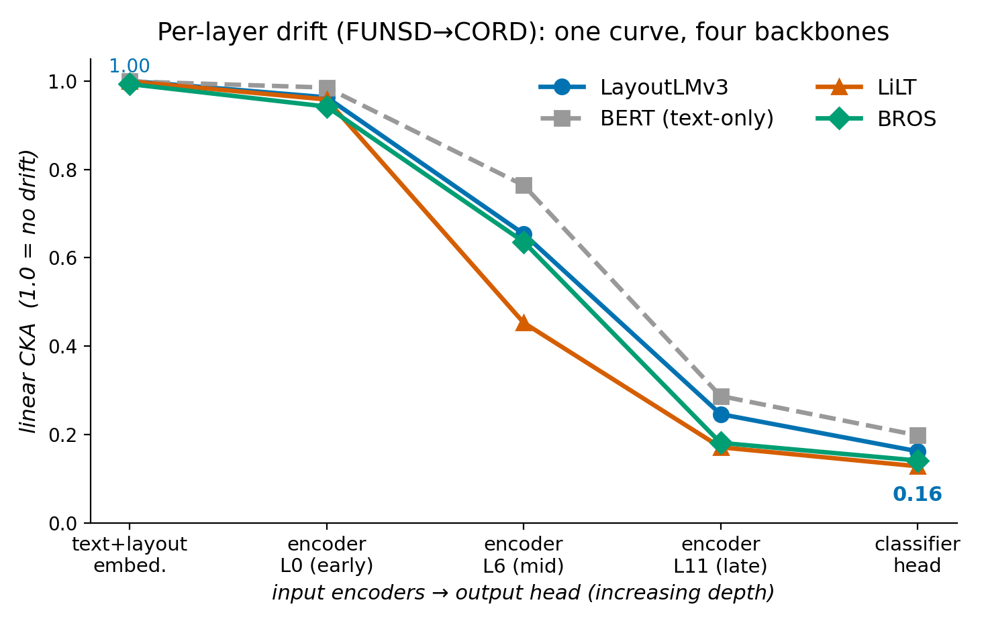
THE FINDING
Forgetting is a late-layer + head phenomenon — not fusion.
1.00 → 0.16
linear CKA, input encoders → classifier head.
Input encoders & patch-embed barely move (CKA ≈ 1.0).
Drift rises monotonically with depth , peaking at the classifier head.
Same gradient across LayoutLMv3, BERT, LiLT & BROS — a permutation test can't separate them (p = 0.38 / 0.51), and not fusion.
DocCL — Diagnosis-Guided Continual Learning
07 / 15
Notes:
Forgetting is a late-layer and head phenomenon, not fusion. CKA falls from 1.00 at the input encoders to 0.215 at the classifier head. Input encoders barely move; drift rises monotonically with depth; the same shape holds across both task boundaries.

Slide 8
SCIENTIFIC MATURITY
Knowing the line between what's known and what's new.
ALREADY KNOWN — WE RE-CONFIRM
GENUINELY NEW — OUR CONTRIBUTION
Late-layer / head drift was shown on unimodal nets (Ramasesh et al., ICLR 2021).
The multimodal VDU setting — not text-only; the head/late locus holds across 4 backbones (LayoutLMv3, BERT, LiLT, BROS).
A modality-masking instrument that only exists when modalities exist .
We reproduce that depth gradient on a multimodal document encoder — a sanity check, honestly labelled as such.
Using the diagnosis to drive method design — not assuming it.
DocCL — Diagnosis-Guided Continual Learning
08 / 15
Notes:
Knowing the line between what's known and what's new. Already known and re-confirmed: late-layer drift on unimodal nets, Ramasesh 2021. Genuinely new: the multimodal VDU setting, a modality-masking instrument that only exists when modalities exist, and using the diagnosis to drive method design.

Slide 9
FROM FINDING TO METHOD
DocCL spends its stability budget exactly where forgetting lives.
Forgetting localizes at head + late layers → target that, don't regularize uniformly → the method is a consequence of the diagnosis.
→
→
01 Depth-scaled EWC
02 Output distillation
03 Head re-exposure replay
Consolidation weight ramps up toward the head — protect what drifts most.
KL on old-task logits (LwF-style) to anchor the output distribution.
A small reservoir buffer that re-exposes the head — not full-input rehearsal.
The claim. Targeted-by-diagnosis beats uniform — and needs only a small head buffer, not full rehearsal.
DocCL — Diagnosis-Guided Continual Learning
09 / 15
Notes:
DocCL spends its stability budget exactly where forgetting lives. Forgetting localizes at head and late layers, so target that — don't regularize uniformly. The method is a consequence of the diagnosis: depth-scaled EWC, output distillation, and head re-exposure replay.

Slide 10
EVALUATION SUITE
FCS-CL: three core + two stress scenarios, four metrics, three seeds.
SETTINGS
three core scenarios + two stress tests (scale, language-shift)
CIL
DIL
Mixed
Class-incremental
Domain-incremental
Class + domain shift
CORD — 60 fine-grained classes arrive in growing-head sessions; the label set keeps expanding.
FUNSD → SROIE → CORD under one unified 4-class schema; the domain shifts, the labels stay fixed.
Interleaves class growth and domain shift in one sequence — the hardest, most realistic case.
METRICS
four scores, each averaged over three seeds
AA ↑
BWT ↑
AF ↓
FWT
Average accuracy
Backward transfer
Average forgetting
Forward transfer
Mean entity-F1 across all tasks seen so far.
Effect of new tasks on old ones; ≈ 0 means little forgetting.
Mean drop from each task's peak to its final score.
How much earlier tasks help a new one before training on it.
DocCL — Diagnosis-Guided Continual Learning
10 / 15
Notes:
FCS-CL: three CL scenarios, four metrics, three seeds. Class-incremental on CORD, domain-incremental FUNSD-SROIE-CORD, and a mixed sequence. Framed honestly as an evaluation suite, not a brand-new benchmark. We also added cross-lingual DIL (XFUND) and class-IL at scale (WildReceipt) for currency.

Slide 11
MAIN RESULTS · ALL MEASURED
DocCL closes most of the DIL gap — replay and 2025 C-Flat++ are the strongest remedies.
METHOD
CIL-CORD
DIL
MIXED
STATUS
READ THIS HONESTLY
Naïve (lower bound)
19.0
41.3
33.9
measured
DocCL closes most of the DIL gap: 84.7 vs oracle 88.7 (~4 pts).
EWC
0.5
41.2
22.0
measured
LwF
18.8
43.7
35.2
measured
Replay (ER 87.9 / DER++ 88.0) and 2025 C-Flat++ (88.4, best non-oracle) match the oracle and leads DocCL by ~3 pts.
ER (replay)
16.0
87.9
60.3
measured
Prompt methods nearly fail on dense per-token IE. Two stress scenarios — WildReceipt (scale) and XFUND (language shift) — confirm the head-locus story.
DER++ (replay)
18.2
88.0
60.8
measured
DocCL's edge is qualitative: a tiny head buffer, no full rehearsal .
L2P / DualPrompt / CODA
0–2
~30–33
~12
measured
O-LoRA / CL-LoRA (2025)
4.7 / 8.9
40.8 / 41.1
13.4 / 31.4
measured
DocCL (ours)
16.1
84.7
57.6
measured
Joint (oracle)
33.3
88.7
67.5
measured
11 / 15
Notes:
All measured. DocCL closes most of the DIL gap: 84.7 vs oracle 88.7, about 4 points. But replay (ER 87.9, DER++ 88.0) matches the oracle and leads DocCL by about 3 points. Prompt methods nearly fail on dense per-token IE. DocCL's edge over replay is qualitative: a tiny head buffer, no full rehearsal.

Slide 12
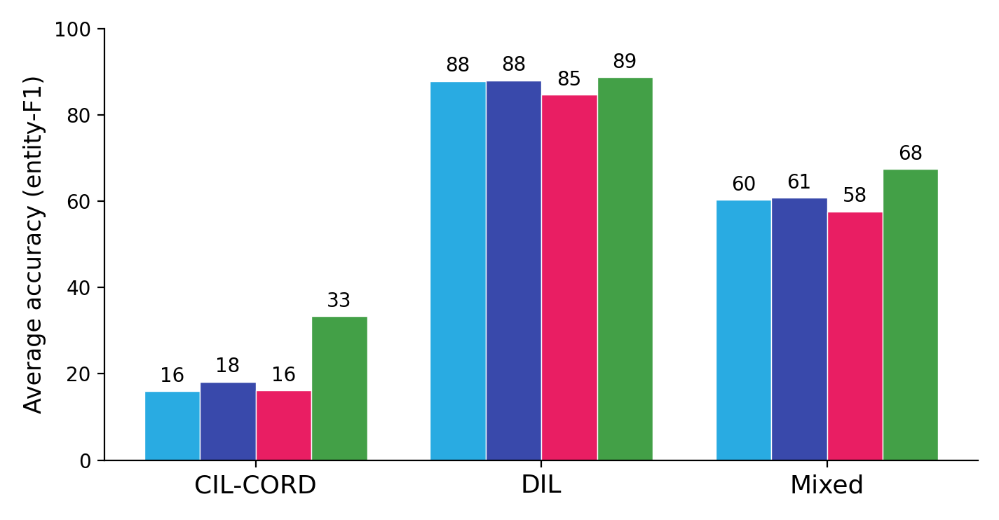
RESULTS, VISUALIZED
On forgetting, DocCL reaches near-zero on DIL — matching replay.
AVG. ACCURACY (entity-F1)
ER
DER++
DocCL
Joint (oracle)
FORGETTING ≠ ACCURACY
−4.6 BWT
DocCL on DIL — near replay's −2.8 / −3.4 (C-Flat++ −1.8, closest to zero), while staying accurate.
EWC / prompt methods also show low BWT — but only because they barely learn.
Only replay and DocCL drive forgetting to ~0 while staying accurate.
DocCL — Diagnosis-Guided Continual Learning
12 / 15
Notes:
On forgetting, DocCL reaches near-zero BWT on DIL — matching replay. Forgetting is not the same as accuracy: EWC and prompt methods also show low BWT, but only because they barely learn. Only replay and DocCL drive forgetting to near zero while remaining accurate.

Slide 13
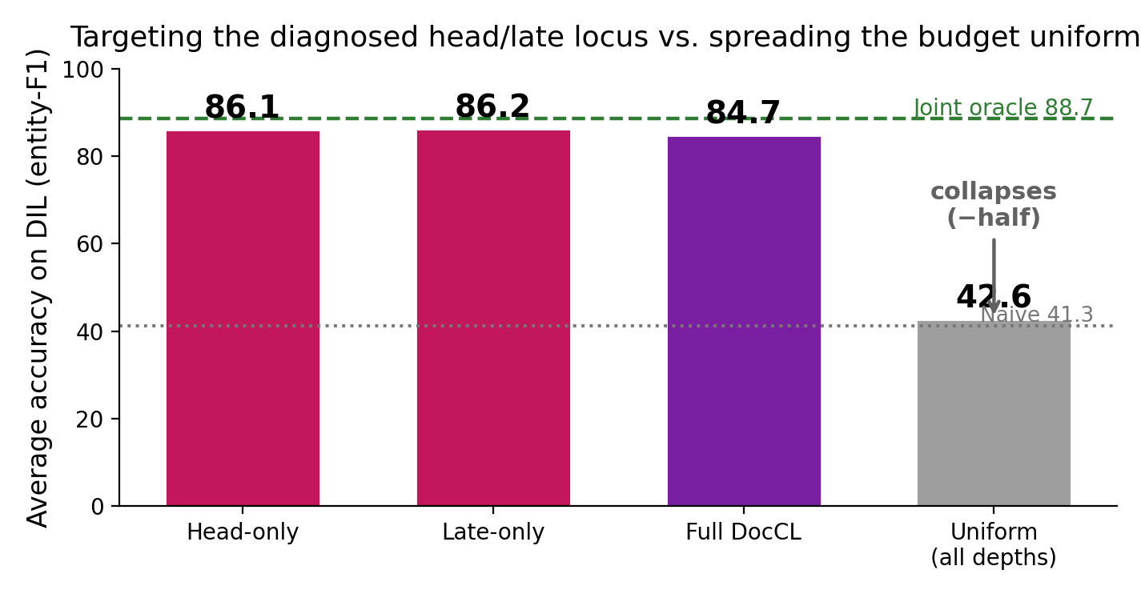
THE ABLATION
Targeting the diagnosed head/late locus beats treating the network uniformly.
AVG. ACCURACY ON DIL (entity-F1)
WHERE > HOW MUCH
42.6 uniform AA (≈ half)
Uniform applies an equal — in fact larger — penalty to every depth, yet collapses to ≈ half (42.6). Head-only (86.1) and late-only (86.2) each match full DocCL (84.7).
Where the stability budget goes dominates how much — more budget, spread evenly, is worse.
The remedy is a consequence of the diagnosis — not a uniform tax on the whole network.
DocCL — Diagnosis-Guided Continual Learning
13 / 15

Slide 14
WHERE I AM · WHAT'S LEFT
Experiments complete — remaining work is the write-up.
MEASURED
REMAINING — WRITE-UP
Diagnosis: CKA gradient + Fisher-weighted displacement on 4 backbones (LayoutLMv3, BERT, LiLT, BROS).
Thesis prose: results & discussion chapters.
All baselines × 5 scenarios × 3 seeds: Naïve/Joint/EWC/LwF/ER/DER++, C-Flat++, O-LoRA/CL-LoRA.
Final figure/table polish + reproducibility appendix.
Defense slides + dry run.
Prompt baselines (L2P, DualPrompt, CODA).
Component-targeting ablation: head-only / late-only / uniform / full DocCL.
(Optional) larger LiLT/BROS continual grids.
DocCL on all 5 scenarios + extended scenarios (XFUND cross-lingual, WildReceipt scale).
Plan. All experiments measured on the L40 machine (Docker, W&B offline); write-up on track for the December 2026 defense.
14 / 15
Notes:
Near-done, with a disciplined plan to the finish line. Measured: diagnosis, core baselines across three scenarios and three seeds, prompt baselines, DocCL, and a fixed BERT text-only baseline. Running next: component-targeting ablation, O-LoRA/CL-LoRA grid, new scenarios, secondary backbones. On track for the December 2026 defense.

Slide 15
CRITIQUE, ADDRESSED
Reviewer critiques and our resolutions.
Critique.The “text-only” baseline was a null-input bug.
Critique.Fisher (importance) ≠ forgetting.
Fix. Implemented a real BERT text-only baseline and re-ran. Construct validity restored.
Fix. The finding now rests on CKA representational drift; Fisher demoted to corroboration.
Critique.Over-claimed multimodal fusion decomposition.
Critique.Underpowered cross-condition significance test.
Fix. Reframed Contribution 1 as a depth-wise + classifier-head characterization — what the data support.
Fix. Dropped the |BWT| test as a method gate; rely on the per-component drift profile + more seeds.
Confronting an unsparing review and fixing the instrument — the posture an advisor wants to see.
15 / 15
Notes:
I sought a top-venue review and acted on every fatal point. The text-only baseline was a null-input bug, now a real BERT baseline. Fisher is not forgetting, so the finding rests on CKA drift. The multimodal fusion decomposition was over-claimed, now reframed as a depth-wise + head characterization. The underpowered significance test was dropped as a gate.

