Slide 2
Diagnosis-Guided Continual Learning
for Document Understanding & Information Extraction
Thanh Hoang — Master Thesis Progress, Aug 2026
Notes:
Master's thesis pitch. One-line thesis: catastrophic forgetting in multimodal document transformers concentrates at the output side; a pre-registered falsification program shows only task-consistent re-exercise repairs it, with CoLaR as the constructive control.

Slide 3
THE PROBLEM
Documents keep arriving — the model must keep learning without forgetting.
Moving target — new form types, fields and schemas keep showing up after deployment.
Retraining from scratch is unrealistic — data is siloed, expensive, sometimes inaccessible.
Continual fine-tuning, task by task — FUNSD (forms) → CORD (receipts) → SROIE (invoices); each step risks erasing the last.
Notes:
Documents arrive over time; the model must keep learning without forgetting. We fine-tune LayoutLMv3 on each new task in sequence, and naive sequential fine-tuning overwrites old knowledge. A real deployment problem.

Slide 4
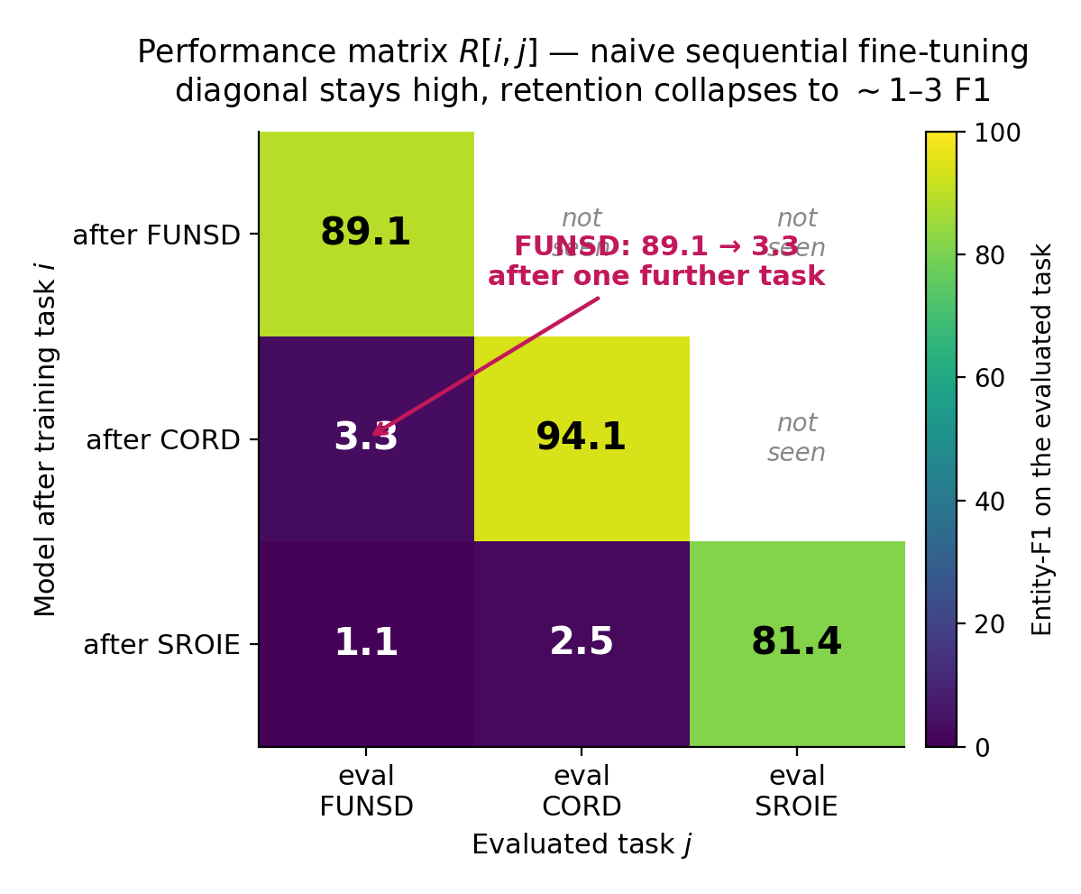
THE HOOK
Forgetting is severe and nearly absolute.
89.1 → 3.3 — FUNSD entity-F1 immediately after training the next task (naive sequential fine-tuning, LayoutLMv3, DIL).
Essentially everything learned earlier is lost — the off-diagonal of the retention matrix collapses at the first boundary.
Notes:
Forgetting is real and near-total. FUNSD entity-F1 collapses from 89.1 to 3.3 after training the very next task. Essentially everything learned earlier is lost.

Slide 5
THE GAP
Every CL family treats the network uniformly. No one localizes where forgetting lives.
Regularization — EWC, SI
Distillation — LwF
Replay — ER, DER++
Prompt-based — L2P → DualPrompt → CODA-Prompt
LoRA / PEFT — O-LoRA, CL-LoRA, SD-LoRA (2025)
Their shared blind spot — all regularize, replay, or adapt the network as one undifferentiated block. None asks WHICH components forget in a multimodal document encoder. → Measure first, then target.
Notes:
Every continual-learning family treats the network uniformly. Nobody localizes where forgetting lives. The scientific opening: measure first, then target.

Slide 6
RESEARCH QUESTION
Inside a multimodal document transformer, WHERE does catastrophic forgetting actually localize?
The intuitive guess — the fusion layers — by analogy with VLM continual learning.
Or somewhere else entirely? — a single, falsifiable question — answerable by measurement.
Notes:
A single falsifiable question: where does catastrophic forgetting actually localize? In the fusion layers — the intuitive guess — or somewhere else entirely? Answerable by measurement.

Slide 7
THE INSTRUMENT
How to measure forgetting.
Modality masking — zero out the text / layout / image streams to isolate each modality’s role.
Linear CKA — per-layer representational drift between checkpoints; 1.0 = no drift. The forgetting signal.
Per-group Fisher displacement — parameter importance to the old task × movement — a complementary lens.
Construct-validity discipline — CKA measures forgetting, Fisher measures importance; the central finding rests on CKA drift, Fisher corroborates.
Notes:
We measure forgetting, we don't guess it. CKA measures forgetting; Fisher measures importance — we do not conflate them. This addresses the AAAI AC review.

Slide 8
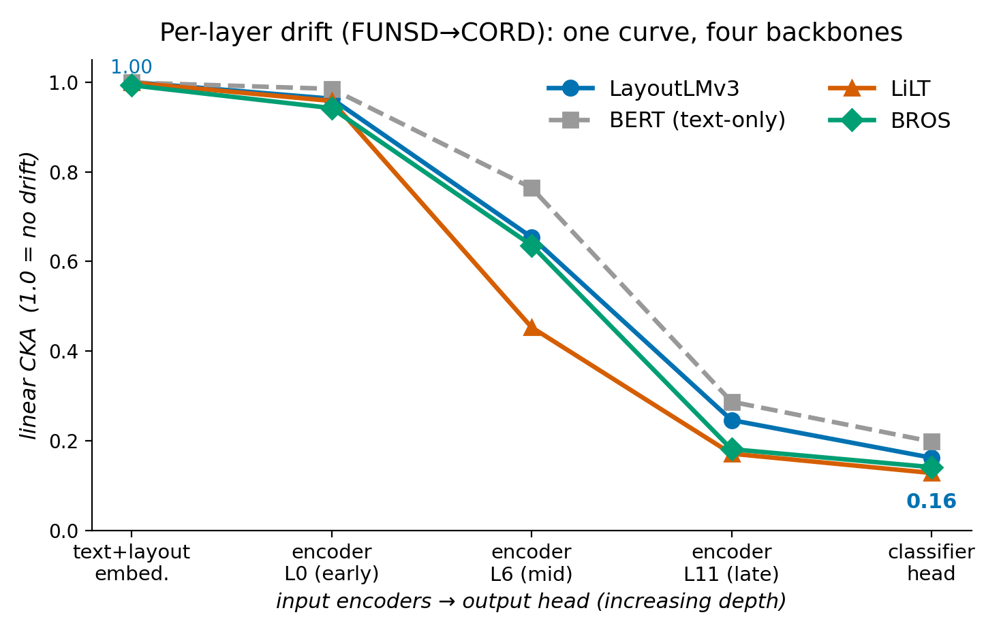
FINDING 1
Forgetting is a late-layer + head phenomenon. Not fusion.
1.00 → 0.16 — linear CKA from input encoders to classifier head: encoders barely move, the head moves most.
Architecture-general — the head-dominant displacement and depth gradient reproduce on all 4 backbones (LayoutLMv3, BERT, LiLT, BROS); permutation test cannot separate their profiles (p = 0.38, 0.51).
Known vs. new — late-layer drift was shown on unimodal nets (Ramasesh et al., ICLR’21); the multimodal VDU setting, the modality-masking instrument, and the locus MIGRATION under protection are new.
Notes:
Forgetting is a late-layer and head phenomenon, not fusion. CKA falls from 1.00 to 0.16 toward the head. Now confirmed on 4 backbones including the completed BERT grid; permutation test cannot separate the profiles.

Slide 9
THE ROOT CAUSE (NEW)
The readout-marginal snap: the head’s output marginal snaps to the just-trained task.
cos 0.997–0.998 — failing methods’ output marginal on OLD tasks vs. the just-trained task’s gold marginal (replay methods stay at 0.99–1.00 to their OWN marginal).
Class-asymmetric extinction — never-re-exercised classes (KEY, HEADER) hit exactly 0.0 F1 under every modality mask; even background O collapses (0.00% row accuracy, invisible to entity-F1).
5 pre-registered kill-tests — all null — eval-time marginal repair recovers −0.1 AA (old-class mass already ~10⁻⁶: information destroyed); marginal-KL and balanced-softmax training objectives leave extinct classes at 0.0.
The verdict — the snap is a symptom, not an invertible transformation — only task-consistent re-exercise (replay) prevents it.
Notes:
The root cause, established after the deck's first version: the head's output marginal on old tasks snaps to the just-trained task's marginal. Five pre-registered kill-tests show no cheap correction recovers it — the information is destroyed, not miscalibrated. Registered nulls, not absence of evidence. Registration was self-administered — say so if asked.

Slide 10
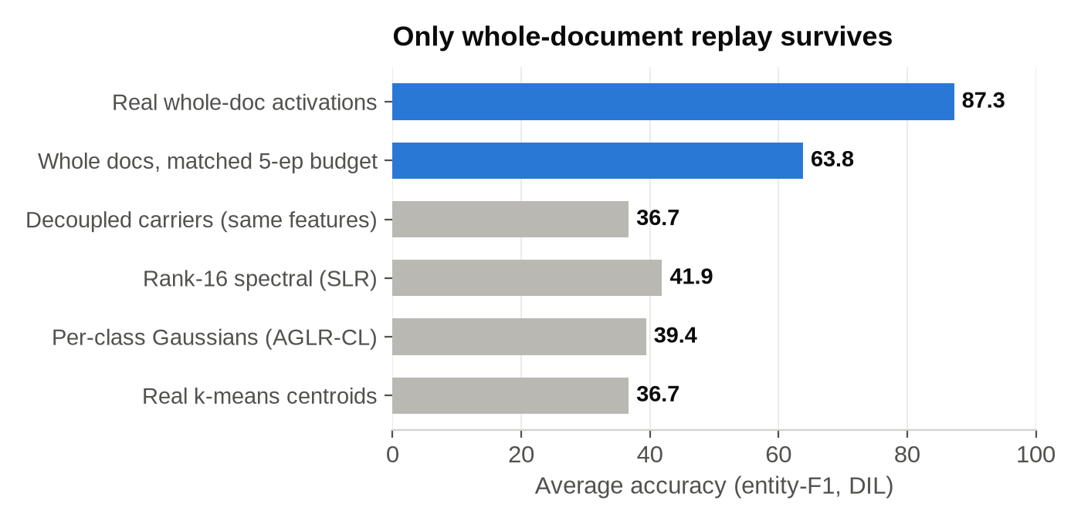
THE FALSIFICATION CHAIN (NEW)
Buffer-free replay compression fails for ONE identified reason: broken whole-document consistency.
Same frozen boundary (layer k=8), same task stream — only the replay representation differs.
Whole-document (feature, position, label) binding is the necessary ingredient — summaries that break it fail regardless of pointwise fidelity — even REAL centroids.
Single-variable control — 4 whole docs → AA 63.8 vs. the same features on decoupled carriers → 36.7.
Notes:
The falsification ladder: at the same frozen boundary, only whole-document replay works. Every summary — even real centroids — collapses. The single-variable control isolates whole-document (feature, position, label) binding as the necessary ingredient.

Slide 11
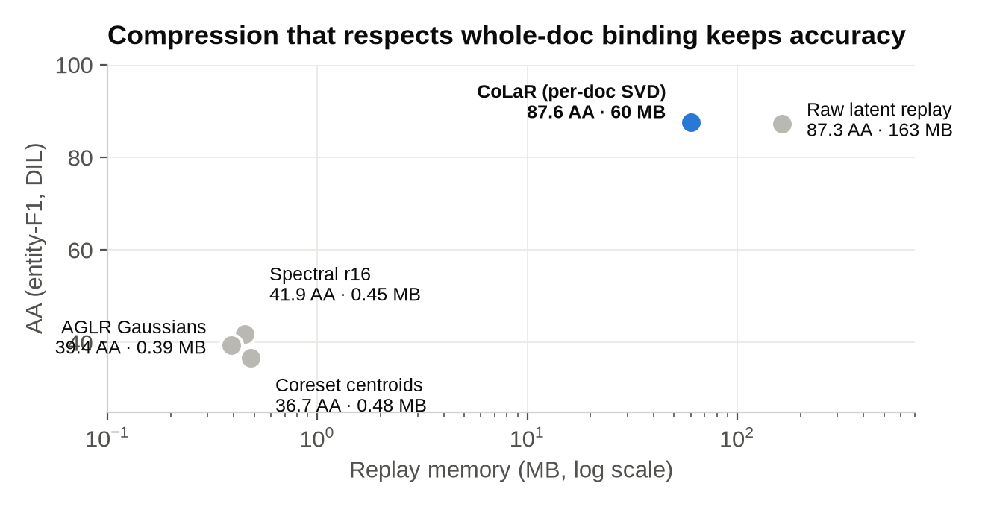
THE CONSTRUCTIVE CONTROL (NEW)
CoLaR: compression that RESPECTS whole-doc consistency works — the negatives are not effort-limited.
87.6 AA @ 60 MB — per-document rank-r SVD factors: 2.7× smaller than raw replay, within 1.4 pts of the joint oracle.
A conservation law — every improvement lever trades FUNSD surplus for SROIE ~1:1 without moving AA (3-seed confirmed); read-side extensions are clean negatives.
Honest LexSlot accounting — the 87.3 row is the small-buffer hybrid (200 exemplars); standalone ≈ naive (42.2) — reproduced on BERT.
Reframed contribution — diagnosis + pre-registered falsification; CoLaR is the control, not a claimed SOTA method.
Notes:
CoLaR proves the negatives are not effort-limited: compression that respects whole-doc binding works (87.6 at 60 MB). But it is a control, not a claimed method — improvements obey a conservation law. Honest LexSlot accounting: the 87.3 row is the small-buffer hybrid; standalone is naive-level, reproduced on BERT.

Slide 12
EVALUATION SUITE
Five scenarios × four metrics × three seeds × four backbones — every headline claim multi-seed.
CIL — CORD — 60 fine-grained classes arrive in growing-head sessions.
DIL — FUNSD → SROIE → CORD under one unified 4-class schema; domain shifts, labels fixed.
Mixed — interleaves class growth and domain shift — the hardest, most realistic case.
Stress tests — WildReceipt (scale) and XFUND (language shift).
Metrics — AA (mean entity-F1 over seen tasks), BWT/AF (forgetting), FWT — all over 3 seeds (42/7/123).
Backbones — LayoutLMv3 (primary, full grid) · BERT text-only (full grid — DONE) · LiLT (partial) · BROS (pending).
Notes:
FCS-CL evaluation suite: three core scenarios plus two stress tests, four metrics, three seeds. Framed honestly as an evaluation suite, not a brand-new benchmark.

Slide 13
MAIN RESULTS · ALL MEASURED
Replay dominates; 2025 flat-minima replay is the strongest; DocCL closes most of the DIL gap.
METHOD | CIL-CORD | DIL | MIXED
Naïve (lower bound) | 19.0±0.2 | 41.3±1.5 | 33.9±0.3
EWC | 0.5±0.6 | 41.2±1.1 | 22.0±9.4
LwF | 18.8±0.2 | 43.7±1.1 | 35.2±1.2
ER (replay) | 16.0±1.4 | 87.9±1.4 | 60.3±5.3
DER++ (replay) | 18.2±0.3 | 88.0±0.9 | 60.8±2.7
ER + C-Flat++ (2025) | 15.9±1.5 | 88.4±0.2 | 62.2±0.7
L2P / DualPrompt / CODA | 0–2 | ~30–33 | ~8–12
O-LoRA / CL-LoRA (2025) | 4.7 / 8.9 | 40.8 / 41.1 | 13.4 / 31.4
DocCL (diagnosis-guided) | 16.1±0.9 | 84.7±1.7 | 57.6±2.4
BERT text-only comparator | 19.3±0.1 | 39.4±0.3 | 23.4±0.3
Joint (oracle) | 33.3±0.3 | 88.7±1.1 | 67.5±0.8
Notes:
All measured. Replay matches the oracle on DIL; C-Flat++ (2025) is the single strongest. DocCL closes most of the gap with a tiny head buffer. Prompt/LoRA methods fail on dense per-token IE. CIL is brutally hard for everything — even the oracle only reaches 33.

Slide 14
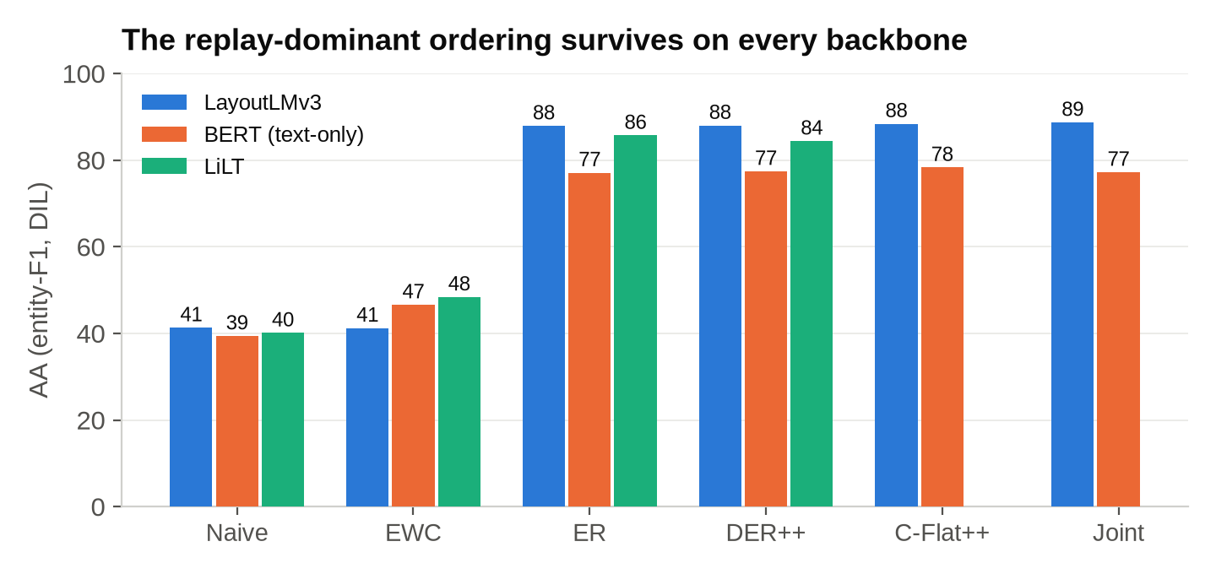
GENERALISATION (NEW)
The ordering survives on every backbone — even with layout and vision removed entirely.
BERT text-only, FULL grid done — replay reaches its own joint oracle (78.3 vs. 77.2 DIL); regularization barely moves the naive floor; prompt/LoRA at or below naive.
LiLT (partial) — same three tiers — ER 85.7 ≫ EWC 48.4 > naive 40.1. BROS: pending rented grid.
Takeaway — replay-dominance is a property of the PROBLEM, not of one backbone or of multimodality.
Notes:
The ordering is not an artifact of one backbone: full BERT grid reproduces replay-dominance at its own oracle level with layout and vision removed entirely. LiLT partial, BROS pending on the rented grid.

Slide 15
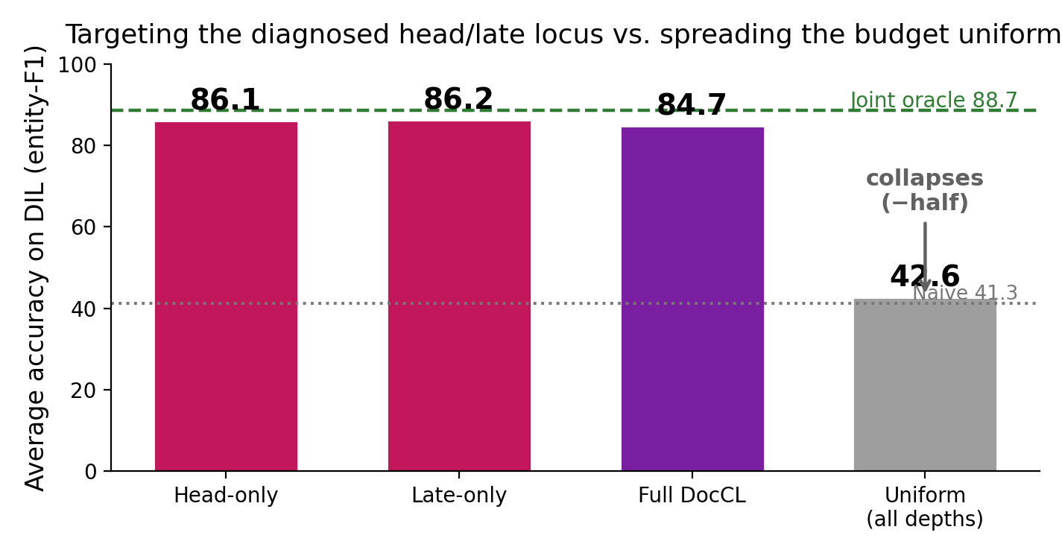
THE ABLATION
Targeting the diagnosed head/late locus beats treating the network uniformly.
WHERE > HOW MUCH — a uniform penalty at every depth costs more and still collapses to ≈ half the targeted AA.
On forgetting — DocCL reaches near-zero BWT on DIL, matching replay.
Notes:
Targeting the diagnosed locus beats uniform treatment — WHERE matters more than HOW MUCH. DocCL reaches near-zero BWT while remaining accurate; EWC and prompts show low BWT only because they barely learn.

Slide 16
CAPACITY GATES ON CoLaR (NEW)
Can task-specific head capacity break the conservation law? Every pre-registered gate says no.
CoLaSlot-R: NO-GO — +14.0 AA over matched CoLaR but the final domain regresses (CORD −0.84 < the −0.5 guardrail); an exhaustive test-blind margin calibration found NO usable abstention threshold — design closed.
CoLaSlot-RF: inert — post-task hard-label residual refit — the dual slots-on/off evaluation shows EXACTLY equal results (AA 72.4 both ways; refit losses ~10⁻⁵, no drift signal in hard labels).
CoLaSlot-RA: harmful — acquisition-logit anchors restore a training signal but cost −0.43 AA (SROIE precision −1.2): residual overgeneralization from 5 replay docs.
The pattern — wrong routes are destructive, right routes are inert — consistent with the conservation law; head residuals on compressed replay are closed in their current form.
Notes:
Task-capacity gates on CoLaR, all pre-registered, all closed: R breaks the CORD guardrail and no abstention threshold exists; RF is exactly inert (dual evaluation); RA hurts precision. Wrong routes destructive, right routes inert — the conservation law again.

Slide 17
WHERE I AM · WHAT’S LEFT
Status & next actions.
Done — diagnosis — CKA gradient + Fisher displacement on 4 backbones; root-cause RCA + 5 kill-test registered nulls.
Done — benchmark — all baselines × 5 scenarios × 3 seeds on LayoutLMv3; full BERT slice (126+ runs, 9 days local GPU).
Done — thesis — results chapters updated (ch6 falsification section, backbone tables, 128 pp builds clean).
Next — LiLT + BROS grids on a rented 24 GB GPU (~3 days, paste-ready) · method-chapter structural reframe · defense dry-run.
Notes:
Near-done. Diagnosis, RCA, kill-tests, full LayoutLMv3 + BERT grids, thesis results chapters all done. Remaining: LiLT/BROS rented grid, method-chapter reframe, defense dry-run. On track for the December 2026 defense.

Slide 18
THANK YOU !

