Slide 1
Fashion recommender
Segmentation of fashion-related items

Slide 2
Agenda
Project overview
Masking Architectures
- Structure
- Pros and Cons
- Train process and time
- Results/Examples
Alternative Applications
Conclusions
Guidelines:
20 min + 5-10 mins for questions
Clear explanation of method or algorithm
Illustrative results
Text size 16+; large enough to read

Slide 3
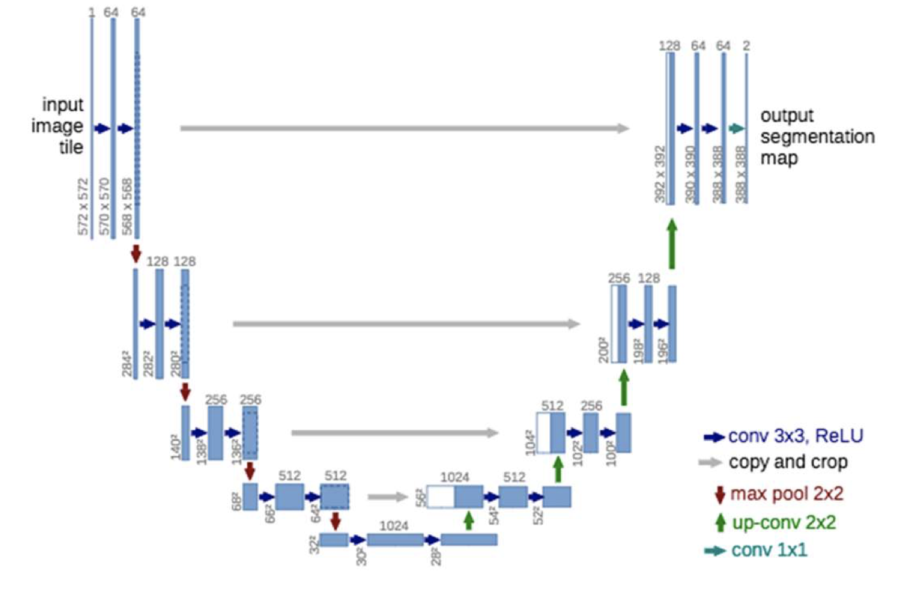
Unet Architecture with Resnet Encoder
Build Steps:
Isolate Unet decoder
Import Resnet pretrained network
Connect Layers
Adjust Image scaling for training
Train
Adjust image scaling for inference
ResNet
Unet
Input
Block 1
uuuu
Block 2
uuuu
Block 3
uuuu
Block 4
uuuu
Block 5
Encoder
uuuu

