Slide 1
Using Stored Procedures for Processing Data
By Thien Van Hoang

Slide 2
Agenda
1. Introduction
2. Stored Procedures Advantages
3. Stored Procedures Disadvantages
4. Syntax
5. Conclusion
6. Q&A

Slide 3
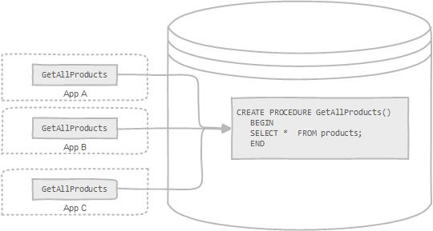
Introduction
What is Stored Procedures ? Should I use it ?
Notes:
A stored procedure is nothing more than prepared SQL code that you save so you can reuse the code over and over again. So if you think about a query that you write over and over again, instead of having to write that query each time you would save it as a stored procedure and then just call the stored procedure to execute the SQL code that you saved as part of the stored procedure.
In addition to running the same SQL code over and over again you also have the ability to pass parameters to the stored procedure, so depending on what the need is the stored procedure can act accordingly based on the parameter values that were passed.
A stored procedure is a segment of declarative SQL statements stored inside the database catalog. A stored procedure can be invoked by triggers, other stored procedures, and applications such as Java, Python, PHP, etc.

Slide 4

Stored Procedures Advantages
Increase Performance
Reduce the Traffic to Server
Reusable
Secure
Easier Manage
Notes:
1. Typically stored procedures help increase the performance of the applications. Once created, stored procedures are compiled and stored in the database. However, MySQL implements the stored procedures slightly different. MySQL stored procedures are compiled on demand. After compiling a stored procedure, MySQL puts it into a cache. And MySQL maintains its own stored procedure cache for every single connection. If an application uses a stored procedure multiple times in a single connection, the compiled version is used, otherwise, the stored procedure works like a query.
2. Stored procedures help reduce the traffic between application and database server because instead of sending multiple lengthy SQL statements, the application has to send only name and parameters of the stored procedure.
3. Stored procedures are reusable and transparent to any applications. Stored procedures expose the database interface to all applications so that developers don’t have to develop functions that are already supported in stored procedures.
4. Stored procedures are secure. The database administrator can grant appropriate permissions to applications that access stored procedures in the database without giving any permissions on the underlying database tables.
If the user account created for the application or web site is configured with EXECUTE permissions only then the underlying tables cannot be accessed directly by the user account. This helps prevent hacking directly into the database tables. The risk of a hacker using the user account to run a stored procedure that has been written by you is far safer than having the user account have full insert, update and delete authority on the tables directly.
.Using procedure parameters helps guard against SQL injection attacks. Since parameter input is treated as a literal value and not as executable code, it is more difficult for an attacker to insert a command into the Transact-SQL statement(s) inside the procedure and compromise security.
5. Another advantage to using stored procedures, especially in medium to large scale web sites or applications, is the data functionality is separated from the application making it easier to manage, document, and maintain. For example, if an application updates the customer table in ten different places, there can be a single stored procedure and a standard procedure call from the application for this functionality. If a change needs to be made to the way a customer record is managed, then the SQL statements only need to be changed in one place, in the database layer. In most cases, the application is not affected unless the procedure call requires modification. Changing the procedure call is also easier, because a standard call is already in place. Managing the data in the data layer avoids having to keep track of embedded SQL calls that may be different in each place, whenever a change is required.

Slide 5

Stored Procedures Disadvantages
Memory Usage
Difficult to Debug
Not Easy to Develop and Maintain
Notes:
. If you use a lot of stored procedures, the memory usage of every connection that is using those stored procedures will increase substantially. In addition, if you overuse a large number of logical operations inside store procedures, the CPU usage will also increase because the database server is not well-designed for logical operations.
. It is difficult to debug stored procedures. Only a few database management systems allow you to debug stored procedures. Example, MySQL does not provide facilities for debugging stored procedures.
. It is not easy to develop and maintain stored procedures. Developing and maintaining stored procedures are often required a specialized skill set that not all application developers possess. This may lead to problems in both application development and maintenance phases.

Slide 6
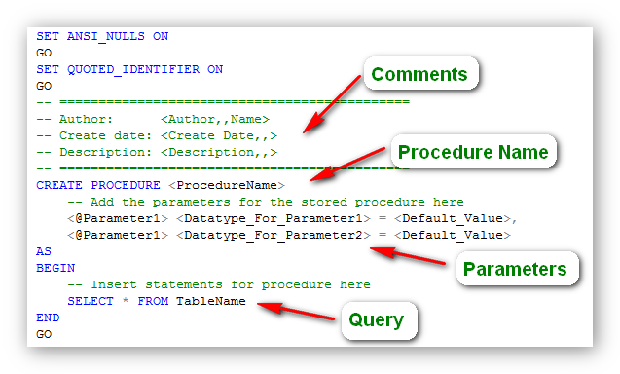
Syntax
Notes:
To call this stored procedure we would execute it as follows:
Using the EXECUTE keyword

Slide 7

Conclusion
Should use it
Notes:
MySQL stored procedures have their own advantages and disadvantages.
However, I recommend that Stored Procedures be applied as one of a useful array of tools. Put it into your toolbox and you’ll be surprised at how useful it can become.

Slide 8

Q & A
Notes:
Thank you for listenning

