Slide 1
E-commerce business models
Lecturer: Nguyen Thien Bao

Slide 2
Contents
01
E-Commerce business models
02
B2C E-commerce business models
03
B2B E-commerce business models

Slide 3
E-Commerce business Models

Slide 4
Set of planned activities designed to result in a profit in a marketplace Business plan
E-commerce business model is a descriptive and financial “blueprint” for a business E-commerce business model
A Business Model that uses/leverages unique qualities of Internet and Web
What is E-commerce business models?

Slide 5
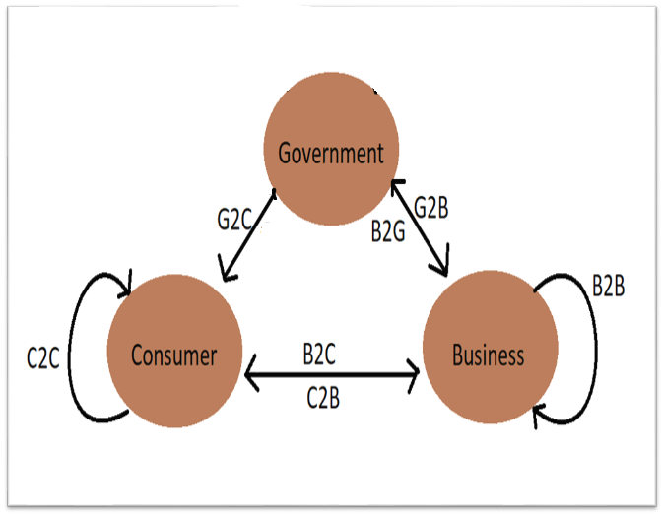
• Consumer
– C2C (Consumer-To-Consumer)
– C2B (Consumer-To-Business)
• Business
– B2C (Business-To-Consumer)
– B2B (Business-To-Business)
– B2G (Business-To-Government)
• Government
– G2C (Government-To-Citizen)
– G2B (Government-To-Business)

Slide 6

Business-to-Business
(B2B)

Slide 7
Business-to-business (B2B), also called B-to-B, is a form of transaction between businesses, such as one involving a manufacturer and wholesaler, or a wholesaler and a retailer
B2B refers to business that is conducted between companies, rather than between a company and individual consumer.
What is B2B model?

Slide 8
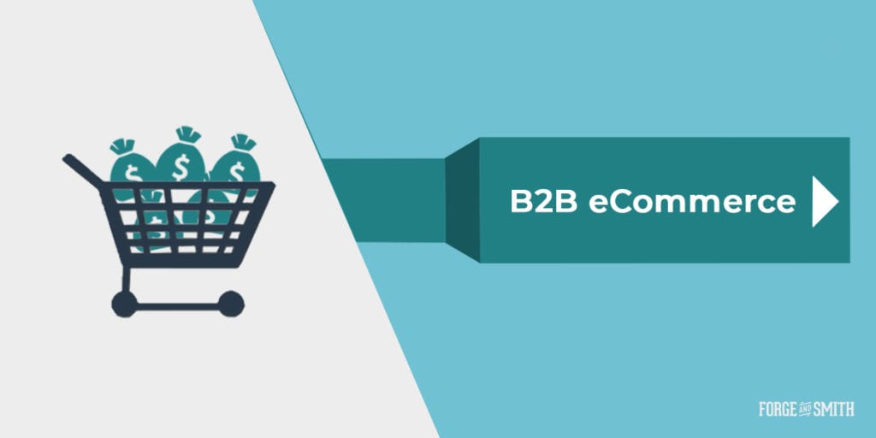

Slide 9
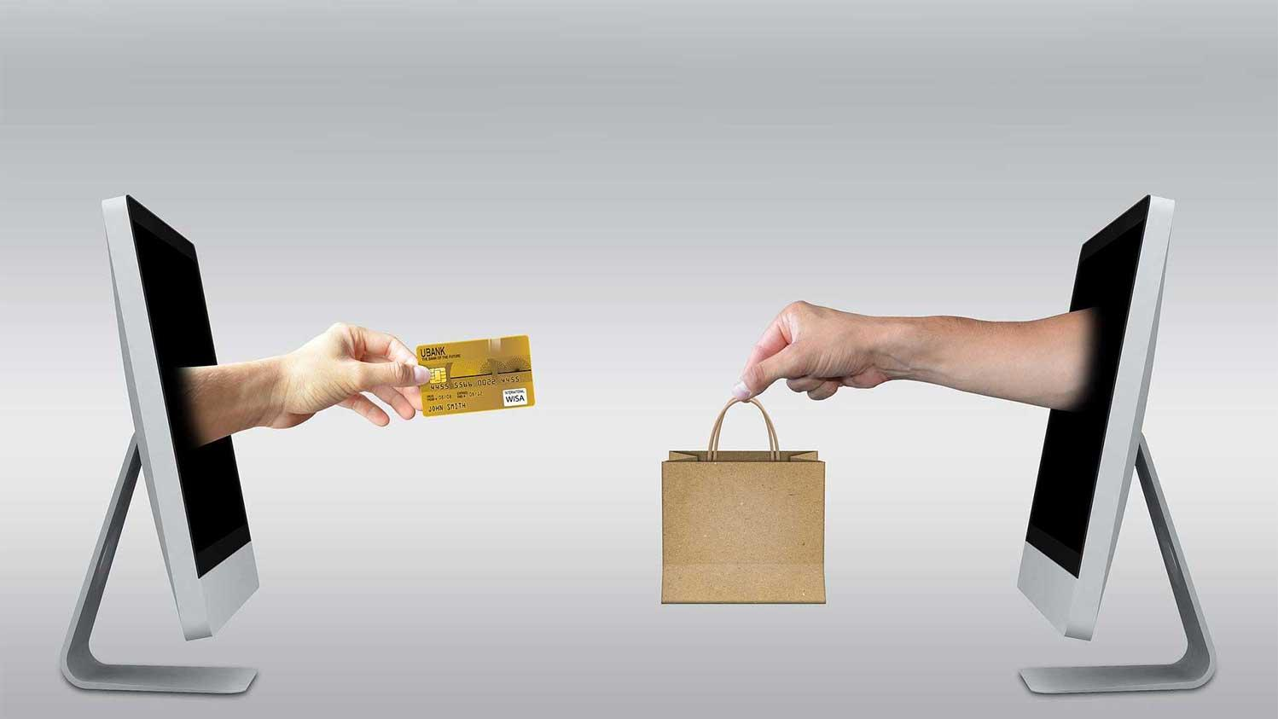
B2B ecommerce describes online order transactions between businesses.
Because orders are processed digitally, buying efficiency is improved for wholesalers, manufacturers, distributors and other types of B2B sellers

Slide 10
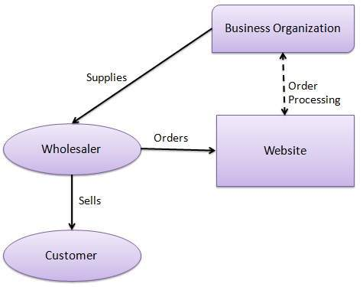
A website following the B2B business model sells its products to an intermediate buyer who then sells the products to the final customer.
As an example, a wholesaler places an order from a company's website and after receiving the consignment, it sells the end product to the final customer who comes to buy the product at the wholesaler's retail outlet.

Slide 11
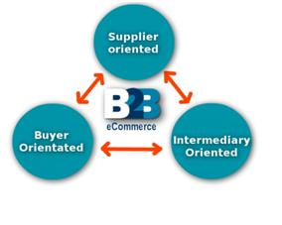
Architectural Models

Slide 12
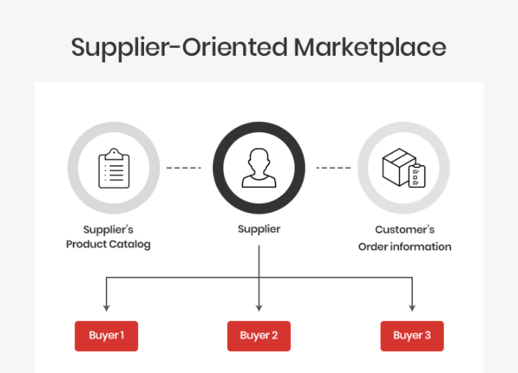
In this type of model, a common marketplace provided by supplier is used by both individual customers as well as business users. A supplier offers an e-stores for sales promotion.

Slide 13
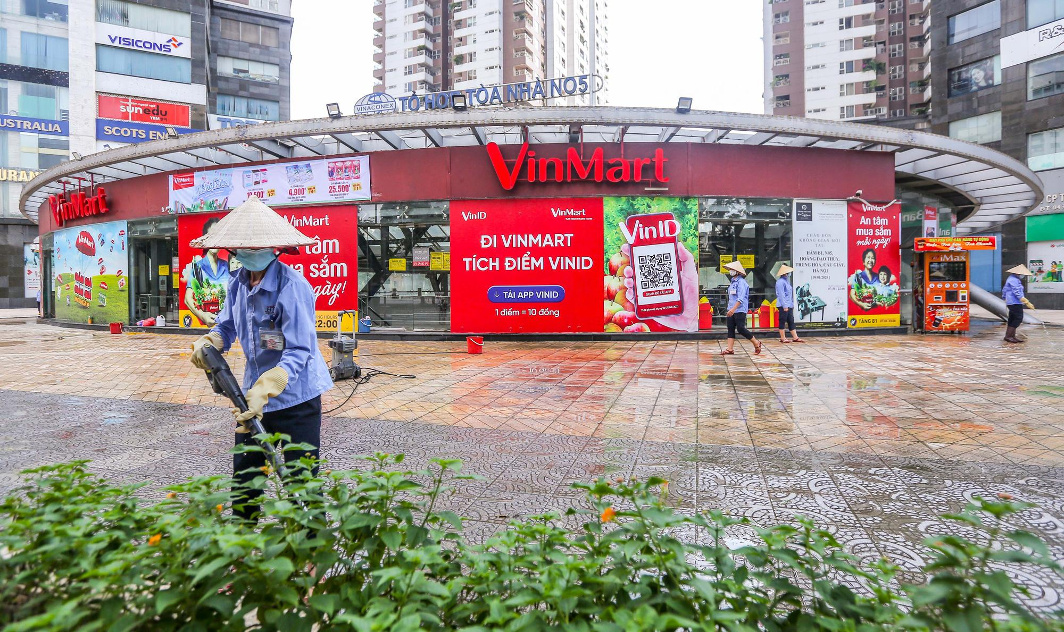

Slide 14
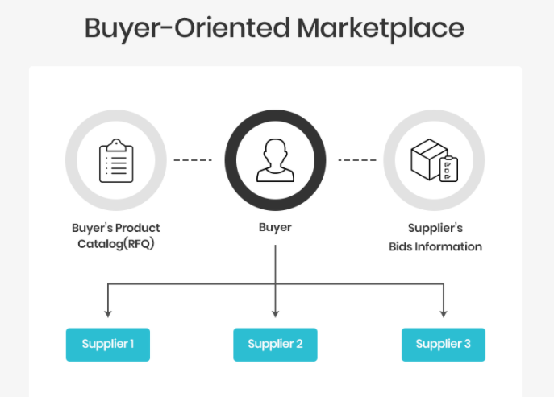
In this type of model, buyer has his/her own market place or e-market. He invites suppliers to bid on product's catalog. A Buyer company opens a bidding site

Slide 15
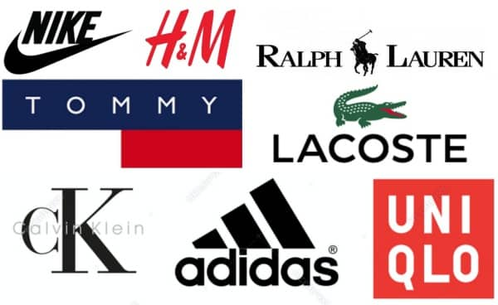

Slide 16
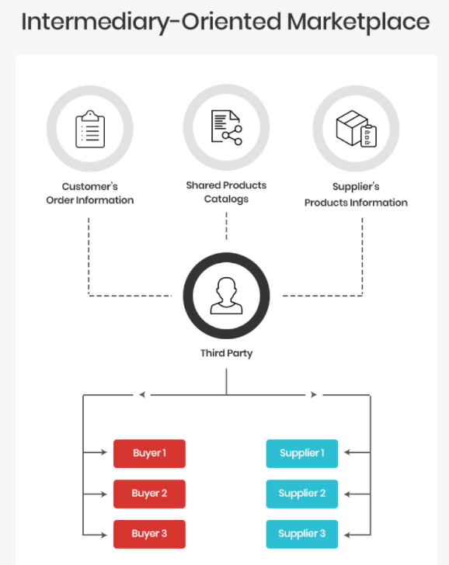
In this type of model, an intermediary company runs a market place where business buyers and sellers can transact with each other.

Slide 17
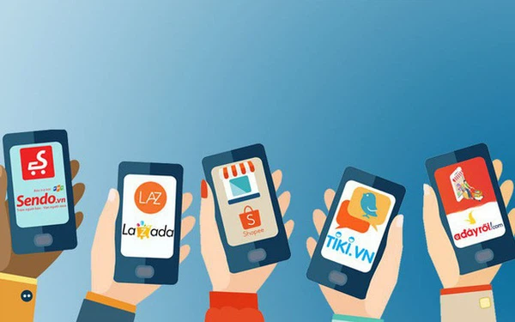

Slide 18
Advantages of B2B Platform

Slide 19
Advantages of B2B
Reaching new customers.
A B2B ecommerce site with public-facing catalog pages is a powerful way to reach new B2B customers.
By going online, you can utilize digital marketing strategies to increase your reach.
The concept of B2B ecommerce offers better management of both the suppliers and customers.
Going digital means you can utilize a business management software. This will show you data about how your customers shop. You'll be able to use this information to create better, more personalized shopping experiences for your customers
Better management of suppliers and customers.

Slide 20
Advantages of B2B
Not only will you reach new customers, ecommerce also allows you to easily implement an automated cross-sell and up-sell recommendation program.
This goes hand-in-hand with offering shoppers a personalized experience. You'll be able to help them find products they're looking for, without them having to ask — much like an in-person sales associate would do
Sell more to existing customers
Better data analytics
Analytics will help you to identify what's working and what's not for your business.
You can find out what the customer is looking for on your site and accordingly take steps to boost site engagement

Slide 21
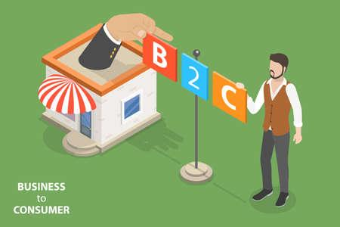
Business-to-Consumer
(B2C)

Slide 22
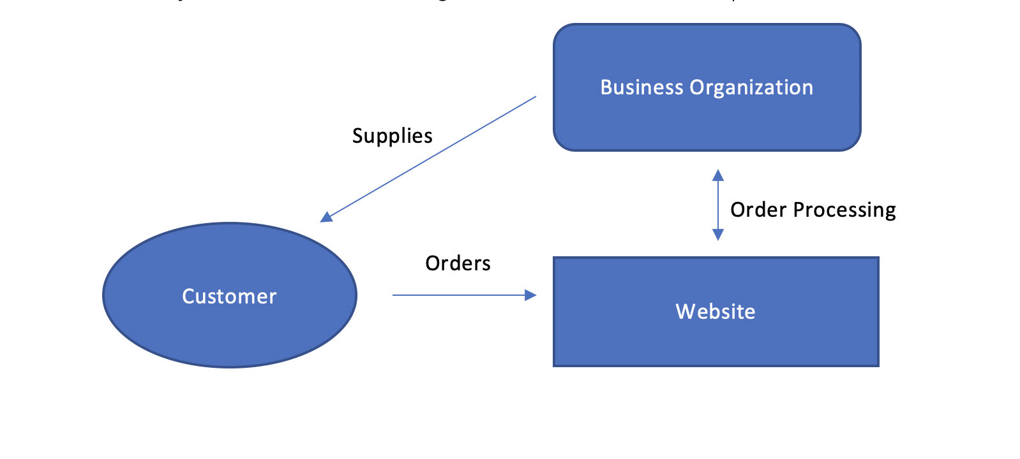
What is B2C model?
A business-to-consumer, or B2C, is business model whereby a company sells a service or product directly to a consumer.

Slide 23
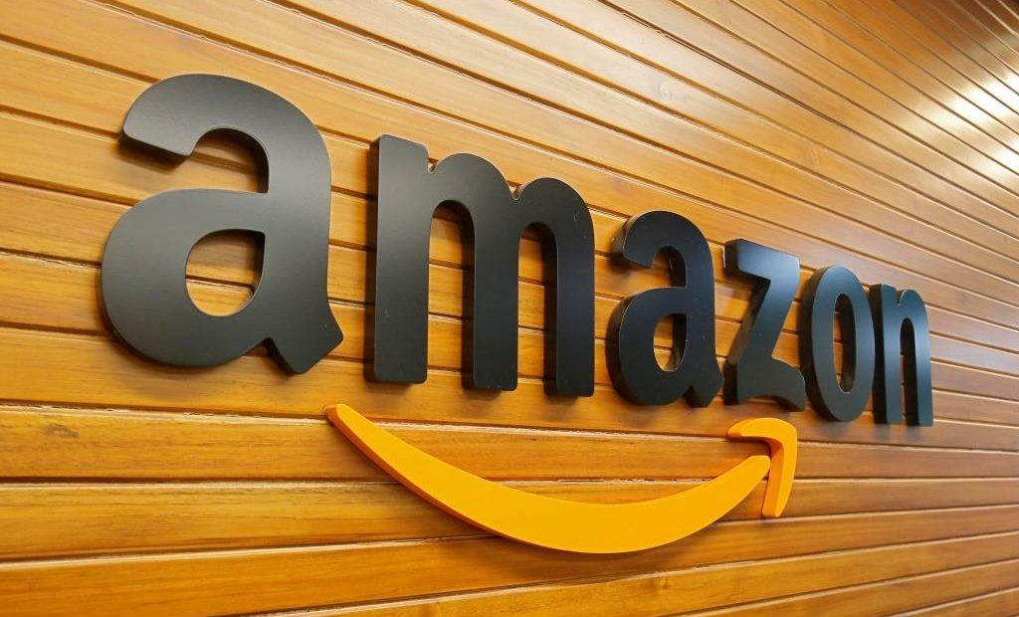
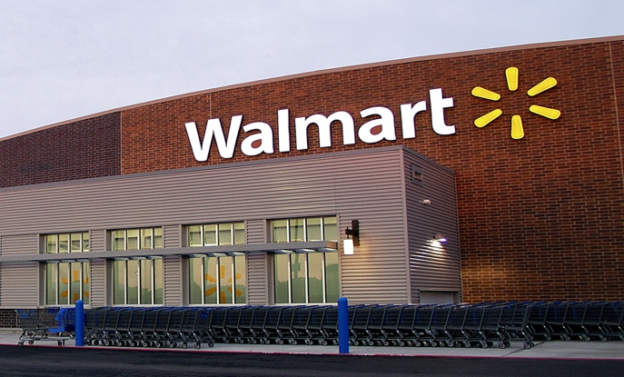
Familiar examples of B2C companies include Amazon, Walmart,..
Example (B2C)

Slide 24
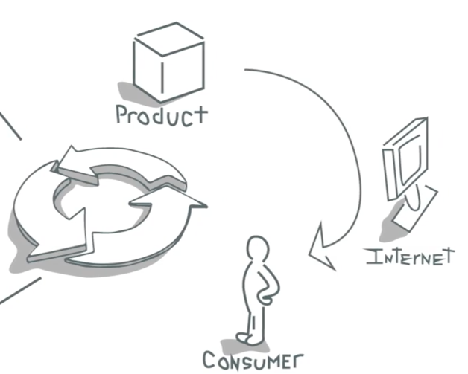
Understanding B2C model

Slide 25
History
Business-to-consumer (B2C) is among the most popular and widely known sales models. The idea of B2C was first utilized by Michael Aldrich in 1979, who used television as the primary medium to reach out to customers.
B2C became immensely popular during the dotcom boom of the late 1990s when it was mainly used to refer to online retailers who sold products and services to consumers through the Internet

Slide 26
Key features
Business-to-consumer refers to the process of businesses selling products and services directly to consumers, with no middleperson.
- Heavy advertising required to attract customers
- High investments in terms of hardware/software.
- Support or good customer care service.

Slide 27
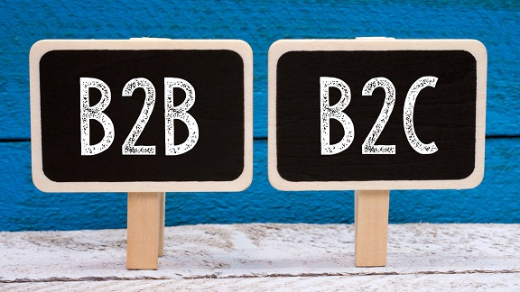
Compare B2B and B2C models
 | B2B | B2C
Purchasing power | More complex | Easier
Volume of clients | Lower | Higher
Transaction | Higher | Lower

Slide 28
Affection
B2C became immensely popular during the dotcom boom of the late 1990s when it was mainly used to refer to online retailers who sold products and services to consumers through the Internet.
B2C became controversial in some sectors of economy, especially in the retail industry.
Online B2C become a threat to traditional retailers.

Slide 29
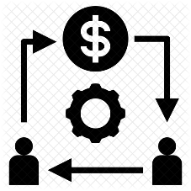
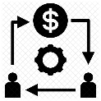
B2C Business Models
Direct selling B2C model
.
Online intermediary B2C model
B2C business model based on advertising
.
Community-based B2C model
.
Fee-based B2C business model
.

Slide 30
THANK YOU
For listening

