Slide 1
Multi-Layer Network Topology Visualization
Duong Tuan Nguyen
Synchromedia Laboratory

Slide 2
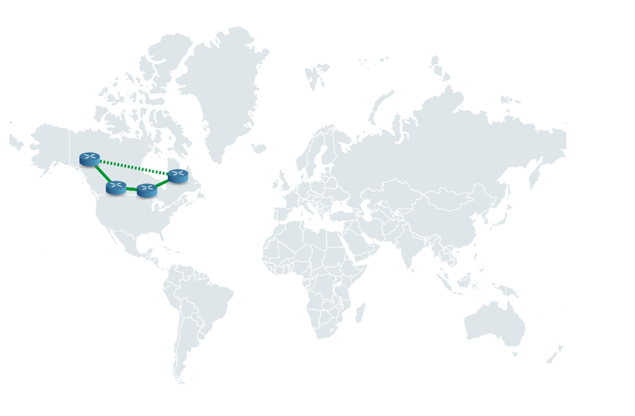
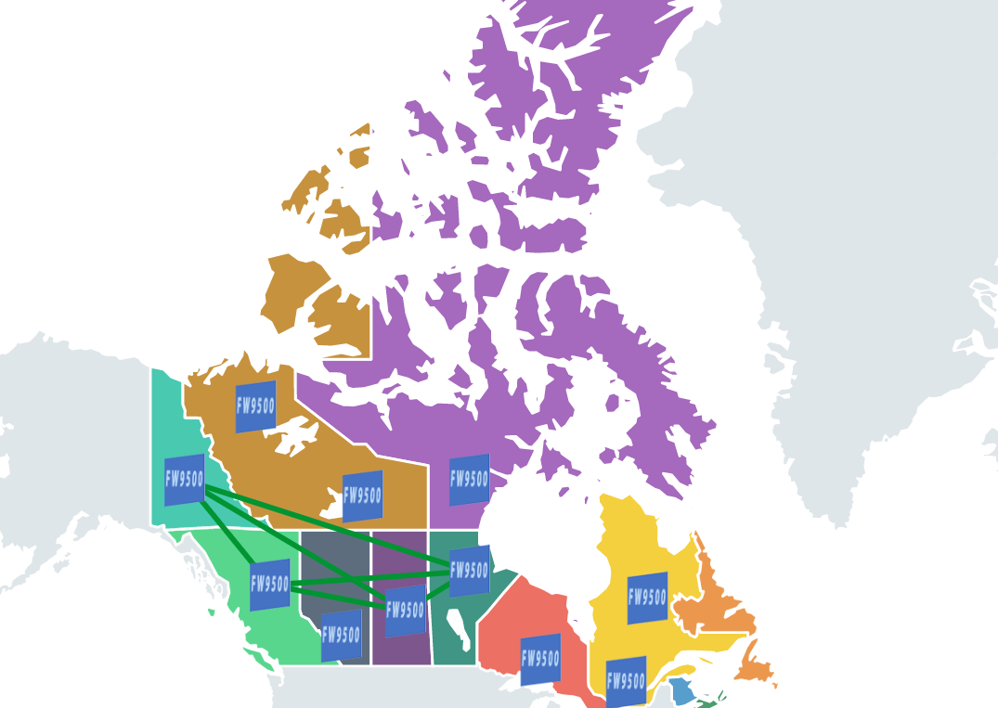
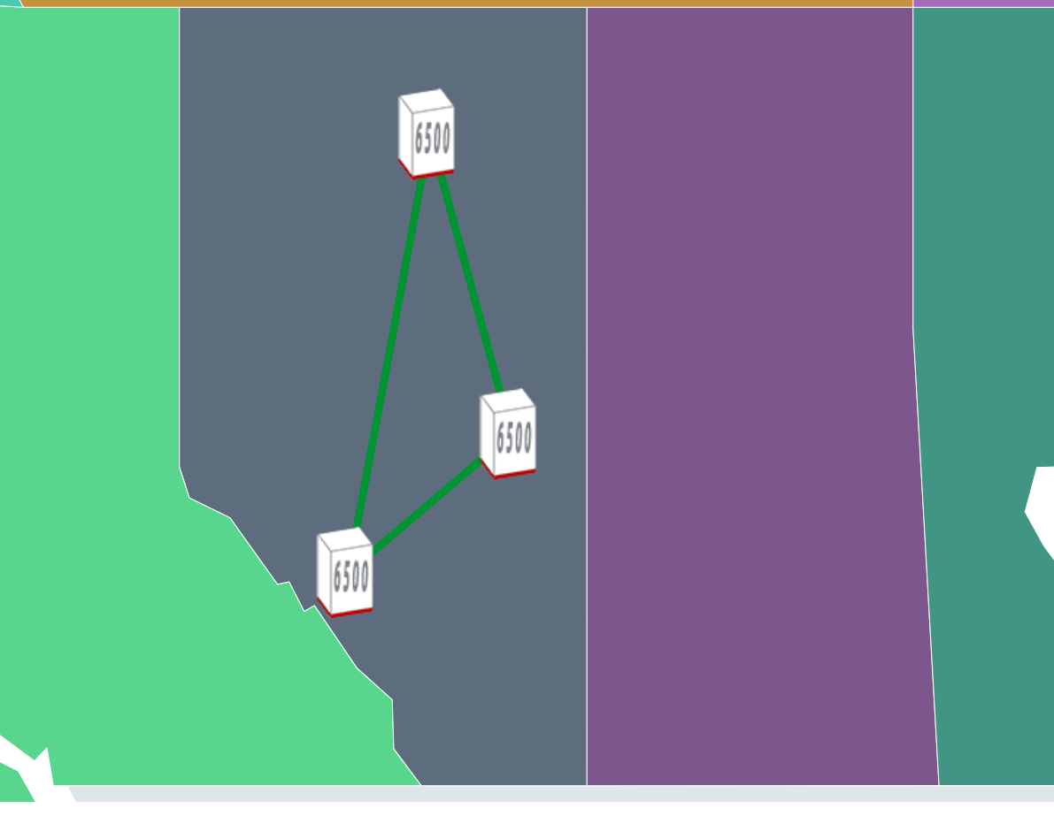
2D Perspective Visualization
Scale oriented topology interaction
Nationwide view
Statewide view
City-wide view

Slide 3
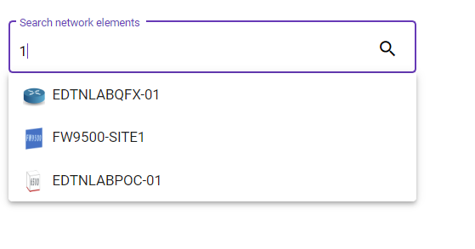
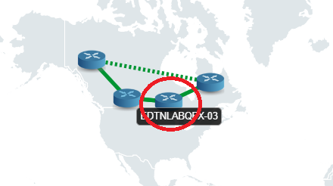
2D Perspective Visualization
Detail information of network elements or links can be retrieved by
Searching
Directly interacting

Slide 4
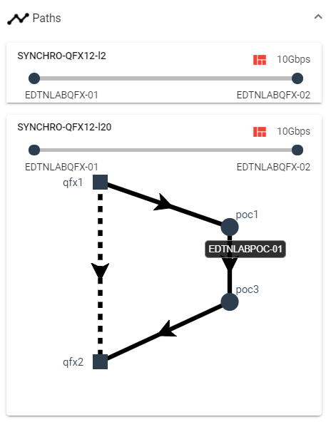
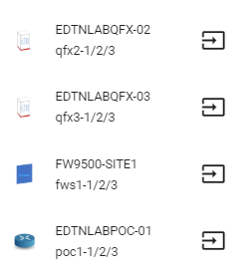
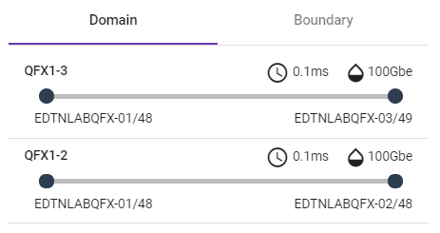
2D Perspective Visualization
Detail information includes
Connected NEs
Inter/Intra-layer Links
Crossing multi-layer paths

Slide 5
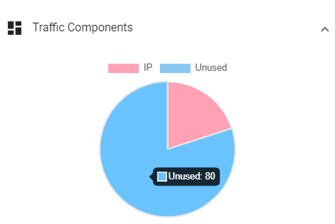
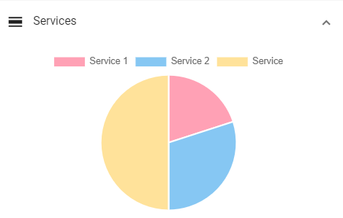
2D Perspective Visualization
Detail information includes
For layer 3 link/paths
For multi-layer link/paths

Slide 6
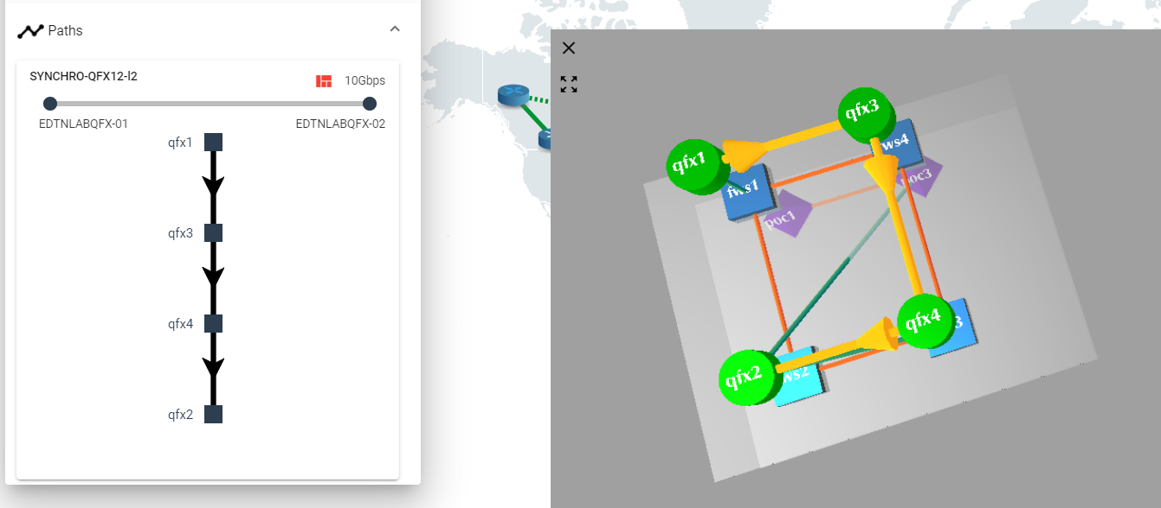
3D Perspective Visualization
Region oriented topology rendering
3D view based on selected 2D entity

Slide 7
Used frameworks
System
Angular 2+
Material design
Typescript
Github - https://github.com/hoangtuansu/mlo-gui
D3.js – manipulating documents based on data
Rendering world map and handling mouse interaction
Perform DOM manipulation
THREE.js – display 3D objects

Slide 8
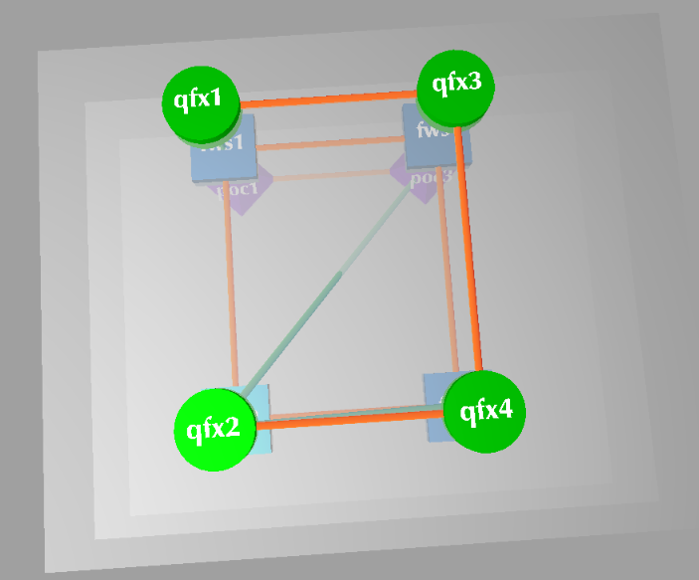
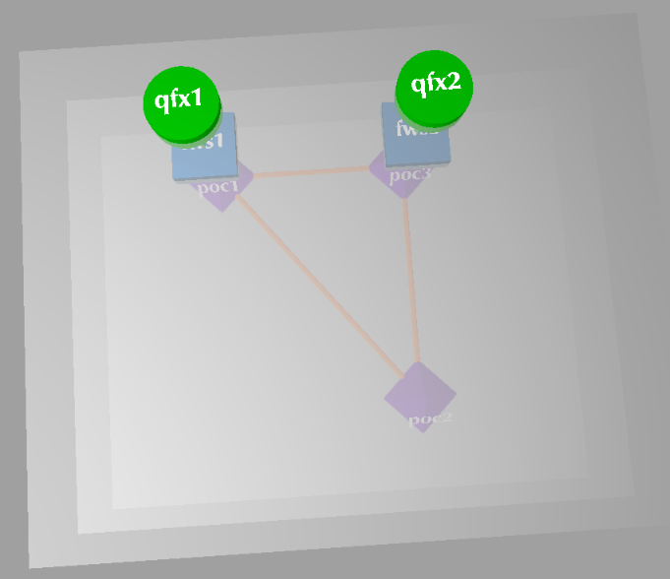
Algorithms
Locating 3D entities on the planes according to the number of relevant entities
4 NEs on a plane
2 NEs on a plane

Slide 9
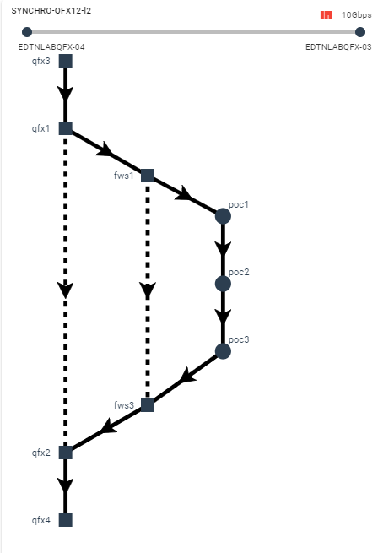
Algorithms
Visualizing multi-layer paths which nodes stay at different places depending on their layers
2D visualization of a multi-layer path

