Slide 1
Warehouse Safety Monitor
An agentic safety-monitoring app built on the NVIDIA VSS Blueprint + LangGraph
Hoang Tuan Vu | NVIDIA Interview Take-Home
github.com/hoangtuanvu/vss-demo

Slide 2
AGENDA
What I'll Cover
01
How I approached the project — thinking, constraints, decisions
02
The Blueprint I selected, and why
03
The skills I used to build and operate it, and why
04
Conclusion — what this demonstrates
Warehouse Safety Monitor — NVIDIA Interview
2

Slide 3
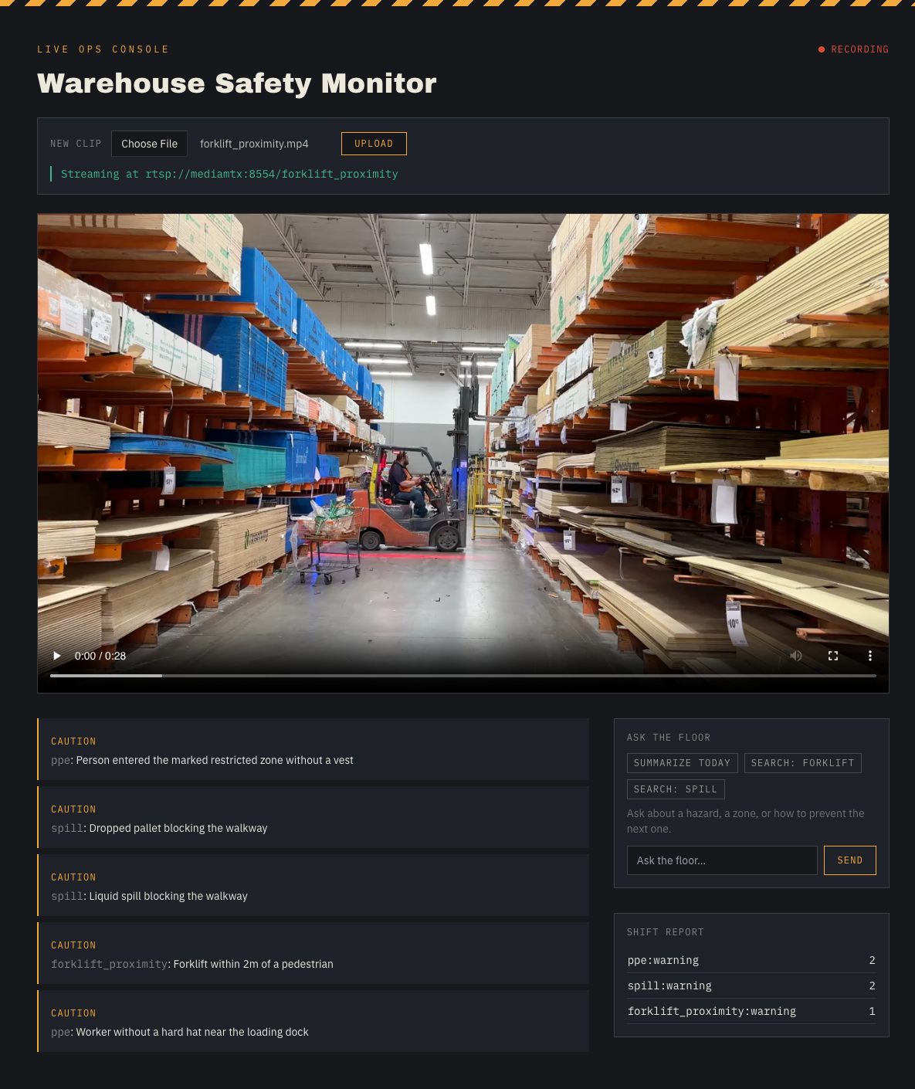
SCENARIO
The Problem I Set Out to Solve
Warehouse Safety Monitor
5 hazards covered in alert rules + mock (full scope, no cuts; 2 pending real-VSS category-map confirmation):
• PPE compliance
• Restricted-zone intrusion
• Forklift–pedestrian proximity
• Fall / man-down detection
• Spill / obstruction in walkway
• Watch warehouse video for safety hazards in real time
• Triage and de-duplicate detections so the same incident isn't reported twice
• Auto-escalate genuinely critical incidents (Slack / webhook)
• Draft incident reports automatically
• Answer natural-language questions about footage ("ask the video")
Warehouse Safety Monitor — NVIDIA Interview
3

Slide 4
MY THOUGHT PROCESS
How I Approached Development
I weighed three build strategies before writing a line of code:
Full VSS stack
Elasticsearch + Kafka + video-analytics-api + behavior-analytics — most faithful to the blueprint, but too many moving parts to stand up reliably in the time box.
Bypass VSS entirely
Call Cosmos-Reason2 / Nemotron NIMs directly and build the CV/alert pipeline from scratch in LangGraph — fast and fully controlled, but skips the assignment's explicit ask to actually use the Blueprint and its vss-* skills.
Lean VSS core + LangGraph ops layer (chosen)
Deploy VSS's warehouse profile for ingestion, dense-captioning, and alerting only. Skip VSS's own analytics stack. The agent owns triage, dedupe, escalation, reporting, and chat — calling VSS as a tool.
Warehouse Safety Monitor — NVIDIA Interview
4

Slide 5
ARCHITECTURE
How the Pieces Fit Together
Frontend (Next.js + Tailwind)
LangGraph Triage classify severity → dedupe → persist → escalate
Frontend (SSE-driven) Live incident feed Incident detail + report Chat panel Stats summary
Agent (FastAPI) upload → ffmpeg → mediamtx RTSP
Incident Store (SQLite / Postgres)
VSS warehouse profile (Brev GPU) Dense-captioning + 5 alert rules
Critical → report + Slack/webhook
Chat graph: ask-video / analytics / SOP
Polled by Agent (alert-bridge :9080)
Key decision: VSS owns video ingestion, captioning, and raw alerting. The agent owns the incident store and every triage / escalation / report / chat decision — that's the agentic layer actually being evaluated.
Warehouse Safety Monitor — NVIDIA Interview
5

Slide 6
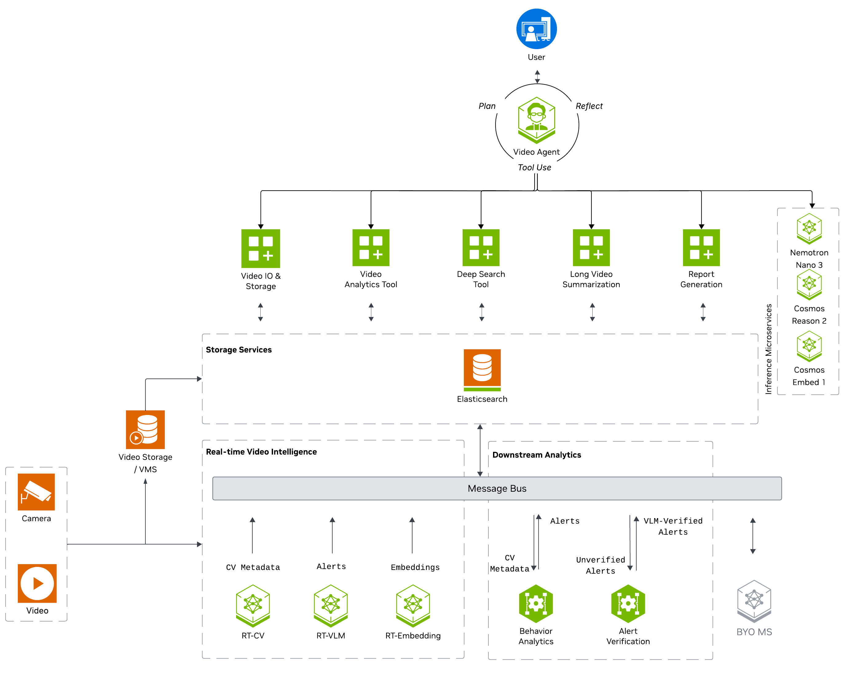
NVIDIA AI BLUEPRINT
Video Search & Summarization (VSS) — Warehouse Profile
What it is: build.nvidia.com's Video Search & Summarization Blueprint, deployed with the warehouse profile — live RTSP ingestion, Cosmos-Reason2 VLM dense-captioning, and configurable alert rules.
Why warehouse, specifically: It ships built-in support for exactly the hazard categories this scenario needed — PPE, zone intrusion, proximity, fall detection, spill/obstruction — instead of generic captioning I'd have to repurpose.
Why deploy it for real: The assignment explicitly evaluates genuine blueprint + skills usage, not a description of them — so it had to be a real Brev GPU deployment the interview can be run against live.
Why not the full VSS stack: Its own Elasticsearch / Kafka / video-analytics-api / behavior-analytics services add reliability risk for a multi-day build with no payoff for what's being assessed — the agentic layer, not VSS's own analytics UI.
Used from the Blueprint:
• Live RTSP ingestion (mediamtx loopback)
• Cosmos-Reason2 VLM dense-captioning
• 5 configured alert rules (warehouse hazards; 2 of 5 raw categories not yet confirmed live, see slide 3 note)
• MCP/REST in use: alerts, chat (ask-video/SOP), generate-report. query-analytics/search-archive not yet wired — roadmap, see next slide
Deliberately NOT used:
VSS's own Elasticsearch analytics stack — the agent keeps its own incident store instead.
Warehouse Safety Monitor — NVIDIA Interview
6

Slide 7
NVIDIA AGENT SKILLS (GITHUB.COM/NVIDIA/SKILLS)
Skills Used — Build & Operate the Blueprint
Dev-time ops skills — run from Claude Code against the live Brev deployment, not shipped in the app:
vss-deploy-profile — deployed the warehouse profile itself onto the Brev GPU instance (2×A6000).
vss-manage-alerts — configured the 5 hazard alert rules (PPE, zone intrusion, forklift proximity, fall, spill) so VSS emits the right alert categories for the agent to poll.
vss-deploy-dense-captioning — set up the Cosmos-Reason2 VLM captioning pipeline the alert rules and chat both depend on.
vss-generate-video-calibration — configured the camera/source settings used for the upload-as-simulated-stream source.
Warehouse Safety Monitor — NVIDIA Interview
7

Slide 8
NVIDIA AGENT SKILLS (GITHUB.COM/NVIDIA/SKILLS)
Skills Used — Runtime Capabilities the App Depends On
These skills describe how to configure capabilities the agent calls at runtime. Two are wired to real VSS REST calls today (ask-video, generate-report); two are roadmap items described here for completeness, not yet live integrations:
vss-ask-video — backs the chat graph's general-question intent via VSS's /chat endpoint ("what happened at the loading dock at 2pm?").
vss-query-analytics — NOT yet wired up: chat graph has no separate analytics intent today; would reuse the same /chat call. Roadmap.
vss-search-archive — NOT yet wired up: no dedicated search-archive call exists in vss_client.py today. Roadmap.
vss-generate-video-report — invoked by the triage graph automatically whenever an incident is classified critical, to draft the incident report.
Warehouse Safety Monitor — NVIDIA Interview
8

Slide 9
CLAUDE CODE SKILLS
How I Built It — Process Skills, Not Just Blueprint Skills
brainstorming — explored intent/requirements before committing to the "lean VSS core + LangGraph ops layer" architecture, instead of jumping straight to code.
writing-plans / test-driven-development — every feature (triage graph, dedupe, escalation, chat formatting, dashboard redesign) went through a written design doc + a checkbox TDD plan before implementation.
systematic-debugging — used for root-causing issues (e.g. real VSS integration quirks) instead of guessing at fixes.
verification-before-completion — ran the actual test suite / manual demo script before ever declaring a feature "done".
vss-deploy-profile / vss-manage-alerts (as Claude Code skills) — same blueprint-ops skills above, invoked directly from this Claude Code session against the Brev box.
Warehouse Safety Monitor — NVIDIA Interview
9

Slide 10
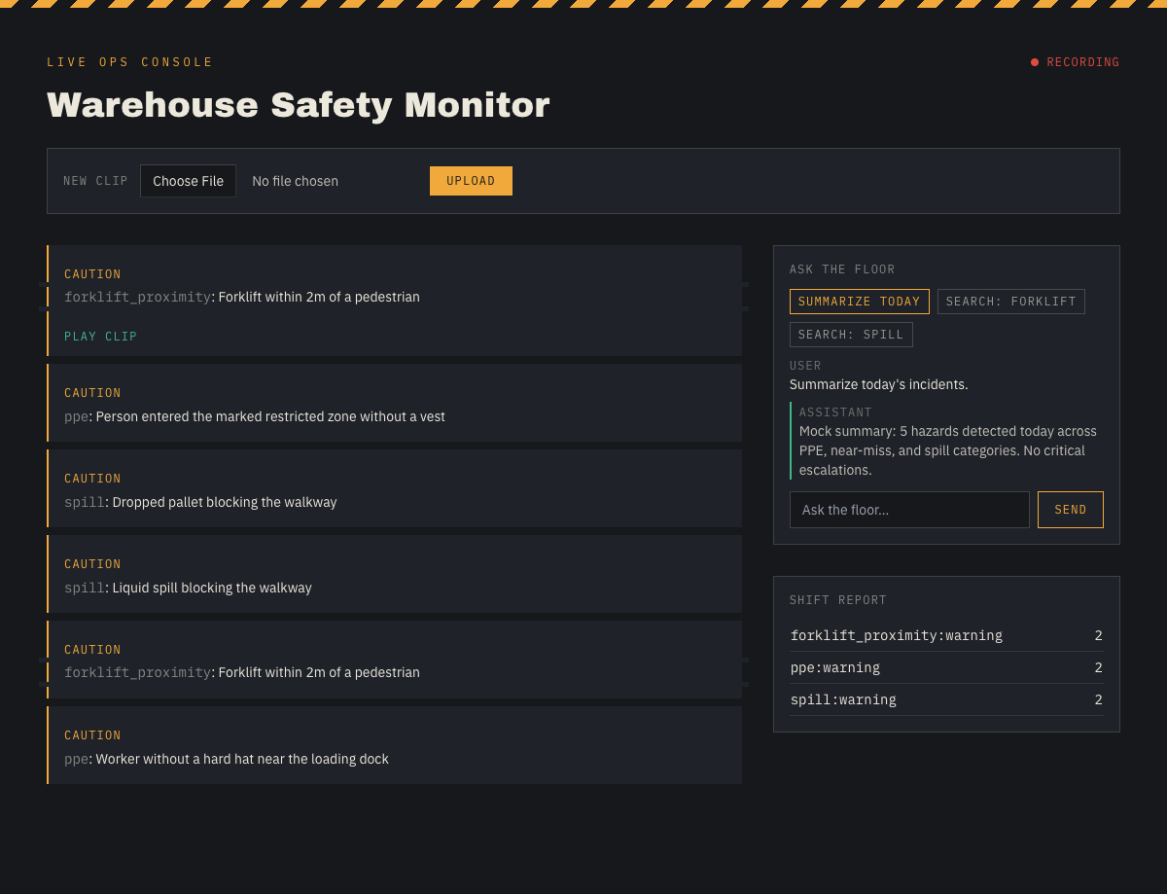
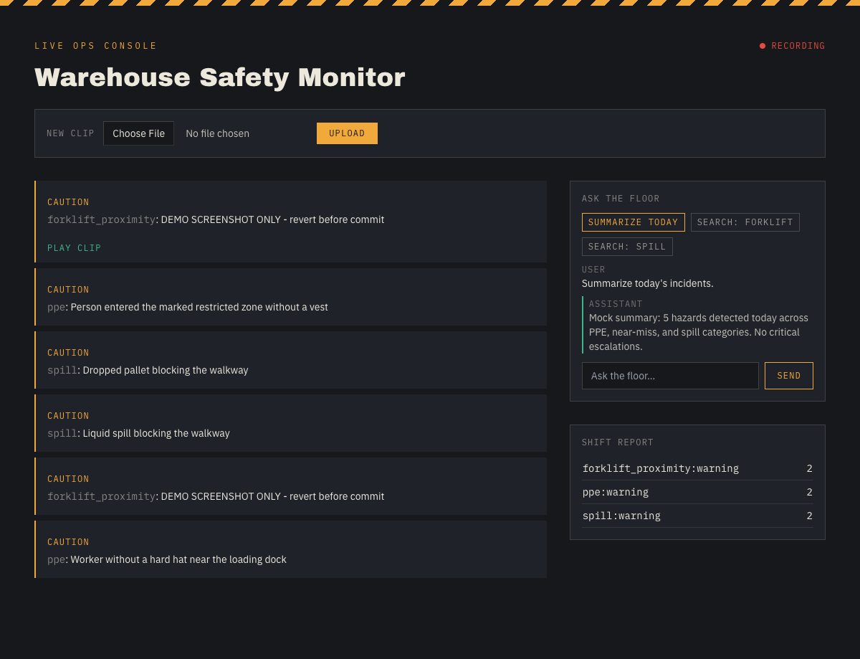
THE AGENTIC CORE
What's Actually Being Evaluated
VSS supplies raw, noisy VLM-detected events. The LangGraph agent decides what's real:
classify_severity
dedupe
persist_incident
generate_report (critical only)
escalate_notify
• Severity classification + dedupe is the core triage contribution — merges repeated VLM detections of the same incident and escalates only genuine hazards, never raising on classification failure (falls back to 'warning').
• SOP-suggestion chat node drafts corrective guidance from incident patterns — the clearest "full ops agent" differentiator beyond basic alerting.
• Best-effort error handling throughout: report generation, escalation, and chat all catch/fallback rather than ever blocking the core upload → triage pipeline.
Warehouse Safety Monitor — NVIDIA Interview
10

Slide 11
CONCLUSION
What This Project Demonstrates
Genuine blueprint usage — a real VSS warehouse profile deployed on Brev GPU, not a mocked description, with a local mock fallback purely for offline dev.
Genuine skills usage — NVIDIA skills for blueprint deployment/alert-config, plus Claude Code process skills (brainstorming, TDD, systematic debugging) for the build itself.
A real agentic layer — LangGraph owns triage, dedupe, escalation, reporting, and conversational Q&A — the part of the system that's actually intelligent, sitting on top of VSS rather than reimplementing it.
Full scope, no cuts — all 5 hazard types, full "ops agent" tier (triage, dedupe, auto-report, chat, autonomous escalation), working end-to-end with tests.
Ready for a live walkthrough — questions welcome.

