Slide 1
From a question to a validated simulation campaign
Multi-agent LLM framework on NERSC Perlmutter — 2 executed case studies
question → plan → sampling → per-column ELM runs → analysis → observation validation
generated 2026-07-16 from workflow_outputs/

Slide 2
Case 1 — Naches
HUC 17030002 · 2860.6 km² · elevation 352.0–1977.4 m
“Partitioning of runoff/recharge in the Naches sub-watershed (HUC8 17030002), validate with observations”
goal: Mechanistic: quantify how the representative Naches profile partitions incoming water among ET, surface runoff (QOVER) and sub-surface drainage/recharge (QDRAI), and how that partitioning shifts with water availability (forcing period)
goal: Validation: compare ELM water balance against integrated streamflow at in-HUC USGS gages, SNOTEL SWE as snow driver, and Fan-2013 WTD as deep-storage context — MOST of which is blocked by current execution limits
sampling: N=8 — stratified (elevation bands for surface-data sampling) + forcing-period treatment on a representative column
why N: 4 columns to span the four elevation bands and sample whatever per-column surface-data (PFT/default soil) heterogeneity exists across the basin under baseline forcing (NOT an elevation/climate test — forcing is uniform). Plus a forcing-period sweep (wet + drought = 2 extra periods) applied to two representative columns (1 mid-elevation valley-influenced, 1 upland) = 4 more, to isolate the only usable mechanistic lever: water-availability control on partitioning. Total 8. A denser grid is unjustified because neither elevation-climate nor soil texture can be resolved.
feasibility: partial — the elevation/snow-driven partitioning mechanism (the brief's stated primary control) is NOT representable, and the observation-based validation goal is largely blocked. Only the soil-profile water-balance partitioning and its forcing-period sensitivity are answerable.
not answerable: Elevation / snow-regime control on partitioning (the brief's stated primary driver) — needs elevation-downscaled forcing
not answerable: Validation against SNOTEL SWE / melt timing — needs snow/SWE history output AND elevation-downscaled forcing

Slide 3
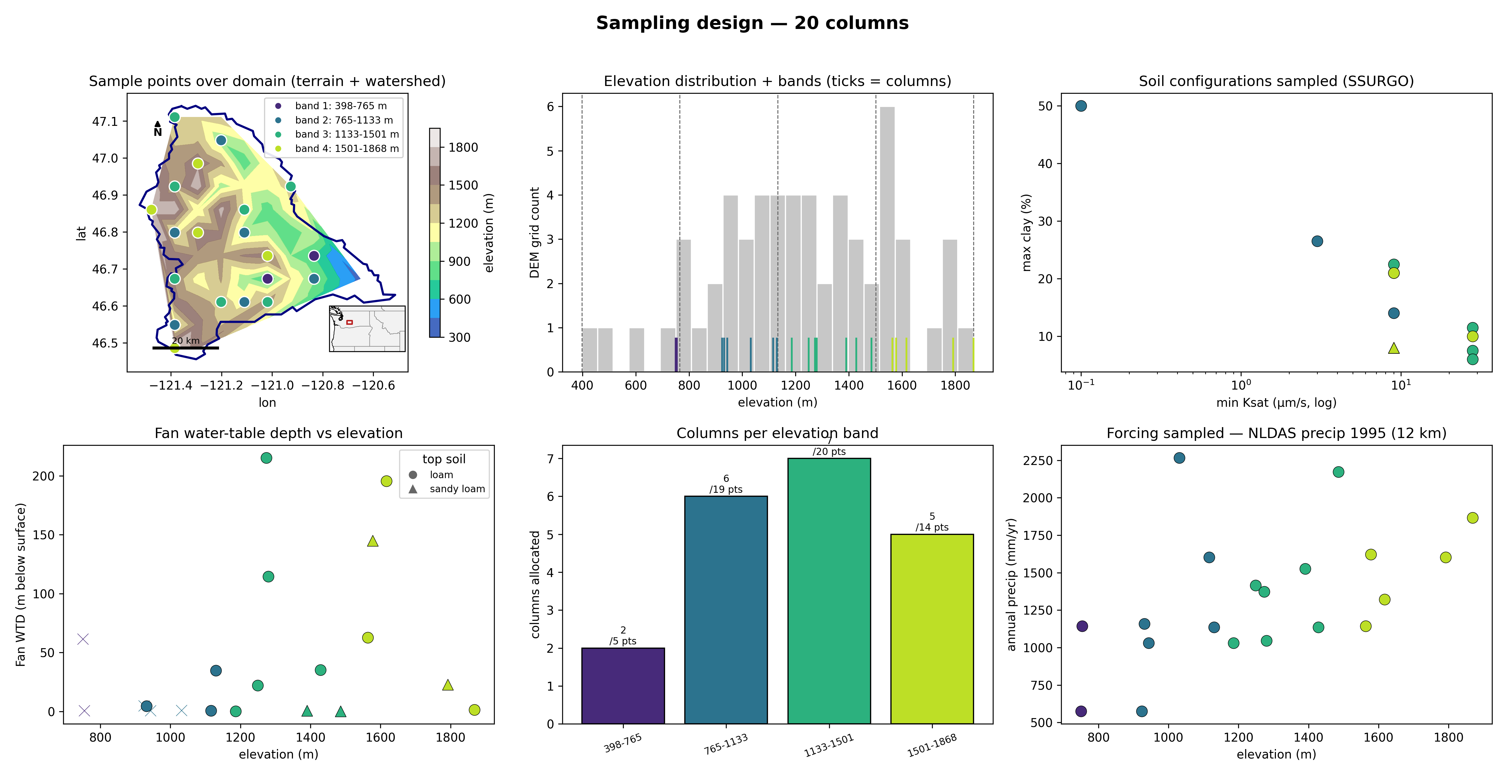
Naches — sampling design (Tier-2 expander)
Panels — top-left: chosen columns on the DEM, coloured by elevation band, navy = watershed boundary. top-right: histogram of the basin's DEM sample (grey = how much terrain sits at each elevation); dashed lines = the equal-interval band edges; coloured ticks = the chosen columns' elevations. bottom-left: Fan (2013) equilibrium water-table depth at each column. bottom-right: columns allocated per band — proportional to the band's share of the basin's DEM points (annotated n / points), minimum 1 per band.

Slide 4
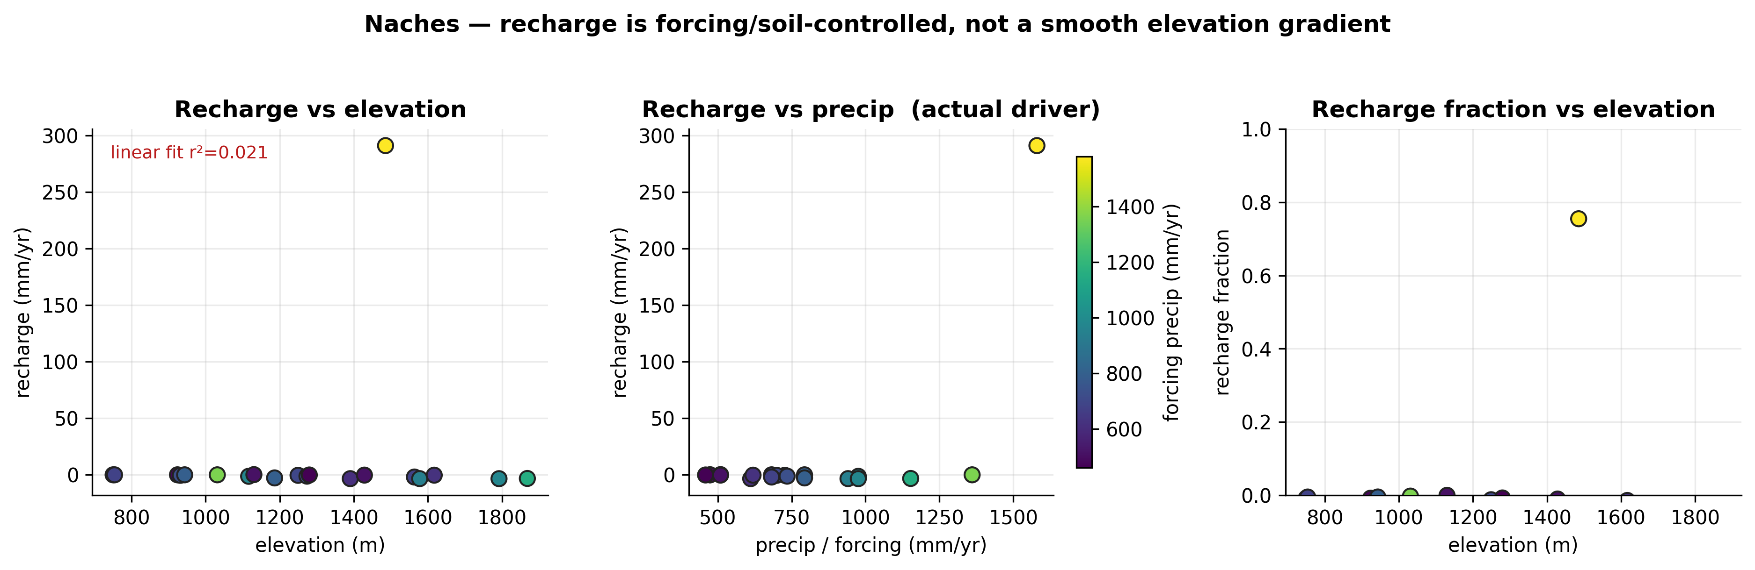
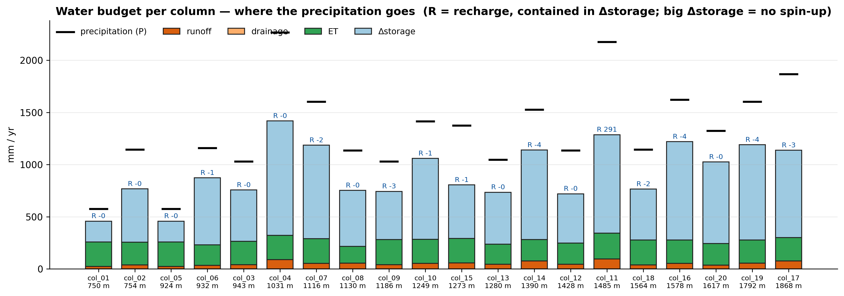
Naches — execution & results
execution: 20 columns ran as one batch job (concurrent) in 58 min
Definitions — recharge = ELM QCHARGE (flux from the soil column to the water table); runoff = QOVER (surface runoff); recharge fraction = QCHARGE/(QCHARGE+QOVER); WTD = ZWT (the column's own water-table depth); forcing = NLDAS-2 (0.125°, ~12 km) precip at the column.

Slide 5
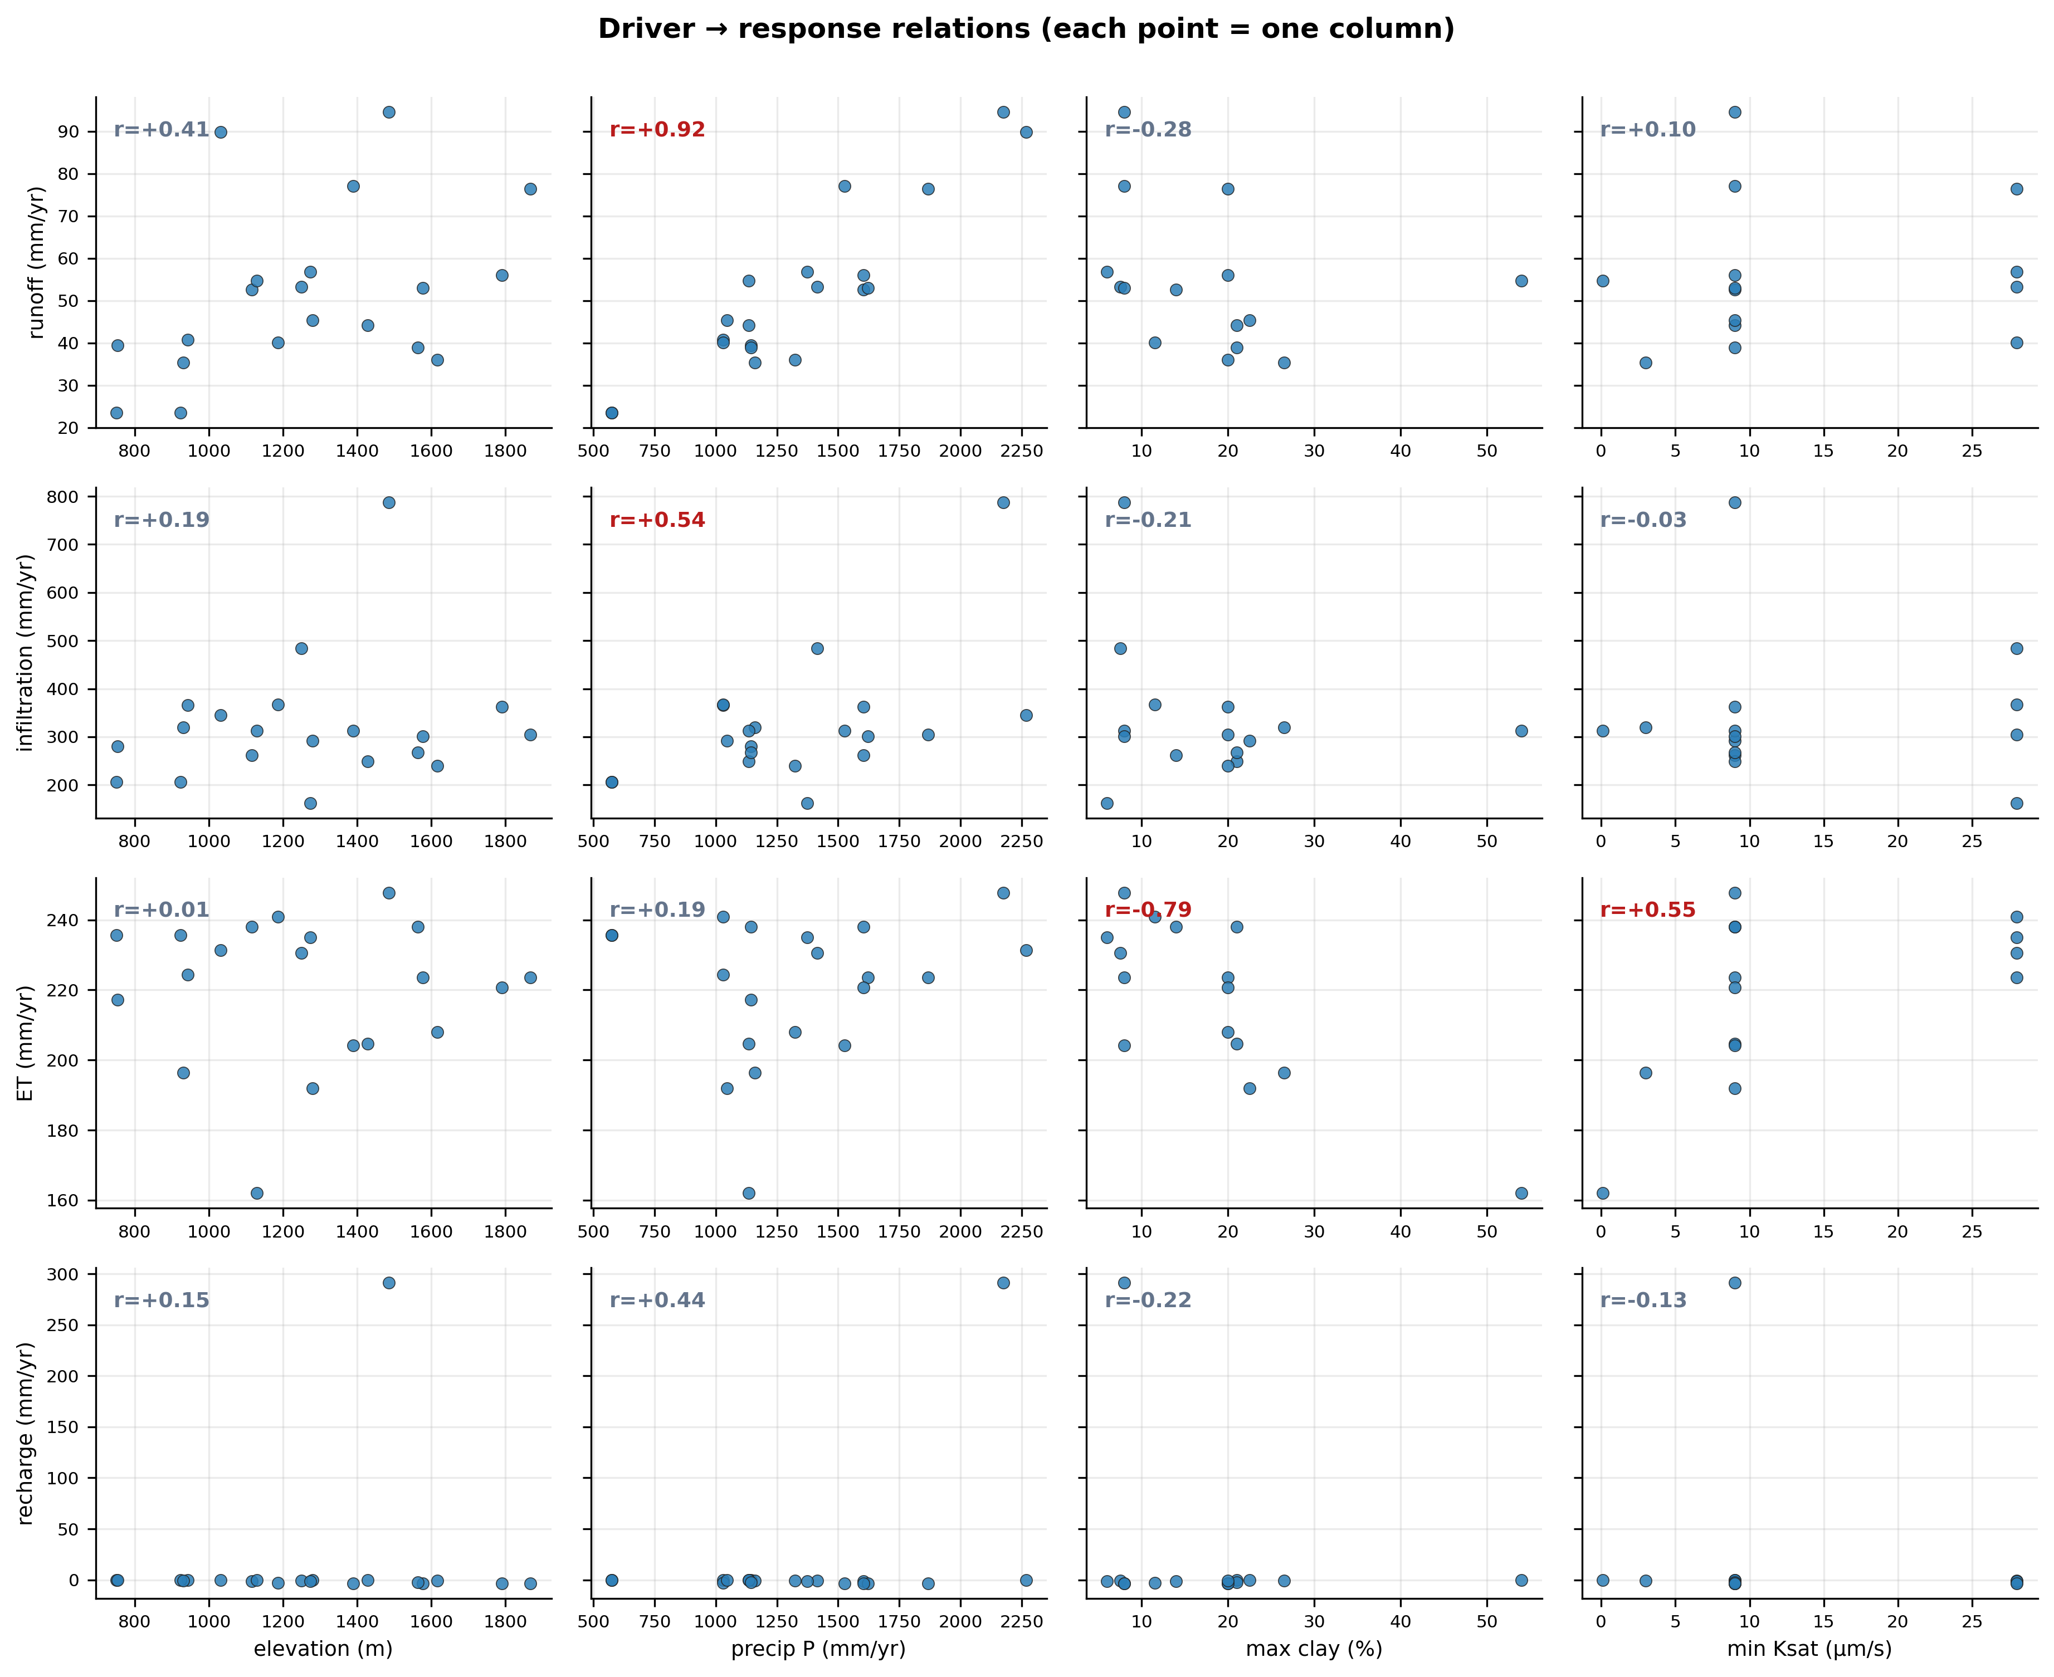
Naches — results (continued)

Slide 6
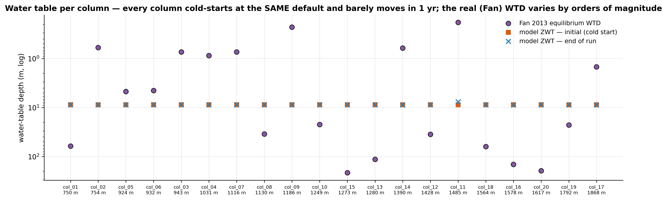
Naches — results (continued)

Slide 7
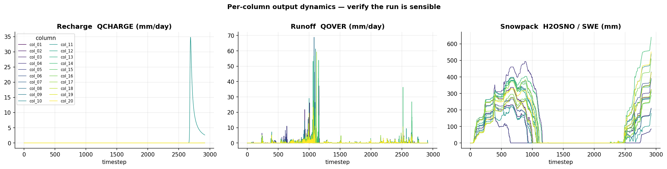
Naches — results (continued)

Slide 8
Naches — driver × response (Pearson r)
all 20 columns · correlations across ALL columns — when precip is quantized, elevation and precip are confo
response | elevation | precip | clay | Ksat
runoff | +0.41 | +0.78 | -0.28 | +0.10
infiltration | +0.19 | +0.66 | -0.21 | -0.03
et | +0.01 | +0.47 | -0.79 | +0.55
recharge | +0.15 | +0.61 | -0.22 | -0.13
recharge_fraction | +0.07 | +0.57 | -0.17 | -0.15

Slide 9
Naches — assumptions & scope
every load-bearing choice, source-tagged · what these results can and cannot claim
Assumptions (source-tagged)
simulation period = 1995-1995 [user]: science year = last simulated year; the year's climatic percentile is not characterized
spin-up = none [derived]: recharge/storage terms are transient without >=3 spin-up years
initialization = cold start (uniform ELM default) [DEFAULT]: initial water table controls recharge sign in 1-yr runs
soil configuration = native [DEFAULT]: substrate=extrapolate
forcing period class = baseline [DEFAULT]
N (columns) = 20 [planner/expander]: materialized by the deterministic expander from the planner's stratification
met forcing = NLDAS-2 0.125° [user]: chosen to break the Qian elevation confound (backfilled for a pre-ledger run)
Structural limits — the 1-D model class (reruns cannot fix)
• runoff (QOVER): local runoff GENERATION on a 1 m² column — not routed discharge; no downslope concentration, so it is not comparable to a stream gauge without aggregation/routing.
• runoff/infiltration partitioning: no run-on: a column never receives runoff generated uphill, which in reality re-infiltrates downslope — runoff is likely biased high on slopes and infiltration biased low in valleys.
• water table (ZWT/WTD): 1-D vertical equilibrium only — the lateral groundwater convergence that sets real valley water tables is absent; ELM parameterizes lateral losses (QDRAI) as a local sink but routes nothing between columns.
• streamflow validation: columns provide no native integrated streamflow; gauge comparisons use unweighted column means (specific discharge) and are labeled context-only until routing exists.
• snow (SWE) at stations: forcing is a 12 km cell average — ridgetop SNOTEL stations sample terrain the cell cannot resolve; systematic underestimation at high-relief stations is expected.
This run's configuration limits (fixable by rerunning)
• recharge, storage change, deep soil moisture: run starts from non-equilibrated storage (no multi-year spin-up): slow-state fluxes are transient, storage-change terms are large, and recharge magnitude/sign is initialization-dependent.
• all annual results: a single simulated year; interannual variability and the year's climatic percentile are not characterized.
• elevation-dependent results: NLDAS-2 resolves orographic gradients at ~12 km but not sub-cell terrain (no within-cell lapse rate).

Slide 10
Naches — analyzer interpretation
Answer
• In the representative Naches profiles the model sends incoming water almost entirely to ET and soil storage: surface runoff is only ~3–5% of P (23–95 mm/yr) and sub-surface recharge is effectively nil (−0.2 to −3.6 mm/yr in 19 of 20 columns; one anomalous column shows +291 mm/yr). This partitioning tracks precipitation (recharge–P r=0.61), not elevation (r=0.15).
Why
• Precip ↑ → runoff ↑ (r=0.78) but stays 3–5% of P → most water infiltrates, not overland.
• Recharge ≈0 with QDRAI=0 everywhere → deep drainage inactive; no groundwater coupling.
• Clay ↑ → ET ↓ (r=−0.79), ksat ↑ → ET ↑ (r=0.55) → low-conductivity layers trap water in root zone.
• Storage_change 199–1098 mm and closure residuals 117–888 mm/yr → column not equilibrated (no spin-up).
Trust
• Observations contradict the model: modeled yield 64.9 vs 1427 mm/yr, NSE=−1.11, ZWT 8.8 m vs 15.2 m wells, SWE 154–640 vs 645–1981 mm. Top caveat: single unrouted, un-spun-up columns can't reproduce integrated streamflow or deep water table.
Next
• Add spin-up to close the storage/residual gap before trusting recharge sign.
• Route + area-weight columns to a gage for a valid yield/hydrograph test.

Slide 11
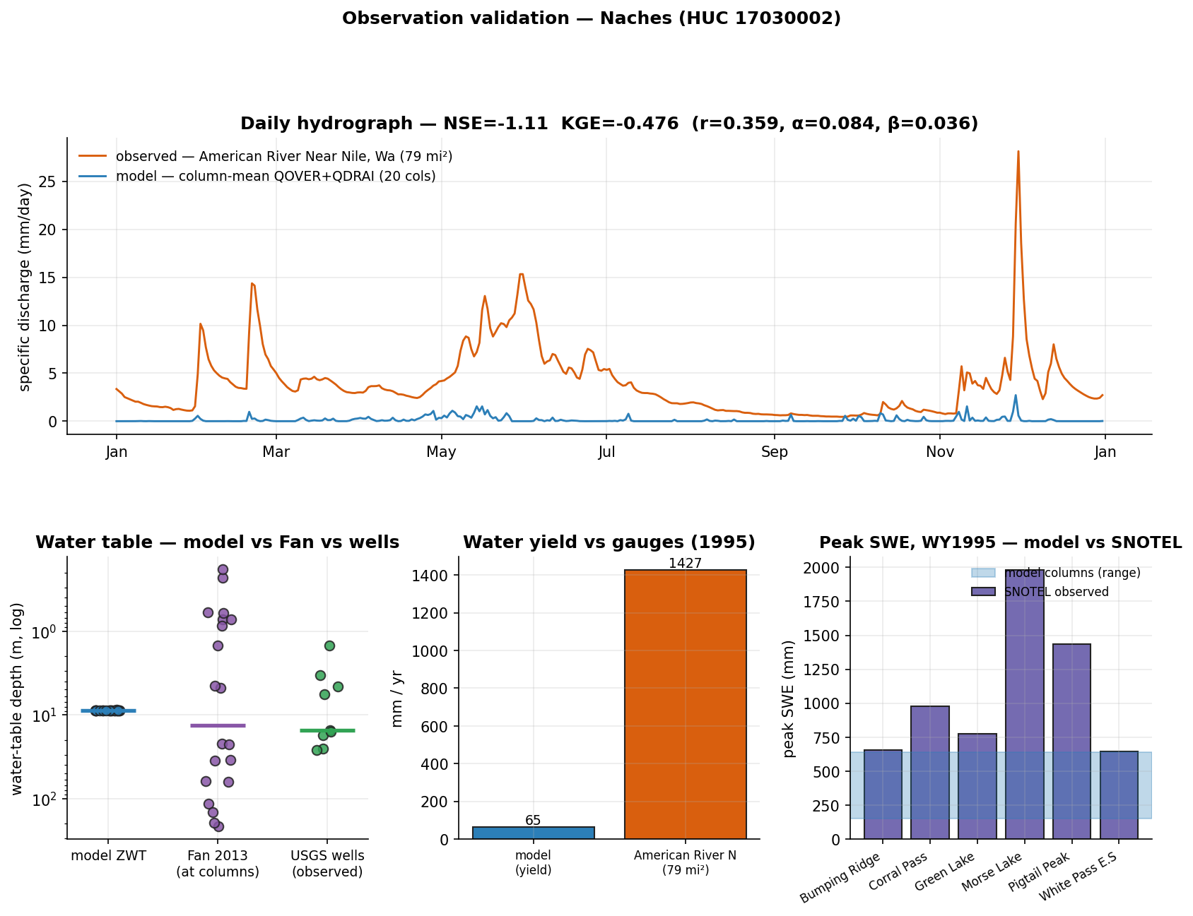
Naches — evaluation vs observations
what could be compared honestly, and what still blocks rigorous validation
in-domain obs: SNOTEL 6 · stream gages 93 · GW wells 200 (9/10 sampled have records)
✓ COMPARED — water-table depth: model ZWT median 8.8 m vs Fan 13.46 m vs observed wells 15.23 m (median; n=9)
✓ COMPARED — streamflow (water yield): modeled yield 64.9 mm/yr vs observed specific discharge 1426.8 mm/yr (American River Near Nile, Wa)
✓ COMPARED — streamflow (daily hydrograph): NSE=-1.11, KGE=-0.476 (r=0.359, variability α=0.084, bias β=0.036) — column-mean QOVER+QDRAI vs gauge
✓ COMPARED — snow water equivalent: model peak SWE 154–640 mm across columns vs observed 645–1981 mm across stations (coarse uniform forcing — expect underestimation)
Metrics — NSE: 1=perfect, 0=no better than the observed mean, <0 worse than the mean. KGE: 1=perfect; components r (timing correlation), α (variability ratio σm/σo), β (volume ratio μm/μo). Specific discharge = gauge flow ÷ drainage area, making a gauge comparable to 1-D columns (mm/yr or mm/day).

Slide 12
Case 2 — Naches — Fan warm start
HUC 17030002 · 2860.6 km² · elevation 352.0–1977.4 m
“Partitioning of runoff/recharge in the Naches sub-watershed (HUC8 17030002), validate with observations”
goal: Mechanistic: quantify how the representative Naches profile partitions incoming water among ET, surface runoff (QOVER) and sub-surface drainage/recharge (QDRAI), and how that partitioning shifts with water availability (forcing period)
goal: Validation: compare ELM water balance against integrated streamflow at in-HUC USGS gages, SNOTEL SWE as snow driver, and Fan-2013 WTD as deep-storage context — MOST of which is blocked by current execution limits
sampling: N=8 — stratified (elevation bands for surface-data sampling) + forcing-period treatment on a representative column
why N: 4 columns to span the four elevation bands and sample whatever per-column surface-data (PFT/default soil) heterogeneity exists across the basin under baseline forcing (NOT an elevation/climate test — forcing is uniform). Plus a forcing-period sweep (wet + drought = 2 extra periods) applied to two representative columns (1 mid-elevation valley-influenced, 1 upland) = 4 more, to isolate the only usable mechanistic lever: water-availability control on partitioning. Total 8. A denser grid is unjustified because neither elevation-climate nor soil texture can be resolved.
feasibility: partial — the elevation/snow-driven partitioning mechanism (the brief's stated primary control) is NOT representable, and the observation-based validation goal is largely blocked. Only the soil-profile water-balance partitioning and its forcing-period sensitivity are answerable.
not answerable: Elevation / snow-regime control on partitioning (the brief's stated primary driver) — needs elevation-downscaled forcing
not answerable: Validation against SNOTEL SWE / melt timing — needs snow/SWE history output AND elevation-downscaled forcing

Slide 13
Naches — Fan warm start — sampling design (Tier-2 expander)
Panels — top-left: chosen columns on the DEM, coloured by elevation band, navy = watershed boundary. top-right: histogram of the basin's DEM sample (grey = how much terrain sits at each elevation); dashed lines = the equal-interval band edges; coloured ticks = the chosen columns' elevations. bottom-left: Fan (2013) equilibrium water-table depth at each column. bottom-right: columns allocated per band — proportional to the band's share of the basin's DEM points (annotated n / points), minimum 1 per band.

Slide 14
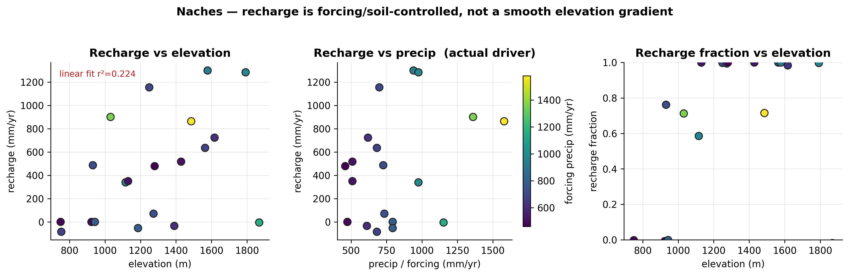
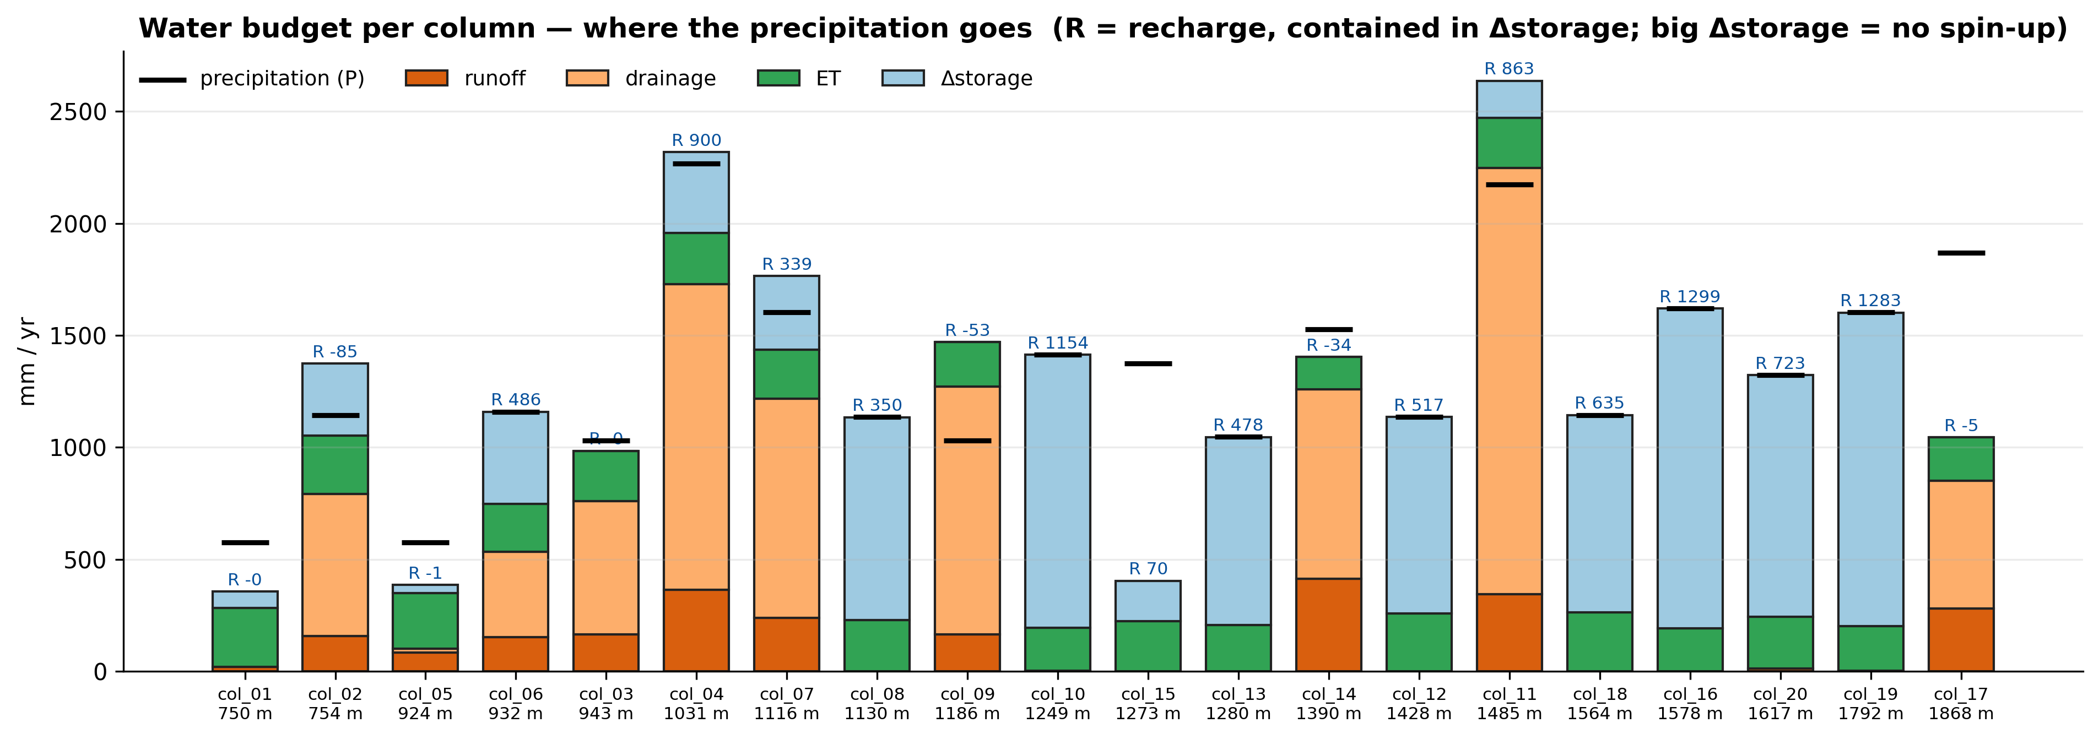
Naches — Fan warm start — execution & results
execution: 20 columns ran as one batch job (concurrent) in 61 min
Definitions — recharge = ELM QCHARGE (flux from the soil column to the water table); runoff = QOVER (surface runoff); recharge fraction = QCHARGE/(QCHARGE+QOVER); WTD = ZWT (the column's own water-table depth); forcing = NLDAS-2 (0.125°, ~12 km) precip at the column.

Slide 15
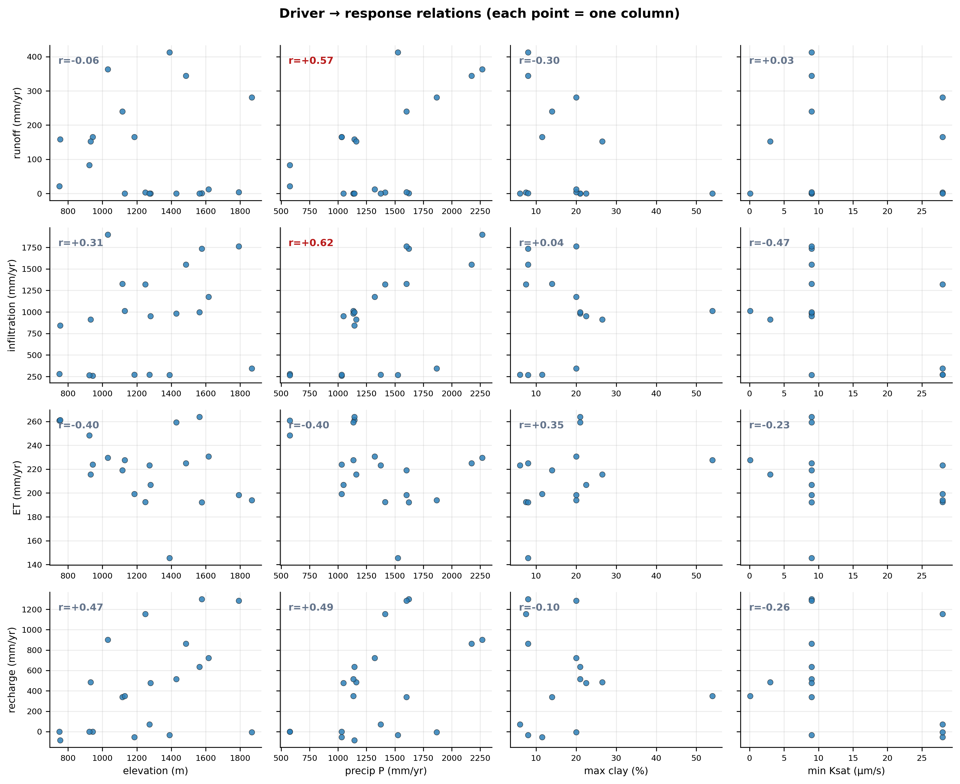
Naches — Fan warm start — results (continued)

Slide 16
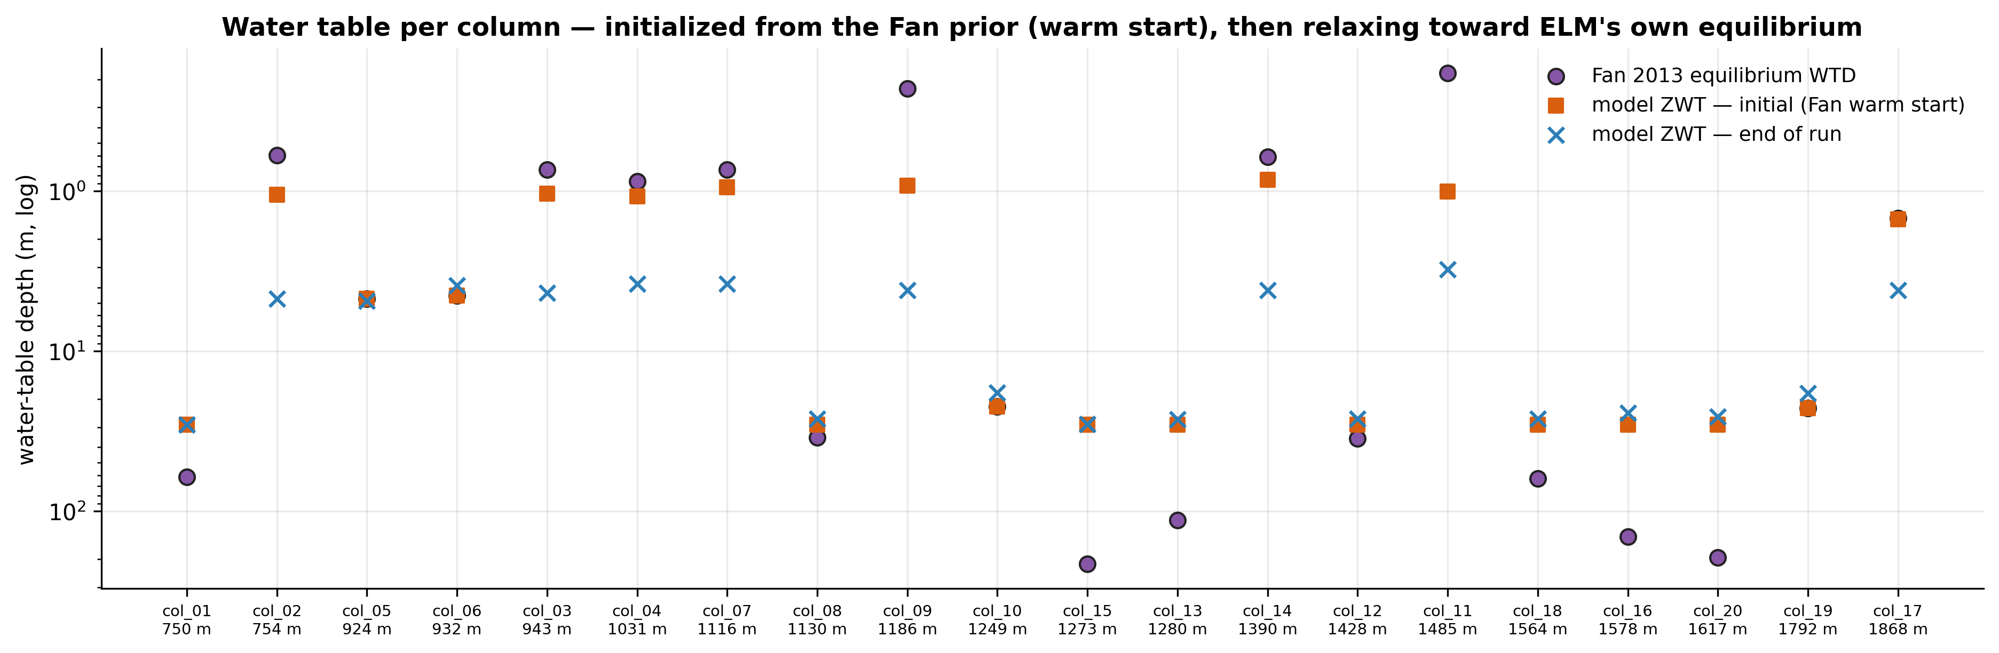
Naches — Fan warm start — results (continued)

Slide 17
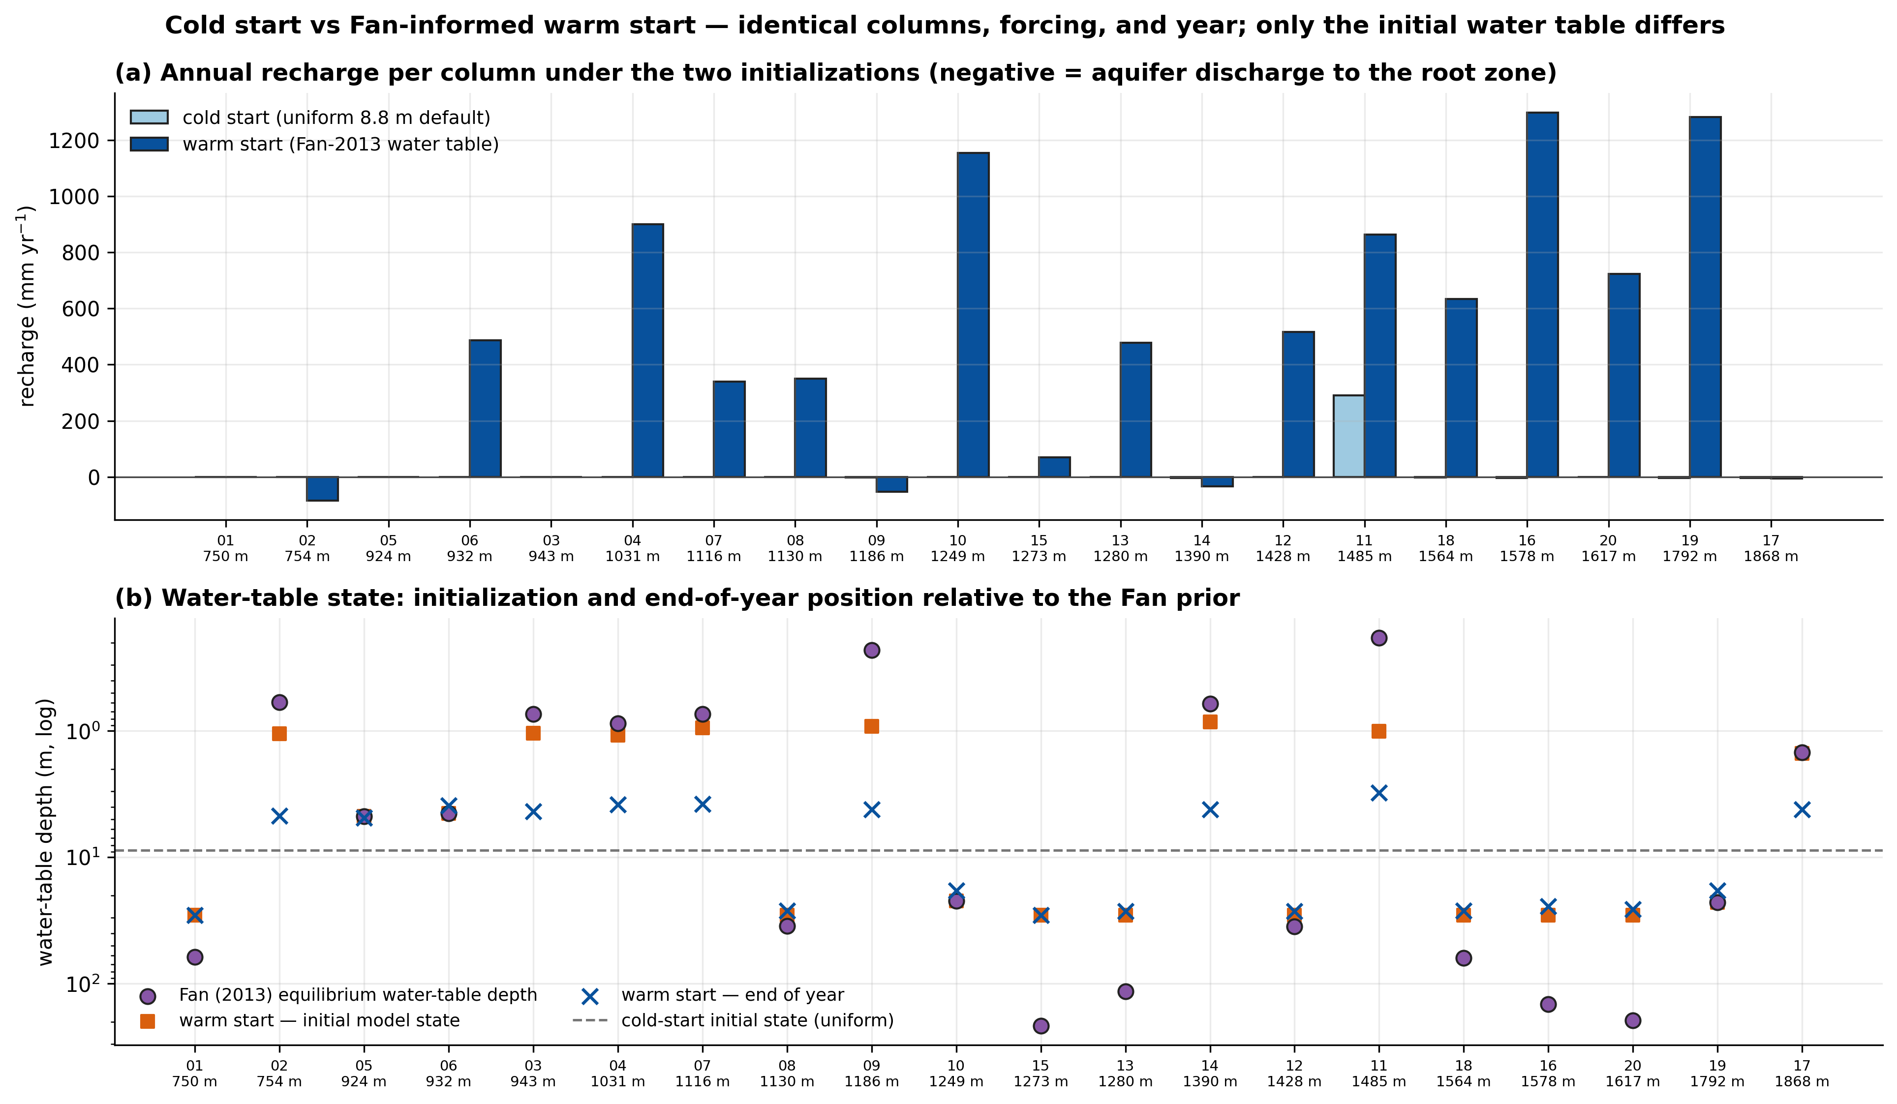
Naches — Fan warm start — results (continued)

Slide 18
Naches — Fan warm start — driver × response (Pearson r)
all 20 columns · correlations across ALL columns — when precip is quantized, elevation and precip are confo
response | elevation | precip | clay | Ksat
runoff | -0.06 | +0.61 | -0.30 | +0.03
infiltration | +0.31 | +0.50 | +0.04 | -0.47
et | -0.40 | -0.20 | +0.35 | -0.23
recharge | +0.47 | +0.37 | -0.10 | -0.26
recharge_fraction | +0.46 | +0.06 | +0.25 | -0.41

Slide 19
Naches — Fan warm start — assumptions & scope
every load-bearing choice, source-tagged · what these results can and cannot claim
Assumptions (source-tagged)
simulation period = 1995-1995 [user]: science year = last simulated year; the year's climatic percentile is not characterized
spin-up = none [derived]: recharge/storage terms are transient without >=3 spin-up years
initialization = Fan-2013 warm start (finidat) [user]: initial water table controls recharge sign in 1-yr runs
soil configuration = native [DEFAULT]: substrate=extrapolate
forcing period class = baseline [DEFAULT]
N (columns) = 20 [planner/expander]: materialized by the deterministic expander from the planner's stratification
met forcing = NLDAS-2 0.125° [user]: chosen to break the Qian elevation confound (backfilled for a pre-ledger run)
Structural limits — the 1-D model class (reruns cannot fix)
• runoff (QOVER): local runoff GENERATION on a 1 m² column — not routed discharge; no downslope concentration, so it is not comparable to a stream gauge without aggregation/routing.
• runoff/infiltration partitioning: no run-on: a column never receives runoff generated uphill, which in reality re-infiltrates downslope — runoff is likely biased high on slopes and infiltration biased low in valleys.
• water table (ZWT/WTD): 1-D vertical equilibrium only — the lateral groundwater convergence that sets real valley water tables is absent; ELM parameterizes lateral losses (QDRAI) as a local sink but routes nothing between columns.
• streamflow validation: columns provide no native integrated streamflow; gauge comparisons use unweighted column means (specific discharge) and are labeled context-only until routing exists.
• snow (SWE) at stations: forcing is a 12 km cell average — ridgetop SNOTEL stations sample terrain the cell cannot resolve; systematic underestimation at high-relief stations is expected.
This run's configuration limits (fixable by rerunning)
• recharge, storage change, deep soil moisture: run starts from non-equilibrated storage (no multi-year spin-up): slow-state fluxes are transient, storage-change terms are large, and recharge magnitude/sign is initialization-dependent.
• water table, recharge: initial water table prescribed from the Fan (2013) equilibrium prior; ELM's own 1-D equilibrium differs, so early-run drift reflects model-vs-prior disagreement. Note the prior is also used as a validation reference — a circularity to keep in view.
• all annual results: a single simulated year; interannual variability and the year's climatic percentile are not characterized.
• elevation-dependent results: NLDAS-2 resolves orographic gradients at ~12 km but not sub-cell terrain (no within-cell lapse rate).

Slide 20
Naches — Fan warm start — analyzer interpretation
Answer
• The representative Naches profile is infiltration-dominated: surface runoff is a minor term (mostly 0–16% of P, up to 27% only at the wettest upland col_14), while the bulk of water leaves as sub-surface drainage/recharge (30–80% of P) and ET stays nearly fixed at ~190–265 mm/yr. Whether that subsurface flux is booked as "recharge" vs "drainage" is set almost entirely by water-table depth, not soil texture, so the recharge/runoff split is a soft model result, not an observed partition.
Why
• High infiltration fraction (0.46–1.07 of P) -> tiny QOVER -> permeable loam/sandy-loam soils accept snowmelt.
• Shallow-WTD columns (~3.5–4 m) show recharge≈0 but drainage 0.3–1.07 P; deep-WTD columns (~27 m) show recharge 0.5–0.8 P, drainage 0 -> bookkeeping switch tied to initialized WTD.
• ET flat (~0.1–0.45 P) across all forcing -> energy/vegetation-limited, not water-limited.
• Runoff vs precip r=0.61, vs clay_max r=−0.30 -> wetness drives runoff more than texture.
Trust
• Model ZWT (median 12.4 m) brackets Fan-2013 (13.5 m) and wells (15.2 m), but SWE is underestimated (238–1000 vs 645–1981 mm) and no in-domain gauge existed to validate yield; top caveat: no spin-up + no lateral routing, so the recharge/drainage split and deep storage are unequilibrated defaults.
Next
• Run with multi-decade spin-up to equilibrate WTD and stabilize the recharge-vs-drainage partition.
• Add runoff routing/area-weighted aggregation to a headwater USGS gage to validate water yield.

Slide 21
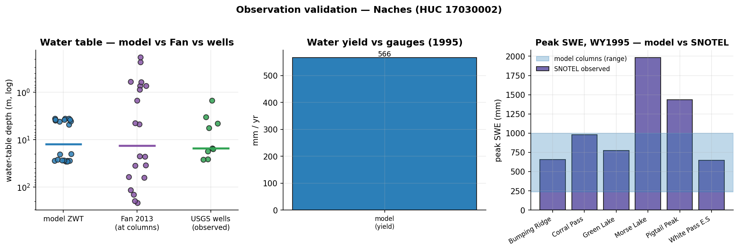
Naches — Fan warm start — evaluation vs observations
what could be compared honestly, and what still blocks rigorous validation
in-domain obs: SNOTEL 6 · stream gages 93 · GW wells 200 (9/10 sampled have records)
✓ COMPARED — water-table depth: model ZWT median 12.39 m vs Fan 13.46 m vs observed wells 15.23 m (median; n=9)
· context-only — streamflow (water yield): no in-domain gauge had 1995 daily records — needs: runoff routing / column aggregation
· context-only — streamflow (daily hydrograph): daily comparison unavailable
✓ COMPARED — snow water equivalent: model peak SWE 238–1000 mm across columns vs observed 645–1981 mm across stations (coarse uniform forcing — expect underestimation)
Metrics — NSE: 1=perfect, 0=no better than the observed mean, <0 worse than the mean. KGE: 1=perfect; components r (timing correlation), α (variability ratio σm/σo), β (volume ratio μm/μo). Specific discharge = gauge flow ÷ drainage area, making a gauge comparable to 1-D columns (mm/yr or mm/day).

Slide 22
Case 3 — Naches groundwater — ELM-coupled
question: When does today's infiltration become recharge at the water table?
model: ELM (warm-started, NLDAS) → PFLOTRAN 1-D RICHARDS, one-way daily flux
forcing: each column's own ELM daily infiltration — the forcing gradient varies per column (one-way coupling)
execution: 18/20 columns × (10 y spin + 1 transient ELM year), serial, seconds each on the login node — 2 stiff columns excluded (solver divergence, a known Richards challenge)

Slide 23
Naches groundwater — ELM-coupled — sampling design (same columns as the ELM studies)

Slide 24
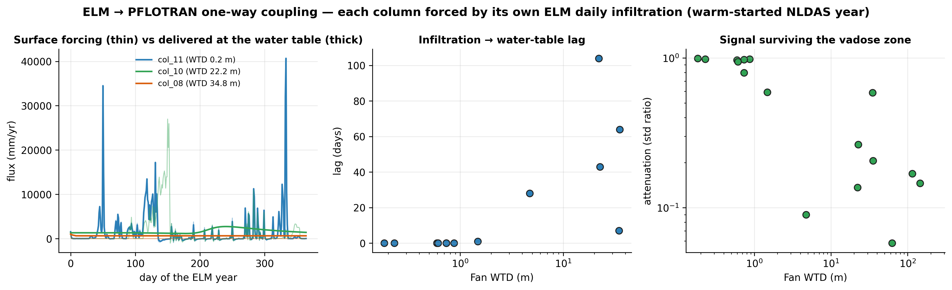
Naches groundwater — ELM-coupled — ELM → PFLOTRAN coupling — lag & attenuation

Slide 25
Naches groundwater — ELM-coupled — interpretation
• One-way coupling: each column's PFLOTRAN top flux is ITS OWN ELM daily infiltration (warm-started NLDAS run) — the forcing gradient is back (annual flux 260–1897 mm/yr across columns).
• Infiltration reaches the water table with lags of 0–104 days across 13 columns where a coherent response exists; deeper/finer vadose zones lag longer.
• Attenuation spans orders of magnitude: shallow water tables receive most of the surface signal; the capped ridge columns damp it to near zero — the vadose zone is a low-pass filter whose cutoff is set by the water-table depth.
• This is what ELM alone cannot represent: its bucket aquifer has no travel time. The two models now answer the question jointly — ELM partitions the surface water, PFLOTRAN carries it to the water table.

Slide 26
Case 4 — Naches groundwater (PFLOTRAN)
question: How different are the groundwater dynamics across the Naches — same recharge everywhere, only the subsurface varies?
model: PFLOTRAN 1-D RICHARDS (standalone — no ELM)
scenarios: steady uniform recharge 30/100/300 mm/yr — a controlled experiment: only the subsurface varies
execution: 20 columns × 3 scenarios = 60 serial runs, ~0.5 s each, login node — no batch queue

Slide 27
Naches groundwater (PFLOTRAN) — sampling design (same columns as the ELM studies)

Slide 28
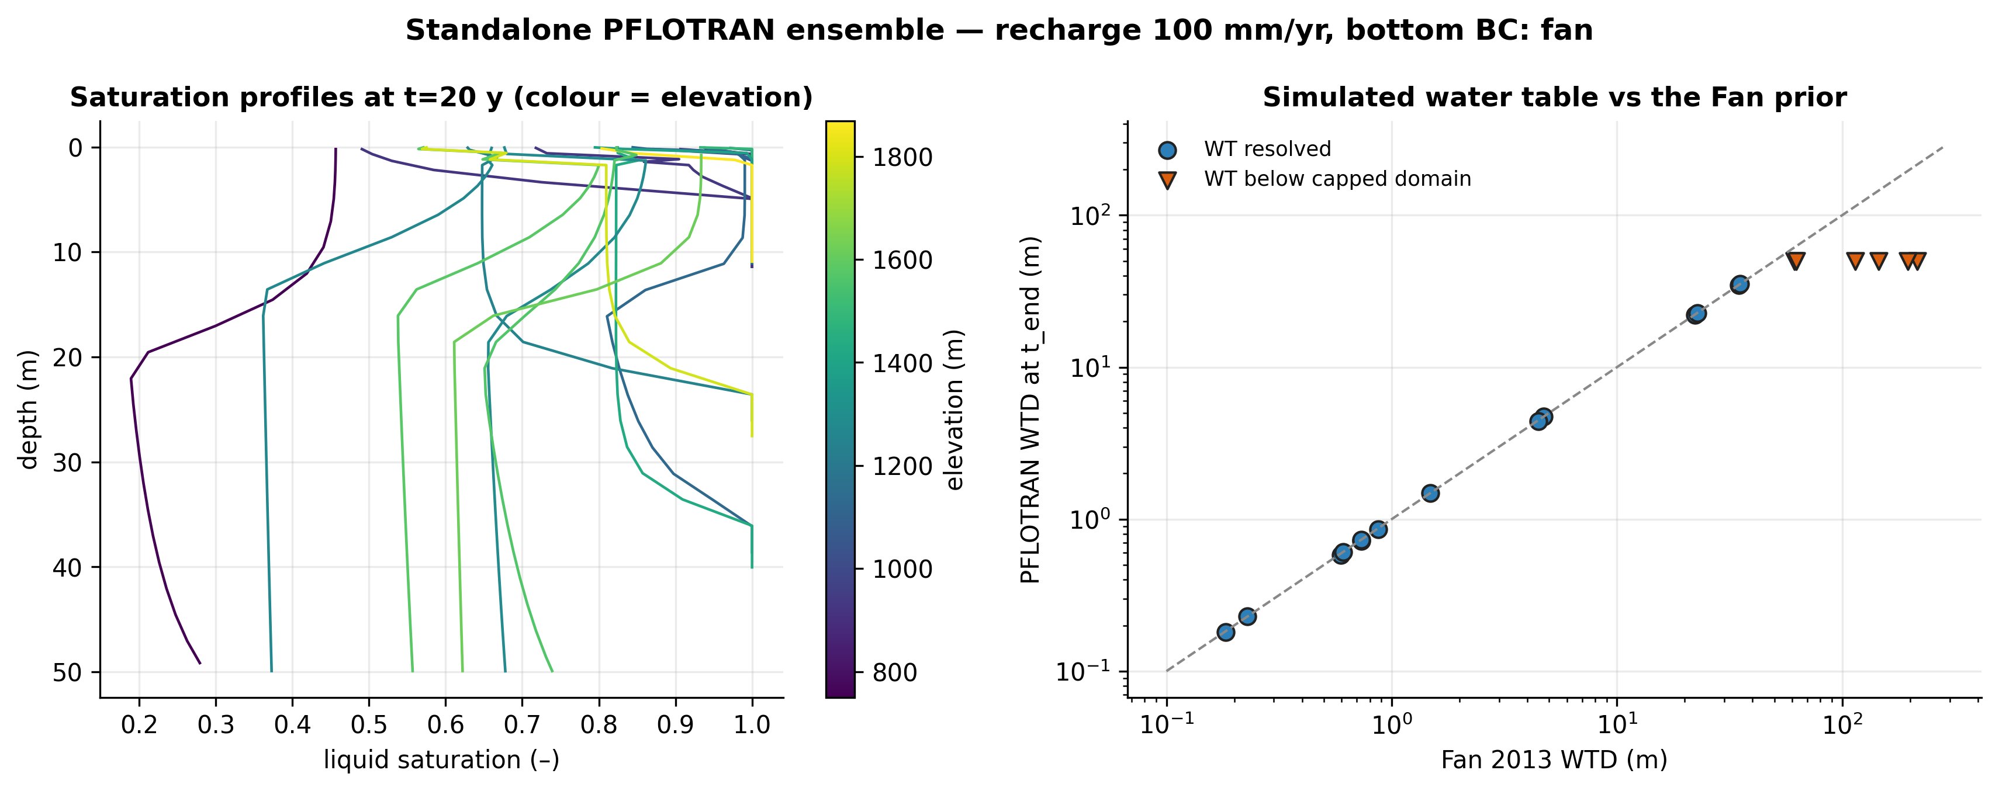
Naches groundwater (PFLOTRAN) — profiles & water tables (100 mm/yr)

Slide 29
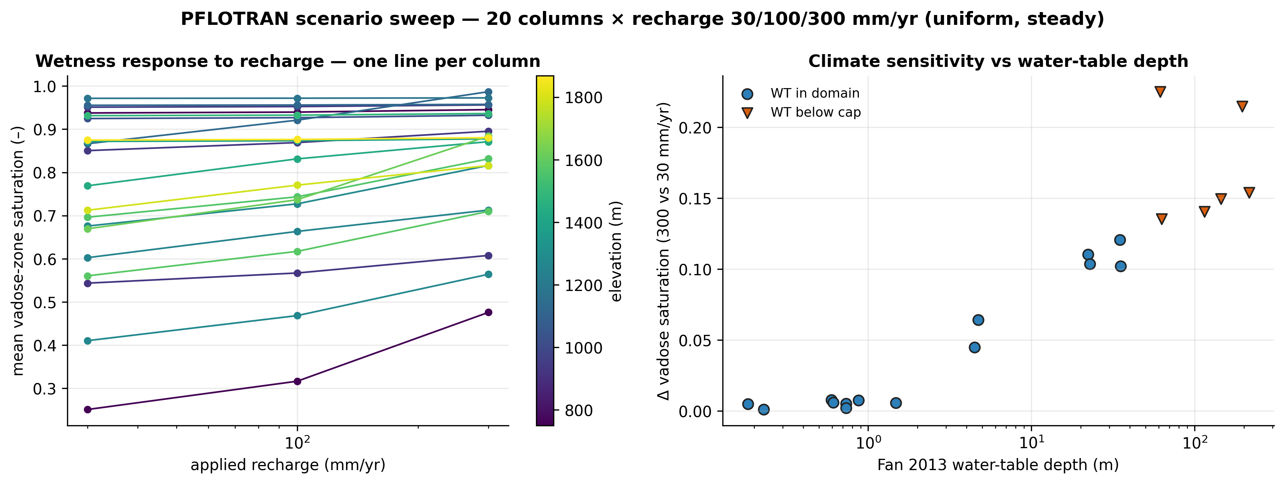
Naches groundwater (PFLOTRAN) — scenario sweep — the dynamics

Slide 30
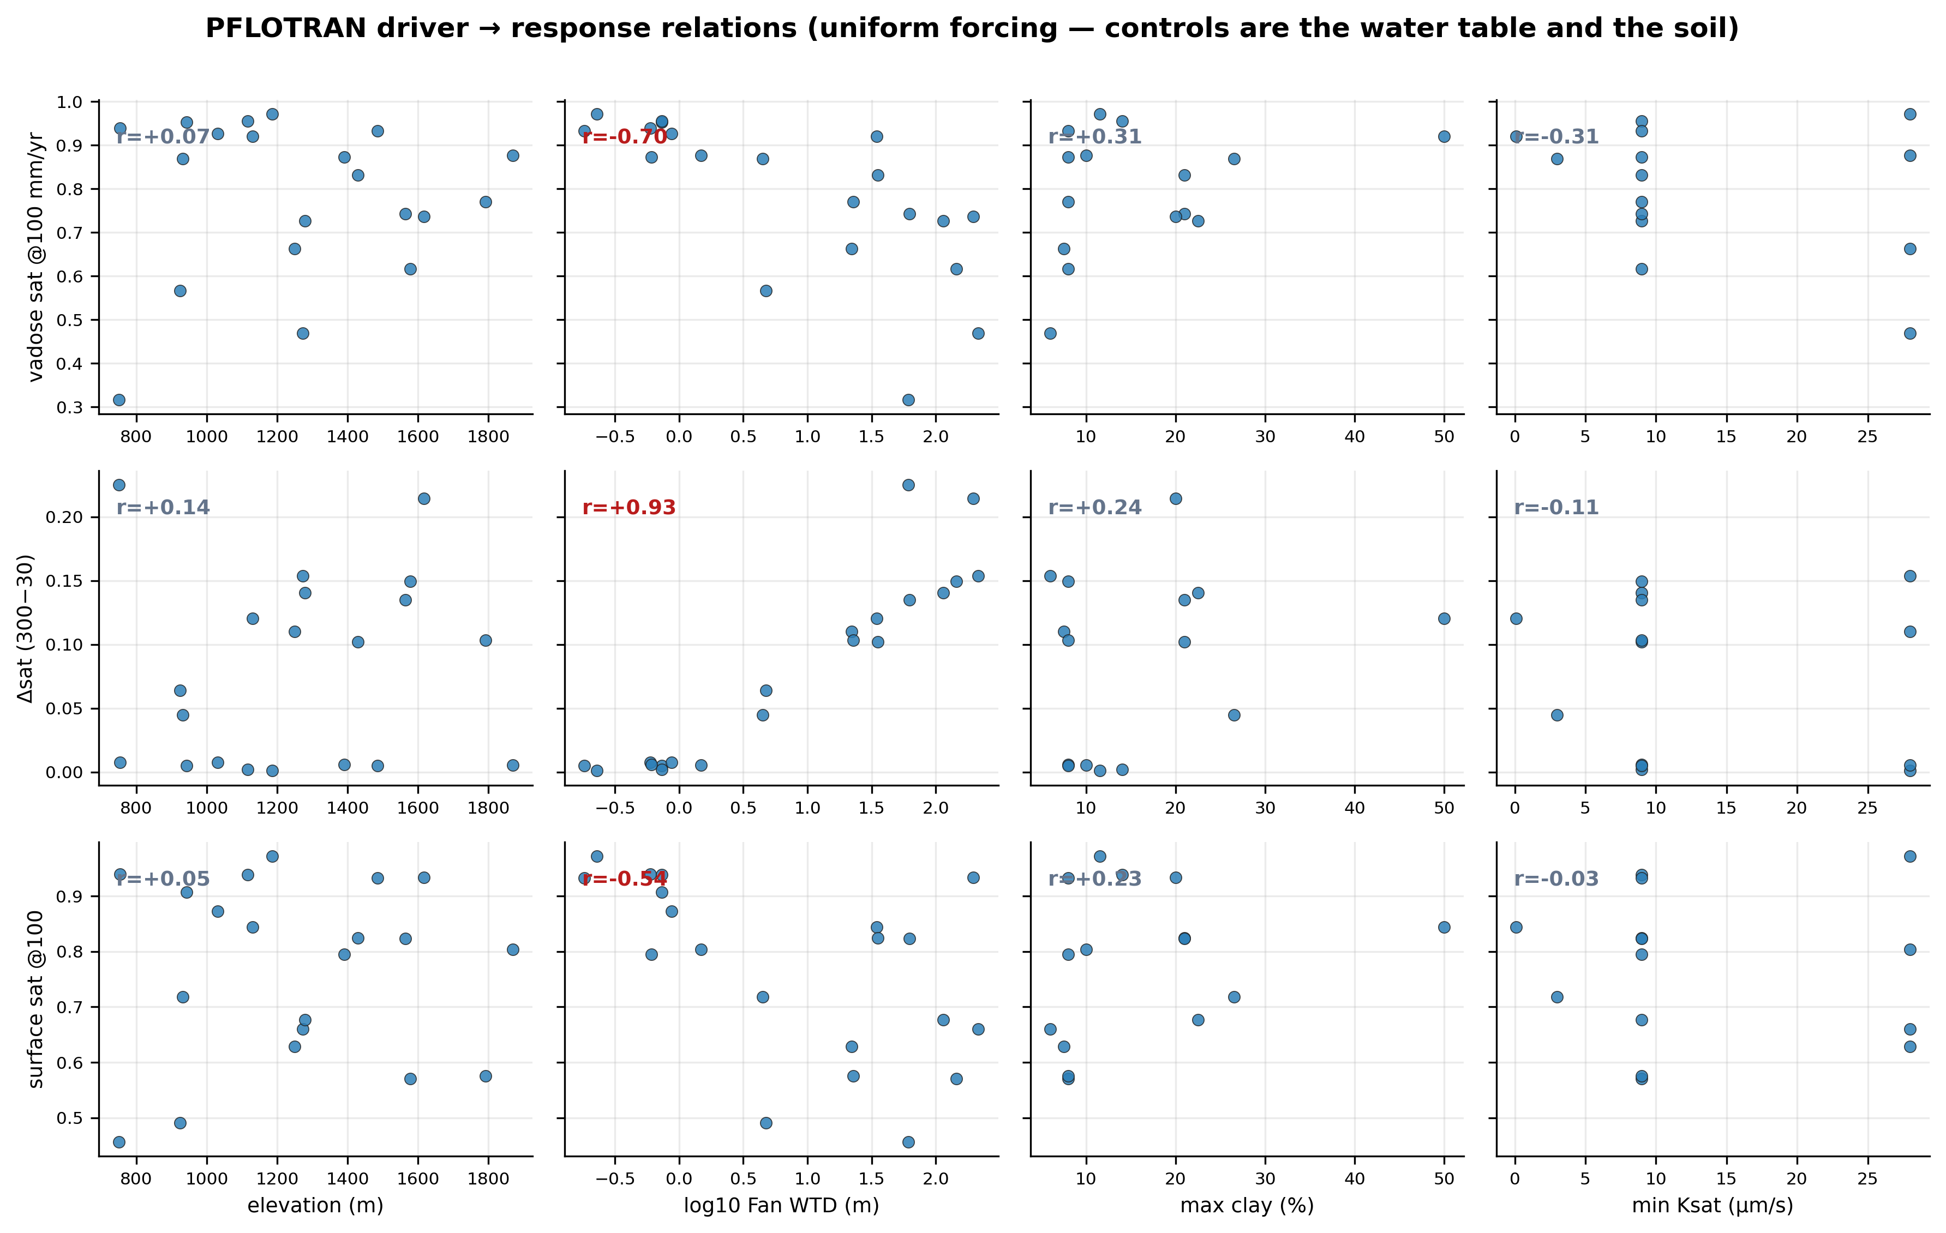
Naches groundwater (PFLOTRAN) — driver → response relations (controls: water table + soil)

Slide 31
Naches groundwater (PFLOTRAN) — interpretation
• Uniform steady recharge (30/100/300 mm/yr) on all 20 columns — every difference below is subsurface structure, not climate.
• Vadose-zone wetness spans 0.32–0.97 at the same forcing — soil layering and water-table depth set the baseline, not recharge.
• Most climate-sensitive: col_01 (Δsat +0.22, Fan WTD 61.5 m); least: col_09 (Δsat +0.00, Fan WTD 0.2 m) — deep unsaturated zones buffer recharge changes; shallow water tables pin the profile.
• 6 ridge columns keep their water table below the capped 50 m domain at every rate (Fan says 61–215 m there) — honestly flagged, not simulated.
• Water tables are held by the bottom boundary (pinned at the Fan prior), so this sweep isolates the UNSATURATED-zone response; transient forcing and a free water table are the ELM-coupling phase.
• Strongest controls (|r|≥0.5): Δsat (300−30) vs log10 Fan WTD (m) (r=+0.93) · vadose sat @100 mm/yr vs log10 Fan WTD (m) (r=-0.70) · surface sat @100 vs log10 Fan WTD (m) (r=-0.54) — elevation matters only where it proxies the water table (no orographic forcing exists in this design, unlike the ELM/NLDAS studies).

Slide 32
Cross-study synthesis
same framework, three experiments — the control on recharge/runoff partitioning depends on climate
study | columns | forcing (mm/yr) | recharge (mm/yr) | strongest control
Naches | 20 | 459, 474, 509, 611, 619, 682, 699, 727, 735, 793, 941, 975, 1153, 1361, 1580 | -3.6 → 291.2 | —
Naches — Fan warm start | 20 | 459, 474, 509, 611, 619, 682, 699, 727, 735, 793, 941, 975, 1153, 1361, 1580 | -84.8 → 1298.8 | —
wet basin: recharge is CLAY-limited — water is ample; the impeding layer decides
dry basin: recharge is Ksat-limited (threshold) — only the most permeable soil recharges
controlled sweep: confirms causality: clay 5→55% collapses recharge 755→9 mm/yr with everything else fixed

Slide 33
Appendix A1 — Naches: columns & results
characteristics from the real data (SSURGO soil, Fan 2013 WTD, NLDAS-2 (0.125°, ~12 km) forcing) · results are annual means (mm/yr)
column | elev m | top soil | clay% | Ksat µm/s | Fan WTD m | precip | recharge | runoff | rech.frac | ZWT m
col_01 | 750 | — | — | — | 61.5 | 474 | -0.2 | 23.5 | -0.01 | 8.80
col_02 | 754 | — | — | — | 0.6 | 682 | -0.2 | 39.5 | -0.00 | 8.80
col_05 | 924 | — | — | — | 4.7 | 474 | -0.2 | 23.5 | -0.01 | 8.80
col_06 | 932 | loam | 26 | 3.0 | 4.5 | 727 | -0.6 | 35.3 | -0.02 | 8.80
col_03 | 943 | — | — | — | 0.7 | 793 | -0.2 | 40.7 | -0.00 | 8.80
col_04 | 1031 | — | — | — | 0.9 | 1361 | -0.2 | 89.8 | -0.00 | 8.80
col_07 | 1116 | loam | 14 | 9.0 | 0.7 | 975 | -1.5 | 52.6 | -0.03 | 8.81
col_08 | 1130 | loam | 54 | 0.1 | 34.8 | 509 | -0.0 | 54.7 | -0.00 | 8.80
col_09 | 1186 | loam | 12 | 28.0 | 0.2 | 793 | -2.9 | 40.1 | -0.08 | 8.81
col_10 | 1249 | loam | 8 | 28.0 | 22.2 | 699 | -0.6 | 53.3 | -0.01 | 8.80
col_15 | 1273 | loam | 6 | 28.0 | 215.2 | 735 | -1.4 | 56.8 | -0.02 | 8.80
col_13 | 1280 | loam | 22 | 9.0 | 114.5 | 459 | -0.3 | 45.4 | -0.01 | 8.80
col_14 | 1390 | sandy loam | 8 | 9.0 | 0.6 | 611 | -3.6 | 77.1 | -0.05 | 8.81
col_12 | 1428 | loam | 21 | 9.0 | 35.2 | 509 | -0.4 | 44.2 | -0.01 | 8.80
col_11 | 1485 | sandy loam | 8 | 9.0 | 0.2 | 1580 | 291.2 | 94.6 | 0.75 | 8.74
col_18 | 1564 | loam | 21 | 9.0 | 62.7 | 682 | -2.1 | 38.9 | -0.06 | 8.81
col_16 | 1578 | sandy loam | 8 | 9.0 | 145.0 | 941 | -3.6 | 52.9 | -0.07 | 8.81
col_20 | 1617 | loam | 20 | — | 195.5 | 619 | -0.5 | 36.0 | -0.01 | 8.80
col_19 | 1792 | sandy loam | 20 | 9.0 | 22.7 | 975 | -3.6 | 56.0 | -0.07 | 8.81
col_17 | 1868 | loam | 20 | 28.0 | 1.5 | 1153 | -3.4 | 76.4 | -0.05 | 8.81

Slide 34
Appendix A2 — Naches — Fan warm start: columns & results
characteristics from the real data (SSURGO soil, Fan 2013 WTD, NLDAS-2 (0.125°, ~12 km) forcing) · results are annual means (mm/yr)
column | elev m | top soil | clay% | Ksat µm/s | Fan WTD m | precip | recharge | runoff | rech.frac | ZWT m
col_01 | 750 | — | — | — | 61.5 | 474 | -0.0 | 21.4 | -0.00 | 28.80
col_02 | 754 | — | — | — | 0.6 | 682 | -84.8 | 158.2 | -1.15 | 4.16
col_05 | 924 | — | — | — | 4.7 | 474 | -0.6 | 83.0 | -0.01 | 4.79
col_06 | 932 | loam | 26 | 3.0 | 4.5 | 727 | 486.1 | 152.3 | 0.76 | 4.05
col_03 | 943 | — | — | — | 0.7 | 793 | -0.2 | 165.1 | -0.00 | 3.94
col_04 | 1031 | — | — | — | 0.9 | 1361 | 900.2 | 363.5 | 0.71 | 3.60
col_07 | 1116 | loam | 14 | 9.0 | 0.7 | 975 | 338.8 | 239.9 | 0.59 | 3.56
col_08 | 1130 | loam | 54 | 0.1 | 34.8 | 509 | 349.5 | 0.4 | 1.00 | 27.59
col_09 | 1186 | loam | 12 | 28.0 | 0.2 | 793 | -53.1 | 165.7 | -0.47 | 3.79
col_10 | 1249 | loam | 8 | 28.0 | 22.2 | 699 | 1154.1 | 3.4 | 1.00 | 19.98
col_15 | 1273 | loam | 6 | 28.0 | 215.2 | 735 | 70.3 | 0.4 | 0.99 | 28.73
col_13 | 1280 | loam | 22 | 9.0 | 114.5 | 459 | 478.4 | 0.3 | 1.00 | 27.68
col_14 | 1390 | sandy loam | 8 | 9.0 | 0.6 | 611 | -34.5 | 412.7 | -0.09 | 3.79
col_12 | 1428 | loam | 21 | 9.0 | 35.2 | 509 | 516.8 | 0.4 | 1.00 | 27.58
col_11 | 1485 | sandy loam | 8 | 9.0 | 0.2 | 1580 | 863.2 | 344.4 | 0.71 | 3.56
col_18 | 1564 | loam | 21 | 9.0 | 62.7 | 682 | 634.9 | 0.4 | 1.00 | 27.50
col_16 | 1578 | sandy loam | 8 | 9.0 | 145.0 | 941 | 1298.8 | 0.9 | 1.00 | 26.38
col_20 | 1617 | loam | 20 | — | 195.5 | 619 | 722.6 | 12.4 | 0.98 | 27.19
col_19 | 1792 | sandy loam | 20 | 9.0 | 22.7 | 975 | 1283.2 | 4.1 | 1.00 | 20.18
col_17 | 1868 | loam | 20 | 28.0 | 1.5 | 1153 | -5.1 | 281.3 | -0.02 | 3.78

Slide 35
Appendix P1 — Naches groundwater — ELM-coupled: columns & scenario wetness
vadose-zone mean saturation per recharge rate · WTD from the hydrostatic prior
column | elev m | Fan WTD m | domain m | flux annual mm yr | lag days | attenuation
col_01 | 750 | 61.5 | 50.0 | 280.00 | — | 0.00
col_02 | 754 | 0.6 | 12.0 | 841.90 | 0.00 | 0.97
col_03 | 943 | 0.7 | 12.0 | 259.70 | 0.00 | 0.80
col_04 | 1031 | 0.9 | 12.0 | 1897.00 | 0.00 | 0.98
col_05 | 924 | 4.7 | 12.0 | 264.90 | 28.00 | 0.09
col_07 | 1116 | 0.7 | 12.0 | 1325.10 | 0.00 | 0.98
col_08 | 1130 | 34.8 | 39.8 | 1011.10 | 7.00 | 0.59
col_09 | 1186 | 0.2 | 12.0 | 270.40 | 0.00 | 0.98
col_10 | 1249 | 22.2 | 27.2 | 1320.80 | 104.00 | 0.14
col_11 | 1485 | 0.2 | 12.0 | 1551.00 | 0.00 | 0.99
col_12 | 1428 | 35.2 | 40.2 | 981.00 | 64.00 | 0.21
col_13 | 1280 | 114.5 | 50.0 | 951.70 | — | 0.17
col_14 | 1390 | 0.6 | 12.0 | 267.90 | 0.00 | 0.94
col_15 | 1273 | 215.2 | 50.0 | 271.10 | — | 0.00
col_16 | 1578 | 145.0 | 50.0 | 1735.50 | — | 0.15
col_17 | 1868 | 1.5 | 12.0 | 345.20 | 1.00 | 0.59
col_18 | 1564 | 62.7 | 50.0 | 996.20 | — | 0.06
col_19 | 1792 | 22.7 | 27.7 | 1761.00 | 43.00 | 0.26

Slide 36
Appendix P2 — Naches groundwater (PFLOTRAN): columns & scenario wetness
vadose-zone mean saturation per recharge rate · WTD from the hydrostatic prior
column | elev m | Fan WTD m | domain m | wtd final m | sat r30 | sat r100 | sat r300
col_01 | 750 | 61.5 | 50.0 | — | 0.25 | 0.32 | 0.48
col_02 | 754 | 0.6 | 12.0 | 0.58 | 0.94 | 0.94 | 0.95
col_05 | 924 | 4.7 | 12.0 | 4.72 | 0.54 | 0.57 | 0.61
col_06 | 932 | 4.5 | 12.0 | 4.42 | 0.85 | 0.87 | 0.90
col_03 | 943 | 0.7 | 12.0 | 0.72 | 0.95 | 0.95 | 0.96
col_04 | 1031 | 0.9 | 12.0 | 0.86 | 0.92 | 0.93 | 0.93
col_07 | 1116 | 0.7 | 12.0 | 0.73 | 0.96 | 0.96 | 0.96
col_08 | 1130 | 34.8 | 39.8 | 34.81 | 0.87 | 0.92 | 0.99
col_09 | 1186 | 0.2 | 12.0 | 0.23 | 0.97 | 0.97 | 0.97
col_10 | 1249 | 22.2 | 27.2 | 22.14 | 0.60 | 0.66 | 0.71
col_15 | 1273 | 215.2 | 50.0 | — | 0.41 | 0.47 | 0.56
col_13 | 1280 | 114.5 | 50.0 | — | 0.68 | 0.73 | 0.82
col_14 | 1390 | 0.6 | 12.0 | 0.61 | 0.87 | 0.87 | 0.88
col_12 | 1428 | 35.2 | 40.2 | 35.16 | 0.77 | 0.83 | 0.87
col_11 | 1485 | 0.2 | 12.0 | 0.18 | 0.93 | 0.93 | 0.94
col_18 | 1564 | 62.7 | 50.0 | — | 0.70 | 0.74 | 0.83
col_16 | 1578 | 145.0 | 50.0 | — | 0.56 | 0.62 | 0.71
col_20 | 1617 | 195.5 | 50.0 | — | 0.67 | 0.74 | 0.88
col_19 | 1792 | 22.7 | 27.7 | 22.63 | 0.71 | 0.77 | 0.82
col_17 | 1868 | 1.5 | 12.0 | 1.48 | 0.87 | 0.88 | 0.88

