Slide 1
From a question to a validated simulation campaign
Multi-agent LLM framework on NERSC Perlmutter — 4 executed case studies
question → plan → sampling → per-column ELM runs → analysis → observation validation
generated 2026-07-02 from workflow_outputs/

Slide 2
Case 1 — Naches
HUC 17030002 · 2860.6 km² · elevation 352.0–1977.4 m
“Determine the partitioning of runoff, infiltration, and recharge and the processes that control it across the Naches sub-watershed (HUC8 17030002, eastern Cascades, WA), and validate against observations”
goal: Mechanistic: quantify partitioning of precip+snowmelt into surface runoff, infiltration, and deep drainage (recharge) across the Naches, and attribute it to elevation/snow regime, soil layering, and ET
goal: Validation: confront simulated SWE against SNOTEL and integrated runoff against USGS streamflow; treat recharge as an unvalidated water-balance residual
sampling: N=10 — stratified (elevation primary, soil-layering secondary) with validation columns pinned to observation sites
why N: 4 elevation bands x 2 soil contrasts = 8 to span the dominant snow-regime gradient and the infiltration-vs-recharge soil control, +2 replicates at the rain-snow transition (bands 2-3) where partitioning is most sensitive. Soil kept to 2 levels because only point SSURGO exists (gridded soil is a gap).

Slide 3
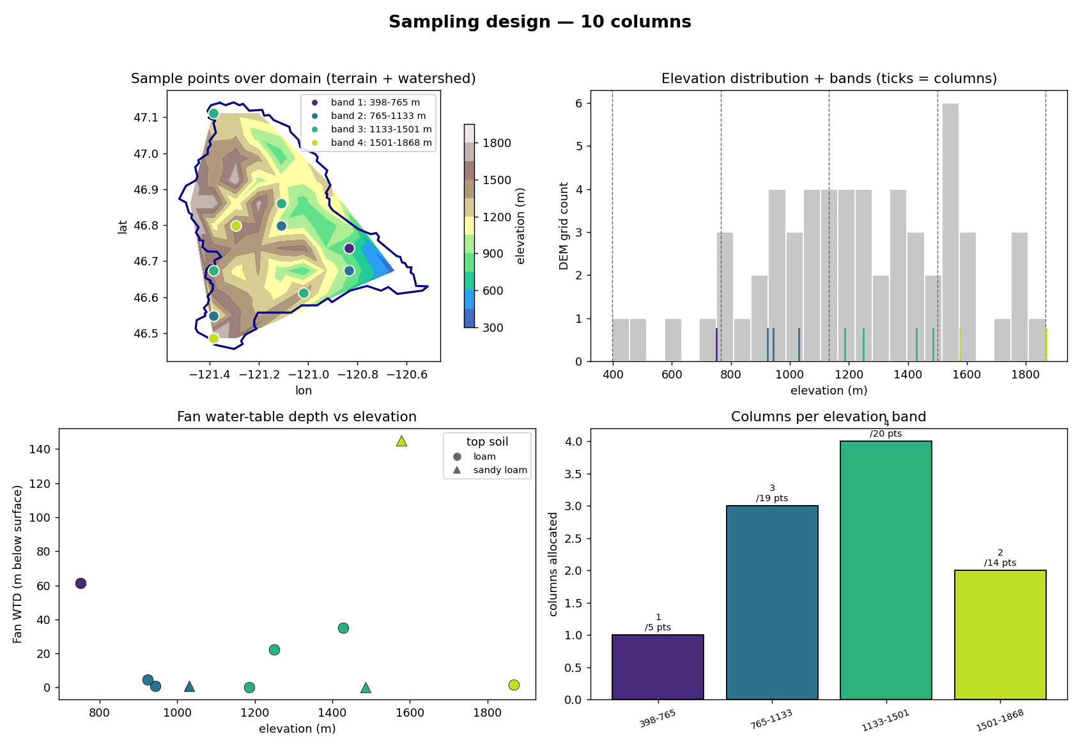
Naches — sampling design (Tier-2 expander)

Slide 4
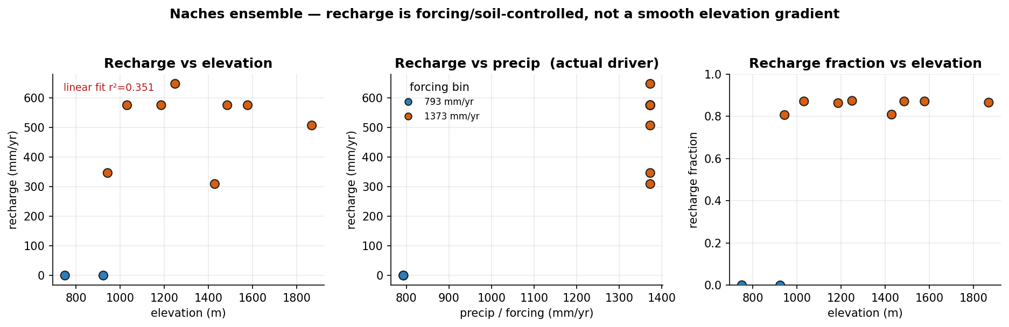
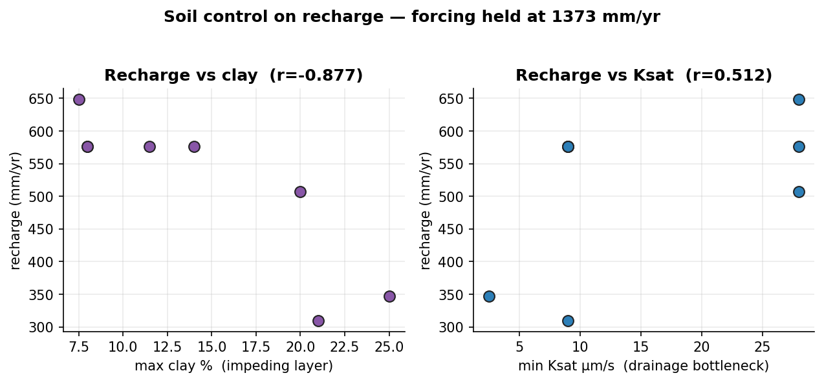
Naches — execution & results
execution: 10/10 columns succeeded · ~3 min each (~15 s clone per column, shared executable)

Slide 5
Naches — analyzer interpretation
finding: precip is quantized to 2 value(s) [793, 1373] mm/yr — coarse DATM forcing, NOT elevation-resolved
finding: recharge tracks precip (r=0.897) more than elevation (r=0.593) — response is forcing/soil-controlled
finding: linear elevation fit is weak (r2=0.351) — the elevation 'gradient' is not a reliable summary
finding: soil control (forcing held at 1373 mm/yr, 8 columns): strongest predictor = recharge_vs_clay_max (r=-0.877)

Slide 6
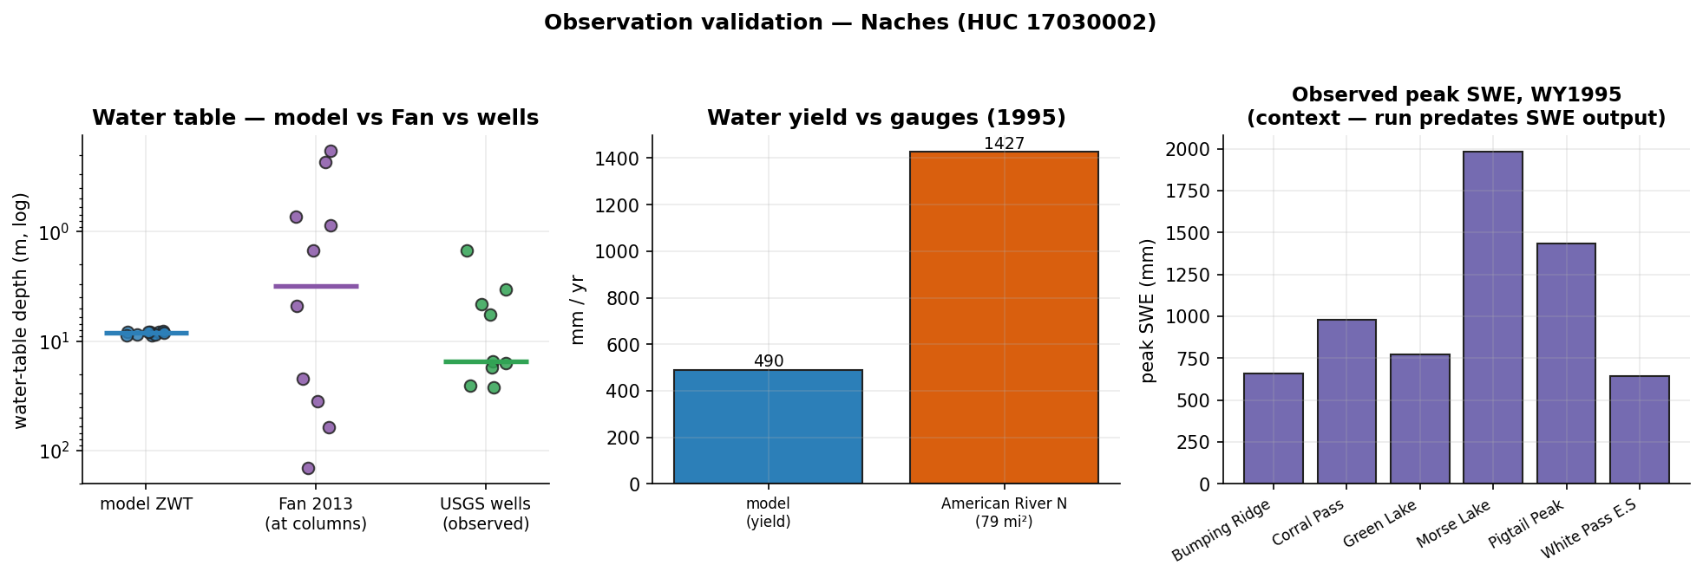
Naches — evaluation vs observations
what could be compared honestly, and what still blocks rigorous validation
in-domain obs: SNOTEL 6 · stream gages 93 · GW wells 200 (9/10 sampled have records)
✓ COMPARED — water-table depth: model ZWT median 8.37 m vs Fan 3.11 m vs observed wells 15.23 m (median; n=9)
✓ COMPARED — streamflow (water yield): modeled yield 490.1 mm/yr vs observed specific discharge 1426.8 mm/yr (American River Near Nile, Wa)
· context-only — streamflow (daily hydrograph): daily comparison unavailable
· context-only — snow water equivalent: observed peak SWE 645–1981 mm across stations vs column forcing precip 793, 1373 mm/yr — this run predates SWE (H2OSNO) in the history output — needs: snow/SWE history output (default since 2026-07) + elevation-downscaled forcing

Slide 7
Case 2 — Naches
HUC 17030002 · 2860.6 km² · elevation 352.0–1977.4 m
“Partitioning of runoff/recharge in the Naches sub-watershed (HUC8 17030002), validate with observations”
goal: Mechanistic: quantify how the representative Naches profile partitions incoming water among ET, surface runoff (QOVER) and sub-surface drainage/recharge (QDRAI), and how that partitioning shifts with water availability (forcing period)
goal: Validation: compare ELM water balance against integrated streamflow at in-HUC USGS gages, SNOTEL SWE as snow driver, and Fan-2013 WTD as deep-storage context — MOST of which is blocked by current execution limits
sampling: N=8 — stratified (elevation bands for surface-data sampling) + forcing-period treatment on a representative column
why N: 4 columns to span the four elevation bands and sample whatever per-column surface-data (PFT/default soil) heterogeneity exists across the basin under baseline forcing (NOT an elevation/climate test — forcing is uniform). Plus a forcing-period sweep (wet + drought = 2 extra periods) applied to two representative columns (1 mid-elevation valley-influenced, 1 upland) = 4 more, to isolate the only usable mechanistic lever: water-availability control on partitioning. Total 8. A denser grid is unjustified because neither elevation-climate nor soil texture can be resolved.
feasibility: partial — the elevation/snow-driven partitioning mechanism (the brief's stated primary control) is NOT representable, and the observation-based validation goal is largely blocked. Only the soil-profile water-balance partitioning and its forcing-period sensitivity are answerable.
not answerable: Elevation / snow-regime control on partitioning (the brief's stated primary driver) — needs elevation-downscaled forcing
not answerable: Validation against SNOTEL SWE / melt timing — needs snow/SWE history output AND elevation-downscaled forcing

Slide 8
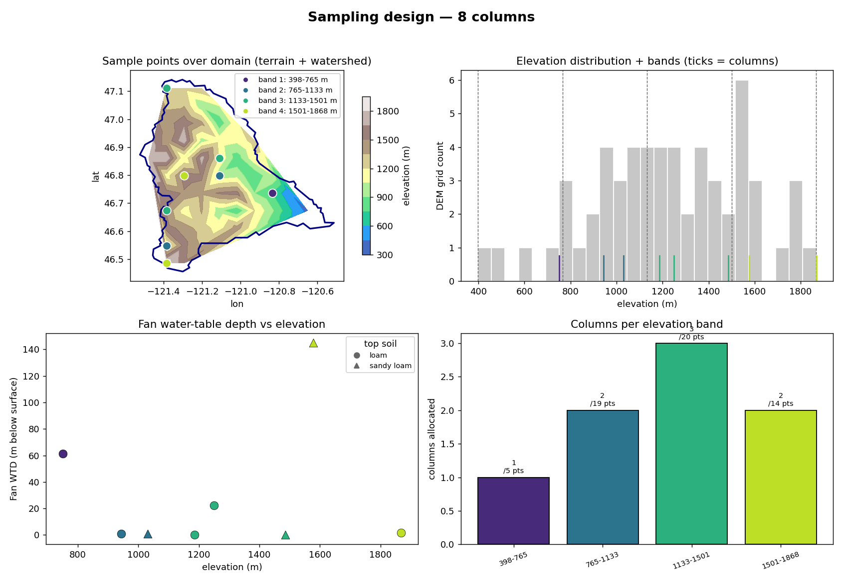
Naches — sampling design (Tier-2 expander)

Slide 9
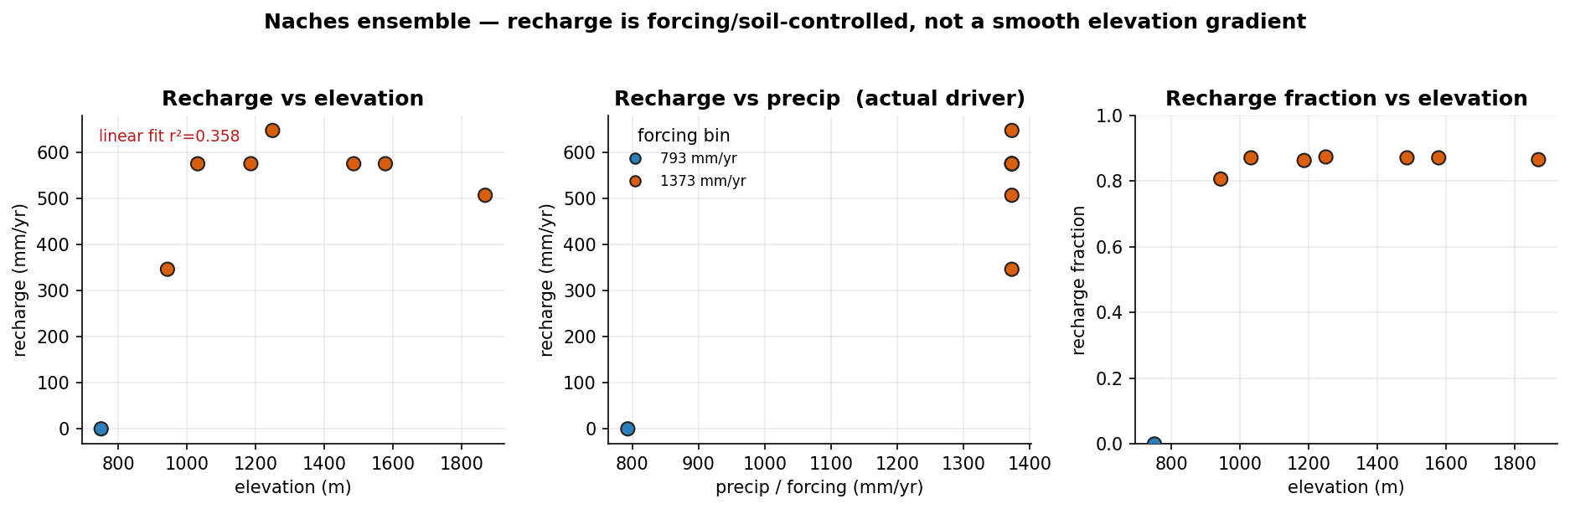
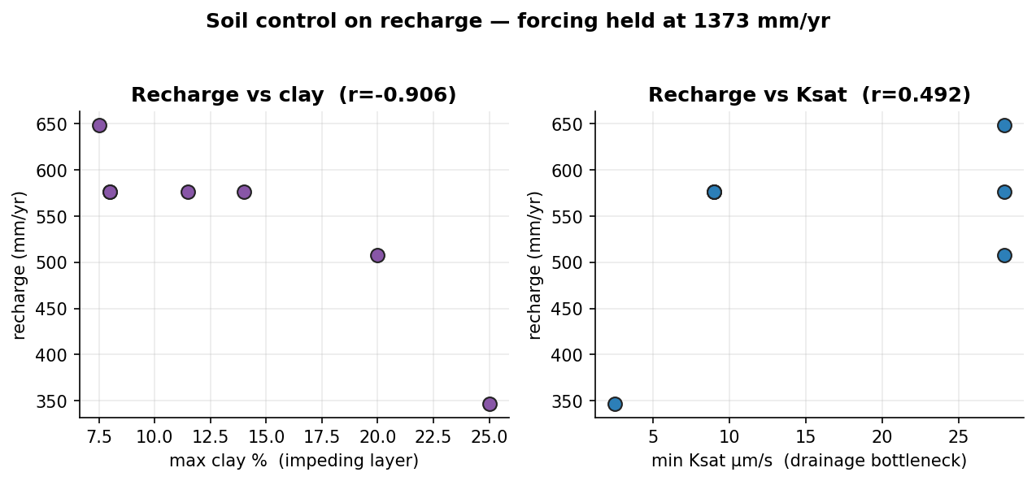
Naches — execution & results
execution: 8/8 columns succeeded · ~3 min each (~15 s clone per column, shared executable)

Slide 10
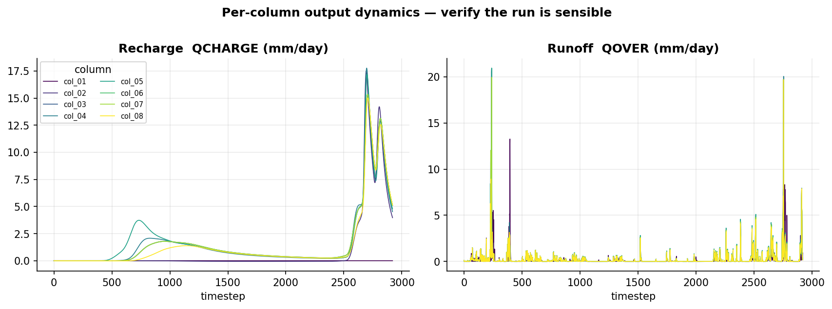
Naches — results (continued)

Slide 11
Naches — analyzer interpretation
finding: precip is quantized to 2 value(s) [793, 1373] mm/yr — coarse DATM forcing, NOT elevation-resolved
finding: recharge tracks precip (r=0.908) more than elevation (r=0.598) — response is forcing/soil-controlled
finding: linear elevation fit is weak (r2=0.358) — the elevation 'gradient' is not a reliable summary
finding: soil control (forcing held at 1373 mm/yr, 7 columns): strongest predictor = recharge_vs_clay_max (r=-0.906)

Slide 12
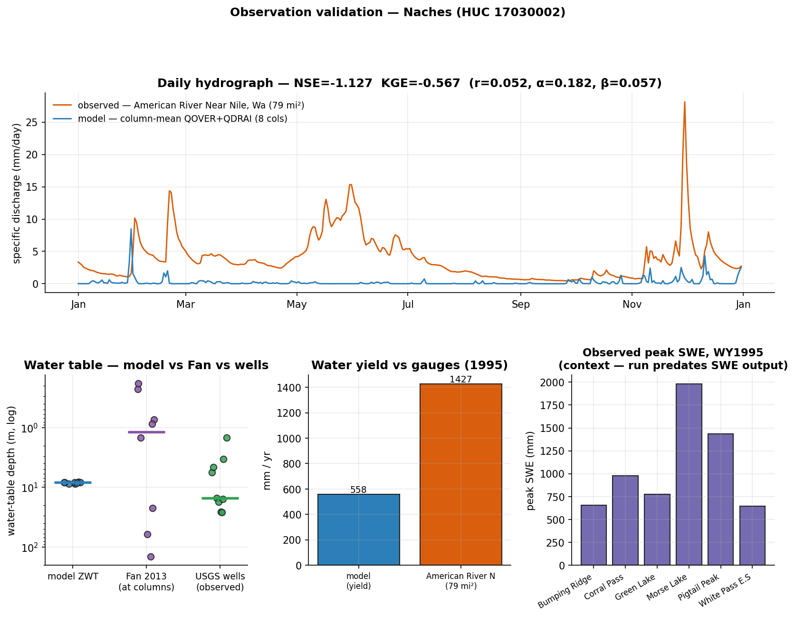
Naches — evaluation vs observations
what could be compared honestly, and what still blocks rigorous validation
in-domain obs: SNOTEL 6 · stream gages 93 · GW wells 200 (9/10 sampled have records)
✓ COMPARED — water-table depth: model ZWT median 8.31 m vs Fan 1.18 m vs observed wells 15.23 m (median; n=9)
✓ COMPARED — streamflow (water yield): modeled yield 557.8 mm/yr vs observed specific discharge 1426.8 mm/yr (American River Near Nile, Wa)
✓ COMPARED — streamflow (daily hydrograph): NSE=-1.127, KGE=-0.567 (r=0.052, variability α=0.182, bias β=0.057) — column-mean QOVER+QDRAI vs gauge
· context-only — snow water equivalent: observed peak SWE 645–1981 mm across stations vs column forcing precip 793, 1373 mm/yr — this run predates SWE (H2OSNO) in the history output — needs: snow/SWE history output (default since 2026-07) + elevation-downscaled forcing

Slide 13
Case 3 — Walla Walla
HUC 17070102 · 4600.97 km² · elevation 169.4–1675.0 m
“Partitioning of runoff/recharge in the Walla Walla basin (HUC8 17070102), validate with observations. Thanks”
goal: Mechanistic: quantify column-scale partitioning of precipitation among surface runoff, sub-surface drainage/deep recharge (QDRAI), and ET, and its sensitivity to the levers the stack can pull (soil texture, forcing period)
goal: Validation: compare simulated water balance against observed streamflow (integrated), water-table depth, and SNOTEL SWE — to the extent each is feasible in-domain
sampling: N=8 — stratified (soil × elevation-band surface data) with forcing-period treatments
why N: Four elevation bands give surface-data (soil/PFT) spanning across the basin; sampling ~2 columns per band (dominant + secondary soil where heterogeneity exists once gridded soil is ingested) yields 8. This is NOT an elevation/climate test — forcing is uniform — it spans surface heterogeneity. The forcing-period axis (baseline/wet/drought) is applied as a treatment over the same columns, not as extra columns, to probe partitioning sensitivity to climate variability.
feasibility: partial
not answerable: Elevation/climate-gradient control on partitioning (snow-dominated headwaters vs. semi-arid lowland) — needs elevation-downscaled forcing
not answerable: SNOTEL SWE / montane snowpack validation — needs elevation-downscaled forcing + snow/SWE history output

Slide 14
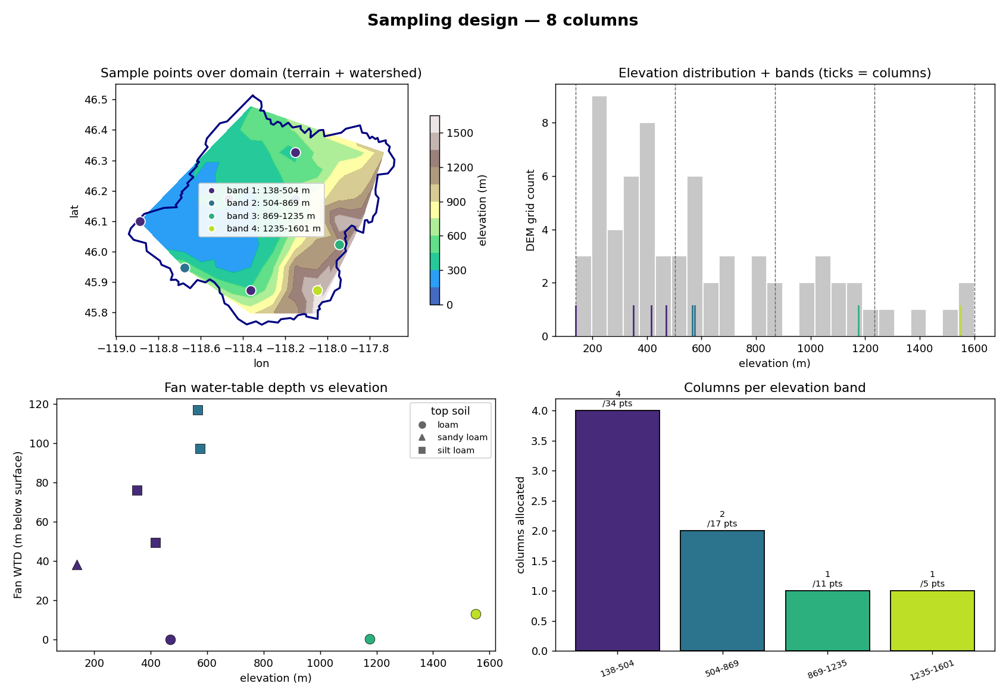
Walla Walla — sampling design (Tier-2 expander)

Slide 15
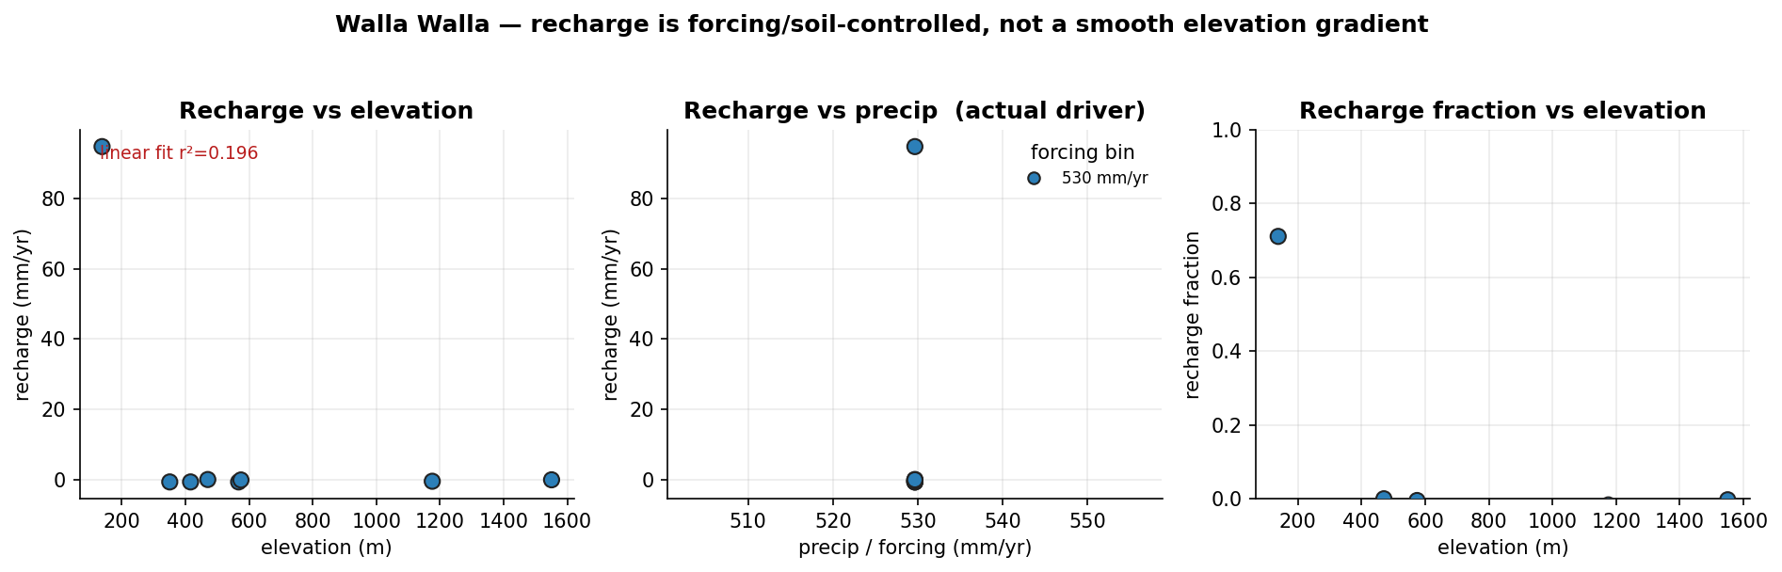
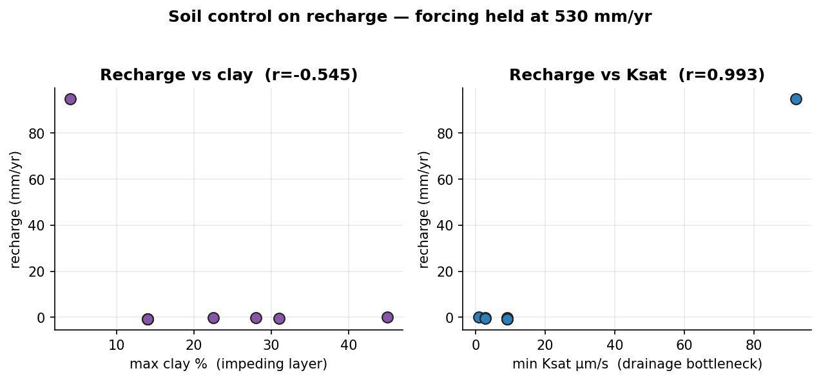
Walla Walla — execution & results
execution: 4/4 columns succeeded · ~7 min each (~15 s clone per column, shared executable)

Slide 16
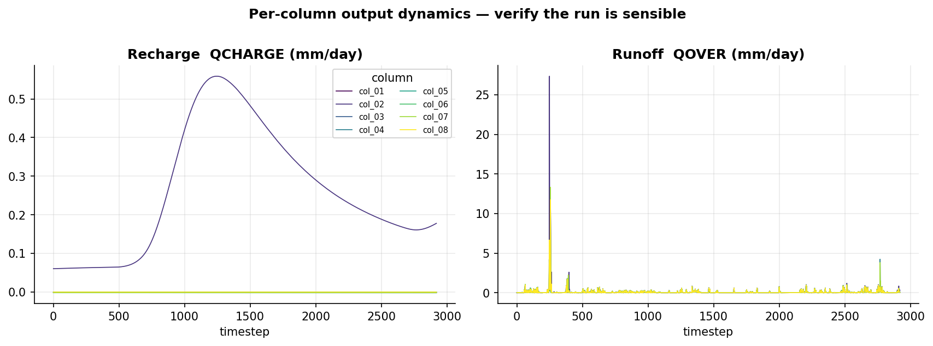
Walla Walla — results (continued)

Slide 17
Walla Walla — analyzer interpretation
finding: precip is quantized to 1 value(s) [530] mm/yr — coarse DATM forcing, NOT elevation-resolved
finding: linear elevation fit is weak (r2=0.196) — the elevation 'gradient' is not a reliable summary
finding: soil control (forcing held at 530 mm/yr, 8 columns): strongest predictor = recharge_vs_ksat_min (r=0.993)

Slide 18
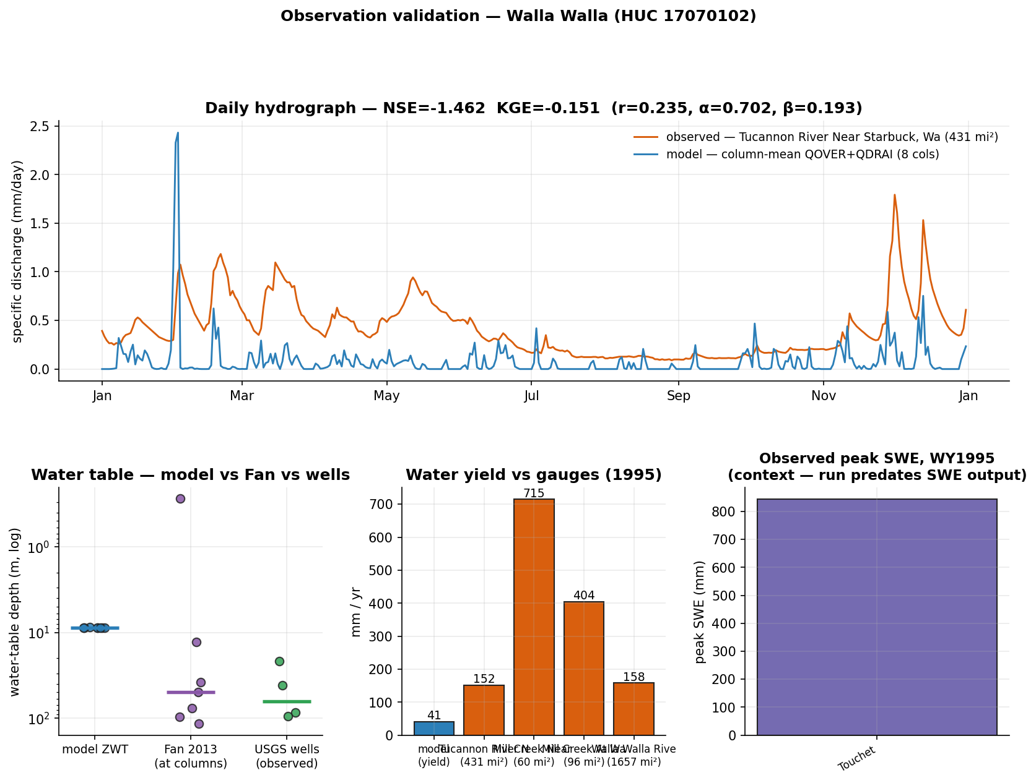
Walla Walla — evaluation vs observations
what could be compared honestly, and what still blocks rigorous validation
in-domain obs: SNOTEL 2 · stream gages 159 · GW wells 200 (4/10 sampled have records)
✓ COMPARED — water-table depth: model ZWT median 8.8 m vs Fan 43.71 m vs observed wells 63.94 m (median; n=4)
✓ COMPARED — streamflow (water yield): modeled yield 40.7 mm/yr vs observed specific discharge 151.6, 714.9, 404.3, 158.1 mm/yr (Tucannon River Near Starbuck, Wa, Mill Creek Near Walla Walla, Wa, Mill Creek At Walla Walla, Wa, Walla Walla River Near Touchet, Wa)
✓ COMPARED — streamflow (daily hydrograph): NSE=-1.462, KGE=-0.151 (r=0.235, variability α=0.702, bias β=0.193) — column-mean QOVER+QDRAI vs gauge
· context-only — snow water equivalent: observed peak SWE 843–843 mm across stations vs column forcing precip 530 mm/yr — this run predates SWE (H2OSNO) in the history output — needs: snow/SWE history output (default since 2026-07) + elevation-downscaled forcing

Slide 19
Case 4 — Controlled soil sweep
7 uniform-soil treatments (clay05, clay10, clay18, clay27, clay35, clay45, clay55) at one site — forcing, vegetation and location held identical
“Controlled experiment: how does soil texture (clay content) control the runoff/recharge partitioning?”
design: conceptual archetype — vary ONE factor (clay 5→55%), hold everything else fixed; the cleanest isolation of soil control

Slide 20
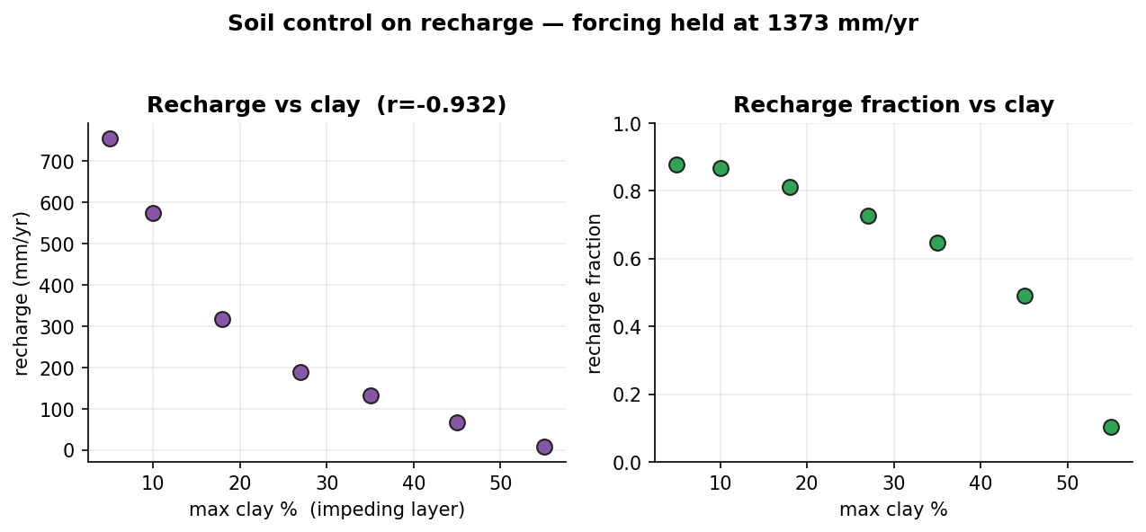
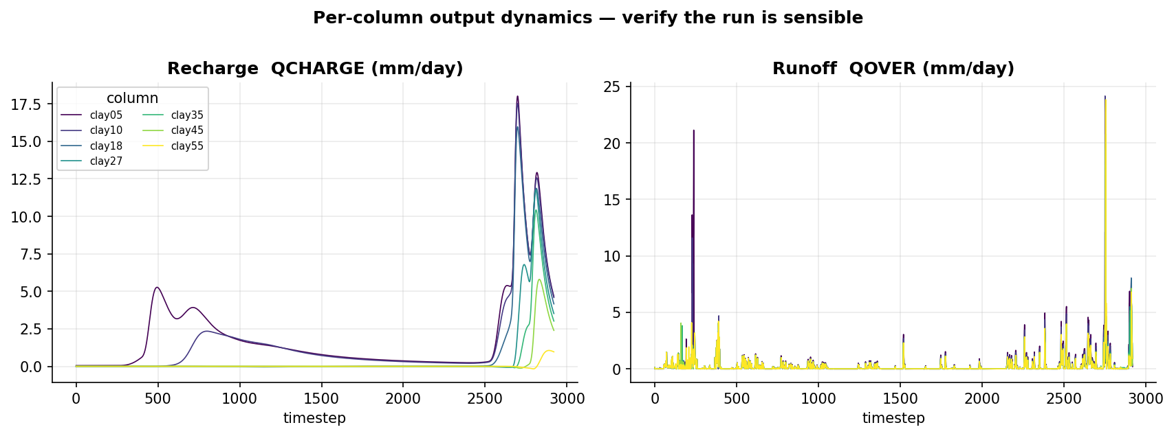
Controlled soil sweep — execution & results
execution: 7/7 columns succeeded · ~3 min each (~15 s clone per column, shared executable)

Slide 21
Controlled soil sweep — analyzer interpretation
finding: soil control (forcing held at 1373 mm/yr, 7 columns): strongest predictor = recharge_vs_clay_max (r=-0.932)

Slide 22
Cross-study synthesis
same framework, three experiments — the control on recharge/runoff partitioning depends on climate
study | columns | forcing (mm/yr) | recharge (mm/yr) | strongest control
Naches | 10 | 793, 1373 | -0.1 → 648.3 | recharge_vs_clay_max (r=-0.877)
Naches | 8 | 793, 1373 | -0.0 → 648.3 | recharge_vs_clay_max (r=-0.906)
Walla Walla | 8 | 530 | -0.7 → 94.8 | recharge_vs_ksat_min (r=0.993)
Controlled soil sweep | 7 | 1373 | 8.6 → 754.7 | recharge_vs_clay_max (r=-0.932)
wet basin: recharge is CLAY-limited — water is ample; the impeding layer decides
dry basin: recharge is Ksat-limited (threshold) — only the most permeable soil recharges
controlled sweep: confirms causality: clay 5→55% collapses recharge 755→9 mm/yr with everything else fixed

