Slide 1
From a question to a validated simulation campaign
Multi-agent LLM framework on NERSC Perlmutter — 6 executed case studies
question → plan → sampling → per-column ELM runs → analysis → observation validation
generated 2026-07-05 from workflow_outputs/

Slide 2
Case 1 — Naches
HUC 17030002 · 2860.6 km² · elevation 352.0–1977.4 m
“Partitioning of runoff/recharge in the Naches sub-watershed (HUC8 17030002), validate with observations”
goal: Mechanistic: quantify how the representative Naches profile partitions incoming water among ET, surface runoff (QOVER) and sub-surface drainage/recharge (QDRAI), and how that partitioning shifts with water availability (forcing period)
goal: Validation: compare ELM water balance against integrated streamflow at in-HUC USGS gages, SNOTEL SWE as snow driver, and Fan-2013 WTD as deep-storage context — MOST of which is blocked by current execution limits
sampling: N=8 — stratified (elevation bands for surface-data sampling) + forcing-period treatment on a representative column
why N: 4 columns to span the four elevation bands and sample whatever per-column surface-data (PFT/default soil) heterogeneity exists across the basin under baseline forcing (NOT an elevation/climate test — forcing is uniform). Plus a forcing-period sweep (wet + drought = 2 extra periods) applied to two representative columns (1 mid-elevation valley-influenced, 1 upland) = 4 more, to isolate the only usable mechanistic lever: water-availability control on partitioning. Total 8. A denser grid is unjustified because neither elevation-climate nor soil texture can be resolved.
feasibility: partial — the elevation/snow-driven partitioning mechanism (the brief's stated primary control) is NOT representable, and the observation-based validation goal is largely blocked. Only the soil-profile water-balance partitioning and its forcing-period sensitivity are answerable.
not answerable: Elevation / snow-regime control on partitioning (the brief's stated primary driver) — needs elevation-downscaled forcing
not answerable: Validation against SNOTEL SWE / melt timing — needs snow/SWE history output AND elevation-downscaled forcing

Slide 3
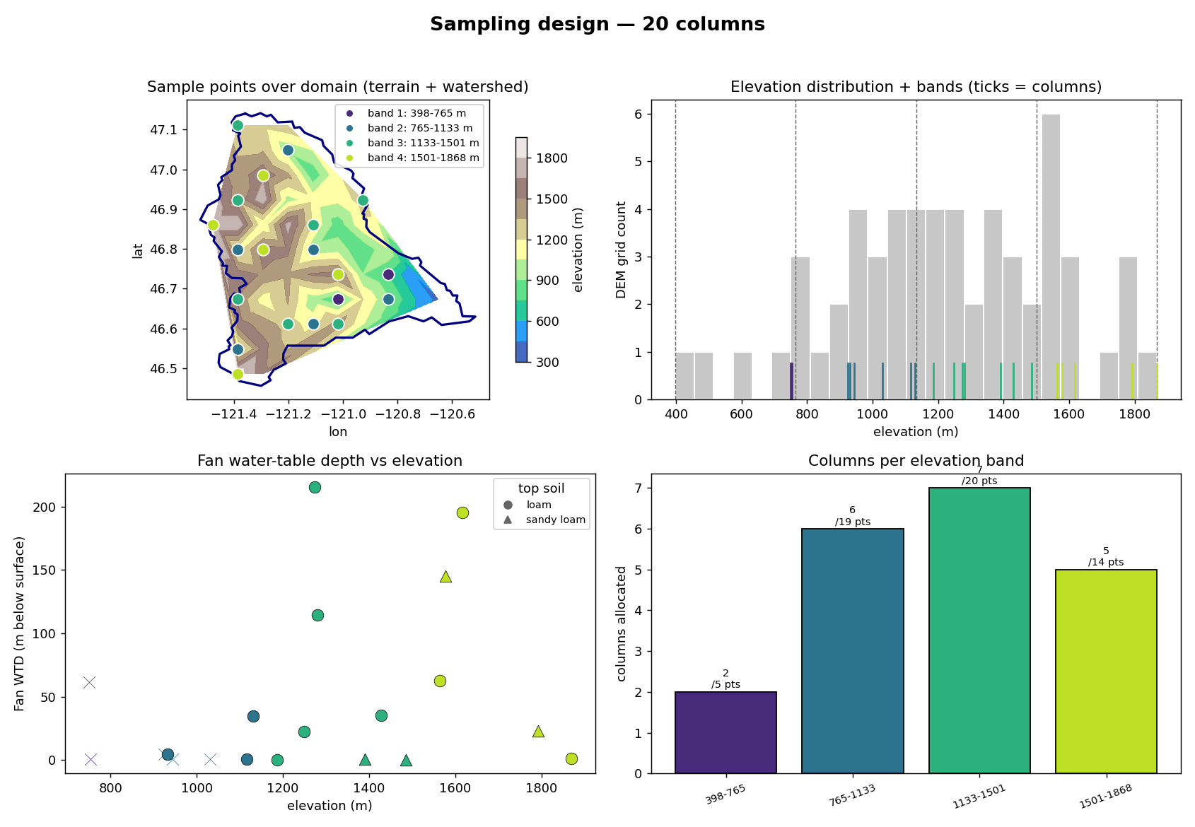
Naches — sampling design (Tier-2 expander)
Panels — top-left: chosen columns on the DEM, coloured by elevation band, navy = watershed boundary. top-right: histogram of the basin's DEM sample (grey = how much terrain sits at each elevation); dashed lines = the equal-interval band edges; coloured ticks = the chosen columns' elevations. bottom-left: Fan (2013) equilibrium water-table depth at each column. bottom-right: columns allocated per band — proportional to the band's share of the basin's DEM points (annotated n / points), minimum 1 per band.

Slide 4
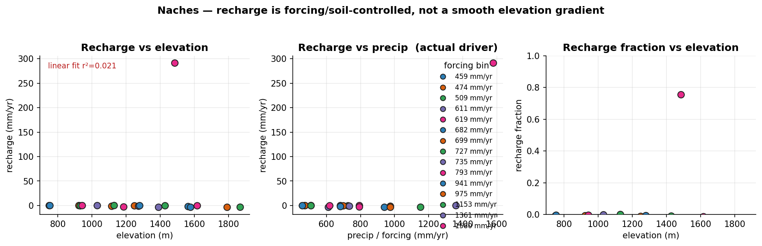
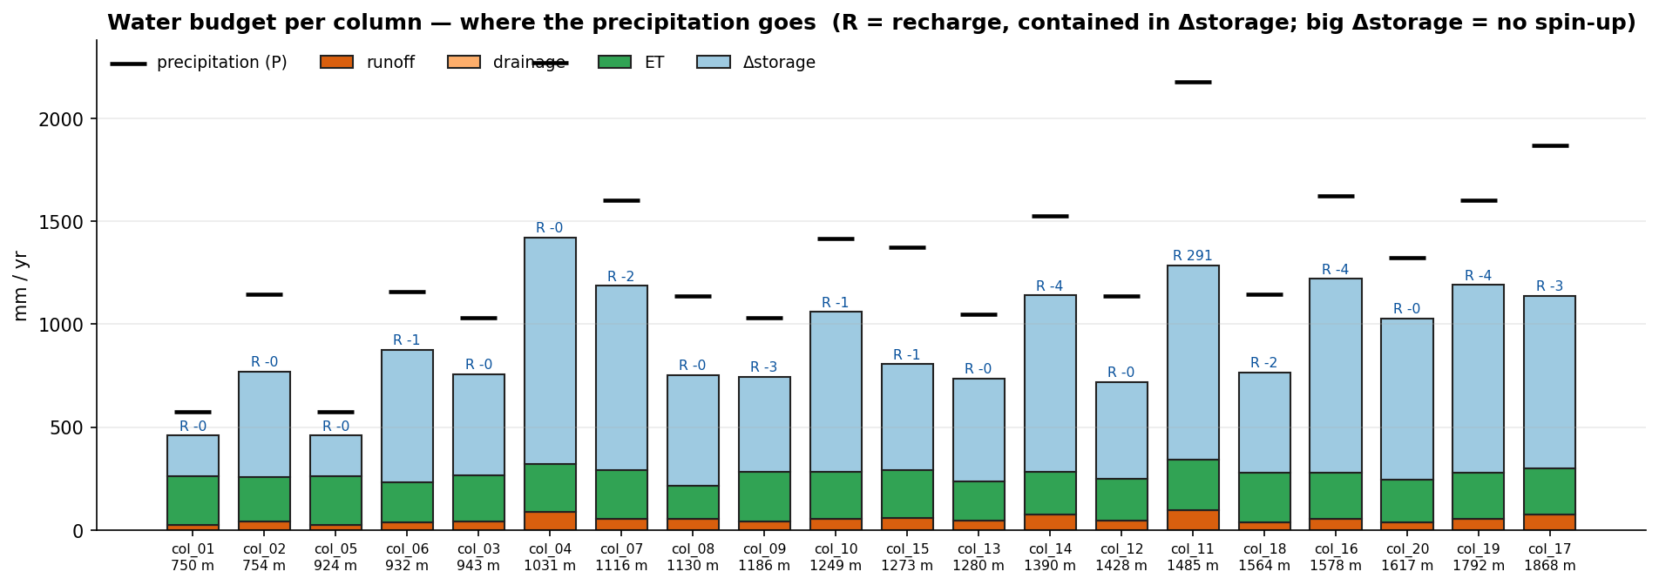
Naches — execution & results
execution: 20 columns ran as one batch job (concurrent) in 58 min
Definitions — recharge = ELM QCHARGE (flux from the soil column to the water table); runoff = QOVER (surface runoff); recharge fraction = QCHARGE/(QCHARGE+QOVER); WTD = ZWT (the column's own water-table depth); forcing = NLDAS-2 (0.125°, ~12 km) precip at the column.

Slide 5
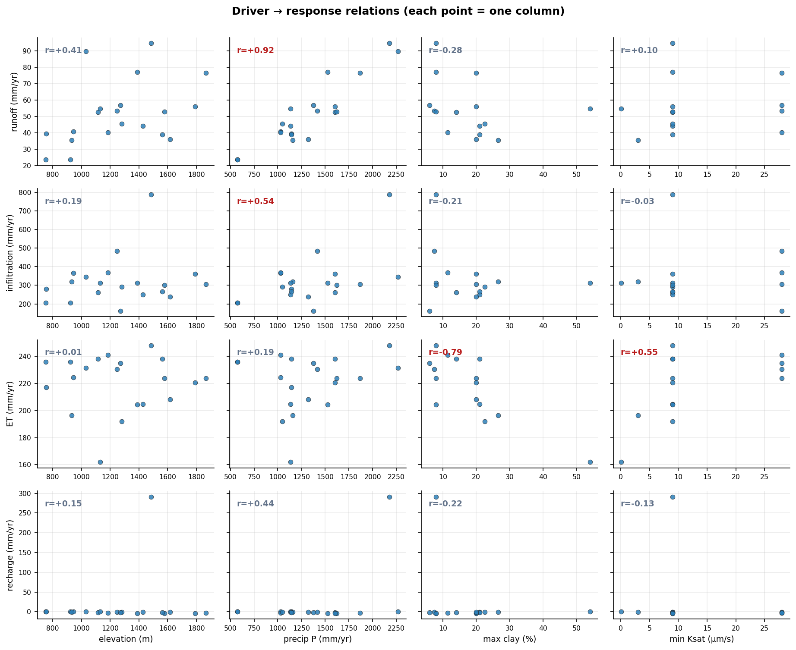
Naches — results (continued)

Slide 6
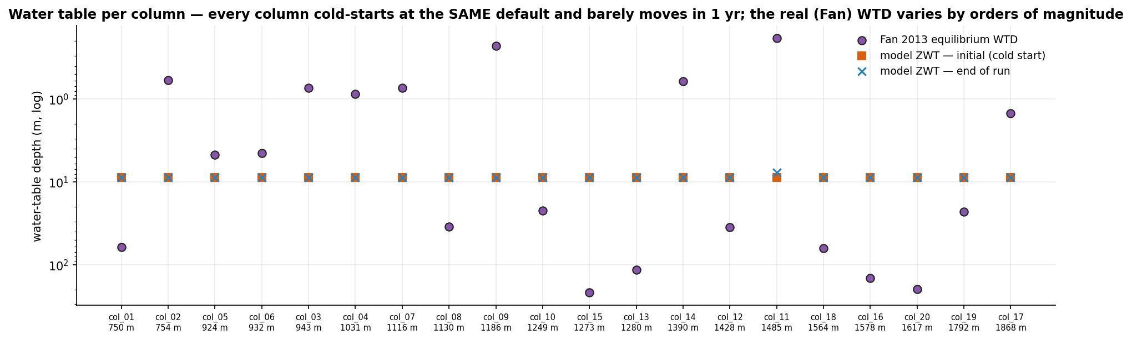
Naches — results (continued)

Slide 7
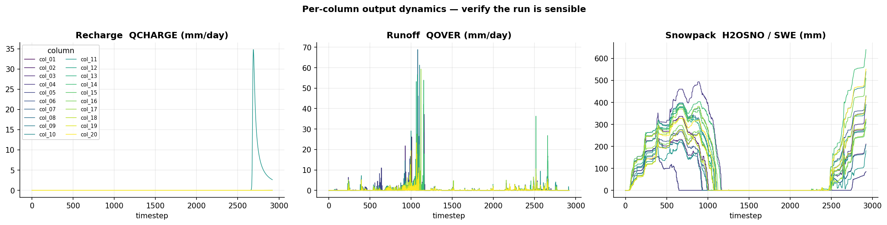
Naches — results (continued)

Slide 8
Naches — driver × response (Pearson r)
all 20 columns · correlations across ALL columns — when precip is quantized, elevation and precip are confo
response | elevation | precip | clay | Ksat
runoff | +0.41 | +0.78 | -0.28 | +0.10
infiltration | +0.19 | +0.66 | -0.21 | -0.03
et | +0.01 | +0.47 | -0.79 | +0.55
recharge | +0.15 | +0.61 | -0.22 | -0.13
recharge_fraction | +0.07 | +0.57 | -0.17 | -0.15

Slide 9
Naches — analyzer interpretation
Answer
• In the representative Naches profiles the model sends incoming water almost entirely to ET and soil storage: surface runoff is only ~3–5% of P (23–95 mm/yr) and sub-surface recharge is effectively nil (−0.2 to −3.6 mm/yr in 19 of 20 columns; one anomalous column shows +291 mm/yr). This partitioning tracks precipitation (recharge–P r=0.61), not elevation (r=0.15).
Why
• Precip ↑ → runoff ↑ (r=0.78) but stays 3–5% of P → most water infiltrates, not overland.
• Recharge ≈0 with QDRAI=0 everywhere → deep drainage inactive; no groundwater coupling.
• Clay ↑ → ET ↓ (r=−0.79), ksat ↑ → ET ↑ (r=0.55) → low-conductivity layers trap water in root zone.
• Storage_change 199–1098 mm and closure residuals 117–888 mm/yr → column not equilibrated (no spin-up).
Trust
• Observations contradict the model: modeled yield 64.9 vs 1427 mm/yr, NSE=−1.11, ZWT 8.8 m vs 15.2 m wells, SWE 154–640 vs 645–1981 mm. Top caveat: single unrouted, un-spun-up columns can't reproduce integrated streamflow or deep water table.
Next
• Add spin-up to close the storage/residual gap before trusting recharge sign.
• Route + area-weight columns to a gage for a valid yield/hydrograph test.

Slide 10
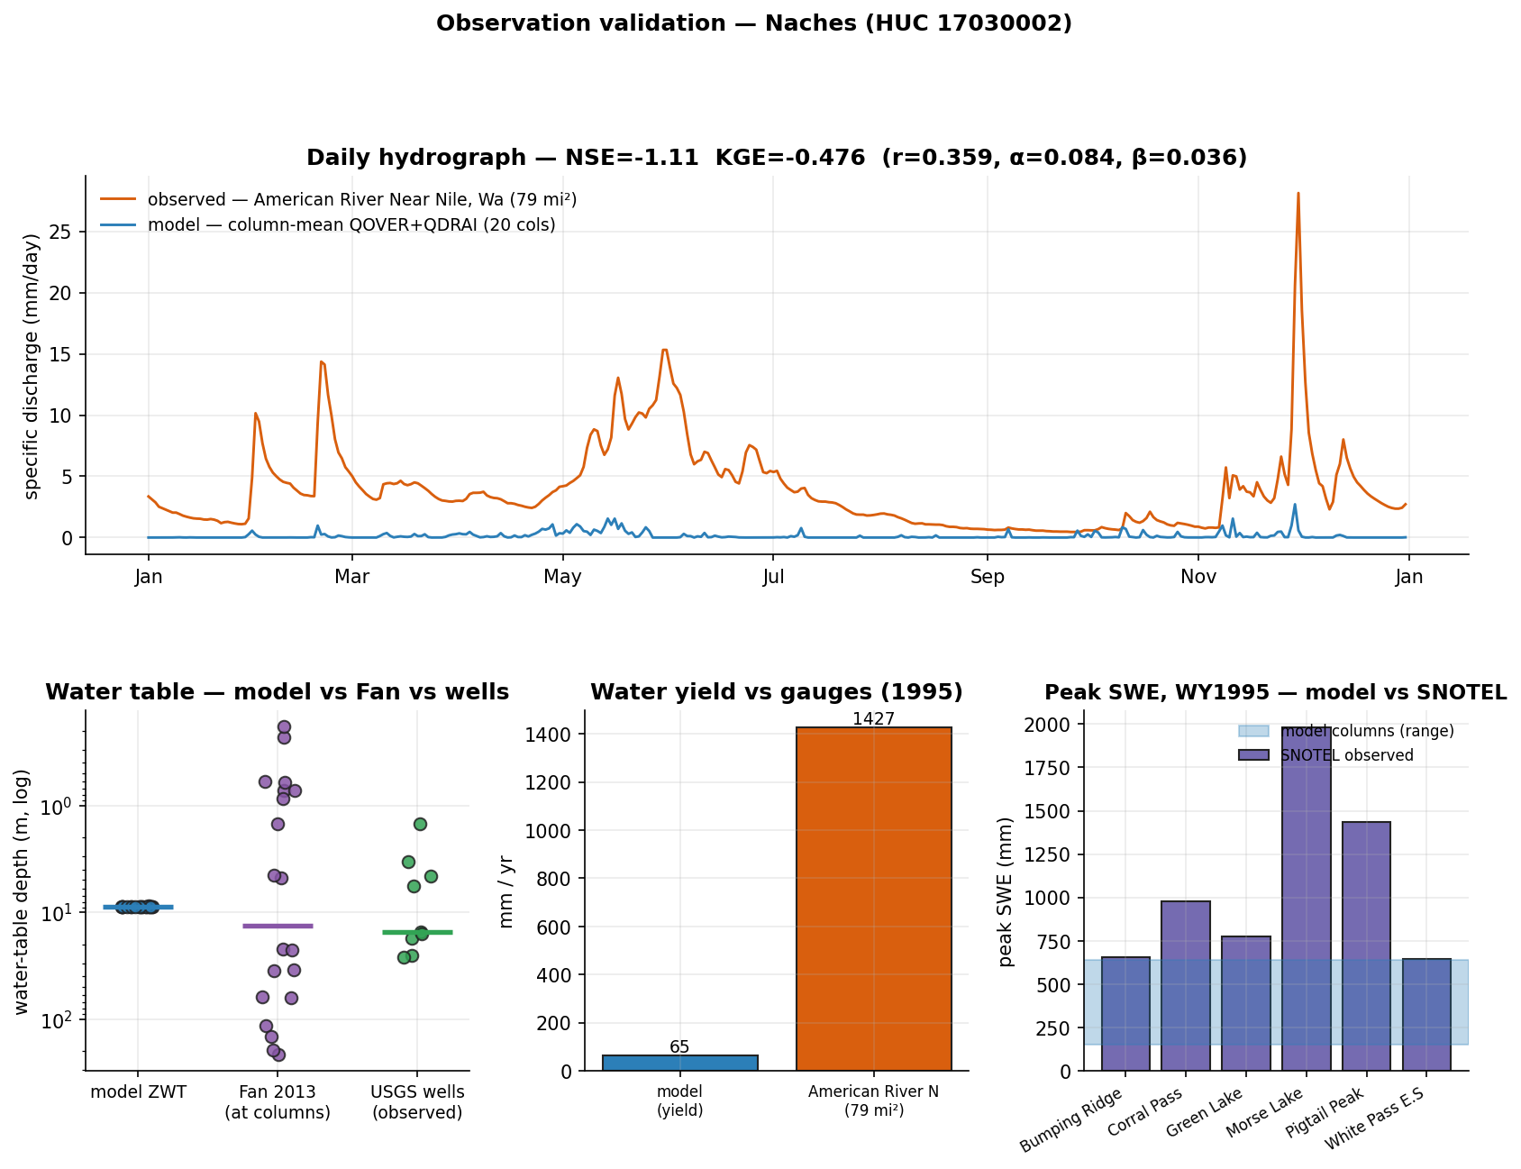
Naches — evaluation vs observations
what could be compared honestly, and what still blocks rigorous validation
in-domain obs: SNOTEL 6 · stream gages 93 · GW wells 200 (9/10 sampled have records)
✓ COMPARED — water-table depth: model ZWT median 8.8 m vs Fan 13.46 m vs observed wells 15.23 m (median; n=9)
✓ COMPARED — streamflow (water yield): modeled yield 64.9 mm/yr vs observed specific discharge 1426.8 mm/yr (American River Near Nile, Wa)
✓ COMPARED — streamflow (daily hydrograph): NSE=-1.11, KGE=-0.476 (r=0.359, variability α=0.084, bias β=0.036) — column-mean QOVER+QDRAI vs gauge
✓ COMPARED — snow water equivalent: model peak SWE 154–640 mm across columns vs observed 645–1981 mm across stations (coarse uniform forcing — expect underestimation)
Metrics — NSE: 1=perfect, 0=no better than the observed mean, <0 worse than the mean. KGE: 1=perfect; components r (timing correlation), α (variability ratio σm/σo), β (volume ratio μm/μo). Specific discharge = gauge flow ÷ drainage area, making a gauge comparable to 1-D columns (mm/yr or mm/day).

Slide 11
Case 2 — Naches
HUC 17030002 · 2860.6 km² · elevation 352.0–1977.4 m
“Partitioning of runoff/recharge in the Naches sub-watershed (HUC8 17030002), validate with observations”
goal: Mechanistic: quantify how the representative Naches profile partitions incoming water among ET, surface runoff (QOVER) and sub-surface drainage/recharge (QDRAI), and how that partitioning shifts with water availability (forcing period)
goal: Validation: compare ELM water balance against integrated streamflow at in-HUC USGS gages, SNOTEL SWE as snow driver, and Fan-2013 WTD as deep-storage context — MOST of which is blocked by current execution limits
sampling: N=8 — stratified (elevation bands for surface-data sampling) + forcing-period treatment on a representative column
why N: 4 columns to span the four elevation bands and sample whatever per-column surface-data (PFT/default soil) heterogeneity exists across the basin under baseline forcing (NOT an elevation/climate test — forcing is uniform). Plus a forcing-period sweep (wet + drought = 2 extra periods) applied to two representative columns (1 mid-elevation valley-influenced, 1 upland) = 4 more, to isolate the only usable mechanistic lever: water-availability control on partitioning. Total 8. A denser grid is unjustified because neither elevation-climate nor soil texture can be resolved.
feasibility: partial — the elevation/snow-driven partitioning mechanism (the brief's stated primary control) is NOT representable, and the observation-based validation goal is largely blocked. Only the soil-profile water-balance partitioning and its forcing-period sensitivity are answerable.
not answerable: Elevation / snow-regime control on partitioning (the brief's stated primary driver) — needs elevation-downscaled forcing
not answerable: Validation against SNOTEL SWE / melt timing — needs snow/SWE history output AND elevation-downscaled forcing

Slide 12
Naches — sampling design (Tier-2 expander)
Panels — top-left: chosen columns on the DEM, coloured by elevation band, navy = watershed boundary. top-right: histogram of the basin's DEM sample (grey = how much terrain sits at each elevation); dashed lines = the equal-interval band edges; coloured ticks = the chosen columns' elevations. bottom-left: Fan (2013) equilibrium water-table depth at each column. bottom-right: columns allocated per band — proportional to the band's share of the basin's DEM points (annotated n / points), minimum 1 per band.

Slide 13
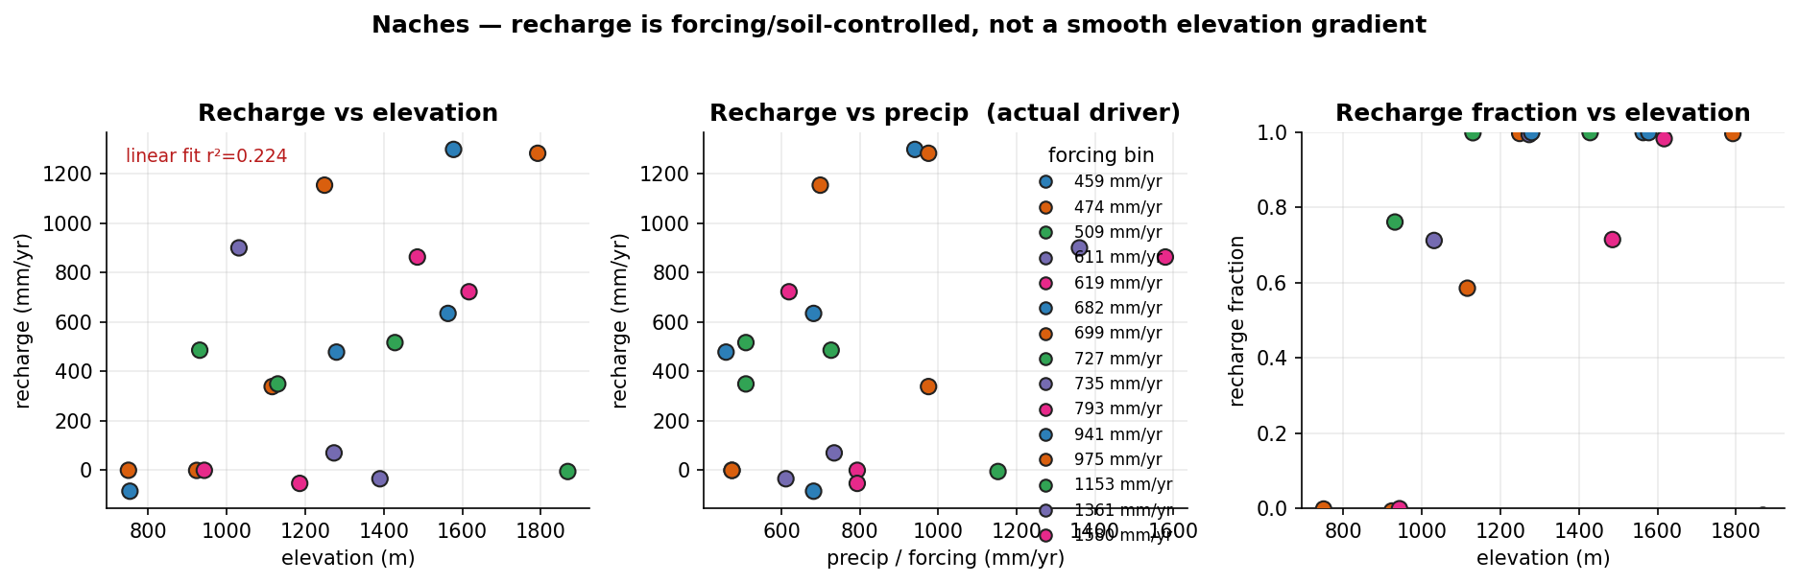
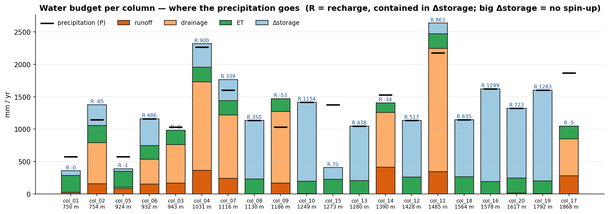
Naches — execution & results
execution: 20 columns ran as one batch job (concurrent) in 61 min
Definitions — recharge = ELM QCHARGE (flux from the soil column to the water table); runoff = QOVER (surface runoff); recharge fraction = QCHARGE/(QCHARGE+QOVER); WTD = ZWT (the column's own water-table depth); forcing = NLDAS-2 (0.125°, ~12 km) precip at the column.

Slide 14
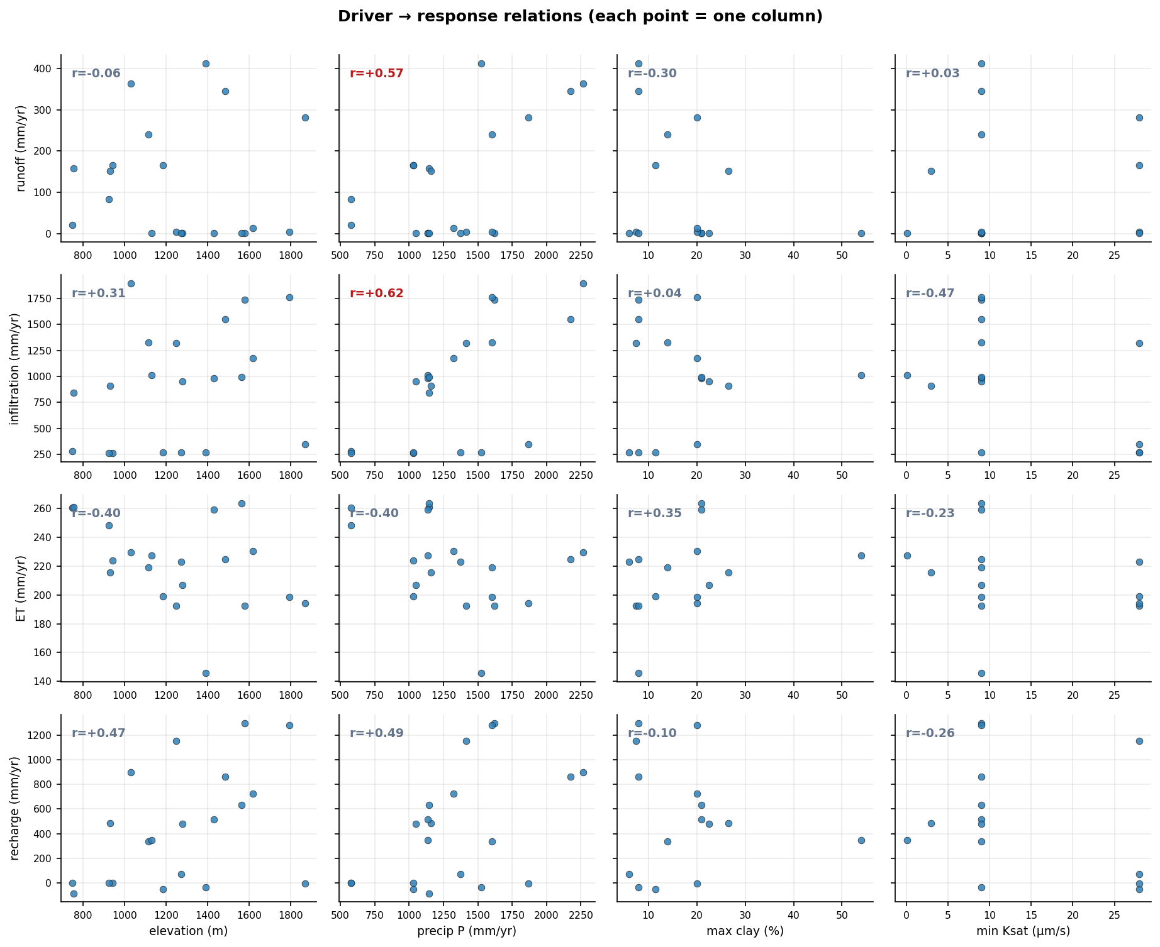
Naches — results (continued)

Slide 15
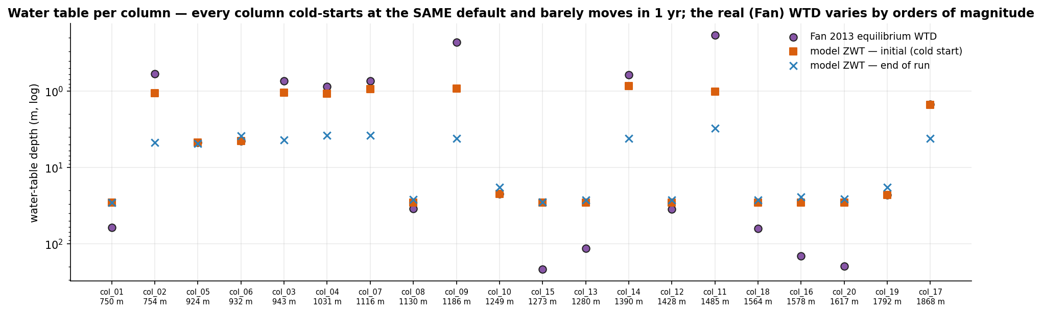
Naches — results (continued)

Slide 16
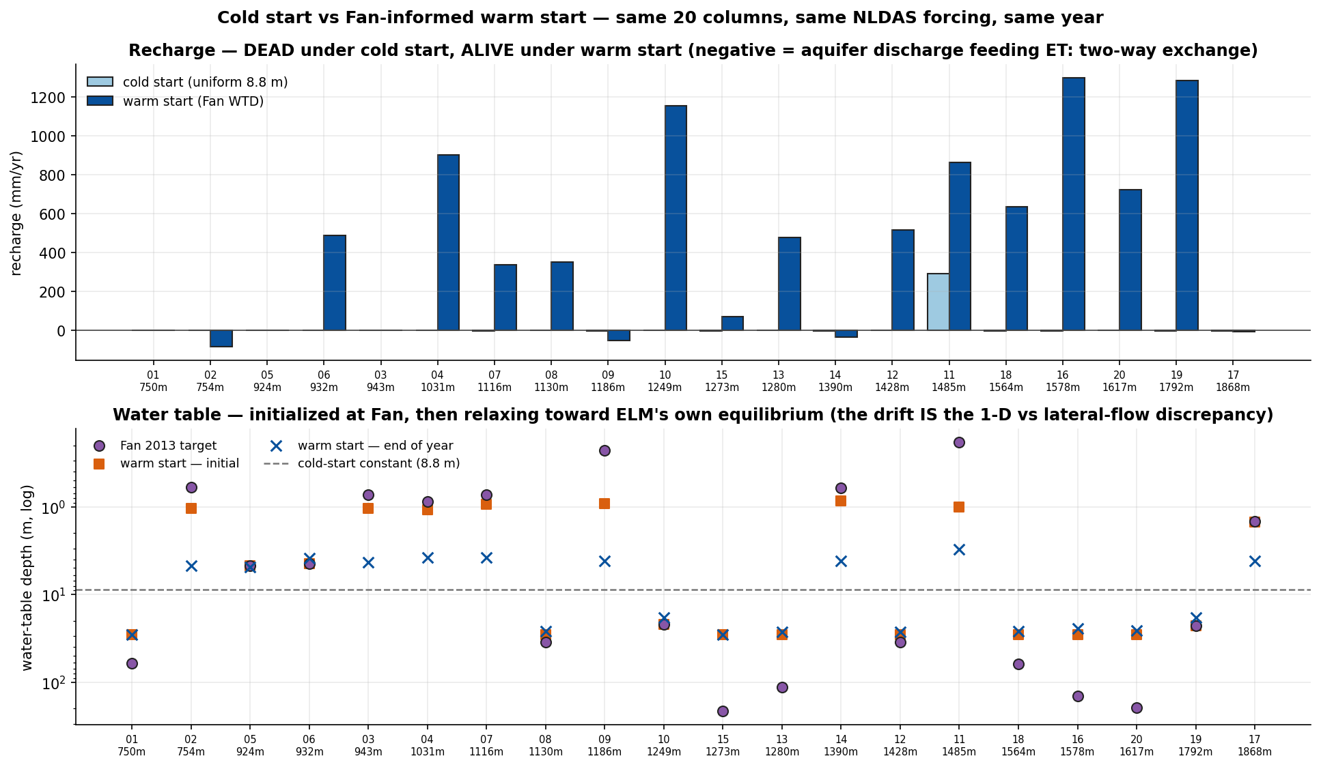
Naches — results (continued)

Slide 17
Naches — driver × response (Pearson r)
all 20 columns · correlations across ALL columns — when precip is quantized, elevation and precip are confo
response | elevation | precip | clay | Ksat
runoff | -0.06 | +0.61 | -0.30 | +0.03
infiltration | +0.31 | +0.50 | +0.04 | -0.47
et | -0.40 | -0.20 | +0.35 | -0.23
recharge | +0.47 | +0.37 | -0.10 | -0.26
recharge_fraction | +0.46 | +0.06 | +0.25 | -0.41

Slide 18
Naches — analyzer interpretation
Answer
• The representative Naches profiles are strongly infiltration-dominated: surface runoff is only 0–16% of precipitation (median ~0.14, max 0.27 at col_14), while sub-surface drainage + recharge take the majority (drainage 0.55–0.88 of P where the water table is shallow; recharge 0.4–0.8 of P where it is deep). ET is nearly invariant (~190–265 mm/yr) regardless of input.
Why
• Higher precip → more infiltration (r=0.50) and more runoff (r=0.61), but runoff stays a small share → deep soils absorb most input.
• Shallow water table (col_02,03,09,14,17: ZWT 3.6–4.8 m) → QDRAI dominates (0.55–1.07 of P) and recharge goes negative → lateral drainage bleeds storage.
• Deep water table (ZWT ~20–29 m) → drainage≈0, recharge captures 0.5–0.8 of P → water banks as storage, no outlet.
• More clay → less runoff (r=−0.30); low-ksat col_08 (ksat 0.1, clay 54%) still infiltrates 0.89 of P → clay throttles surface flow, not deep percolation here.
Trust
• Model ZWT (median 12.4 m) brackets Fan (13.5 m) and wells (15.2 m); SWE is underestimated (238–1000 vs obs 645–1981 mm) from coarse forcing. Top caveat: no spin-up — enormous storage_change (up to +1427 mm) and closure residuals (col_17 +1148, col_15 +970 mm) mean recharge/storage terms are non-equilibrated, not steady-state fluxes.
Next
• Run multi-decade spin-up, then re-derive recharge — closes the storage imbalance driving the residuals.
• Add routing/aggregation to an in-domain gauge to convert QOVER+QDRAI into validatable streamflow.

Slide 19
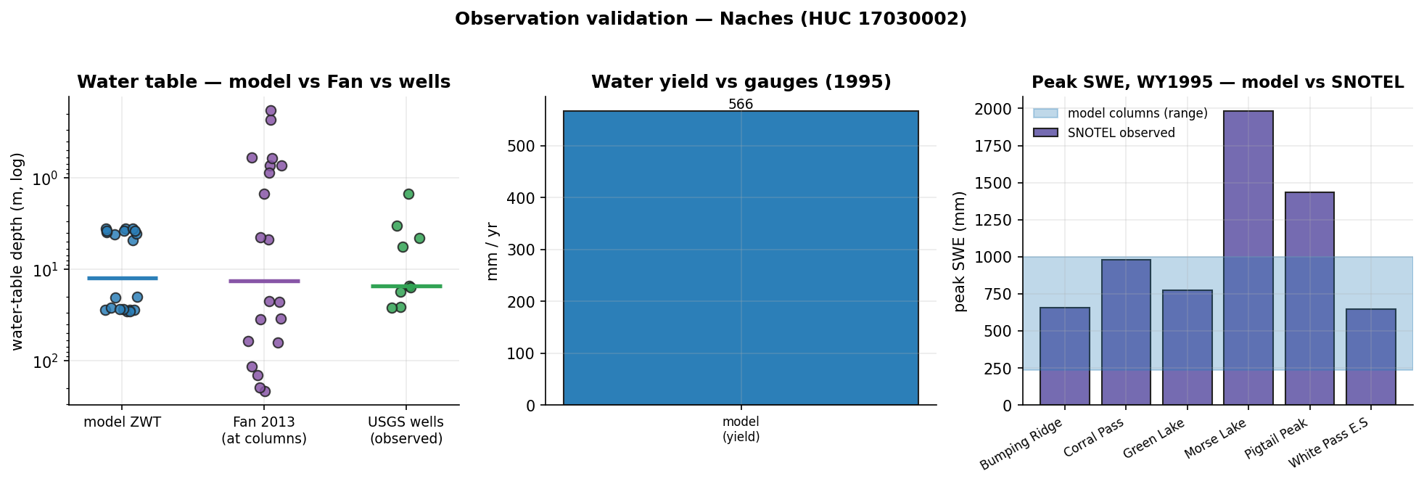
Naches — evaluation vs observations
what could be compared honestly, and what still blocks rigorous validation
in-domain obs: SNOTEL 6 · stream gages 93 · GW wells 200 (9/10 sampled have records)
✓ COMPARED — water-table depth: model ZWT median 12.39 m vs Fan 13.46 m vs observed wells 15.23 m (median; n=9)
· context-only — streamflow (water yield): no in-domain gauge had 1995 daily records — needs: runoff routing / column aggregation
· context-only — streamflow (daily hydrograph): daily comparison unavailable
✓ COMPARED — snow water equivalent: model peak SWE 238–1000 mm across columns vs observed 645–1981 mm across stations (coarse uniform forcing — expect underestimation)
Metrics — NSE: 1=perfect, 0=no better than the observed mean, <0 worse than the mean. KGE: 1=perfect; components r (timing correlation), α (variability ratio σm/σo), β (volume ratio μm/μo). Specific discharge = gauge flow ÷ drainage area, making a gauge comparable to 1-D columns (mm/yr or mm/day).

Slide 20
Case 3 — Naches
HUC 17030002 · 2860.6 km² · elevation 352.0–1977.4 m
“Determine the partitioning of runoff, infiltration, and recharge and the processes that control it across the Naches sub-watershed (HUC8 17030002, eastern Cascades, WA), and validate against observations”
goal: Mechanistic: quantify partitioning of precip+snowmelt into surface runoff, infiltration, and deep drainage (recharge) across the Naches, and attribute it to elevation/snow regime, soil layering, and ET
goal: Validation: confront simulated SWE against SNOTEL and integrated runoff against USGS streamflow; treat recharge as an unvalidated water-balance residual
sampling: N=10 — stratified (elevation primary, soil-layering secondary) with validation columns pinned to observation sites
why N: 4 elevation bands x 2 soil contrasts = 8 to span the dominant snow-regime gradient and the infiltration-vs-recharge soil control, +2 replicates at the rain-snow transition (bands 2-3) where partitioning is most sensitive. Soil kept to 2 levels because only point SSURGO exists (gridded soil is a gap).

Slide 21
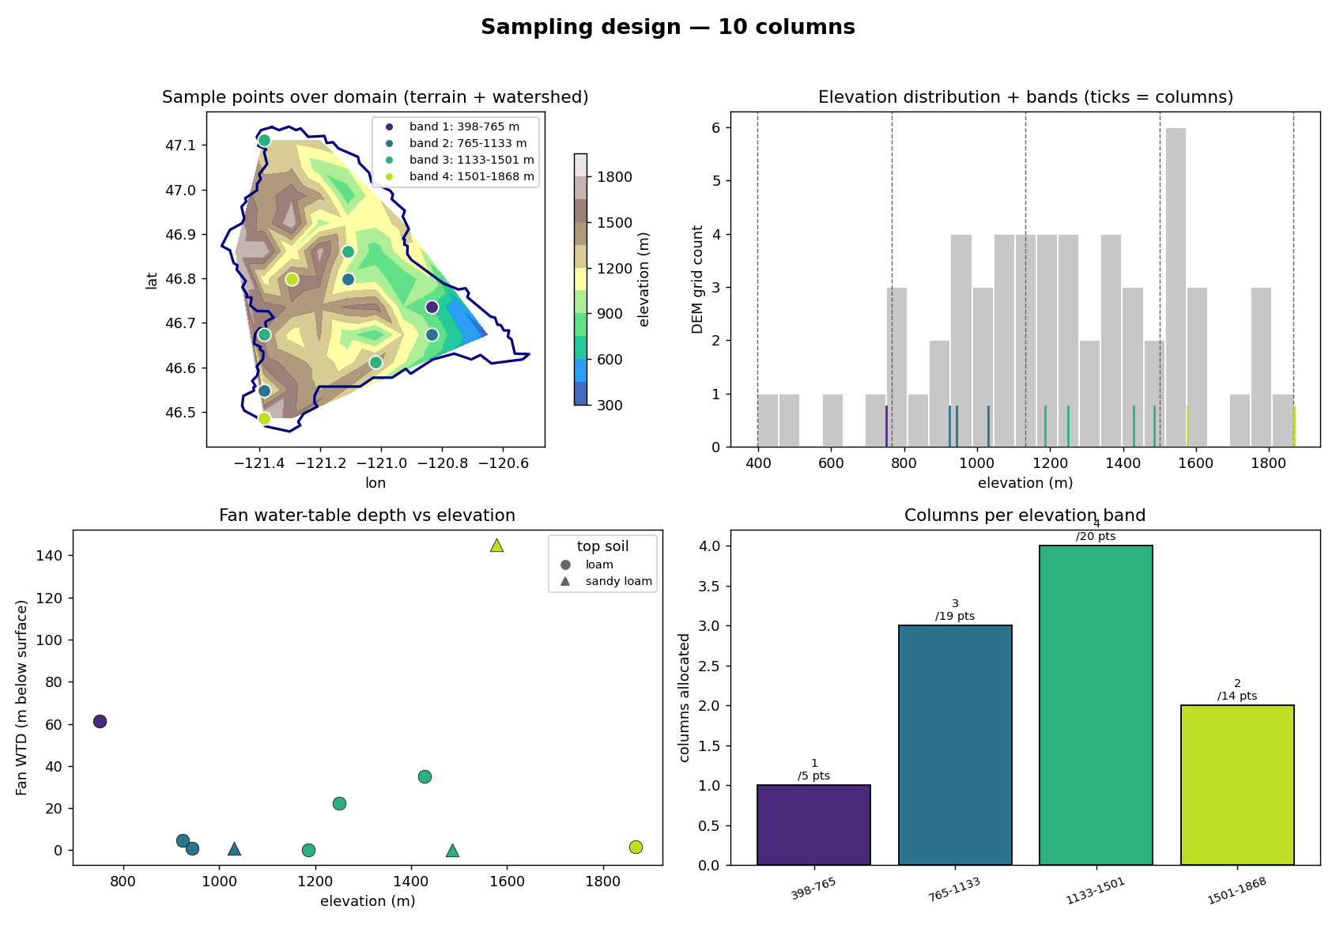
Naches — sampling design (Tier-2 expander)
Panels — top-left: chosen columns on the DEM, coloured by elevation band, navy = watershed boundary. top-right: histogram of the basin's DEM sample (grey = how much terrain sits at each elevation); dashed lines = the equal-interval band edges; coloured ticks = the chosen columns' elevations. bottom-left: Fan (2013) equilibrium water-table depth at each column. bottom-right: columns allocated per band — proportional to the band's share of the basin's DEM points (annotated n / points), minimum 1 per band.

Slide 22
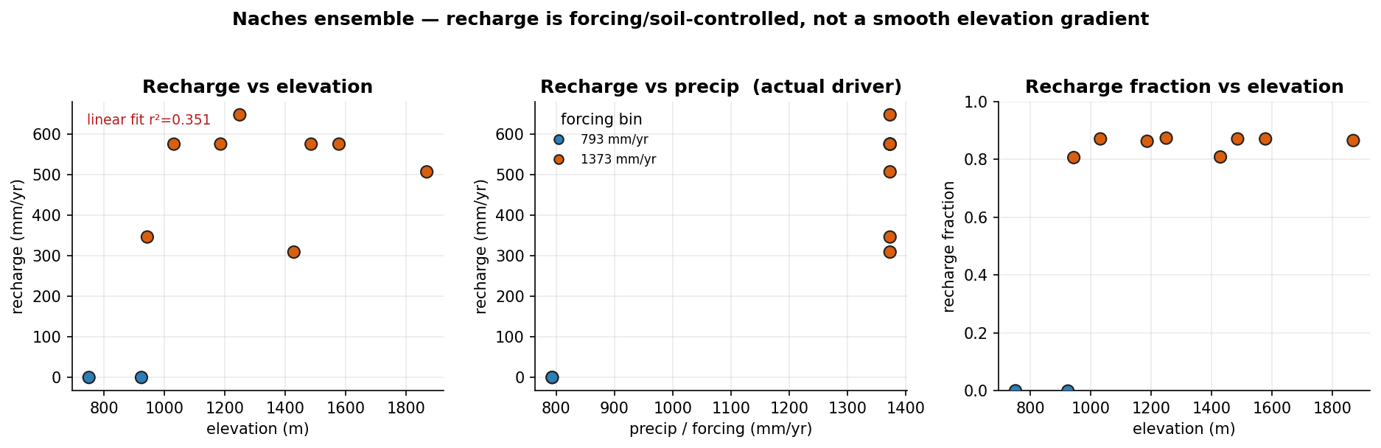
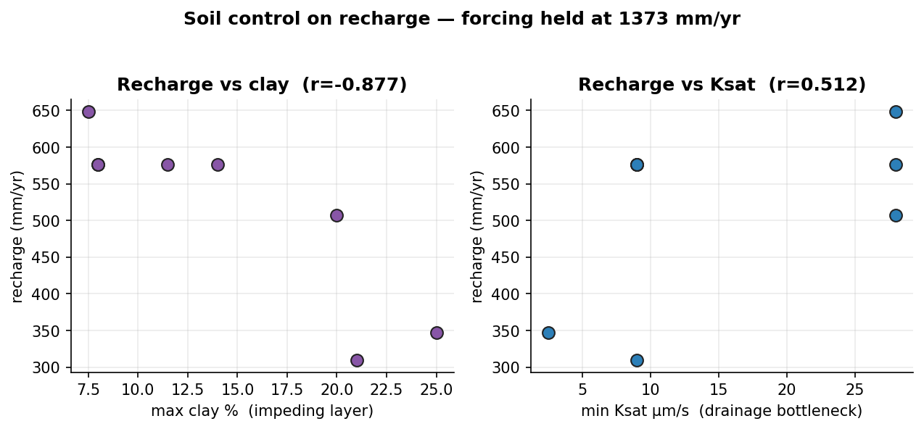
Naches — execution & results
execution: 10/10 columns succeeded · ~3 min each (~15 s clone per column, shared executable)
Definitions — recharge = ELM QCHARGE (flux from the soil column to the water table); runoff = QOVER (surface runoff); recharge fraction = QCHARGE/(QCHARGE+QOVER); WTD = ZWT (the column's own water-table depth); forcing = CLM_QIAN (Qian 2006, T62 ≈ 1.9°) precip at the column.

Slide 23
Naches — analyzer interpretation
Answer
• In the wet columns (1373 mm/yr precip) recharge dominates partitioning at 81–87% of throughput (~510–650 mm/yr) with only 13–19% runoff, whereas the two dry columns (793 mm/yr) yield essentially zero recharge and route nearly all water to runoff — so partitioning is set by precipitation forcing (r=0.897) and soil clay (r=−0.877), not elevation (weak fit, r²=0.35).
Why
• Precip step 793→1373 mm/yr -> recharge fraction −0.001→0.81+ : threshold wetness enables drainage.
• Clay-max ↑ (col_02/08, 25–31%) -> recharge drops to 310–347 mm/yr : low-Ksat base perches flow.
• Low-clay/high-Ksat (col_03/06, ≤14%) -> recharge peaks 576–648 mm/yr : open profile drains freely.
• Elevation +1000 m -> runoff only +18 mm/yr (r²=0.20) : elevation acts mainly via forcing, unresolved here.
Trust
• Modeled water yield 490 vs observed 1427 mm/yr under-predicts ~3× (headwater gauge bias); recharge is an unvalidated residual. Top caveat: precip is quantized to 2 bins, not elevation-downscaled, so the elevation gradient is artificial.
Next
• Rerun with elevation-downscaled forcing to separate snow-regime from the precip step.
• Add gridded soil + groundwater coupling to test the clay-recharge control and deep-WTD offset (8.4 vs 15 m).

Slide 24
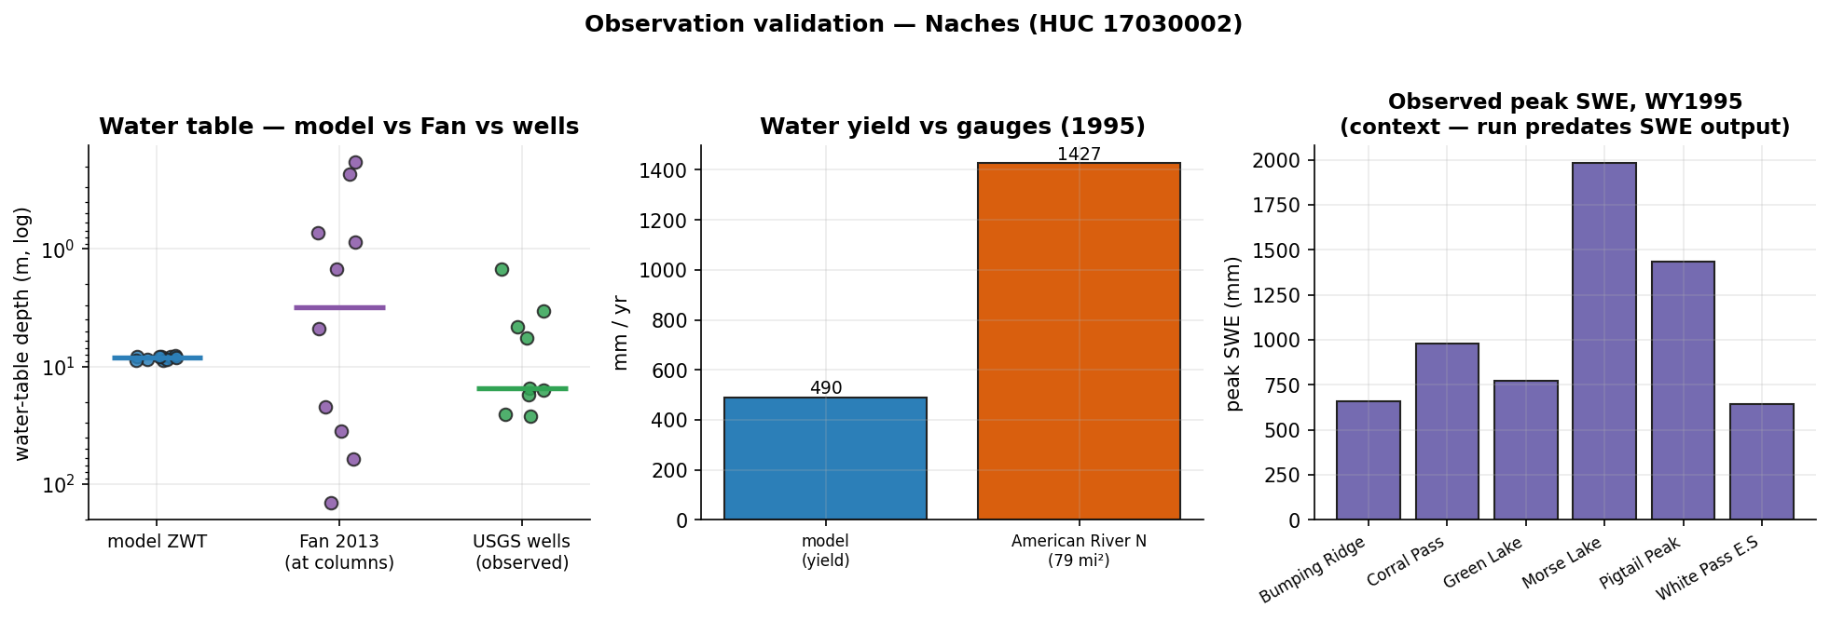
Naches — evaluation vs observations
what could be compared honestly, and what still blocks rigorous validation
in-domain obs: SNOTEL 6 · stream gages 93 · GW wells 200 (9/10 sampled have records)
✓ COMPARED — water-table depth: model ZWT median 8.37 m vs Fan 3.11 m vs observed wells 15.23 m (median; n=9)
✓ COMPARED — streamflow (water yield): modeled yield 490.1 mm/yr vs observed specific discharge 1426.8 mm/yr (American River Near Nile, Wa)
· context-only — streamflow (daily hydrograph): daily comparison unavailable
· context-only — snow water equivalent: observed peak SWE 645–1981 mm across stations vs column forcing precip 793, 1373 mm/yr — this run predates SWE (H2OSNO) in the history output — needs: snow/SWE history output (default since 2026-07) + elevation-downscaled forcing
Metrics — NSE: 1=perfect, 0=no better than the observed mean, <0 worse than the mean. KGE: 1=perfect; components r (timing correlation), α (variability ratio σm/σo), β (volume ratio μm/μo). Specific discharge = gauge flow ÷ drainage area, making a gauge comparable to 1-D columns (mm/yr or mm/day).

Slide 25
Case 4 — Naches
HUC 17030002 · 2860.6 km² · elevation 352.0–1977.4 m
“Partitioning of runoff/recharge in the Naches sub-watershed (HUC8 17030002), validate with observations”
goal: Mechanistic: quantify how the representative Naches profile partitions incoming water among ET, surface runoff (QOVER) and sub-surface drainage/recharge (QDRAI), and how that partitioning shifts with water availability (forcing period)
goal: Validation: compare ELM water balance against integrated streamflow at in-HUC USGS gages, SNOTEL SWE as snow driver, and Fan-2013 WTD as deep-storage context — MOST of which is blocked by current execution limits
sampling: N=8 — stratified (elevation bands for surface-data sampling) + forcing-period treatment on a representative column
why N: 4 columns to span the four elevation bands and sample whatever per-column surface-data (PFT/default soil) heterogeneity exists across the basin under baseline forcing (NOT an elevation/climate test — forcing is uniform). Plus a forcing-period sweep (wet + drought = 2 extra periods) applied to two representative columns (1 mid-elevation valley-influenced, 1 upland) = 4 more, to isolate the only usable mechanistic lever: water-availability control on partitioning. Total 8. A denser grid is unjustified because neither elevation-climate nor soil texture can be resolved.
feasibility: partial — the elevation/snow-driven partitioning mechanism (the brief's stated primary control) is NOT representable, and the observation-based validation goal is largely blocked. Only the soil-profile water-balance partitioning and its forcing-period sensitivity are answerable.
not answerable: Elevation / snow-regime control on partitioning (the brief's stated primary driver) — needs elevation-downscaled forcing
not answerable: Validation against SNOTEL SWE / melt timing — needs snow/SWE history output AND elevation-downscaled forcing

Slide 26
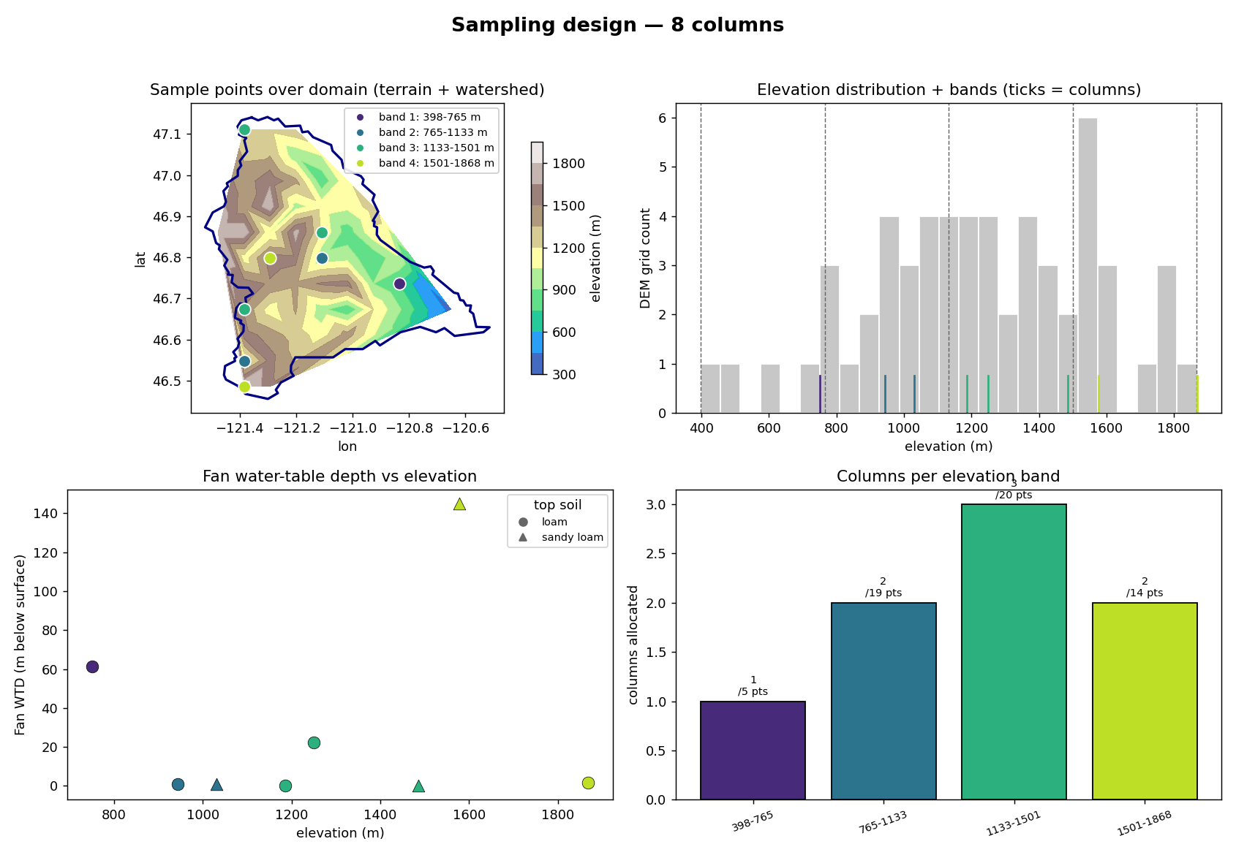
Naches — sampling design (Tier-2 expander)
Panels — top-left: chosen columns on the DEM, coloured by elevation band, navy = watershed boundary. top-right: histogram of the basin's DEM sample (grey = how much terrain sits at each elevation); dashed lines = the equal-interval band edges; coloured ticks = the chosen columns' elevations. bottom-left: Fan (2013) equilibrium water-table depth at each column. bottom-right: columns allocated per band — proportional to the band's share of the basin's DEM points (annotated n / points), minimum 1 per band.

Slide 27
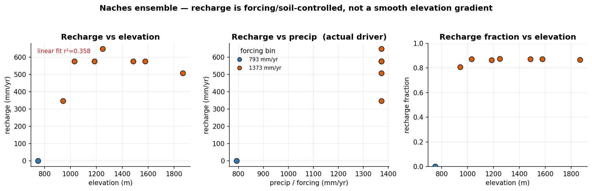
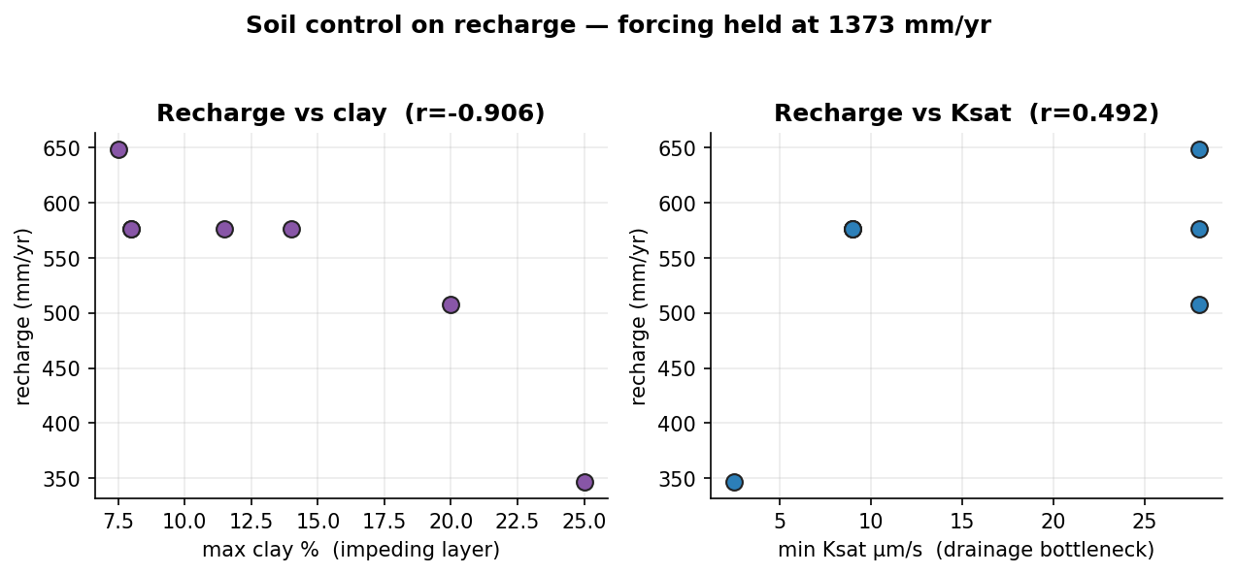
Naches — execution & results
execution: 8/8 columns succeeded · ~3 min each (~15 s clone per column, shared executable)
Definitions — recharge = ELM QCHARGE (flux from the soil column to the water table); runoff = QOVER (surface runoff); recharge fraction = QCHARGE/(QCHARGE+QOVER); WTD = ZWT (the column's own water-table depth); forcing = CLM_QIAN (Qian 2006, T62 ≈ 1.9°) precip at the column.

Slide 28
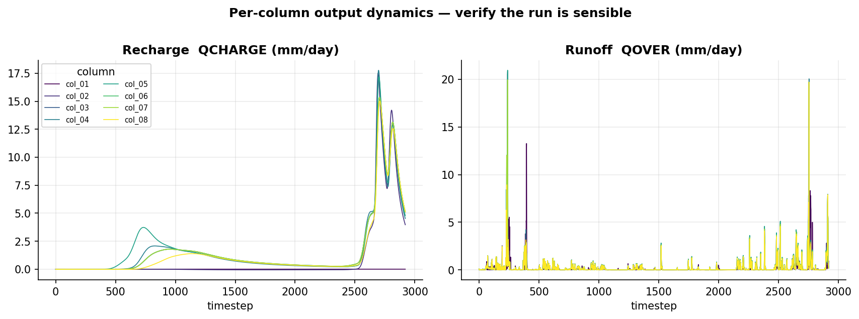
Naches — results (continued)

Slide 29
Naches — analyzer interpretation
Answer
• Under wetter forcing (1373 mm/yr) the representative Naches profile routes ~81–87% of water to sub-surface drainage/recharge and only ~13–19% to surface runoff (col_02–08), but this partitioning is soil- and forcing-controlled, not elevation-driven. Observational validation largely fails (streamflow NSE=−1.13, KGE=−0.57), so the split is a process result, not a validated basin flux.
Why
• Precip 793→1373 mm/yr -> recharge flips −0.03 to 346–648 mm/yr (r=0.908) -> deeper profile wetting.
• Higher clay_max -> lower recharge (r=−0.906) -> low-Ksat layer impedes vertical drainage.
• Dry column (col_01, 793 mm) -> recharge_fraction −0.0006, runoff ~1.0 -> ET consumes nearly all infiltration.
• Elevation fit weak (r²=0.36, uniform forcing) -> no resolvable snow/orographic control.
Trust
• Wells (obs 15.2 m vs model 8.3 m ZWT) and streamflow (557 vs 1427 mm/yr; NSE=−1.13) contradict absolute fluxes; top caveat — single unrouted, un-spun-up columns with elevation-uniform forcing cannot reproduce integrated gauge flow.
Next
• Add runoff routing + area-weighting to test the modeled 13–19% runoff share against gauge yield.
• Apply elevation-downscaled forcing + SWE output to resolve the missing snow-regime partitioning control.

Slide 30
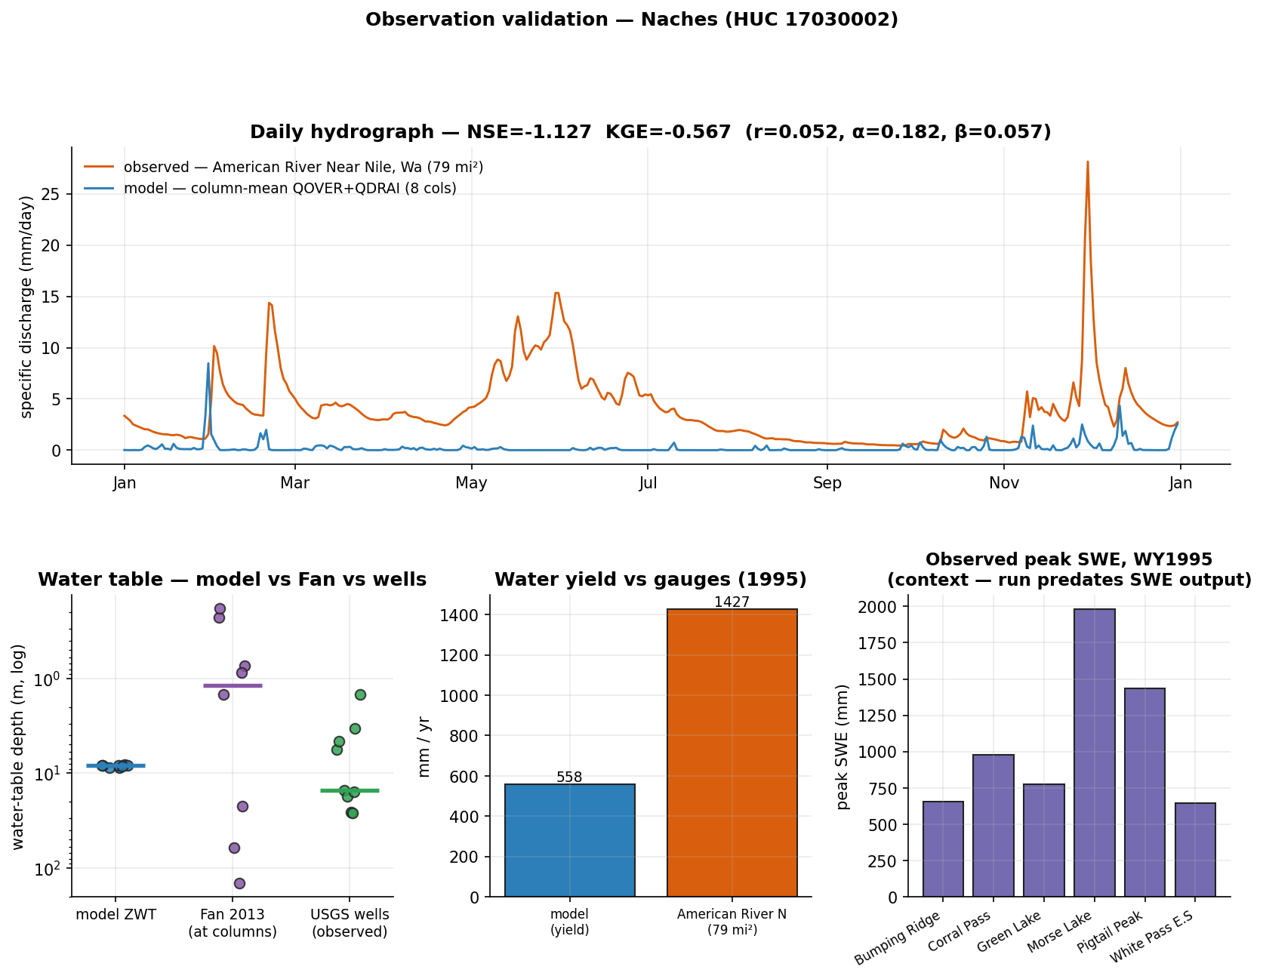
Naches — evaluation vs observations
what could be compared honestly, and what still blocks rigorous validation
in-domain obs: SNOTEL 6 · stream gages 93 · GW wells 200 (9/10 sampled have records)
✓ COMPARED — water-table depth: model ZWT median 8.31 m vs Fan 1.18 m vs observed wells 15.23 m (median; n=9)
✓ COMPARED — streamflow (water yield): modeled yield 557.8 mm/yr vs observed specific discharge 1426.8 mm/yr (American River Near Nile, Wa)
✓ COMPARED — streamflow (daily hydrograph): NSE=-1.127, KGE=-0.567 (r=0.052, variability α=0.182, bias β=0.057) — column-mean QOVER+QDRAI vs gauge
· context-only — snow water equivalent: observed peak SWE 645–1981 mm across stations vs column forcing precip 793, 1373 mm/yr — this run predates SWE (H2OSNO) in the history output — needs: snow/SWE history output (default since 2026-07) + elevation-downscaled forcing
Metrics — NSE: 1=perfect, 0=no better than the observed mean, <0 worse than the mean. KGE: 1=perfect; components r (timing correlation), α (variability ratio σm/σo), β (volume ratio μm/μo). Specific discharge = gauge flow ÷ drainage area, making a gauge comparable to 1-D columns (mm/yr or mm/day).

Slide 31
Case 5 — Walla Walla
HUC 17070102 · 4600.97 km² · elevation 169.4–1675.0 m
“Partitioning of runoff/recharge in the Walla Walla basin (HUC8 17070102), validate with observations. Thanks”
goal: Mechanistic: quantify column-scale partitioning of precipitation among surface runoff, sub-surface drainage/deep recharge (QDRAI), and ET, and its sensitivity to the levers the stack can pull (soil texture, forcing period)
goal: Validation: compare simulated water balance against observed streamflow (integrated), water-table depth, and SNOTEL SWE — to the extent each is feasible in-domain
sampling: N=8 — stratified (soil × elevation-band surface data) with forcing-period treatments
why N: Four elevation bands give surface-data (soil/PFT) spanning across the basin; sampling ~2 columns per band (dominant + secondary soil where heterogeneity exists once gridded soil is ingested) yields 8. This is NOT an elevation/climate test — forcing is uniform — it spans surface heterogeneity. The forcing-period axis (baseline/wet/drought) is applied as a treatment over the same columns, not as extra columns, to probe partitioning sensitivity to climate variability.
feasibility: partial
not answerable: Elevation/climate-gradient control on partitioning (snow-dominated headwaters vs. semi-arid lowland) — needs elevation-downscaled forcing
not answerable: SNOTEL SWE / montane snowpack validation — needs elevation-downscaled forcing + snow/SWE history output

Slide 32
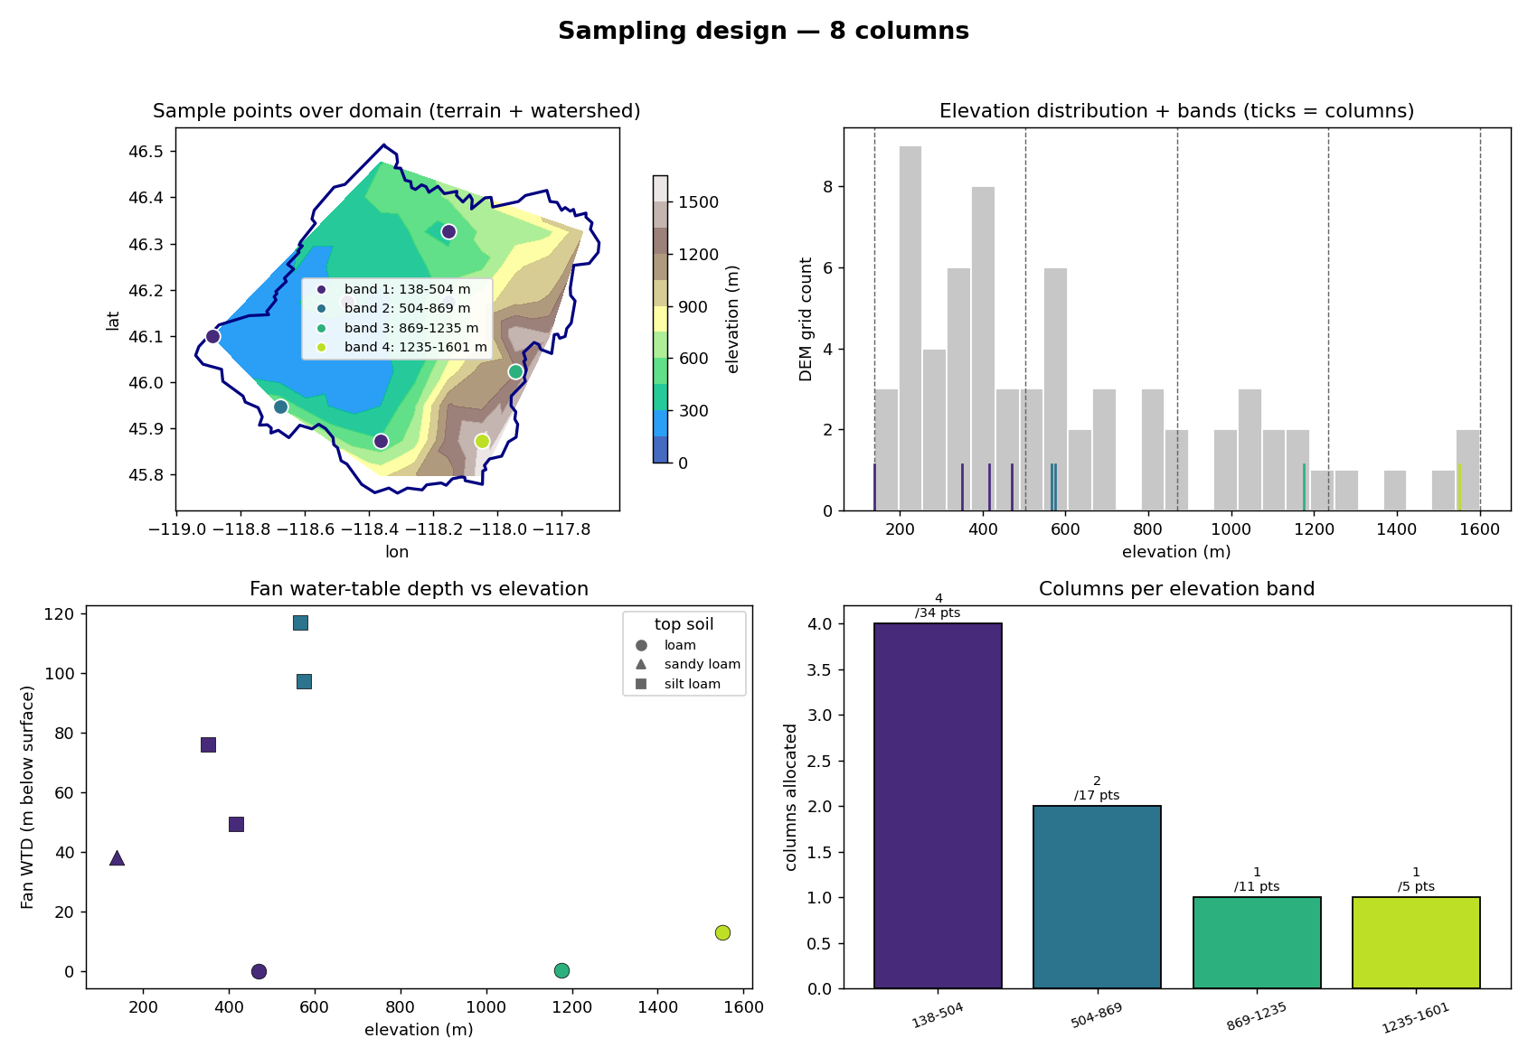
Walla Walla — sampling design (Tier-2 expander)
Panels — top-left: chosen columns on the DEM, coloured by elevation band, navy = watershed boundary. top-right: histogram of the basin's DEM sample (grey = how much terrain sits at each elevation); dashed lines = the equal-interval band edges; coloured ticks = the chosen columns' elevations. bottom-left: Fan (2013) equilibrium water-table depth at each column. bottom-right: columns allocated per band — proportional to the band's share of the basin's DEM points (annotated n / points), minimum 1 per band.

Slide 33
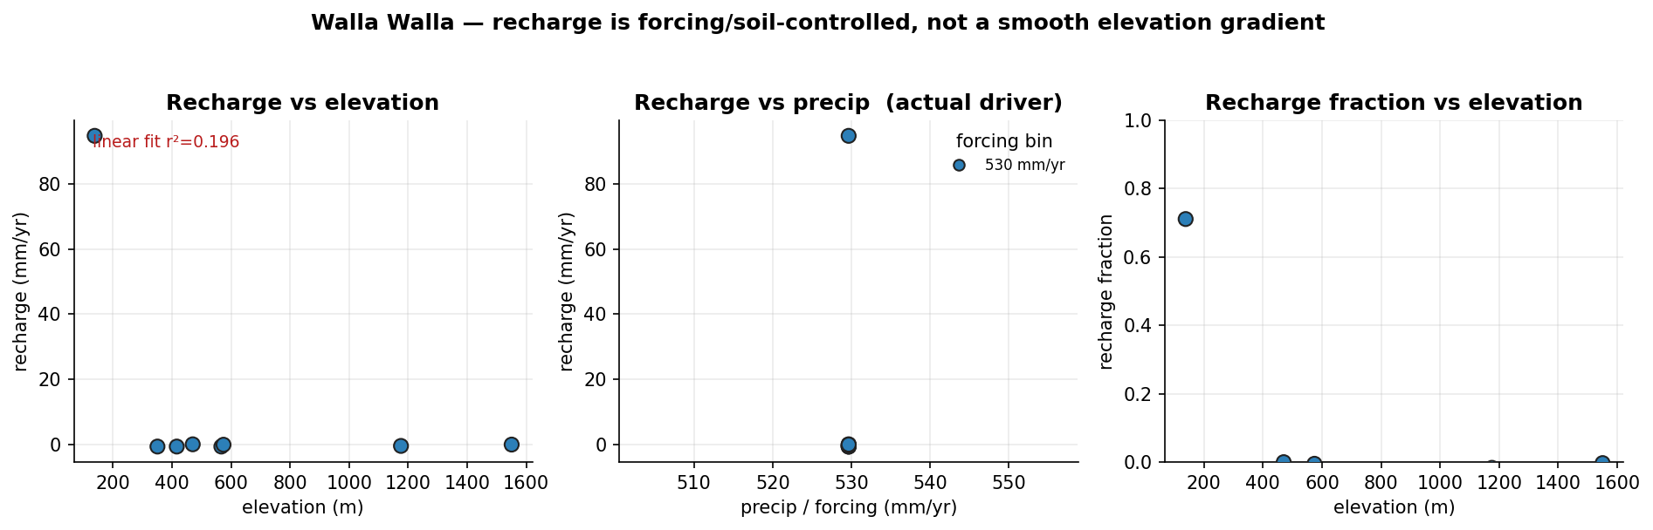
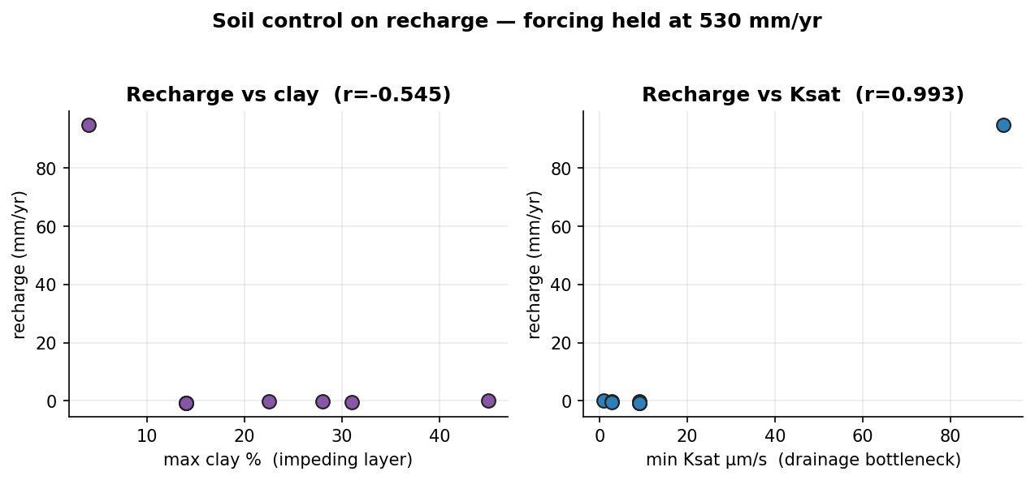
Walla Walla — execution & results
execution: 4/4 columns succeeded · ~7 min each (~15 s clone per column, shared executable)
Definitions — recharge = ELM QCHARGE (flux from the soil column to the water table); runoff = QOVER (surface runoff); recharge fraction = QCHARGE/(QCHARGE+QOVER); WTD = ZWT (the column's own water-table depth); forcing = CLM_QIAN (Qian 2006, T62 ≈ 1.9°) precip at the column.

Slide 34
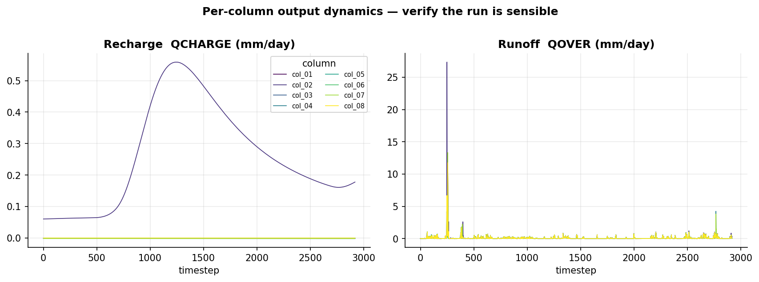
Walla Walla — results (continued)

Slide 35
Walla Walla — driver × response (Pearson r)
all 8 columns · correlations across ALL columns — when precip is quantized, elevation and precip are confo
response | elevation | precip | clay | Ksat
runoff | -0.21 | — | -0.57 | +0.93
recharge | -0.44 | — | -0.55 | +0.99
recharge_fraction | -0.43 | — | -0.52 | +0.99

Slide 36
Walla Walla — analyzer interpretation
Answer
• Partitioning is runoff- and ET-dominated: with uniform 530 mm/yr precip, 7 of 8 columns route essentially all drainage to surface runoff (~26–30 mm/yr) with near-zero/negative recharge, leaving ET as the ~500 mm/yr residual. Deep recharge appears only in the sandy-loam column (col_02: 94.8 mm/yr, 71% of P), so recharge is soil-controlled, not elevation-controlled.
Why
• High Ksat -> recharge (r=0.993); col_02 (Ksat 92 µm/s) yields 94.8 mm/yr — coarse soil permits drainage.
• High clay -> suppressed recharge (r=−0.545); silt/loam columns (Ksat 0.9–9) sit at ~0 mm/yr — fine pores impede percolation.
• Uniform forcing (1 precip bin, 530 mm/yr) -> weak elevation fit (r²=0.20) — apparent gradient is really soil.
• Low runoff + ~0 recharge -> ET dominates (~500 mm/yr residual) — semi-arid evaporative demand.
Trust
• Observations contradict magnitude: yield 40.7 vs gauged 152–715 mm/yr, hydrograph NSE=−1.46, WTD 8.8 vs 63.9 m. Top caveat: single-column, no routing/spin-up/elevation-downscaled forcing — headwater snow and lateral flow are missing.
Next
• Add elevation-downscaled forcing + SWE output to capture montane snowmelt runoff (missing yield).
• Ingest gridded soil + spin-up to test whether coarse-soil fraction reconciles recharge and water-table depth.

Slide 37
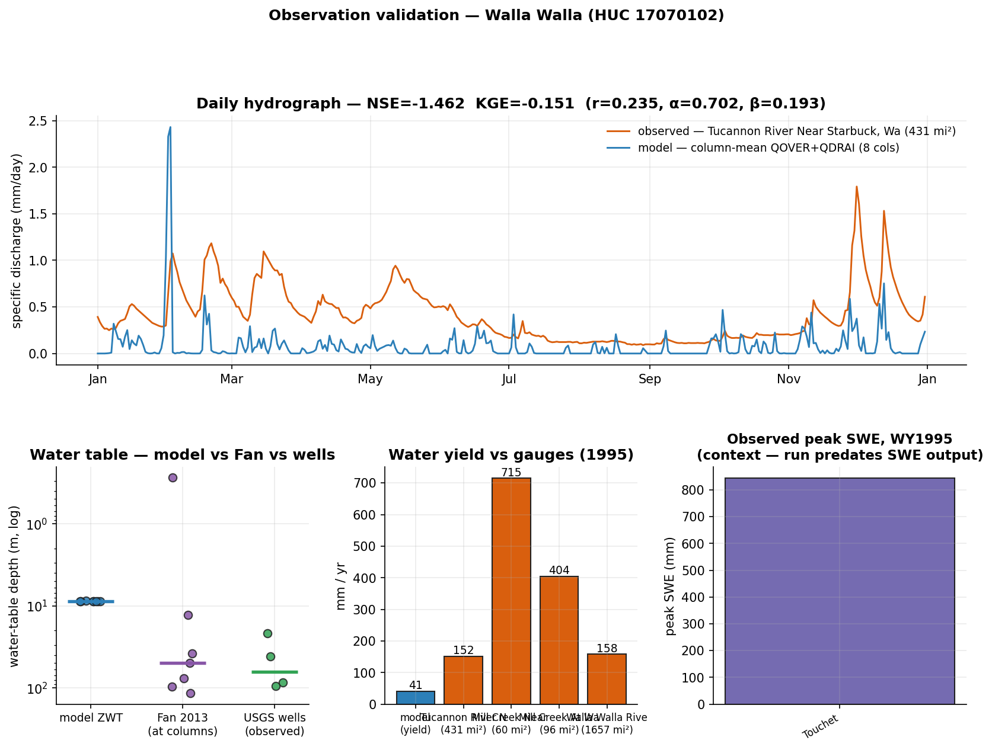
Walla Walla — evaluation vs observations
what could be compared honestly, and what still blocks rigorous validation
in-domain obs: SNOTEL 2 · stream gages 159 · GW wells 200 (4/10 sampled have records)
✓ COMPARED — water-table depth: model ZWT median 8.8 m vs Fan 43.71 m vs observed wells 63.94 m (median; n=4)
✓ COMPARED — streamflow (water yield): modeled yield 40.7 mm/yr vs observed specific discharge 151.6, 714.9, 404.3, 158.1 mm/yr (Tucannon River Near Starbuck, Wa, Mill Creek Near Walla Walla, Wa, Mill Creek At Walla Walla, Wa, Walla Walla River Near Touchet, Wa)
✓ COMPARED — streamflow (daily hydrograph): NSE=-1.462, KGE=-0.151 (r=0.235, variability α=0.702, bias β=0.193) — column-mean QOVER+QDRAI vs gauge
· context-only — snow water equivalent: observed peak SWE 843–843 mm across stations vs column forcing precip 530 mm/yr — this run predates SWE (H2OSNO) in the history output — needs: snow/SWE history output (default since 2026-07) + elevation-downscaled forcing
Metrics — NSE: 1=perfect, 0=no better than the observed mean, <0 worse than the mean. KGE: 1=perfect; components r (timing correlation), α (variability ratio σm/σo), β (volume ratio μm/μo). Specific discharge = gauge flow ÷ drainage area, making a gauge comparable to 1-D columns (mm/yr or mm/day).

Slide 38
Case 6 — Controlled soil sweep
7 uniform-soil treatments (clay05, clay10, clay18, clay27, clay35, clay45, clay55) at one site — forcing, vegetation and location held identical
“Controlled experiment: how does soil texture (clay content) control the runoff/recharge partitioning?”
design: conceptual archetype — vary ONE factor (clay 5→55%), hold everything else fixed; the cleanest isolation of soil control

Slide 39
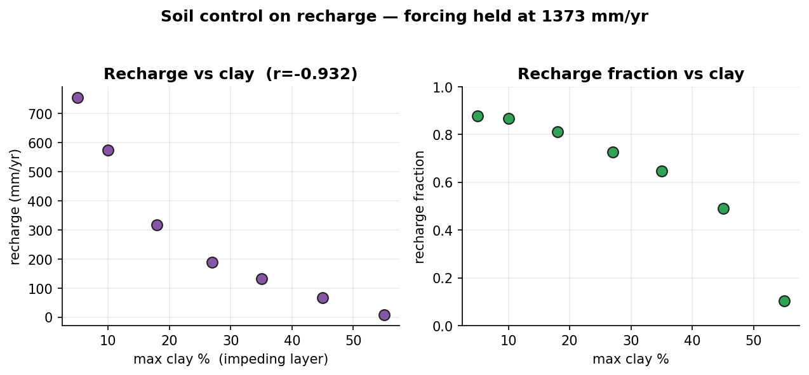
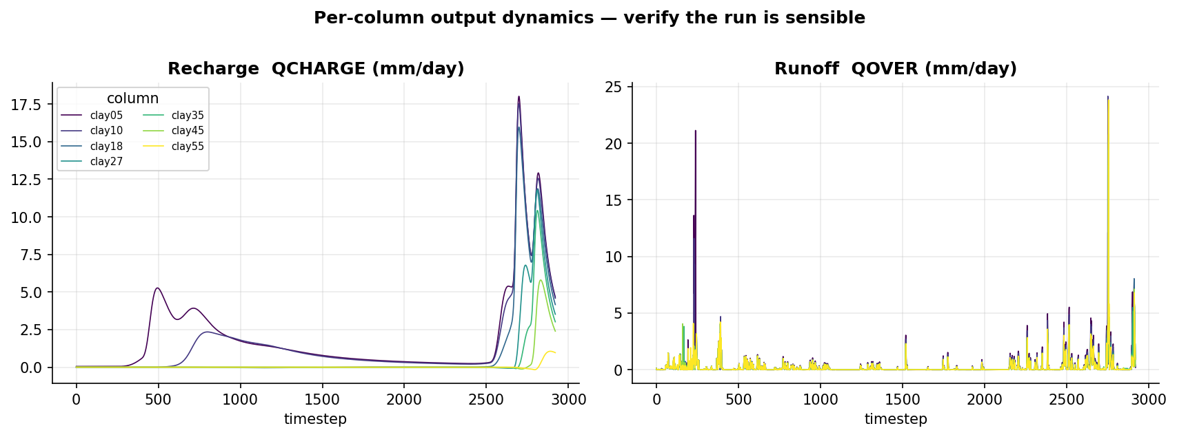
Controlled soil sweep — execution & results
execution: 7/7 columns succeeded · ~3 min each (~15 s clone per column, shared executable)
Definitions — recharge = ELM QCHARGE (flux from the soil column to the water table); runoff = QOVER (surface runoff); recharge fraction = QCHARGE/(QCHARGE+QOVER); WTD = ZWT (the column's own water-table depth); forcing = CLM_QIAN (Qian 2006, T62 ≈ 1.9°) precip at the column.

Slide 40
Controlled soil sweep — analyzer interpretation
Answer
• Increasing topsoil clay from 5% to 55% cuts annual recharge ~88× (754.7→8.6 mm/yr) and flips the system from recharge- to runoff-dominated: recharge fraction drops 0.88→0.10 while runoff fraction rises 0.12→0.90, with the crossover near 45% clay (recharge:runoff ≈0.97).
Why
• Clay 5→55% -> recharge 754.7→8.6 mm/yr; low Ksat blocks infiltration.
• Clay 5→55% -> runoff fraction 0.12→0.90; rejected water runs off.
• Clay_max -> recharge r=−0.932 (forcing held 1373 mm/yr); soil-driven, not climate.
• Clay 5→55% -> water table 7.84→8.80 m; less deep drainage, deeper WT.
Trust
• Strong soil-recharge signal (r=−0.932) with precip fixed isolates texture; but no observational validation and Ksat values are null, so the recharge-clay mapping rests on model pedotransfer assumptions.
Next
• Add water-table/streamflow observations to confirm the ~45% runoff crossover.
• Vary Ksat independently of clay% (currently null) to disentangle texture vs. conductivity control on recharge.

Slide 41
Cross-study synthesis
same framework, three experiments — the control on recharge/runoff partitioning depends on climate
study | columns | forcing (mm/yr) | recharge (mm/yr) | strongest control
Naches | 20 | 459, 474, 509, 611, 619, 682, 699, 727, 735, 793, 941, 975, 1153, 1361, 1580 | -3.6 → 291.2 | —
Naches | 20 | 459, 474, 509, 611, 619, 682, 699, 727, 735, 793, 941, 975, 1153, 1361, 1580 | -84.8 → 1298.8 | —
Naches | 10 | 793, 1373 | -0.1 → 648.3 | recharge_vs_clay_max (r=-0.877)
Naches | 8 | 793, 1373 | -0.0 → 648.3 | recharge_vs_clay_max (r=-0.906)
Walla Walla | 8 | 530 | -0.7 → 94.8 | recharge_vs_ksat_min (r=0.993)
Controlled soil sweep | 7 | 1373 | 8.6 → 754.7 | recharge_vs_clay_max (r=-0.932)
wet basin: recharge is CLAY-limited — water is ample; the impeding layer decides
dry basin: recharge is Ksat-limited (threshold) — only the most permeable soil recharges
controlled sweep: confirms causality: clay 5→55% collapses recharge 755→9 mm/yr with everything else fixed

Slide 42
Appendix A1 — Naches: columns & results
characteristics from the real data (SSURGO soil, Fan 2013 WTD, NLDAS-2 (0.125°, ~12 km) forcing) · results are annual means (mm/yr)
column | elev m | top soil | clay% | Ksat µm/s | Fan WTD m | precip | recharge | runoff | rech.frac | ZWT m
col_01 | 750 | — | — | — | 61.5 | 474 | -0.2 | 23.5 | -0.01 | 8.80
col_02 | 754 | — | — | — | 0.6 | 682 | -0.2 | 39.5 | -0.00 | 8.80
col_05 | 924 | — | — | — | 4.7 | 474 | -0.2 | 23.5 | -0.01 | 8.80
col_06 | 932 | loam | 26 | 3.0 | 4.5 | 727 | -0.6 | 35.3 | -0.02 | 8.80
col_03 | 943 | — | — | — | 0.7 | 793 | -0.2 | 40.7 | -0.00 | 8.80
col_04 | 1031 | — | — | — | 0.9 | 1361 | -0.2 | 89.8 | -0.00 | 8.80
col_07 | 1116 | loam | 14 | 9.0 | 0.7 | 975 | -1.5 | 52.6 | -0.03 | 8.81
col_08 | 1130 | loam | 54 | 0.1 | 34.8 | 509 | -0.0 | 54.7 | -0.00 | 8.80
col_09 | 1186 | loam | 12 | 28.0 | 0.2 | 793 | -2.9 | 40.1 | -0.08 | 8.81
col_10 | 1249 | loam | 8 | 28.0 | 22.2 | 699 | -0.6 | 53.3 | -0.01 | 8.80
col_15 | 1273 | loam | 6 | 28.0 | 215.2 | 735 | -1.4 | 56.8 | -0.02 | 8.80
col_13 | 1280 | loam | 22 | 9.0 | 114.5 | 459 | -0.3 | 45.4 | -0.01 | 8.80
col_14 | 1390 | sandy loam | 8 | 9.0 | 0.6 | 611 | -3.6 | 77.1 | -0.05 | 8.81
col_12 | 1428 | loam | 21 | 9.0 | 35.2 | 509 | -0.4 | 44.2 | -0.01 | 8.80
col_11 | 1485 | sandy loam | 8 | 9.0 | 0.2 | 1580 | 291.2 | 94.6 | 0.75 | 8.74
col_18 | 1564 | loam | 21 | 9.0 | 62.7 | 682 | -2.1 | 38.9 | -0.06 | 8.81
col_16 | 1578 | sandy loam | 8 | 9.0 | 145.0 | 941 | -3.6 | 52.9 | -0.07 | 8.81
col_20 | 1617 | loam | 20 | — | 195.5 | 619 | -0.5 | 36.0 | -0.01 | 8.80
col_19 | 1792 | sandy loam | 20 | 9.0 | 22.7 | 975 | -3.6 | 56.0 | -0.07 | 8.81
col_17 | 1868 | loam | 20 | 28.0 | 1.5 | 1153 | -3.4 | 76.4 | -0.05 | 8.81

Slide 43
Appendix A2 — Naches: columns & results
characteristics from the real data (SSURGO soil, Fan 2013 WTD, NLDAS-2 (0.125°, ~12 km) forcing) · results are annual means (mm/yr)
column | elev m | top soil | clay% | Ksat µm/s | Fan WTD m | precip | recharge | runoff | rech.frac | ZWT m
col_01 | 750 | — | — | — | 61.5 | 474 | -0.0 | 21.4 | -0.00 | 28.80
col_02 | 754 | — | — | — | 0.6 | 682 | -84.8 | 158.2 | -1.15 | 4.16
col_05 | 924 | — | — | — | 4.7 | 474 | -0.6 | 83.0 | -0.01 | 4.79
col_06 | 932 | loam | 26 | 3.0 | 4.5 | 727 | 486.1 | 152.3 | 0.76 | 4.05
col_03 | 943 | — | — | — | 0.7 | 793 | -0.2 | 165.1 | -0.00 | 3.94
col_04 | 1031 | — | — | — | 0.9 | 1361 | 900.2 | 363.5 | 0.71 | 3.60
col_07 | 1116 | loam | 14 | 9.0 | 0.7 | 975 | 338.8 | 239.9 | 0.59 | 3.56
col_08 | 1130 | loam | 54 | 0.1 | 34.8 | 509 | 349.5 | 0.4 | 1.00 | 27.59
col_09 | 1186 | loam | 12 | 28.0 | 0.2 | 793 | -53.1 | 165.7 | -0.47 | 3.79
col_10 | 1249 | loam | 8 | 28.0 | 22.2 | 699 | 1154.1 | 3.4 | 1.00 | 19.98
col_15 | 1273 | loam | 6 | 28.0 | 215.2 | 735 | 70.3 | 0.4 | 0.99 | 28.73
col_13 | 1280 | loam | 22 | 9.0 | 114.5 | 459 | 478.4 | 0.3 | 1.00 | 27.68
col_14 | 1390 | sandy loam | 8 | 9.0 | 0.6 | 611 | -34.5 | 412.7 | -0.09 | 3.79
col_12 | 1428 | loam | 21 | 9.0 | 35.2 | 509 | 516.8 | 0.4 | 1.00 | 27.58
col_11 | 1485 | sandy loam | 8 | 9.0 | 0.2 | 1580 | 863.2 | 344.4 | 0.71 | 3.56
col_18 | 1564 | loam | 21 | 9.0 | 62.7 | 682 | 634.9 | 0.4 | 1.00 | 27.50
col_16 | 1578 | sandy loam | 8 | 9.0 | 145.0 | 941 | 1298.8 | 0.9 | 1.00 | 26.38
col_20 | 1617 | loam | 20 | — | 195.5 | 619 | 722.6 | 12.4 | 0.98 | 27.19
col_19 | 1792 | sandy loam | 20 | 9.0 | 22.7 | 975 | 1283.2 | 4.1 | 1.00 | 20.18
col_17 | 1868 | loam | 20 | 28.0 | 1.5 | 1153 | -5.1 | 281.3 | -0.02 | 3.78

Slide 44
Appendix A3 — Naches: columns & results
characteristics from the real data (SSURGO soil, Fan 2013 WTD, CLM_QIAN (Qian 2006, T62 ≈ 1.9°) forcing) · results are annual means (mm/yr)
column | elev m | top soil | clay% | Ksat µm/s | Fan WTD m | precip | recharge | runoff | rech.frac | ZWT m
col_01 | 750 | loam | 32 | 3.0 | 61.5 | 793 | -0.0 | 53.4 | -0.00 | 8.80
col_04 | 924 | loam | 31 | 3.0 | 4.7 | 793 | -0.1 | 56.3 | -0.00 | 8.80
col_02 | 943 | loam | 25 | 2.5 | 0.7 | 1373 | 346.7 | 83.1 | 0.81 | 8.71
col_03 | 1031 | sandy loam | 14 | 9.0 | 0.9 | 1373 | 576.0 | 85.2 | 0.87 | 8.31
col_05 | 1186 | loam | 12 | 28.0 | 0.2 | 1373 | 576.1 | 91.4 | 0.86 | 8.25
col_06 | 1249 | loam | 8 | 28.0 | 22.2 | 1373 | 648.3 | 93.5 | 0.87 | 8.10
col_08 | 1428 | loam | 21 | 9.0 | 35.2 | 1373 | 309.5 | 73.2 | 0.81 | 8.73
col_07 | 1485 | sandy loam | 8 | 9.0 | 0.2 | 1373 | 576.0 | 85.2 | 0.87 | 8.31
col_09 | 1578 | sandy loam | 8 | 9.0 | 145.0 | 1373 | 576.1 | 85.2 | 0.87 | 8.31
col_10 | 1868 | loam | 20 | 28.0 | 1.5 | 1373 | 507.5 | 78.8 | 0.87 | 8.44

Slide 45
Appendix A4 — Naches: columns & results
characteristics from the real data (SSURGO soil, Fan 2013 WTD, CLM_QIAN (Qian 2006, T62 ≈ 1.9°) forcing) · results are annual means (mm/yr)
column | elev m | top soil | clay% | Ksat µm/s | Fan WTD m | precip | recharge | runoff | rech.frac | ZWT m
col_01 | 750 | loam | 32 | 3.0 | 61.5 | 793 | -0.0 | 53.4 | -0.00 | 8.80
col_02 | 943 | loam | 25 | 2.5 | 0.7 | 1373 | 346.7 | 83.1 | 0.81 | 8.71
col_03 | 1031 | sandy loam | 14 | 9.0 | 0.9 | 1373 | 576.0 | 85.2 | 0.87 | 8.31
col_04 | 1186 | loam | 12 | 28.0 | 0.2 | 1373 | 576.1 | 91.4 | 0.86 | 8.25
col_05 | 1249 | loam | 8 | 28.0 | 22.2 | 1373 | 648.3 | 93.5 | 0.87 | 8.10
col_06 | 1485 | sandy loam | 8 | 9.0 | 0.2 | 1373 | 576.0 | 85.2 | 0.87 | 8.31
col_07 | 1578 | sandy loam | 8 | 9.0 | 145.0 | 1373 | 576.1 | 85.2 | 0.87 | 8.31
col_08 | 1868 | loam | 20 | 28.0 | 1.5 | 1373 | 507.5 | 78.8 | 0.87 | 8.44

Slide 46
Appendix A5 — Walla Walla: columns & results
characteristics from the real data (SSURGO soil, Fan 2013 WTD, CLM_QIAN (Qian 2006, T62 ≈ 1.9°) forcing) · results are annual means (mm/yr)
column | elev m | top soil | clay% | Ksat µm/s | Fan WTD m | precip | recharge | runoff | rech.frac | ZWT m
col_02 | 138 | sandy loam | 4 | 92.0 | 38.1 | 530 | 94.8 | 38.5 | 0.71 | 8.65
col_01 | 351 | silt loam | 14 | 9.0 | 75.9 | 530 | -0.7 | 27.9 | -0.03 | 8.80
col_03 | 416 | silt loam | 14 | 9.0 | 49.3 | 530 | -0.7 | 27.9 | -0.03 | 8.80
col_04 | 470 | loam | 45 | 0.9 | 0.0 | 530 | -0.0 | 26.0 | -0.00 | 8.80
col_06 | 567 | silt loam | 14 | 9.0 | 116.8 | 530 | -0.7 | 27.8 | -0.03 | 8.80
col_05 | 574 | silt loam | 22 | 9.0 | 97.1 | 530 | -0.1 | 26.7 | -0.00 | 8.80
col_07 | 1176 | loam | 31 | 2.7 | 0.3 | 530 | -0.5 | 30.1 | -0.02 | 8.80
col_08 | 1551 | loam | 28 | 2.7 | 12.9 | 530 | -0.1 | 29.2 | -0.00 | 8.80

Slide 47
Appendix A6 — Controlled soil sweep: columns & results
characteristics from the real data (SSURGO soil, Fan 2013 WTD, CLM_QIAN (Qian 2006, T62 ≈ 1.9°) forcing) · results are annual means (mm/yr)
column | elev m | top soil | clay% | Ksat µm/s | Fan WTD m | precip | recharge | runoff | rech.frac | ZWT m
clay05 | — | clay5 | 5 | — | — | 1373 | 754.7 | 104.3 | 0.88 | 7.84
clay10 | — | clay10 | 10 | — | — | 1373 | 575.1 | 88.1 | 0.87 | 8.24
clay18 | — | clay18 | 18 | — | — | 1373 | 318.0 | 73.5 | 0.81 | 8.73
clay27 | — | clay27 | 27 | — | — | 1373 | 189.4 | 71.3 | 0.73 | 8.76
clay35 | — | clay35 | 35 | — | — | 1373 | 131.6 | 71.9 | 0.65 | 8.77
clay45 | — | clay45 | 45 | — | — | 1373 | 67.6 | 70.0 | 0.49 | 8.79
clay55 | — | clay55 | 55 | — | — | 1373 | 8.6 | 73.8 | 0.10 | 8.80

