Slide 1

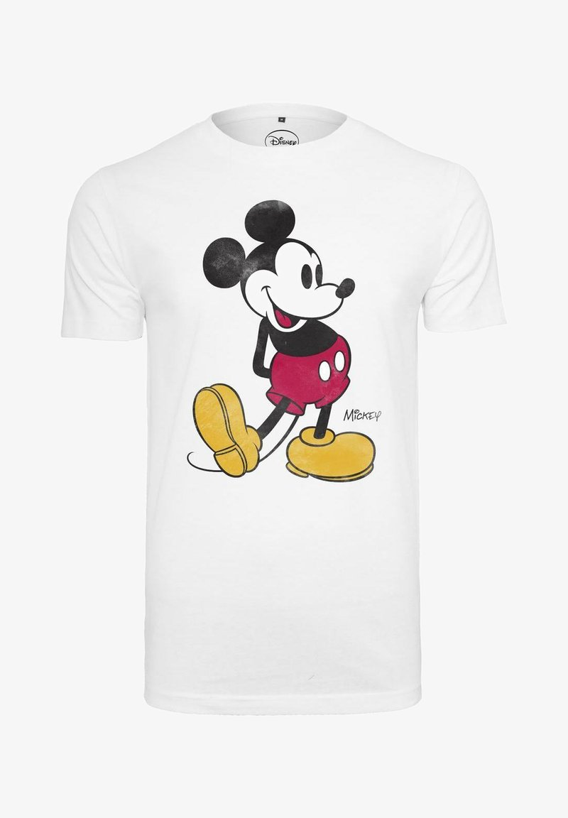
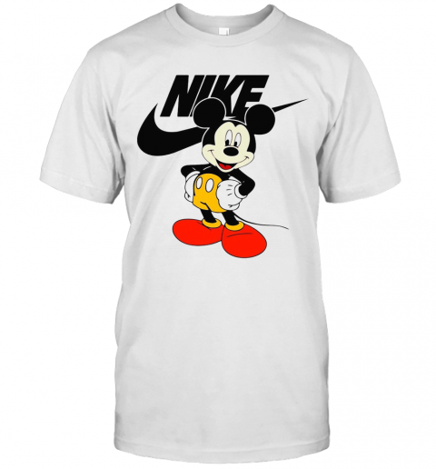

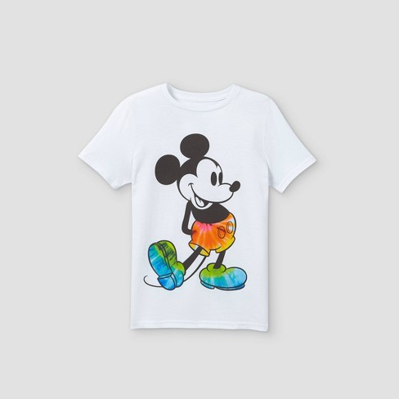
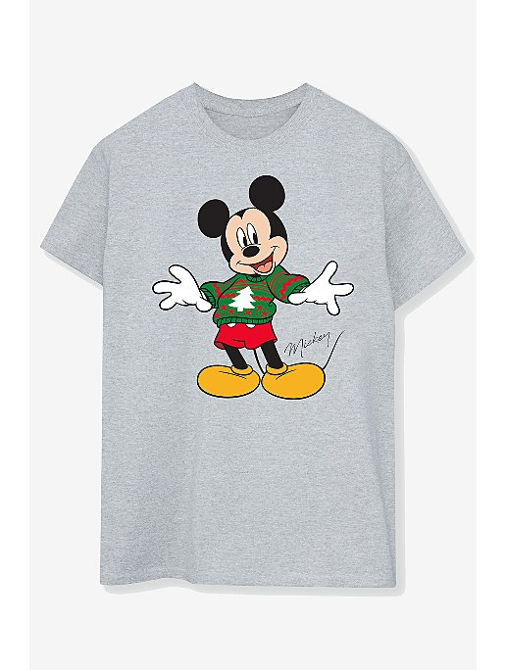
ComposeTransformers: an end-to-end woman clothing recommender system via image-text content retrieval
Hello, can you find me a t-shirt looks like this but has a Mickey mouse logo?
Hello, can you find me a t-shirt looks like this but has a Mickey mouse logo?
Here are your top 5 results
Sinh viên thực hiện:
Trần Việt Hoàng – 18520785
Hoàng Ngọc Bá Thi – 19522255
Hold on a second, let me check all products in the database
5 minutes later…
Manually…
With ComposeTransformers

Slide 2
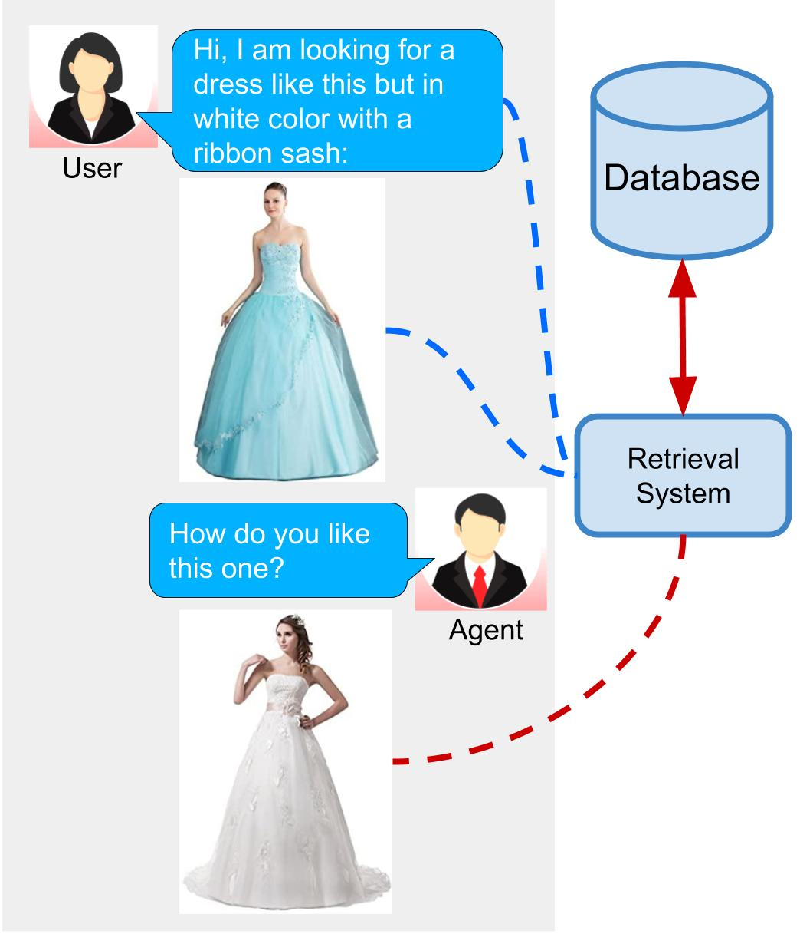
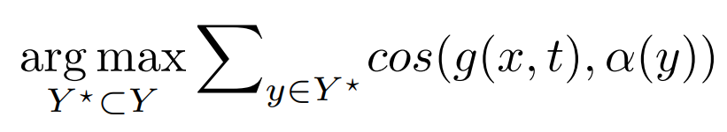
Objective: Inference
Given a query image: x
Given a query text: t
Given the set of target images: Y = {y₁, y₂, y₃ ..., y_{m}} in Database
by users
We obtain the set Y* as relevant results.
Image feature extractor
ComposeTransformers
Src: ecom-research/ComposeAE: Official code for WACV 2021 paper - Compositional Learning of Image-Text Query for Image Retrieval (github.com)

Slide 3
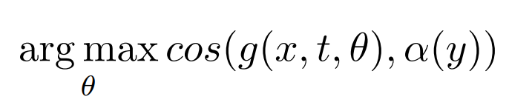
Objective: Training
Given the set of query images: X = {x₁, x₂, x₃ ..., x_{n}}
Given the set of query texts: T = {t₁, t₂, t₃ ..., t_{n}}
Given the set of images: Y = {y₁, y₂, y₃ ..., y_{n}} are corresponding target images.
For the training phase, the objective is to learn a composed representation of the image-text query (x, t) to the corresponding target image y by the supervised learning method, the composed representation module is denoted by g(x, t, θ), the training objective is maximizing:

Slide 4
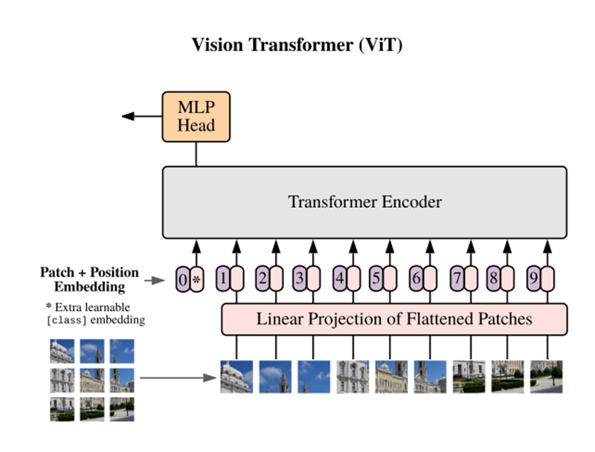
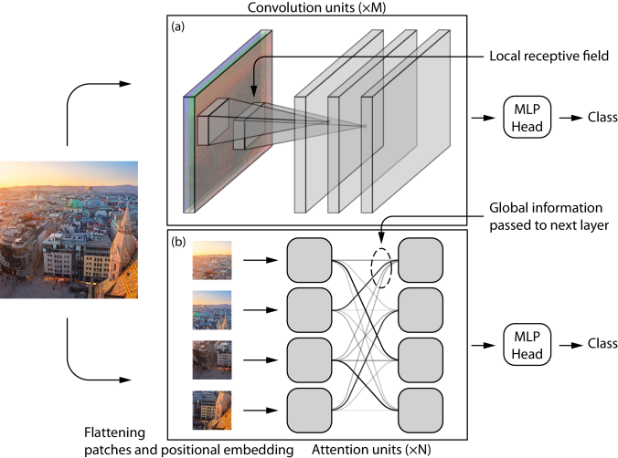
Image model α(·)
Input: image x
Output: image feature vector z = α(x)
z
x
Src: [2105.07197] Are Convolutional Neural Networks or Transformers more like human vision? (arxiv.org)
[2010.11929] An Image is Worth 16x16 Words: Transformers for Image Recognition at Scale (arxiv.org)

Slide 5
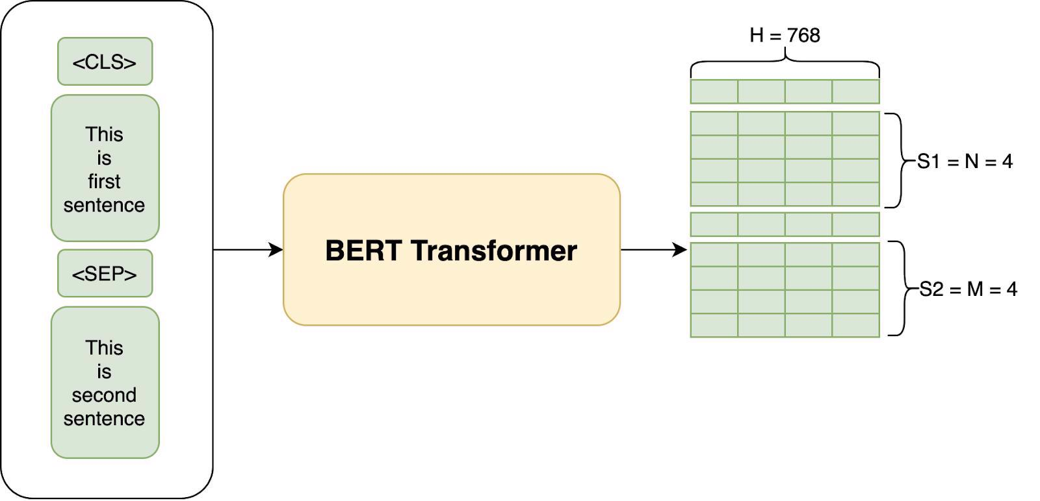
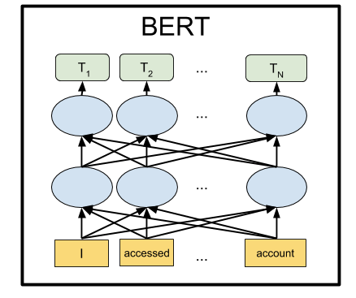
Text model β(·)
h-dimensions
SENTENCE EMBEDDINGs
q
Input: Text t
Output: Text feature vector q = β(t)
BERT
[CLS]
Token
1
…
Token
n
[SEP]
“Bidirectional” in BERT
t
SENTENCE
Source: https://researchgate.com

Slide 6


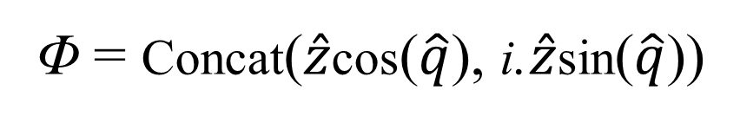
Composition module
Imaginary space
Target feature
Query text feature
q
μ(q)
ϑ
$$\hat{q}$$
Φ
ρ
z
γ(z)
Mapping to image space
Query image feature
$$\hat{z}$$
Complex module
Real space
Composition module
ϑ
Composed representation
Composed query feature
μ(q) : MLP; Mapping text feature to Complex module’s space.
γ(z) : MLP; Mapping image feature to Complex module’s space.
Φ : Complex projection operation on the Complex space.
ρ : MLP; Go back to image feature space to compare with target image.
Φ = Concat($\hat{z}$cos($\hat{q}$), i.$\hat{z}$sin($\hat{q}$))

Slide 7
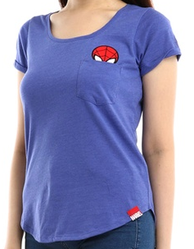
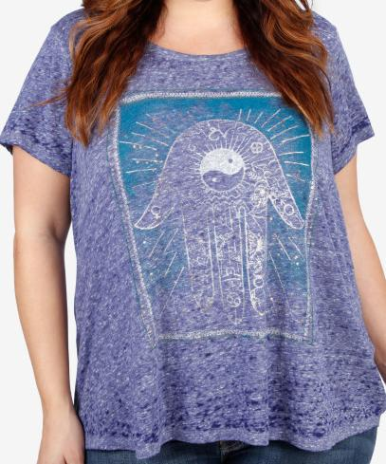
Query text [t]
Inference
blue t-shirt but more trendy plus size graphic
μ(.)
β(.)
Φ
ρ
Query image
[x]
γ(.)
Mapping to image space
α(.)
Complex module
Composition module
ϑ
Composed representation
Target image
[y]
α(y)
Inference: similarity metric between
ϑ (x, t) and α(y)

Slide 8
Training
L_{BASE} = SoftTripletLoss(ϑ^{i} , y^{i}_{pos}, y^{i}_{neg})
L_{RT} = MSELoss(d_{text}(ϑ) , β(t))
L_{RI} = MSELoss(d_{image}(ϑ) , α(x))
L_{SYM} = SoftTripletLoss(ϑ^{*i} , x^{i}, x^{j})
blue t-shirt but more trendy plus size graphic
μ(t)
β(t)
Φ
ρ
Query text [t]
γ(.)
Mapping to image space
Query image
[x]
α(x)
Complex module
Text reconstruction module between d_{text}(ϑ) and β(t)
Composition module
ϑ
Composed representation
L_{RT}
Rotational symmetry loss
ϑ*(y, t) and α(x)
Target image
[y]
L_{SYM}
Image reconstruction module between d_{image}(ϑ) and α(x)
α(y)
base-loss
ϑ (x, t) and α(y)
L_{RI}
L_{BASE}

Slide 9
Training: Base Loss
L_{BASE} = SoftTripletLoss(ϑ^{i} , y^{i}_{pos}, y^{i}_{neg})
Before training
After training
Negative
Target image
[y]
Negative
Target image
[y]
Query text [t]
Query text [t]
Query image
[x]
Query image
[x]
Positive
Target image
[y]
Positive
Target image
[y]

Slide 10
Training: Rotational Symmetry Loss
Imaginary space
Composed target feature
blue t-shirt but more trendy plus size graphic
μ(t)
β(t)
Φ
ρ
ϑ*
Query text [t]
γ(.)
Mapping to image space
Target image
[y]
Complex module
Real space
α(y)
Composition module
Composed query feature
Rotational symmetry loss
ϑ*(y, t) and α(x)
ϑ*
Composed representation
Query image
[x]
α(x)
L_{SYM} = SoftTripletLoss(ϑ^{*i} , x^{i}_{pos}, x^{i}_{neg})

Slide 11
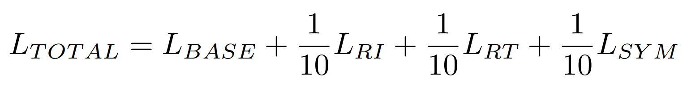
Training: Total Loss

Slide 12
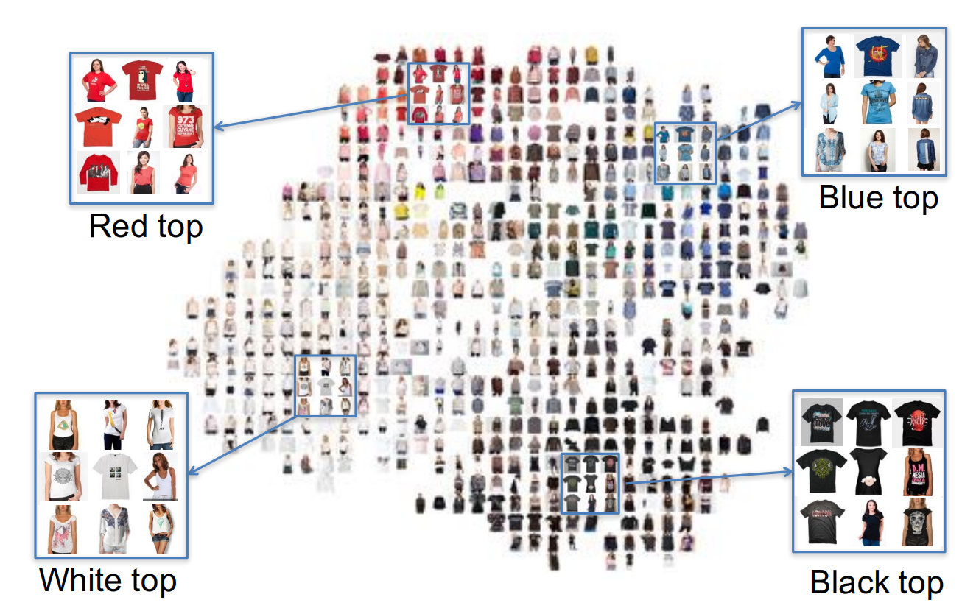
Experiment: Dataset
The real-world Fashion200k dataset. Which consist of 200k images of 5 different fashion categories, namely: pants, skirts, dresses, tops and jackets.
t-shirt, shirt
We limit the scope of problem to retrieve women's t-shirts and shirts. We collect totally 24,657 images and 7,945 unique captions (i.e. unique clothes) to these images to perform our task.
Example of subspace embedding corresponding to concept {black,
blue, white, red, gray, green, purple, beige, ...} for tops.
Src: [1708.01311] Automatic Spatially-aware Fashion Concept Discovery (arxiv.org)

Slide 13
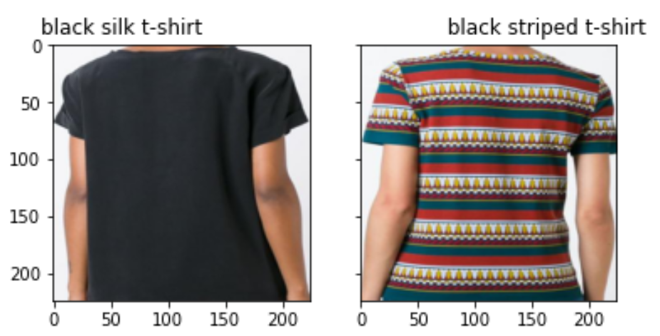
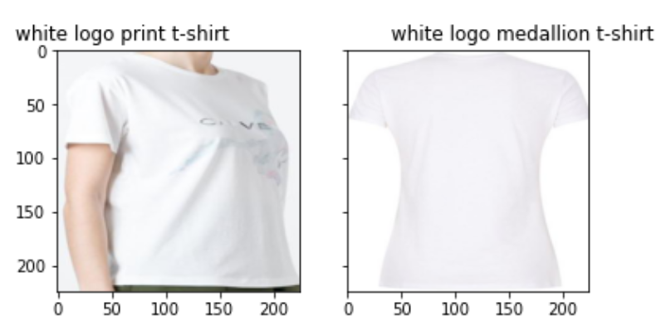
Experiment: Dataset
Development set: 13,335 images and 4,227 unique captions.
Evaluation set: 1,200 image-text query pairs to perform the retrieval to the collected 2,646 images, which are annotated test annotation files as ground truth.
Image: 11055; Source maps to target with the mod string: replace silk with striped
Image: 8915; Source maps to target with the mod string: replace print with medallion

Slide 14
Experiment: Model
μ(t)
Φ
ρ
ϑ
Composed representation
γ(.)
Mapping to image space
β(t)
Complex module
Composition module
Pre-trained Sentence-BERT:
Version: all-MiniLM-L6-v1
Total: 22.7M params. (non-trainable)
Composition module:
Total/Trainable: 0.89M params.
α(x)
Text reconstruction module between d_{text}(ϑ) and β(t)
Image reconstruction module between d_{image}(ϑ) and α(x)
ImageNet pre-trained Knowledge distillation ViT:
Total: 21.8M params.
Trainable: 5.51M params. (freeze 11/12 blocks)
Image-text reconstruction module:
Total/Trainable: 0.3M params.

Slide 15
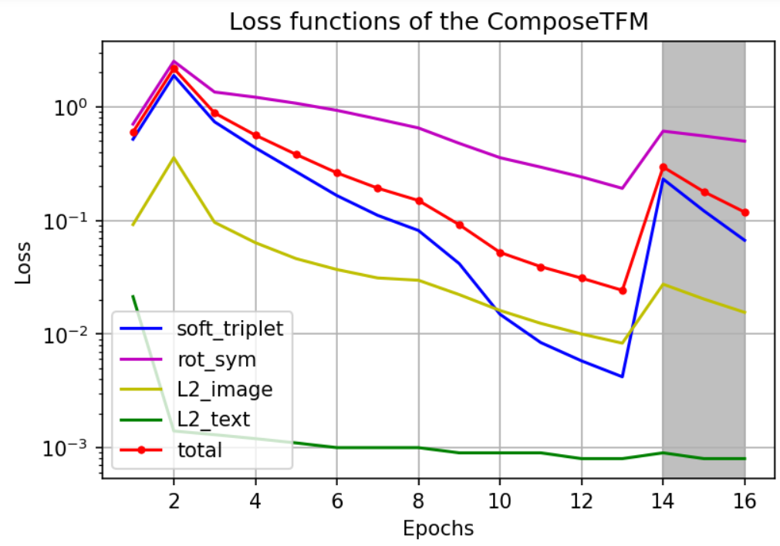
Experiment: Empirical Result
The graph describes the reduction of 4 training loss functions. Where ‘soft triplet’ represents L_{BASE}; ‘L2_image’, ‘L2_text’ respectively represent L_{RI} , L_{RT} ; ‘rot_sym’ represents L_{SYM} and ‘total’ represents L_{TOTAL}. Where shaded area is the training epochs with minimum learning rate and reduced batch-size.

Slide 16
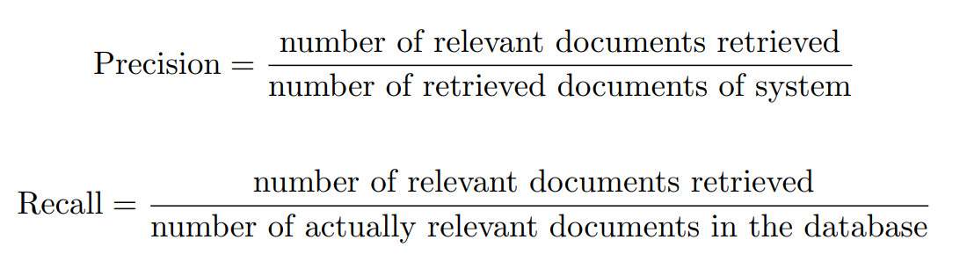
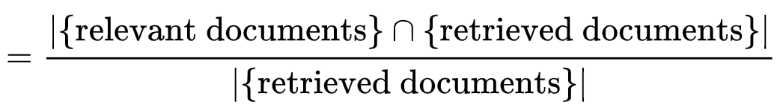
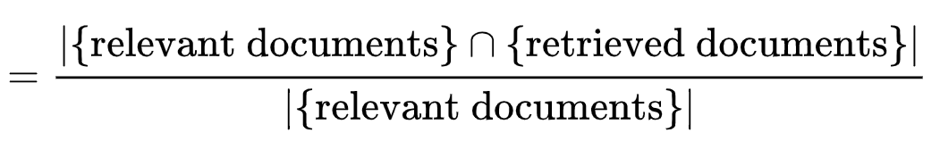
Experiment: Evaluation Metrics
Use Evaluation Mectrics from Information Retrieval:

Slide 17
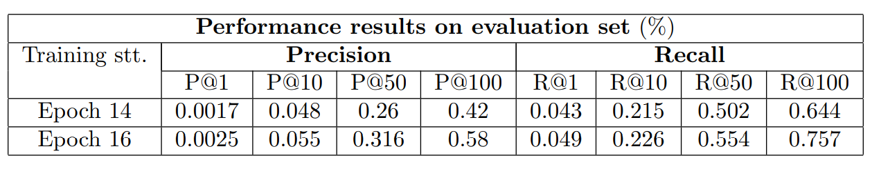
Model Performance
Evaluation results of model in two training statuses: epoch 14th and epoch 16th.

Slide 18
Inference

