Slide 1
TVM
An Automated End-to-End Optimizing Compiler for Deep Learning

Slide 2
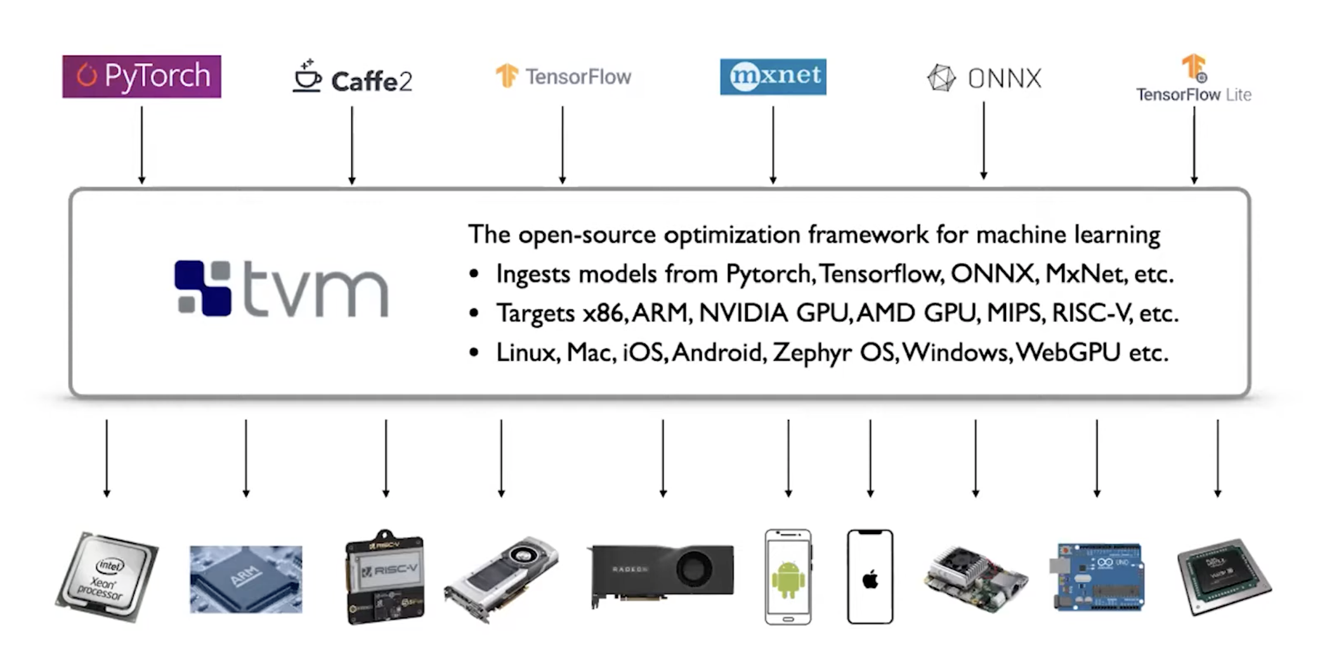
TVM: input/output

Slide 3
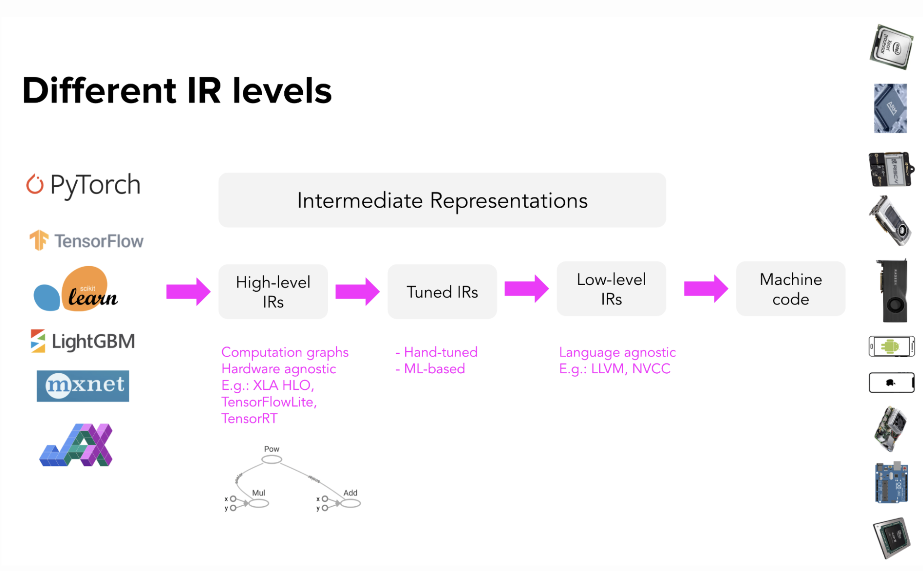
TVM compiler flow

Slide 4
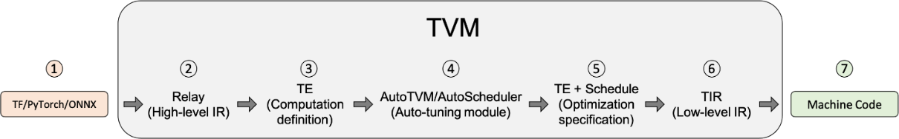
TVM compiler flow
1. Input model from ONNX, Pytorch, Tensorflow,...

Slide 5
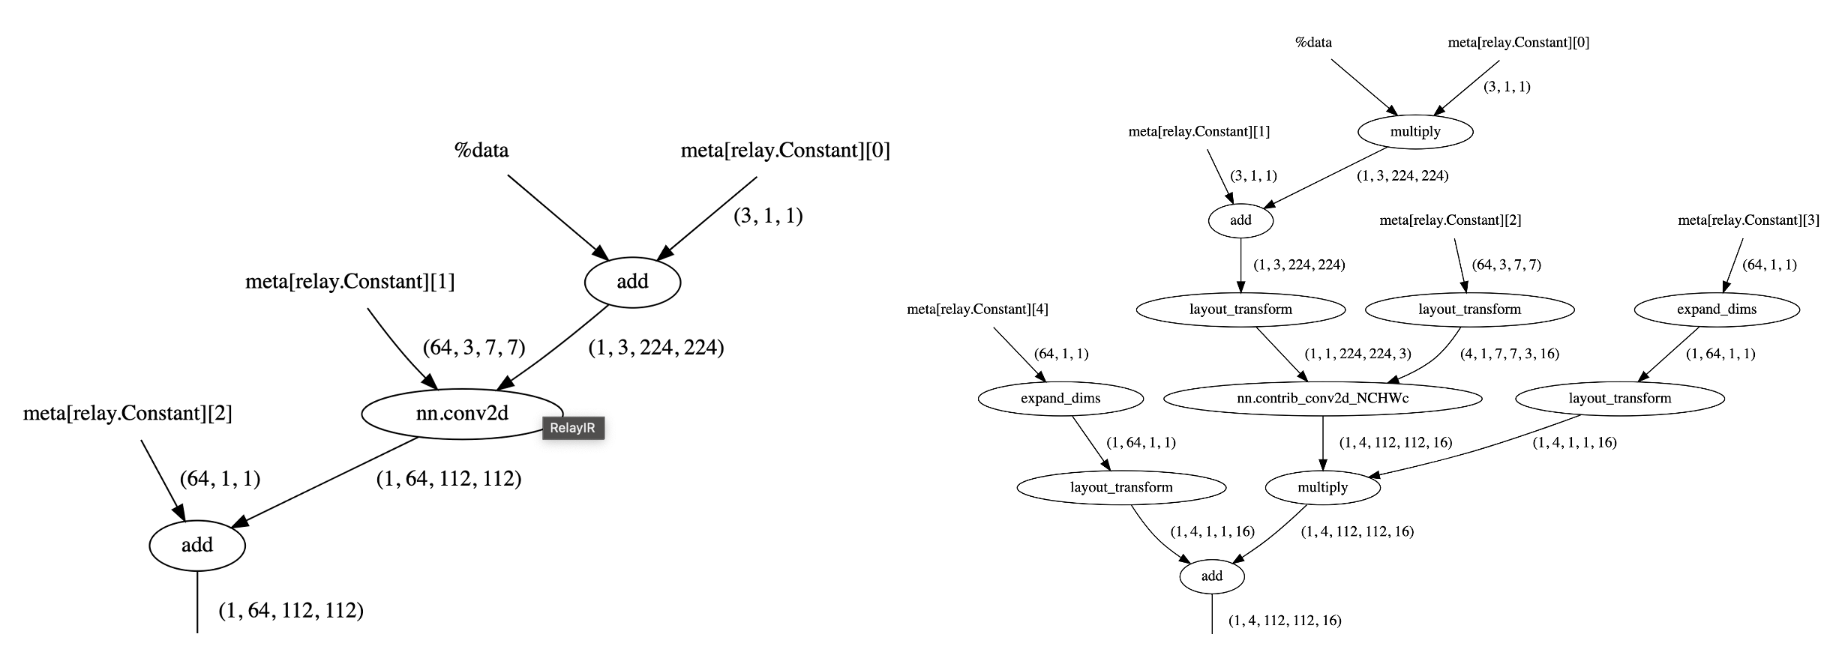
TVM compiler flow
2. Parse model to Relay, a kind of Directed Acyclic Graph
and apply Relay transformations, such as Operator Fusion, Layout Transformation

Slide 6
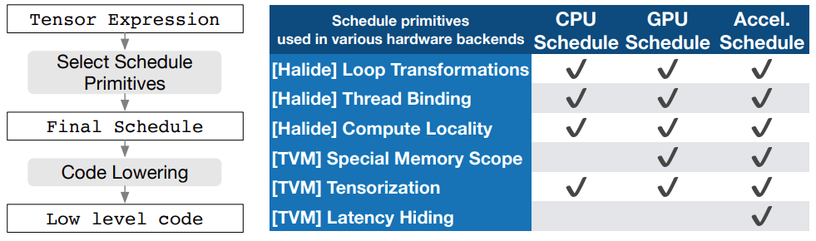
TVM compiler flow
3. Model is lowered to TE (Tensor Expression) by FuseOps pass
TE is a domain-specific language to describe tensor computation.
TVM provides schedule primitives to implement low-level (hardware-aware) optimization.
schedule primitives is a set of transformations used to simplify and optimize tensor computation to hardware.

Slide 7
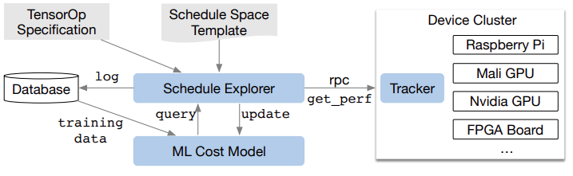
TVM compiler flow
4. Find the best way to deploy schedule primitives for tensor-expressed model to the target hardware.
Schedule Exporer examines the schedule space using an ML-cost model and chooses experiments to run on distributed device cluster via RPC.
Measurement data is collected during exploration.
Not require detailed hardware configuration.

Slide 8
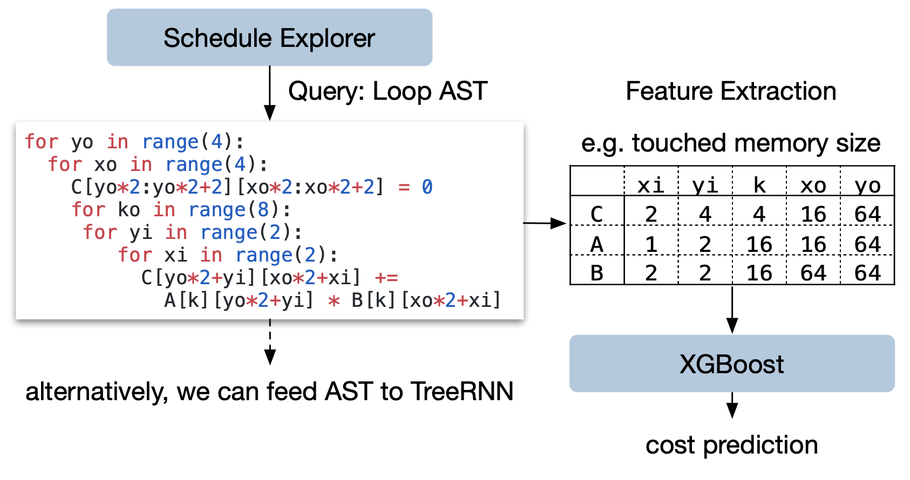
TVM compiler flow
4. Find the best way to deploy schedule primitives for tensor-expressed model to the target hardware.
ML-cost model:
gradient-boosting model
predicts running time on hardware backend
trained by real measurement data
inference time = 1000x faster than real measurement

Slide 9
TVM compiler flow
4. Find the best way to deploy schedule primitives for tensor-expressed model to the target hardware.
ML-cost model:
gradient-boosting model
predicts running time on hardware backend
trained by real measurement data
inference time = 1000x faster than real measurement

