Slide 1
TVM
An Automated End-to-End Optimizing Compiler for Deep Learning

Slide 2
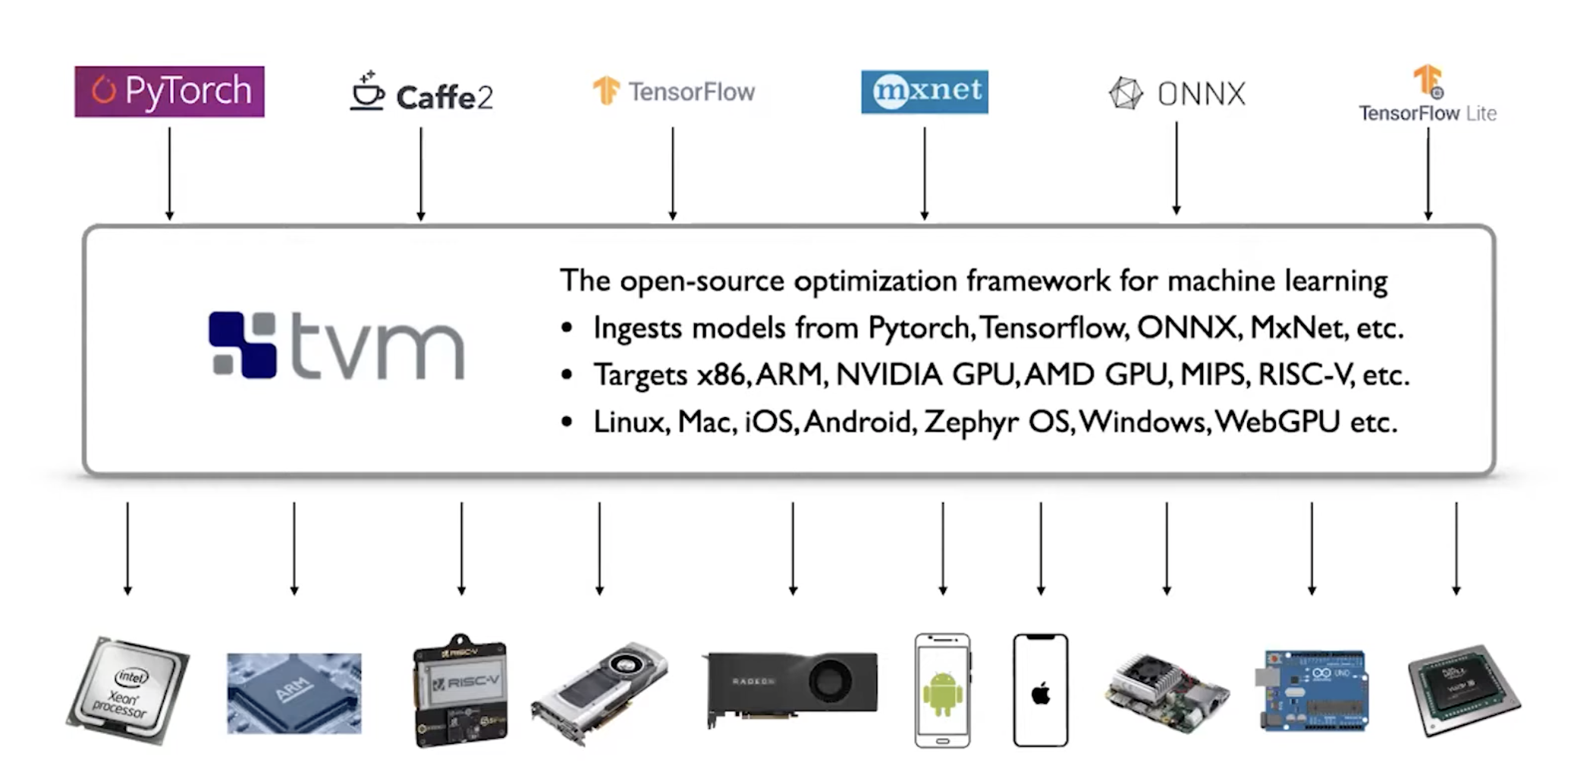
TVM: input/output

Slide 3
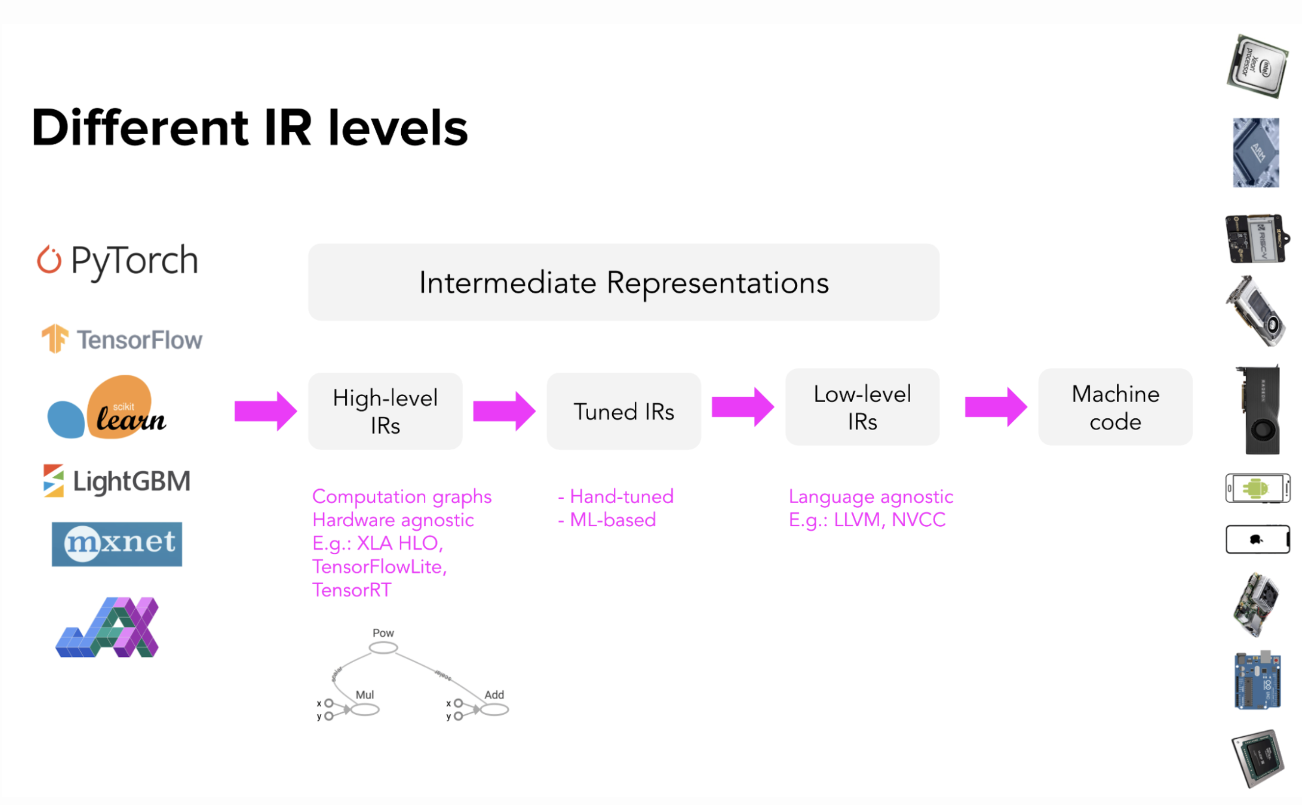
TVM compiler flow

Slide 4
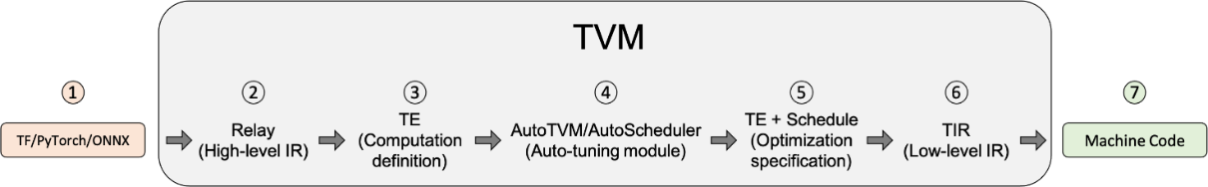
TVM compiler flow
1. Input model from ONNX, Pytorch, Tensorflow,...

Slide 5
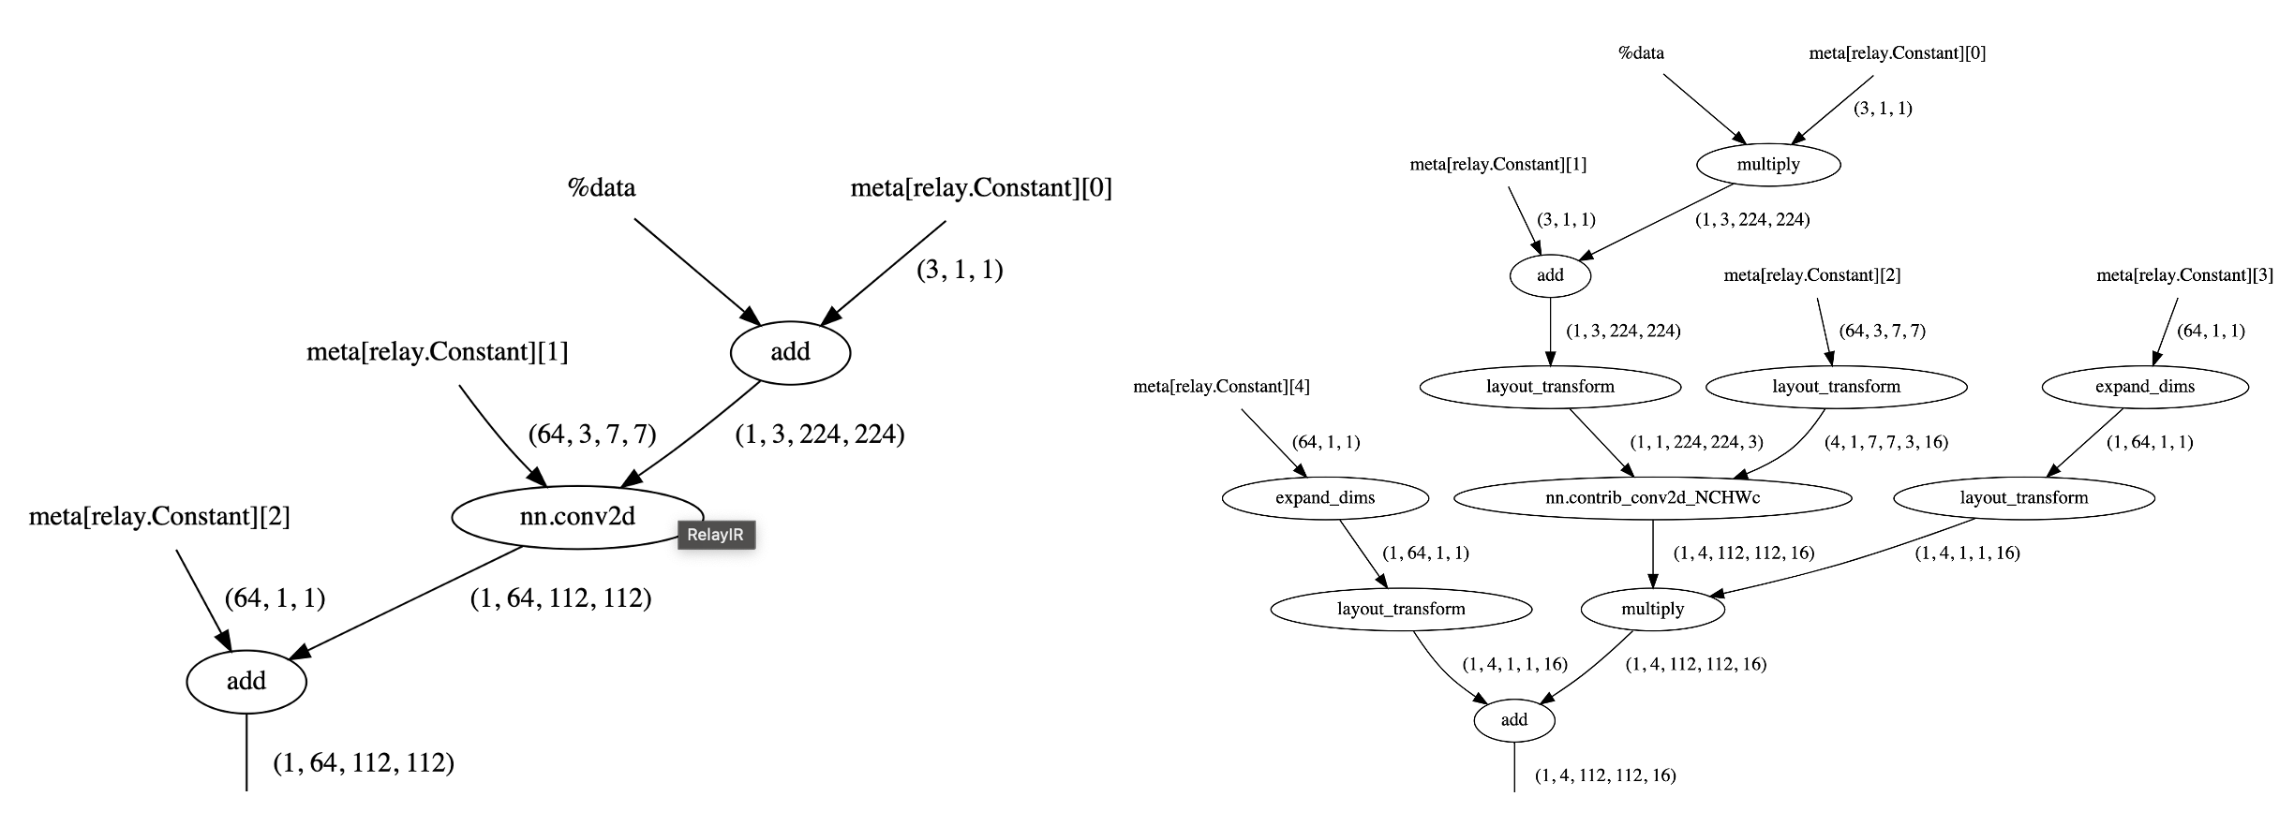
TVM compiler flow
2. Parse model to Relay, a kind of Directed Acyclic Graph
and apply Relay transformations, such as Operator Fusion, Layout Transformation

Slide 6
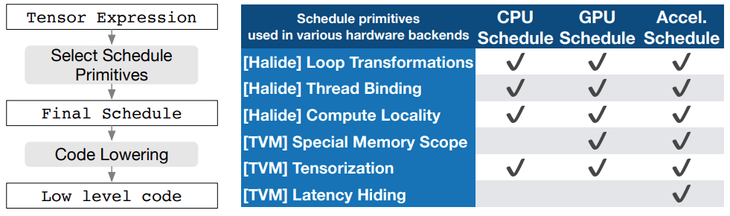
TVM compiler flow
3. Model is lowered to TE (Tensor Expression) by FuseOps pass
TE is a domain-specific language to describe tensor computation.
TVM provides schedule primitives to implement low-level (hardware-aware) optimization.
schedule primitives is a set of transformations used to simplify and optimize tensor computation to hardware.

Slide 7
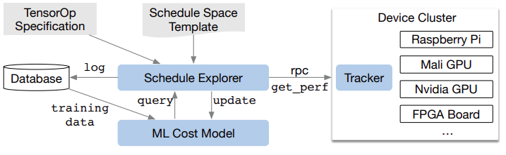
TVM compiler flow
4. Find the best way to deploy schedule primitives for tensor-expressed model to the target hardware.
Schedule Exporer examines the schedule space using an ML-cost model and chooses experiments to run on distributed device cluster via RPC.
Measurement data is collected during exploration.
Not require detailed hardware configuration.

Slide 8
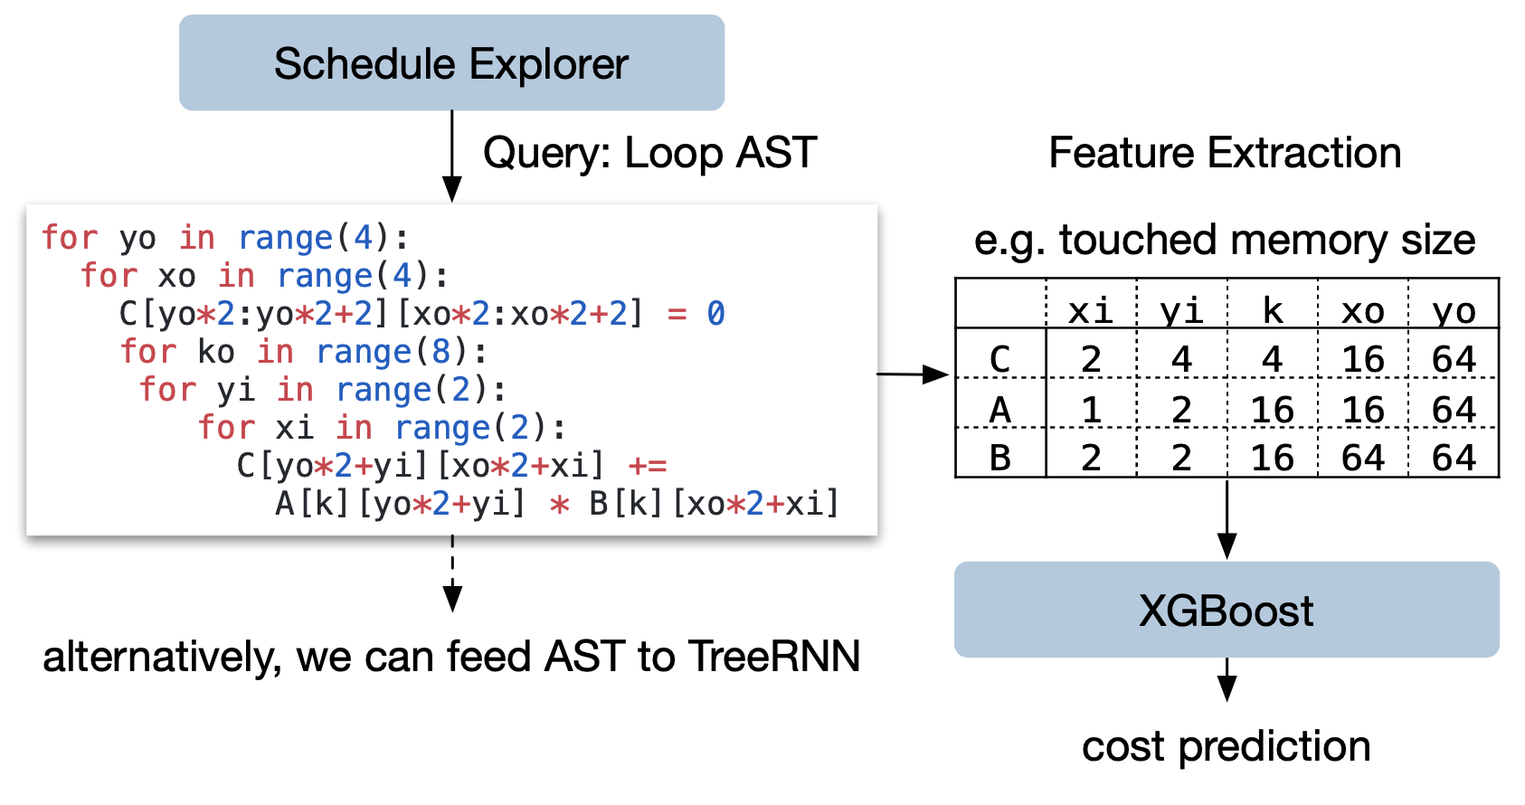
TVM compiler flow
4. Find the best way to deploy schedule primitives for tensor-expressed model to the target hardware.
ML-cost model:
gradient-boosting model
predicts running time on hardware backend
trained by real measurement data
inference time = 1000x faster than real measurement

Slide 9
TVM compiler flow
5. Computation graph of model after optimization is saved to “.json” file.
Lower to TIR (Tensor Intermediate Representation) and apply low-level optimization such as access index simplification & dead code elimination
6. Compile TIR to hardware, TVM supports:
LLVM
NVCC (NVIDIA’s CUDA Compiler), OpenCL
Customed compiler (via TVM Bring Your Own Codegen)

Slide 10
Device/Target Interactions
Compile low-level TIR to TVM runtime on hardware
How the TVM framework interacts with specific device APIs, or who may want to implement support for
a new API or new hardware.
3 main aspects:
DeviceAPI for querying device parameters (avail. memory, num. of threads,…) and simple actions (copy mem. from host or between buffers on the device).
Target contains description of device on which functions will run. Target exposes both to target code generators and to optimization passes
The target code generators construct a Module consisting of one or more PackedFunc, from an IRModule.

Slide 11
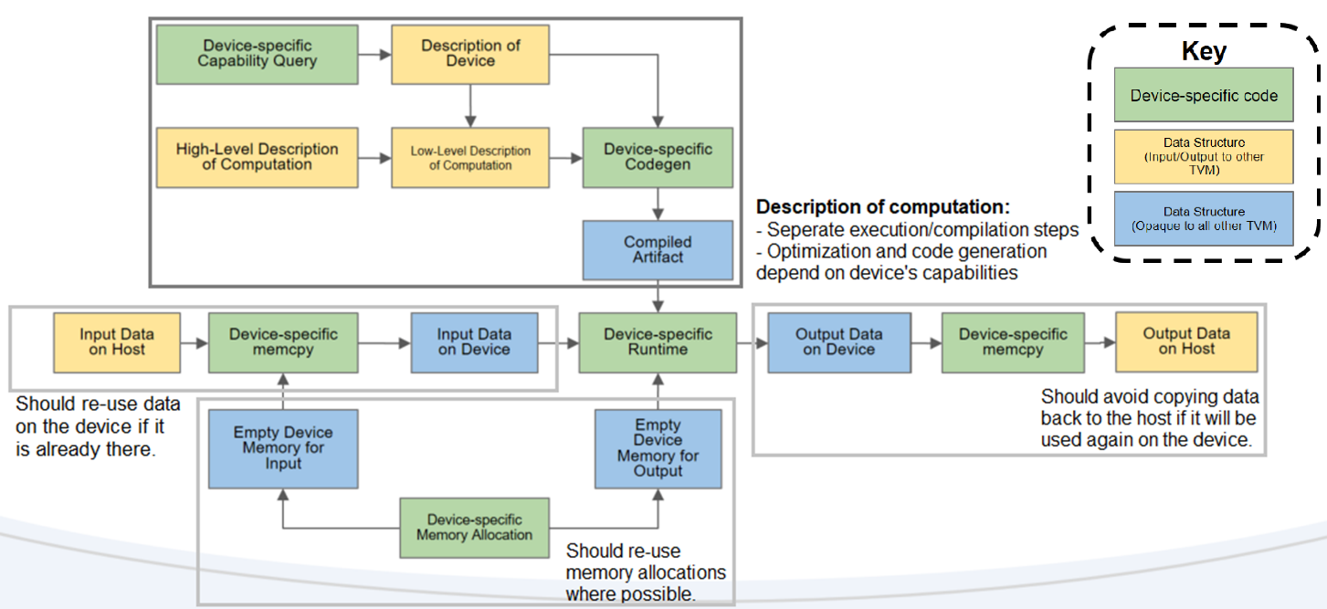
Device/Target Interactions

Slide 12
UMA: Universal Modular Accelerator Interface

Slide 13
Applying TVM to gencode C for ASIP
Known approaches to add ASIP hardware to TVM:
1. TVM BYOC:
A bridge from hardware provider to user.
Hardware backend provider can easily implement your own codegen and register it as a Relay backend compiler to support your hardware device/library.
=> CHALLENGING! Need someone who has backend and codegen background!
2. Generate code C for ASIP
Can generate from .tflte and .onnx model to pure code C.
TVM Runtime (no external libraries are used) checks generated code C by random input tensor. => Generated code are compatible with LLVM front-end. => Generated code can not use custom variables or functions of ASIP.

