Slide 1
Systems Analysis and Design 5th Edition Chapter 2. Project Selection and Management
Roberta Roth, Alan Dennis, and Barbara Haley Wixom

Slide 2
Chapter 2 Outline
Project selection.
Creating the project plan.
Managing and controlling the project.

Slide 3
INTRODUCTION
CIOs (chief information officers) are challenged to select projects that will provide highest return on the IT investments.
Project portfolio management has become a critical success factor for IT departments.
A selected system development project must undergo a thorough process of project management.
A critical success factor for project management is to start with a realistic assessment of the work and then manage the project according to the plan.

Slide 4
PROJECT SELECTION
Systems projects today are evaluated in the context of an entire portfolio of projects.
Determination of a project’s contribution to an entire portfolio of a project reinforces the need for a feasibility study.
Portfolio management takes into consideration the different of projects that exist in an organization.

Slide 5
(cont’d)
An approval committee must be selective about where to allocate resources as most organizations have limited funds.
If there are several potentially high-payoff projects, and they all have the same risk, then maybe only one of the projects will be selected.

Slide 6
CREATING THE PROJECT PLAN
Project management phases consist of
- initiation
- planning
- execution
- control, and
- enclosure.

Slide 7
Project Methodology Options
A methodology is a formalized approach to implementing the SDLC.
- Waterfall Development
- Parallel Development
- V-model (variation of the Waterfall Development)
- Rapid Application Development (RAD)
- Iterative Development
- System prototyping
- Agile Development

Slide 8
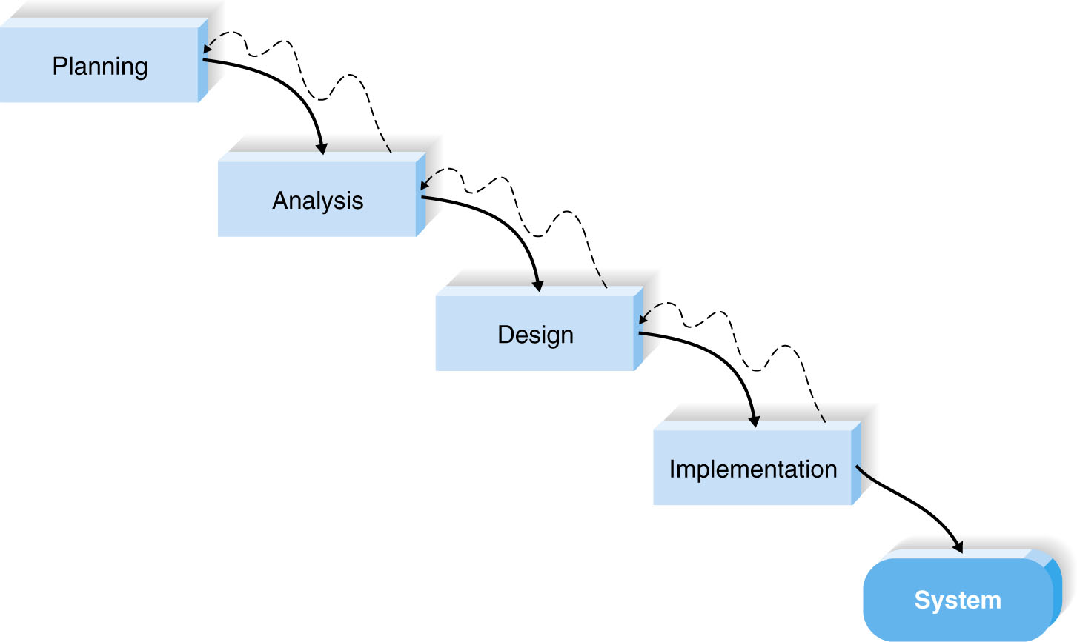
Waterfall Development

Slide 9
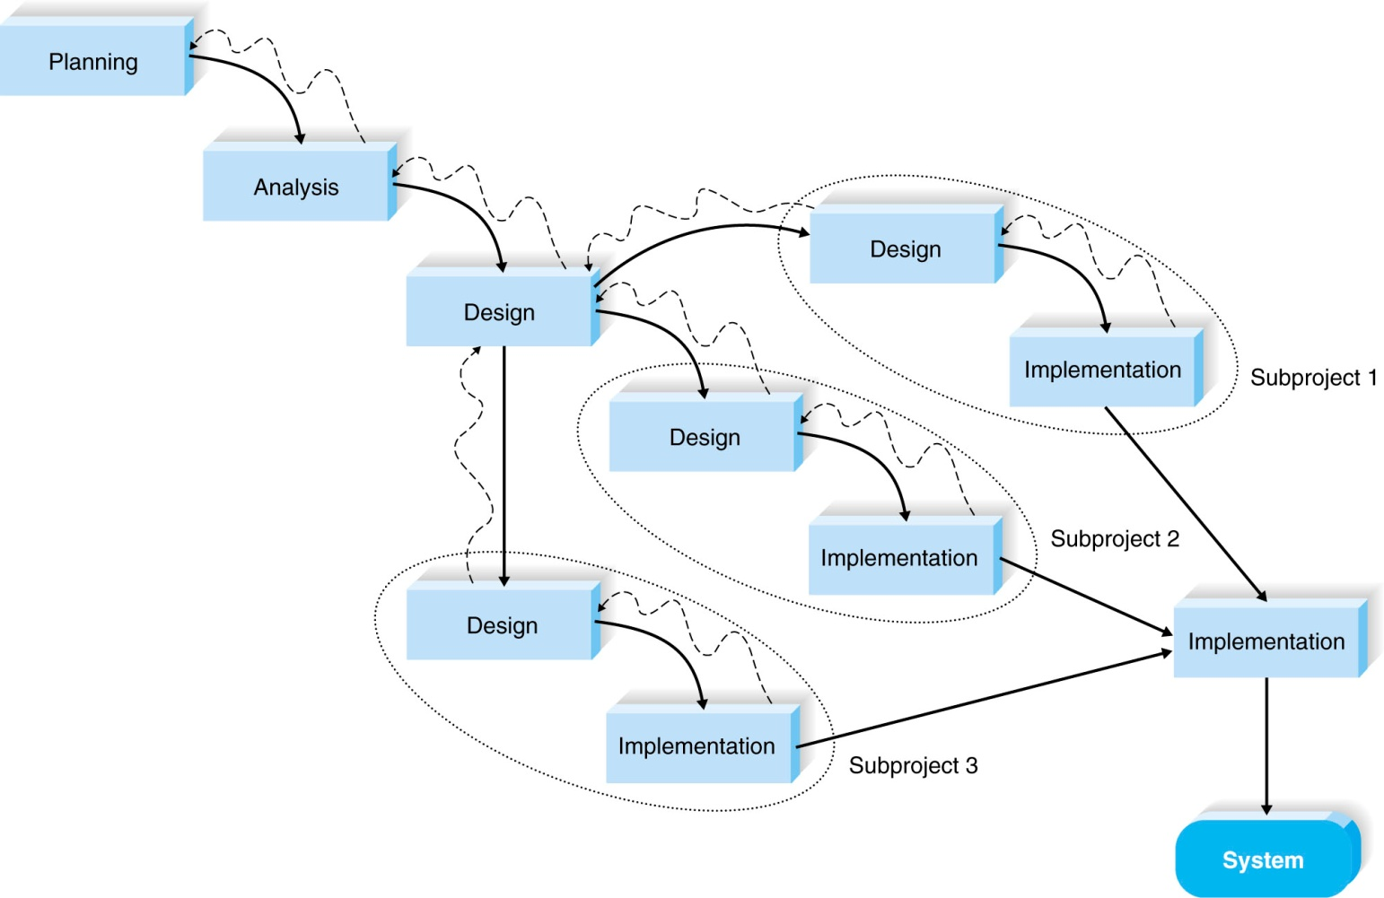
Parallel Development

Slide 10
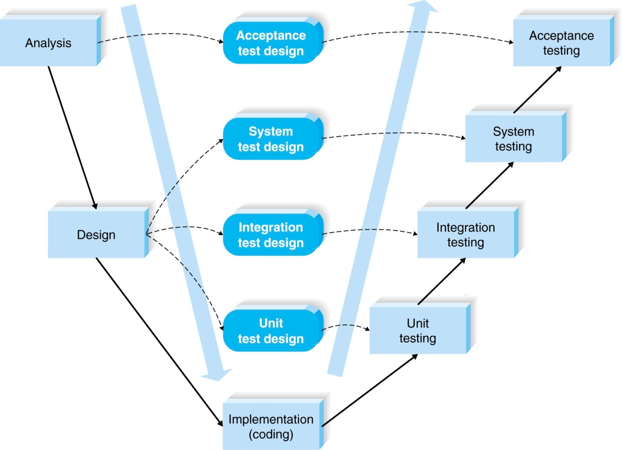
V-model

Slide 11
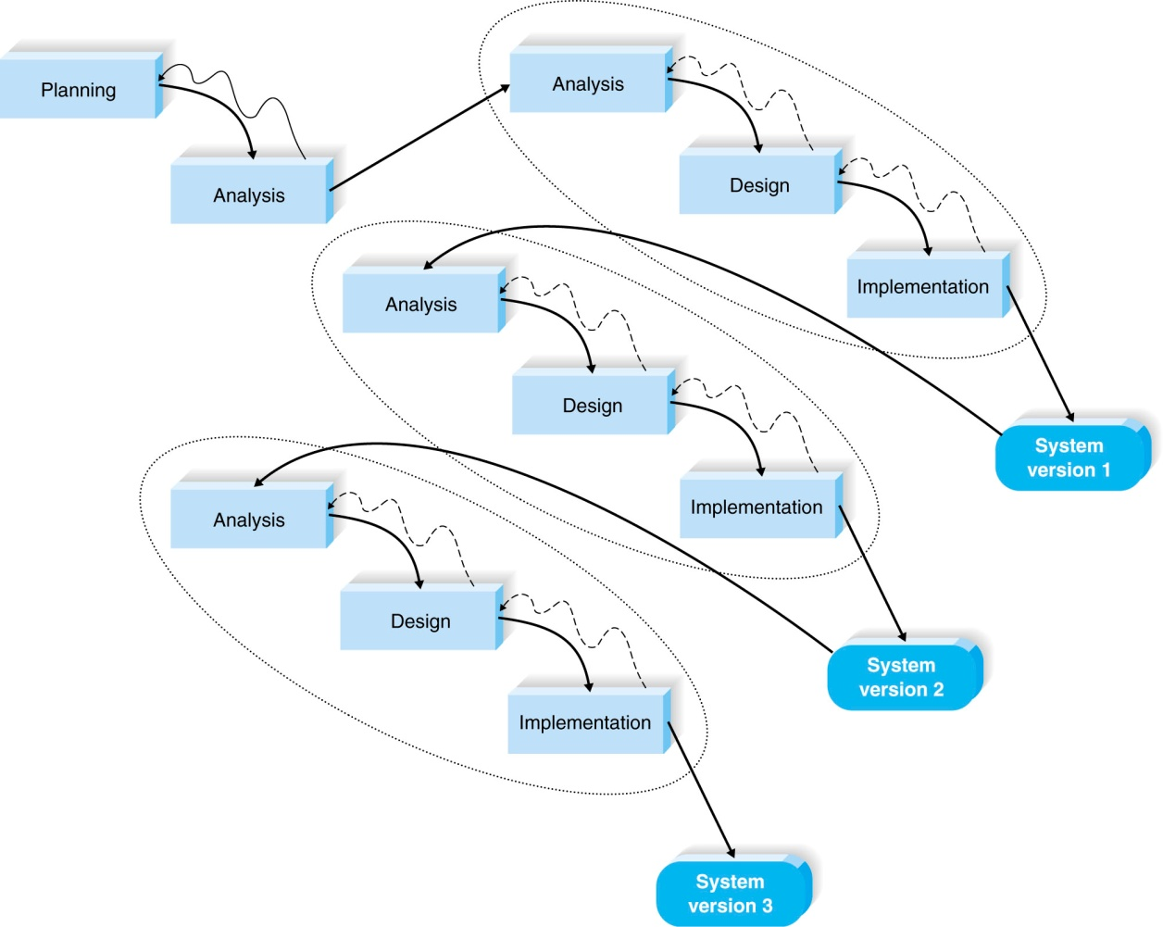
Rapid Application Development: Iterative Development

Slide 12
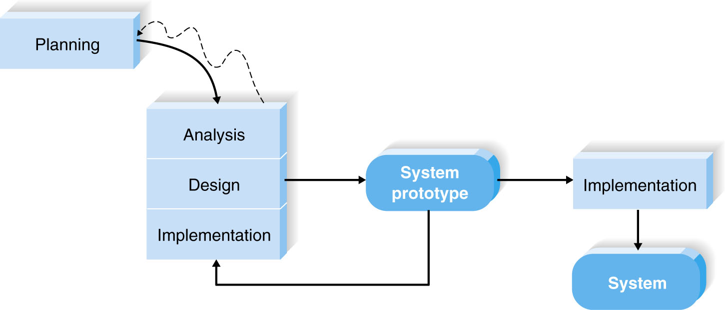
Rapid Application Development: System Prototyping

Slide 13
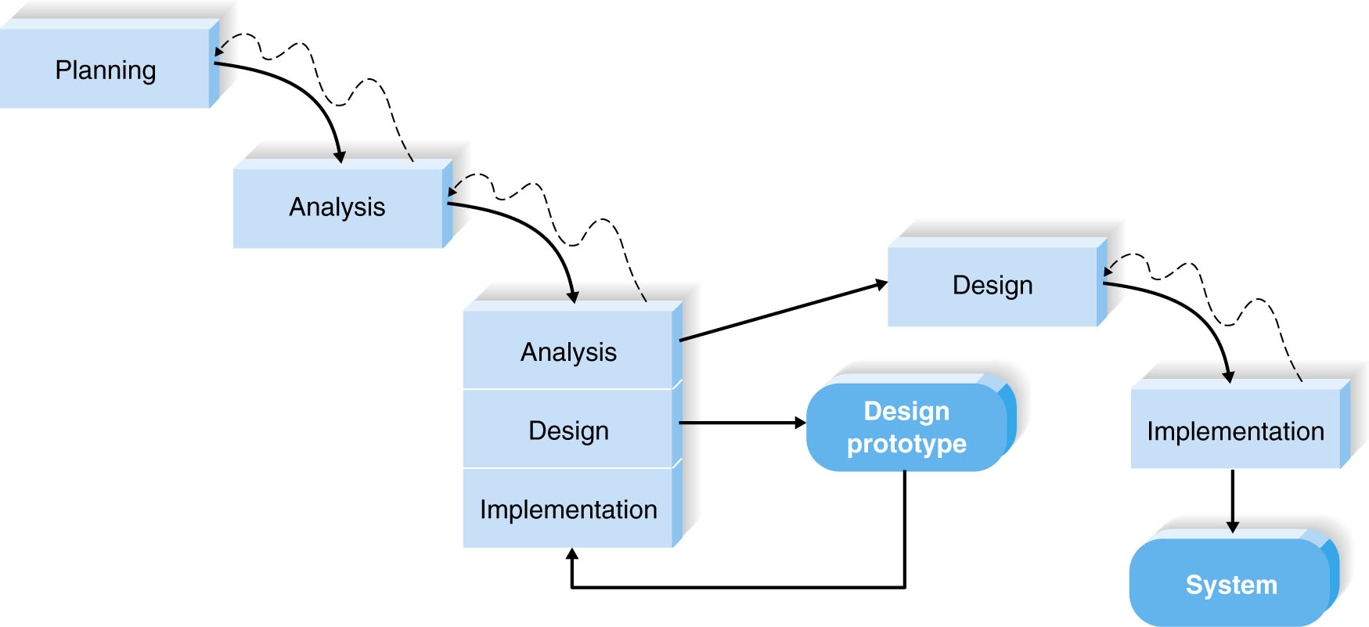
(cont’d)
Throwaway prototyping

Slide 14
Agile Development
A group of programming-centric methodologies that focus on streamlining the SDLC.
Includes face-to-face communication
Extreme programming – emphasizes customer satisfaction and teamwork.

Slide 15
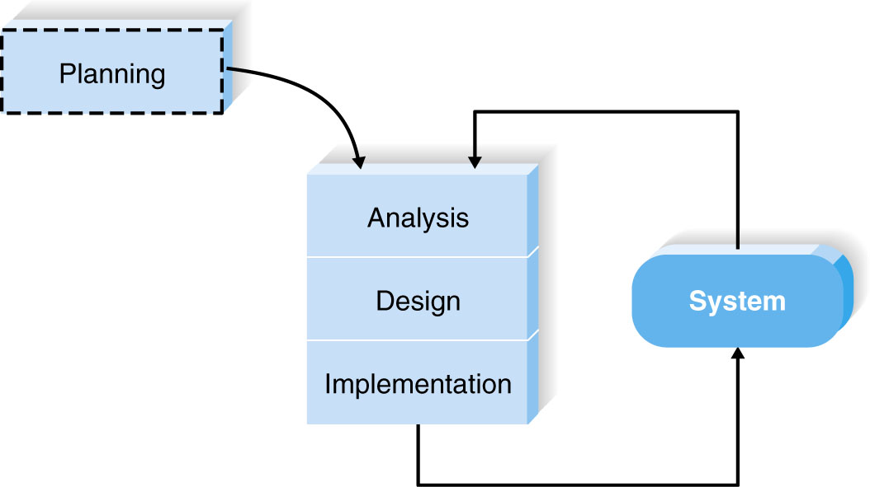
Extreme Programming

Slide 16
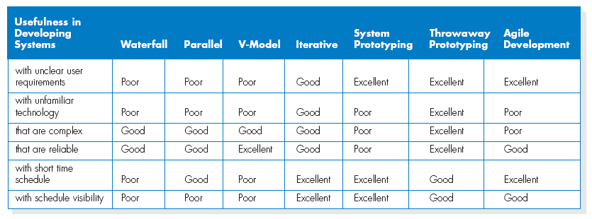
Selecting the Appropriate Development Methodology

Slide 17
(cont’d)
Important factors to consider in selecting the development methodology
- Clarity of User Requirements
- Familiarity with Technology
- System Complexity
- System Reliability
- Short Time Schedules
- Schedule Visibility

Slide 18
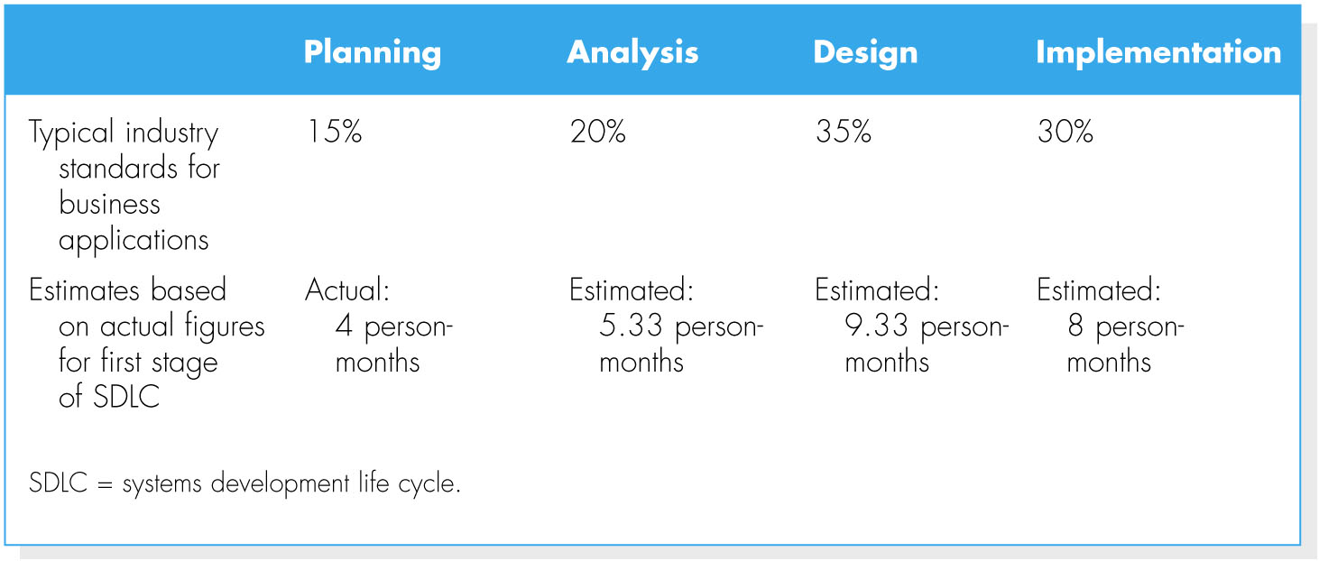
Estimating the Project Time Frame
1. Estimating Project Time Using Industry Standards
2. Function point approach (Appendix 2A)

Slide 19
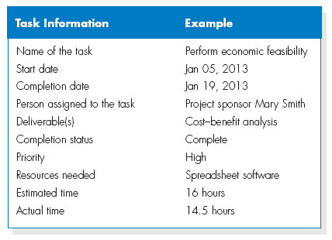
Developing the Work Plan
Identify Tasks

Slide 20
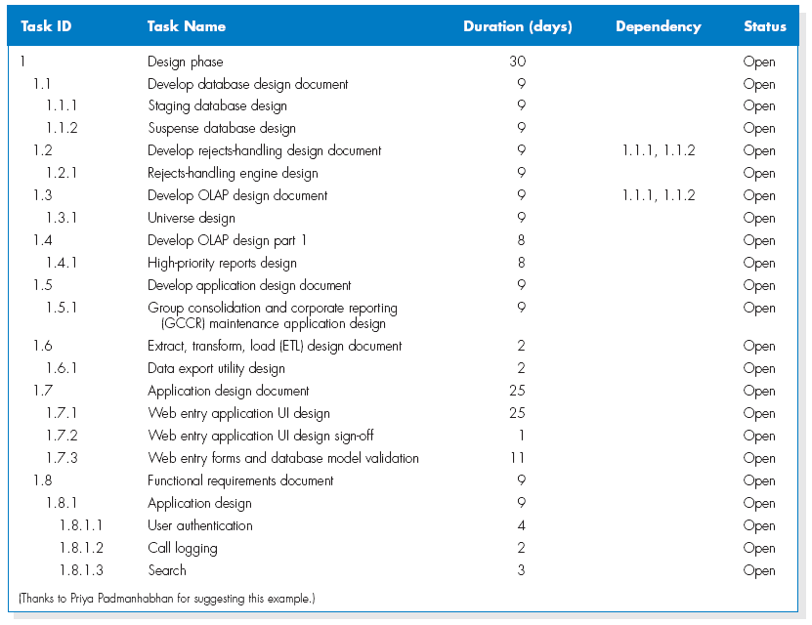
(cont’d)
Work Breakdown Structure

Slide 21
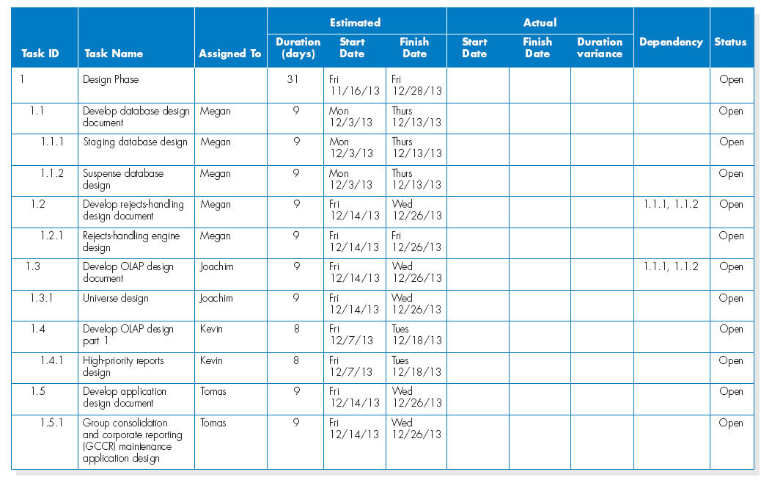
(cont’d)
The project work plan

Slide 22
STAFFING THE PROJECT
Staffing Plan
- Staffing levels will change over a project’s lifetime
- Adding staff may add more overhead than additional labor
- Using teams of 8-10 reporting in a hierarchical structure can reduce complexity

Slide 23
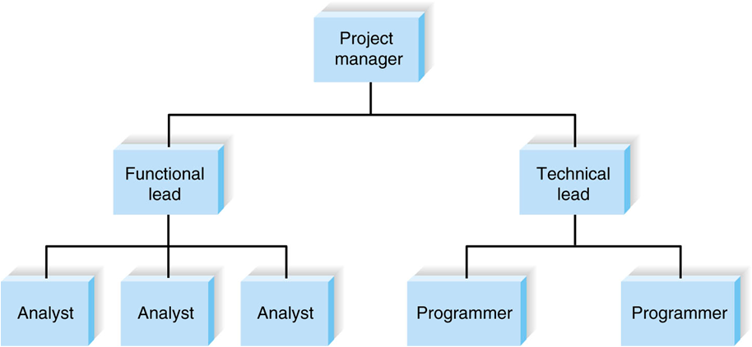
(cont’d)
Reporting structure

Slide 24
(cont’d)
The staffing plan describes the kinds of people working on the project
The project charter describes the project’s objectives and rules
A functional lead manages a group of analysts
A technical lead oversees progress of programmers and technical staff members

Slide 25
Motivation
Use monetary rewards cautiously
Use intrinsic rewards
Recognition
Achievement
The work itself
Responsibility
Advancement
Chance to learn new skills

Slide 26
Handling Conflict
Clearly define plans for the project.
Recognize project importance to organization.
Project charter listing norms and ground rules.
Develop schedule commitments ahead of time.
Forecast other priorities and their possible impact on the project.

Slide 27
Coordinating Project Activities
CASE (computer-aided software engineering) tools – A category of software that automate all or part of the development process.
- Upper CASE
- Lower CASE
- Integrated CASE

Slide 28
(cont’d)
Standards
Formal rules for naming files
Forms indicating goals reached
Programming guidelines
Documentation
Project binder
Table of contents
Continual updating

Slide 29
MANAGING AND CONTROLLING THE PROJECT
The science (or art) of project management is in making trade-offs among three important concepts:
- the size of the system,
- the time to complete the project, and
- the cost of the project.

Slide 30
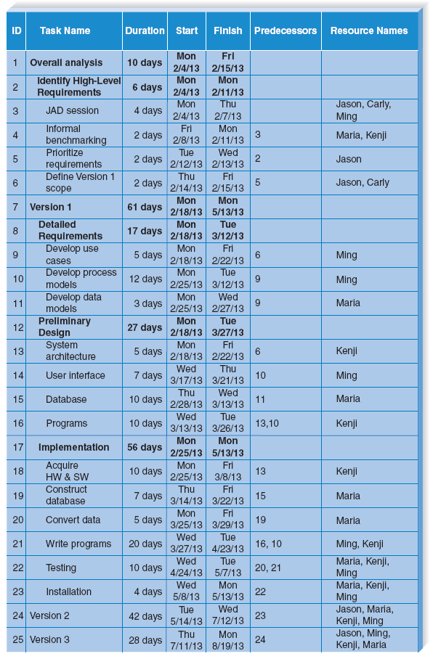
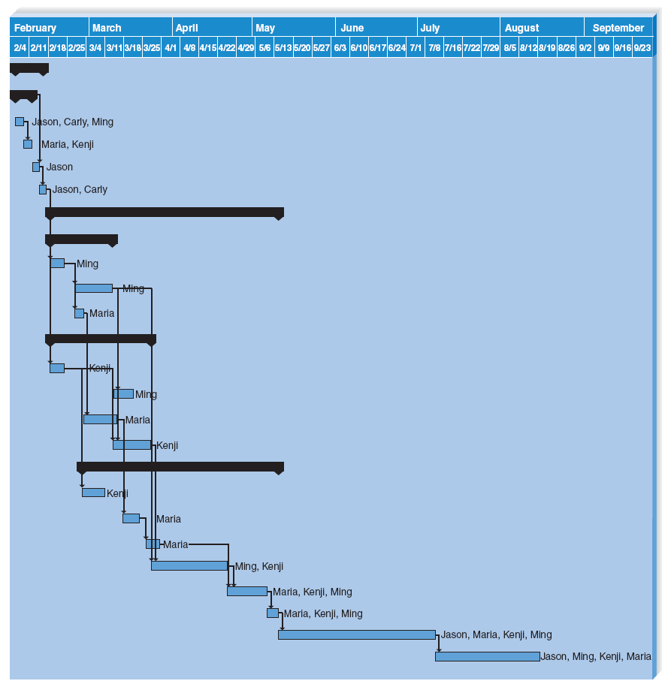
(cont’d)
Tools for project management – Example of Gantt Chart

Slide 31
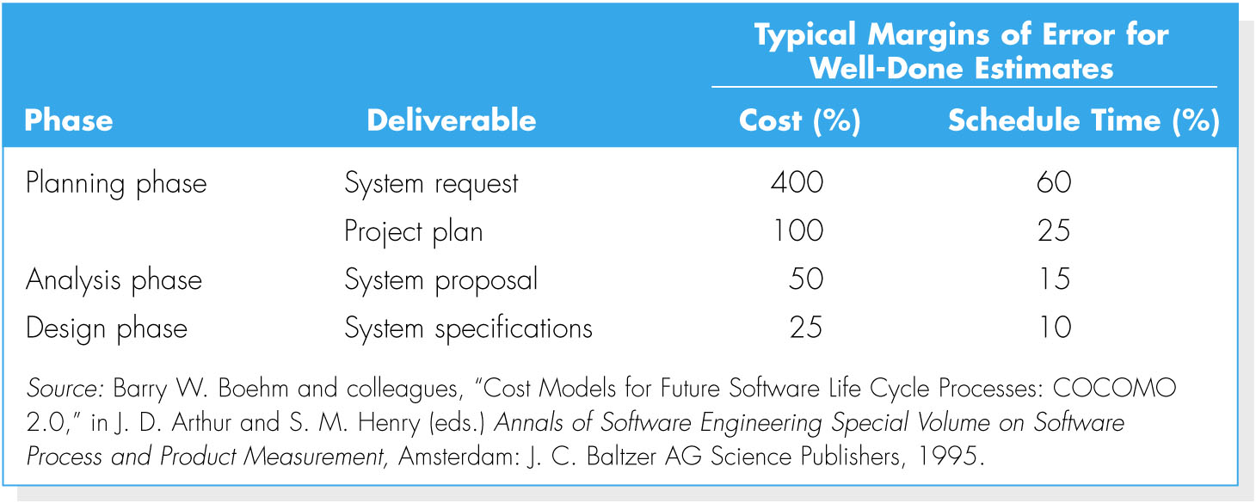
Refining Estimates

Slide 32
Managing Scope
Scope creep – the most common reason for schedule and cost overruns occurs after the project is underway.
The project manager should allow only absolutely necessary requirements to be added after the project begins.

Slide 33
Timeboxing
Set a fixed deadline for a project
Reduce functionality, if necessary
Don’t get hung up on the final “finishing touches”

Slide 34
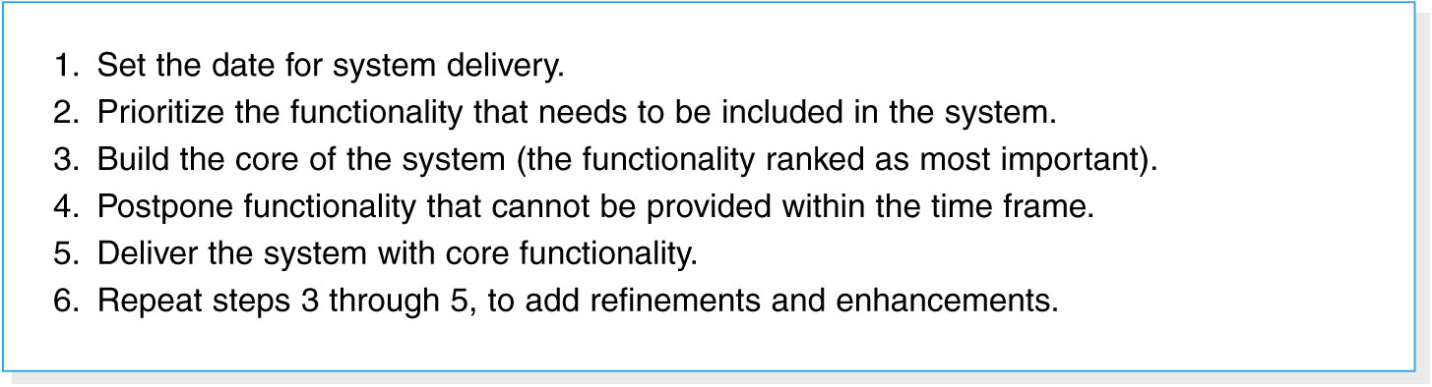
Timeboxing steps

Slide 35
Managing Risk
Risk assessment
Actions to reduce risk
Revised assessment

Slide 36
SUMMARY
The project selection process takes into account all of the projects in the organization, using project portfolio management.
The project plan defines the tasks, task time estimates, and other information.
A project requires staffing and coordinating project activities.
Managing and controlling the project include timeboxing and risk assessment.

Slide 37
Copyright 2011 John Wiley & Sons, Inc.
All rights reserved. Reproduction or translation of this work beyond that permitted in Section 117 of the 1976 United States Copyright Act without the express written permission of the copyright owner is unlawful. Request for further information should be addressed to the Permissions Department, John Wiley & Sons, Inc. The purchaser may make back-up copies for his/her own use only and not for redistribution or resale. The Publisher assumes no responsibility for errors, omissions, or damages, caused by the use of these programs or from the use of the information contained herein.

