Slide 1
Systems Analysis and Design 5th Edition Chapter 4. Use Case Analysis
Roberta Roth, Alan Dennis, and Barbara Haley Wixom

Slide 2
Chapter 4 Outline
Use Cases
Elements of a use case.
Alternative use case formats.
Use cases and functional requirements.
Use cases and testing.
Building use cases.

Slide 3
INTRODUCTION
Use cases are a means of expressing user requirements.
Use cases are used extensively in the analysis phase.
A use case represents how a system interacts with its environment by illustrating the activities that are performed by the users and the system’s responses.
The text-based use case is easy for the users to understand, and also flows easily into the creation of process models and the data model.

Slide 4
USE CASES
A use case depicts a set of activities that produce some output result.
Each use case describes how an external user triggers an event to which the system must respond.
With this type of event-driven modeling, everything in the system can be thought of as a response to some triggering event.
Creation of use cases is often done as a part of interview session with users or a part of JAD sessions.

Slide 5
Elements of a Use Case
Basic Information
Each use case has a name and number, and brief description.
The priority may be assigned to indicate the relative significance.
The actor refers to a person, another system, or a hardware device that interacts with the system to achieve a useful goal.
The trigger for the use case – the event that causes the use case to begin.

Slide 6
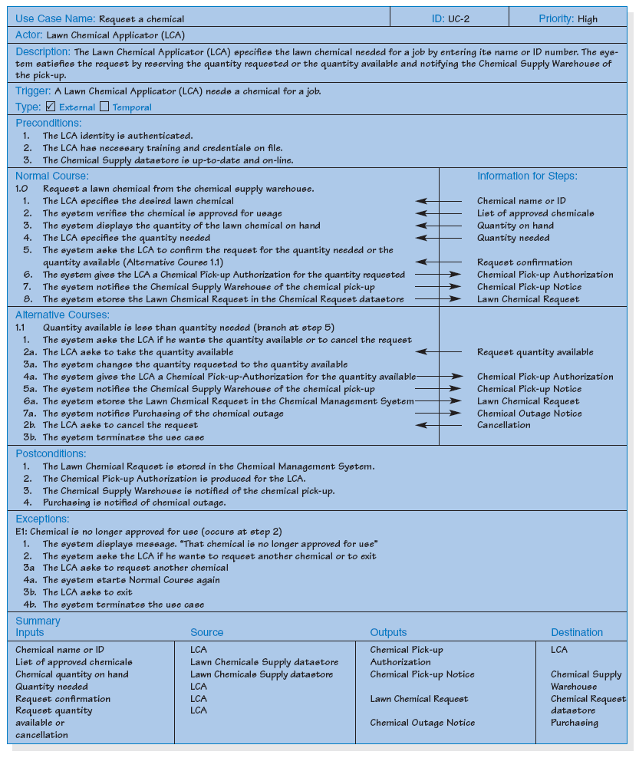
Example

Slide 7
Preconditions
It is common practice to create smaller, more focused use cases breaking the whole process down into parts.
It is important to define clearly what needs to be accomplished before each use case begins.
The preconditions define the state the system must be in before the use case commences.

Slide 8
Normal Course
The next part of a use case is the description of the major steps that are performed to execute the response to the event, the inputs used for the steps, and the outputs produced by the steps.
The normal course lists the steps.

Slide 9
Alternative Courses
Alternative courses depict branches (alternative paths of the steps) in logic that also will lead to a successful conclusion of the use case.

Slide 10
Postconditions
The postconditions section of defines the final product of the use case.
These postconditions also serve to define the preconditions for the next use case in the series.

Slide 11
Exceptions
A use case should describe any error conditions or exceptions that may occur as the use case steps are performed.
These are not normal branches in decision logic, but are unusual occurrences or errors that could potentially be encountered and will lead to an unsuccessful result.

Slide 12
Summary of Inputs and Outputs
The final section of the use case summarizes the set of major inputs and outputs of the use case, along with their source or destination.

Slide 13
Additional Use Case Issues
Additional sections may be included, e.g.,
- Frequency of use
- Business rules
- Special requirements
- Assumptions
- Notes and issues

Slide 14
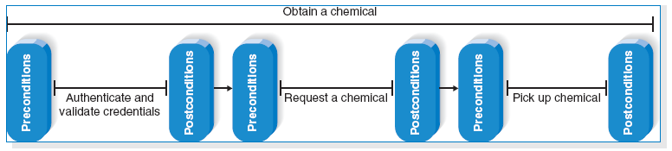
Chain of use cases – an example

Slide 15
Alternative Use Case Formats
A full-dressed use case is very thorough, detailed, and highly structured.
The project team may decide that a more casual use case format is acceptable.

Slide 16
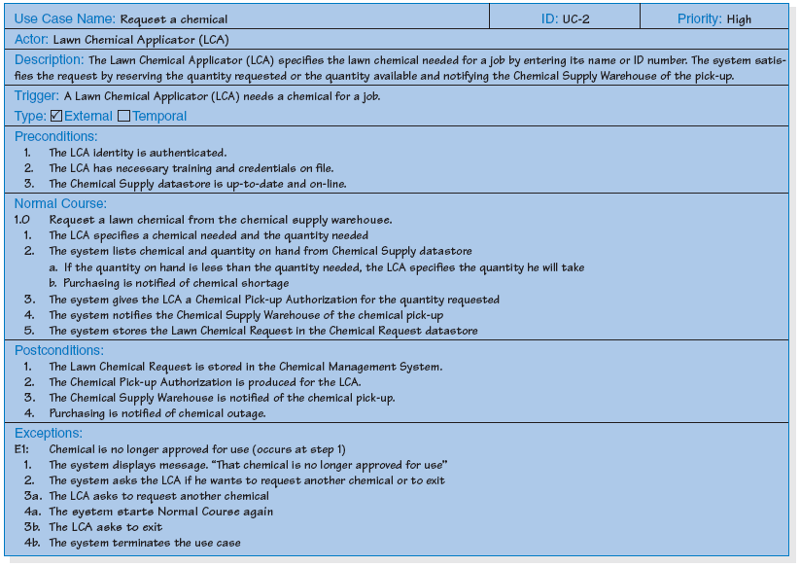
Example

Slide 17
Use Cases and the Functional Requirements
Use cases are very useful tools to us to understand user requirements. However, use cases only convey the user’s point of view.
Transforming the user’s view into the developer’s view by creating functional requirements is one of the important contributions of system analyst.
The derived functional requirements give more information to the developer about what the system must do.

Slide 18
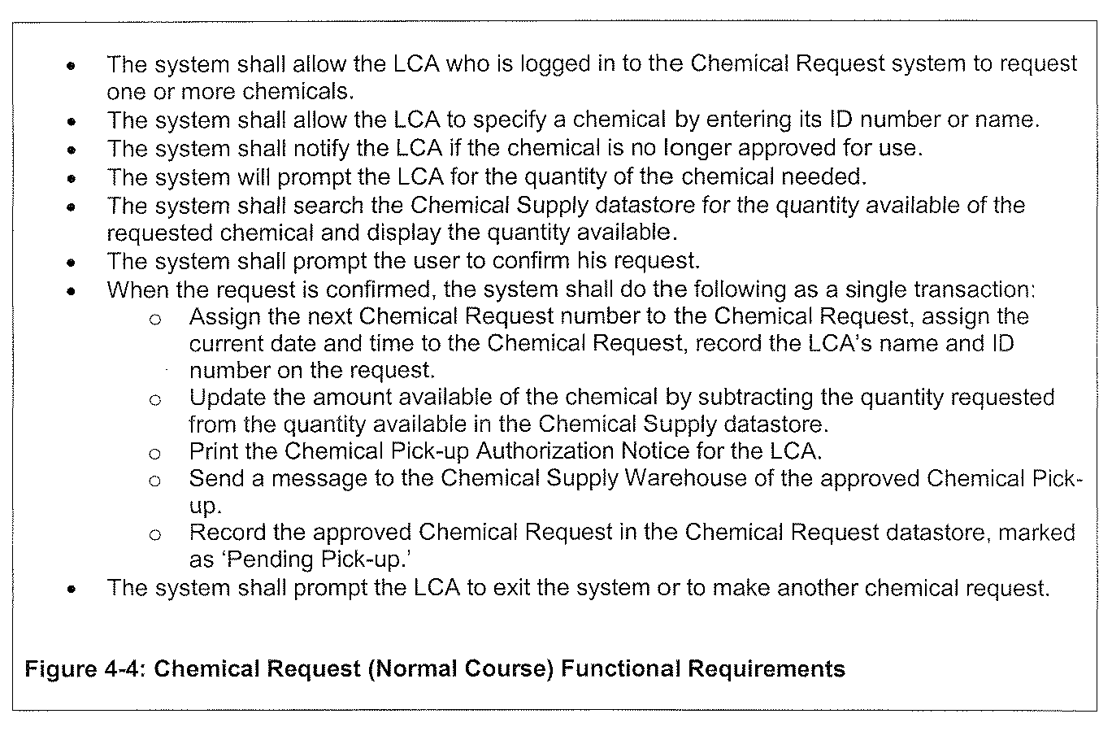
Example

Slide 19
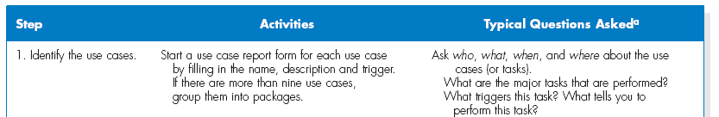
Use Cases and Testing
Building Use Cases
Step 1: Identify the major use cases

Slide 20
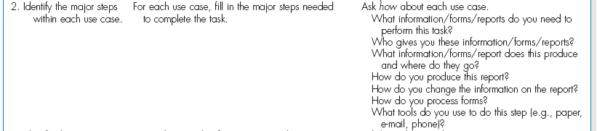
Step 2: Identify the major steps for each use case

Slide 21
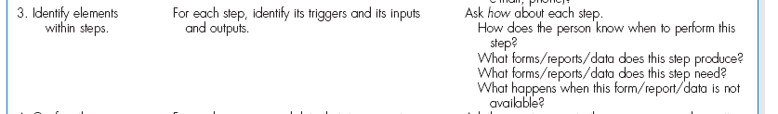
Step 3: Identify elements within steps

Slide 22
Step 4. Confirm the use case

Slide 23
Revise functional requirements based on use cases
The functional requirements in the requirements definition may be modified to reflect the more detailed understanding and to provide insight to the development team on some “back-end” processing.

Slide 24
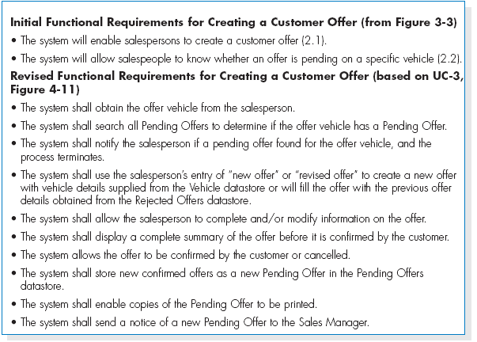
Example

Slide 25
SUMMARY
A use case contains all the information needed to build one part of a process model, expressed in an informal, simple way.
When writing a use case,
- identify the triggering event,
- develop a list of the major steps,
- identify the input(s) and output(s) for every step,
- have the users role-play the use case to verify.

Slide 26
Copyright 2011 John Wiley & Sons, Inc.
All rights reserved. Reproduction or translation of this work beyond that permitted in Section 117 of the 1976 United States Copyright Act without the express written permission of the copyright owner is unlawful. Request for further information should be addressed to the Permissions Department, John Wiley & Sons, Inc. The purchaser may make back-up copies for his/her own use only and not for redistribution or resale. The Publisher assumes no responsibility for errors, omissions, or damages, caused by the use of these programs or from the use of the information contained herein.

