Slide 1
Systems Analysis and Design 5th Edition Chapter 5. Process Modeling
Roberta Roth, Alan Dennis, and Barbara Haley Wixom

Slide 4
Chapter 5 Outline
Data flow diagrams.
- Reading data flow diagrams
- Elements of data flow diagrams
- Using data flow diagrams to define business processes
- Process descriptions
Creating data flow diagrams.

Slide 5
INTRODUCTION
A process model can be used to further clarify the requirements definition and use cases.
A process model is a graphical way of representing how a business system should operate.
A process model can be used to document the as-is system or the to-be system, whether computerized or not.

Slide 6
(cont’d)
Data flow diagramming is a technique that diagrams the business processes and the data that pass among them.
Logical process models describe processes without suggesting how they are conducted.
Physical process models provide information that is needed to build the system.

Slide 7
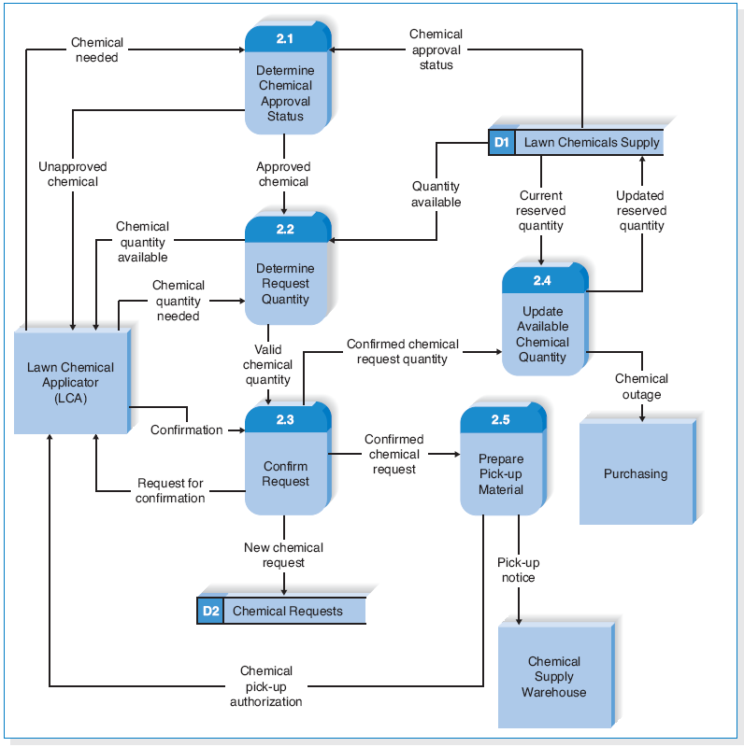
DATA FLOW DIAGRAMS (DFDs)
Reading Data Flow Diagrams

Slide 8
Elements of Data Flow Diagrams
Process – A process is an activity or a function performed for some specific business reason.
Data Flow – A data flow is a single piece of data, or a logical collection of several pieces of information.
Data Store – A data store is a collection of data that is stored in some way.
External Entity – An external entity is a person, organization, organization unit, or system that is external to the system, but interacts with it.

Slide 9
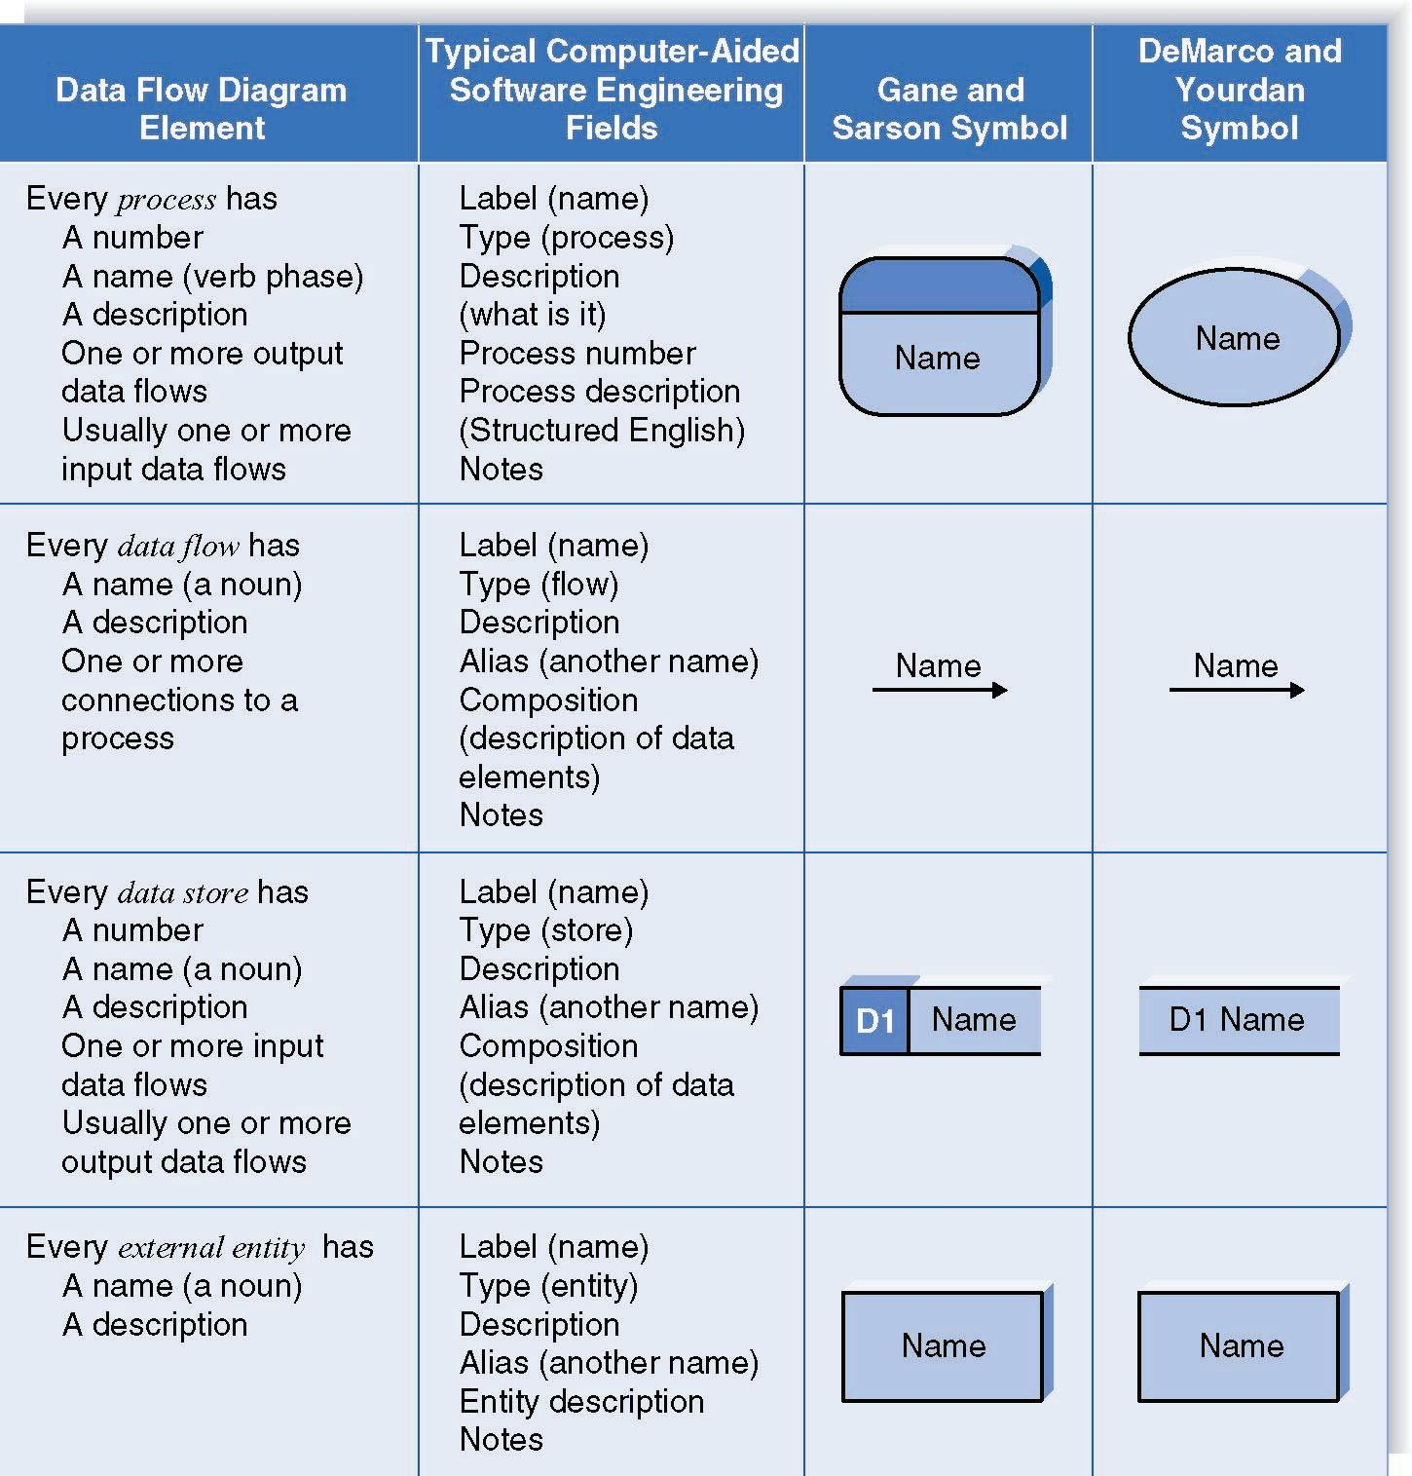
(cont’d)

Slide 10
Using DFDs to Define Business Processes
Business processes are too complex to be explained in one DFD.
One important principle in process modeling with DFDs is the decomposition of the business process into a series of DFDs, each representing a lower level of detail.

Slide 11
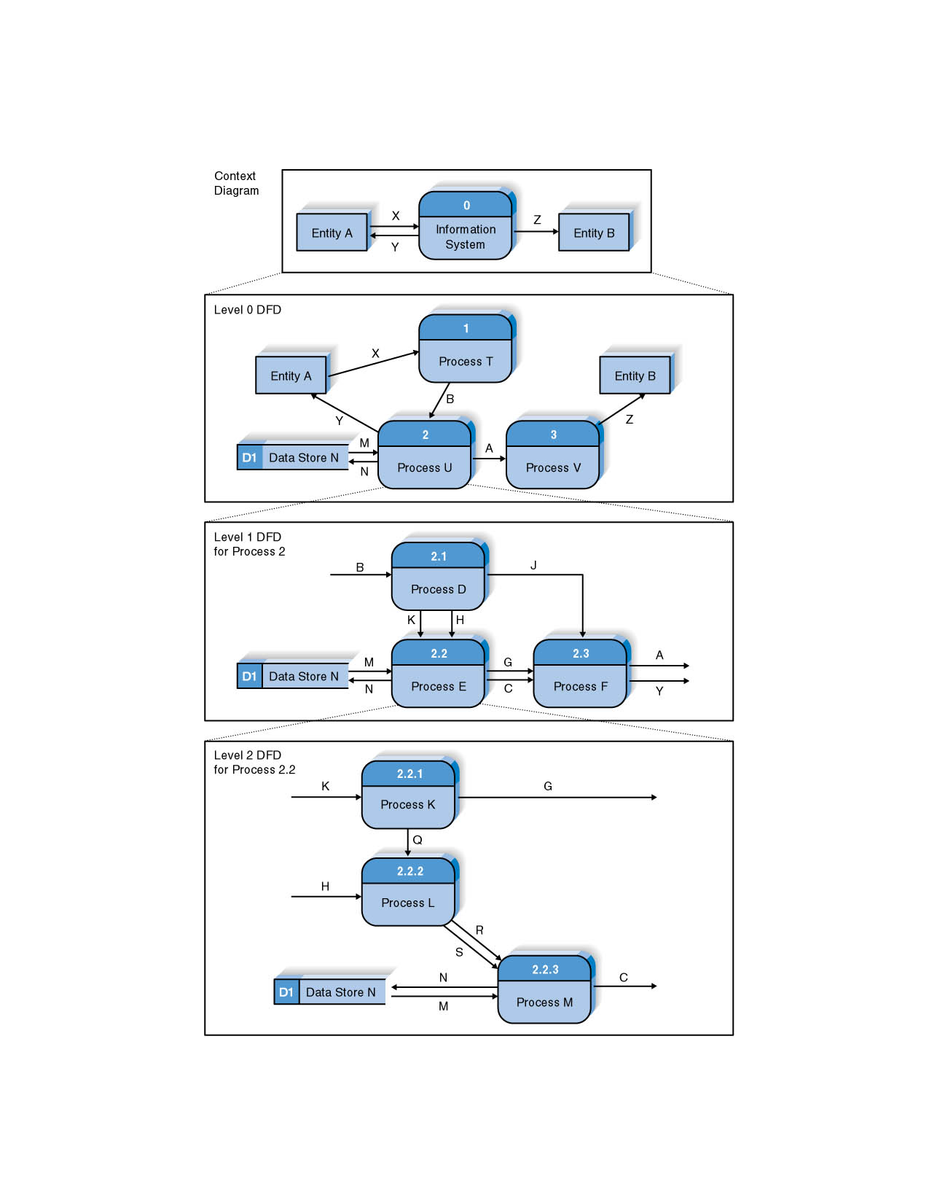
(cont’d)
Decomposition

Slide 12
Context Diagram
The first DFD in every business process is the context diagram.
It shows the entire system in context with its environment.
The context diagram shows the overall business process as just one process and shows the data flows to and from external entities.

Slide 13
Level 0 Diagram
The level 0 diagram (or level 0 DFD) shows all the major high-level processes of the system and how they are interrelated.
The Level 0 diagram shows all the processes at the first level the numbering, the data stores, external entities, and data flows among them.
A key concept: Balancing
- Ensuring that all information presented in a DFD at one level is accurately represented in the next-level DFD.
A process model has one and only one level 0 DFD.

Slide 14
Level 1 Diagrams
Each process on the level 0 DFD can be decomposed into a more explicit DFD called level 1 diagram (or level 1 DFD).
The set of children and the parent are identical; they are simply different ways of looking at the same thing.
It is important to ensure that level 0 and level 1 DFDs are balanced.

Slide 15
(cont’d)
All process models have as many level 1 diagrams as there are processes on the level 0 diagram.
The parent process and the children processes are numbered consistently.

Slide 16
Level 2 Diagrams
The next level of decomposition: a level 2 diagram, or level 2 DFD.
A level 2 DFD shows all processes, data flows, and data stores that comprise a single process on the level 1 diagram.
It is important to ensure that level 1 and level 2 DFDs are balanced.

Slide 17
Alternative Data Flows
A process can produce different data flows under different circumstance.
We show both data flows and use the process description to explain why they are alternatives.

Slide 18
Process Descriptions
The purpose of the process descriptions is to explain what the process does and provide additional information that the DFD does not provide.
Three techniques are commonly used to describe more complex processing logic:
Structured English
Decision trees
Decision tables

Slide 19
CREATING DATA FLOW DIAGRAMS
DFDs start with the information in the use cases and the requirements definition.
Generally, the set of DFDs integrates the individual use cases.
The project team takes the use cases and rewrites them as DFDs, following the DFD formal rules about symbols and syntax.
CASE tools are used to draw process models.

Slide 20
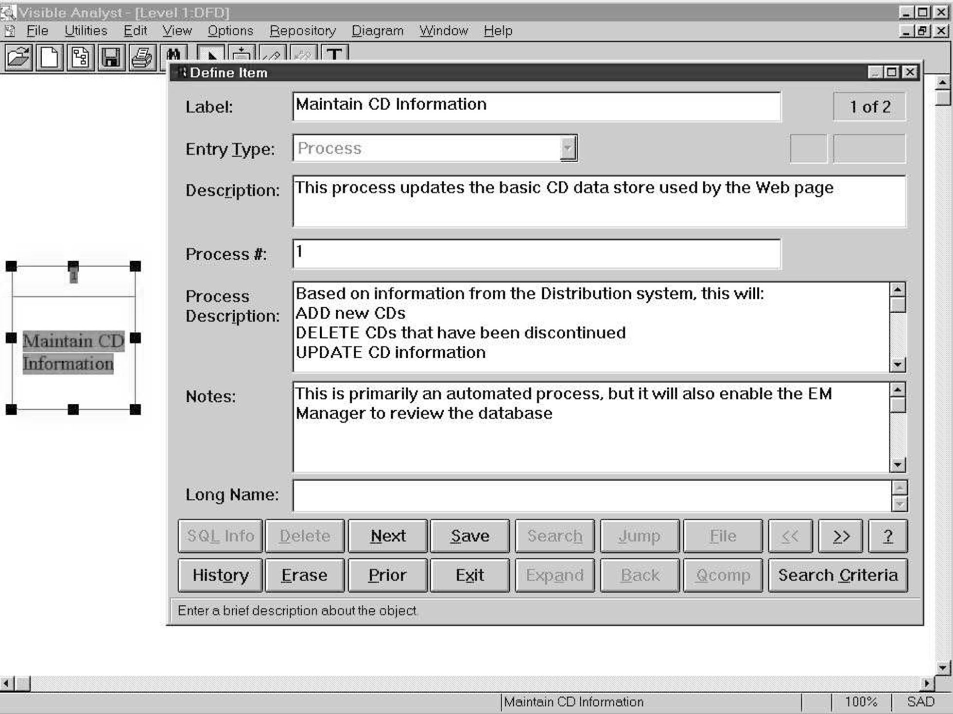
(cont’d)
Example of the use of CASE Tools

Slide 21
(cont’d)
1. Build the context diagram.
2. Create DFD fragments for each use case.
3. Organize the DFD fragments into level 0 diagram.
4. Develop level 1 DFDs based on the steps with each use case. In some cases, these level 1 DFDs are further decomposed into level 2 DFDs, level 3 DFDs., and so son.
5. Validate the set of DFDs to make sure that they are complete and correct.

Slide 22
Creating the Context Diagram
The context diagram defines how the business process or computer system interacts with its environment.
Draw one process symbol for the business process or system being modeled (numbered 0 and named for the process or system).
Add all inputs and outputs listed on the form of the use cases as data flows.
Draw in external entities as the source or destination of the data flows.
No data stores are included in the context diagram.

Slide 23
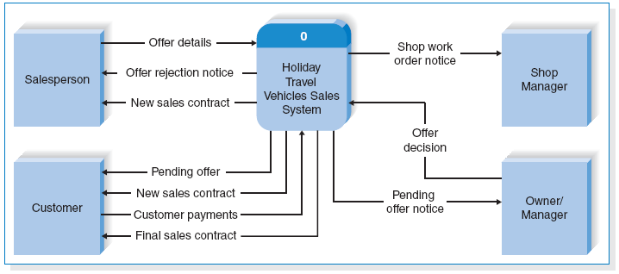
(cont’d)
Example of Context Diagram

Slide 24
Creating DFD Fragments
A DFD fragment is one part of a DFD that eventually will be combined with other DFD fragments to form a DFD.
Each use case is converted into one DFD fragment using the information given on the form of the use case: the name, the ID number, and major inputs and outputs.
The information about the major steps that make up each use case is ignored at this point; it will be used in a later step.

Slide 25
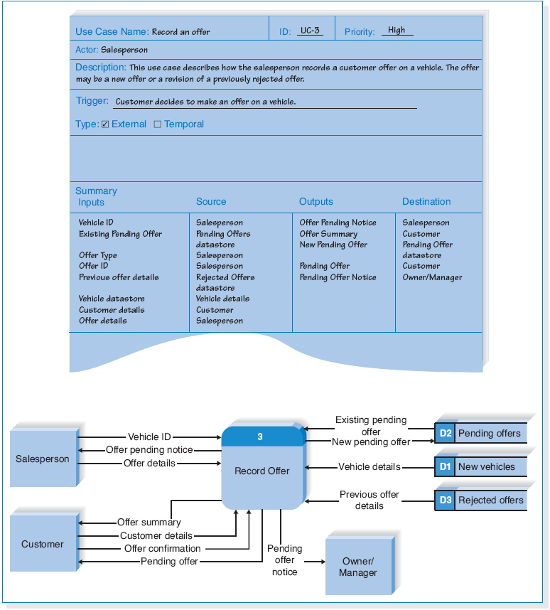
(cont’d)
Example of Fragment

Slide 26
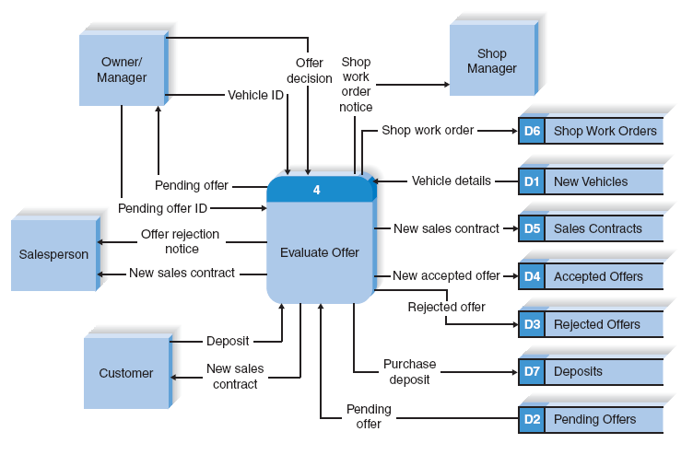
(cont’d)
Additional Example of Fragment

Slide 27
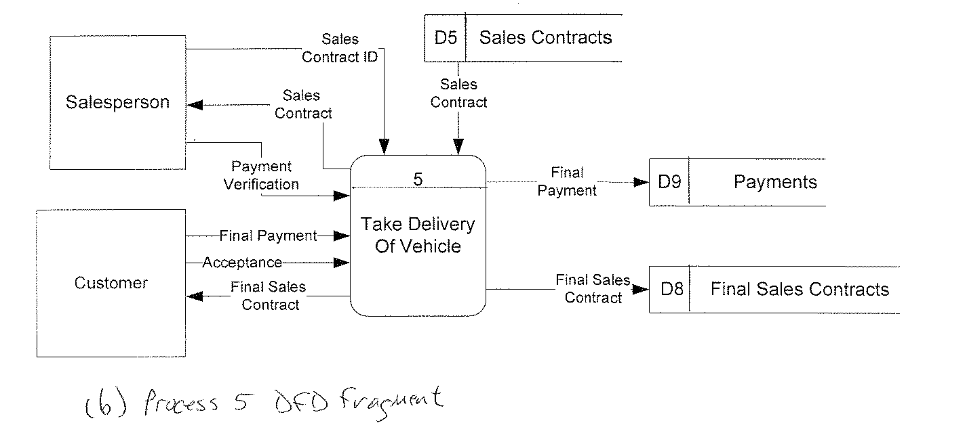
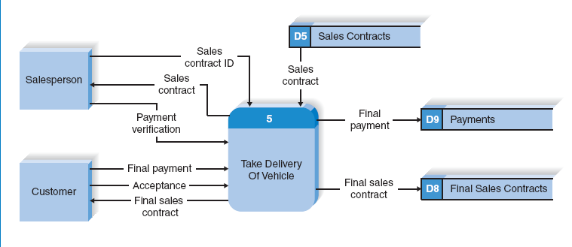
(cont’d)
Additional Example of Fragment

Slide 28
(cont’d)
Important changes are often made in converting the use case into a DFD:
- modifications to the process names
- the addition of data flows.
Make sure that any information given to the user is obtained from a data store.
There are not formal rules covering the layouts; typically
place the processes in the middle
inputs start from the left or top
outputs leave from the right or the bottom
place data stores below the processes

Slide 29
Creating the Level 0 Diagram
Combine the set of DFD fragments into one diagram – the level 0 DFD.
There are not formal layout rules. Generally,
- to put the process that is first chronologically in the upper-left corner and work the way from top to bottom, left to right;
- to reduce the number of crossed data flow lines.
Iteration is the cornerstone of good DFD design.

Slide 30
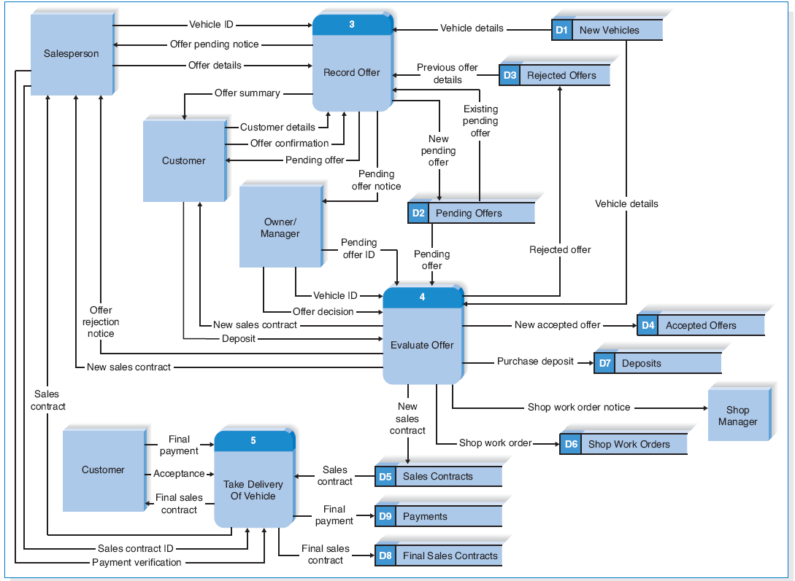
(cont’d)
Example of Level 0 DFD

Slide 31
Creating Level 1 Data Flow Diagrams (and Below)
Level 1 DFD – lower-level DFDs for each process in the level 0 DFD.
Each one of the use cases is turned into its own DFD
Each major step in the use case becomes a process on the level 1 DFD, with the inputs and outputs becoming the input and output data flows.
Level 1 DFDs include the sources and destinations of data flows for data stores and data flows to processes.
Including external entities in level 1 and lower DFDs can simplify the readability of DFDs.

Slide 32
(cont’d)
There is no simple answer to the “ideal” level of decomposition, because it depends on the complexity of the system or business process being modeled.
In general, you decompose a process into a lower-level DFD whenever the process is sufficiently complex that additional decomposition can help explain the process.
Rules of thumb:
- There should be at least 3, and no more than 7-9, processes on every DFD.
- Decompose until you can provide a detailed description of the process in no more than 1 page of process descriptions.

Slide 33
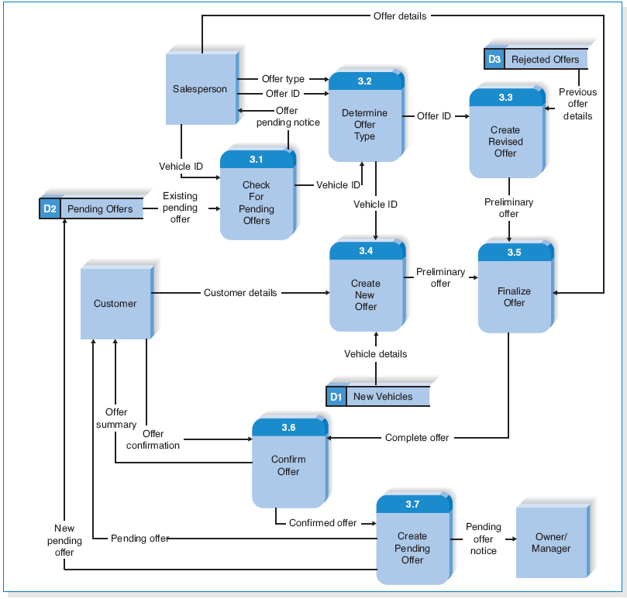
(cont’d)
Example of Level 1 DFD (for P3)

Slide 34
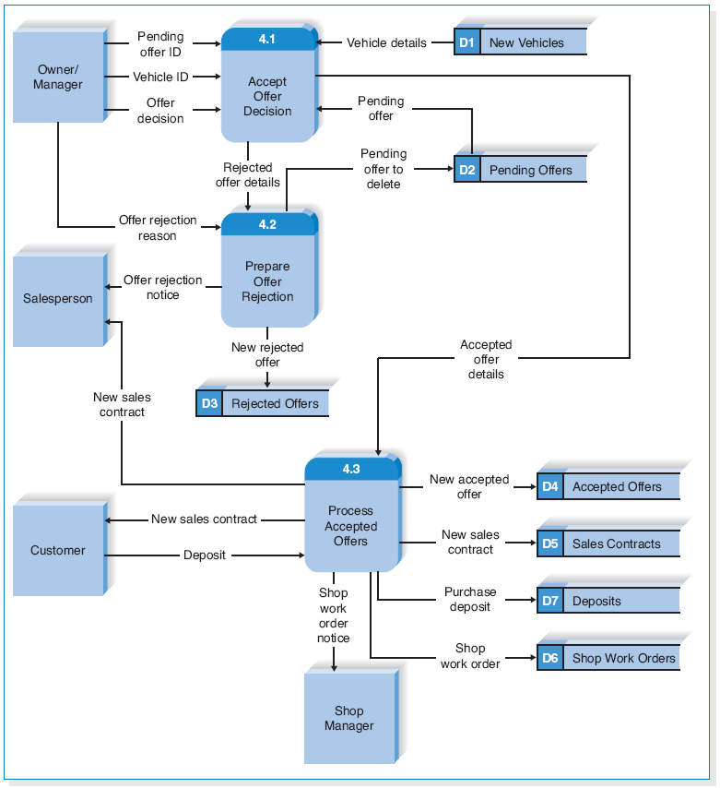
(cont’d)
Example of Level 1 DFD (for P4)

Slide 35
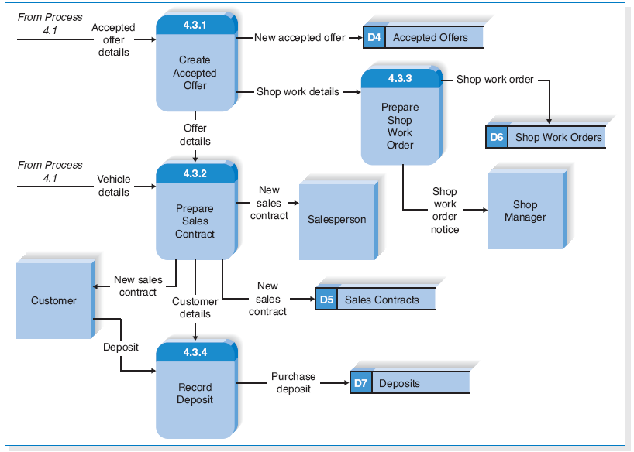
(cont’d)
Example of Level 2 DFD (for P4.3)

Slide 36
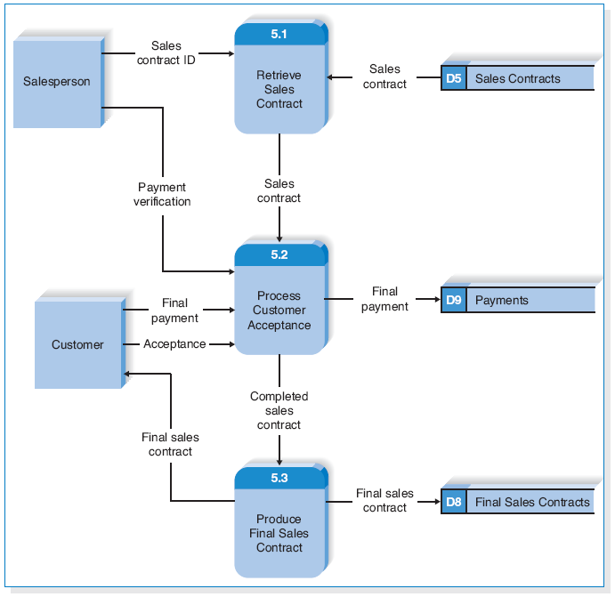
(cont’d)
Example of Level 1 DFD (for P5)

Slide 37
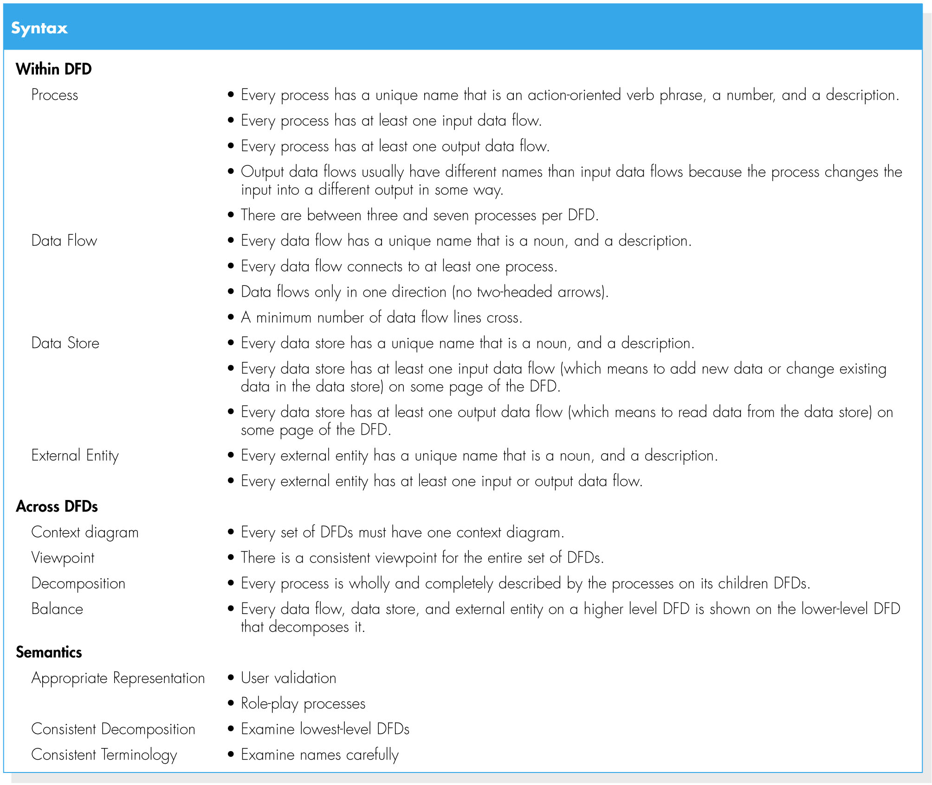
Validating the DFD
Checklist of Common Errors in DFDs

Slide 38
Validating the DFD (cont’d)
There two fundamental types of errors in DFDs:
1. Syntax errors – can be thought of as grammatical errors that violate the rules of the DFD language.
2. Semantics errors – can be thought of as misunderstandings by the analyst in collecting, analyzing, and reporting information about the system.

Slide 39
(cont’d)
Syntax errors are easier to find and fix than are semantics errors because there are clear rules that can be used to identify them.
Most CASE tools have syntax checkers that will detect syntax errors.

Slide 40
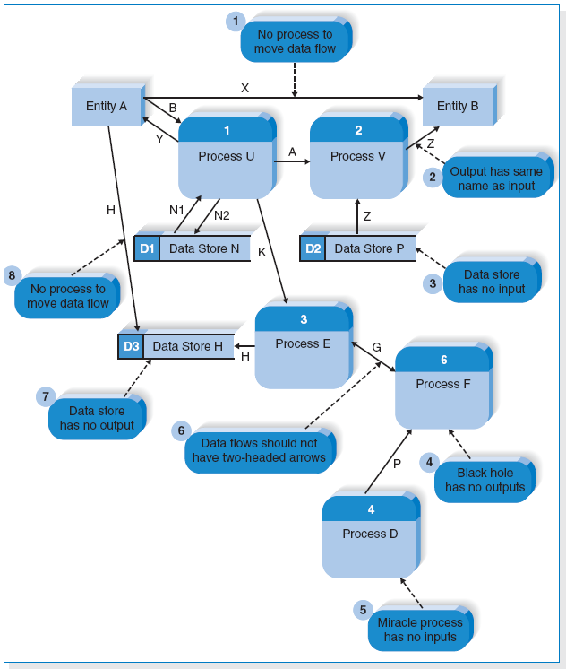
(cont’d)
Common
Syntax
Errors

Slide 41
(cont’d)
Semantics errors cause the most problems in system development.
Three useful checks to help ensure that models are semantically correct:
1. to ensure that the model is an appropriate representation by asking the users to validate the model in a walk-through
2. to ensure consistent decomposition
3. to ensure that the terminology is consistent throughout the model

Slide 42
SUMMARY
Data Flow Diagram Syntax – four symbols are used on data flow diagrams (processes, data flows, data stores, and external entities).
Creating Data Flow Diagrams
- The DFDs are created from use cases.
- Every set of DFDs starts with a context diagram.
- DFDs segments are created for each use case, and are then organized into a level 0 DFD.
- Level 1 DFDs are developed on the basis of the steps within each use case.
- The set of DFDs are validated to make sure that they are complete and correct and contain no syntax or semantics errors.

Slide 43
Copyright 2011 John Wiley & Sons, Inc.
All rights reserved. Reproduction or translation of this work beyond that permitted in Section 117 of the 1976 United States Copyright Act without the express written permission of the copyright owner is unlawful. Request for further information should be addressed to the Permissions Department, John Wiley & Sons, Inc. The purchaser may make back-up copies for his/her own use only and not for redistribution or resale. The Publisher assumes no responsibility for errors, omissions, or damages, caused by the use of these programs or from the use of the information contained herein.

