Slide 1
Systems Analysis and Design 5th Edition Chapter 6. Data Modeling
Roberta Roth, Alan Dennis, and Barbara Haley Wixom

Slide 2
Chapter 6 Outline
The Entity Relationship Diagram (ERD).
- Elements of ERD
- The Data Dictionary and Metadata
Creating an Entity Relationship Diagram.
Validating an ERD.

Slide 3
INTRODUCTION
In this chapter, we discuss how the data are organized and presented.
A data model is a formal way of representing the data that are used and created by a business system.
During analysis (this Chapter), analysts draw a Logical data model which shows the logical organization of data without indicating how it is stored, created, or manipulated.
During design (Chapter 10), analysts draw a physical data model to reflect how the data will physically be stored in databases or files.

Slide 4
(cont’d)
Topics of this chapter:
- Creating an entity relationship diagram (ERD).
- Normalization, a technique that helps analysts validate the data models.
- How data models balance, or interrelate, with the process models.

Slide 5
THE ENTITY-RELATIONSHIP DIAGRAM (ERD)
An entity-relationship diagram (ERD) is a picture showing the information that is created, stored, and used by a business system.
Entities lists similar kinds of information
Lines drawn between entities represent relationships among the data.
Special symbols communicate high-level business rules.

Slide 6
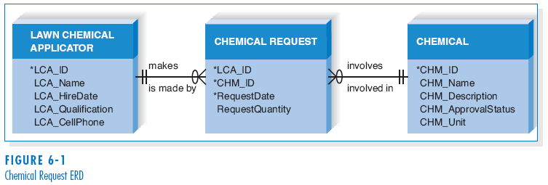
Reading an Entity Relationship Diagram

Slide 7
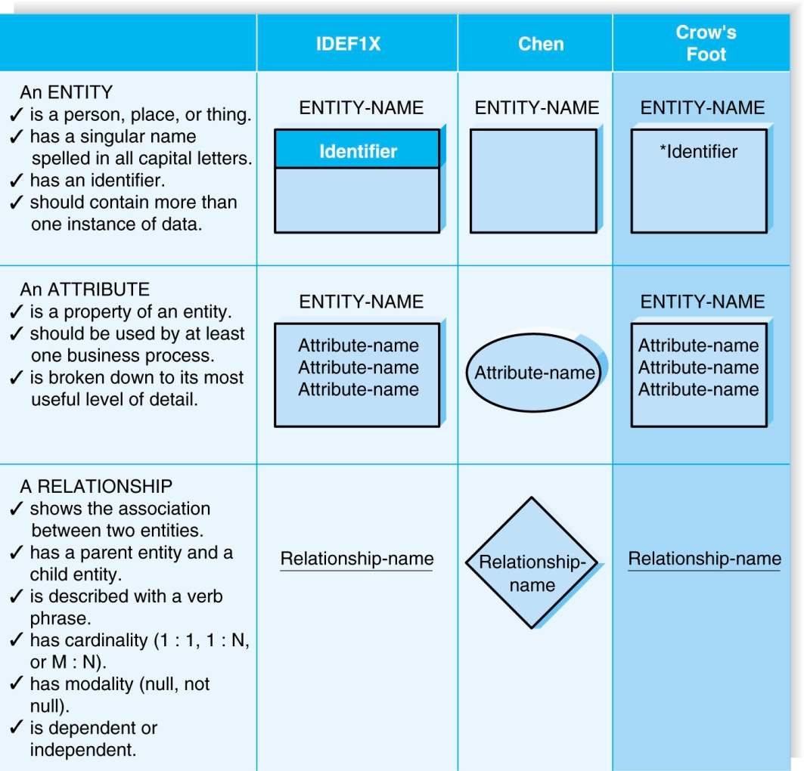
Elements of an Entity Relationship Diagram

Slide 8
Entity
The entity is the basic building block for a data model. It is a person, place, event, or thing about which data is collected.
Entities represent something for which there exist multiple instances, or occurrences.
- E.g., John Smith could be an instance of the customer entity.

Slide 9
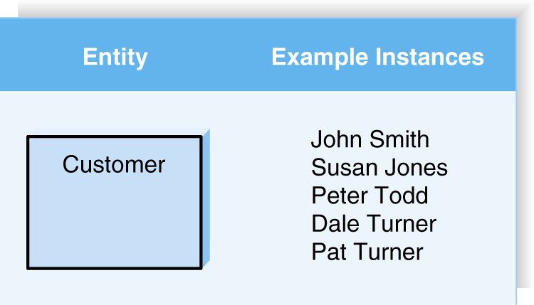
(cont’d)

Slide 10
Attributes
An attribute is some type of information that is captured about an entity.
Attributes are nouns that are listed with an entity.
One or more attributes can serve as the entity identifier - the attribute(s) that can uniquely identify one instance of an entity.
Concatenated identifier - several attributes are combined to uniquely identify an instance.

Slide 11
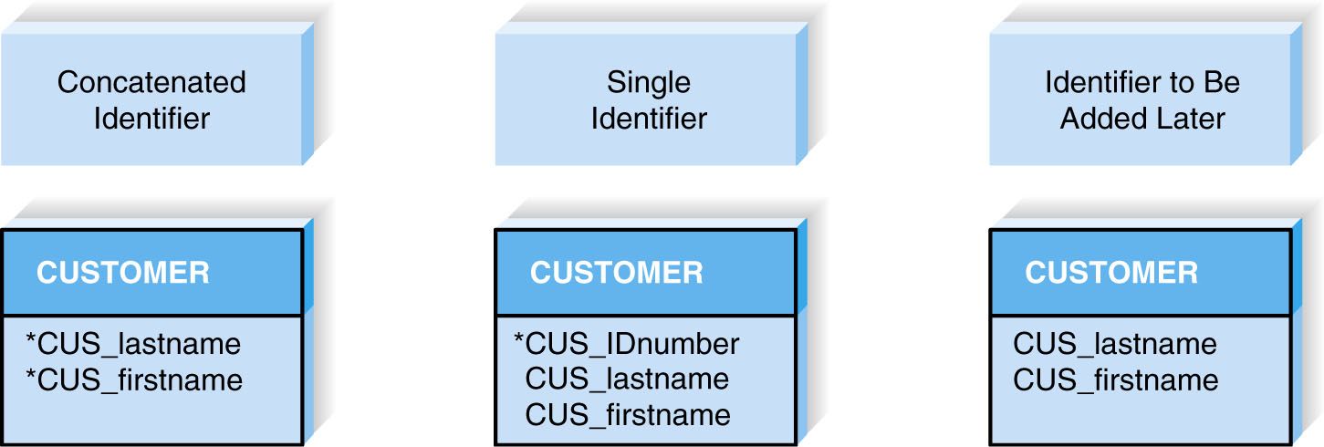
(cont’d)
Choices for Identifiers

Slide 12
Relationships
Relationships are associations between entities.
Every relationship has a parent entity and a child entity.
Relationships should be labeled with active verbs.

Slide 13
Cardinality
A relationship has cardinality which is the ratio of parent instances to child instances.
The 1:1 relationship means that one instance of the parent entity is associated with one instance of the child entity.
The 1:N relationship means that a single instance of a parent entity is associated with many instances of a child entity.
The M:N relationship means that many instances of a parent entity can relate to many instances of a child entity.

Slide 14
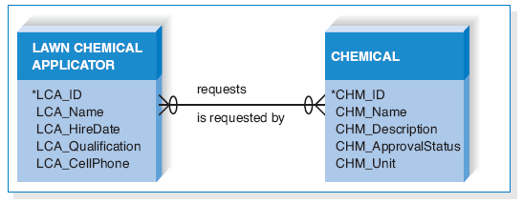
(cont’d)
Example of M:N Relationship

Slide 15
Modality
A relationship has modality of null or not null, which refers to whether or not an instance of a child entity can exist without a related instance in the parent entity.
Null means that an instance of a child entity can exist without a related instance in the parent entity.
Not Null means that an instance of a child entity can’t exist without a related instance in the parent entity.

Slide 16
The Data Dictionary and Metadata
A data dictionary contains the information about the entities, attributes, and relationships on the ERD, or metadata.
Metadata is data about data.
Metadata is stored in the data dictionary so it can be shared by developers and users throughout the SDLC.

Slide 17
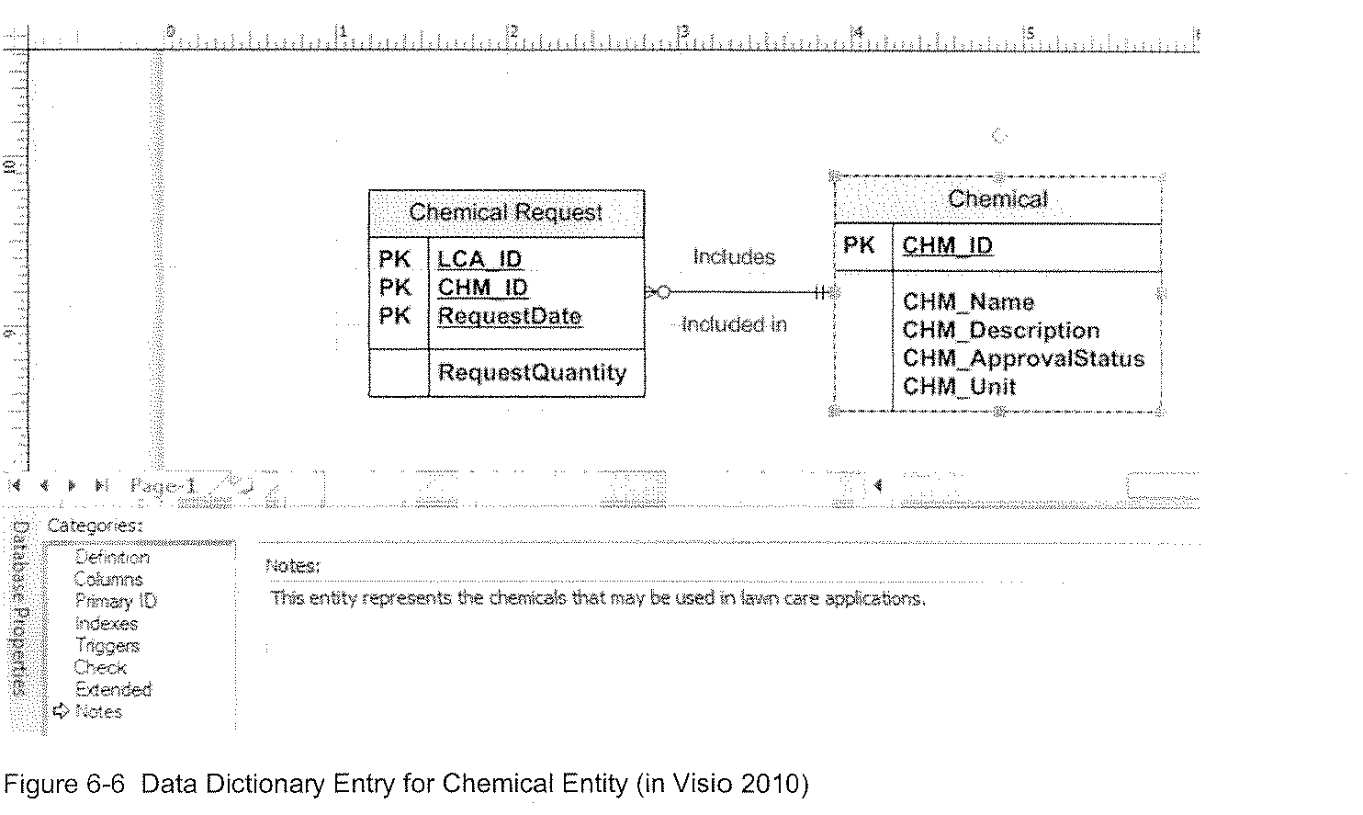
(cont’d)
Example of Data Dictionary Entry for Entity

Slide 18
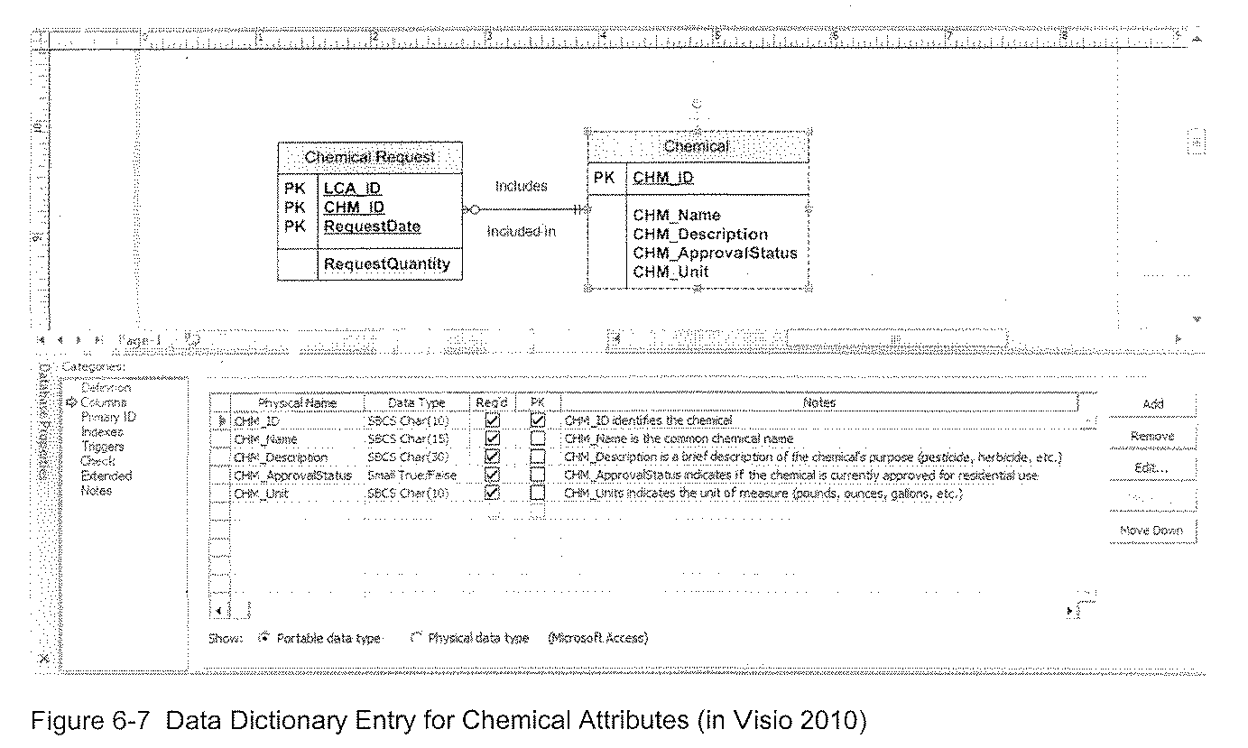
(cont’d)
Example of Data Dictionary Entry for Attributes

Slide 19
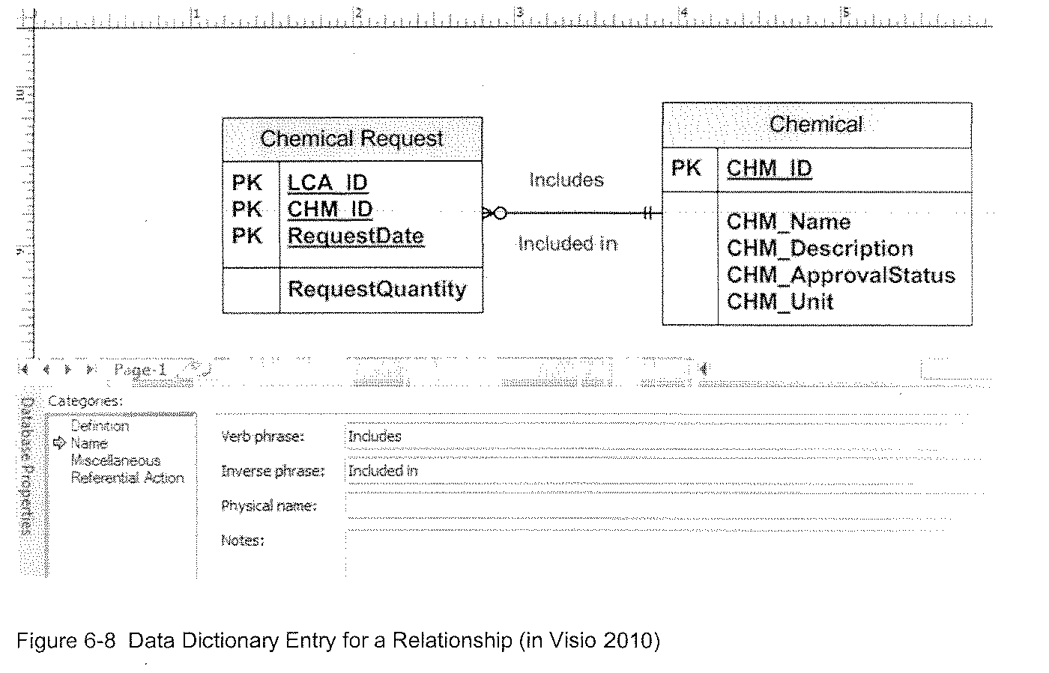
(cont’d)
Example of Data Dictionary of Entry for Relationship

Slide 20
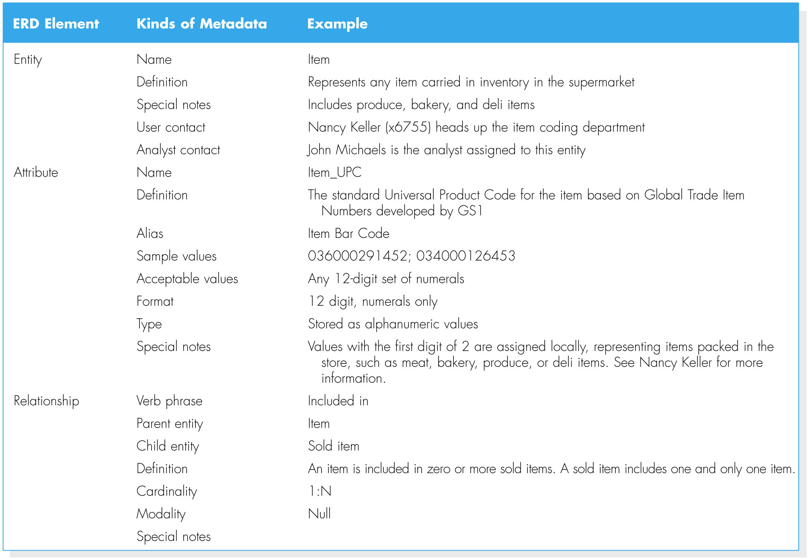
(cont’d)
Types of Metadata Captured by the Data Dictionary

Slide 21
CREATING AN ENTITY RELATIONSHIP DIAGRAM (ERD)
Drawing the ERD is an iterative process of trial and revision.
The basic steps in building an ERD:
1. Identify the entities;
2. add the appropriate attributes to each entity; and
3. draw relationships among entities.

Slide 22
Step 1: Identify the Entities
The entities should represent the major categories of information that you need to store in your system.
If you begin the data model using a use case, look at the major inputs and outputs of the use case.
If the process models are available, look at the data stores, external entities, and data flows.

Slide 23
Step 2: Add Attributes and Assign Identifiers
The information that describes each entity becomes its attributes.
Check in the CASE repository of the process model for details on data flows and data stores.
Check the data requirements of the requirements definition.
Use requirements elicitation techniques (e.g., interview and document analysis).
One or more of the attributes will become the entity’s identifier.

Slide 24
Step3: Identify Relationships
The last step in creating ERDs is to determine how the entities are related to each other.
Lines are drawn between the entities that have relationships.
Each relationship is labeled, and cardinality and modality are assigned.

Slide 25
Advanced Syntax
Three special types of entities:
Independent Entity
Can exist without the help of another entity.
The identifiers is created from the entity’s own attributes.
Attributes from other entities are not needed to uniquely identify instances of these entities.

Slide 26
(cont’d)
Dependent Entity
There are situations when a child entity does require attributes from the parent entity to uniquely identify an instance. In these cases, the child entity is called a dependent entity, and its identifier consists of at least one attributes from the parent entity.
(E.g., the Chemical Request entity in Figure 6.1).

Slide 27
(cont’d)
Intersection Entity
It exists in order to capture some information about the relationship between two other entities. Typically, intersection entities are added to a data model to store information about two entities sharing an M : N relationship.

Slide 28
(cont’d)
There are three steps involved in adding an intersection entity:
Step 1. Remove the M:N relationship line and insert a new entity (intersection entity) in between the two existing ones.
Step 2. Add two 1:N relationships to the model.
Step 3. Name the intersection entity.

Slide 29
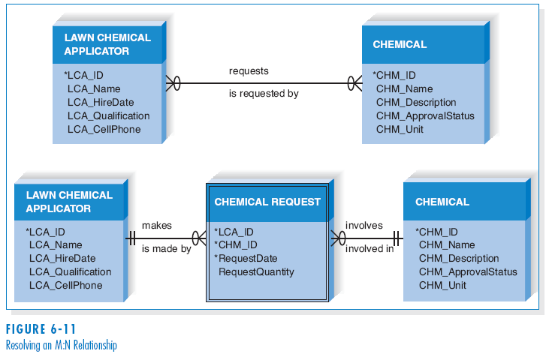
(cont’d)
Resolving an M:N Relationship

Slide 30
VALIDATING AN ERD
General design guidelines.
Normalization.
Check the ERD against the process models to make sure that both model balance each other.

Slide 31
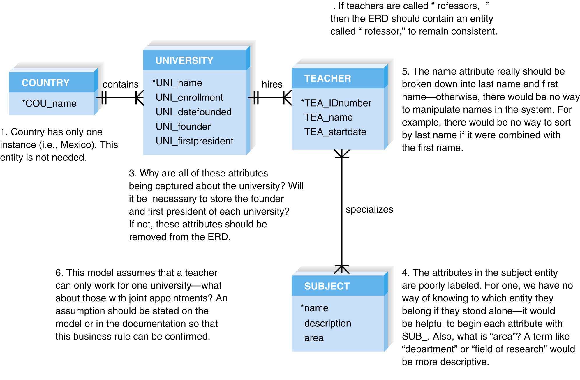
Design Guidelines

Slide 32
Normalization
Normalization is a technique that can help analysts validate the data models.
It is a process whereby a series of rules are applied to a logical data model to determine how well formed it is.

Slide 33
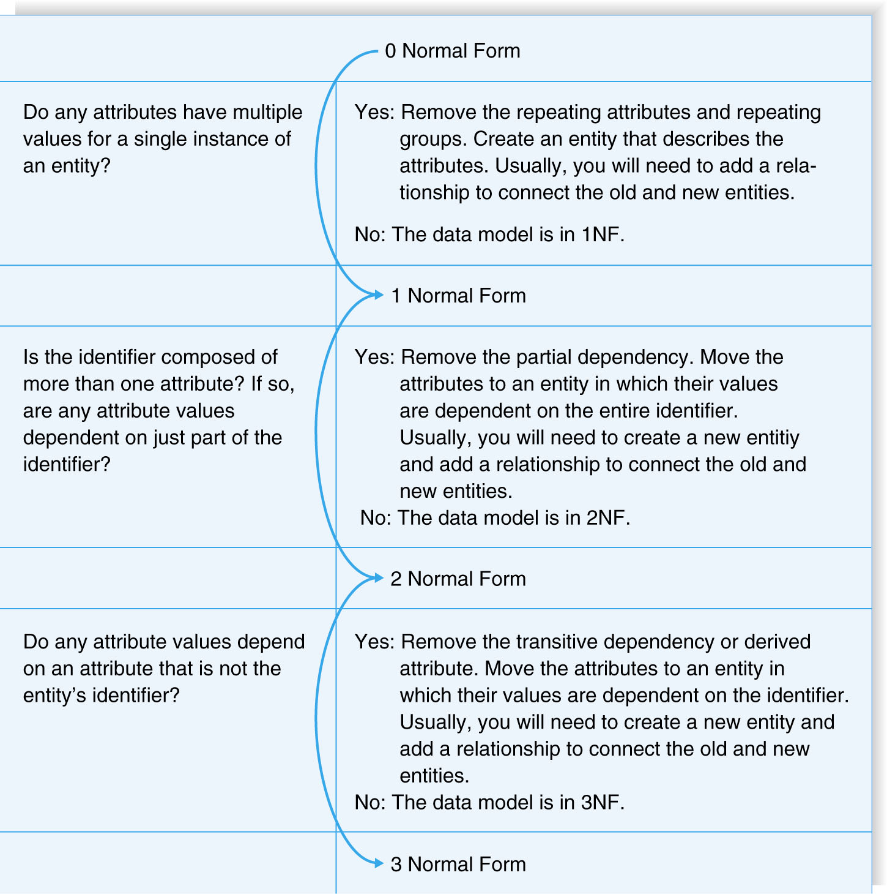
(cont’d)
Normalization Steps

Slide 34
Balancing ERDs with DFDs
The process models and data models are interrelated.
Although the process model focuses on the business processes, it contains two data components – the data and the data store.
These two data components of the DFDs need to balance with the ERDs.
The DFD data components need to correspond with the ERD’s data stores (i.e., entities) and the data elements that comprise the data flows (i.e., attributes) depicted on the data model.

Slide 35
(cont’d)
Many CASE tools provide features of identifying problems with balance between DFDs and ERDs; however, it is important to understand how to identify problems on your own.
Check your DFDs and ERDs to make sure all data components correspond between DFDs and ERDs.
A useful tools to clearly depict the interrelationship between process and data models is the CRUD matrix (create, read, update, delete matrix).

Slide 36
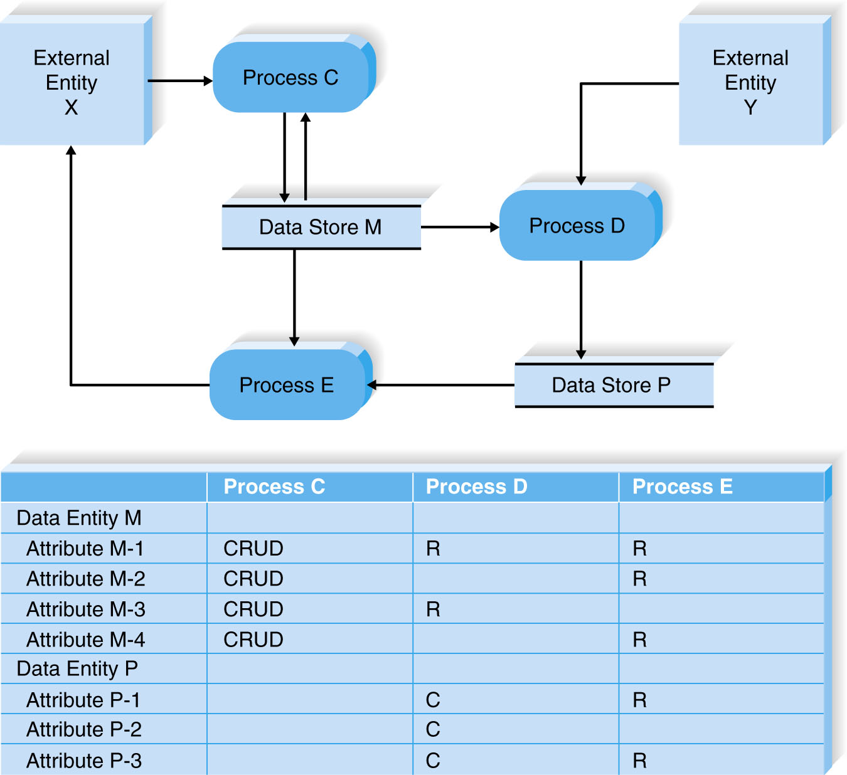
(cont’d)
A Portion of a DFD and the CRUD Matrix

Slide 37
SUMMARY
Basic Entity Relationship Diagram Syntax
- Entity describes people, places, or things.
- Attribute is some type of information about the entity.
- Relationship conveys the associations between entities.
Creating an ERD
- Identify the entities.
- Add the attributes to each entity.
- Draw relationships among entities.
Validating an ERD
- Normalization
- CRUD matrix

Slide 38
Copyright 2011 John Wiley & Sons, Inc.
All rights reserved. Reproduction or translation of this work beyond that permitted in Section 117 of the 1976 United States Copyright Act without the express written permission of the copyright owner is unlawful. Request for further information should be addressed to the Permissions Department, John Wiley & Sons, Inc. The purchaser may make back-up copies for his/her own use only and not for redistribution or resale. The Publisher assumes no responsibility for errors, omissions, or damages, caused by the use of these programs or from the use of the information contained herein.

