Slide 1
struc2vec: Learning Node Representations from Structural Identity

Slide 2
Related work
Walk on the network to generate the context
Word2vec: embedding words from sentences into Euclidean space
Deepwalk: embedding nodes by random walk
Node2vec: biased randomwalk to generate sentences
Walk on the original network to generate context.
However, In some cases, two vertices that are not close neighbors may also have high similarity .

Slide 3
Ex.

Slide 4
Struct2vec
Structueally similar nodes close in spce
Key idea:
Structural similarity does not depend on hop distance
Neighbor nodes can be different, far away nodes can be simiar
Flexible 4 steps:

Slide 5
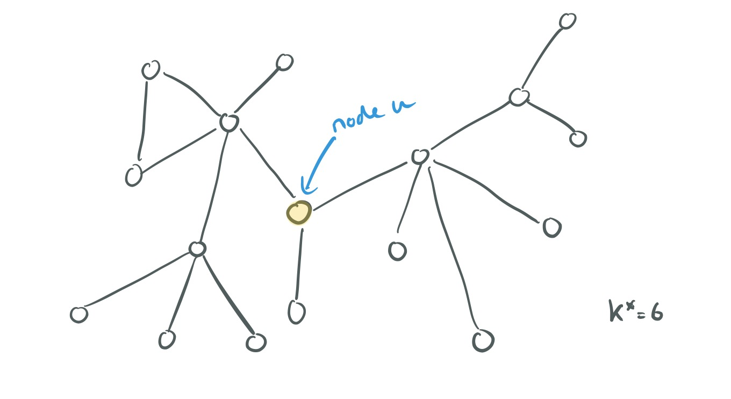
Step1. structural similarity
Hierachical measure for structural similarity
Rk(u): set of nodes at distance k from u (ring)
s(S): ordered degree sequence of set S
Ex:
s(R₀(u)) = 3
s(R₁(u)) = 0, 5, 5
...
S(R_{k}(u))

Slide 6
Step 1. Structural similarity
g(D1,D2): distane between 2 order sequences
Cost of pairwire: max(a,b)/min(a,b) -1
Ex:
s(R₀(u)) = 4
s(R₀(v)) = 3
g(,) = 0.33
F_{k}(u,v): structural distance between nodes u and v considering first k rings:
f_{k}(u,v) = f_{k-1}(u,v) +g (s(R_{k}(u)), s(R_{k}(v)))

Slide 7
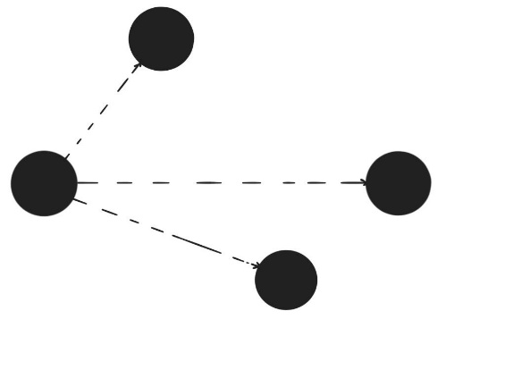
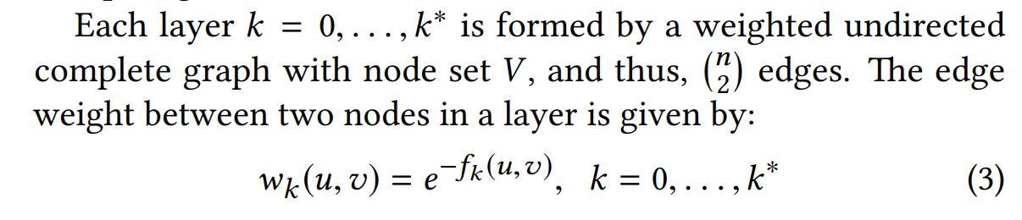
Step 2: multi-layer graph
Encodes structural similarity between all node pairs
Each layer is weighted complete graph
Edge weights in layer k:
Wk(u,v) = exp

Slide 8
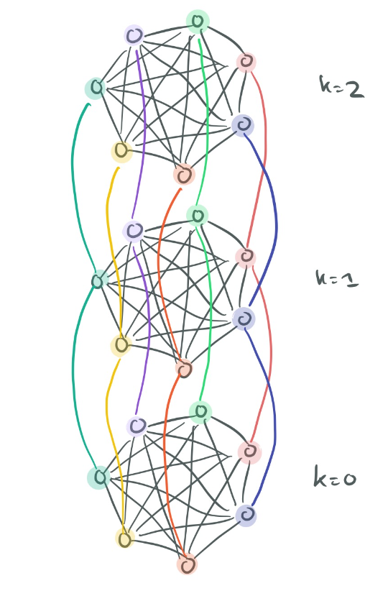

Slide 9
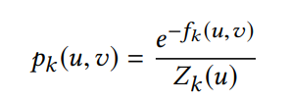
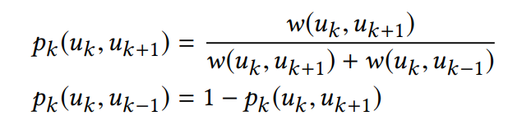
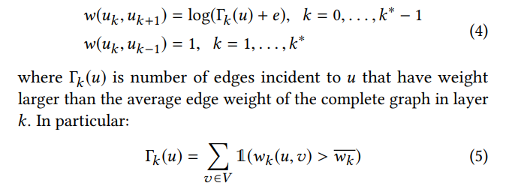
Step 3. generate context
Context generated by biased random walk
Walking on multi-layer graph
Walk in current layer with p probability
Choose neighbor according to edge weight
RW prefers more similar nodes
Change layer with 1-p probability
Choose up/down according to edge weight
RW prefer layer with less similar neighbors

Slide 10
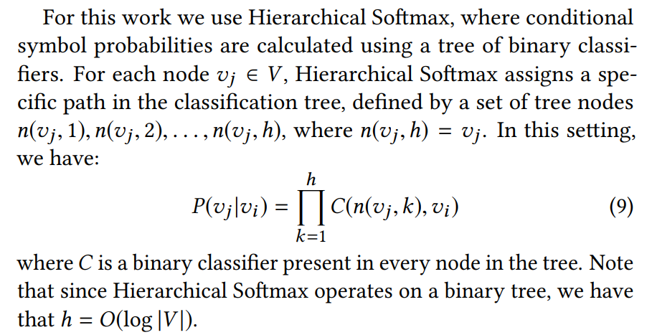
Step 4. Learn representation
Train a neural network
Maximine probability of nodes within context
Skip-gram (Hierarchical softmax)

Slide 11
Optimization
Reduce time to generate/store multilayer graph and context for nodes:
reduce number of edges:
Only log n neighbors per node
reduce number of layers in multilayers

