Slide 1
Fingerprint Recognition
Wuzhili (99050056)
        Supervisor: Dr Tang, Yuan Yan
        Co-supervisor: Dr Leung, Yiu Wing
        13/April/2002

Slide 2
Fingerprint Recognition
Outline:
  Introduction
    My Project Scope
    Fingerprint Research Background
  Algorithm
    Overview of My Approach
    Detailed Design
    Conclusion

Slide 3
Fingerprint Recognition Introduction
Objective:
    Study History, Methodology
    Compare reported algorithms
    Implement a FR system
    Give experimental results
Some papers used:
Direct Gray-Scale Minutiae Detection In Fingerprint
Intelligent biometric techniques in fingerprint face recognition
Adaptive flow orientation based feature extraction in fingerprint images
Fingerprint Image Enhancement:Algorithm and Performance Evaluation
Online Fingerprint Verification

Slide 4
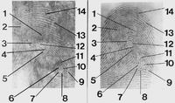
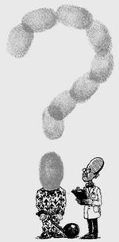
Introduction-
Giving thumbprints thumbs-down
“A judge has ruled that fingerprint evidence is scientifically unreliable “
Economist, 19/Jan/2002

Slide 5
Introduction
Giving thumbprints thumbs-up
Thumb marks as a personal seal, Ancient China
Galton,F.(1892) Finger Prints
Henry,E.R(1900), Classification and Uses of Finger Prints
FBI (US) (1924) 810,000 fingerprints
Now more than 70 million fingerprints, 1300 experts
FBI Home Office(UK) (1960)
Automatic fingerprint Identification System

Slide 6
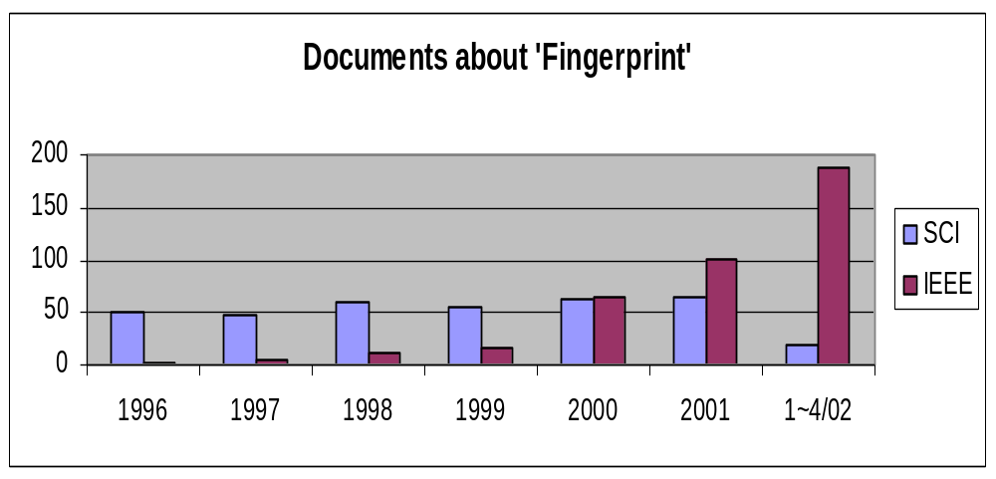
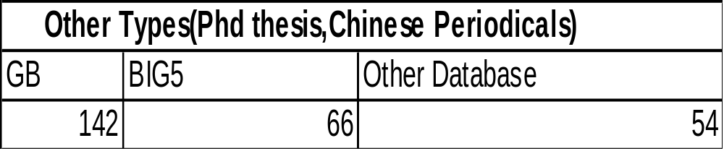
Introduction
Giving thumbprints thumbs-up
Research Paper Statistics

Slide 7
Introduction
Giving thumbprints thumbs-up
Intensive researches show Fingerprints are scientifically
Unique
Permanent
Universal
The judge just proved:
fingerprint recognition is scientifically
difficult

Slide 8
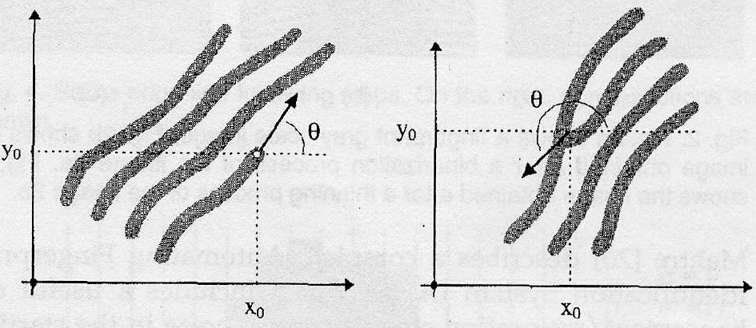
Minutiae-Based Approach
  Minutiae
  terminations bifurcations
  Ridge Valley

Slide 9
Verification (AFAS) vs. Identification (AFIS)
System Level Design
User’s
Magnetic
Card….
User
System
Database
1:1 Match
Verification
User ID
Minutia
Extractor
Minutiae
Matcher
Sensor
1:m Match
Identification
System
Database

Slide 10
Algorithm Level Design
Minutia Extractor:
Image Segmentation
Image Enhancement
Image Binarization
Preprocessing
Minutia extraction
Thinning
Minutiae Marking
Post-processing
Remove False Minutiae

Slide 11
Algorithm Level Design
Minutia Matcher:
Find Reference Minutia Pair
Affined Transform
Return Match Score

Slide 12
Minutia Extractor- Segmentation
    Block directional estimation
        Foreground : have a dominant direction
        Background : No global direction

Slide 13
Fingerprint Image Segmentation
  Ridge Flow Orientation Estimate
    Edge detector: get gradient x (g_{x}),gradient y (g_{y})
    Estimate the ß according to:
    tg2ß = 2 sigma(g_{x}*g_{y})/sigma(g_{x}²-g_{y}²)
  Region of Interest
    Morphological Method
    Close + Open

Slide 14
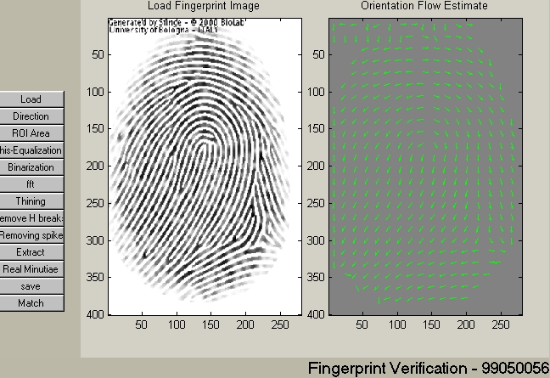
Fingerprint Image Segmentation

Slide 15



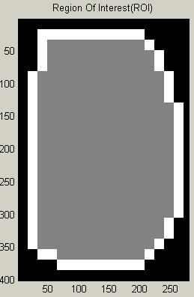
Fingerprint Image Segmentation
Area
Close
Open
ROI + Bound

Slide 16
Fingerprint Image Enhancement
  Histogram Equalization

Slide 17
Fingerprint Image Enhancement
        Fourier Transform

Slide 18
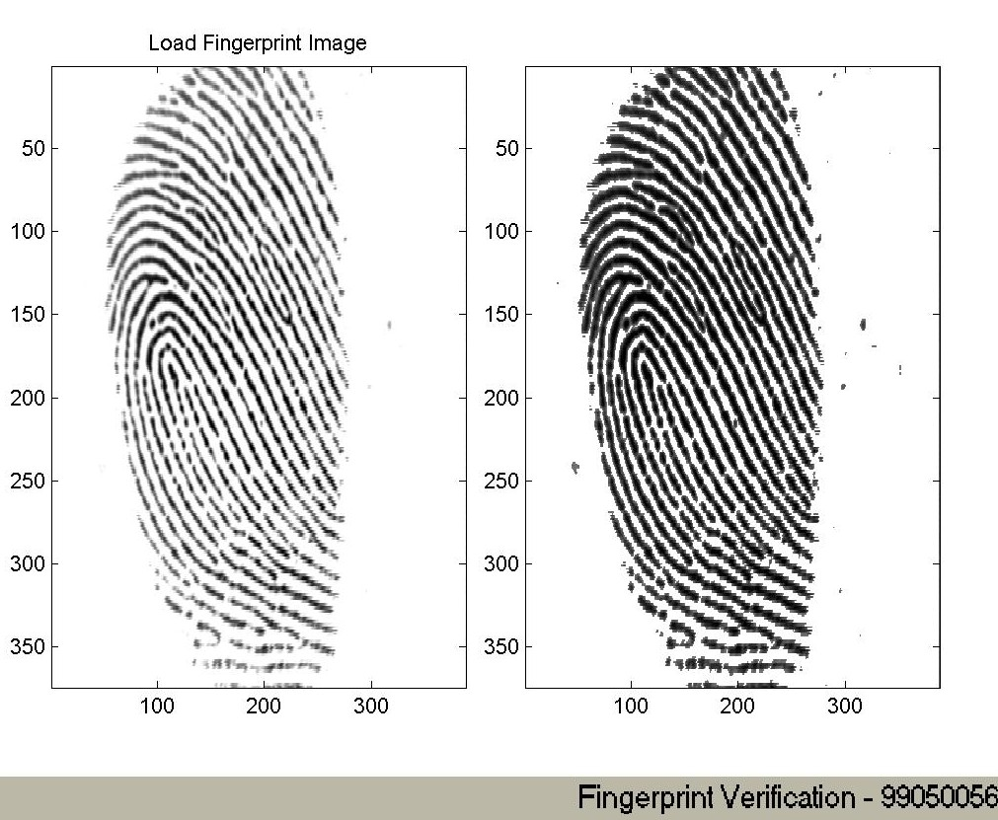
Preprocessing - Enhancement

Slide 19
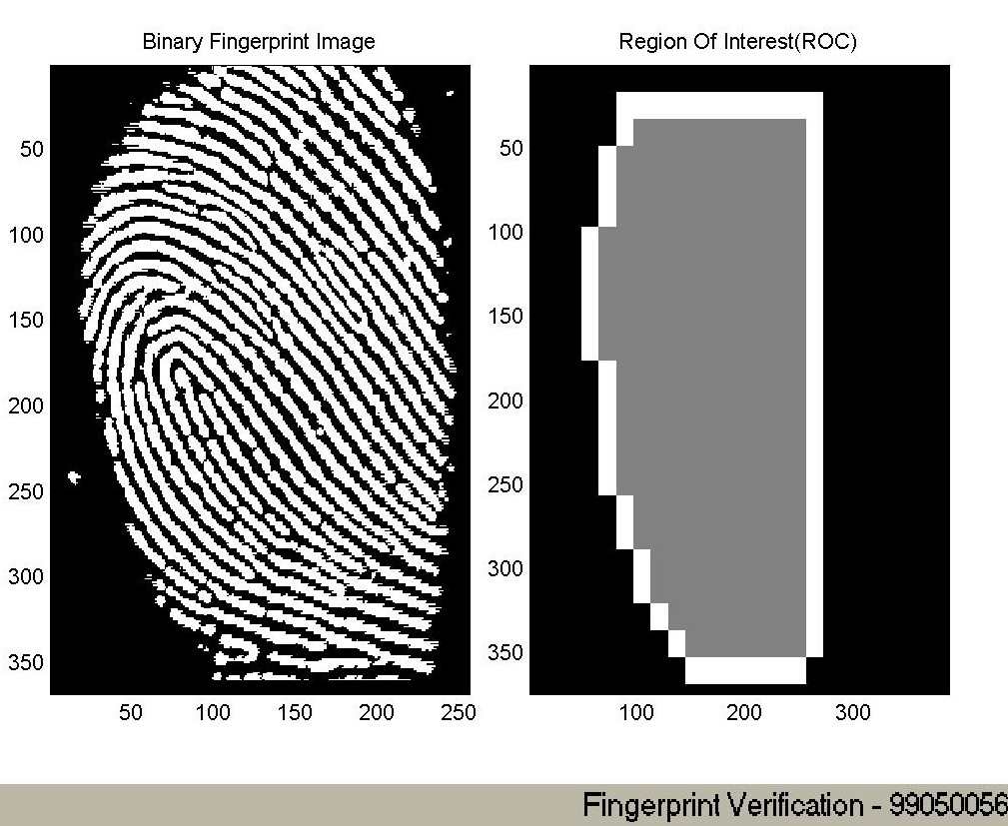
Fingerprint Image Binarization

Slide 20
Fingerprint Image Binarization
  Common Approaches:
    Local Adaptation
    gray value of each pixel g
    if g > Mean(block gray value) , set g = 1;
    Otherwise g = 0
    Directly ridge Retrieval from Gray Image
    get Ridge Maximums Implying binarization

Slide 21
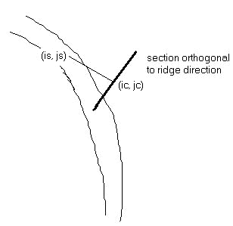
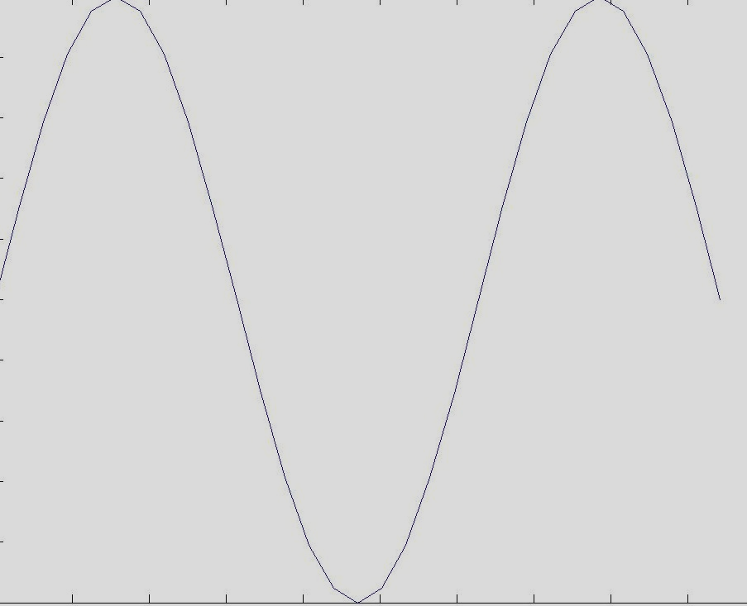
Fingerprint Image Binarization
Directly ridge Retrieval
    1.Estimate ridge direction D
    2.Advance by a step length
    3.Along the direction orthogonal to D
    Return to ridge Center
    4.go to 1
    1.Block ridge flow orientation O
    2.Get direction P orthogonal to O
    3.Project block image to the lines along P

Slide 22
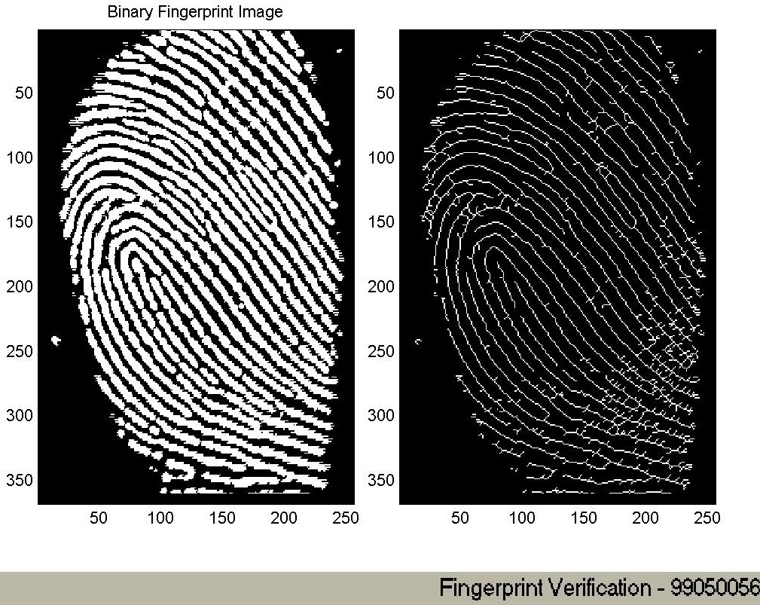
Minutia extraction stage - Thinning

Slide 23
Minutia extraction stage - Thinning
  Morphological Approaches:
    bwmorph(binaryImage,''thin'',Inf)
  Parallel thinning algorithm:
    1) 2=< N(p1) <= 6 T(p1) = 1
    p2 * p4 * p6 = 0 p4 * p6 * p8 = 0
    2) 2=< N(p1) <= 6 T(p1) = 1
    p2 * p4 * p8 = 0 p2 * p6 * p8 = 0
    N(p) sum of Neighbors
    T(p) Transition sum from 0 to 1 and 1 to 0
P9 | P2 | P3
P8 | P1 | P4
P7 | P6 | P5

Slide 24
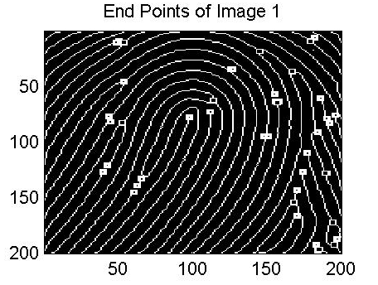
Minutia extraction
Preprocessing Steps:
0 | 1 | 0
0 | 1 | 0
1 | 0 | 1
Bifurcation
0 | 0 | 0
0 | 1 | 0
0 | 0 | 1
Termination

Slide 25
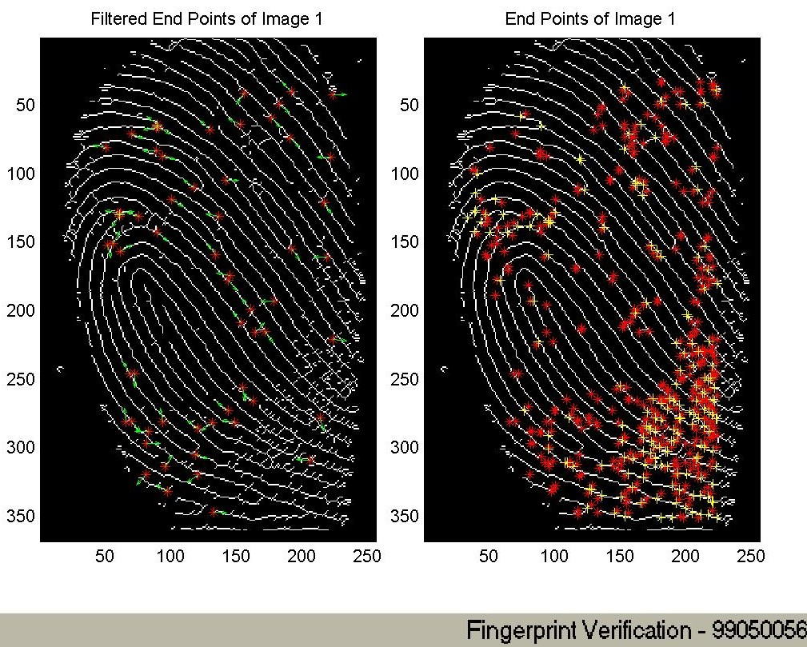
Minutia extraction

Slide 26
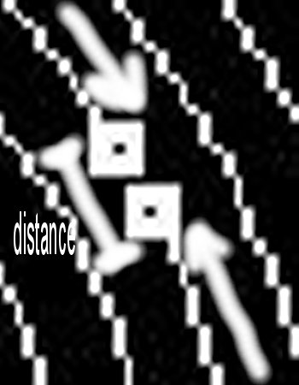

Post-processing stage
False Minutia Remove:
Two disconnected terminations
short distance
Same/opposite direction flow
Two terminations at a ridge
are too close

Slide 27
Post-processing stage
False Minutia Remove:

Slide 28
Minutia Match
  Minutia Representation:
    M_{n} ( Position, Direction ß, Associate Ridge)
tgß = (yp-y0)/(xp-x0);
Xp = sigma(xi)/Lpath;
Yp = sigma(yi)/Lpath;
ridge
y
Lpath
Minutia
x0 x1 x2 x3 x4 x5 x6 x
Generally, ridge endings and bifurcations are consolidated

Slide 29
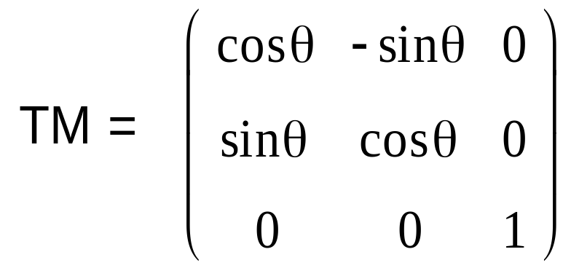

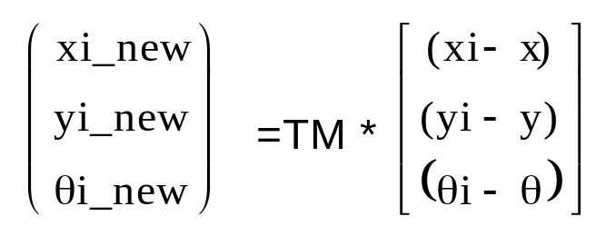
Minutia Match
Simple Relax Match Algorithm :
For each pair of Minutia
Construct the Transform Matrix
y
(xi,yi, i)
(x,y, )
x

Slide 30
Minutia Match
Simple Relax Match Algorithm :
For any two minutia from different image,
If They are in a box with small length
And their direction has large consistence
They are Matched Minutia
Match Score =
Num(Matched Minutia)
Max(Num Of Minutia (image1,image2));

Slide 31
Minutia Match
Alignment – based Algorithm :
Ridge_direction
Ridge information is used to
determine the goodness of a
reference Minutia pair
ridge
y
If two ridge are matched well
Continue use the
Relax Box Match Or
Use
String Match
Minutia
x0 x1 x2 x3 x4 x5 x6 x

Slide 32
Fingerprint Verification
Performance Evaluation Index
Program
result (Yes/No)
FRR: False Rejection Rate
FRR = 2/total1
FAR: False Acceptance Rate
FAR = 3/total2
Total1 = m*(n+1)*n/2
Total2 = m*(m-1)/2
Same
Finger
1 Yes
2 No
Different
Finger
3 Yes
4 No
F10 F11 F12 F13 …F1n
F20 F21 F22 F23 …F2n
F30 F31 F32 F33 …F3n
Fm0 Fm1 Fm2 Fm3 …Fmn

Slide 33
Fingerprint Verification
Thanks
Question and Answer

Slide 34
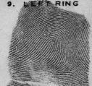
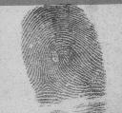
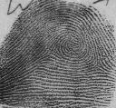
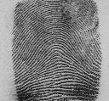
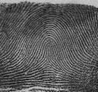
Fingerprint Classification
Left Loop
Right Loop
Delta
Pore
Whorl
Arch
Tented Arch

Slide 35
Introduction
Biometric Research
  Fingerprint
    Unique,Portable,Large storage per finger template
    Largest Market Sharing
    Feature: Minutiae & Classification
  Face & Hand
    Non-unique,Large operation device,Fast
    Feature: Shape,Area…
  Iris & Retina
    Unique,Large Device,Less User Safety Consideration
    Feature: Shape,Vein…

Slide 36
Introduction
Fingerprint Research Topics
  Fingerprint Verification & Identification
    Minutiae-Based-Approach
    Similar System & Algorithm Designs
  Fingerprint Classification
    Five Categories By Core & Delta Types
  Fingerprint image Compression
    WSQ Standard

Slide 37
Fingerprint Image
Compression
  FBI Standard
    64-sub band structure WSQ
  Correlation-Based Approach For
  Fingerprint Verification
    Also called Image-based approach
    Relatively little work has been conducted
    Gabor filter; Wavelet Domain Feature Extraction

