Slide 1
iCommerce

Slide 2
Installation

Slide 3
Follow steps in order
Install & run Kafka service with port: 9092 (you can follow this link)
Install & run MySQL server.
Take file “nab-db.sql” in nab-product-service, and execute it in Mysql server. The step just initiates data.
Install & run nab-product-service (in README)
Install & run nab-order-service (in README)
Install & run nab-eureka (in README)
Install & run nab-api-gateway (in README)
Install & run nab-fe (in README)

Slide 4
Overview

Slide 5
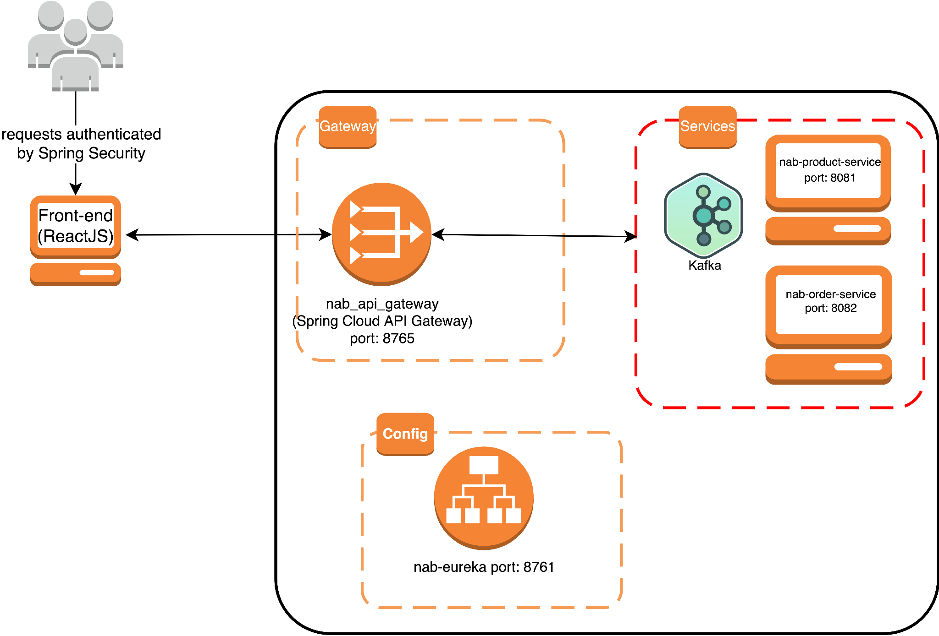
Workflow

Slide 6
Technologies
Back-end:
Spring Boot
Spring Cloud: API-Gateway, Eureka, OpenFeign
Spring Data JPA, Spring JDBC
Kafka service
Front-end:
ReactJS, NEXT
DB: MySQL

Slide 7
Code quality
Spotless Java check
Unit Test
Integration Test using H2 DB (to be updated)
SOLID
DRY

Slide 8
Functionalities
by
screenshots

Slide 9
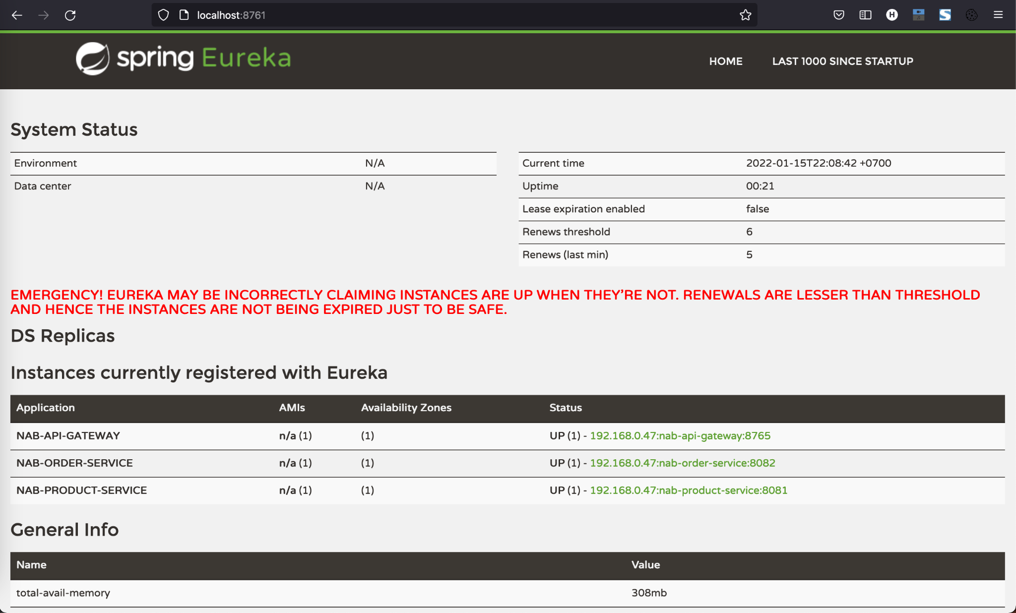
Eureka server (check to make sure all services ready)

Slide 10
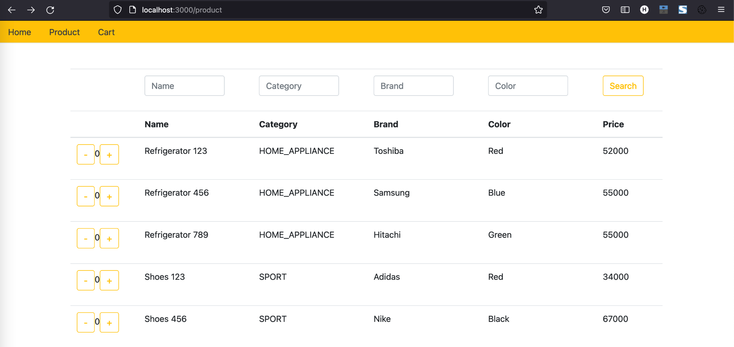
Products list

Slide 11
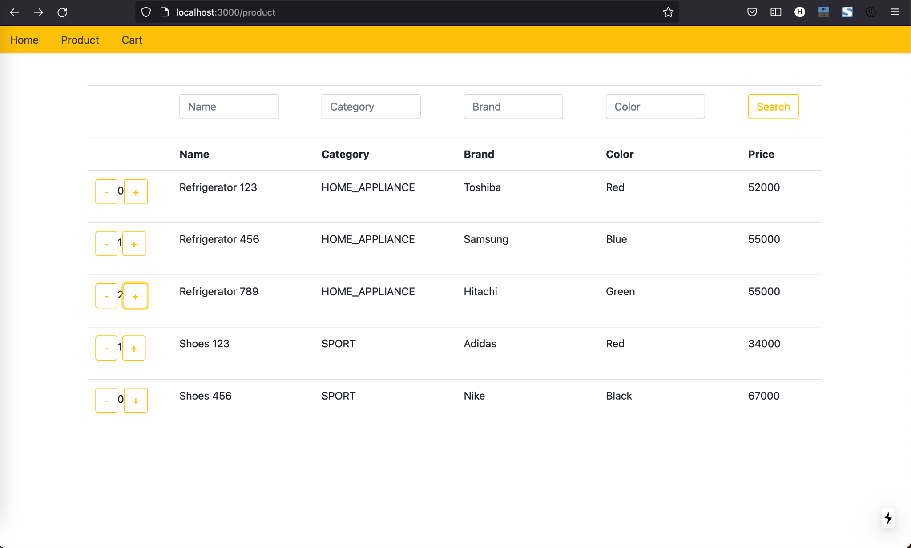
Order products

Slide 12
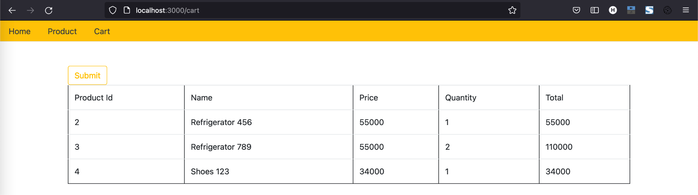
Submit order

Slide 13
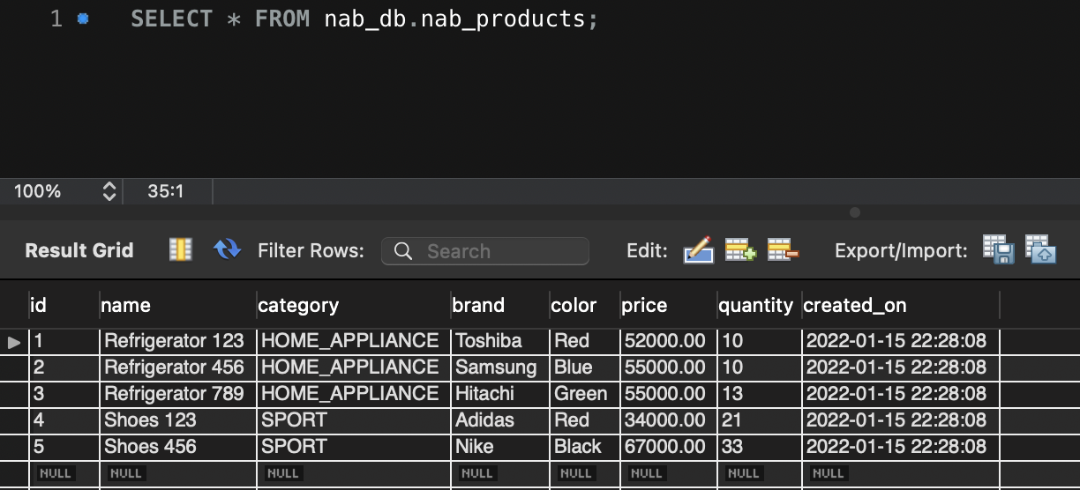
Checking DB (product table)

Slide 14
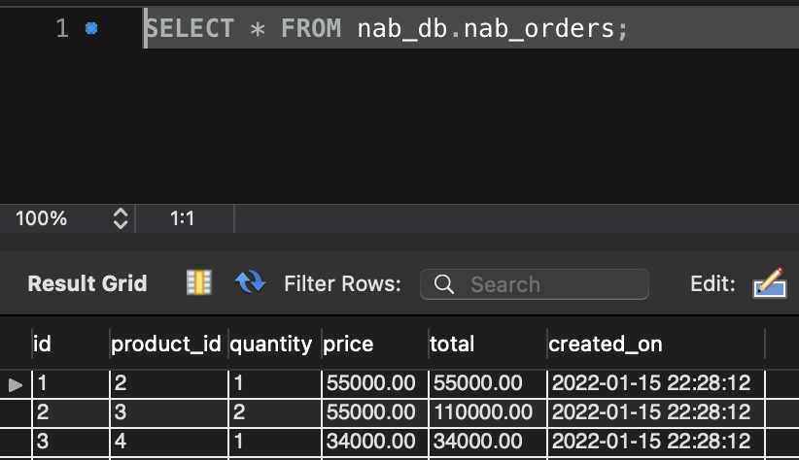
Checking DB (order table)

Slide 15
What need improving

Slide 16
Things should be improving
Back-end technologies & functionalities:
Spring Security for API-Gateway.
Spring Config server with config files stored in GitHub.
Docker
Kubernetes
AWS CodePipeline
Zipkin server for tracking logs
Swagger or Spring REST docs.
Caching
More testing (integration test using H2 DB)
Front-end
UT for every function
Common constants
Style checking

Slide 17
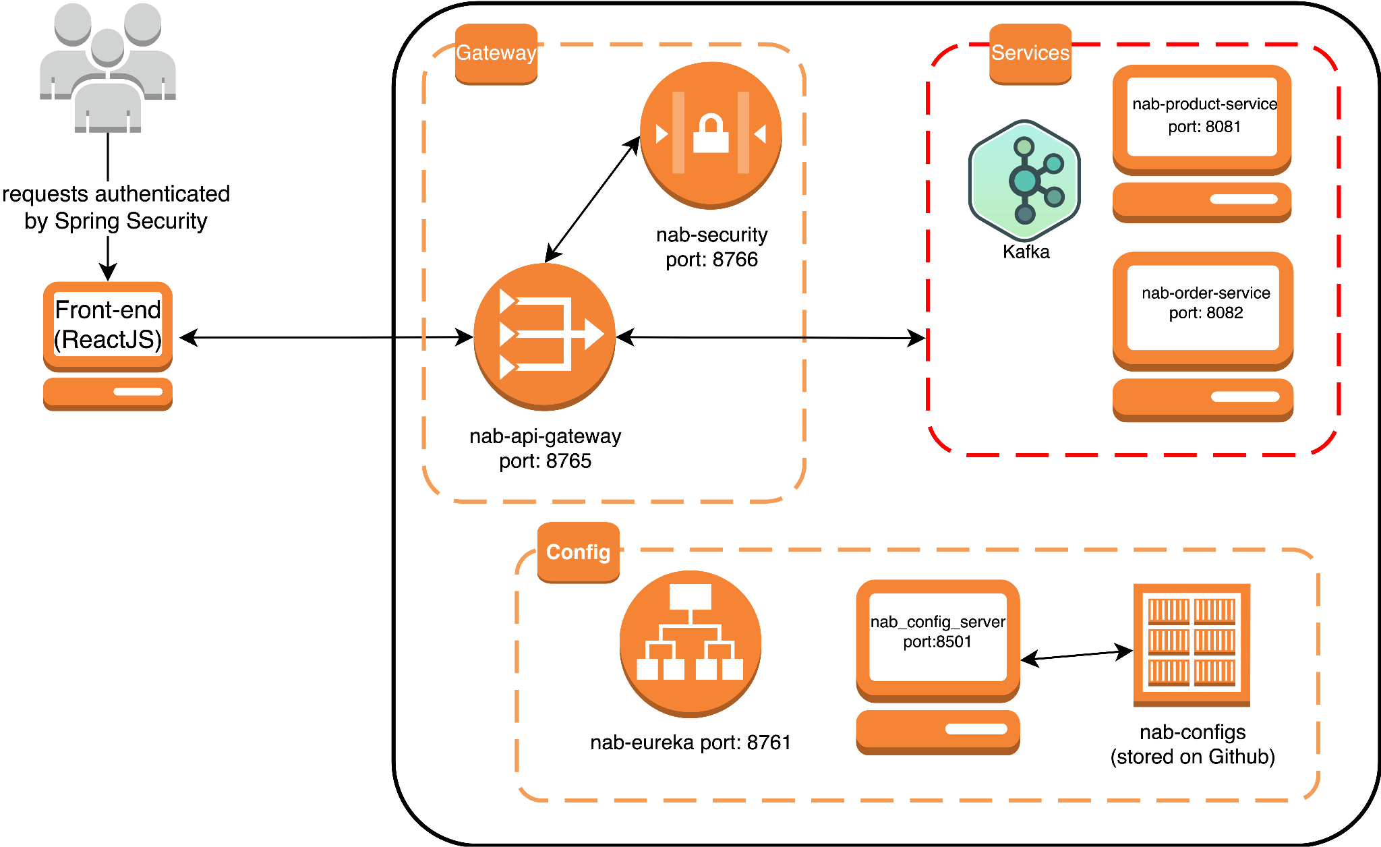
New Workflow (suggestion for next step)

