Slide 1
Innovations in Finance and Risk – Robotic Process Automation
April 2016

Slide 2
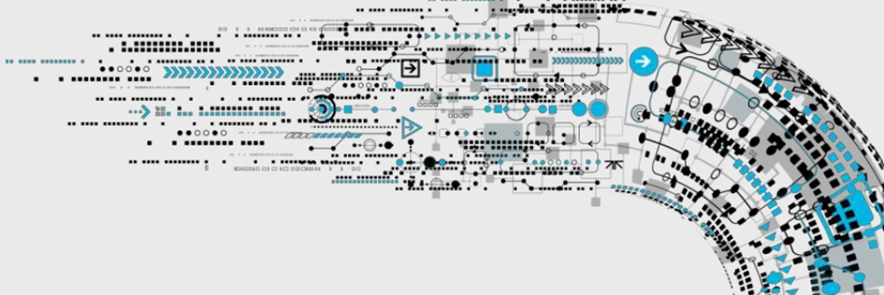
What is Robotic Process Automation (RPA)?
Robotic automation lets organizations automate current tasks as if a real person was doing them across applications and systems
Interacts with individual systems in the same way as a human user, meaning no complex system integration required
Functional trained robots are virtual workers and execute rule-based information processes, improving accuracy and efficiency
Robotic software can rapidly model and deploy the automation

Slide 3





Robotics is the use of software to “mimic” the actions a human user would perform on a PC at scale and ….
Automation of Business Processes
Emulates human execution of
repetitive processes with existing applications
Robots are a virtual workforce controlled by the business operations teams
Robots can be
trained by business users via configuration
Sits alongside existing infrastructure, governed and controlled by IT
Robots work with existing IT architecture – no complex system integration

Slide 4


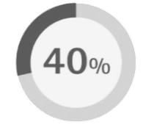
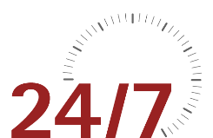
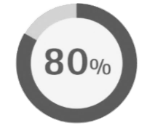



… helps generate measurable benefits
Robotics drives efficiency benefits, along with improvements in quality, scalability and resiliency in a cost-effective way
Higher Quality
Capacity increase by robotics virtual workforce and refocus of staff on customer service
Human errors eliminated
Improved compliance/auditability
Higher staff satisfaction
Productivity Boost
Average Handling Times reduced
Monitoring around the clock
Cost Saver
Processing costs Reduced by up to
Payback in up to 3 months
Implementation Speed
Fast Implementation of new processes
Re-usable process elements

Slide 5
Transforming finance and risk operations through automation
Most organizations have focused on the “key” transformation levers. In the last few years the real power of service automation has been unleashed and organizations are adopting this lever to help transform to high performing back office operations.
Challenges
Key Levers
Examples
Efficiency*
High variable costs in the front and back office
1
Centralise
Create centers of excellence (CoEs) / centralize common processes
Poor speed of service, human error and customer journey
2
Relocate
Move from high-cost base to low-cost base / labor arbitrage
Low staff morale and poor productivity
3
Standardise
Identify global process commonalities and promote / embed procedures
5 to 10%
Less innovation in the front and back office
4
Optimise
Define, simplify and LEAN processes, removing wasted effort
10 to 15%
Not flexible or scalable at pace
5
Digitise
Deliver workflow, document Management, self service and data warehouse
Risk of non-compliant processes and procedures
6
Automate
Implement Robotic Process Automation and Cognitive Computing
20 to 60%
Benefits
Lower
Costs
Service Excellence
Scalable / Flexible Ops
Enables
Growth
High Compliance
Drives Innovation
* Indicative % benefit estimate based on total cost base

Slide 6
Impact of Robotic Process Automation
Input (from supplier)
Process locally
Example: Invoice Processing
Legend
Represents replacement of manual processes with RPA
Supplier sends invoice via email
Supplier accepts or resends invoice
Email received and printed
Barcode and document scan
Supplier name correct?
No
Hold; Pass to exception team
Flag for exception handling
Work item created
Enter PO to retrieve invoices
Yes
Key invoice #, date and amount
No
Hold; Follow with vendor
Amount match?
Work item closed
Match PO and invoice
Yes
Match invoice
Calculate tax
Complete invoice processing
Outcomes
Roughly 70% improvement in productivity (volume processed per day, average handling time)
100% accuracy on existing process
60% of full-time equivalents (FTEs) replaced by RPA

Slide 7
Accenture Finance and Risk Services – Sample RPA use cases
Finance and Accounting | Sourcing and Procurement | Regulatory and Compliance | Financial Risk Management | Cyber Risk and Resilience
Fixed Asset Accounting Calculate asset depreciation Procure to Pay (AP) Manage incoming vendor invoices Process vendor payments Handle vendor inquiries/disputes Order to Cash (AR) Establish sales quotes. Validate sales orders Monitor customer credit Create and distribute customer invoice Process customer payments and apply cash Record to Report (GL) Record journal entries GL account reconciliation Intercompany transactions Maintain accounting master data Travel and Expense Audit expense reports | Contract Management Systematically vetting of contract details and populating appropriate metadata is captured in straight through processing systems Invoice Processing Scanning invoices and automatically preparing payment file using logic and rules to validate invoices and route to appropriate teams to manage exceptions (no middleman) Reconciliation Automatic evaluation of open orders or non-receipts through business logic and rules route to appropriate team for resolution or close item Spend Analytics Robust spend analytics tools to allow for a single stop for supplier management, contract compliance and spend data | Licensing and Registrations Data entry and validation for U4 Form and other jurisdictional forms Transfer amendments Personal Account Dealing Periodic disclosure attestations with changes. Review of account openings with paper statements. Paper trade entry Paper statement uploading to accounts Transfer disclosures Outside Affiliations and Private Investments Affiliations and investment reviewing with papers artefacts and responses from other functions within the organization Periodic disclosure attestations Transfer disclosures Gifts and Entertainment Reconciliation of the gifts and entertainment to expense system | Risk Change Explain Identification and explanation of exposure movements Determination of data-related or business-related causes for exposure movement Limits Management Perform evaluation of credit limits Determine causes for limit breaches Recommend or perform remediation action based on circumstance Risk Reporting Aggregate and segment data for standard reports (e.g., Top 50 Counterparty Report) Data Quality Execute timeliness, accuracy, and comprehensiveness checks, and initiate remediation actions where required Data Quality Control Testing Ongoing evaluation of real-time, in-line controls, or post-process controls on data | Control Assessment Analyze standardized control evidence to substantiate effectiveness Activity Tracking Examine system logs to identify suspicious or illegal activity Client On boarding / Know Your Customers Validate customer due diligence info and enter into account opening system Reporting Compile information into standard reporting formats, and act on results Data Reconciliation Reconcile processes, risks, and controls across operational risk management and business process management systems. Anti-Money Laundering (AML) Suspicious activity report prep based on AML monitoring outcomes Comprehensive Capital Analysis Review Run models, and prepare reporting based on model outputs

Slide 8
Process Automation – Timeframes
The average time taken for a process to be analyzed, designed, developed and deployed to production depends on complexity
 | Timescale | 1 month |  |  |  | 2 months |  |  |  | 3 months
Process Complexity | Low
 | Medium
 | High
Process analysis and solution design
Development/ testing of solution
Implemen-tation into produc-tion
Low complexity Process
Process automation completed in 3 weeks
Assumption of implementation timeline to be 1 week
Process analysis and solution design
Development/ testing of solution
Implementation into production
Medium complexity Process
Process automation completed in 6 weeks
Assumption of implementation timeline to be 2 weeks
Process analysis and solution design
Development/ testing of solution
Implementation into production
High complexity Process
Process automation completed in 8 weeks
Assumption of implementation timeline to be 3 weeks

Slide 9
A step-by-step guide to the automation journey
Journey to automation goes from proof of concept pilot, to a center of excellence
Discovery Workshop
In weeks 1 and 2, a Discovery Workshop is held as a starting point to define the scope of the processes and their maturity
Robotic Process Automation Pilot
In weeks 3 to 6, a Robotic Process Automation (RPA) pilot is performed on a few selected processes
Factory Solution
During the next phase we build out a ‘factory’ solution, covering approximately 30 processes and using an established factory model. This model can be used as a basis for the center of excellence in the longer term
RPA Center of Excellence
In the long term, establish a RPA Center of Excellence to allow all areas of the company to automate their individual processes

Slide 10
Innovations in Finance and Risk – Robotic Process Automation
Disclaimer
This presentation is intended for general informational purposes only and does not take into account the reader’s specific circumstances, and may not reflect the most current developments. Accenture disclaims, to the fullest extent permitted by applicable law, any and all liability for the accuracy and completeness of the information in this presentation and for any acts or omissions made based on such information. Accenture does not provide legal, regulatory, audit, or tax advice. Readers are responsible for obtaining such advice from their own legal counsel or other licensed professionals.
About Accenture
Accenture is a leading global professional services company, providing a broad range of services and solutions in strategy, consulting, digital, technology and operations. Combining unmatched experience and specialized skills across more than 40 industries and all business functions — underpinned by the world’s largest delivery network — Accenture works at the intersection of business and technology to help clients improve their performance and create sustainable value for their stakeholders. With more than 373,000 people serving clients in more than 120 countries, Accenture drives innovation to improve the way the world works and lives. Visit us at www.accenture.com
Accenture, its logo, and High Performance Delivered are trademarks of Accenture.

