Slide 1



Slide 2
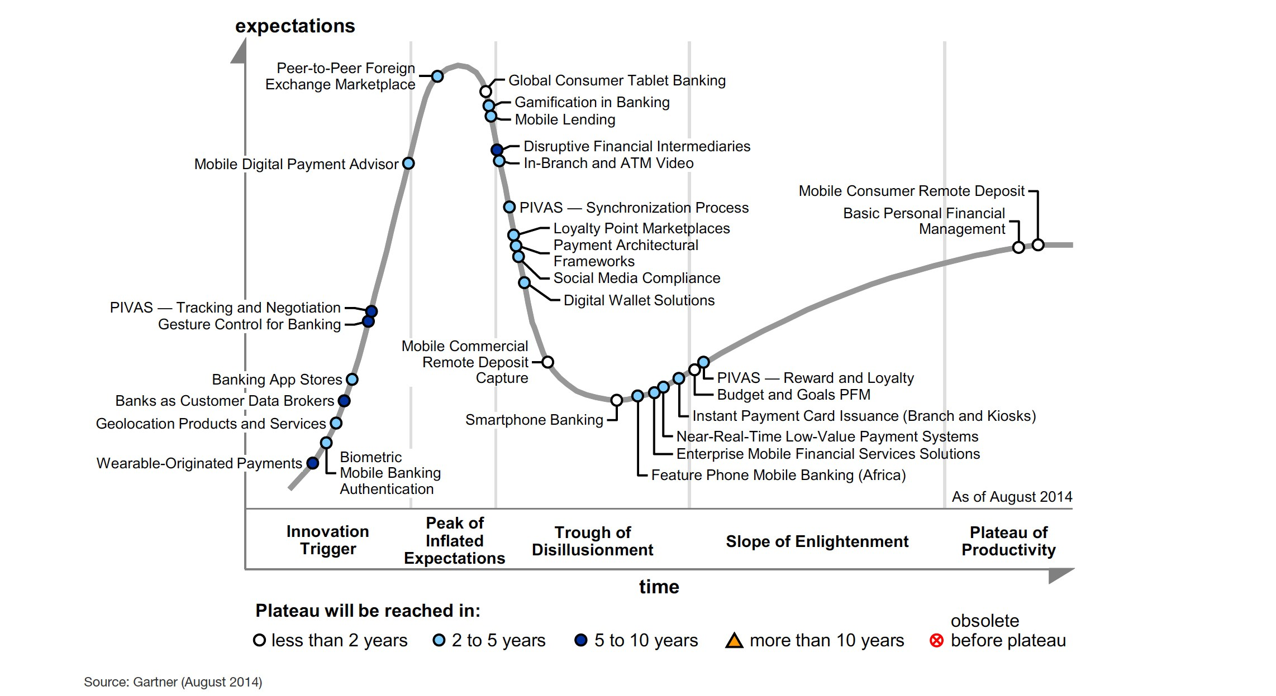

Slide 3
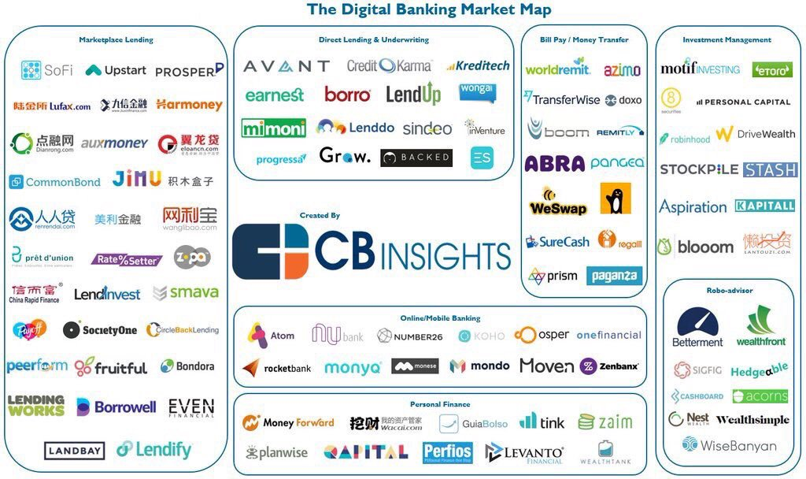

Slide 4
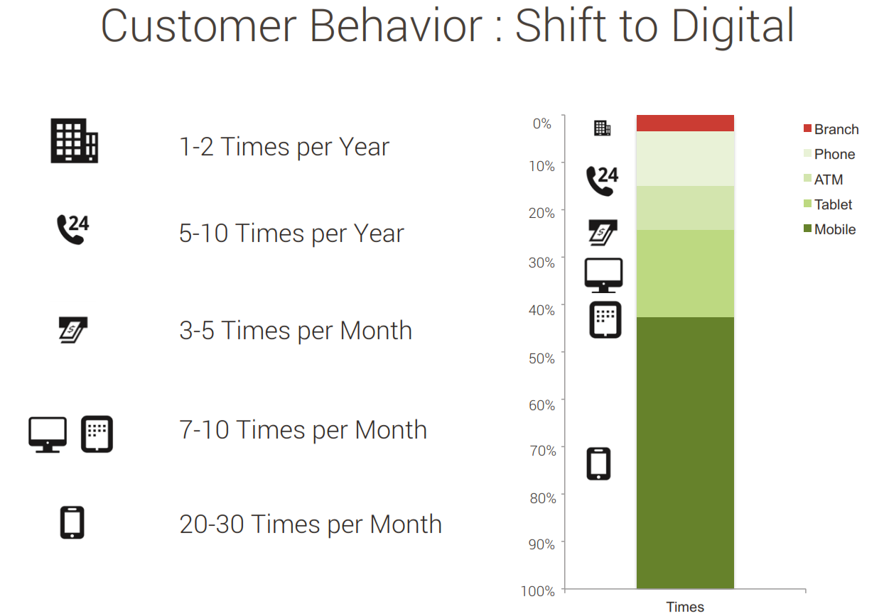

Slide 5
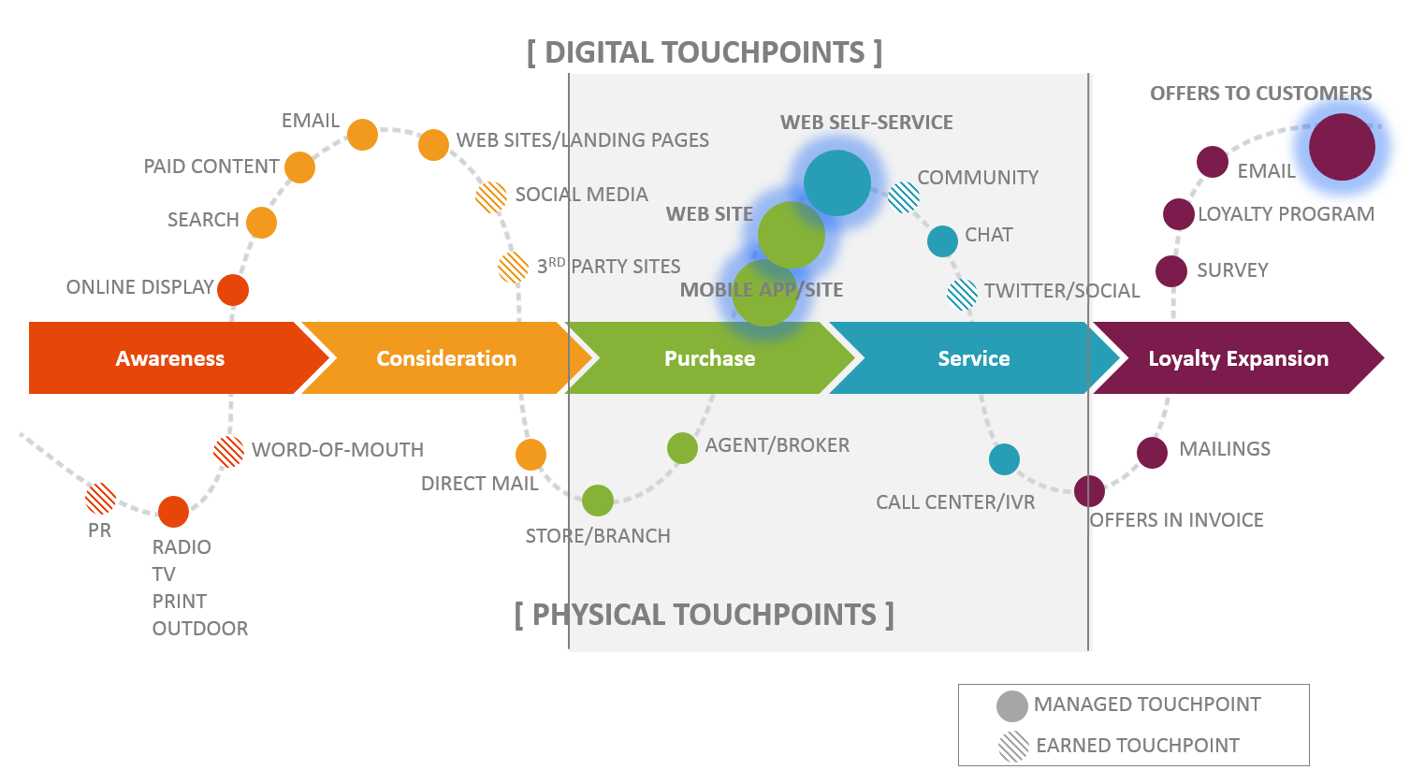

Slide 6
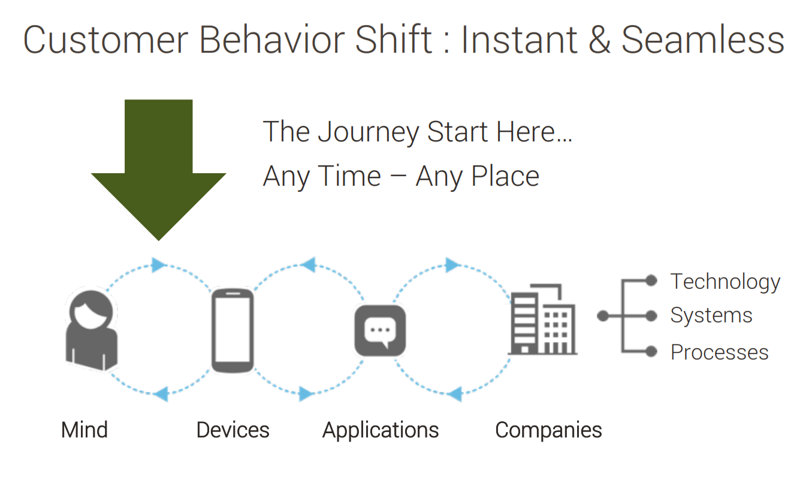

Slide 7
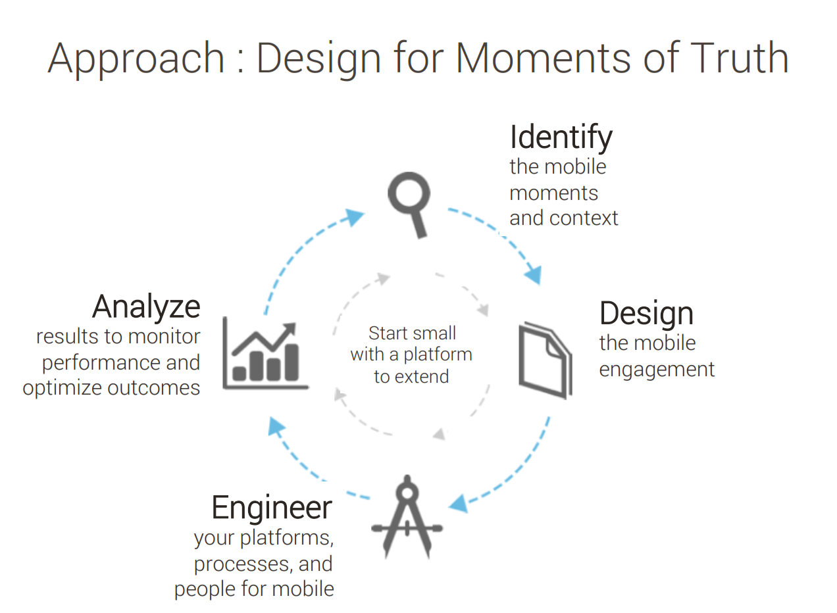

Slide 8
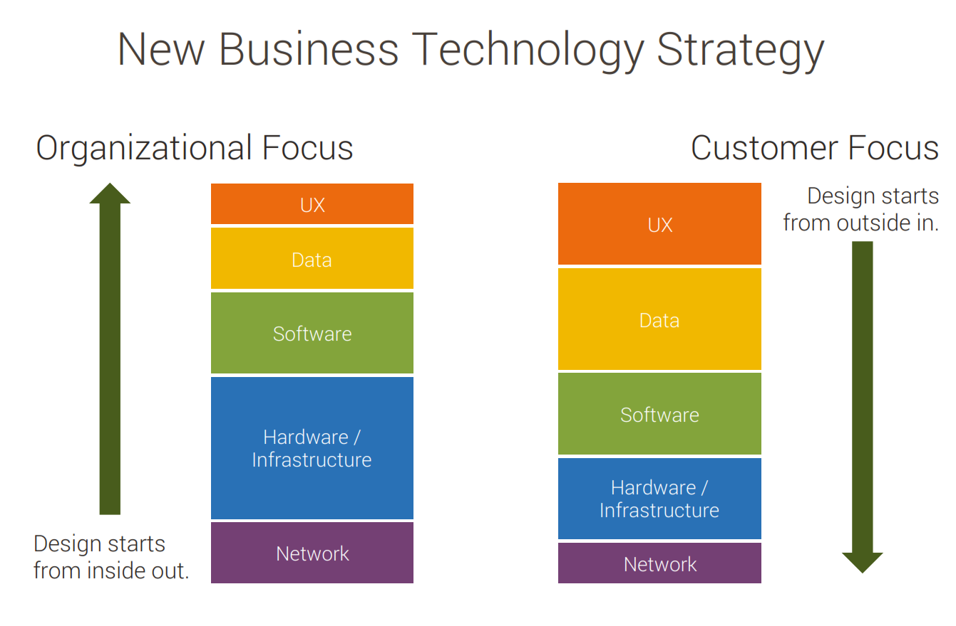

Slide 9

CUSTOMER CONTACT CHANNELS
Website
Email
Phone
Location
Online paid media
Interaction Data
User ID /session ID
Time onsite/bound rate
Click streams
Offers
Context
Source/channel/medium
Attitudinal Data
Opinions
Preferences
Needs
Desires
Moods
ONLINE USER
CUSTOMER CENTRIC - 360 ⁰ INSIGHT
OFFLINE USER
CUSTOMER 360 VIEW
Descriptive Data
Attributes
Geographic
Characteristic
Self declare info
Behavioral Data
Orders
Transactions
Payment history
Usage history
Location
Life time value
CUSTOMER CONTACT CHANNELS
Store
Call center
Agent
Event

Slide 10
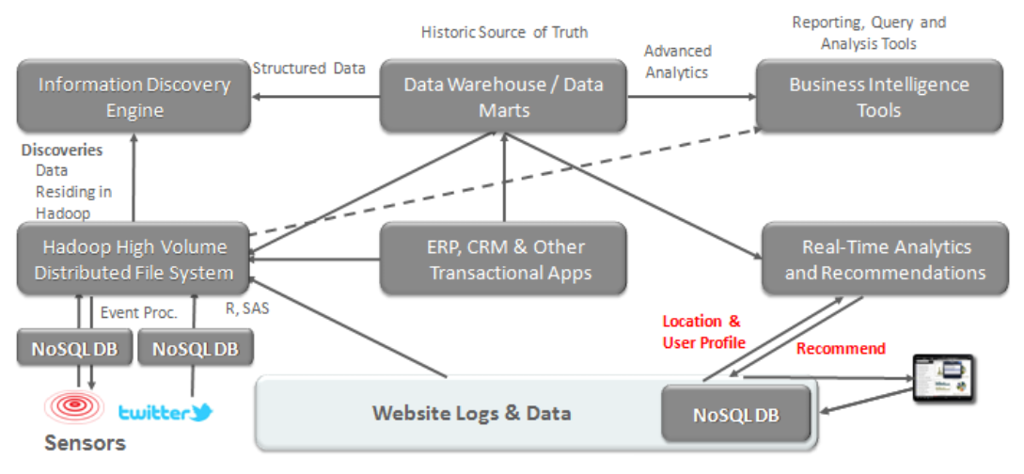

TCB & ANTS
TCB
ANTS

