Slide 1
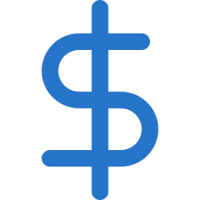
QMA
QUANTUM MARKET ADVISOR
Autonomous Agent Market Intelligence & Frictionless Micro-Payments
Presented by the QMA Team

Slide 2

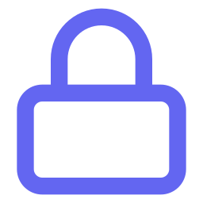
THE CORE PROBLEM
The Paywall Friction
Traditional paywalls require manual account creation, credit cards, and long-term subscriptions.
AI agents and automated micro-services cannot easily bypass these barriers.
REPORT LOCKED
Sign up · Add card · Subscribe monthly
Quant traders face massive subscription fatigue just to access simple, segmented market data.
ACCESS DENIED
QMA
02 / 16

Slide 3


THE SOLUTION
On-Demand Agentic Intelligence
Paid Queries
QMA · Live Query
Buy only the single report you need for a fraction of a cent.
BTC-USDT Order Flow Signal
Aggregated depth + momentum report, updated 30s ago
Zero Friction
$0.04
No accounts, no signups — directly pay-per-call.
Agent-First
Unlock Report
Built for humans and autonomous agents to purchase intelligence programmatically.
No signup · No card on file · Pay-per-call
Settled on Arc in 0.4s
QMA
03 / 16

Slide 4
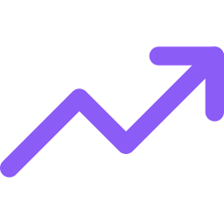
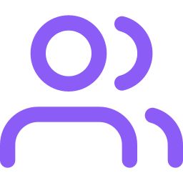
TARGET MARKET
Who QMA Serves
01
02
03
Quant & DeFi Traders
Autonomous AI Agents
Market Creators & Providers
Need quick, programmatically accessible data feeds and market signals without overhead.
Systems that need to buy datasets or reports from other agents dynamically.
Financial analysts who want to instantly monetize their indicators via APIs.
QMA
04 / 16

Slide 5
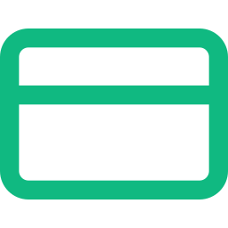
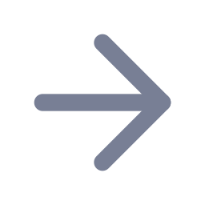
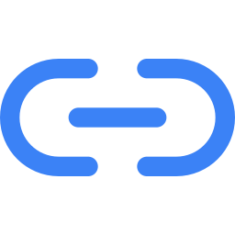
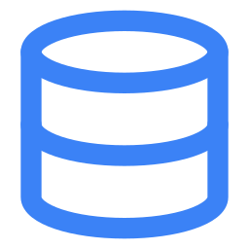

ARCHITECTURE
The QMA Ecosystem
MetaMask Wallet
User-funded, non-custodial
Arc Gateway
QMA Ledger
Paid Report
USDC settlement rail
HTTP 402 trigger
Instantly decrypted
Autonomous Agent
Agent-owned smart wallet
User-funded MetaMask payments (via the Arc Gateway) and fully autonomous agent wallets converge on one settlement ledger — both trigger the same HTTP 402 paid-access flow before instant report decryption.
QMA
05 / 16

Slide 6


INFRASTRUCTURE PARTNER
Powered by Circle
Programmable Wallets
Smart Contract Accounts (SCA) handle credentials securely.
USDC as Native Utility
All reports and services are priced and paid in USDC.
CIRCLE
Programmable USDC Infrastructure
Developer-Controlled Wallets
Lets QMA agents autonomously store and spend funds.
QMA
06 / 16

Slide 7

SETTLEMENT LAYER
Powered by Arc Blockchain
SETTLEMENT SPEED COMPARISON
TRADITIONAL L1
ARC
~12s
< 0.5s
to final settlement
to final settlement
ARC NETWORK
The blockchain built for USDC
USDC as Gas
No need for ETH or MATIC — USDC is the native gas token.
< 500ms
Predictable Fees
SETTLEMENT FINALITY
Micro-cent transaction fees enable sustainable nanopayments.
QMA
07 / 16

Slide 8
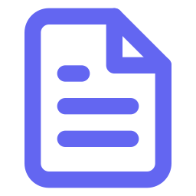
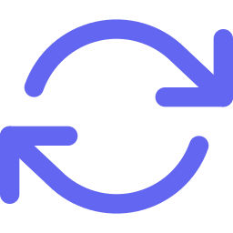
PAYMENT PROTOCOL
The x402 Payment Protocol
Intercept
Custom backend middleware intercepts restricted API endpoints.
HTTP/1.1 402 Payment Required
Content-Type: application/json
{
"amount": "0.04",
"currency": "USDC",
"network": "arc",
"recipient": "0x9F2...b71",
"invoice_id": "qma_8x1c2"
}
Invoice
Returns a signed invoice payload when payment is missing.
Retry & Settle
Client signs the payment intent and retries the call with the settled token.
QMA
08 / 16

Slide 9

PRODUCT EXPERIENCE
Unified Deposit / Withdraw Flow
Add / Withdraw Funds
Single Modal
Deposit into your Circle Gateway pre-funded balance or your Agent Smart Wallet.
Deposit
Withdraw
$10
$25
$50
Max
Smart Presets
Preset amounts ($10, $25, $50) plus a Max automatic balance parser.
Balance: 128.40 USDC available
Safe Custody
Confirm & Sign
Fully non-custodial via MetaMask, with direct on-chain refund options.
Non-custodial · MetaMask signature required
QMA
09 / 16

Slide 10
PAYMENT LIFECYCLE
Payment State Machine
Created
Paid
Settling
Settled
Refunded
Cancelled
Idempotency & Lifecycle Security
An immutable state machine supports Refunded and Cancelled states and enforces secure double-spend protection, so access is granted only once payment is confirmed in the ledger database.
QMA
10 / 16

Slide 11
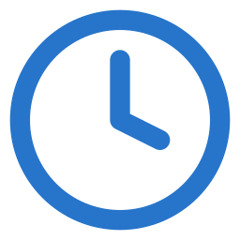
AGENT INFRASTRUCTURE
The Autonomous Agent Wallet
Programmatic Spend Policies
SCA · SMART WALLET
Set spending caps — hourly, daily, or monthly — so the agent can buy reports autonomously.
Non-Custodial Limits
The owner's MetaMask is never exposed to the agent, and limits are enforced on-chain.
$10 / day
Abstracted Gas Fees
EXAMPLE AUTONOMOUS SPEND CAP
Gas is abstracted so agent transactions execute cleanly, without holding a native token.
Owner's MetaMask is never exposed to the agent.
QMA
11 / 16

Slide 12
MARKETPLACE
Creator & Provider Registry
Creator Dashboard
Decentralized Listings
Creators register analytical models or data providers on the platform.
Claimable earnings
$2,148.60
Direct Gateway Splits
USDC ACCRUED THIS MONTH
Fees are split automatically between creators and platform at the contract level.
Ledger Claims
Creators can withdraw accrued claimable ledger earnings instantly.
Withdraw Earnings
QMA
12 / 16

Slide 13
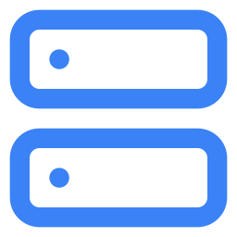
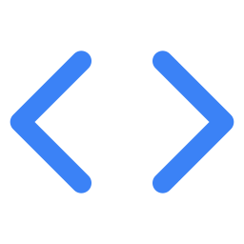
UNDER THE HOOD
Core Technical Stack
Backend
Storage
Python 3.11 · FastAPI
Supabase PostgreSQL · payment event tables
Frontend
Blockchain
React 18 · Vite · TypeScript
Ethers.js · MetaMask · Circle Developer Wallets SDK
QMA
13 / 16

Slide 14
TRUST & SAFETY
Security & Safety Framework
EIP-712 Typed Signing
Users explicitly sign transaction intents before anything executes.
Circle Vault Security
Developer-controlled wallets are secured under Circle's enterprise-grade KMS.
NON-CUSTODIAL FIRST
Idempotency Keys
QMA never holds user private keys.
Prevents double-spend and duplicate charges across every request.
QMA
14 / 16

Slide 15

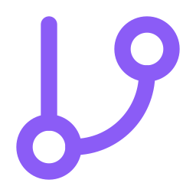

WHAT'S NEXT
QMA Roadmap & Future Vision
PHASE 1 · CURRENT
PHASE 2
PHASE 3
Foundation
Expansion
Decentralization
Arc Testnet deployment
Unified wallet interfaces
HTTP 402 middleware
Circle CCTP mainnet bridges
Multi-agent negotiation network
Predictive market models
Fully decentralized agent marketplace
Cross-chain atomic settlement
QMA
15 / 16

Slide 16
SUMMARY
The Future of Agentic FinTech
Micro-payments are the missing link for AI agent economies.
QMA delivers market intelligence on-demand with zero paywall friction.
QMA
Circle & Arc make gas-abstracted stablecoin transactions a reality today.
qma.advisor.io
QMA
16 / 16

