Slide 1
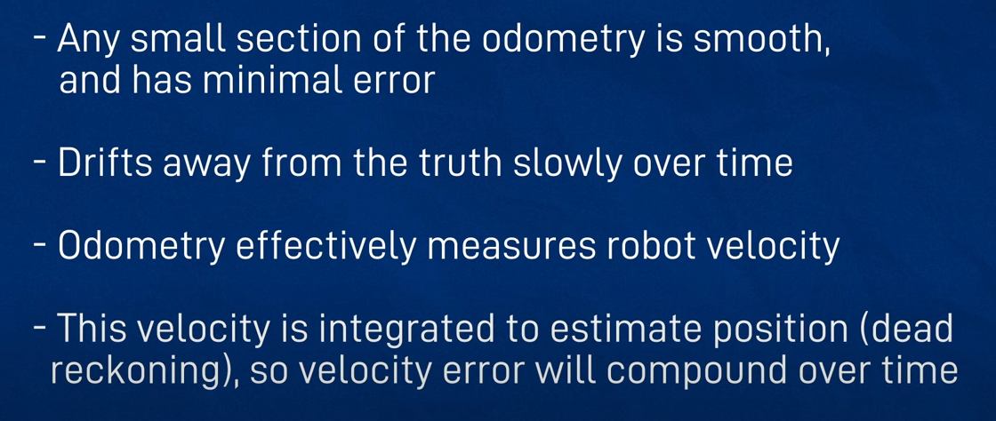
SLAM with ROS using slam_toolbox

Slide 2
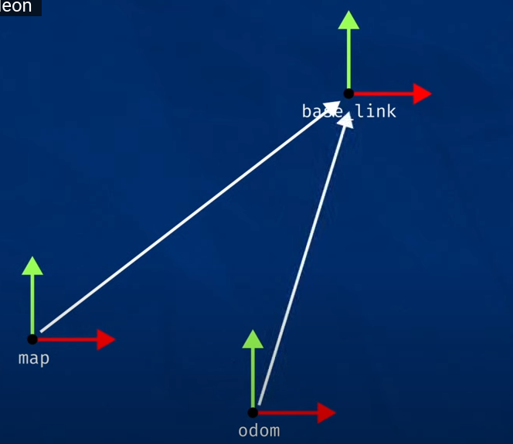
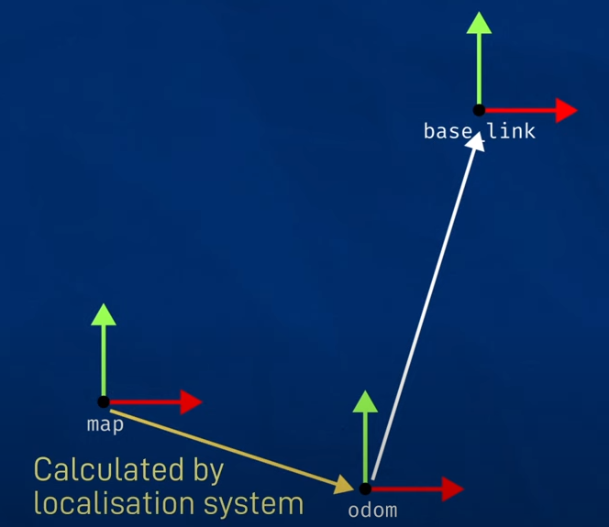

Slide 3
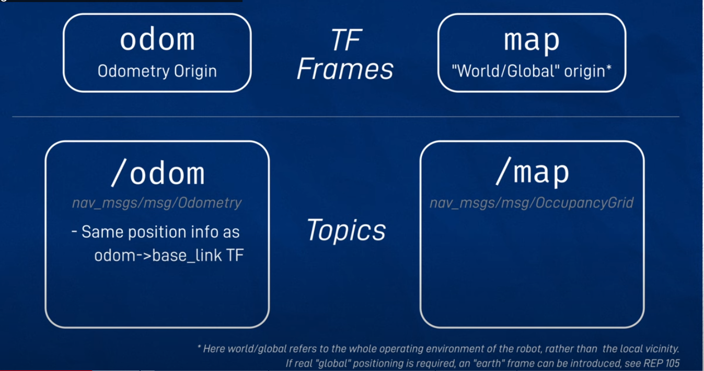


Slide 4
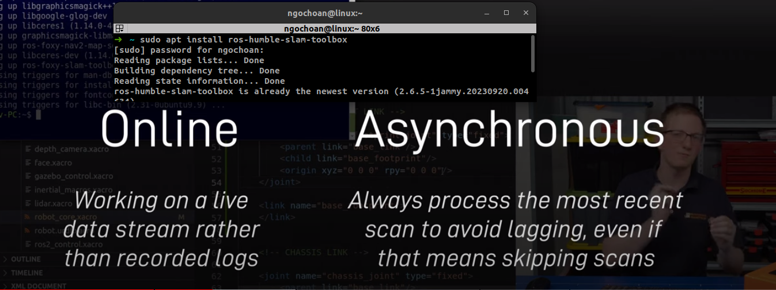
cp /opt/ros/humble/share/slam_toolbox/config/mapper_params_online_async.yaml bbb_ws/src/bbb_robot/config
ros2 launch slam_toolbox online_async_launch.py params_file:=./src/bbb_robot/config/mapper_params_online_async.yaml use_sim_time:=true

Slide 5
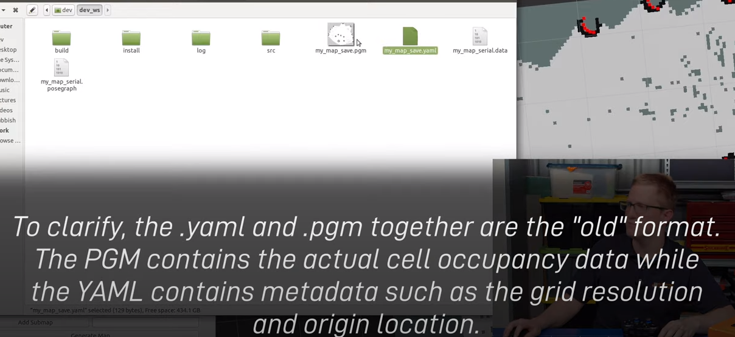


Slide 6


Slide 7
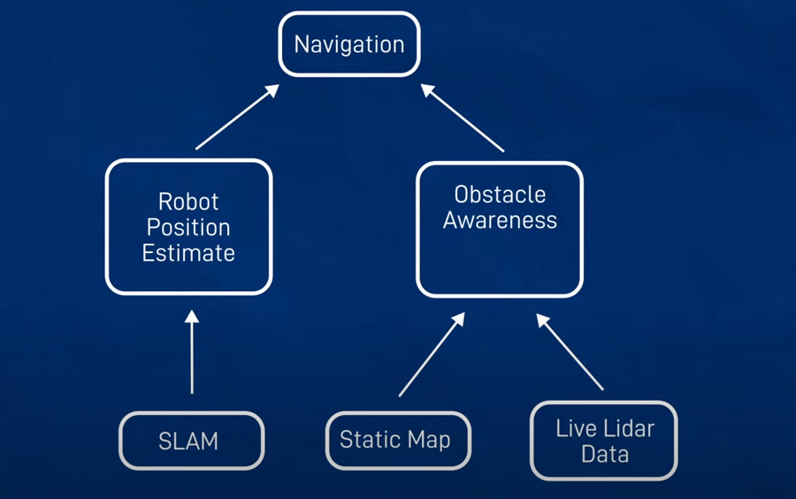

Slide 8
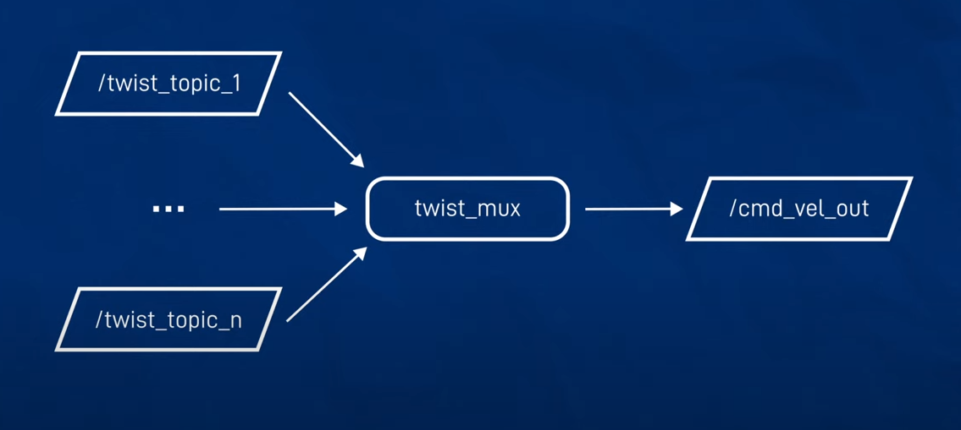
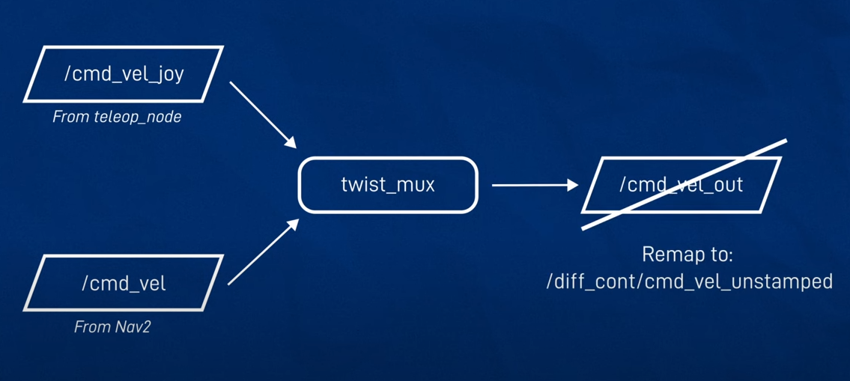

Slide 9
