Slide 1
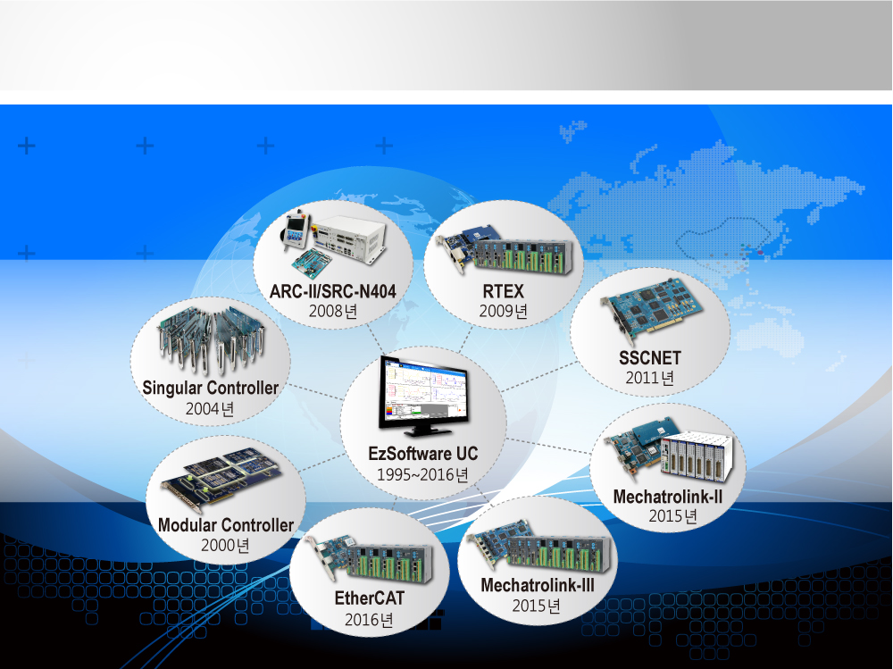


SCARA ROBOT
[Contents]
1. Selection table Robots
- TOSHIBA
- ABB
- YASKAWA
2. External view
- TOSHIBA
- YASKAWA

Slide 2
1. Selection table Robots

Slide 3
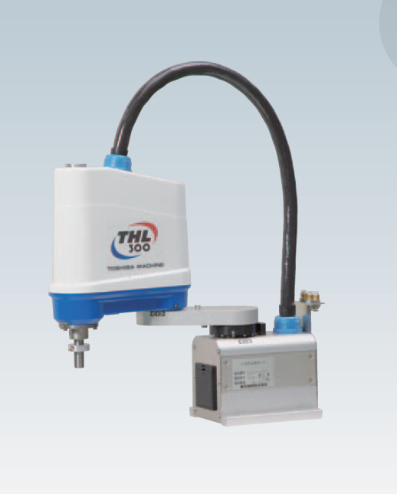
TOSHIBA
Model |  | THL300
Type |  | Horizontal milti-joint
No. of controlled axes |  | 4
Arm length |  | 300mm(125mm+175mm)
Working envelope | Axis 1 | ±125º
 | Axis 2 | ±145º
 | Axis 3(Z axis) | 0~160mm
 | Axis 4(Z axis rotation) | ±360º
Maximum speed | Axis 1 | 660º/S
 | Axis 2 | 660º/S
 | Axis 3(Z axis) | 1120mm/s
 | Axis 4(Z axis rotation) | 1500º/S
 | Composite | 5.1m/s
Standard cycle time(with 2kg load) |  | 0.48s
Maximum payload mass |  | 5kg(rated : 2kg)
Allowable moment of inertia |  | 0.05kg·m²
Positioning | X-Y | ±0.01mm
repeatability | Z(Axis 3) | ±0.015mm
 | Axisθ(Z-axis rotation) | ±0.007º
Hand wiring |  | 8input / 8outputs
Hand pneumatic joints |  | Ø4x3 pcs.
Position detection |  | Absolute
Robot controller cable |  | 3.5m
Power capacity |  | 0.7kVA
Mass |  | 12kg

Slide 4
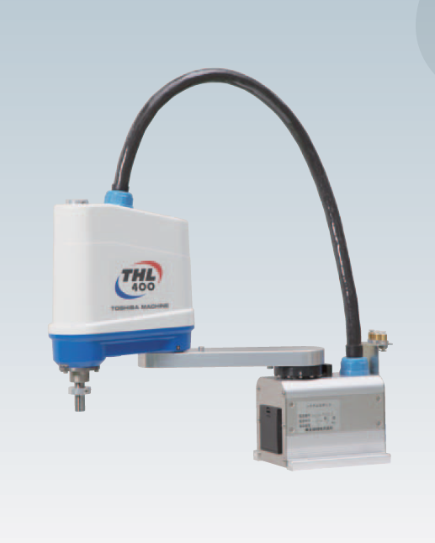
TOSHIBA
Model |  | THL400
Type |  | Horizontal milti-joint
No. of controlled axes |  | 4
Arm length |  | 400mm(225mm+175mm)
Working envelope | Axis 1 | ±125º
 | Axis 2 | ±145º
 | Axis 3(Z axis) | 0~160mm
 | Axis 4(Z axis rotation) | ±360º
Maximum speed | Axis 1 | 660º/S
 | Axis 2 | 660º/S
 | Axis 3(Z axis) | 1120mm/s
 | Axis 4(Z axis rotation) | 1500º/S
 | Composite | 6.3m/s
Standard cycle time(with 2kg load) |  | 0.47s
Maximum payload mass |  | 5kg(rated : 2kg)
Allowable moment of inertia |  | 0.05kg·m²
Positioning | X-Y | ±0.01mm
repeatability | Z(Axis 3) | ±0.015mm
 | Axisθ(Z-axis rotation) | ±0.007º
Hand wiring |  | 8input / 8outputs
Hand pneumatic joints |  | Ø4x3 pcs.
Position detection |  | Absolute
Robot controller cable |  | 3.5m
Power capacity |  | 0.7kVA
Mass |  | 13kg

Slide 5
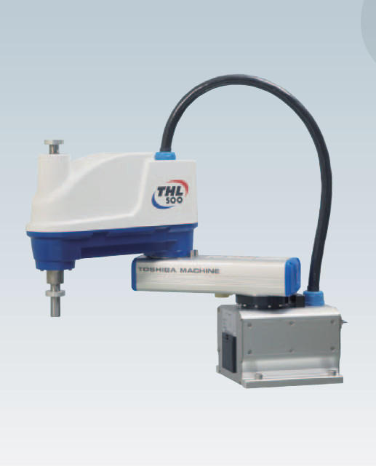
TOSHIBA
Model |  | THL500
Type |  | Horizontal milti-joint
No. of controlled axes |  | 4
Arm length |  | 500mm(200mm+300mm)
Working envelope | Axis 1 | ±125º
 | Axis 2 | ±145º
 | Axis 3(Z axis) | 0~150mm
 | Axis 4(Z axis rotation) | ±360º
Maximum speed | Axis 1 | 450º/S
 | Axis 2 | 450º/S
 | Axis 3(Z axis) | 2000mm/s
 | Axis 4(Z axis rotation) | 1700º/S
 | Composite | 6.3m/s
Standard cycle time(with 2kg load) |  | 0.45s
Maximum payload mass |  | 10kg(rated : 2kg)
Allowable moment of inertia |  | 0.2kg·m²
Positioning | X-Y | ±0.01mm
repeatability | Z(Axis 3) | ±0.015mm
 | Axisθ(Z-axis rotation) | ±0.007º
Hand wiring |  | 8input / 8outputs
Hand pneumatic joints |  | Ø6x3 pcs.
Position detection |  | Absolute
Robot controller cable |  | 3.5m
Power capacity |  | 1.4kVA
Mass |  | 22kg

Slide 6
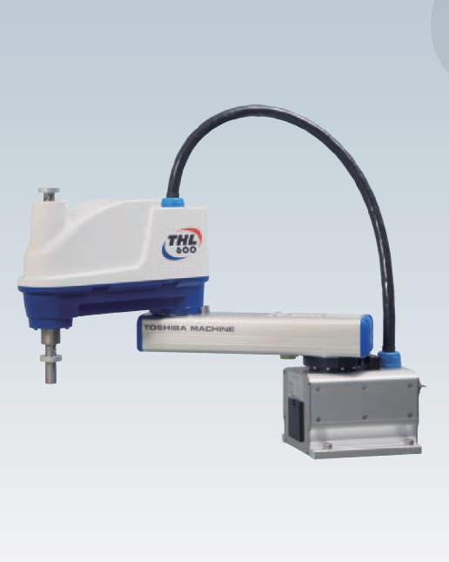
TOSHIBA
Model |  | THL600
Type |  | Horizontal milti-joint
No. of controlled axes |  | 4
Arm length |  | 600mm(300mm+300mm)
Working envelope | Axis 1 | ±125º
 | Axis 2 | ±145º
 | Axis 3(Z axis) | 0~150mm
 | Axis 4(Z axis rotation) | ±360º
Maximum speed | Axis 1 | 450º/S
 | Axis 2 | 450º/S
 | Axis 3(Z axis) | 2000mm/s
 | Axis 4(Z axis rotation) | 1700º/S
 | Composite | 7.1m/s
Standard cycle time(with 2kg load) |  | 0.45s
Maximum payload mass |  | 10kg(rated : 2kg)
Allowable moment of inertia |  | 0.2kg·m²
Positioning | X-Y | ±0.01mm
repeatability | Z(Axis 3) | ±0.015mm
 | Axisθ(Z-axis rotation) | ±0.007º
Hand wiring |  | 8input / 8outputs
Hand pneumatic joints |  | Ø6x3 pcs.
Position detection |  | Absolute
Robot controller cable |  | 3.5m
Power capacity |  | 1.4kVA
Mass |  | 23kg

Slide 7
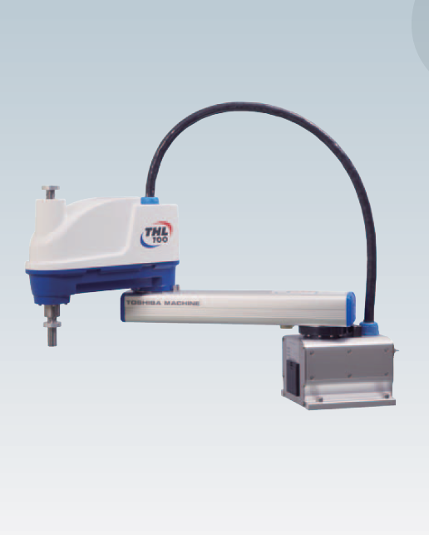
TOSHIBA
Model |  | THL700
Type |  | Horizontal milti-joint
No. of controlled axes |  | 4
Arm length |  | 700mm(400mm+300mm)
Working envelope | Axis 1 | ±125º
 | Axis 2 | ±145º
 | Axis 3(Z axis) | 0~150mm
 | Axis 4(Z axis rotation) | ±360º
Maximum speed | Axis 1 | 450º/S
 | Axis 2 | 450º/S
 | Axis 3(Z axis) | 2000mm/s
 | Axis 4(Z axis rotation) | 1700º/S
 | Composite | 7.9m/s
Standard cycle time(with 2kg load) |  | 0.50s
Maximum payload mass |  | 10kg(rated : 2kg)
Allowable moment of inertia |  | 0.2kg·m²
Positioning | X-Y | ±0.01mm
repeatability | Z(Axis 3) | ±0.015mm
 | Axisθ(Z-axis rotation) | ±0.007º
Hand wiring |  | 8input / 8outputs
Hand pneumatic joints |  | Ø6x3 pcs.
Position detection |  | Absolute
Robot controller cable |  | 3.5m
Power capacity |  | 1.4kVA
Mass |  | 24kg

Slide 8
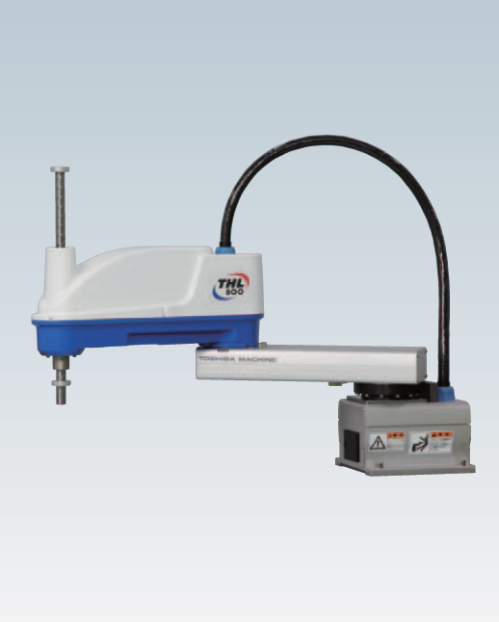
TOSHIBA
Model |  | THL800
Type |  | Horizontal milti-joint
No. of controlled axes |  | 4
Arm length |  | 800mm(350mm+450mm)
Working envelope | Axis 1 | ±125º
 | Axis 2 | ±145º
 | Axis 3(Z axis) | 0~150mm
 | Axis 4(Z axis rotation) | ±360º
Maximum speed | Axis 1 | 187.5º/S
 | Axis 2 | 217.5º/S
 | Axis 3(Z axis) | 2000mm/s
 | Axis 4(Z axis rotation) | 1700º/S
 | Composite | 4.3m/s
Standard cycle time(with 2kg load) |  | 0.47s
Maximum payload mass |  | 10kg(rated : 2kg)
Allowable moment of inertia |  | 0.2kg·m²
Positioning | X-Y | ±0.02mm
repeatability | Z(Axis 3) | ±0.015mm
 | Axisθ(Z-axis rotation) | ±0.007º
Hand wiring |  | 8input / 8outputs
Hand pneumatic joints |  | Ø6x3 pcs.
Position detection |  | Absolute
Robot controller cable |  | 3.5m
Power capacity |  | 1.4kVA
Mass |  | 33kg

Slide 9
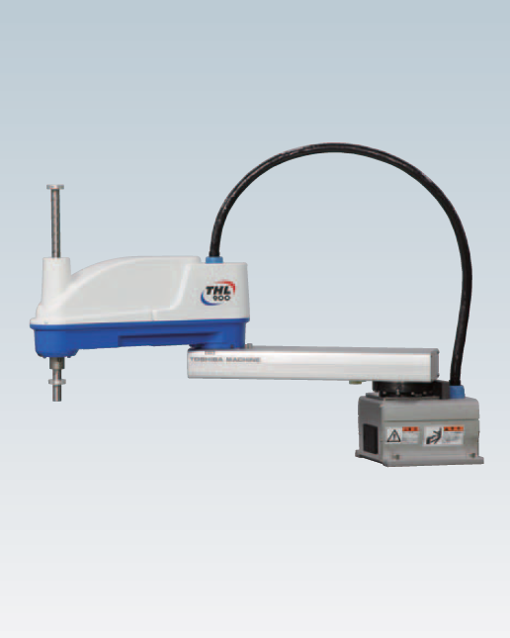
TOSHIBA
Model |  | THL900
Type |  | Horizontal milti-joint
No. of controlled axes |  | 4
Arm length |  | 900mm(450mm+450mm)
Working envelope | Axis 1 | ±125º
 | Axis 2 | ±145º
 | Axis 3(Z axis) | 0~300mm
 | Axis 4(Z axis rotation) | ±360º
Maximum speed | Axis 1 | 187.5º/S
 | Axis 2 | 217.5º/S
 | Axis 3(Z axis) | 2000mm/s
 | Axis 4(Z axis rotation) | 1700º/S
 | Composite | 4.6m/s
Standard cycle time(with 2kg load) |  | 0.48s
Maximum payload mass |  | 10kg(rated : 2kg)
Allowable moment of inertia |  | 0.2kg·m²
Positioning | X-Y | ±0.02mm
repeatability | Z(Axis 3) | ±0.015mm
 | Axisθ(Z-axis rotation) | ±0.007º
Hand wiring |  | 8input / 8outputs
Hand pneumatic joints |  | Ø6x3 pcs.
Position detection |  | Absolute
Robot controller cable |  | 3.5m
Power capacity |  | 1.4kVA
Mass |  | 35kg

Slide 10
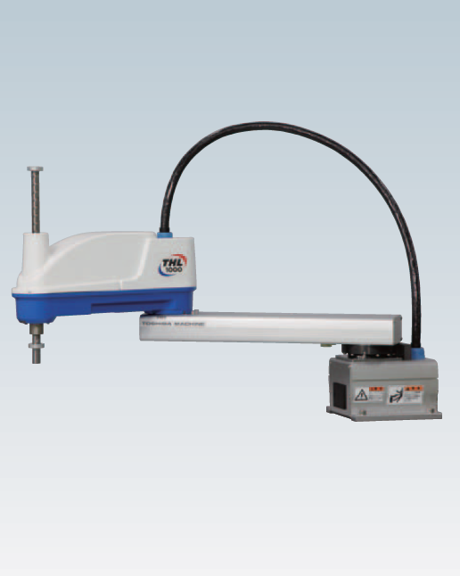
TOSHIBA
Model |  | THL1000
Type |  | Horizontal milti-joint
No. of controlled axes |  | 4
Arm length |  | 1000mm(550mm+450mm)
Working envelope | Axis 1 | ±125º
 | Axis 2 | ±145º
 | Axis 3(Z axis) | 0~300mm
 | Axis 4(Z axis rotation) | ±360º
Maximum speed | Axis 1 | 187.5º/S
 | Axis 2 | 217.5º/S
 | Axis 3(Z axis) | 2000mm/s
 | Axis 4(Z axis rotation) | 1700º/S
 | Composite | 5.0m/s
Standard cycle time(with 2kg load) |  | 0.48s
Maximum payload mass |  | 10kg(rated : 2kg)
Allowable moment of inertia |  | 0.2kg·m²
Positioning | X-Y | ±0.02mm
repeatability | Z(Axis 3) | ±0.015mm
 | Axisθ(Z-axis rotation) | ±0.007º
Hand wiring |  | 8input / 8outputs
Hand pneumatic joints |  | Ø6x3 pcs.
Position detection |  | Absolute
Robot controller cable |  | 3.5m
Power capacity |  | 1.4kVA
Mass |  | 37kg

Slide 11
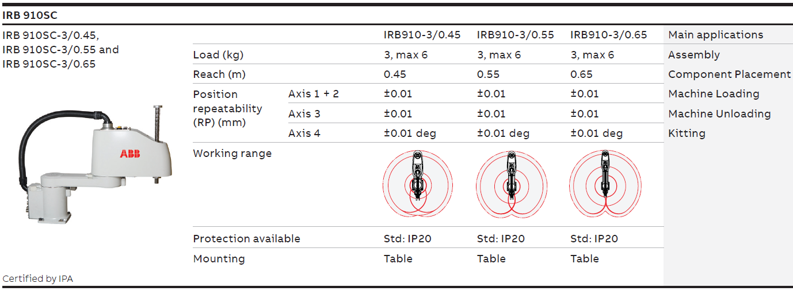
ABB

Slide 12
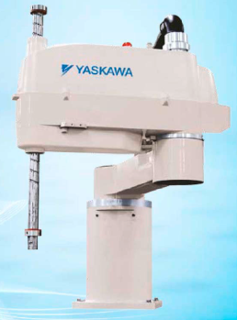
YASKAWA
Model |  | MYS450L | MYS650L | MYS850L | MYS1,000L
Type |  | Horizontal milti-joint | Horizontal milti-joint | Horizontal milti-joint | Horizontal milti-joint
No. of controlled axes |  | 4 | 4 | 4 | 4
Arm length |  | 450mm (200mm+250mm) | 650mm (400mm+250mm) | 650mm (450mm+400mm) | 1,000mm (600mm+400mm)
Working envelope | Axis 1 | - | - | - | -
 | Axis 2 | - | - | - | -
 | Axis 3(Z axis) | 0~330mm | 0~330mm | 0~420mm | 0~420mm
 | Axis 4(Z axis rotation) | - | - | - | -
Maximum speed | Axis 1 | - | - | - | -
 | Axis 2 | - | - | - | -
 | Axis 3(Z axis) | - | - | - | -
 | Axis 4(Z axis rotation) | - | - | - | -
 | Composite | - | - | - | -
Standard cycle time |  | - | - | - | -
Maximum payload mass |  | 6kg | 6kg | 10kg | 20kg
Allowable moment of inertia (Normal / Max) |  | 0.01kg·m² / 0.12kg·m² | 0.01kg·m² / 0.12kg·m² | 0.02kg·m² / 0.25kg·m² | 0.02kg·m² / 0.45kg·m²
Positioning | X-Y | - | - | - | -
repeatability | Z(Axis 3) | - | - | - | -
 | Axisθ(Z-axis rotation) | - | - | - | -
Hand wiring |  | - | - | - | -
Hand pneumatic joints |  | - | - | - | -
Position detection |  | - | - | - | -
Robot controller cable |  | - | - | - | -
Power capacity |  | - | - | - | -
Mass |  | 27kg | 28kg | 46kg | 48kg

Slide 13
2. External view

Slide 14
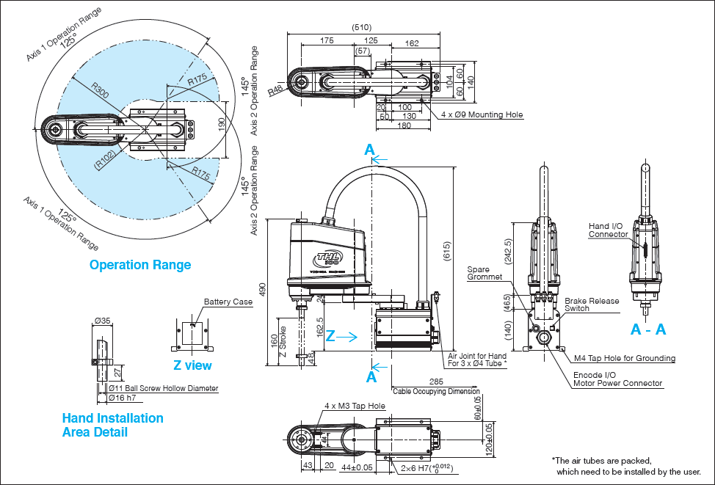
(TOSHIBA-THL300)

Slide 15
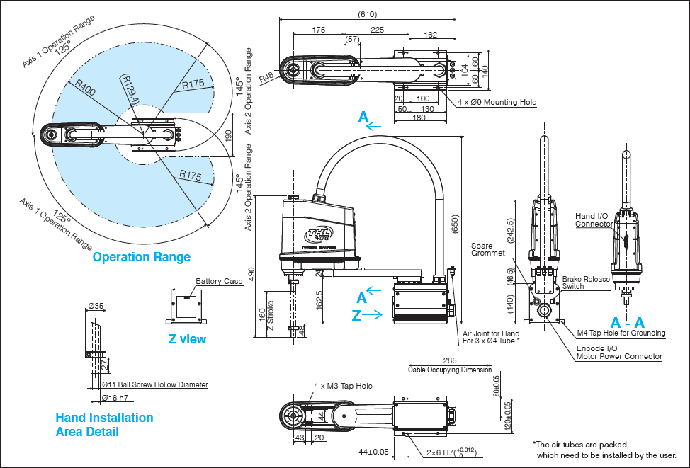
(TOSHIBA-THL400)

Slide 16
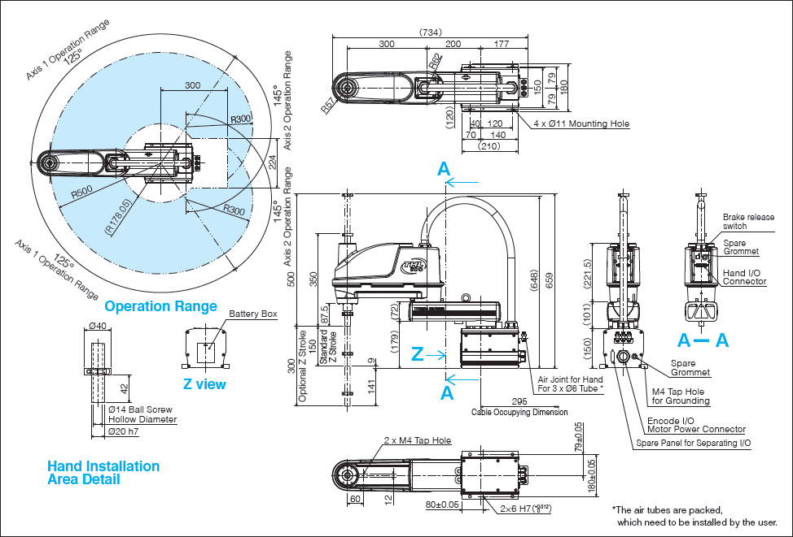
(TOSHIBA-THL500)

Slide 17
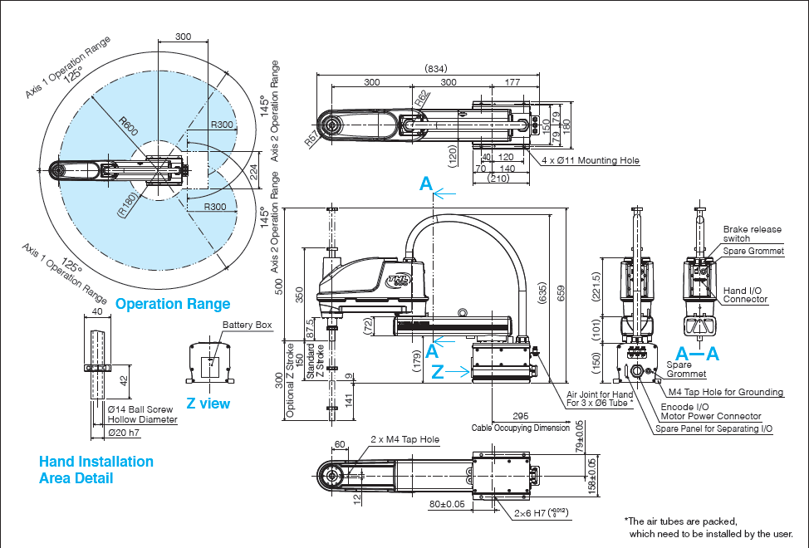
(TOSHIBA-THL600)

Slide 18
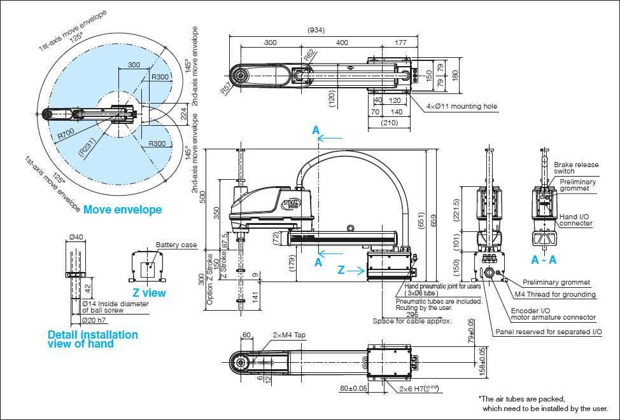
(TOSHIBA-THL700)

Slide 19
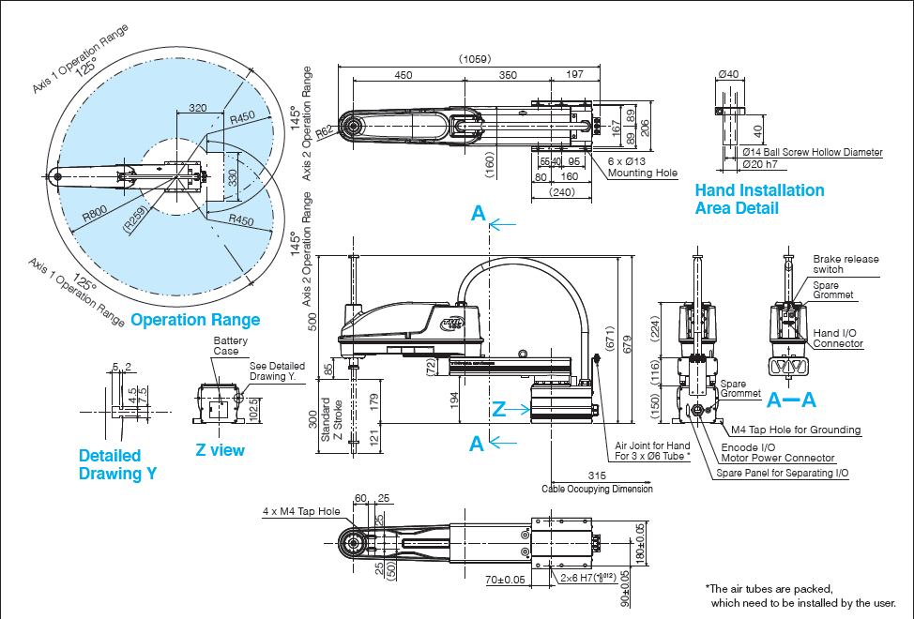
(TOSHIBA-THL800)

Slide 20
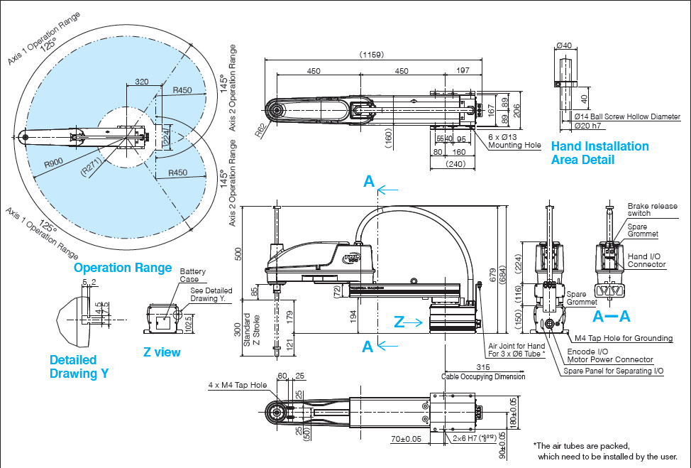
(TOSHIBA-THL900)

Slide 21
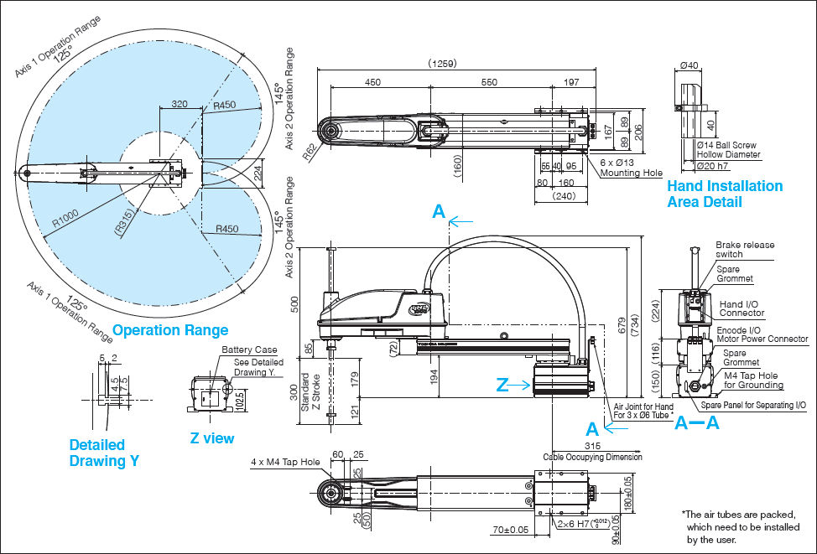
(TOSHIBA-THL1000)

Slide 22
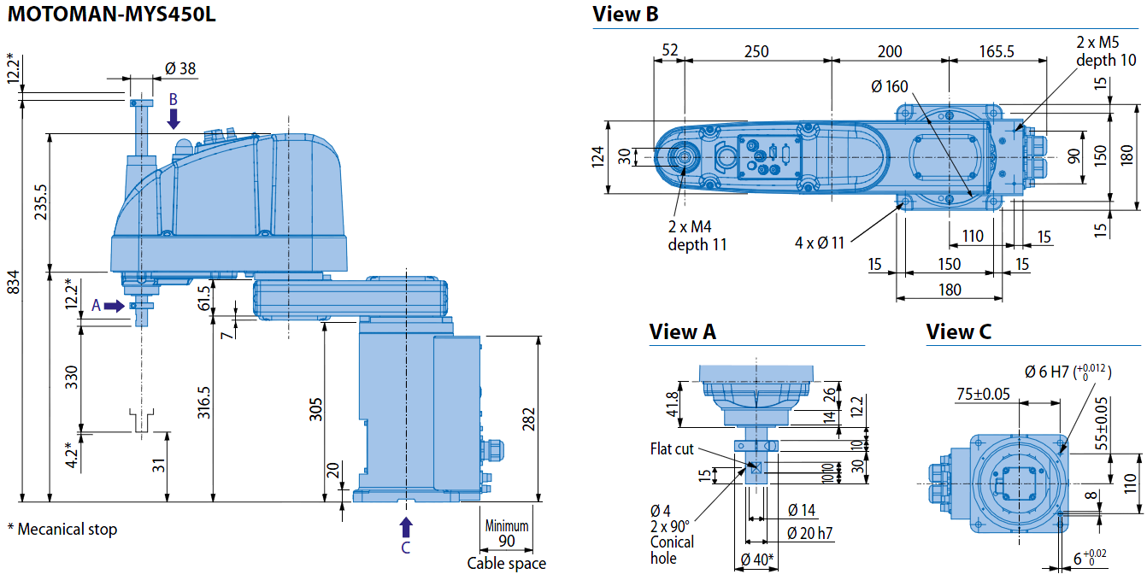
(YASKAWA-MYS450L)

Slide 23
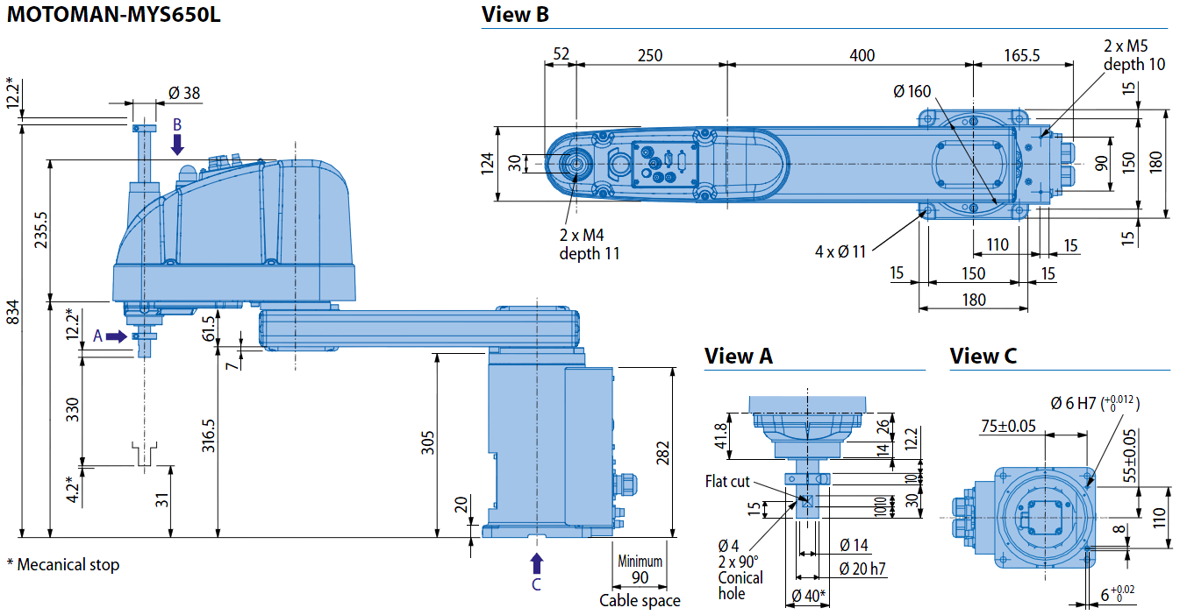
(YASKAWA-MYS650L)

Slide 24
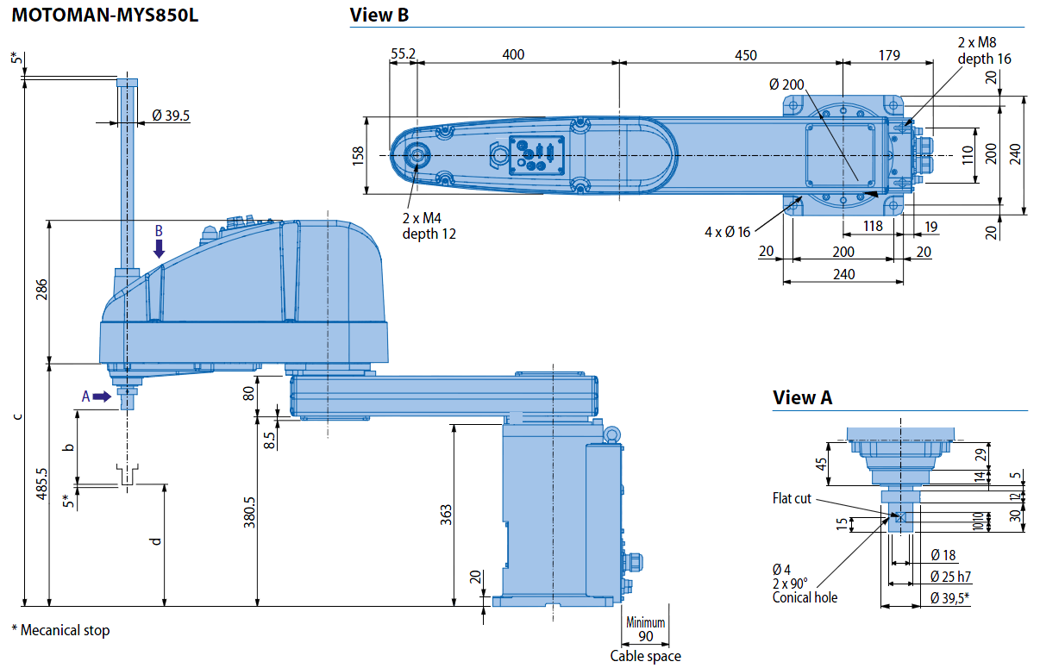
(YASKAWA-MYS850L)

Slide 25
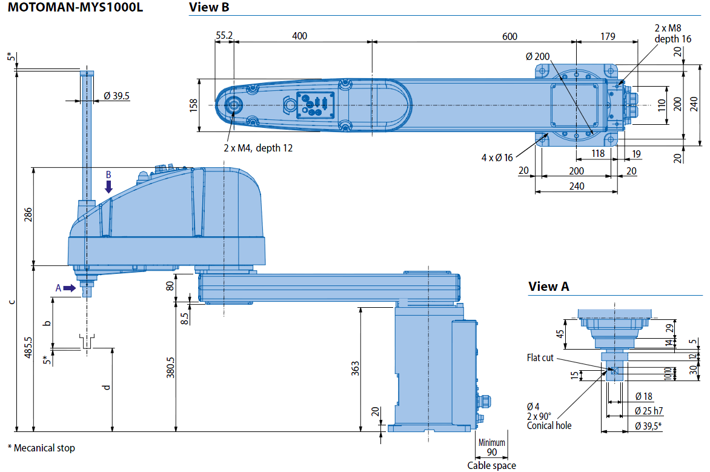
(YASKAWA-MYS1000L)

