Slide 1

Chapter 3. Tree
Nguyễn Khánh Phương
Computer Science department
School of Information and Communication technology
E-mail: phuongnk@soict.hust.edu.vn

Slide 2
Contents
3.1. Definitions
3.2. Tree implementation
3.3. Tree traversal
3.4. Binary tree
Become Rich
Force Others to be Poor
Rob
Banks
Stock
Fraud
Notes:
Chapter 4. Tree • Tree data structure definition • General tree representation • Pre-Order, In-Order, Post-Order traversal on trees • Implementation of basic operations on a tree: node insertion, compute height, depth of a node, count number of nodes, leaf nodes • Binary tree

Slide 3
What is a tree?
A tree is a kind of graph
So what is a “graph”?

Slide 4
What is a graph
Definition = a set of nodes (vertices) with edges (links) between them.
G = (V, E) - graph
V = set of vertices
E = set of edges
1
2
3
4

Slide 5
Two different types of graphs
Directed vs Undirected graphs

Slide 6
More types of graphs
Complete graph
A graph with an edge between each pair of vertices
Subgraph
A graph (V’, E’) such that V’⊆V and E’⊆E
Path from v to w
A sequence of vertices <v₀, v₁, …, v_{k}> such that v₀=v and v_{k}=w
Length of a path
Number of edges in the path
1
2
3
4
path from v₁ to v₄ <v₁, v₂, v₄>

Slide 7
More more
w is reachable from v
If there is a path from v to w
Simple path
All the vertices in the path are distinct
Cycles
A path <v₀, v₁, …, v_{k}> forms a cycle if v₀=v_{k} and k≥2
Acyclic graph
A graph without any cycles
1
2
3
4
cycle from v₁ to v₁ <v₁, v₂, v_{3,} v₁ >

Slide 8
So what is a tree?
An undirected graph where any two vertices is connected by exactly one path
Equivalently it is a connected graph with no cycle (acyclic graph)
1
2
3
4

Slide 9
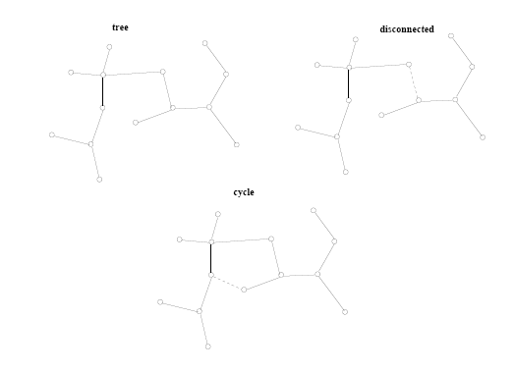
Tree or not tree
A tree is a connected, acyclic undirected graph

Slide 10
Real applications of tree
Match Schedule
Family tree
Directory tree
The structure of a book
Expression tree
Organization chart
Collective partition tree
….

Slide 11
Real applications of tree: Match schedule
In real life, the tree is used to describe the schedule of sports tournaments in the form of knockout matches
France
Spain
Brazil
UK
Germany
Ukraine
Italia
Argentina
France
Brazil
Germany
Italia
France
Italia
Italia

Slide 12
Real applications of tree: family tree
Family tree of mathematicians of the Bernoulli family
Nikolaus
1623-1708
Johan I
1667-1748
Nikolaus
1662-1716
Jacob I
1654-1705
Nikolaus II
1695-1726
Daniel
1700-1782
Johan II
1710-1790
Nikolaus I
1687-1759
Johan III
1746-1807
Jacob II
1759-1789

Slide 13
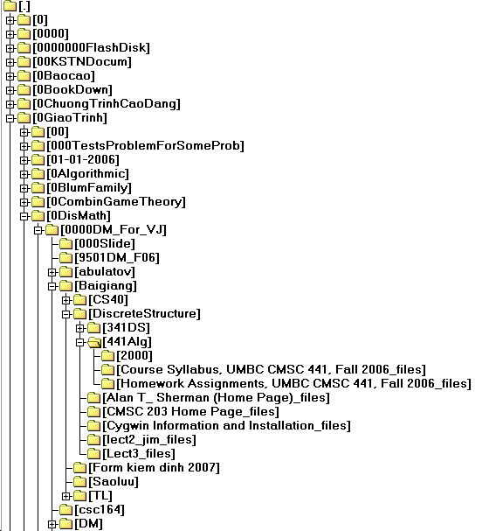
Real applications of tree: directory tree
Directory tree

Slide 14
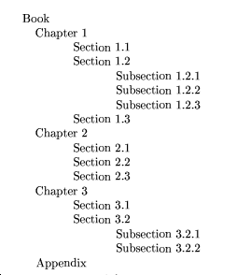
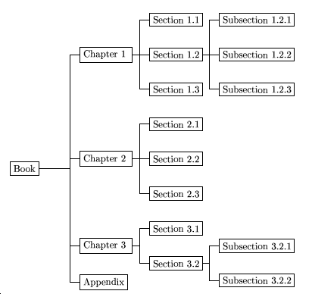
Real applications of tree: table of content

Slide 15
Real applications of tree: Ancestor Tree
Everyone has parents:
e.g.: Crainic has parents: Theo and Marieve
Crainic
Theo
Marieve
Gendreau
Michelle
Toulouse
Mira

Slide 16
Real applications of tree: Expression Tree
+
/
/
1
3
*
4
6
7
1/3 + 6*7 / 4

Slide 17
Real applications of tree: Organization chart
Computers”R”Us
Sales
Manufacturing
R&D
US
International
Laptops
Desktops
Europe
Asia
Canada

Slide 18
3.1. Definitions
3.1.1. Tree definition
3.1.2. Tree terminology
Notes:
Chapter 4. Tree • Tree data structure definition • General tree representation • Pre-Order, In-Order, Post-Order traversal on trees • Implementation of basic operations on a tree: node insertion, compute height, depth of a node, count number of nodes, leaf nodes • Binary tree

Slide 19
3.1.2. Tree terminology
Node or vertex (nút)
Root (gốc)
Leaf (lá)
Child (con)
Parent (cha)
Ancestors (tổ tiên)
Descendants (hậu duệ)
Sibling (anh em)
Internal node (nút trong)
Height (chiều cao)
Depth (chiều sâu)

Slide 20
3.1.2. Tree terminology
Root: node without parent (A)
Siblings: nodes share the same parent (B, C, D are siblings; I, J, K are siblings; E and F are siblings; G and H are siblings)
Internal node: node with at least one child (blue nodes: A, B, C, F)
External node (leaf ): node without children (green nodes: E, I, J, K, G, H, D)
Ancestors of a node: its’ parent, grandparent, grand-grandparent, etc.
Descendant of a node: its’ child, grandchild, grand-grandchild, etc.
Subtree of a node: a tree whose root is a child of that node
Example:
Child of B: E, F
Parent of E: B (a node always has
a single parent)
Ancestor of F: B, A
Descendant of B: E, F, I, J, K
A
B
C
D
E
F
G
H
Subtree of node A
I
J
K

Slide 21
3.1.2. Tree terminology
Path: a sequence of nodes and edges connecting a node with a descendant
Length of a path = number of edges = number of nodes - 1
(e.g.: Length of path (A ➔ C ➔E) = 2; length of path (C➔F) = 1)
Depth/level of a node N = 1 + length of path from root to N
Height of node N = 1 + length of longest path from N to a leaf
Height (depth) of tree = height of root (= maximum depth of any node on the tree)
depth=1
A
height=3
Height of tree = 3
depth=2
B
depth=2
C
D
depth=2
height=1
height=2
height=1
depth=3
E
depth=3
F
height=1
height=1
Notes:
Tree with only one node ➔ height of tree = 1

Slide 22
Height and depth/level
height h = 5
7
depth 1
Height = 4
3
10
4
depth 2
height = 3
8
12
11
2
depth 3
6
5
1
depth 4
h = 2
Height of tree = 5
9
depth 5
height h=1

Slide 23
3.1.2. Tree terminology
Degree of a node: the number of its children (the number of its subtree)
Degree of a tree: the maximum degree of any node on the tree
Degree = 2
A
Degree of tree = ?
2
B
3
C
0
3
0
0
D
E
F
G
H
0
I
J
K
0
0
0
Notes:
Degree of tree =3

Slide 24
Example: Tree Properties
Property Value
Number of nodes
Root Node
Leaves
Internal nodes
Ancestors of H
Descendants of B
Siblings of E
Right subtree of A
Left subtree of A
Height of this tree
Degree of this tree
A
B
C
D
E
F
G
H
I

Slide 25


How we view a tree
root
root
Nature Lovers View
Computer Scientists View

Slide 26
3.1.3. Ordered tree
An ordered tree is a tree in which the children of a node are somehow
"ordered.”
Example: If T₁ and T₂ are ordered tree then T₁ ≠ T₂; else T₁ = T₂
a
a
b
c
c
b
T₁
T₂

Slide 27
3.1.4. Operations on trees
integer size(T) //returns number of nodes on the tree T
boolean isEmpty (T) //returns true if the tree T is empty
element(p) // returns the data of node p
root (T) //returns the root of the tree T
parent(p, T) //returns parent of node p on the tree T
leftmost_child(p) //returns left most child of node p
boolean isInternal(p) //returns true if node p is internal
boolean isExternal(p) // //returns true if node p is external
boolean isRoot(p) //returns true if node p is the root
swapElements(p, q)//swap node p and node q
replaceElement(p, d)//replace the data of node p with d; returns the old data of p

Slide 28
Contents
3.1. Definitions
3.2. Tree implementation
3.3. Tree traversal
3.4. Binary tree
Notes:
Chapter 4. Tree • Tree data structure definition • General tree representation • Pre-Order, In-Order, Post-Order traversal on trees • Implementation of basic operations on a tree: node insertion, compute height, depth of a node, count number of nodes, leaf nodes • Binary tree

Slide 29
3.2. Tree implementation
There are many methods to implement a tree. Some of them are:
Array
Lists of Children
The Leftmost-Child, Right-Sibling representation

Slide 30
3.2. Tree implementation : Array
Assume T consists of n nodes, labelled as 1, 2, …, n.
We use an array A to represent the tree T as following:
A[i] = j if node j is the parent of node i
The root of tree T does not have parent, so A[1] = 0
1
2
3
4
5
6
₁₀
7
8
₉
A
2
2
3
6
6
6
3
0 1 1
A[1]
A[2]
A[3]
A[4]
A[5]
A[6]
A[7]
A[8]
A[9]
A[10]

Slide 31
3.2. Tree implementation : List of children
1 |  |  | 2 |  |  | 3
2 |  |  | 4 |  |  | 5
3 |  |  | 6 |  |  | 10
4 | •
5 | •
6 |  |  | 7 |  |  | 8 |  |  | 9
7 | •
8 | •
9 | •
10 | •
1
2
3
4
5
6
₁₀
List of children of node 6
We could use linked list to represent this list
7
8
₉
header
Header : an array of pointers
each pointer header[i] points to head of the list of children of the node i on the tree
List of children of node i: linked list

Slide 32
3.2. Tree implementation : Leftmost-Child, Right-Sibling representation
Each node on the tree could either:
Have no child, or have exactly one leftmost child
Have no right-sibling, or have exactly one right-sibling
Example 1: node B
Leftmost child of node B: E
Right-sibling of node B: C
A
B
C
D
Example 2: node C
Does not have any child
Leftmost child of node C:
Right-sibling of node C:
E
F
G
H
I
J
K
L
Example 3: node I
Does not have any child
Does not have any right-sibling

Slide 33
3.2. Tree implementation : Leftmost-Child, Right-Sibling representation
Each node on the tree could either:
Have no child, or have exactly one leftmost child
Have no right-sibling, or have exactly one right-sibling
Thus, in order to represent a tree, we could store the information about the leftmost child and right-sibling of each node:
typedef struct
{
int data; // data of each node
struct treeNode * leftmost_child;
struct treeNode * right_sibling;
}treeNode;
treeNode * Root;
Data
Leftmost Child
Right-sibling

Slide 34
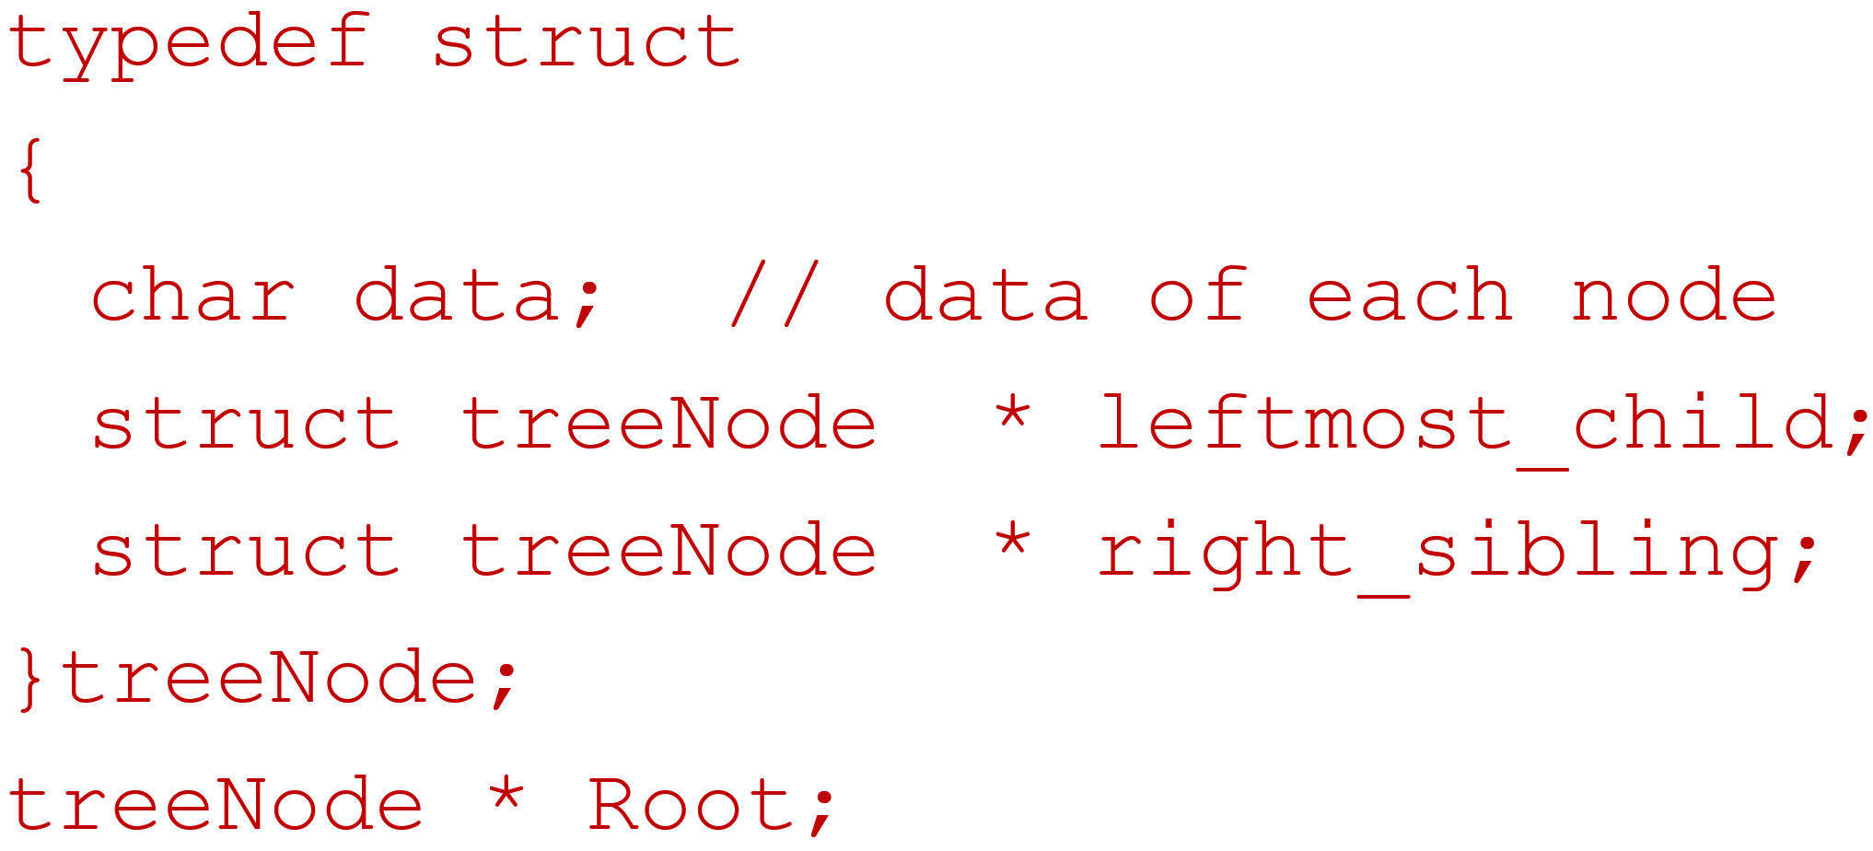
3.2. Tree implementation: Leftmost-Child, Right-Sibling representation
A
Data
Leftmost Child
Right-sibling
B
C
D
E
F
G
A
H
I
J
K
B
C
D
E
F
G
H
I
J
K

Slide 35
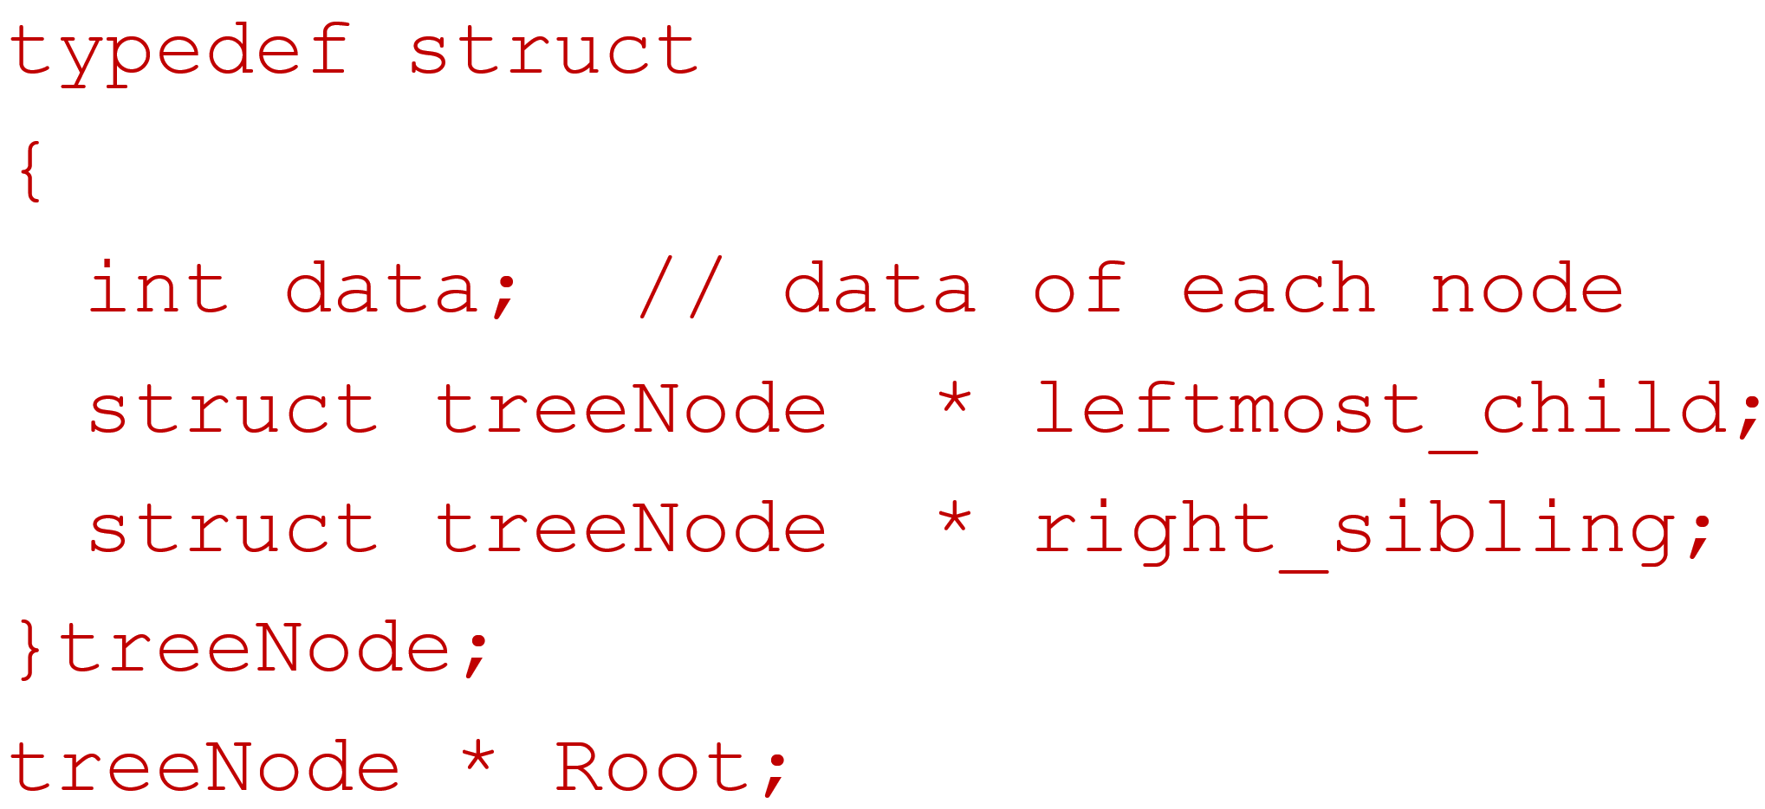
3.2. Tree implementation : Leftmost-Child, Right-Sibling representation
1
Data
Leftmost Child
Right-sibling
2
1
2
3
5
4
11
7
3
5
6
4
11
7
8
6
-2
9
8
-2
9

Slide 36
Contents
3.1. Definitions
3.2. Tree implementation
3.3. Tree traversal
3.4. Binary tree

Slide 37
3.3. Tree Traversal
Three main methods:
Preorder:
visit the root
traverse in preorder the children (subtrees)
Postorder
traverse in postorder the children (subtrees)
visit the root
Inorder
traverse in inorder the left-most children (the leftmost subtree)
visit the root
traverse in inorder the remaining children that not the leftmost one

Slide 38
Preorder Traversal
In a preorder traversal, a node is visited before its descendants.
Example: Preorder traversal on tree T:
Step 1: visit root r,
Step 2: visit T₁ in preorder,
Step 3: visit T₂ in preorder
……..
Step k+1: visit T_{k} in preorder
preorder(r)
print r
for each child c of r from left to right
preorder(c)
r
r₁
r₂
r_{k}
T₁
T₂
T_{k}

Slide 39
Preorder Traversal
A
preorder(r)
print r
for each child c of r from left to right
preorder(c)
B
C
D
E
F
G
print E
print B preorder(E)
print A preorder(B) preorder(B)
empty stack preorder(A) preorder(A) preorder(A)
H
I
J
K

Slide 40
Preorder Traversal
A
preorder(r)
print r
for each child c of r from left to right
preorder(c)
B
C
D
E
F
G
print E print F
preorder(E) preorder(F)
preorder(B) preorder(B) preorder(B) preorder(B)
preorder(A) preorder(A) preorder(A) preorder(A) preorder(A)
H
I
J
K

Slide 41
Preorder Traversal
A
preorder(r)
print r
for each child c of r from left to right
preorder(c)
B
C
D
E
F
G
print H
print G preorder(H)
print C preorder(G) preorder(G)
preorder(C) preorder(C) preorder(C)
preorder(A) preorder(A) preorder(A) preorder(A)
H
I
J
K

Slide 42
Preorder Traversal
A
preorder(r)
print r
for each child c of r from left to right
preorder(c)
B
C
D
E
F
G
H
I
J
K
print H print I print J
preorder(H) preorder(I) preorder(J)
preorder(G) preorder(G) preorder(G) preorder(G) preorder(G)
preorder(C) preorder(C) preorder(C) preorder(C) preorder(C)
preorder(A) preorder(A) preorder(A) preorder(A) preorder(A)

Slide 43
Preorder Traversal
A
preorder(r)
print r
for each child c of r from left to right
preorder(c)
B
C
D
E
F
G
H
I
J
K
print J print K
preorder(J) preorder(K)
preorder(G) preorder(G) preorder(G) preorder(G)
preorder(C) preorder(C) preorder(C) preorder(C) preorder(C)
preorder(A) preorder(A) preorder(A) preorder(A) preorder(A)

Slide 44
Preorder Traversal
A
preorder(r)
print r
for each child c of r from left to right
preorder(c)
B
C
D
E
F
G
H
I
J
K
print D
preorder(C) preorder(D)
preorder(A) preorder(A) preorder(A) preorder(A) empty stack

Slide 45
Postorder Traversal
In a postorder traversal, a node is visited after its descendants.
Example: Postorder traversal on tree T:
Step 1: visit T₁ in postorder,
Step 2: visit T₂ in postorder,
……..
Step k: visit T_{k} in postorder,
Step k+1: visit root r
r
postorder(r)
for each child c of r from left to right
postorder(c)
print r
r₁
r₂
r_{k}
T₁
T₂
T_{k}

Slide 46
postorder Traversal
A
B
C
D
postorder(r)
for each child c of r from left to right
postorder(c)
print r
E
F
G
print E
postorder(E)
postorder(B) postorder(B)
empty stack postorder(A) postorder(A) postorder(A)
H
I
J
K

Slide 47
postorder Traversal
A
B
C
D
postorder(r)
for each child c of r from left to right
postorder(c)
print r
E
F
G
print E print F
postorder(E) postorder(F) print B
postorder(B) postorder(B) postorder(B) postorder(B)
postorder(A) postorder(A) postorder(A) postorder(A) postorder(A)
H
I
J
K

Slide 48
postorder Traversal
A
B
C
D
postorder(r)
for each child c of r from left to right
postorder(c)
print r
E
F
G
H
I
J
K
print H
postorder(H)
postorder(G) postorder(G)
postorder(C) postorder(C) postorder(C)
postorder(A) postorder(A) postorder(A) postorder(A)

Slide 49
postorder Traversal
A
B
C
D
postorder(r)
for each child c of r from left to right
postorder(c)
print r
E
F
G
H
I
J
K
print H print I print J
postorder(H) postorder(I) postorder(J)
postorder(G) postorder(G) postorder(G) postorder(G) postorder(G)
postorder(C) postorder(C) postorder(C) postorder(C) postorder(C)
postorder(A) postorder(A) postorder(A) postorder(A) postorder(A)

Slide 50
postorder Traversal
A
B
C
D
postorder(r)
for each child c of r from left to right
postorder(c)
print r
E
F
G
print J print K
postorder(J) postorder(K) print G
postorder(G) postorder(G) postorder(G) postorder(G) print C
postorder(C) postorder(C) postorder(C) postorder(C) postorder(C)
postorder(A) postorder(A) postorder(A) postorder(A) postorder(A)
H
I
J
K

Slide 51
postorder Traversal
A
B
C
D
postorder(r)
for each child c of r from left to right
postorder(c)
print r
E
F
G
H
I
J
K
print C print D
postorder(C) postorder(D) print A
postorder(A) postorder(A) postorder(A) postorder(A) empty stack

Slide 52
Inorder Traversal
Inorder traversal on tree T:
Step 1: visit T₁ in inorder,
Step 2: visit root r,
Step 3: visit T₂ in inorder,
……..
Step k+1: visit T_{k} in inorder
r
inorder(r)
if r is a leaf then print r
else
l := first child of r from left to right
inorder(l)
print r
for each child c of r except for l left to right
inorder(c)
r₁
r₂
r_{k}
T₁
T₂
T_{k}

Slide 53
inorder Traversal
A
inorder(r)
if r is a leaf then print r
else
l := first child of r from left to right
inorder(l)
print r
for each child c of r except for l left to right
inorder(c)
B
C
D
E
F
G
print E
inorder(E)
inorder(B) inorder(B)
empty stack inorder(A) inorder(A) inorder(A)
H
I
J
K

Slide 54
inorder Traversal
A
inorder(r)
if r is a leaf then print r
else
l := first child of r from left to right
inorder(l)
print r
for each child c of r except for l left to right
inorder(c)
B
C
D
E
F
G
print E print F
inorder(E) print B inorder(F)
inorder(B) inorder(B) inorder(B) inorder(B) print A
inorder(A) inorder(A) inorder(A) inorder(A) inorder(A)
H
I
J
K

Slide 55
inorder Traversal
A
inorder(r)
if r is a leaf then print r
else
l := first child of r from left to right
inorder(l)
print r
for each child c of r except for l left to right
inorder(c)
B
C
D
E
F
G
H
I
J
K
print H
inorder(H)
inorder(G) inorder(G)
print A inorder(C) inorder(C) inorder(C)
inorder(A) inorder(A) inorder(A) inorder(A)

Slide 56
inorder Traversal
A
inorder(r)
if r is a leaf then print r
else
l := first child of r from left to right
inorder(l)
print r
for each child c of r except for l left to right
inorder(c)
B
C
D
E
F
G
H
I
J
K
print H print I print J
inorder(H) print G inorder(I) inorder(J)
inorder(G) inorder(G) inorder(G) inorder(G) inorder(G)
inorder(C) inorder(C) inorder(C) inorder(C) inorder(C)
inorder(A) inorder(A) inorder(A) inorder(A) inorder(A)

Slide 57
inorder Traversal
A
inorder(r)
if r is a leaf then print r
else
l := first child of r from left to right
inorder(l)
print r
for each child c of r except for l left to right
inorder(c)
B
C
D
E
F
G
H
I
J
K
print J print K
inorder(J) inorder(K)
inorder(G) inorder(G) inorder(G) inorder(G) print C
inorder(C) inorder(C) inorder(C) inorder(C) inorder(C)
inorder(A) inorder(A) inorder(A) inorder(A) inorder(A)

Slide 58
inorder Traversal
A
inorder(r)
if r is a leaf then print r
else
l := first child of r from left to right
inorder(l)
print r
for each child c of r except for l left to right
inorder(c)
B
C
D
E
F
G
H
I
J
K
print C print D
inorder(C) inorder(D)
inorder(A) inorder(A) inorder(A) inorder(A) empty stack

Slide 59
Example: tree traversal
Given the ordered tree T rooted at node 7. Show the order of nodes that they are visited if we traverse the tree T in:
postorder
Inorder
Postorder
7
3
10
4
8
12
11
2
6
5
1
9
Notes:
Preorder: 7, 3, 8, 6, 5, 9, 12, 1, 10, 4, 11, 2
Inorder: 6, 8, 9, 5, 3, 12, 1, 7, 10, 11, 4, 2
Postorder: 6, 9 , 5, 8, 1, 12, 3, 10, 11, 2, 4, 7

Slide 60
Preorder: Root, left child, right child
7,
3,
8,
6,
5,
9,
12,
1,
10,
4,
11,
2
7
3
10
4
8
12
11
2
6
5
1
9
Notes:
Preorder: 7, 3, 8, 6, 5, 9, 12, 1, 10, 4, 11, 2
Inorder: 6, 8, 9, 5, 3, 12, 1, 7, 10, 11, 4, 2
Postorder: 6, 9 , 5, 8, 1, 12, 3, 10, 11, 2, 4, 7

Slide 61
Inorder: Left child, Root, right child
6,
8,
9,
5,
3,
12,
1,
7,
10,
11,
4,
2
7
3
10
4
8
12
11
2
6
5
1
9
Notes:
Preorder: 7, 3, 8, 6, 5, 9, 12, 1, 10, 4, 11, 2
Inorder: 6, 8, 9, 5, 3, 12, 1, 7, 10, 11, 4, 2
Postorder: 6, 9 , 5, 8, 1, 12, 3, 10, 11, 2, 4, 7

Slide 62
Postorder: Left child, right child, Root
6,
9 ,
5,
8,
1,
12,
3,
10,
11,
2,
4,
7
7
3
10
4
8
12
11
2
6
5
1
9
Notes:
Preorder: 7, 3, 8, 6, 5, 9, 12, 1, 10, 4, 11, 2
Inorder: 6, 8, 9, 5, 3, 12, 1, 7, 10, 11, 4, 2
Postorder: 6, 9 , 5, 8, 1, 12, 3, 10, 11, 2, 4, 7

Slide 63
Example: tree traversal
Given the ordered tree T rooted at node a. Show the order of nodes that they are visited if we traverse the tree T in:
Preorder
Inorder
Postorder
a
b
c
d
e
f
g
h
i
j
k
l
m
n
o
p
Notes:
Preorder: a, b, e, j, k, n, o, p, f, c, d, g, l, m, h, i
Inorder: j e n k o p b f a c l g m d h i
Postorder: j, n, o, p, k, e, f, b, c, l, m, g, h, I, d, a

Slide 64
Preorder Traversal
In a preorder traversal, a node is visited before its descendants.
Example: Preorder traversal on tree T:
Step 1: visit root r,
Step 2: visit T₁ in preorder,
Step 3: visit T₂ in preorder
……..
Step k+1: visit T_{k} in preorder
procedure preorder(T: ordered rooted tree)
r := root of T
visit r
for each child c of r from left to right
begin
T(c) := subtree with c as its root
preorder(T(c))
end
r
Step 1
r₁
r₂
r_{k}
T₁
T₂
T_{k}
Step 2, 3…

Slide 65
PreOrder
Visit root
Visit leftmost subtree in preorder
Visit remaining subtrees in preorder
b
e
f
j
k
n
o
p
b

Slide 66
PreOrder
Visit root
Visit leftmost subtree in preorder
Visit remaining subtrees in preorder
b
e
f
j
k
n
o
p
b

Slide 67
PreOrder
Visit root
Visit leftmost subtree in preorder
2.1. Visit root
2.2. Visit leftmost subtree in preorder
2.3. Visit remaining subtrees in preorder
Visit remaining subtrees in preorder
b
e
f
j
k
n
o
p
b

Slide 68
PreOrder
Visit root
Visit leftmost subtree in preorder
2.1. Visit root
2.2. Visit leftmost subtree in preorder
2.3. Visit remaining subtrees in preorder
Visit remaining subtrees in preorder
b
e
f
j
k
n
o
p
b
e

Slide 69
PreOrder
Visit root
Visit leftmost subtree in preorder
2.1. Visit root
2.2. Visit leftmost subtree in preorder
2.3. Visit remaining subtrees in preorder
Visit remaining subtrees in preorder
b
e
f
j
k
n
o
p
b
e
j

Slide 70
PreOrder
Visit root
Visit leftmost subtree in preorder
2.1. Visit root
2.2. Visit leftmost subtree in preorder
2.3. Visit remaining subtrees in preorder
Visit remaining subtrees in preorder
b
e
f
j
k
n
o
p
b
e
j

Slide 71
PreOrder
Visit root
Visit leftmost subtree in preorder
2.1. Visit root
2.2. Visit leftmost subtree in preorder
2.3. Visit remaining subtrees in preorder
2.3.1. Visit root
2.3.2. Visit leftmost subtree in preorder
2.3.3. Visit remaining subtrees in preorder
Visit remaining subtrees in preorder
b
e
f
j
k
n
o
p
b
e
j
k

Slide 72
PreOrder
Visit root
Visit leftmost subtree in preorder
2.1. Visit root
2.2. Visit leftmost subtree in preorder
2.3. Visit remaining subtrees in preorder
2.3.1. Visit root
2.3.2. Visit leftmost subtree in preorder
2.3.3. Visit remaining subtrees in preorder
Visit remaining subtrees in preorder
b
e
f
j
k
n
o
p
b
e
j
k
n

Slide 73
PreOrder
Visit root
Visit leftmost subtree in preorder
2.1. Visit root
2.2. Visit leftmost subtree in preorder
2.3. Visit remaining subtrees in preorder
2.3.1. Visit root
2.3.2. Visit leftmost subtree in preorder
2.3.3. Visit remaining subtrees in preorder
Visit remaining subtrees in preorder
b
e
f
j
k
n
o
p
b
e
j
k
n
o

Slide 74
PreOrder
Visit root
Visit leftmost subtree in preorder
2.1. Visit root
2.2. Visit leftmost subtree in preorder
2.3. Visit remaining subtrees in preorder
2.3.1. Visit root
2.3.2. Visit leftmost subtree in preorder
2.3.3. Visit remaining subtrees in preorder
Visit remaining subtrees in preorder
b
e
f
j
k
n
o
p
b
e
j
k
n
o
p

Slide 75
PreOrder
Visit root
Visit leftmost subtree in preorder
2.1. Visit root
2.2. Visit leftmost subtree in preorder
2.3. Visit remaining subtrees in preorder
2.3.1. Visit root
2.3.2. Visit leftmost subtree in preorder
2.3.3. Visit remaining subtrees in preorder
Visit remainingsubtrees in preorder
b
e
f
j
k
DONE
n
o
p
b
e
j
k
n
o
p

Slide 76
PreOrder
Visit root
Visit leftmost subtree in preorder
2.1. Visit root
2.2. Visit leftmost subtree in preorder
2.3. Visit remaining subtrees in preorder
2.3.1. Visit root
2.3.2. Visit leftmost subtree in preorder
2.3.3. Visit remaining subtrees in preorder
Visit remaining subtrees in preorder
b
e
DONE
f
j
k
n
o
p
b
e
j
k
n
o
p

Slide 77
PreOrder
Visit root
Visit leftmost subtree in preorder
2.1. Visit root
2.2. Visit leftmost subtree in preorder
2.3. Visit remaining subtrees in preorder
2.3.1. Visit root
2.3.2. Visit leftmost subtree in preorder
2.3.3. Visit remaining subtrees in preorder
Visit remaining subtrees in preorder
b
e
f
j
k
n
o
p
b
e
j
k
n
o
p
f

Slide 78
PreOrder
Visit root
Visit leftmost subtree in preorder
2.1. Visit root
2.2. Visit leftmost subtree in preorder
2.3. Visit remaining subtrees in preorder
2.3.1. Visit root
2.3.2. Visit leftmost subtree in preorder
2.3.3. Visit remaining subtrees in preorder
Visit remaining subtrees in preorder
b
e
f
DONE
j
k
n
o
p
b
e
j
k
n
o
p
f

Slide 79
Inorder Traversal
Inorder traversal on tree T:
Step 1: visit T₁ in inorder,
Step 2: visit root r,
Step 3: visit T₂ in inorder,
……..
Step k+1: visit T_{k} in inorder
r
procedure inorder(T: ordered rooted tree)
r := root of T
if r is a leaf then visit r
else
begin
l := first child of r from left to right
T(l) := subtree with l as its root
inorder(T(l))
visit r
for each child c of r except for l left to right
T(c) := subtree with c as its root
inorder(T(c))
end
r₁
r₂
r_{k}
T₁
T₂
T_{k}
Step 1
Step 2
Step 3, 4..

Slide 80
InOrder
Visit leftmost subtree in Inorder
Visit root
Visit remaining subtrees in Inorder
b
e
f
j
k
n
o
p

Slide 81
InOrder
Visit leftmost subtree in Inorder
1.1. Visit leftmost subtree in Inorder
1.2. Visit root
1.3. Visit remaining subtrees in Inorder
2. Visit root
3. Visit remaining subtrees in Inorder
b
e
f
j
k
n
o
p

Slide 82
InOrder
Visit leftmost subtree in Inorder
1.1. Visit leftmost subtree in Inorder
1.2. Visit root
1.3. Visit remaining subtrees in Inorder
2. Visit root
3. Visit remaining subtrees in Inorder
b
e
f
j
k
n
o
p
j

Slide 83
InOrder
Visit leftmost subtree in Inorder
1.1. Visit leftmost subtree in Inorder
1.2. Visit root
1.3. Visit remaining subtrees in Inorder
2. Visit root
3. Visit remaining subtrees in Inorder
b
e
f
j
k
n
o
p
j
e

Slide 84
InOrder
Visit leftmost subtree in Inorder
1.1. Visit leftmost subtree in Inorder
1.2. Visit root
1.3. Visit remaining subtrees in Inorder
2. Visit root
3. Visit remaining subtrees in Inorder
b
e
f
j
k
n
o
p
j
e

Slide 85
InOrder
Visit leftmost subtree in Inorder
1.1. Visit leftmost subtree in Inorder
1.2. Visit root
1.3. Visit remaining subtrees in Inorder
1.3.1. Visit leftmost subtree in Inorder
1.3.2. Visit root
1.3.3. Visit remaining subtrees in Inorder
2. Visit root
3. Visit remaining subtrees in Inorder
b
e
f
j
k
n
o
p
j
e
n

Slide 86
InOrder
Visit leftmost subtree in Inorder
1.1. Visit leftmost subtree in Inorder
1.2. Visit root
1.3. Visit remaining subtrees in Inorder
1.3.1. Visit leftmost subtree in Inorder
1.3.2. Visit root
1.3.3. Visit remaining subtrees in Inorder
2. Visit root
3. Visit remaining subtrees in Inorder
b
e
f
j
k
n
o
p
j
e
n
k

Slide 87
InOrder
Visit leftmost subtree in Inorder
1.1. Visit leftmost subtree in Inorder
1.2. Visit root
1.3. Visit remaining subtrees in Inorder
1.3.1. Visit leftmost subtree in Inorder
1.3.2. Visit root
1.3.3. Visit remaining subtrees in Inorder
2. Visit root
3. Visit remaining subtrees in Inorder
b
e
f
j
k
n
o
p
j
e
n
k
o

Slide 88
InOrder
Visit leftmost subtree in Inorder
1.1. Visit leftmost subtree in Inorder
1.2. Visit root
1.3. Visit remaining subtrees in Inorder
1.3.1. Visit leftmost subtree in Inorder
1.3.2. Visit root
1.3.3. Visit remaining subtrees in Inorder
2. Visit root
3. Visit remaining subtrees in Inorder
b
e
f
j
k
n
o
p
j
e
n
k
o
p

Slide 89
InOrder
Visit leftmost subtree in Inorder
1.1. Visit leftmost subtree in Inorder
1.2. Visit root
1.3. Visit remaining subtrees in Inorder
1.3.1. Visit leftmost subtree in Inorder
1.3.2. Visit root
1.3.3. Visit remaining subtrees in Inorder
2. Visit root
3. Visit remaining subtrees in Inorder
b
e
f
j
k
DONE
n
o
p
j
e
n
k
o
p

Slide 90
InOrder
Visit leftmost subtree in Inorder
1.1. Visit leftmost subtree in Inorder
1.2. Visit root
1.3. Visit remaining subtrees in Inorder
1.3.1. Visit leftmost subtree in Inorder
1.3.2. Visit root
1.3.3. Visit remaining subtrees in Inorder
2. Visit root
3. Visit remaining subtrees in Inorder
b
e
DONE
f
j
k
n
o
p
j
e
n
k
o
p

Slide 91
InOrder
Visit leftmost subtree in Inorder
1.1. Visit leftmost subtree in Inorder
1.2. Visit root
1.3. Visit remaining subtrees in Inorder
1.3.1. Visit leftmost subtree in Inorder
1.3.2. Visit root
1.3.3. Visit remaining subtrees in Inorder
2. Visit root
3. Visit remaining subtrees in Inorder
b
e
f
j
k
n
o
p
j
e
n
k
o
p
b

Slide 92
InOrder
Visit leftmost subtree in Inorder
1.1. Visit leftmost subtree in Inorder
1.2. Visit root
1.3. Visit remaining subtrees in Inorder
1.3.1. Visit leftmost subtree in Inorder
1.3.2. Visit root
1.3.3. Visit remaining subtrees in Inorder
2. Visit root
3. Visit remaining subtrees in Inorder
b
e
f
j
k
n
o
p
j
e
n
k
o
p
b
f

Slide 93
Postorder Traversal
In a postorder traversal, a node is visited after its descendants.
Example: Postorder traversal on tree T:
Step 1: visit T₁ in postorder,
Step 2: visit T₂ in postorder,
……..
Step k: visit T_{k} in postorder,
Step k+1: visit root r
r
procedure postorder(T: ordered rooted tree)
r := root of T
for each child c of r from left to right
begin
T(c) := subtree with c as its root
postorder(T(c))
end
visit r
r₁
r₂
r_{k}
T₁
T₂
T_{k}

Slide 94
PostOrder
Visit leftmost subtree in Postorder
Visit remaining subtrees in Postorder
Visit root
b
e
f
j
k
n
o
p

Slide 95
PostOrder
Visit leftmost subtree in Postorder
1.1. Visit leftmost subtree in Postorder
1.2. Visit remaining subtrees in Postorder
1.3. Visit root
2. Visit remaining subtrees in Postorder
3. Visit root
b
e
f
j
k
n
o
p

Slide 96
PostOrder
Visit leftmost subtree in Postorder
1.1. Visit leftmost subtree in Postorder
1.2. Visit remaining subtrees in Postorder
1.3. Visit root
2. Visit remaining subtrees in Postorder
3. Visit root
b
e
f
j
k
n
o
p
j

Slide 97
PostOrder
Visit leftmost subtree in Postorder
1.1. Visit leftmost subtree in Postorder
1.2. Visit remaining subtrees in Postorder
1.3. Visit root
2. Visit remaining subtrees in Postorder
3. Visit root
b
e
f
j
k
n
o
p
j

Slide 98
PostOrder
Visit leftmost subtree in Postorder
1.1. Visit leftmost subtree in Postorder
1.2. Visit remaining subtrees in Postorder
1.2.1. Visit leftmost subtree in Postorder
1.2.2. Visit remaining subtrees in Postorder
1.2.3. Visit root
1.3. Visit root
2. Visit remaining subtrees in Postorder
3. Visit root
b
e
f
j
k
n
o
p
j

Slide 99
PostOrder
Visit leftmost subtree in Postorder
1.1. Visit leftmost subtree in Postorder
1.2. Visit remaining subtrees in Postorder
1.2.1. Visit leftmost subtree in Postorder
1.2.2. Visit remaining subtrees in Postorder
1.2.3. Visit root
1.3. Visit root
2. Visit remaining subtrees in Postorder
3. Visit root
b
e
f
j
k
n
o
p
j
n

Slide 100
PostOrder
Visit leftmost subtree in Postorder
1.1. Visit leftmost subtree in Postorder
1.2. Visit remaining subtrees in Postorder
1.2.1. Visit leftmost subtree in Postorder
1.2.2. Visit remaining subtrees in Postorder
1.2.3. Visit root
1.3. Visit root
2. Visit remaining subtrees in Postorder
3. Visit root
b
e
f
j
k
n
o
p
j
n
o

Slide 101
PostOrder
Visit leftmost subtree in Postorder
1.1. Visit leftmost subtree in Postorder
1.2. Visit remaining subtrees in Postorder
1.2.1. Visit leftmost subtree in Postorder
1.2.2. Visit remaining subtrees in Postorder
1.2.3. Visit root
1.3. Visit root
2. Visit remaining subtrees in Postorder
3. Visit root
b
e
f
j
k
n
o
p
j
n
o
p

Slide 102
PostOrder
Visit leftmost subtree in Postorder
1.1. Visit leftmost subtree in Postorder
1.2. Visit remaining subtrees in Postorder
1.2.1. Visit leftmost subtree in Postorder
1.2.2. Visit remaining subtrees in Postorder
1.2.3. Visit root
1.3. Visit root
2. Visit remaining subtrees in Postorder
3. Visit root
b
e
f
j
k
DONE
n
o
p
j
n
o
p
k

Slide 103
PostOrder
Visit leftmost subtree in Postorder
1.1. Visit leftmost subtree in Postorder
1.2. Visit remaining subtrees in Postorder
1.2.1. Visit leftmost subtree in Postorder
1.2.2. Visit remaining subtrees in Postorder
1.2.3. Visit root
1.3. Visit root
2. Visit remaining subtrees in Postorder
3. Visit root
b
e
f
j
k
n
o
p
j
e
n
o
p
k

Slide 104
PostOrder
Visit leftmost subtree in Postorder
1.1. Visit leftmost subtree in Postorder
1.2. Visit remaining subtrees in Postorder
1.2.1. Visit leftmost subtree in Postorder
1.2.2. Visit remaining subtrees in Postorder
1.2.3. Visit root
1.3. Visit root
2. Visit remaining subtrees in Postorder
3. Visit root
b
e
f
Done
j
k
n
o
p
j
e
n
o
p
k

Slide 105
PostOrder
Visit leftmost subtree in Postorder
1.1. Visit leftmost subtree in Postorder
1.2. Visit remaining subtrees in Postorder
1.2.1. Visit leftmost subtree in Postorder
1.2.2. Visit remaining subtrees in Postorder
1.2.3. Visit root
1.3. Visit root
2. Visit remaining subtrees in Postorder
3. Visit root
b
e
f
j
k
n
o
p
j
e
f
n
o
p
k

Slide 106
PostOrder
Visit leftmost subtree in Postorder
1.1. Visit leftmost subtree in Postorder
1.2. Visit remaining subtrees in Postorder
1.2.1. Visit leftmost subtree in Postorder
1.2.2. Visit remaining subtrees in Postorder
1.2.3. Visit root
1.3. Visit root
2. Visit remaining subtrees in Postorder
3. Visit root
b
e
f
j
k
n
o
p
j
e
f
b
n
o
p
k

Slide 107
Contents
3.1. Definitions
3.2. Tree implementation
3.3. Tree traversal
3.4. Binary tree

Slide 108
3.4. Binary tree
3.4.1. Definitions
3.4.2. Binary tree representation
3.4.3. Binary tree traversal
3.4.4. Some applications

Slide 109
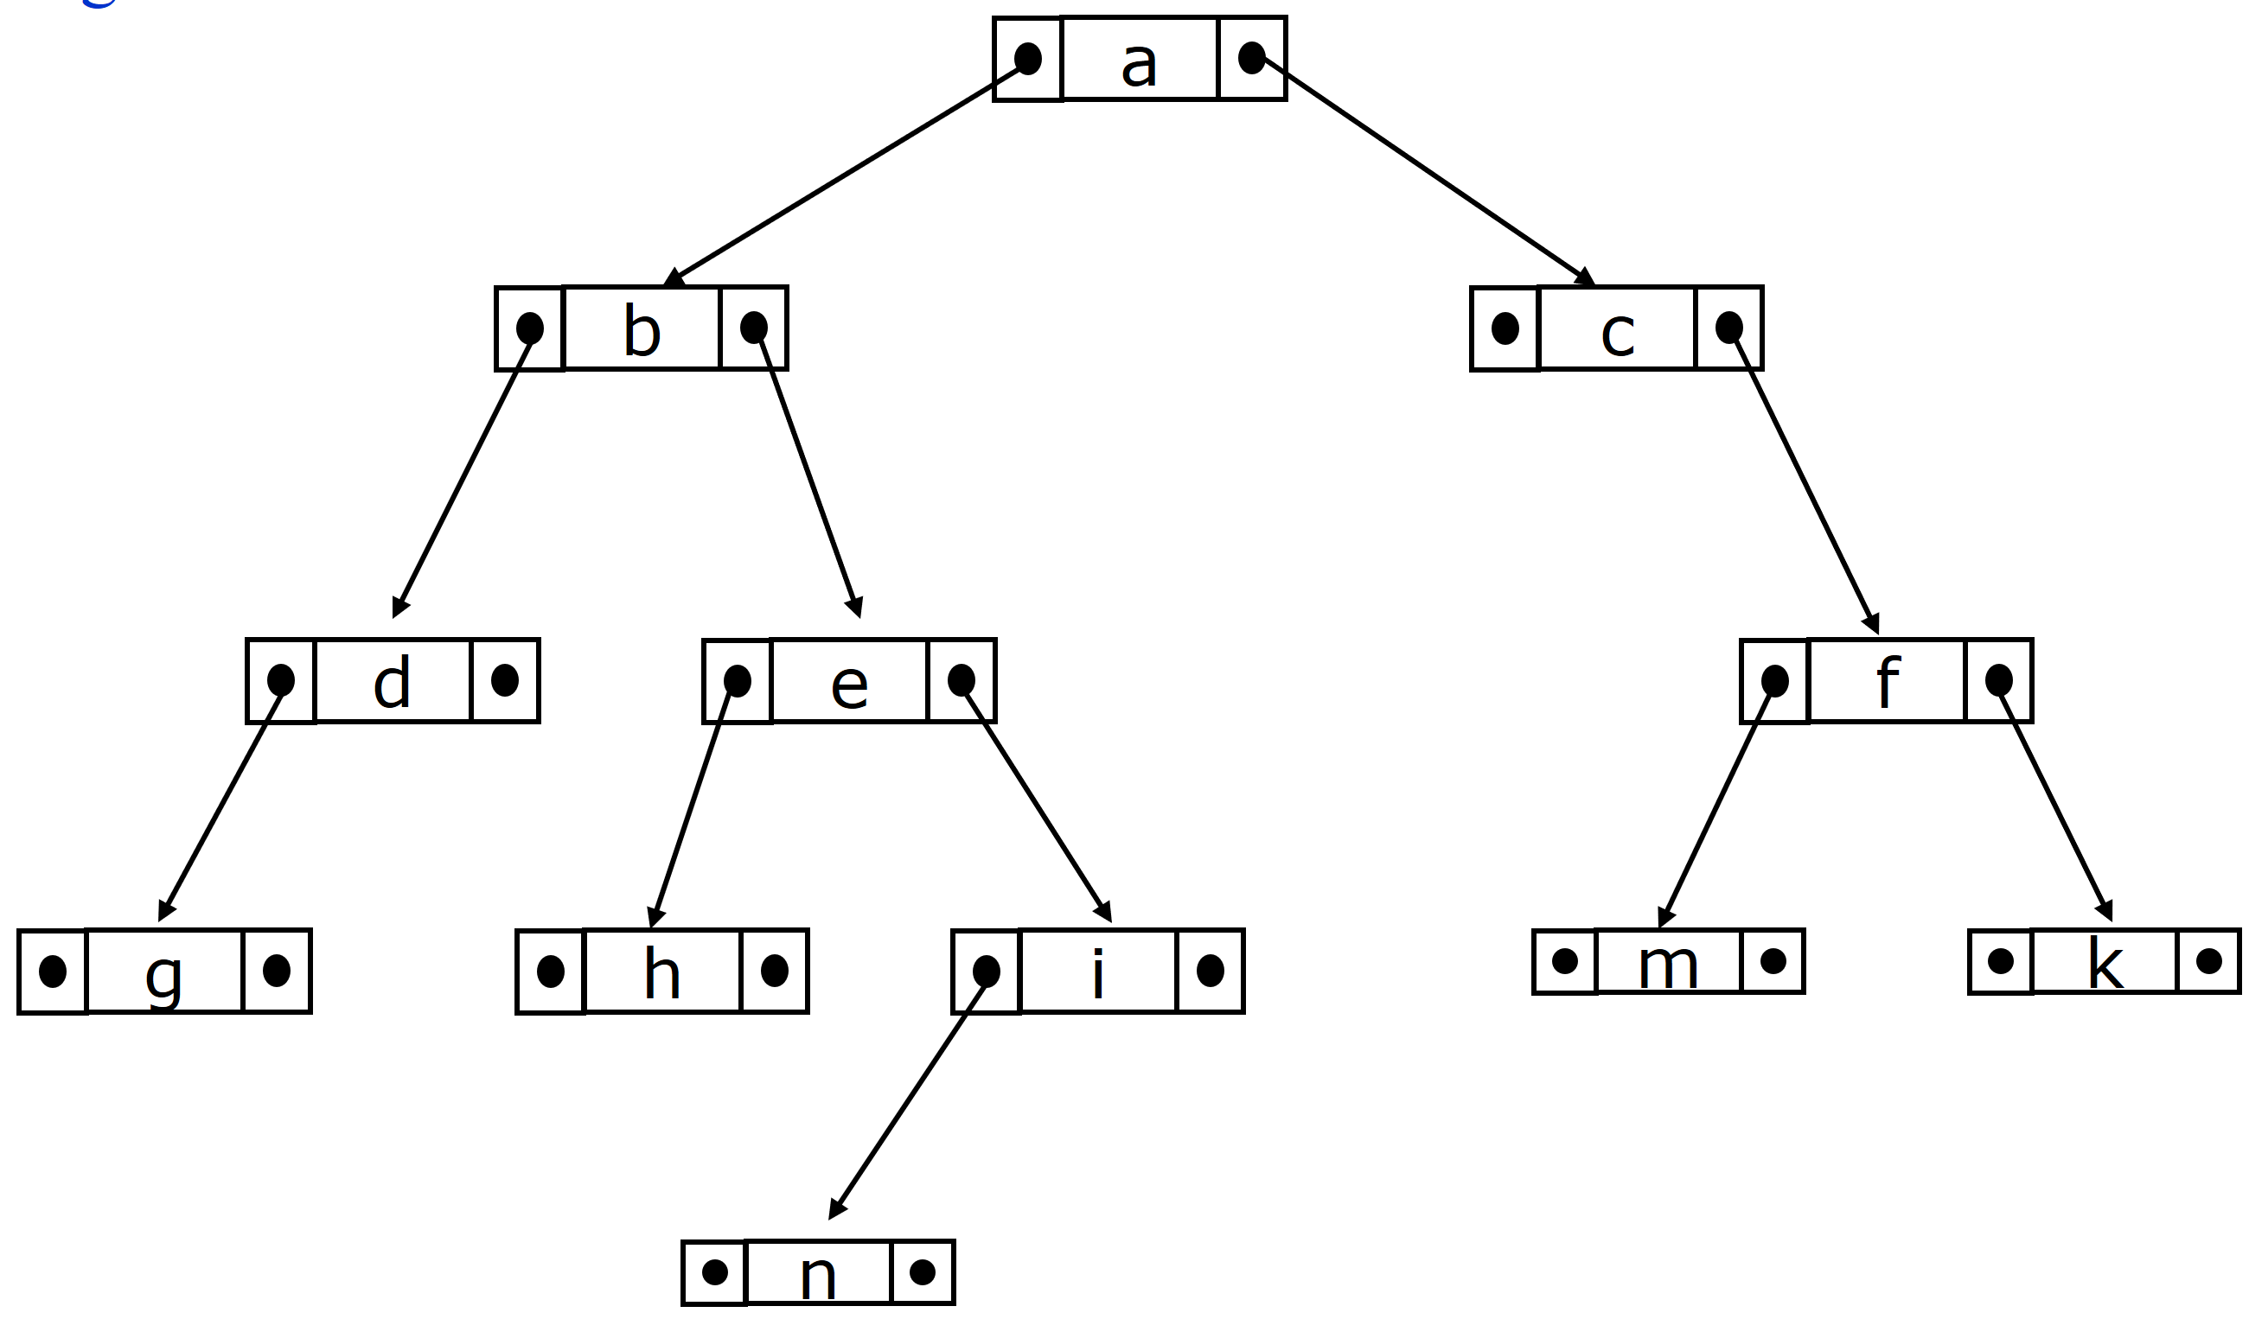
3.4.1. Definitions: Binary tree
A binary tree is a tree in which no node can have more than two children.
➔ Each node could either: (1) has no child, (2) has only left child, (3) has only right child, (4) has both left child and right child
Each node has the data, a reference to a left child and a reference to a right child.
Right child of a
Left child of a
Data
left
pointer
right
pointer

Slide 110
Note
a
a
a
b
b
b
c
d
c
d
c
d
e
e
e
Binary tree T₁
Binary tree T₂
General tree
T₁ ≠ T₂

Slide 111
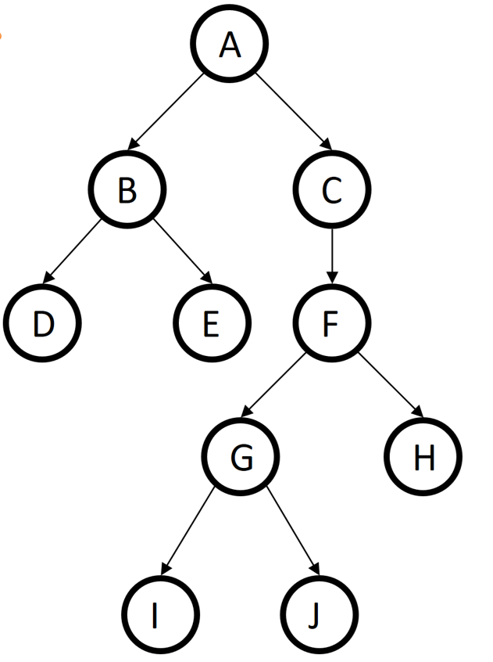
Given a binary tree of n nodes
Properties:
height(tree) = depth(tree)
= MAX {depth(leaf)} = height(root)
max # of leaves = 2^{depth(tree)-1}
max # of nodes = 2^{depth(tree)} – 1
max # of nodes on level i^{th} = 2^{i-1}
Binary tree with n nodes: depth(tree) ≥ ⎡log₂(n)⎤
h = 5
Depth/level =1
h = 4
l = 2
h = 3
l = 3
h = 2
l = 4
Height= 1
l = 5

Slide 112
Full binary tree vs complete binary tree
Full binary tree: a binary tree in which
every parent has 2 children,
every leaf has equal depth
Complete binary tree: a binary tree in which
every level is full except possibly the deepest level
if the deepest level isn’t full, leaf nodes are as far to the left as possible
4
1
3
2
16
9
10
Full binary tree

Slide 113
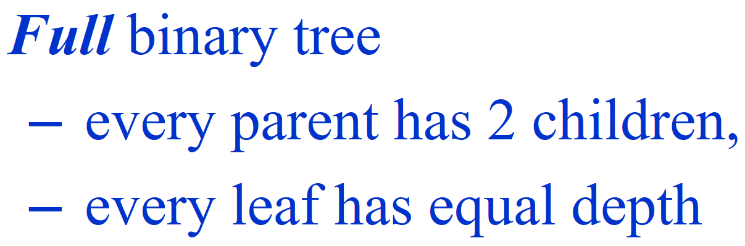
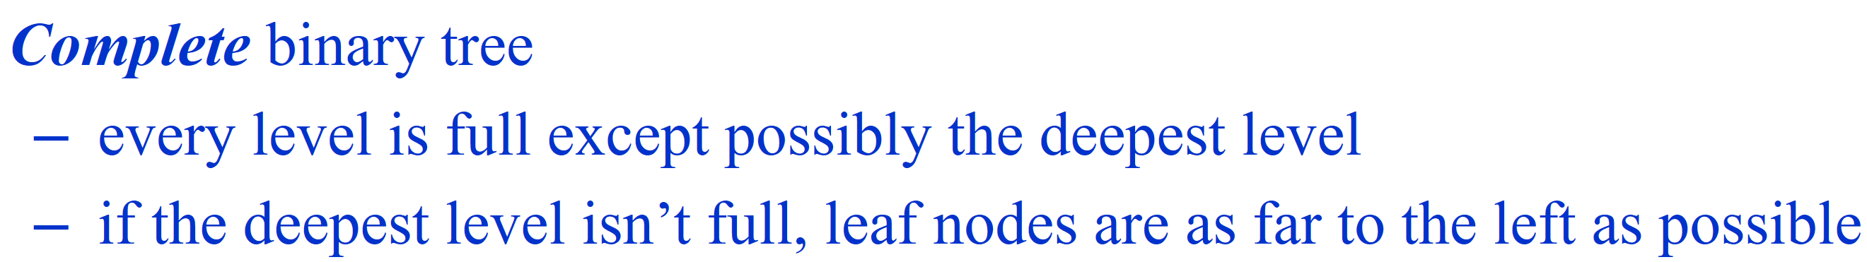
Which tree is full binary tree / complete binary tree?
Complete binary tree
Full and complete
Complete
Neither full nor complete
Full and complete
Neither full nor complete

Slide 114
3.4. Binary tree
3.4.1. Definitions
3.4.2. Binary tree representation
3.4.3. Binary tree traversal
3.4.4. Some applications

Slide 115
3.4.2. Binary tree representation
3.4.2.1. Array
3.4.2.2. Pointer

Slide 116
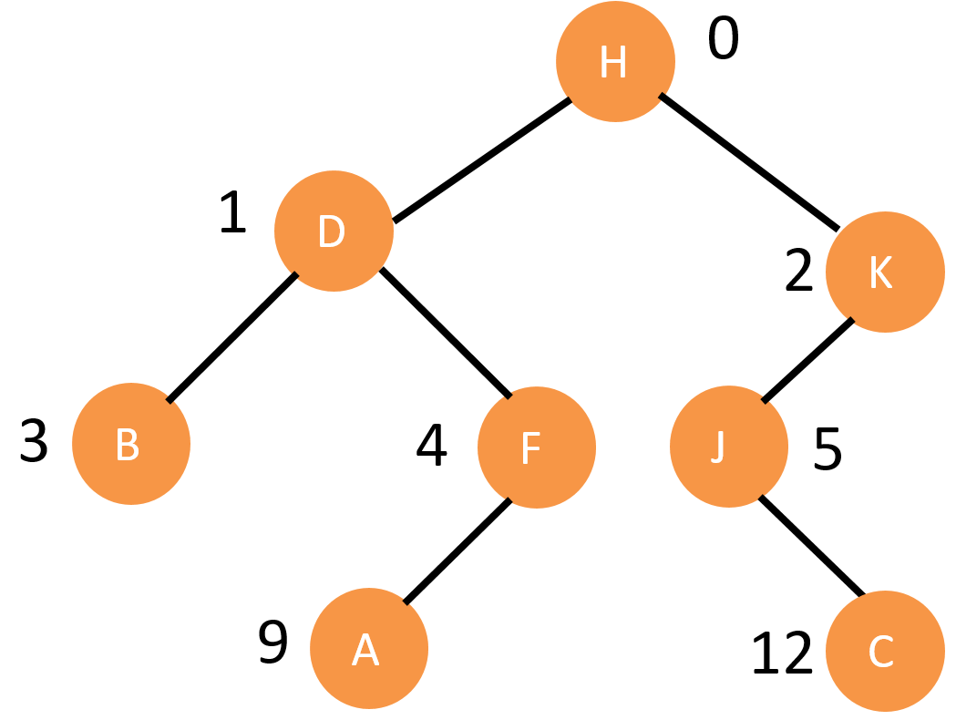
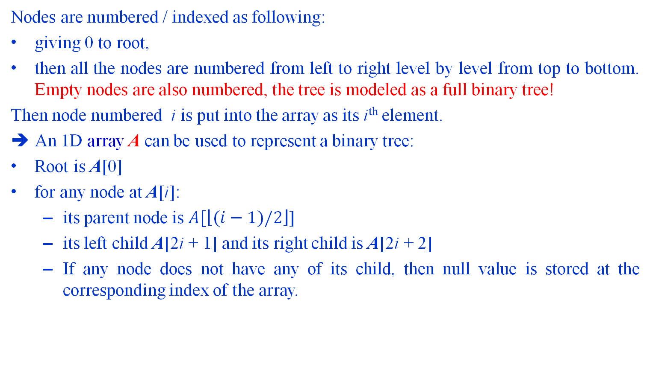
1D array representation of a binary tree
Nodes are numbered / indexed as following:
giving 0 to root,
then all the nodes are numbered from left to right level by level from top to bottom. Empty nodes are also numbered, the tree is modeled as a full binary tree!
Then node numbered i is put into the array as its i^{th} element.
An 1D array A can be used to represent a binary tree:
Root is A[0]
for any node at A[i]:
its parent node is $A[\left\lfloor (i−1)/2\right\rfloor$]
its left child A[2i + 1] and its right child is A[2i + 2]
If any node does not have any of its child, then null value is stored at the corresponding index of the array.
H | D | K | B | F | J | NULL | NULL | NULL | A | NULL | NULL | C | NULL
0 | 1 | 2 | 3 | 4 | 5 | 6 | 7 | 8 | 9 | 10 | 11 | 12 | 13 | 14 | ………………… | 25 | 26 | ….. | 30
A
Right child of K
left child of J
Left child of C
Right child of C
Left child of B
Right child of B
Notes:
A single array can be used to represent a binary tree.
For these nodes are numbered / indexed according to a scheme giving 0 to root. Then all the nodes are numbered from left to right level by level from top to bottom. Empty nodes are also numbered. Then each node having an index i is put into the array as its ith element.

Slide 117
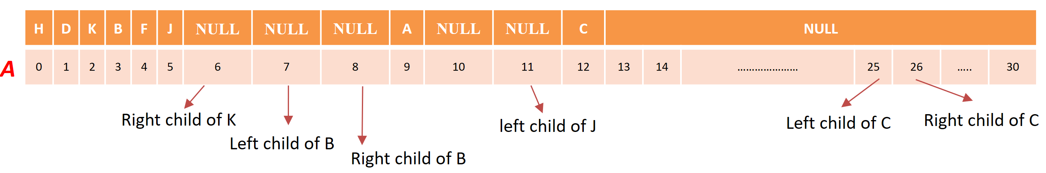

1D array representation of a binary tree
Depth/level =1
Max #nodes = 2⁰=1
l = 2
Max #nodes = 2¹=2
l = 3
Max #nodes = 2²=4
l = 4
Max #nodes = 2³=8
Max #nodes = 2⁴=16
$$\sum{max\#nodes=31}$$

Slide 118
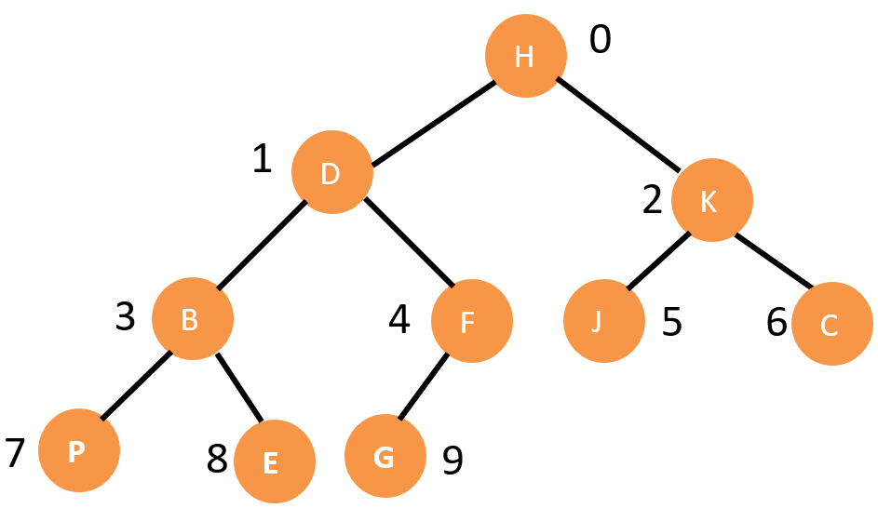
1D array representation of a complete binary tree
H | D | K | B | F | J | C | P | E | G
A[0] | A[1] | A[2] | A[3] | A[4] | A[5] | A[6] | A[7] | A[8] | A[9]
If using 1D array to represent a complete binary tree of n nodes:
We only need the array of n elements
To check a node A[i] is leaf or not ?

Slide 119
1D array representation of a binary tree
[0]
A
(1) waste space
(2) insertion/deletion problem
A
[0]
A
[1]
B
[1]
B
[2]
NULL
A
[2]
C
B
[3]
C
[3]
D
[4]
NULL
[4]
E
C
[5]
NULL
B
C
[5]
F
[6]
NULL
[6]
G
D
[7]
D
[7]
H
D
E
F
G
[8]
L
E
NULL
[15]
E
H
L

Slide 120
3.4.2. Binary tree representation
3.4.2.1. Array
3.4.2.2. Pointer

Slide 121
Pointer representation of a binary tree
Each node contains the address of the left child and the right child.
If any node has its left or right child empty then it will have in its respective link field, a null value.
A leaf node has null value in both of its links.
The structure defining a node of binary tree in C is as follows:
typedef struct
{
DataType data; /*data of node; DataType: int, char, double..*/
struct node *left ; /* points to the left child */
struct node *right; /* points to the right child */
}node;
Point to left child
Point to right child
data
Notes:
Binary trees can be represented by links where each node contains the address of the left child and the right child. If any node has its left or right child empty then it will have in its respective link field, a null value. A leaf node has null value in both of its links.
The structure defining a node of binary tree in C is as follows.
Binary trees can be represented by links where each node contains the address of the left child and the right child. If any node has its left or right child empty then it will have in its respective link field, a null value. A leaf node has null value in both of its links.
The structure defining a node of binary tree in C is as follows.
Struct node
{
struct node *lc ; /* points to the left child */
int data; /* data field */
struct node *rc; /* points to the right child */
}

Slide 122
Pointer representation of a binary tree: Example
A
B
A
E
C
B
C
D
F
G
D
H
E
F
G
I
J
H
I
J
K
K

Slide 123
Basic operations on binary tree
typedef struct
{
char word[20]; // Data of node
struct node * left;
struct node *right;
}node;
node* makeTreeNode(char *word);
node *insertNode(node* root, char *word, bool LEFT);
int countNodes(node *root);
int depth(node *root);
void freeTree(node *root);
void printPreorder(node *root);
void printPostorder(node *root);
void printInorder(node *root);

Slide 124
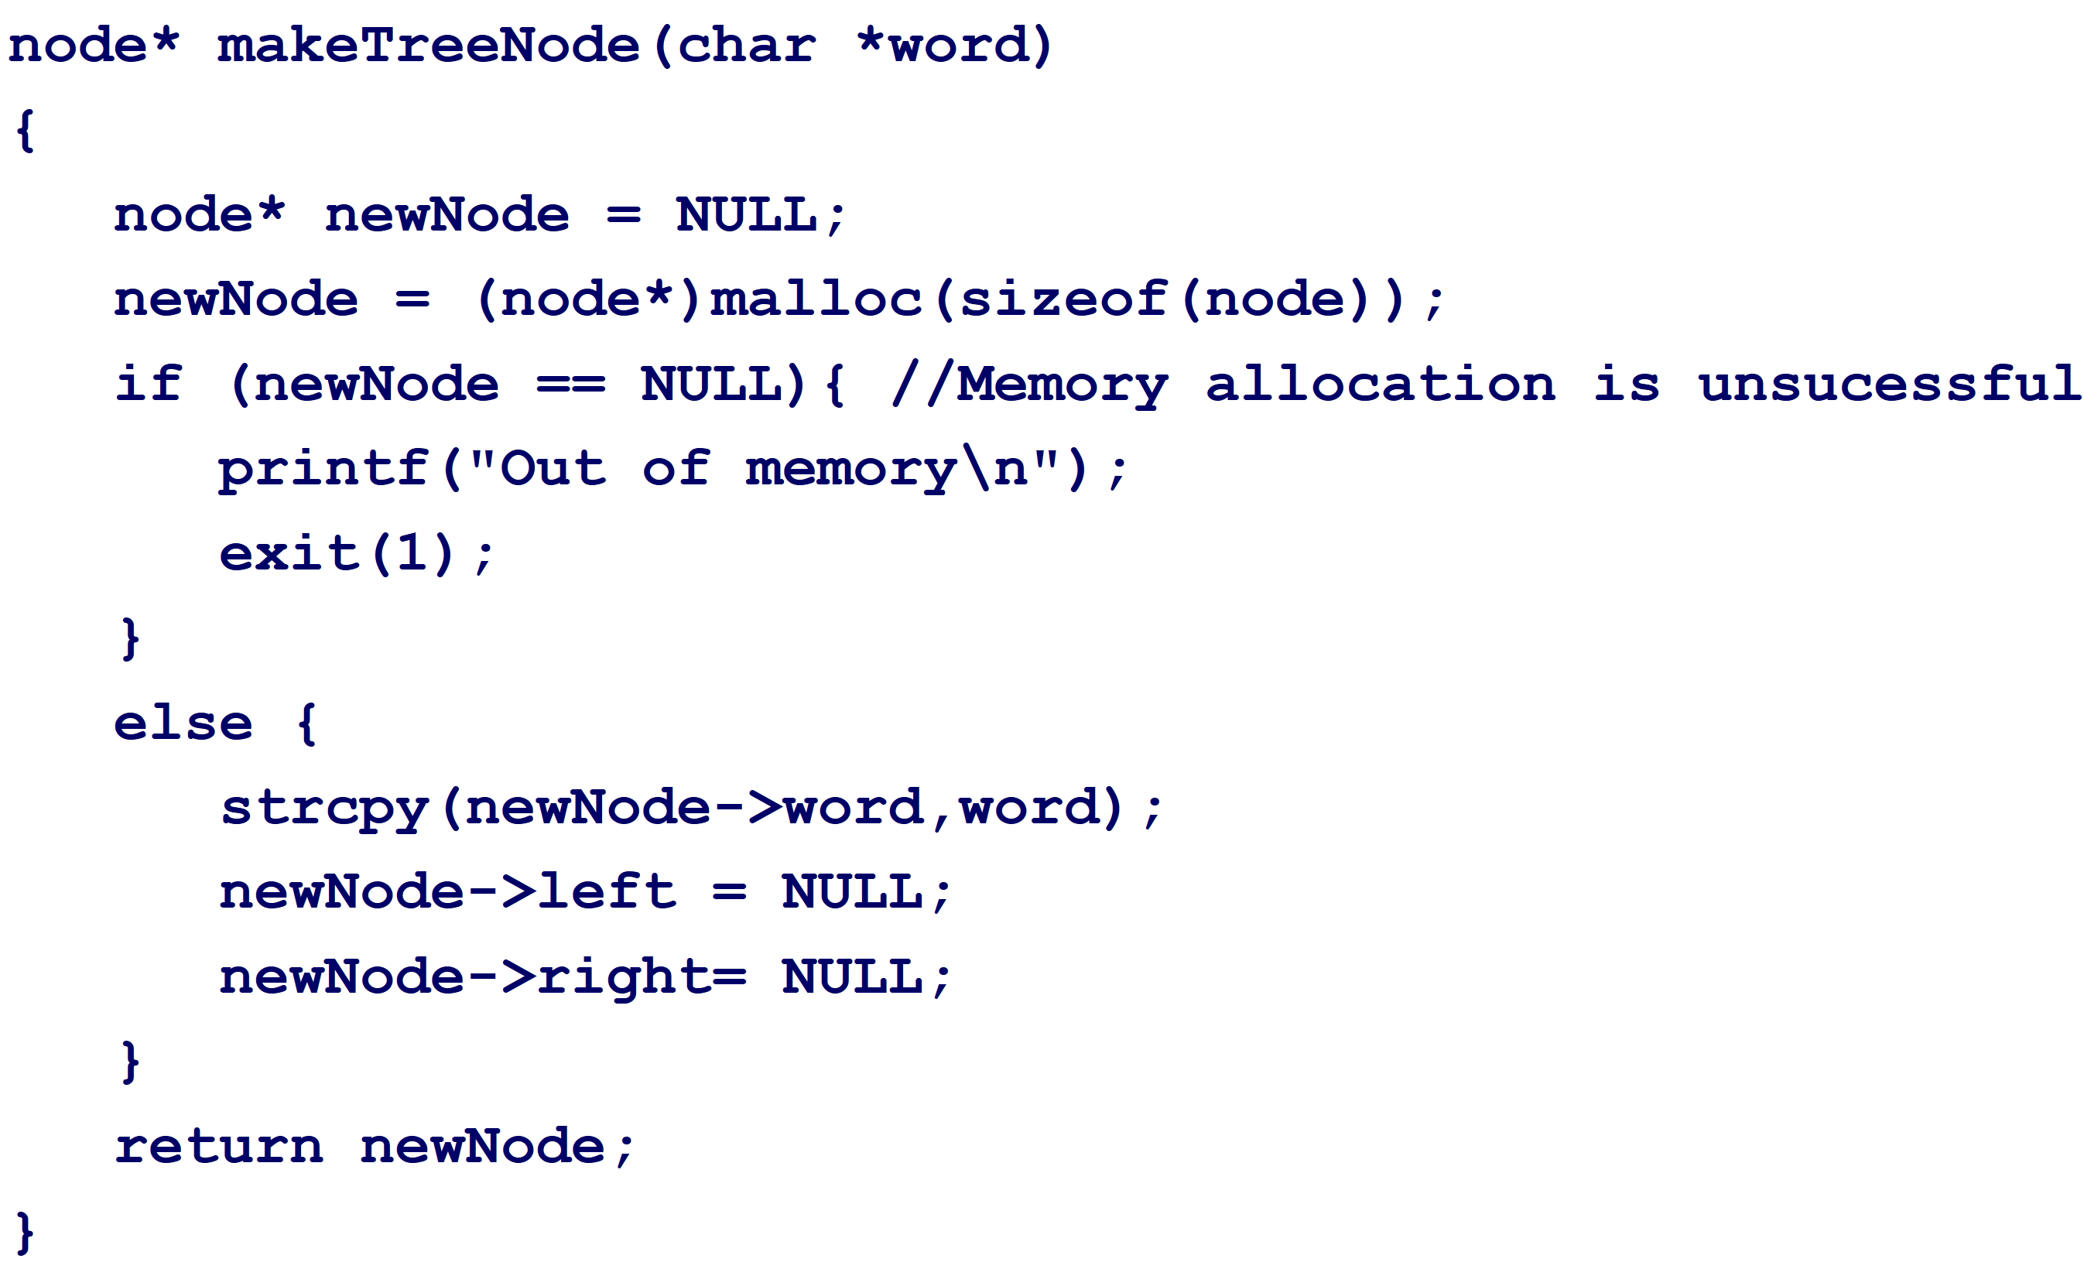
Basic operations on binary tree: MakeNode
node* makeTreeNode(char *word);
Input parameter: data of the inserted node
Output: Return the pointer to (address of) the new node
Steps:
Allocate memory for new node. Check whether the allocation is successful?
If Yes: assign data of new node = word
pointer of left child = NULL
pointer to right child = NULL
Return the pointer to (address of) the new node

Slide 125
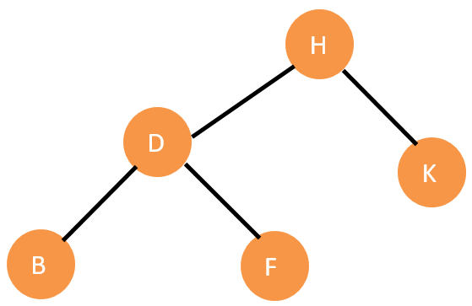
Basic operations on binary tree: insert new node into the tree
node *insertNode(node *tree, char *word, bool LEFT)
{
node *newNode, *p;
newNode = makeTreeNode(word);
if ( tree == NULL ) return newNode;
if (LEFT) //insert node on the leftmost of the tree
{
p = tree;
while (p->left !=NULL) p = p->left;
p->left = newNode;
printf("Node %s is left child of %s \n",word,(*p).word);
}
else { //insert node on the rightmost of the tree
p = tree;
while (p->right !=NULL) p = p->right;
p->right = newNode;
printf("Node %s is right child of %s \n", word,(*p).word);
}
return tree;
}
C
Call: RandomInsert(H, “C”, 1);
Notes:
// Base case : Leaf Node. This accounts for height = 1.
if (root->left == NULL && root->right == NULL)
return 1;
// If left subtree is NULL, recur for right subtree
if (!root->left)
return minDepth(root->right) + 1;
// If right subtree is NULL, recur for left subtree
if (!root->right)
return minDepth(root->left) + 1;
return min(minDepth(root->left), minDepth(root->right)) + 1;

Slide 126
Basic operations on binary tree: insert new node into the tree
node *insertNode(node *tree, char *word, bool LEFT)
{
node *newNode, *p;
newNode = makeTreeNode(word);
if ( tree == NULL ) return newNode;
if (LEFT) //insert node on the leftmost of the tree
{
p = tree;
while (p->left !=NULL) p = p->left;
p->left = newNode;
printf("Node %s is left child of %s \n",word,(*p).word);
}
else { //insert node on the rightmost of the tree
p = tree;
while (p->right !=NULL) p = p->right;
p->right = newNode;
printf("Node %s is right child of %s \n", word,(*p).word);
}
return tree;
}
C
Call: RandomInsert(H, “C”, 0);
Notes:
// Base case : Leaf Node. This accounts for height = 1.
if (root->left == NULL && root->right == NULL)
return 1;
// If left subtree is NULL, recur for right subtree
if (!root->left)
return minDepth(root->right) + 1;
// If right subtree is NULL, recur for left subtree
if (!root->right)
return minDepth(root->left) + 1;
return min(minDepth(root->left), minDepth(root->right)) + 1;

Slide 127
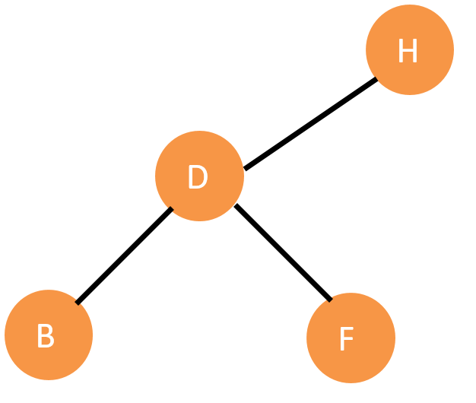
Basic operations on binary tree: calculate depth of tree
int depth(node *root) { /* the function computes the depth of a tree */
if( root == NULL ) return 0;
// Base case : Leaf Node. This accounts for height = 1.
if (root->left == NULL && root->right == NULL) return 1;
// If left subtree is NULL, recur for right subtree
if (root->left==NULL) return depth(root->right) + 1;
// If right subtree is NULL, recur for left subtree
if (root->right==NULL) return depth(root->left) + 1;
return min(depth(root->left), depth(root->right)) + 1;
}
Call depth(H):
depth(D) + 1
Min(depth(B), depth(F)) + 1
1 1
Notes:
// Base case : Leaf Node. This accounts for height = 1.
if (root->left == NULL && root->right == NULL)
return 1;
// If left subtree is NULL, recur for right subtree
if (!root->left)
return minDepth(root->right) + 1;
// If right subtree is NULL, recur for left subtree
if (!root->right)
return minDepth(root->left) + 1;
return min(minDepth(root->left), minDepth(root->right)) + 1;

Slide 128
Basic operations on binary tree: count number of nodes on the tree
int countNodes(node *root) {
if( root == NULL ) return 0;
else {
int ld = countNodes(root->left);
int rd = countNodes(root->right);
return 1+ld+rd;
}
}
A
B
E
C
F
G
D
H
I
return 0
countN(N) countN(F)
countN(E) countN(E) countN(E) countN(E)
countN(B) countN(B) countN(B) countN(B) countN(B)
countN(A) countN(A) countN(A) countN(A) countN(A) countN(A)

Slide 129
Basic operations on binary tree: count number of nodes on the tree
int countNodes(node *root) {
if( root == NULL ) return 0;
else {
int ld = countNodes(root->left);
int rd = countNodes(root->right);
return 1+ld+rd;
}
}
A
B
E
C
F
G
D
H
I
return 0 return 0
countN(N) countN(N) return 1
countN(F) countN(F) countN(F) countN(F) countN(F) return 2
countN(E) countN(E) countN(E) countN(E) countN(E) countN(E)
countN(B) countN(B) countN(B) countN(B) countN(B) countN(B)
countN(A) countN(A) countN(A) countN(A) countN(A) countN(A)

Slide 130
Basic operations on binary tree: count number of nodes on the tree
int countNodes(node *root) {
if( root == NULL ) return 0;
else {
int ld = countNodes(root->left);
int rd = countNodes(root->right);
return 1+ld+rd;
}
}
A
B
E
C
F
G
D
H
I
return 0
countN(N)
countN(H) countN(H)
return 2 countN(G) countN(G) countN(G)
countN(E) countN(C) countN(C) countN(C) countN(C)
countN(B) countN(B) countN(B) countN(B) countN(B) countN(B)
countN(A) countN(A) countN(A) countN(A) countN(A) countN(A) etc

Slide 131
Basic operations on binary tree: free the tree
void freeTree(node *root)
{
if( root == NULL ) return;
freeTree(root->left);
freeTree(root->right);
free(root);
}

Slide 132
3.4. Binary tree
3.4.1. Definitions
3.4.2. Binary tree representation
3.4.3. Binary tree traversals
3.4.4. Some applications

Slide 133
3.4.3. Binary Tree Traversals
A traversal is where each node in a tree is visited and visited once
There are two very common traversals
Breadth First
Depth First

Slide 134
3.4.3. Binary Tree Traversals: Breadth First
In a breadth first traversal all of the nodes on a given level are visited and then all of the nodes on the next level are visited.
Usually in a left to right fashion
Breadth_First_Search(2): 2, 4, 5, 7, 3, 10, 8, 1, 9, 11, 6
2
Depth/level =1
2
4
5
l = 2
7
3
10
8
l = 3
1
9
11
l = 4
6
l = 5

Slide 135
3.4.3. Binary Tree Traversals: Depth First
In a depth first traversal all the nodes on a branch are visited before any others are visited
There are three common depth first traversals
Inorder
Preorder
Postorder
Each type has its use and specific application

Slide 136
3.4.3. Binary Tree Traversals: Depth First
Preorder NLR
Visit a node,
Visit left subtree in preorder,
Visit right subtree in preorder
Inorder LNR
Visit left subtree in inorder,
Visit a node,
Visit right subtree in inorder
Postorder LRN
Visit left subtree in postorder,
Visit right subtree in postorder,
Visit a node

Slide 137
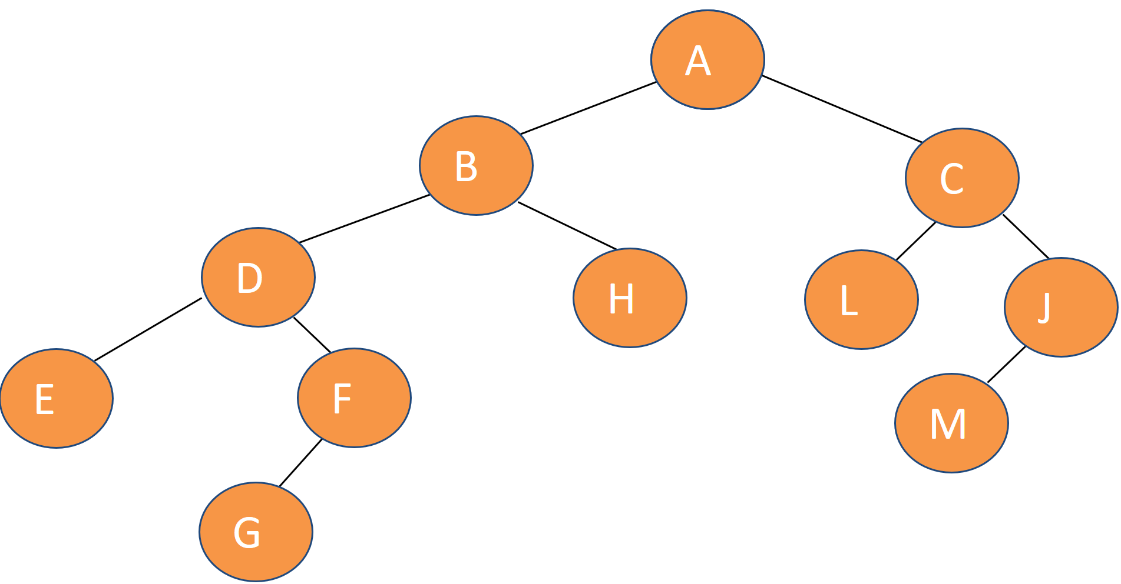
Preorder traversal - NLR
Visit the node.
Traverse the left subtree.
Traverse the right subtree.
void printPreorder(node *root)
{ if( root != NULL )
{
printf("%s ", root->word);
printPreorder(root->left);
printPreorder(root->right);
}
}
Call: printPreorder(A);
A B D E F G H C L J M
left subtree
right subtree

Slide 138
Inorder traversal - LNR
Traverse the left subtree
Visit the node
Traverse the right subtree
void printInorder(node *tree)
{
if( tree != NULL )
{
printInorder(tree->left);
printf("%s ", tree->word);
printInorder(tree->right);
}
}
Call: printInorder(A);
E D G F B H A L C M J
left subtree
right subtree

Slide 139
Postorder traversal - LRN
Traverse the left subtree
Traverse the right subtree
Visit the node
void printPostorder(node *tree)
{
if( tree != NULL )
{
printPostorder(tree->left);
printPostorder(tree->right);
printf("%s ", tree->word);
}
}
Call: printPostorder(A);
E G F D H B L M J C A
left subtree
right subtree

Slide 140
Program in C
/* The program for testing binary tree traversal */
#include <stdio.h>
#include <conio.h>
#include <string.h>
#include <stdlib.h>
typedef struct {
char word[20];
struct node * left;
struct node *right;
} node;
node *makeTreeNode(char *word);
node *insertNode(node* tree,char *word);
void freeTree(node *tree);
void printPreorder(node *tree);
void printPostorder(node *tree);
void printInorder(node *tree);
int countNodes(node *tree);
int depth(node *tree);

Slide 141
Program in C
void main() {
node *randomTree=NULL;
char word[20] = "a";
while( strcmp(word,"~")!=0)
{ printf("\nEnter item (~ to finish): ");
scanf("%s", word);
if (strcmp(word,"~")==0) printf(“Finish to input data for node... \n");
else randomTree = insertNode(randomTree,word, rand()%2);
}
printf("The tree in preorder:\n"); printPreorder(randomTree);
printf("The tree in postorder:\n"); printPostorder(randomTree);
printf("The tree in inorder:\n"); printInorder(randomTree);
printf("The number of nodes is: %d\n",countNodes(randomTree));
printf("The depth of the tree is: %d\n", depth(randomTree));
freeTree(randomTree);
}

Slide 142
Exercise
Draw a binary tree of height 3, whose postorder traversal is (10, 30, 50, 20, 40, 70, 60)
Postorder: Left_Right_Root
60
50
70
10
30
20
40
Notes:
Left: 10; right =30 ➔ root = 50
Left =20; right =40 ➔ root = 70
➔ Root = 60

Slide 143
3.4. Binary tree
3.4.1. Definitions
3.4.2. Binary tree representation
3.4.3. Binary tree traversals
3.4.4. Applications of trees as data structure

Slide 144
Applications of trees as data structures
Trees are used to store data in a hierarchical way: the file system on a computer
Store a set of n objects with guarantee insertion, deletion and retrieval in O(log n) steps
Red-black trees
Store computer program during compilation
Syntax tree
Store and provide sorted data: heap tree
Store decision keys in artificial intelligence: decision trees
Store arithmetic expressions: binary expression tree

Slide 145
3.4.4. Some applications
3.4.4.1. Arithmetic expression
3.4.4.2. Huffman code

Slide 146
3.4.4.1. Arithmetic expression
A binary tree can be used to represent an arithmetic expression:
internal nodes: operators
leaves: operands
Example 1: arithmetic expression tree for the expression
((2 × (5 - 1)) + (3 × 2))
Traversing expression tree:
preorder traversal
+ x 2 – 5 1 x 3 2
give us: prefix expression
inorder traversal
2 x 5 – 1 + 3 x 2
give us: infix expression
postorder traversal
2 5 1 – x 3 2 x +
give us: postfix expression
level order traversal (breath first traveral)
+ x x 2 – 3 2 5 1
+
×
×
2
−
3
2
5
1

Slide 147
3.4.4.1. Arithmetic expression
((2 × (5 - 1)) + (3 × 2))
+
Inorder(root)
if(root != NULL )
Inorder(root->left);
printf(data)
Inorder(root->right);
×
×
2
−
3
2
5
1
inorder traversal
2 x 5 – 1 + 3 x 2
give us: infix expression
Inorder(N)
Inorder(N) print 2 Inorder(N) Inorder(5) Inorder(5)
Inorder(2) Inorder(2) Inorder(2) Inorder(2) print x Inorder(-) Inorder(-) Inorder(-)
Inorder(x) Inorder(x) Inorder(x) Inorder(x) Inorder(x) Inorder(x) Inorder(x) Inorder(x)
Inorder(+) Inorder(+) Inorder(+) Inorder(+) Inorder(+) Inorder(+) Inorder(+) Inorder(+)

Slide 148
3.4.4.1. Arithmetic expression
((2 × (5 - 1)) + (3 × 2))
+
Inorder(root)
if(root != NULL )
Inorder(root->left);
printf(data)
Inorder(root->right);
×
×
2
−
3
2
5
1
inorder traversal
2 x 5 – 1 + 3 x 2
give us: infix expression
Inorder(N) print 5 Inorder(N) Inorder(N) print 1
Inorder(5) Inorder(5) Inorder(5) Inorder(5) print - Inorder(1) Inorder(1) Inorder(1)
Inorder(-) Inorder(-) Inorder(-) Inorder(-) Inorder(-) Inorder(-) Inorder(-) Inorder(-)
Inorder(x) Inorder(x) Inorder(x) Inorder(x) Inorder(x) Inorder(x) Inorder(x) Inorder(x)
Inorder(+) Inorder(+) Inorder(+) Inorder(+) Inorder(+) Inorder(+) Inorder(+) Inorder(+)

Slide 149
3.4.4.1. Arithmetic expression
((2 × (5 - 1)) + (3 × 2))
+
Inorder(root)
if(root != NULL )
Inorder(root->left);
printf(data)
Inorder(root->right);
×
×
2
−
3
2
5
1
inorder traversal
2 x 5 – 1 + 3 x 2
give us: infix expression
print 1
Inorder(1) Inorder(N) print 3
Inorder(-) Inorder(-) Inorder(3) Inorder(3) Inorder(3) print x
Inorder(x) Inorder(x) Inorder(x) Inorder(x) Inorder(x) Inorder(x) Inorder(x)
Inorder(+) Inorder(+) Inorder(+) Inorder(+) Inorder(+) Inorder(+) Inorder(+) Inorder(+)

Slide 150
3.4.4.1. Arithmetic expression
((2 × (5 - 1)) + (3 × 2))
+
Inorder(root)
if(root != NULL )
Inorder(root->left);
printf(data)
Inorder(root->right);
×
×
2
−
3
2
5
1
inorder traversal
2 x 5 – 1 + 3 x 2
give us: infix expression
Inorder(N) print 2 Inorder(N)
print x Inorder(2) Inorder(2) Inorder(2) Inorder(2) Inorder(2)
Inorder(x) Inorder(x) Inorder(x) Inorder(x) Inorder(x) Inorder(x) Inorder(x)
Inorder(+) Inorder(+) Inorder(+) Inorder(+) Inorder(+) Inorder(+) Inorder(+) Inorder(+)

Slide 151
3.4.4.1. Arithmetic expression
Binary tree are used to represent for an arithmetic expression:
internal nodes: operators
leaves: operands
Example 2:
+
Traversing expression tree:
preorder traversal
+ * * / A B C D E
give us: prefix expression
inorder traversal
A / B * C * D + E
give us: infix expression
postorder traversal
A B / C * D * E +
give us: postfix expression
level order traversal (breath first traveral)
+ * E * D / C A B
∗
E
∗
D
/
C
A
B

Slide 152
Infix/Postfix/Prefix Expressions
INFIX: the expressions in which operands surround the operator
Example: x+y, x+y*z
POSTFIX (also known as Reverse Polish Notation): operator comes after the operands
Example: xy+ , xyz*+
PREFIX (also Known as Polish notation): operator comes before the operands
Example: +xy, +x*yz
+
x
∗
y
z
Notes:
INFIX: the expressions in which operands surround the operator, e.g. x+y, 6*3 etc this way of writing the Expressions is called infix notation. POSTFIX: Postfix notation are also Known as Reverse Polish Notation (RPN). They are different from the infix and prefix notations in the sense that in the postfix notation, operator comes after the operands, e.g. xy+, xyz+* etc. PREFIX: Prefix notation also Known as Polish notation. In the prefix notation, operator comes before the operands, e.g. +xy, *+xyz

Slide 153
Infix Expressions
INFIX: the expressions in which operands surround the operator
How do you evaluate :
a * b + c / d
This is done by assigning operator priorities:
priority(*) = priority(/) > priority(+) = priority(-)
When an operand lies between two operators, the operand associates with the operator that has higher priority.
Operand b lies between * and + ==> b associates with *
Operand c lies between + and / ==> c associates with /
Therefore: a* b + c / d = (a*b) + (c/d)
Notes:
How do you figure out the operands of an operator? • a + b * c • a * b + c / d This is done by assigning operator priorities. • priority(*) = priority(/) > priority(+) = priority(-) When an operand lies between two operators, the operand associates with the operator that has higher priority.

Slide 154
Example 1: Evaluate postfix expressions: using stack
Evaluate the following postfix expression using stacks: 6 3 6 + 5 * 9 / -
The expression is evaluated by using stack as follows:
Element = 6
STACK
6
Element = 3
STACK
3
6
Element = 6
STACK
6
3
6
Element = +
STACK
6
Evaluate 3+6=9
Push 6
Pop 6
Push 3
Pop 3
Push 6
Push 9

Slide 155
Example 1: Evaluate postfix expressions: using stack
Evaluate the following postfix expression using stacks: 6 3 6 + 5 * 9 / -
The expression is evaluated by using stack as follows:
STACK
9
6
Element = 5
STACK
5
9
6
Element = *
STACK
5
9
6
Evaluate 5*9=45
Push 5
Pop 5
Push 9
Pop 9

Slide 156
Evaluate postfix expressions using stack: 6 3 6 + 5 * 9 / -
STACK
45
6
Element = 9
STACK
9
45
6
Element = /
STACK
9
45
6
Evaluate 45/9=5
Push 9
Pop 9
Push 45
Pop 45
STACK
5
6
Element = -
STACK
5
6
STACK
1
Evaluate 6-5=1
Push 5
Pop 5
Pop 6
Push 1
Final state of stack with result

Slide 157
Evaluate postfix expressions: using stack
evaluationPostfix(stack S, postfixExpression E)
{ //Expression is stored in array E
//Read expression from left to right:
i = 0;
while ( i < number of characters_in_postfix_expression)
{
if (E[i] is an operand)
push E[i] onto stack
else if (E[i] is an operator)
{
Pop the top element from stack and store it in operand2
Pop the next top element from stack and store it in operand2
Evaluate: operand2 op operand1 and push the result onto stack
}
i = i + 1;
}//end while
Pop the top element, store it in Result;
return Result; //which is value of expression
}

Slide 158
Example 1:Evaluate postfix expression: 636+5*9/-
 | Element of expression | Action performed | Stack status
1 | 6 | Push 6 to stack | 6
2 | 3 | Push 3 to stack | 3
3 | 6 | Push 6 to stack | 6 3 6
4 | + | Pop 6 | 3
5 |  | Pop 3 | 6
6 |  | Evaluate 3 + 6 = 9 | 6
7 |  | Push 9 to stack | 9
8 | 5 | Push 5 to stack | 6 9 5
9 | * | Pop 5 | 9
10 |  | Pop 9 | 6
11 |  | Evaluate 9*5=45 | 6
12 |  | Push 45 to stack | 45
13 | 9 | Push 9 to stack | 6 45 9
14 | / | Pop 9 | 45
15 |  | Pop 45 | 6
16 |  | Evaluate 45/9=5 | 6
17 |  | Push 5 to stack | 6 5
18 | - | Pop 5 | 6
19 |  | Pop 6 | Empty
20 |  | Evaluate 6-5=1 | Empty
21 |  | Push 1 to stack | 1
22 |  | Pop value = 1 | Empty
Value of expression = 1
2nd way to display the steps of algorithm
Notes:
Another way to express the steps of algorithm

Slide 159
Example 1: Evaluate postfix expressions: using stack
6 3 6 + 5 * 9 / -
6 9 5 * 9 / -
6 45 9 / -
6 5 -
3 +6 = 9
9 * 5 = 45
Read expression from left to right
45 / 9 = 5
6 – 5 = 1
Value of expression = 1
3rd way to display the steps of algorithm

Slide 160
Example 2: Evaluate prefix expressions: using stack
+ - * 2 3 5 / * 2 3 2
+ - * 2 3 5 / 6 2
+ - * 2 3 5 3
+ - 6 5 3
+ 1 3
2*3 =6
6 / 2 = 3
Read expression from right to left
2 * 3 = 6
6 – 5 = 1
1 + 3 = 4
Value of expression = 4

Slide 161
Example 2: Evaluate prefix expression: +-*235/*232
 | Element of expression | Action performed | Stack status
1 | 2 | Push 2 to stack | 2
2 | 3 | Push 3 to stack | 2 3
3 | 2 | Push 2 to stack | 2 3 2
4 | * | Pop 2 | 2 3
5 |  | Pop 3 | 2
6 |  | Evaluate 2 * 3 = 6 | 2
7 |  | Push 6 to stack | 6
8 | / | Pop 6 to stack | 2
9 |  | Pop 2 | Empty
10 |  | Evaluate: 6/2=3 | Empty
11 |  | Push 3 to stack | 3
12 | 5 | Push 5 to stack | 5
13 | 3 | Push 3 to stack | 3 5 3
14 | 2 | Push 2 to stack | 3 5 3 2
 | Element of expression | Action performed | Stack status
15 | * | Pop 2 | 5 3
16 |  | Pop 3 | 3 5
17 |  | Evaluate 2*3=6 | 3 5
18 |  | Push 6 to stack | 3 5 6
19 | - | Pop 6 | 5
20 |  | Pop 5 | 3
21 |  | Evaluate 6-5 = 1 | 3
22 |  | Push 1 to stack | 3 1
23 | + | Pop 1 | 3
24 |  | Pop 3 | Empty
25 |  | Evaluate 1 + 3 = 4 | Empty
26 |  | Push 4 to stack | 4
27 |  | Pop value = 4 | Empty
Value of expression = 4

Slide 162
Print Arithmetic Expressions
Given a binary tree having root pointer pointed to the root of the tree, and this tree represents an arithmetic expression. Write a function to print this expression.
Inorder traversal:
print “(“ before traversing left subtree
print operand or operator when visiting node
print “)“ after traversing right subtree
void printTree(node *root)
if (root.left != NULL) {
print("(");
printTree (root.left);
}
print(root.data);
if (root.right != NULL)
{
printTree (root.right);
print (")");
}
+
×
×
2
−
3
2
5
1
Call printTree(+);
The expression is:
((2 × (5 - 1)) + (3 × 2))

Slide 163
Evaluate Arithmetic Expressions
Given a binary tree having root pointer pointed to the root of the tree, and this tree represents an arithmetic expression. Write a function to evaluate this expression.
Postorder traversal:
Recursively evaluate subtrees
Apply the operator after subtrees are evaluated
+
×
×
int evaluate (node *root)
if (root.left == NULL)//external node return root.data;
else //internal node
x = evaluate (root.left);
y = evaluate (root.right);
let o be the operator root.data
z = apply o to x and y
return z;
2
−
3
2
5
1
Call A = evaluate(+);
The value of A is:

Slide 164
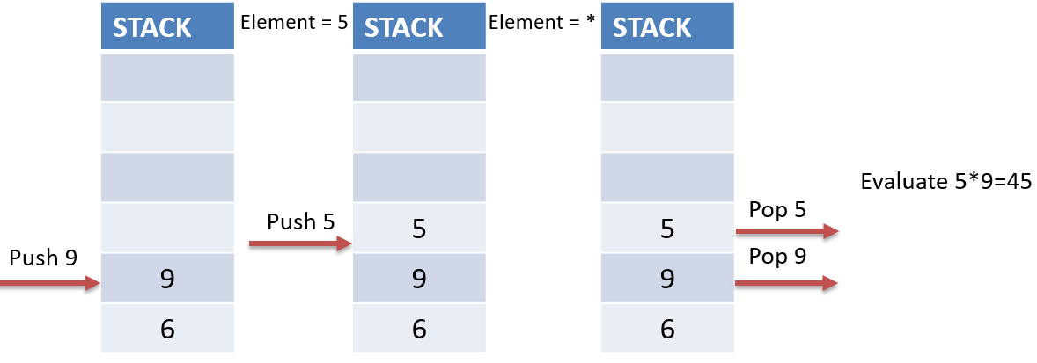
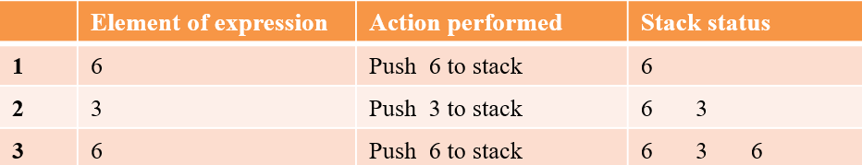
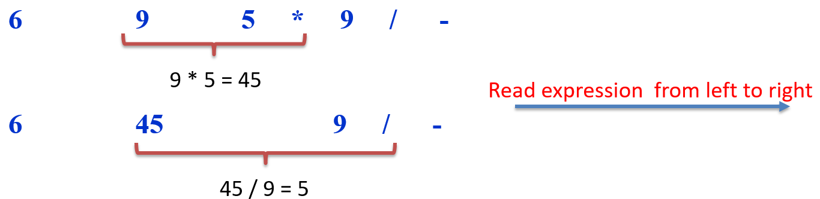
Exercise: Evaluate expression using stack
Exercise 1: evaluate postfix expression using stack
2 3 + 4 * 5 *
27 3 2 ^ / 3 17 * + 27 2 * -
7 6 + 4 * 410 - 5 ^
7 5 – 9 2 / *
Exercise 2: evaluate prefix expression using stack
- + 7 * 4 5 + 2 10
- * 9 + 2 3 / 27 3
1st way to display the steps of algorithm:
2nd way to display the steps of algorithm:
3rd way to display the steps of algorithm:
Notes:
4) (ANS: 9.00)

Slide 165
3.4.4. Some applications
3.4.4.1. Arithmetic expression
3.4.4.2. Huffman code

Slide 166
Exercise
Suppose that we have a 100,000 character data file that we wish to store. The file contains only 6 characters, appearing with the following frequencies:
We encode each character as a binary string (called codeword). Thus, we need to find a binary code that encodes the file using as few bits as possible, i.e., compresses it as much as possible.
There are two possible ways to encode:
A fixed-length code: each codeword has the same length.
A variable-length code: codewords may have different lengths.
Example: if using fixed-length code for our problem, we need at least 3 bits per codeword as there are 6 characters (2² = 4 < 6, 2³ = 8)
 | a | b | c | d | e | f
Frequency | 45000 | 13000 | 12000 | 16000 | 9000 | 5000
 | a | b | c | d | e | f
Frequency | 45000 | 13000 | 12000 | 16000 | 9000 | 5000
A fixed-length | 000 | 001 | 010 | 011 | 100 | 101
A variable-length | 0 | 101 | 100 | 111 | 1101 | 1100

Slide 167
Exercise
Example: if using fixed-length code for our problem, we need at least 3 bits per codeword as there are 6 characters (2² = 4 < 6, 2³ = 8)
The fixed length-code requires:
3 * 100000 = 300000 bits to store the file
The variable-length code uses only:
1 * 45000 + 3*13000+ 3*12000 + 3 * 16000 + 4 * 9000 + 4 * 5000 = 224000 bits
➔ saving a lot of space: 25%
 | a | b | c | d | e | f
Frequency | 45000 | 13000 | 12000 | 16000 | 9000 | 5000
A fixed-length | 000 | 001 | 010 | 011 | 100 | 101
A variable-length | 0 | 101 | 100 | 111 | 1101 | 1100
3 bits for each character
Number of characters
#bits used to encode character “a”
#bits used to encode character “f”

Slide 168
Exercise
There are two possible ways to encode:
A fixed-length code: each codeword has the same length
➔ easy to encode and decode, but requires larger memory.
A variable-length code: codewords may have different lengths
Assign the longest codes to the most infrequent events.
Assign the shortest codes to the most frequent events.
Each code word must be uniquely identifiable regardless of length➔ no codeword is a prefix of another one (example: {a = 1, b = 110, c = 10, d = 111}, then when encoding, what is “1101111”?)
➔ Prefix code: a code is called a prefix code if no codeword is a prefix of another one (Example: {a = 0, b = 110, c = 10, d = 111} is a prefix code)
 | a | b | c | d | e | f
Frequency | 45000 | 13000 | 12000 | 16000 | 9000 | 5000
A fixed-length | 000 | 001 | 010 | 011 | 100 | 101
A variable-length | 0 | 101 | 100 | 111 | 1101 | 1100

Slide 169
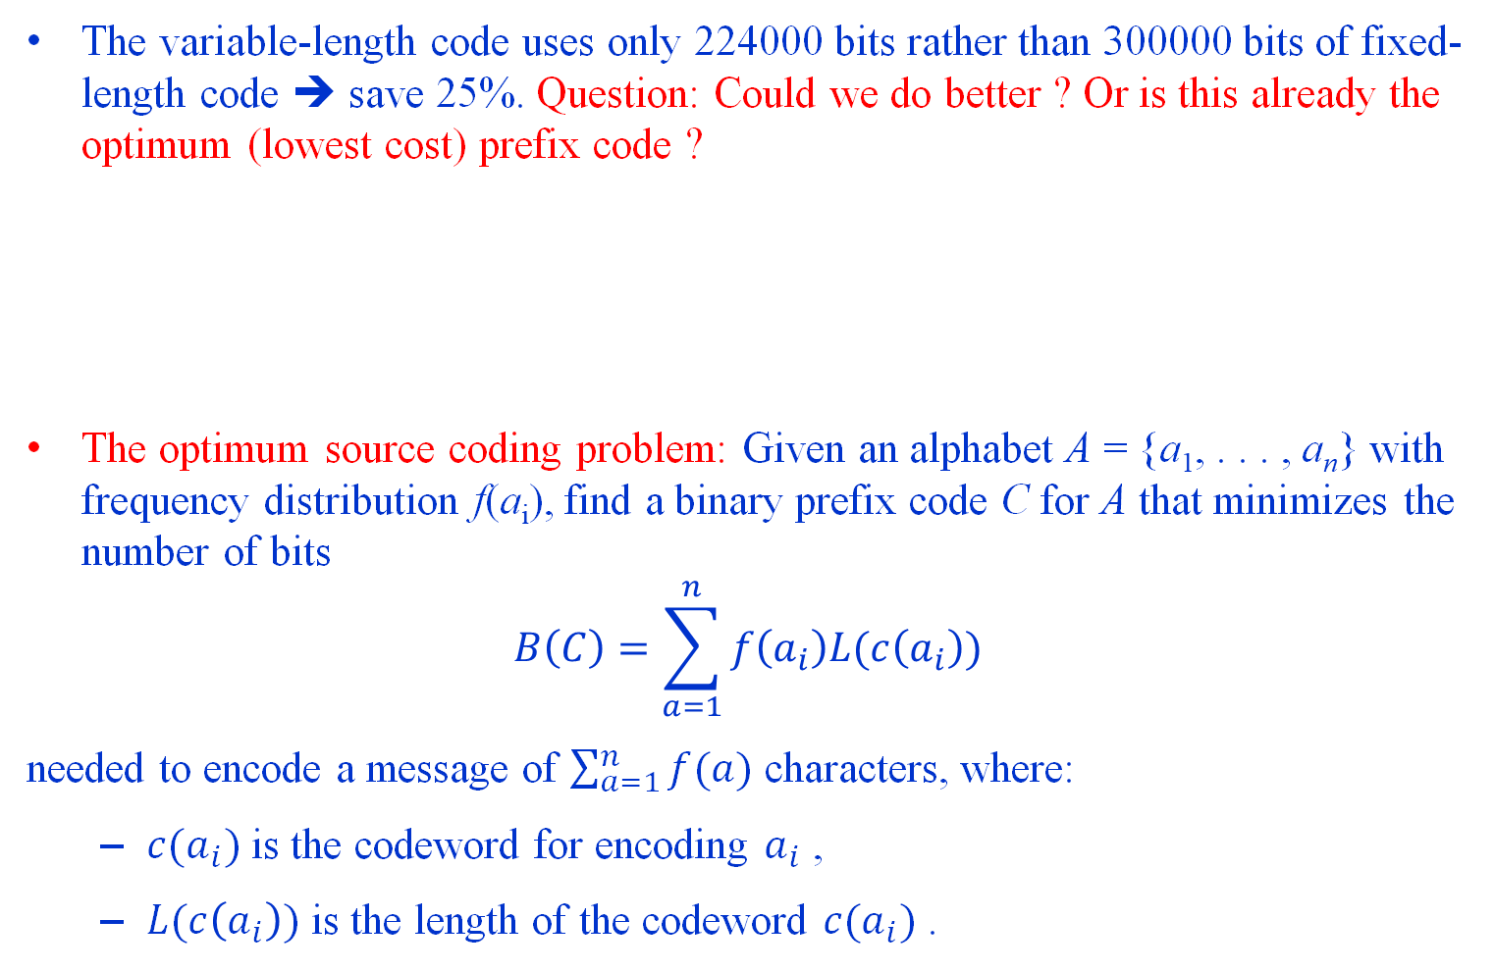
Optimum source coding problem
The variable-length code uses only 224000 bits rather than 300000 bits of fixed-length code ➔ save 25%. Question: Could we do better ? Or is this already the optimum (lowest cost) prefix code ?
The optimum source coding problem: Given an alphabet A = {a₁, . . . , a_{n}} with frequency distribution f(a_{i}), find a binary prefix code C for A that minimizes the number of bits
$$B\left(C\right)=\sum_{a=1}^{n}{f\left(a_{i}\right)L(c\left(a_{i}\right))}$$
needed to encode a message of $\sum_{a=1}^{n}{f(a)}$ characters, where:
$c(a_{i})$ is the codeword for encoding $a_{i}$ ,
$L(c\left(a_{i}\right))$ is the length of the codeword $c(a_{i})$ .
 | a | b | c | d | e | f
Frequency | 45000 | 13000 | 12000 | 16000 | 9000 | 5000
A fixed-length | 000 | 001 | 010 | 011 | 100 | 101
A variable-length | 0 | 101 | 100 | 111 | 1101 | 1100

Slide 170
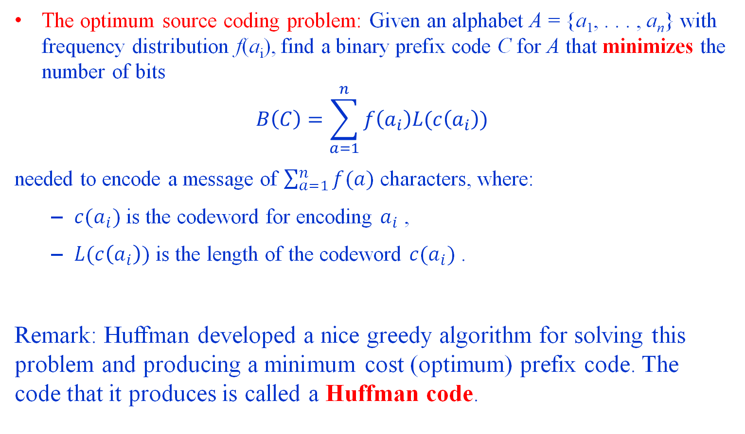
Optimum source coding problem
The optimum source coding problem: Given an alphabet A = {a₁, . . . , a_{n}} with frequency distribution f(a_{i}), find a binary prefix code C for A that minimizes the number of bits
$$B\left(C\right)=\sum_{a=1}^{n}{f\left(a_{i}\right)L(c\left(a_{i}\right))}$$
needed to encode a message of $\sum_{a=1}^{n}{f(a)}$ characters, where:
$c(a_{i})$ is the codeword for encoding $a_{i}$ ,
$L(c\left(a_{i}\right))$ is the length of the codeword $c(a_{i})$ .
Remark: Huffman developed a nice greedy algorithm for solving this problem and producing a minimum cost (optimum) prefix code. The code that it produces is called a Huffman code.

Slide 171
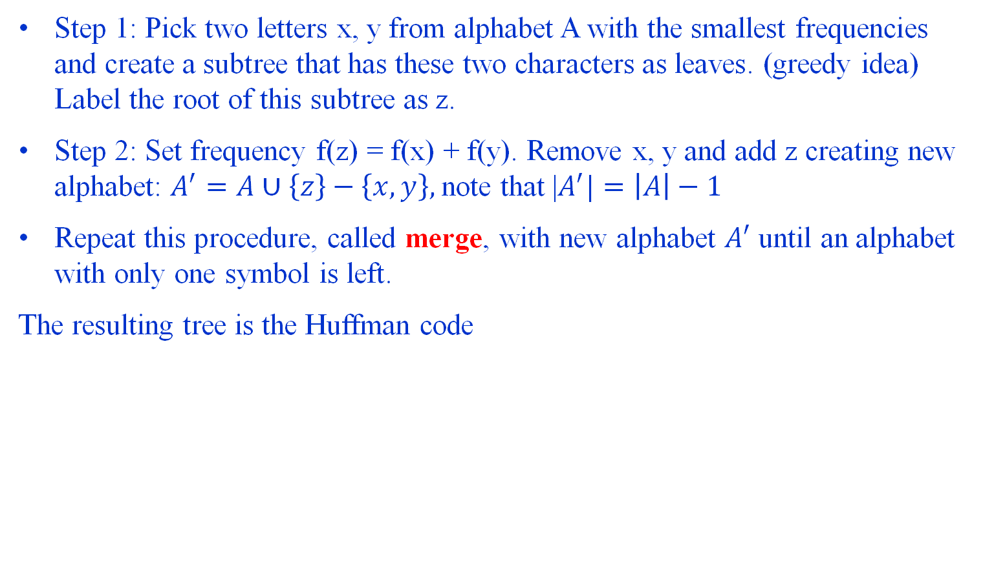
3.4.4.2 Huffman code
Step 1: Pick two letters x, y from alphabet A with the smallest frequencies and create a subtree that has these two characters as leaves. (greedy idea) Label the root of this subtree as z.
Step 2: Set frequency f(z) = f(x) + f(y). Remove x, y and add z creating new alphabet: $A^{′}=A∪\left\{z\right\}−\left\{x,y\right\},$note that |$A^{′}|=\left|A\right|−1$
Repeat this procedure, called merge, with new alphabet $A^{′}$ until an alphabet with only one symbol is left.
The resulting tree is the Huffman code

Slide 172
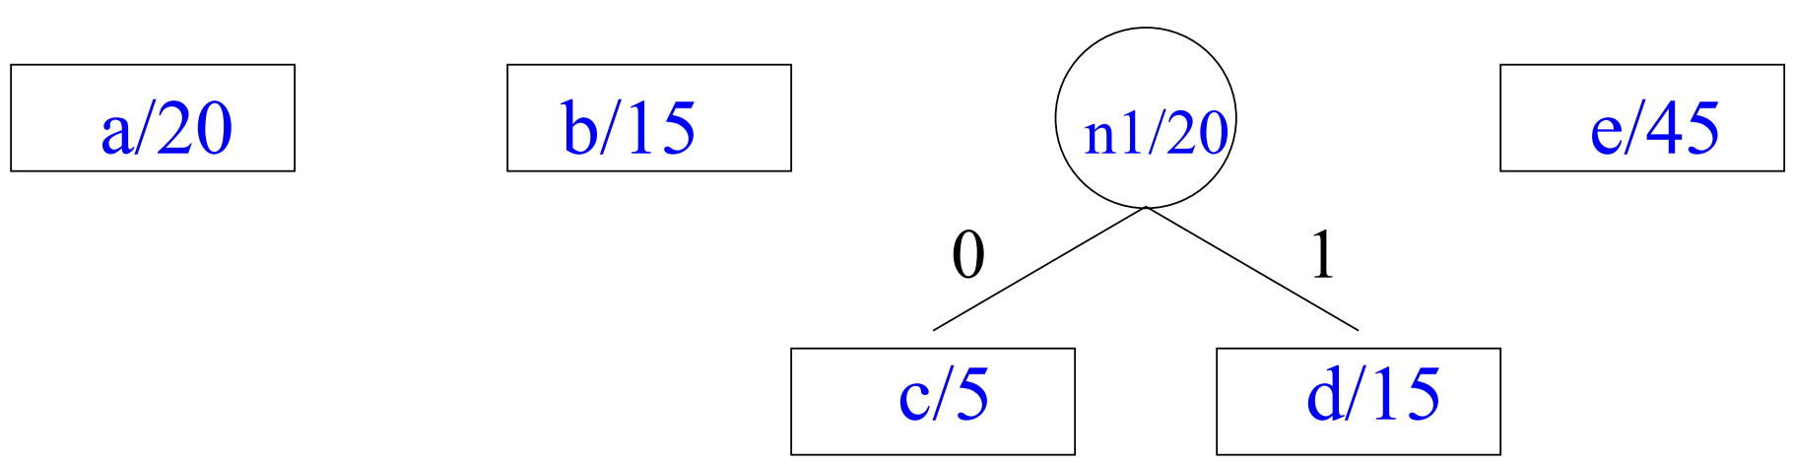
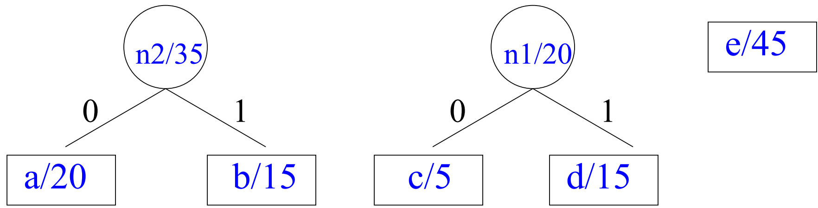
3.4.4.2 Huffman code
Let A = {a / 20, b / 15, c / 5, d /15, e / 45} be the alphabet and its frequency distribution.
In the first step Huffman coding merges c and d
Alphabet is now A₁ = {a / 20, b / 15, n1 / 20, e / 45}
Algorithm merges a and b (could also b and n1)
Alphabet is now A₂ = {n2 / 35, n1: / 20, e / 45}

Slide 173
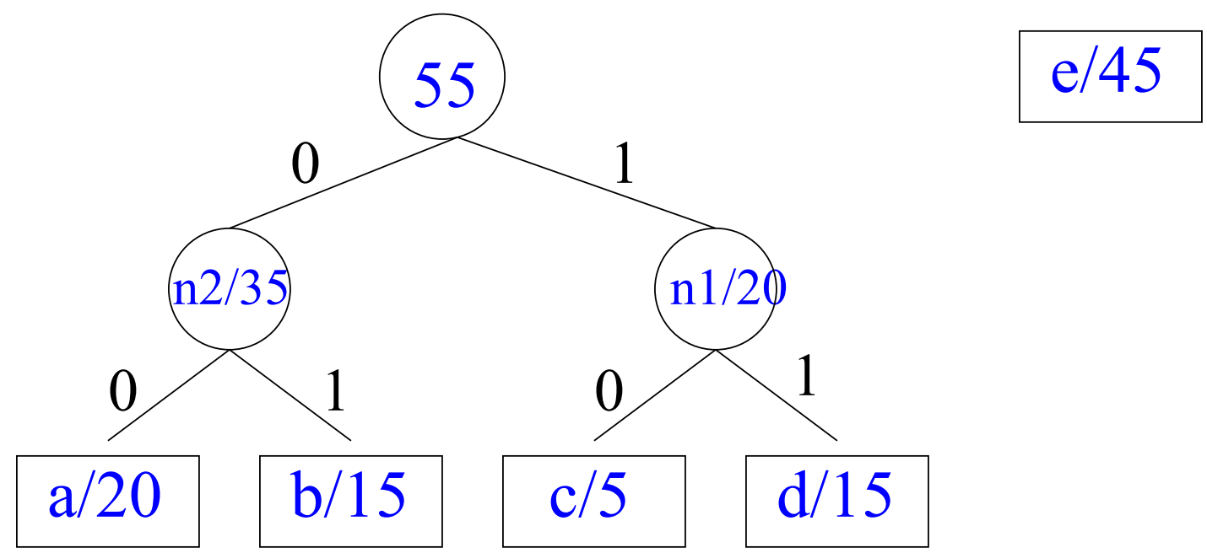
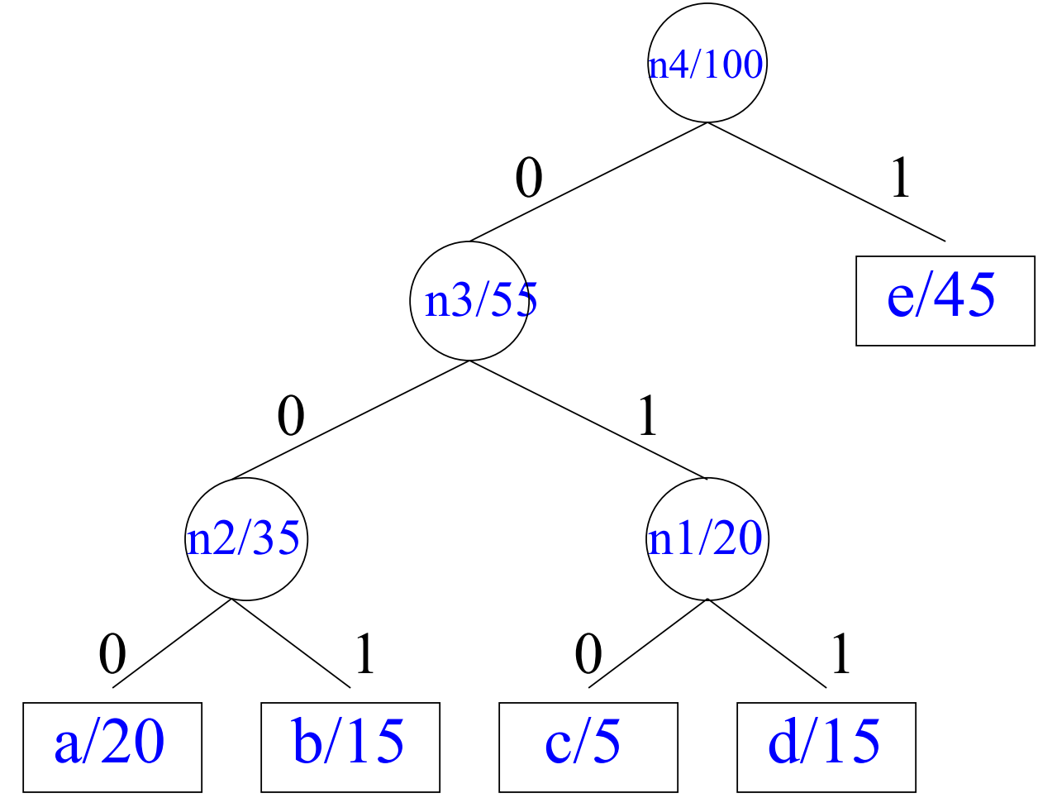
3.4.4.2 Huffman code
Alphabet is now A₂ = {n2 / 35, n1 / 20, e / 45}
Algorithm merges n1 and n2:
Alphabet is now A₂ = {n3 / 55, e / 45}
Algorithm merges e and n3 and finishes
Huffman code is:
a = 000, b = 001, c = 010, d = 011, e = 1
This is the optimum (minimum-cost) prefix
code for this distribution.

Slide 174
3.4.4.2 Huffman code: Creating Tree
Algorithm:
Place each symbol in leaf
Weight of leaf = symbol frequency
Select two trees L and R (initially leafs)
Such that L, R have lowest frequencies in tree
Create new (internal) node
Left child ⇒ L
Right child ⇒ R
New frequency ⇒ frequency( L ) + frequency( R )
Repeat until all nodes merged into one tree

Slide 175
3.4.4.2 Huffman code
Frequency of characters used in a text file:
Char
Freq
E
125
T
93
A
80
O
76
I
72
N
71
S
65
R
61
H
55
L
41
D
40
C
31
U
27

Slide 176
3.4.4.2 Huffman code
A
O
T
E
80
76
93
125
D
L
R
S
N
I
H
40
41
61
65
71
73
55
C
U
31
27

Slide 177
3.4.4.2 Huffman code
A
O
T
E
80
76
93
125
D
L
R
S
N
I
H
40
41
61
65
71
73
58
55
C
U
31
27

Slide 178
3.4.4.2 Huffman code
A
O
T
E
80
76
81
93
125
D
L
R
S
N
I
H
40
41
61
65
71
73
58
55
C
U
31
27

Slide 179
3.4.4.2 Huffman code
A
O
T
E
80
76
81
93
125
113
D
L
R
S
N
I
H
40
41
61
65
71
73
58
55
C
U
31
27

Slide 180
3.4.4.2 Huffman code
A
O
T
E
80
76
81
93
126
125
113
D
L
R
S
N
I
H
40
41
61
65
71
73
58
55
C
U
31
27

Slide 181
3.4.4.2 Huffman code
A
O
T
E
80
76
81
93
126
144
125
113
D
L
R
S
N
I
H
40
41
61
65
71
73
58
55
C
U
31
27

Slide 182
3.4.4.2 Huffman code
156
A
O
T
E
80
76
81
93
126
144
125
113
D
L
R
S
N
I
H
40
41
61
65
71
73
58
55
C
U
31
27

Slide 183
3.4.4.2 Huffman code
156
174
A
O
T
E
80
76
81
93
126
144
125
113
D
L
R
S
N
I
H
40
41
61
65
71
73
58
55
C
U
31
27

Slide 184
3.4.4.2 Huffman code
156
174
238
A
O
T
E
81
126
144
113
D
L
R
S
N
I
H
58
C
U

Slide 185
3.4.4.2 Huffman code
156
174
270
238
A
O
T
E
80
76
81
93
126
144
125
113
D
L
R
S
N
I
H
40
41
61
65
71
73
58
55
C
U
31
27

Slide 186
3.4.4.2 Huffman code
330
156
174
270
238
A
O
T
E
80
76
81
93
126
144
125
113
D
L
R
S
N
I
H
40
41
61
65
71
73
58
55
C
U
31
27

Slide 187
3.4.4.2 Huffman code
330
508
156
174
270
238
A
O
T
E
80
76
81
93
126
144
125
113
D
L
R
S
N
I
H
40
41
61
65
71
73
58
55
C
U
31
27

Slide 188
3.4.4.2 Huffman code
0
1
838
0
330
1
0
508
1
0
1
0
1
0
1
0
156
1
174
270
238
A
O
T
E
80
76
0
81
1
93
0
126
1
0
144
1
125
0
113
1
D
L
R
S
N
I
H
40
41
61
65
71
73
0
58
1
55
C
U
31
27

Slide 189
3.4.4.2 Huffman code
Use Huffman code: save 10%
Huffman encoding is a simple example of data compression: representing data in fewer bits than it would otherwise need
Char
Frequency
Fixed-length code
Huffman code
E
125
0000
110
T
93
0001
011
A
80
0010
000
O
76
0011
001
I
73
0100
1011
N
71
0101
1010
S
65
0110
1001
R
61
0111
1000
H
55
1000
1111
L
41
1001
0101
D
40
1010
0100
C
31
1011
11100
U
27
1100
11101
Sum
838
3352
3036

Slide 190
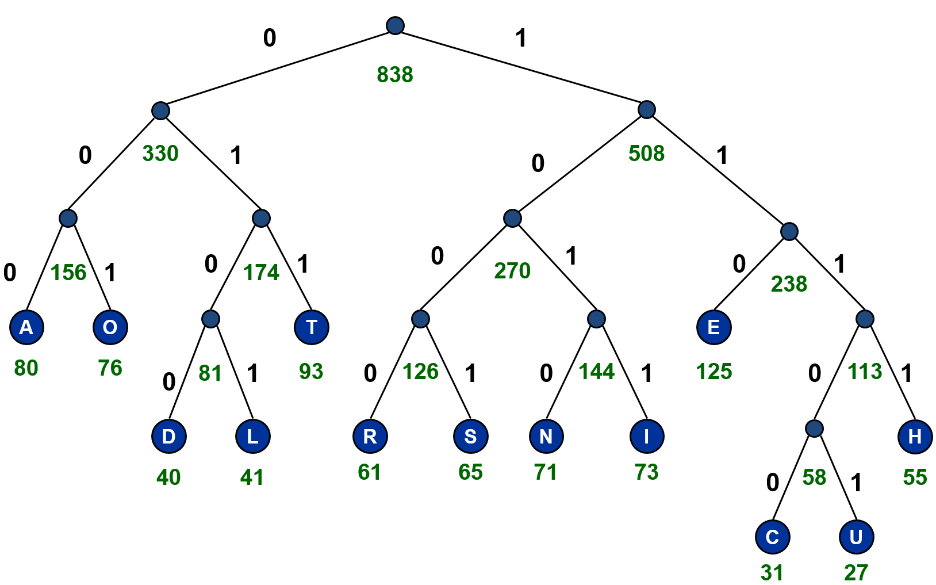
3.4.4.2 Huffman code: Decoding
Algorithm decoding:
Read compressed file & binary tree
Use binary tree to decode file
Follow path from root to leaf
Example: Decode “11100000011”
Notes:
CAT

Slide 191
Data compression
Huffman encoding is a simple example of data compression: representing data in fewer bits than it would otherwise need
A more sophisticated method is GIF (Graphics Interchange Format) compression, for .gif files
Another is JPEG (Joint Photographic Experts Group), for .jpg files
Unlike the others, JPEG is lossy—it loses information
Generally OK for photographs (if you don’t compress them too much), because decompression adds “fake” data very similar to the original

Slide 192
Infix Expressions
Used in arithmetic
Operator is placed between the operands
Parentheses are used to denote the priority of the operation
Examples
a + b
(a + b) * (a - b)
(a ^ b * (c + (d * e) - f ) ) / g
Notes:
INFIX: the expressions in which operands surround the operator, e.g. x+y, 6*3 etc this way of writing the Expressions is called infix notation. POSTFIX: Postfix notation are also Known as Reverse Polish Notation (RPN). They are different from the infix and prefix notations in the sense that in the postfix notation, operator comes after the operands, e.g. xy+, xyz+* etc. PREFIX: Prefix notation also Known as Polish notation. In the prefix notation, operator comes before the operands, e.g. +xy, *+xyz

Slide 193
Postfix Expressions
Mathematical Notation
Operator is placed after all its operands
No need of parentheses
Easy to parse as compared to infix
Examples:
Infix Expression | Postfix Expressions
a + b | a b +
(a + b) * (a - b) | a b + a b - *
(a ^ b * (b + (d * e) - f ) ) / g | a b ^ c d e * + f - * g /

Slide 194
Prefix Expressions
Mathematical Notation
Operator is placed before all its operands
No need of parentheses
Easy to parse as compared to infix
A valid prefix expression always starts with an operator and ends with an operand.
Examples:
Infix Expression | Prefix Expressions
a + b | + a b
(a + b) * (a - b) | * + a b - a b
(a ^ b * (c + (d * e) - f ) ) / g | / * ^ a b - + * d e c f g

Slide 195
Evaluating Prefix Expressions
Example 1 (a=5, b=3) | Example 2(a=4, b=2, c=5, d=6, e=7, f=8, g=3)
* + a b - a b - * + 5 3 - 5 3 * 8 2 * 8 2 16 (Answer) | / * ^ a b - + * d e c f g / * ^ 4 2 - + * 6 7 5 8 3 / * 16 - + 42 5 8 3 / * 16 - + 42 5 8 3 / * 16 - 47 8 3 / * 16 - 47 8 3 / * 16 39 3 / * 16 39 3 / 624 3 / 624 3 208 (Answer)

Slide 196
Evaluating Postfix Expressions
Example 1 (a=5, b=3) | Example 2(a=4, b=2, c=5, d=6, e=7, f=8, g=3)
a b + a b - * 5 3 + 5 3 - * 8 2 * 8 2 * 16 (Answer) | a b ^ c d e * + f - * g / 4 2 ^ 5 6 7 * + 8 - * 3 / 16 5 42 + 8 - * 3 / 16 5 42 + 8 - * 3 / 16 47 8 - * 3 / 16 47 8 - * 3 / 16 39 * 3 / 16 39 * 3 / 624 3 / 624 3 / 208 (Answer)

Slide 197
Why trees?
Upfront cost ➔ improved searching
Searching array/linked list: O(N)
Binary search tree: longer setup, shorter search
Reason for shortened search is that nodes on other
branches are not iterated through
Become Rich
Force Others to be Poor
Rob
Banks
Stock
Fraud
Notes:
Chapter 4. Tree • Tree data structure definition • General tree representation • Pre-Order, In-Order, Post-Order traversal on trees • Implementation of basic operations on a tree: node insertion, compute height, depth of a node, count number of nodes, leaf nodes • Binary tree

Slide 198
H
D
K
B
F
H | D | K | B | F | J | NULL | NULL | NULL | A | NULL | NULL | C | NULL
0 | 1 | 2 | 3 | 4 | 5 | 6 | 7 | 8 | 9 | 10 | 11 | 12 | 13 | 14 | ………………… | 25 | 26
Right child of K
left child of J
Left child of C
Right child of C

Slide 199
3.2. Tree representation : Leftmost-Child, Right-Sibling representation
A
B
C
D
A
E
F
G
H
I
B
C
D
J
K
L
E
F
G
H
I
J
K
L

Slide 200
Infix, Prefix, and Postfix Notation
represent complicated expressions using an ordered rooted tree (typically binary)
Algebraic expressions
preorder – Polish notation
inorder – infix notation
postorder – reverse Polish notation

Slide 201
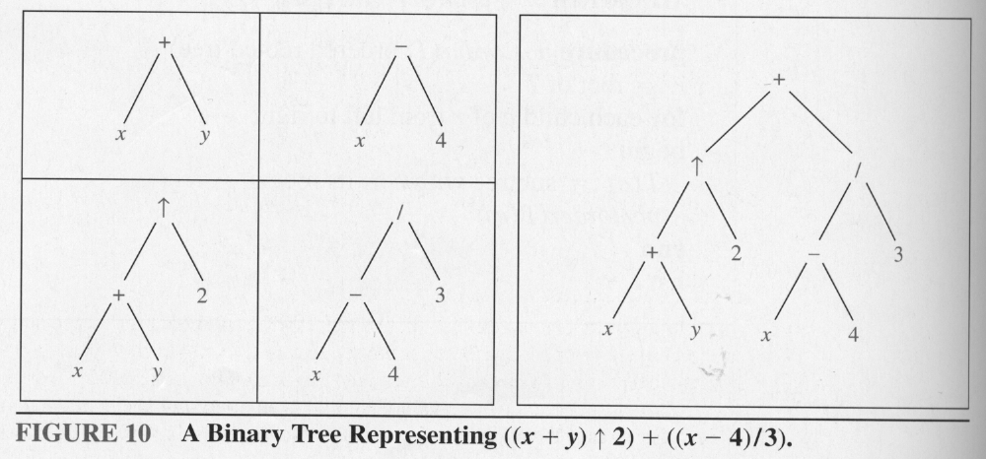
Express in:
Polish
infix
reverse Polish

Slide 202
Evaluate postfix expression 7 2 3 * - 4 ^ 9 e / +

