Slide 1

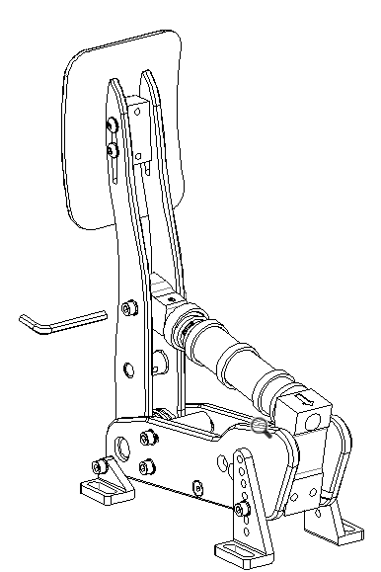
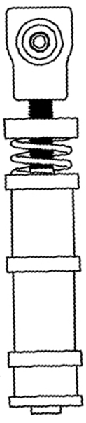
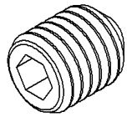
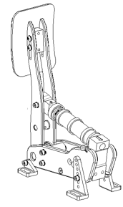
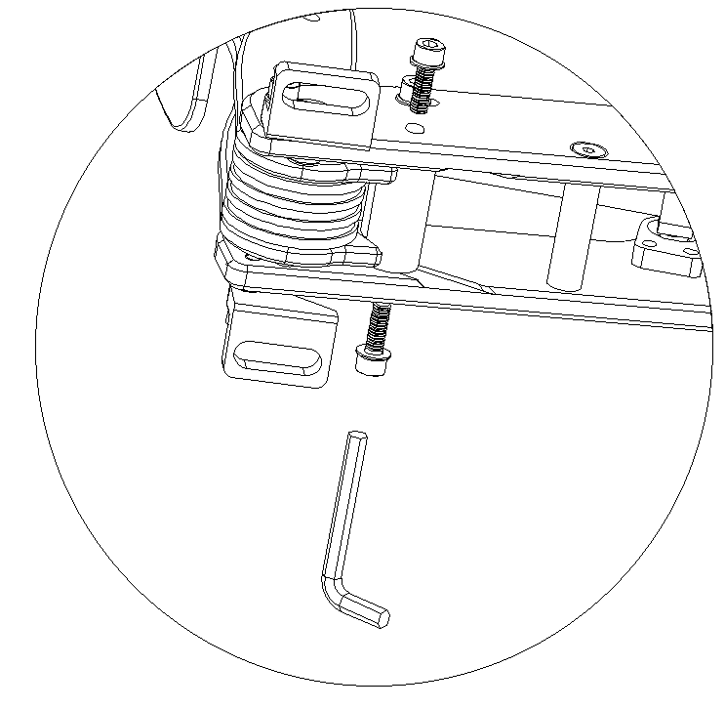
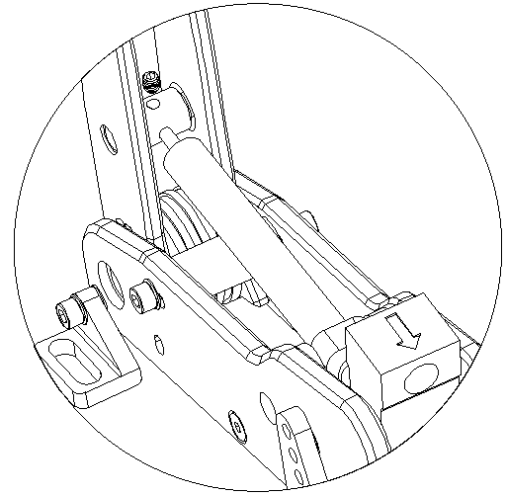
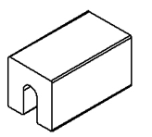
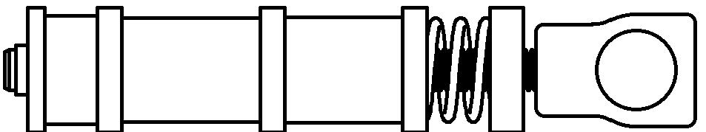

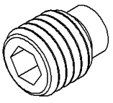
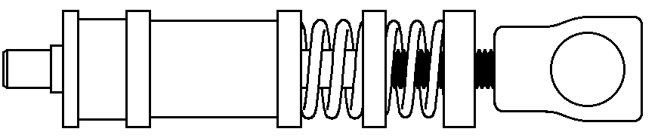
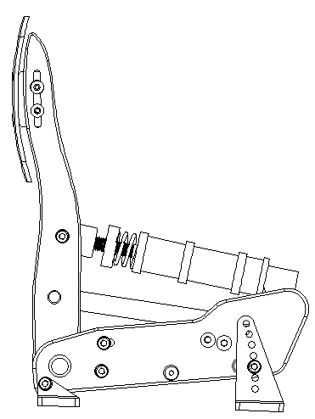
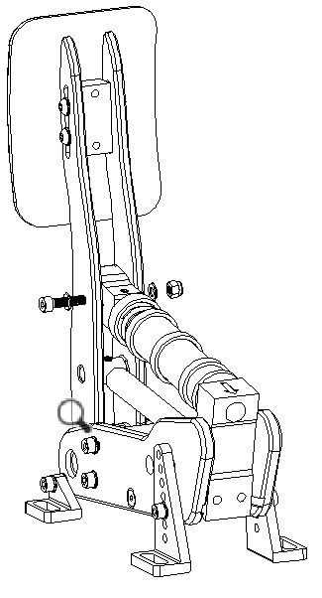
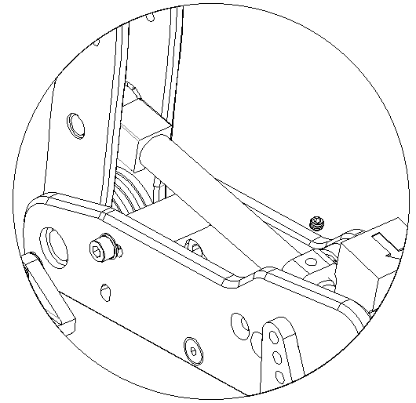
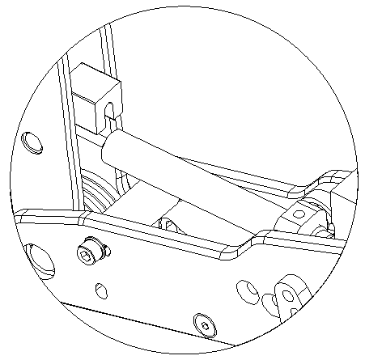
Parts needed to install the damper to your Brake unit
Step 1: Remove the elastomer stack
Step 2: Choose a suitable combination of springs and elastomers
Step 3: Remove the bumpstop
Step 4: Install the damper
Damper
3 combinations are recommended but feel free to mix and match to find the perfect combo for you:
Remove the 2 hex bolts on the sides, push the pedal arm backwards and slide the blue bumpstop downwards
Insert the piston shaft into the hole and tighten with the grub screw
Twist the damper into the large threaded hole
3D printed spacer
Option 1 stiffest: 2.5mm spring + 2 elastomers
Option 2 stiffer: 3mm spring + 2 elastomers
M5x4 plastic-headed grub screw
Option 3 soft: 2.5mm spring + 3mm spring + 1 elastomer
M5x6 flat-headed grub screw
Step 9: Adjust the height of the pedal face
Step 8: Re-install the elastomer stack
Step 7: Re-install the bumpstop.
Step 6: Tighten the damper and remove the spacer
Step 5: Adjust the damper
Step 6.1: Fix the damper in place by screwing in the plastic- headed grub screw
Step 5.2: Tighten the whole damper until it touches the spacer
Reinstall the stack and adjust the preload to your liking.
Step 6.2: Remove the spacer.
Step 5.1: Insert the 3D printed spacer.

