Slide 1

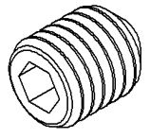
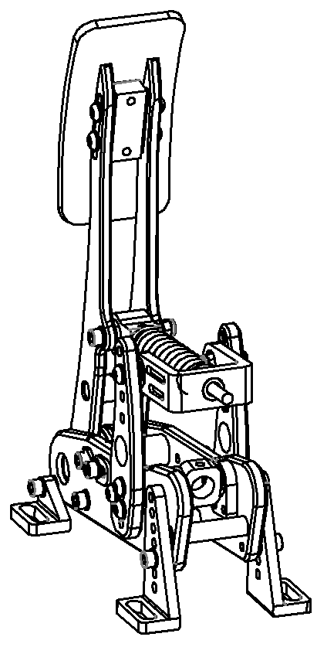
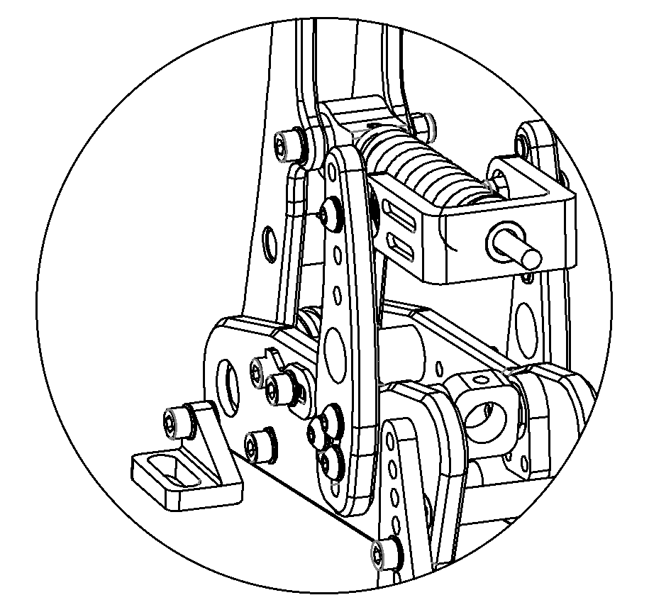
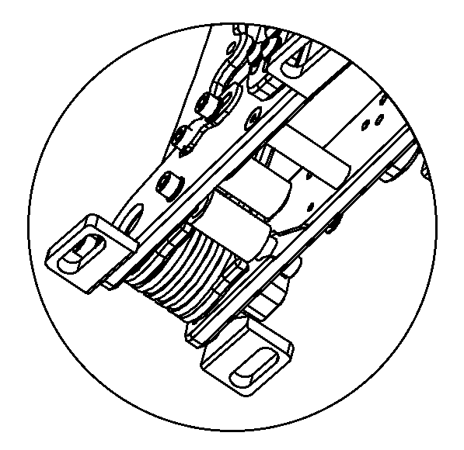
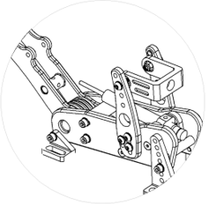
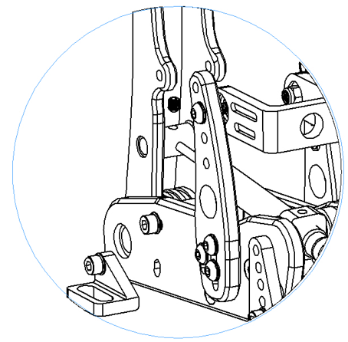
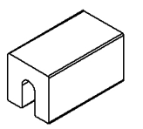
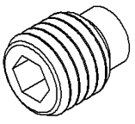
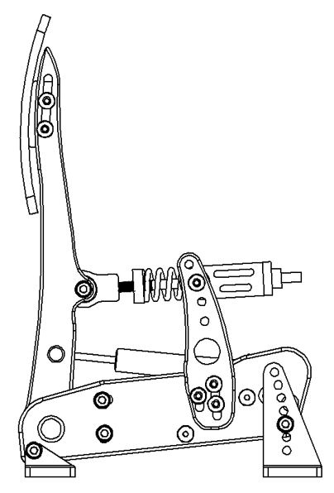
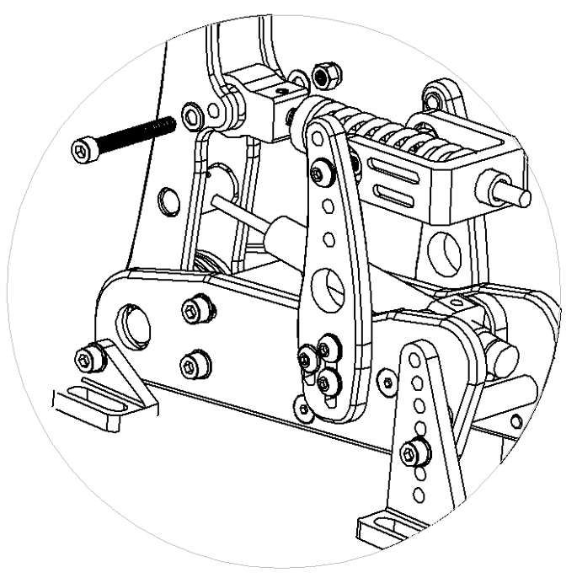
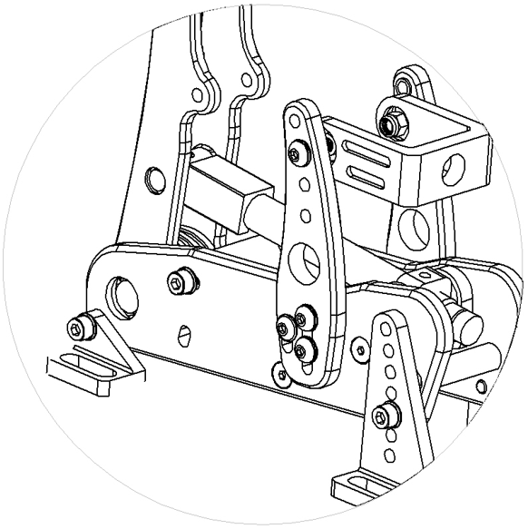
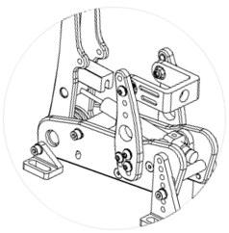
Parts needed to install the damper to your Clutch unit.
Step 1: Remove the spring
Step 2: Remove the bumpstop
Step 3: Install the damper
Remove the nut, bolt and washers to uninstall the spring
Remove the 2 hex bolts on the sides, push the pedal arm backwards and slide the blue bumpstop downwards
Twist the damper into the large threaded hole
Insert the smaller end of the piston into the hole and tighten with the flat-headed grub screw
M5x6 flat headed grub screw
Damper
3D printed spacer
M5x4 plastic-headed grub screw
M5x4 flat-headed grub screw
Step 9: Adjust the height of the pedal face
Step 8: Re-install the springs
Step 7: Re-install the bumpstop.
Step 6: Tighten the damper and remove the spacer
Step 4: Adjust the damper
Push the pedal arm backwards, slide the blue bumpstop back in place and tighten the bolts
Fix the damper in place by screwing in the plastic- headed grub screw
Step 4.1: Insert the 3D printed spacer.
Step 4.2: Tighten the whole damper until it touches the spacer
Remove the spacer.

