Slide 1


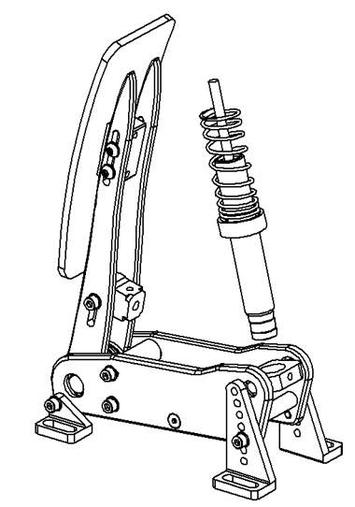
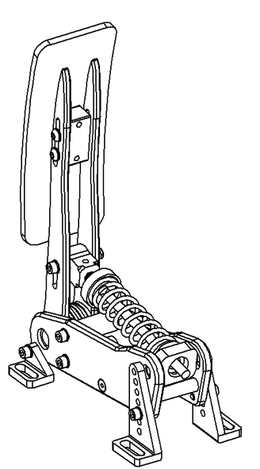
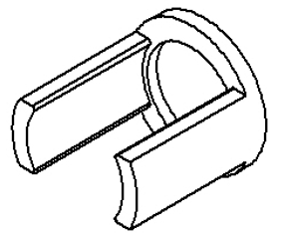
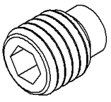
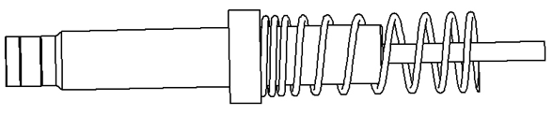
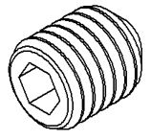
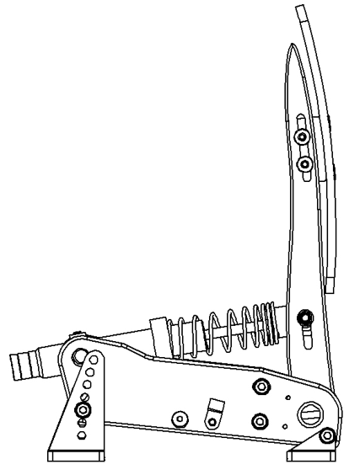
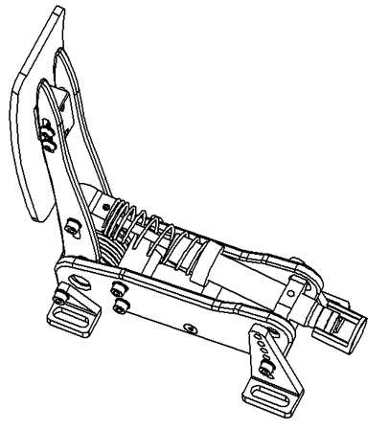
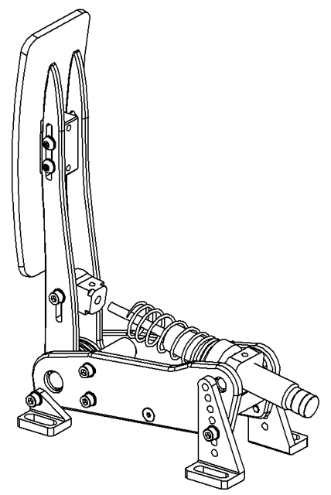
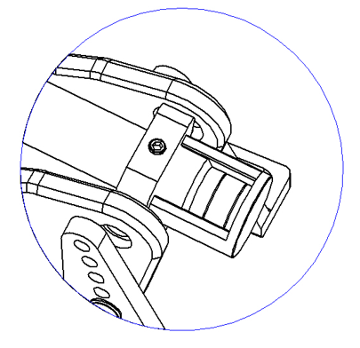
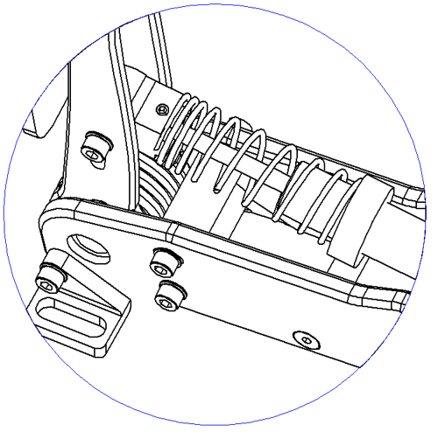
Parts needed to install the damper to your Clutch unit.
Step 1: Remove the spring
Step 2: Replace the spring assembly with the damper cylinder
Step 3: Install the damper
Step 1.1: Remove the grub screw
Twist the damper into the large threaded hole
Damper
3D printed spacer
Step 3: Remove the spring assembly from the throttle unit
Install the included spring to the damper to replace the basic spring assembly.
Throttle Unit
M5x4 plastic-headed grub screw
Rotate the damper bracket so that it faces upwards
M5x4 flat-headed grub screw
Step 1.2: Loosen the spring preload
Step 4: Fix the damper rod’s end to the pedal arm
Step 6: Adjust the pedal face
Step 5: Adjust the damper
Loosen the 4 screws on the sides behind the pedal face, choose a suitable pedal height, then tighten.
Push the 3D printed adjuster into the cylinder and twist until it touches the damper bracket. Tighten using the grub screw and remove the adjuster.
Insert the damper rod’s end into the hole and tighten with the grub screw

