Slide 1
Investigation report for porting ONNX runtime 1.0.0 on python/C#
Apr-15, 2020
Hoaphan
AI Project - SS32
Renesas Electronics Corporation

Slide 2
Agenda
Prepare test data file for python Page 3
Prepare test data file for C# Page 4
Porting onnxruntime 1.0.0 on python Page 5
Porting onnxruntime 1.0.0 on C# Page 7

Slide 3

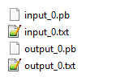
Prepare test data file for python
  This investigation report will run sigmoid on Python, so need to prepare the Input/output data
    Unzip the attached test_data_set_0.zip:
    Put the convert_pb_to_txt_sigmoid.py on the folder as below:
    Run command to convert: python3 convert_pb_to_txt_sigmoid.py
    The convert_pb_to_txt_sigmoid.py script will convert .pb file to .txt file

Slide 4

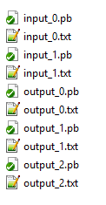
Prepare test data file for C#
  This investigation report will run TinyYolov3 on C#, so need to prepare the Input/output data
    Download test Moldel and test data from: https://github.com/onnx/models/raw/master/vision/object_detection_segmentation/tiny_yolov3/model/yolov3-tiny.tar.gz
    Untar the download file and put to folder as below:
    Run command to convert: python3 convert_pb_to_txt_Yolov3.py
    The convert_pb_to_txt_Yolov3.py script will convert .pb file to .txt file

Slide 5
Porting onnxruntime 1.0.0 on python
  Install onnx before using onnxruntime
    git clone https://github.com/onnx/onnx.git
    git checkout remotes/origin/rel-1.7.0 -B rel-1.7.0
    python3 setup.py install
  Build onnxruntime:
    git clone --recursive https://github.com/Microsoft/onnxruntime
    cd onnxruntime
    git checkout remotes/origin/rel-1.0.0 –B rel-1.0.0
    ./build.sh --config RelWithDebInfo --build_shared_lib --build_wheel --build_csharp --parallel

Slide 6

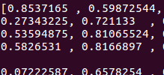

Porting onnxruntime 1.0.0 on python
  Run onnx model on python:
    Get Load_predict.py and model.onnx
    Modify the link data in Load_predict.py
    Run script: python3 Load_predict.py
    The result are the same between output data and expected data

Slide 7
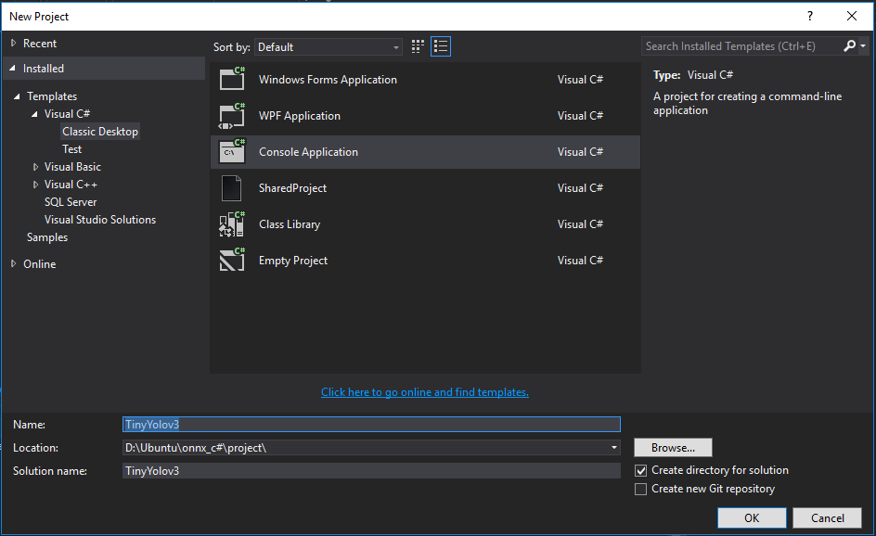
Porting onnxruntime 1.0.0 on c#
  Open MS visual studio
  Create new project TinyYolov3

Slide 8
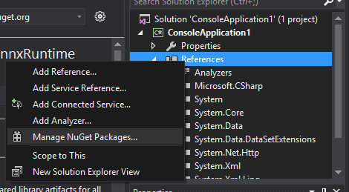
Porting onnxruntime 1.0.0 on c#
  Add CPU Nuget: Microsoft.ML.OnnxRuntime (this step to install pre-built lib of C#)
    Open Solution Explorer
    right-click References and select Manage NuGet Packages...

Slide 9
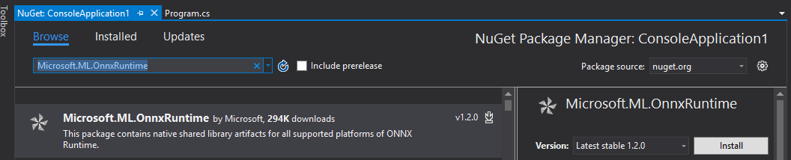
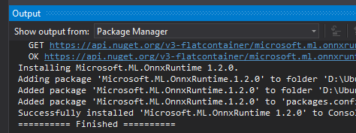
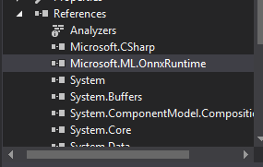
Porting onnxruntime 1.0.0 on c#
    Search Microsoft.ML.OnnxRuntime and install
  Finish install:

Slide 10
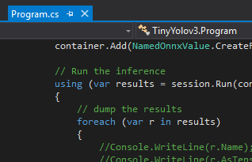
Porting onnxruntime 1.0.0 on c#
  Update file Program.cs as attached file
  Modify the Program.cs to update the link to Model, input file, output file as below:

Slide 11
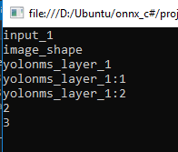



Porting onnxruntime 1.0.0 on c#
    Output file:
  Run program:
    Console:
  Compare the output file with the expected output file in page4
    The result are the same:

Slide 12
Renesas.com

