Slide 1
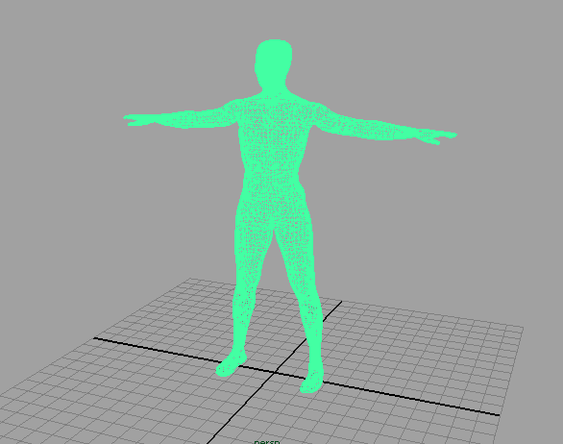
Loading 3D models

Slide 2
*.obj files
Geometric vertices (v -0.587239 8.097115 -0.797167)
Texture vertices (vt 0.025000 0.500000)
Vertex normals (vn 0.624564 -0.235630 -0.744580)
Polygons (f 1/1/1 2/2/2 4/4/3)

Slide 3
Demonstration..

