Slide 1
Animating human model in OpenGL using data from motion capture system
Algirdas Beinaravičius
Gediminas Mazrimas

Slide 2
Contents
Introduction
Motion capture and motion data
Used techniques
Animating human body
Problems

Slide 3
Introduction. Project tasks
Motion capturing
Human body model animation
Skeletal, joint-based structure
Animation program environment (C++/OpenGL)
Data interpretation
Model deformations

Slide 4
Human body animation movie

Slide 5
Motion capture and motion data
Motion capture
What is Mocap?
Mocap in everyday life and in our project
Various motion capture systems
Optical, Magnetic, Mechanical, Inertial
Motion capture using Vicon Motion System
Major elements of Vicon mocap system:
Cameras
Suit with retroreflective markers
System preparations
Setting up cameras and system calibration
Capturing
Post-processing

Slide 6
Motion data
Various motion data formats
Used formats
Default C3D format for Vicon Motion System
BVH format. Getting from C3D to BVH.

Slide 7
Used techniques
Linear blend skinning
Quaternions
Parametric representation of lines in 3D space
Inverse kinematics

Slide 8
Linear blend skinning
Skin deformations
Anatomy (layer) based deformations
Direct skin deformation
Linear blend skinning
Different implementations

Slide 9
Hidden. Anatomy based skin deformation
The anatomy based technique tries to mimic the muscle structure of a human. Normally 3 layers are used: skeleton, muscles+fat, skin. This approach usually works by layering
Individual muscles on the skeleton deform (stretch or bulge) following the motion of the skeleton. The final skin takes the overall shape of the muscle and fat layer of the animated character body.
Hard to implement as need big accuracy on following realistic muscle deformations.

Slide 10
Hidden. Direct skin deformation
Deforming skin directly on the movement. LBS was publicly introduced by the game community, remains very popular because of fast computation speeds, but has it’s problems.
Named differently: Subspace Deformation, “smooth skinning”
Larger angles cause serious artifacts: collapsing elbow, candy-wrapper.
Solutions: adding extra transformation (joint, maybe also used for muscles), direct assignment of weight around the joint – manual labeling and different formula, interpolating transformations (using rotation/translation matrices directly in algorithm) and using quaternions as we did.

Slide 11
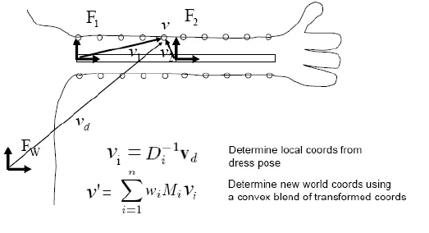
Linear blend skinning
Before animation:
Mesh model and skeleton in T-pose
Mesh vertices assigned influencing joints with weights

Slide 12
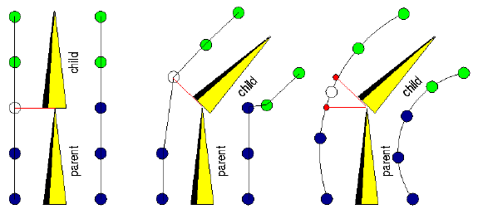
Linear blend skinning Deformation

Slide 13
Quaternions

Slide 14
Parametric representation of lines in 3D space

Slide 15
Inverse kinematics

Slide 16
Animating human body

Slide 17
Animating human body Our approach to linear blend skinning

Slide 18
Problems
Initial BVH pose
Exploding knee problem
Mesh connections collapsing on complex deformations

Slide 19
Problems Initial BVH pose

Slide 20
Problems Exploding knee problem

Slide 21
Problems Mesh connections collapsing on complex deformations

Slide 22
Questions, comments
?

