Slide 1
Animating human model in OpenGL using data from motion capture system
Algirdas Beinaravičius
Gediminas Mazrimas

Slide 2
Contents
Introduction
Motion capture and motion data
Used techniques
Animating human body
Problems
Conclusion and future work

Slide 3
Introduction. Project tasks
Motion capturing
Human body model animation
Animation program environment (C++/OpenGL)
Data interpretation
Skeleton and its motion
Model mesh (skin) and its deformations

Slide 4
Hidden. Introduction. Project tasks
Project has two main task:
Using mocap system capture motion data and to be able to animate character using it. Mocap data gives us opportunity to achieve very realistic body movements.
Create an application that would use this motion data. We chose to animate a human body model in an application that we wrote using C++ programming language in OpenGL environment. This application had to parse and correctly interpret mocap data, cope with various skin deformation problems. Simplified linear blend skinning technique was used for this. Whole character had a joint based skeleton structure with rigid body parts – bones, that are rotated during motion.

Slide 5
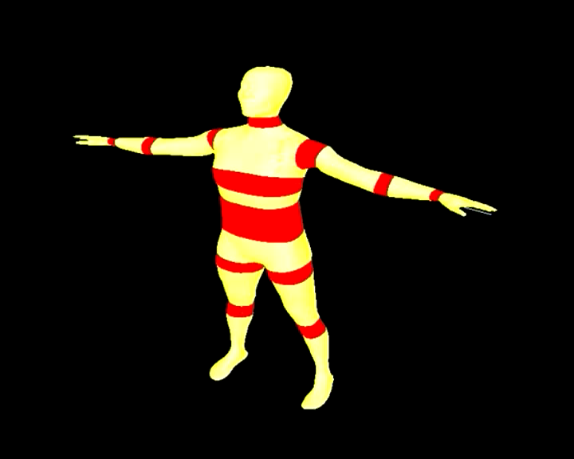
Human body animation movie

Slide 6
Motion capture and motion data
Motion capture
What is Mocap? Where it is used?
Various motion capture systems
Optical, Magnetic, Mechanical, Inertial
Motion capture using Vicon Motion System
Basic Vicon MX system model
+ Suit with retroreflective markers

Slide 7
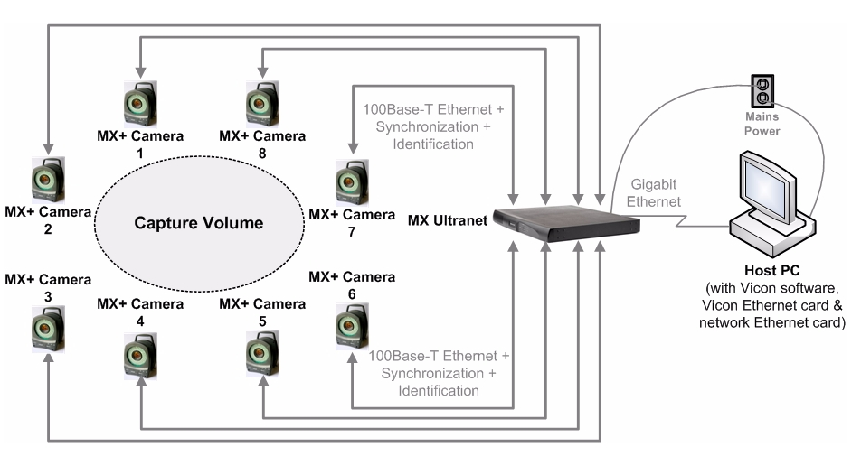
Motion capture system Basic Vicon MX system model

Slide 8
Hidden. Motion capture
Mocap – records movements and converts them into digital data.
Used in various areas, such as entertainment, military, sports, medicine. We used it for capturing body movements and then using captured data animating human model in our application.
Various motion capture systems are available:
Optical – either reflecting (markers reflect light emitting diodes on the cameras) or light emitting markers (markers are diodes) used on capture subjects. -> High rate, accurate, free movement in capture volume, but post-processing required, lightning must be controlled, markers can be invisible sometimes.
Magnetics – magnetic trackers, no post-processing required, markers not occluded, but lower sampling rate, tend to be noisy and can be interfered.
Mechanical – directly tracks body joint angles, skeletal-like structure is attached. Large capture range, cheaper, but provides no global translations, restricts subjects movements.
We used Optical Vicon MX motion capture system with retro-reflective markers, placed on special suit for better accuracy. System consisted of 8 cameras, special ultranet adapter and host pc with Vicon IQ2.5 software.

Slide 9
Motion data
Various motion data formats
C3D, ASF/AMC, BVH, FBX
Used formats
Default C3D format for Vicon Motion System
Binary format, saves 3D coordinates
BVH format. Getting from C3D to BVH
Saves hierarchy (skeleton joint structure) and transformation data

Slide 10
Motion data BVH Hierarchy section
HIERARCHY
ROOT Hips
{
OFFSET 0 34.322 0
CHANNELS 6 Xposition Yposition Zposition Zrotation Xrotation Yrotation
JOINT LeftHip
{
OFFSET 4.587 -1.043 0
CHANNELS 3 Zrotation Xrotation Yrotation
JOINT LeftKnee
{
OFFSET 3.09 -15.571 0
CHANNELS 3 Zrotation Xrotation Yrotation
JOINT LeftAnkle
{
OFFSET 2.179 -16.111 -2.139
CHANNELS 3 Zrotation Xrotation Yrotation
JOINT LeftAnkle_End
{
OFFSET 0 -0.867 1.597
CHANNELS 3 Zrotation Xrotation Yrotation
End Site
{
OFFSET 1 0 0
}
}
}
}
}
JOINT RightHip
{
...
}
...
}

Slide 11
Motion data BVH Motion section
Frames: 1289
Frame Time: 0.033333
19.8598 80.309 -11.521 -0.661911 0.799904 171.213 -1.85002 2.52617 10.7515 3.17067 -1.01583e-010 -10.2854 -1.58501 -1.94847 -0.0287346 0 0 0 -0.0555542 2.6936 -11.4833 -0.562183 1.22223e-006 11.8361 0.284375 -1.65435 -0.00579677 0 0 0 -1.25693 6.24787 -0.51793 3.27727 -16.0419 -1.36162 14.6579 0.0301162 -3.60178 -5.21488 6.12318 -3.03665 2.47876 0.000451064 -6.17142e-006 -0.509607 -8.47663 0.248473 0 0 0 -15.7988 1.60936 -7.32667 1.93902 -8.80292 5.13737 -1.30308 7.39538e-009 8.53796e-007 0.267783 -4.03835 0.26339 0 0 0 0.258752 -0.0812672 0.831621 12.5445 1.71161 -2.09692 0 0 0
19.8771 80.2868 -11.5326 -0.700186 0.756134 171.114 -1.84667 2.51303 10.794 3.13528 -1.01593e-010 -10.2526 -1.58653 -1.95993 -0.0287348 0 0 0 -0.0627105 2.65564 -11.4946 -0.56617 1.2219e-006 11.9114 0.31303 -1.66464 -0.0057968 0 0 0 -1.29175 6.15499 -0.450865 3.47648 -15.6579 -1.30103 14.4269 0.0330917 -3.62714 -5.39613 6.06833 -2.95956 2.27028 0.000451064 -6.17142e-006 -0.527485 -7.40878 0.0488122 0 0 0 -15.6207 1.62543 -7.46368 1.75456 -9.10966 5.12076 -1.08476 7.39538e-009 8.53796e-007 0.274961 -4.00089 0.215719 0 0 0 0.444407 -0.387448 0.74024 12.1183 2.50324 -2.11188 0 0 0
…

Slide 12
Hidden. Motion data
Various motion data file formats are available:
C3D – binary format, that stores 3D coordinates and any numerical data.
ASF/AMC and BVH – both ASCII and stores data in a hierarchical data structure (i.e. skeleton).
FBX – previous file formats were developed specifically for motion capture, this one is for 3D in general. Any previous format can be converted in to this one.
During project we’ve to work with two the mentioned file formats. C3D was data that we got from Vicon IQ software and then, using 3rd party application it was converted into BVH file. Because BVH was the simplest one of all the mentioned and fulfilled all the requirements – we used it in our application program.
As we had to fully parse and interpret this motion data file – I’ll introduce you to its structure.
Offset – determines initial joint position
Channels – defines transformation data for the joint in the motion section of the file.

Slide 13
Used techniques
Parametric representation of lines in 3D space
Linear blend skinning
Quaternions
Forward kinematics

Slide 14
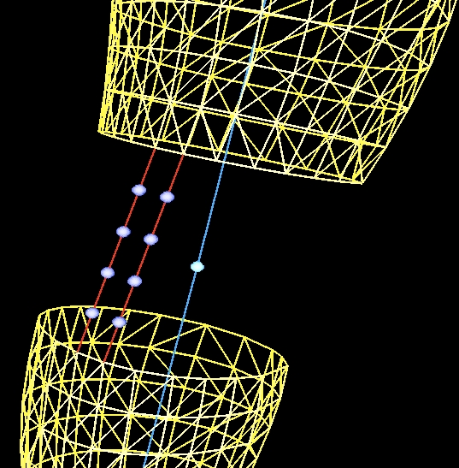
Parametric representation of lines in 3D space
Line segment connects separate mesh body parts
Each vertex on the segment is influenced by our LBS algorithm

Slide 15
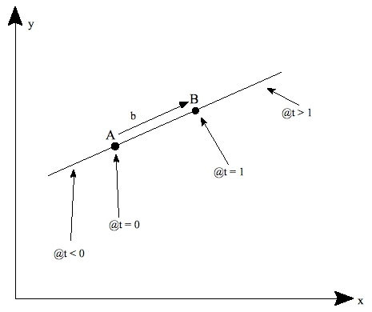
Parametric representation of lines in 3D space
Parametric representation of the line:
L(t) = A + b * t
A – starting point, b = B – A vector, t - parameter
A and B could be taken as two points on two separate meshes.
By scaling t – proportional vertex positioning along the line is achieved.

Slide 16
Hidden. Line representation
As our human body model mesh was cut in separate body part meshes, we had to connect these parts all together in order to get complete and full-scale character. To achieve this we used parametric representation of lines in 3D space method. Basically we connected together vertices of two separate body parts by these lines (or we could call them segments). Parametric representation also helped us evenly distribute vertices on this line, that later were used by our skinning algorithm.

Slide 17
Linear blend skinning
Skin deformations
Anatomy (layer) based deformations
Direct skin deformation
Linear blend skinning and its different implementations
Artifacts of the algorithm

Slide 18
Hidden. Anatomy based skin deformation
The anatomy based technique tries to mimic the muscle structure of a human. Normally 3 layers are used: skeleton, muscles+fat, skin. This approach usually works by layering
Individual muscles on the skeleton deform (stretch or bulge) following the motion of the skeleton. The final skin takes the overall shape of the muscle and fat layer of the animated character body.
Hard to implement as need big accuracy on following realistic muscle deformations.

Slide 19
Hidden. Direct skin deformation
Deforming skin directly on the movement. LBS was publicly introduced by the game community, remains very popular because of fast computation speeds, but has it’s problems.
Named differently: Subspace Deformation, “smooth skinning”
Larger angles cause serious artifacts: collapsing elbow, candy-wrapper.
Solutions: adding extra transformation (extra joint, also used for muscles) – that helps to minimize deformation angle, direct assignment of weight around the joint – manual labeling after observations and different formula, interpolating transformations (using rotation/translation matrices directly in algorithm) and using quaternions as we did.

Slide 20
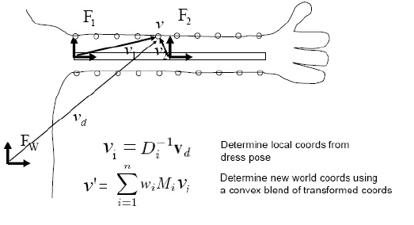
Linear blend skinning
Before animation:
Mesh model and skeleton in T-pose
Mesh vertices assigned influencing joints with weights

Slide 21
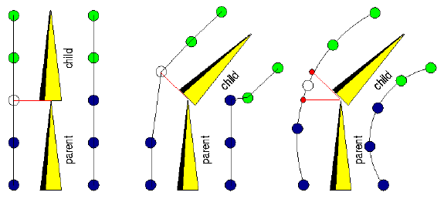
Linear blend skinning Deformation

Slide 22
Quaternions
Replace three separate (Z, Y, X) rotations with a single rotation.
Solve the gimbal lock problem.

Slide 23
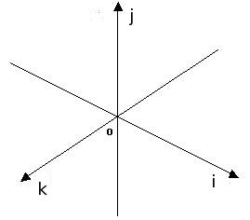
Quaternions. What is quaternion?
Four scalars.
q = a + i * b + j * c + k * d
a – real dimension
i * b, j * c, k * d – imaginary dimensions

Slide 24
Quaternions. Algebra (multiplication)
i * i = j * j = k * k = -1
i * j = k
j * i = -k
j * k = i
k * j = -i
k * i = j
i * k = j
(a + i∗b + j∗c + k∗d) ∗ (e + i∗f + j∗g + k∗h) =
(a ∗e - b∗f - c∗g - d∗h) + i∗(a∗f + b∗e + c∗h - d∗g) + j∗(a∗g- b ∗h + e∗c + d∗f) + k∗(a∗h + b∗g - c∗f + e∗d)

Slide 25
Quaternions. Rotation
Quaternion multiplication represents a rotation.
q1 – representation of rotation around X axis
q2 – representation of rotation around Y axis
q3 – representation of rotation around Z axis
q = q1 * q2 * q3 – representation of rotation around Z Y X axes.

Slide 26
Quaternions. Last bits…
q = a + i * b + j * c + k *d
a = cos(angle / 2)
b = axisX * sin(angle / 2)
c = axisY * sin(angle / 2)
d = axisZ * sin(angle / 2)
angle = arccos(a) * 2
sinA = sqrt(1 – a*a)
vectorX = b/sinA
vectorY = c/sinA
vectorZ = d/sinA

Slide 27
Gimbal lock
Rotation ends up with unsuspected results
Axes of rotations lock together

Slide 28
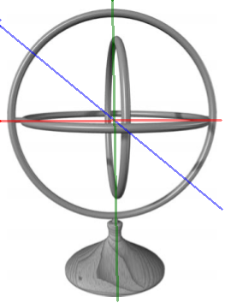
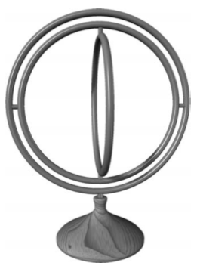
Gimbal lock. Explained Visually

Slide 29
Forward kinematics
Technique, used to position body parts in 3D scene
Each joint has its local transformation
Global transformation of each joint depends on it’s parent transformation

Slide 30
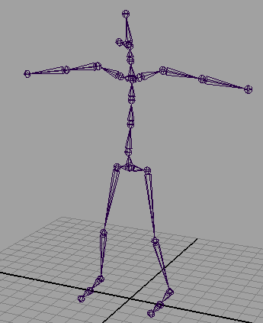
Forward kinematics.
From a mathematical point of view:
M^{n}_{global} = Π^{n}_{i=0}M^{i}_{local}
n – current joint in the hierarchy

Slide 31
Animating human body

Slide 32
Animating human body Mesh model data, OBJ format
Geometry definition file format
Open ASCII format
Supported by many 3D modelling applications

Slide 33
Animating human body Mesh model data, OBJ format
v -0.756447 0.702621 0.047024
vt 0.487840 0.942165 0.000000
vn 0.149280 -0.186998 -0.240511
f 6/9/6 2/5/2 1/1/1

Slide 34
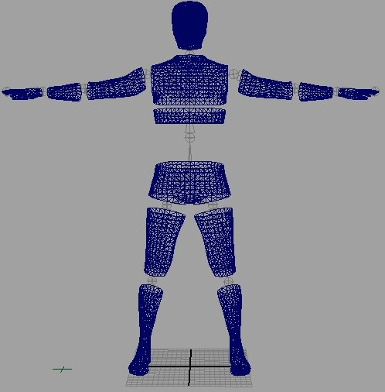
Animating human body Human body mesh model
Continuous body mesh model was cut in separate body parts.
Vertices on the lines connecting these parts are influenced on deformation.
T-pose is required

Slide 35
Animating human body Initial program phase
Generate new skeleton image with big joints, define joint structure, define putting mesh over the skeleton?

Slide 36


Animating human body Our approach to linear blend skinning
Every vertex on the connecting line is assigned a weight (by its position on the line)
P=1..N
Rotation angle for each vertex:
RotA = A*w, A – joint rotation angle
Our final LBS formula:

Slide 37
Problems
Initial BVH pose
Exploding knee problem
Mesh connections collapsing on complex deformations

Slide 38
Problems Initial BVH pose
Initial pose was I-pose, while we needed T-pose:
Caused problems while connecting separate mesh body parts and associating vertices with joints.
Noticed only BVH file import into our program (most of the 3rd party application programs starts at frame 1).
Solution:
Joint offsets in hierarchical skeleton structure had to be changed. After that all rotations also had to be recalculated.

Slide 39
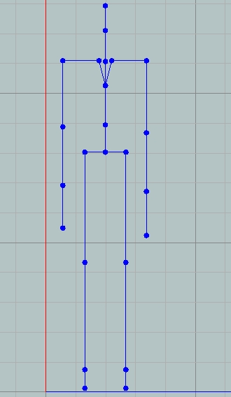
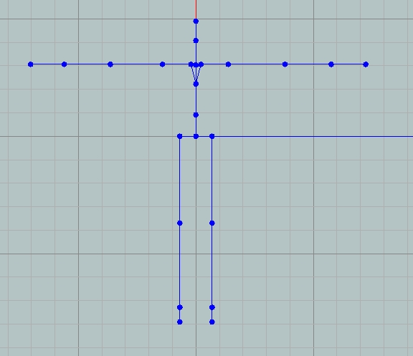
Problems Initial BVH pose

Slide 40
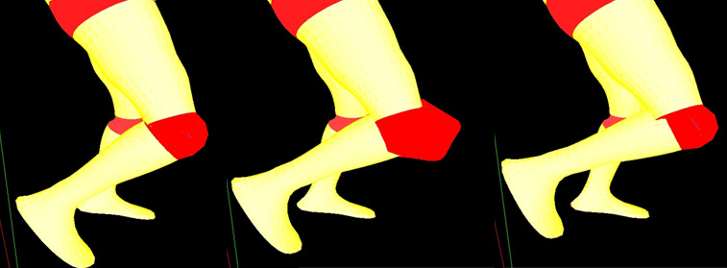
Problems Exploding knee problem
Appeared:
Overall rotation calculated as 3 separate around Z, Y and X axes.
“Gimbal lock” caused faulty vertices positions on LBS algorithm.
Solution:
Use of quaternions and additional filter for rotation angle.

Slide 41
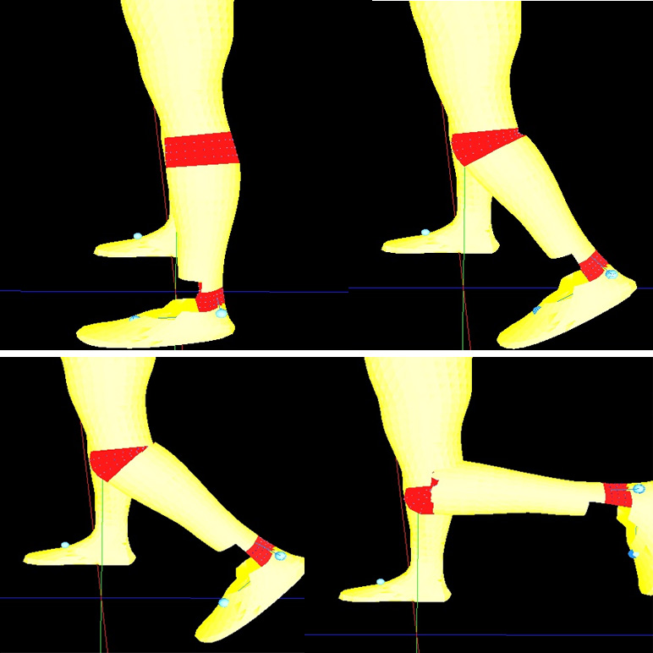
Problems Mesh connections collapsing on complex deformations
Primary tests of our Linear Blend Skinning algorithm (rotation only around 1 axis)

Slide 42
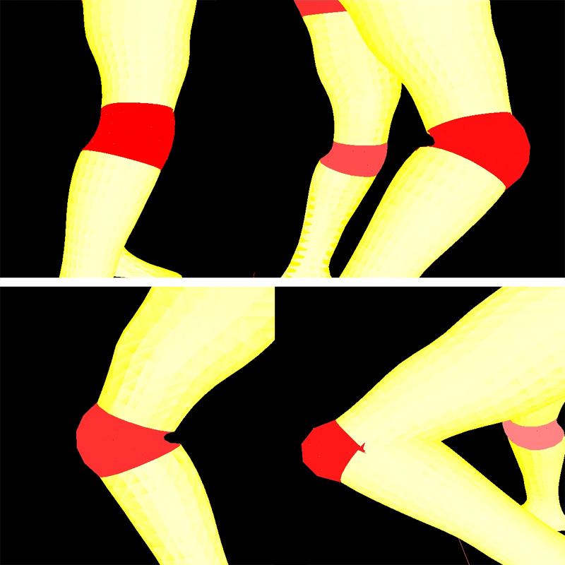
Problems Mesh connections collapsing on complex deformations
Algorithm results with rotations around all 3 axes.

Slide 43
Problems Mesh connections collapsing on complex deformations
Possible solutions for current algorithm:
Defining different weight values for vertices
Cutting mesh body parts differently (cutting out less)

Slide 44
Conclusion and future work
Main project tasks achieved, though various improvements are possible:
More detailed body animation and skin deformations
Integrate facial animation
Skinning algorithm improvement
Live streaming from mocap system

Slide 45
Questions, comments
?

