Slide 1
Linux Basics
WeeSan Lee <weesan@cs.ucr.edu>

Slide 2
Roadmap
What is Unix?
What is Linux?
Which Linux Distribution is better?
Fish vs. Fishing
Basic Commands
Vi and Emacs
Q&A
References

Slide 3
What is Unix?
A multi-task and multi-user Operating System
Developed in 1969 at AT&T’s Bell Labs by
  Ken Thompson (Unix)
  Dennis Ritchie (C)
  Douglas Mcllroy (Pipes - Do one thing, do it well)
Some other variants: System V, Solaris, SCO Unix, SunOS, 4.4BSD, FreeBSD, NetBSD, OpenBSD, BSDI

Slide 4

What is Linux?
A clone of Unix
Developed in 1991 by Linus Torvalds, a Finnish graduate student
Inspired by and replacement of Minix
Linus' Minix became Linux
Consist of
  Linux Kernel
  GNU (GNU is Not Unix) Software
  Software Package management
  Others
http://www.linuxdevices.com/files/misc/ibm-watchpad.jpg

Slide 5

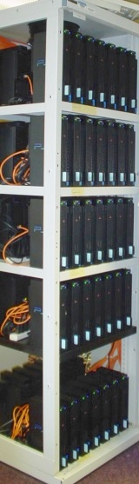
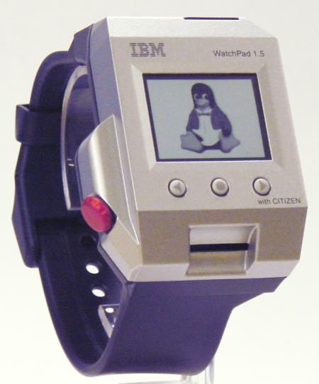
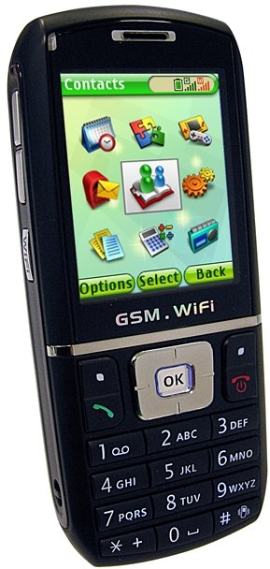
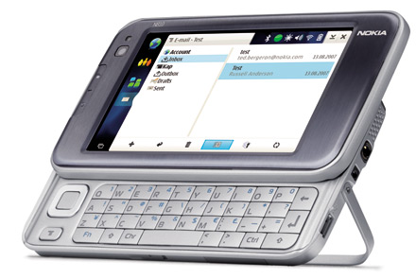
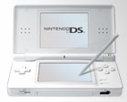


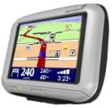
What is Linux?
Originally developed for 32-bit x86-based PC
Ported to other architectures, eg.
  Alpha, VAX, PowerPC, IBM S/390, MIPS, IA-64
  PS2, TiVo, cellphones, watches, Nokia N810, NDS, routers, NAS, GPS, …
* See references at the end
for the corresponding websites.

Slide 6
Which Linux Distribution is better?
> 300 Linux Distributions
  Slackware (one of the oldest, simple and stable distro.)
  Redhat
    RHEL (commercially support)
    Fedora (free)
  CentOS (free RHEL, based in England)
  SuSe ( based in German)
  Gentoo (Source code based)
  Debian (one of the few called GNU/Linux)
  Ubuntu (based in South Africa)
  Knoppix (first LiveCD distro.)
  …

Slide 7
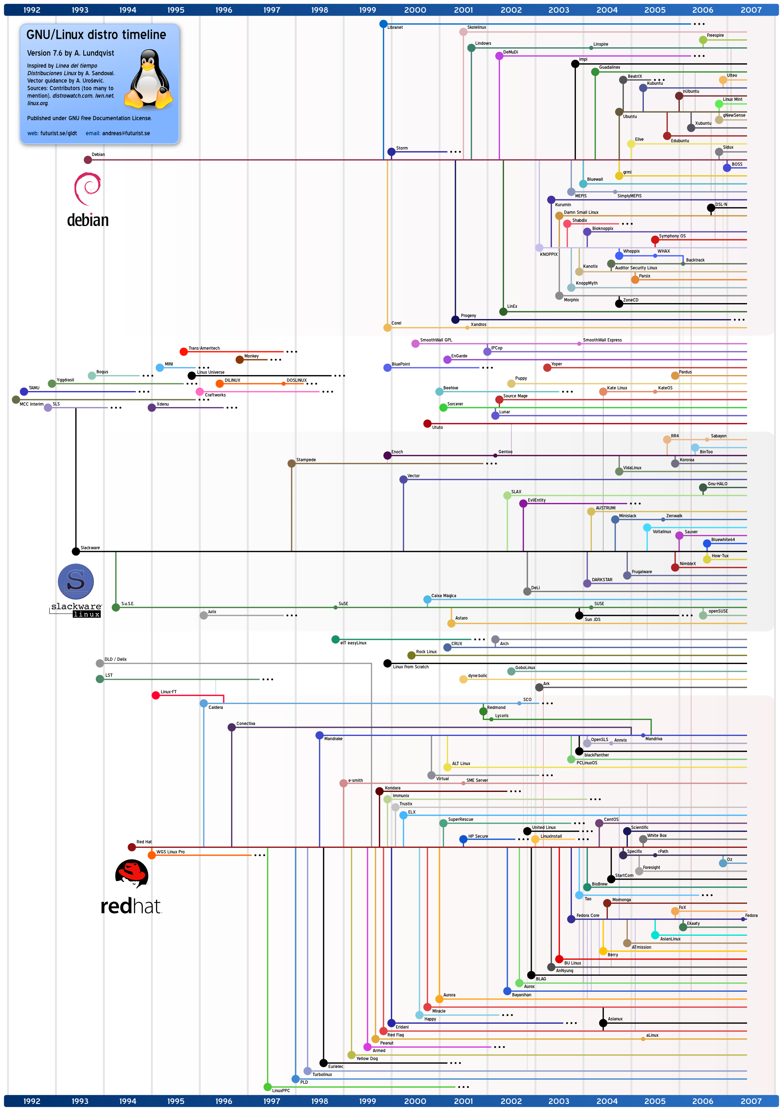
Which Linux Distribution is better?
Ubuntu
Debian
Knoppix
Slackware
Gentoo
CentOS
Redhat
Source:
http://futurist.se/gldt/

Slide 8
Which Linux Distribution is better?
Ask yourself these questions (from LAH)
  Is it going to be around in 5 yrs?
  Is it giong to stay on top of the latest security patches?
  Is it going to release updated software promptly?
  If I have problems, will the vendor talk to me?
Personally, I use Slackware
But, we will use CentOS (possibly along with Slackware :)

Slide 9
Fish vs. Fishing
Manpage
  $ man ls
  $ man 2 mkdir
  $ man man
  $ man -k mkdir
Manpage sections (LAH Table 1.2 @ page 12)
  1 User-level cmds and apps
    /bin/mkdir
  2 System calls
    int mkdir(const char *, …);
  3 Library calls
    int printf(const char *, …);
  4 Device drivers and network protocols
    /dev/tty
  5 Standard file formats
    /etc/hosts
  6 Games and demos
    /usr/games/fortune
  7 Misc. files and docs
    man 7 locale
  8 System admin. Cmds
    /sbin/reboot
$ manpath
$ env | grep MANPATH
/etc/man.config

Slide 10
Fish vs. Fishing (cont)
Google
  linux package management -rpm
  “linux package management” -rpm
  linux OR windows
  rpm site:redhat.com
  linux faq filetype:pdf
Info
  Text-base, menu-based help from GNU
  ?, h, u, t, ^N, ^P, Enter
  $ info info

Slide 11
Basic Commands
ls
  $ ls -l
  $ ls -a
  $ ls -la
  $ ls -l --sort=time
  $ ls -l --sort=size -r
cd
  $ cd /usr/bin
pwd
  $ pwd
~
  $ cd ~
~user
  $ cd ~weesan
What will “cd ~/weesan” do?
which
  $ which ls
whereis
  $ whereis ls
locate
  $ locate stdio.h
  $ locate iostream
rpm
  $ rpm -q bash
  $ rpm -qa
  $ rpm -qa | sort | less
find
  $ find / | grep stdio.h
  $ find /usr/include | grep stdio.h

Slide 12
Basic Commands (cont)
echo
  $ echo “Hello World”
  $ echo -n “Hello World”
cat
  $ cat /etc/motd
  $ cat /proc/cpuinfo
cp
  $ cp foo bar
  $ cp -a foo bar
mv
  $ mv foo bar
mkdir
  $ mkdir foo
rm
  $ rm foo
  $ rm -rf foo
  $ rm -i foo
  $ rm -- -foo
chgrp
  $ chgrp bar /home/foo
chsh
  $ chsh foo
chfn
  $ chfn foo
chown
  $ chown -R foo:bar /home/foo

Slide 13
Basic Commands (cont)
tar
  $ tar cvfp lab1.tar lab1
gzip
  $ gzip -9 lab1.tar
untar & ungzip
  $ gzip -cd lab1.tar.gz | tar xvf –
  $ tar xvfz lab1.tar.gz
touch
  $ touch foo
  $ cat /dev/null > foo
Pipe
  $ cal > foo
  $ cat /dev/zero > foo
  $ cat < /etc/passwd
  $ who | cut -d’ ‘ -f1 | sort | uniq | wc –l
backtick
  $ echo “The date is `date`”
  $ echo `seq 1 10`
Hard, soft (symbolic) link
  ln vmlinuz-2.6.24.4 vmlinuz
  ln -s firefox-2.0.0.3 firefox

Slide 14
Basic Commands (cont)
Disk usage
  $ df -h /
File space usage
  $ du -sxh ~/
Advance stuff ☺
  $ ssh eon who
  $ ssh eon ‘cd .html ; tar cvfp - cs183 | gzip -9c’ | tar xvfpz -
  $ ssh kilo-1 ‘tar cvfp - /extra/weesan’ | tar xvfp - -C /

Slide 15
Vi
2 modes
  Input mode
    ESC to back to cmd mode
  Command mode
    Cursor movement
      h (left), j (down), k (up), l (right)
      ^f (page down)
      ^b (page up)
      ^ (first char.)
      $ (last char.)
      G (bottom page)
      :1 (goto first line)
    Swtch to input mode
      a (append)
      i (insert)
      o (insert line after
      O (insert line before)
    Delete
      dd (delete a line)
      d10d (delete 10 lines)
      d$ (delete till end of line)
      dG (delete till end of file)
      x (current char.)
    Paste
      p (paste after)
      P (paste before)
    Undo
      u
    Search
      /
    Save/Quit
      :w (write)
      :q (quit)
      :wq (write and quit)
      :q! (give up changes)

Slide 16
Emacs
$ emacs
Cursor movement
  ^f (forward one char.)
  ^b (backward one char.)
  ^a (begin of line)
  ^e (end of line)
  ^n (next line)
  ^p (prev. line)
  ^v (page up)
  alt-v (page down)
Deletion
  ^d (delete one char)
  alt-d (delete one word)
  ^k (delete line)
Paste
  ^y (yank)
Undo
  ^/
Load file
  ^x^f
Cancel
  ^g
Save/Quit
  ^x^c (quit w/out saving)
  ^x^s (save)
  ^x^w (write to a new file)

Slide 17
Q&A

Slide 18
References
LAH
  Ch 1: Where to Start
Unix history
  http://en.wikipedia.org/wiki/Unix
  http://upload.wikimedia.org/wikipedia/commons/7/77/Unix_history-simple.svg
Linus Torvalds
  http://en.wikipedia.org/wiki/Linus_Torvalds
Linux Kernel
  http://www.kernel.org/

Slide 19
References
GNU (Gnu’s Not Unix)
  http://www.gnu.org/
Linux Distribution
  http://en.wikipedia.org/wiki/Linux_distribution
  http://en.wikipedia.org/wiki/List_of_Linux_distributions
PS2: Computational Cluster
  http://arrakis.ncsa.uiuc.edu/ps2/cluster.php
Linux Gadgets
  http://linuxdevices.com/articles/AT4936596231.html
TiVo
  http://dynamic.tivo.com/linux/linux.asp

Slide 20
References
Nintendo DS Lite
  http://www.nintendo.com/ds/
Nokia N810
  http://www.nokia.com/
  http://www.engadget.com/2007/10/17/nokia-n810-gets-official/
Linux Distribution
  http://en.wikipedia.org/wiki/Linux_distribution
  GNU/Linux Distro Timeline: http://futurist.se/gldt/
  http://www.distrowatch.com/
  http://www.linux.org/dist/
Google Advance Search
  http://www.google.com/intl/en/help/refinesearch.html

