Slide 1
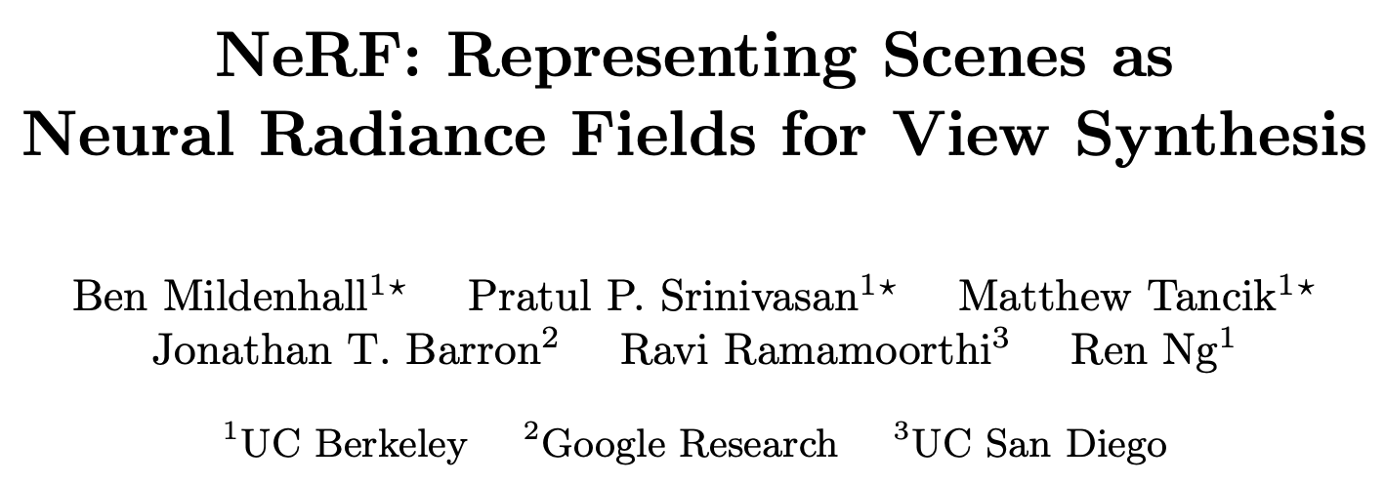
ECCV 2020
Presenter: LEE Sungjae
2025. 8. 5.

Slide 2
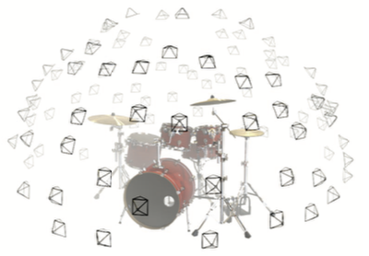
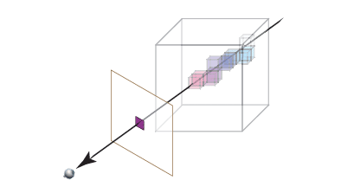
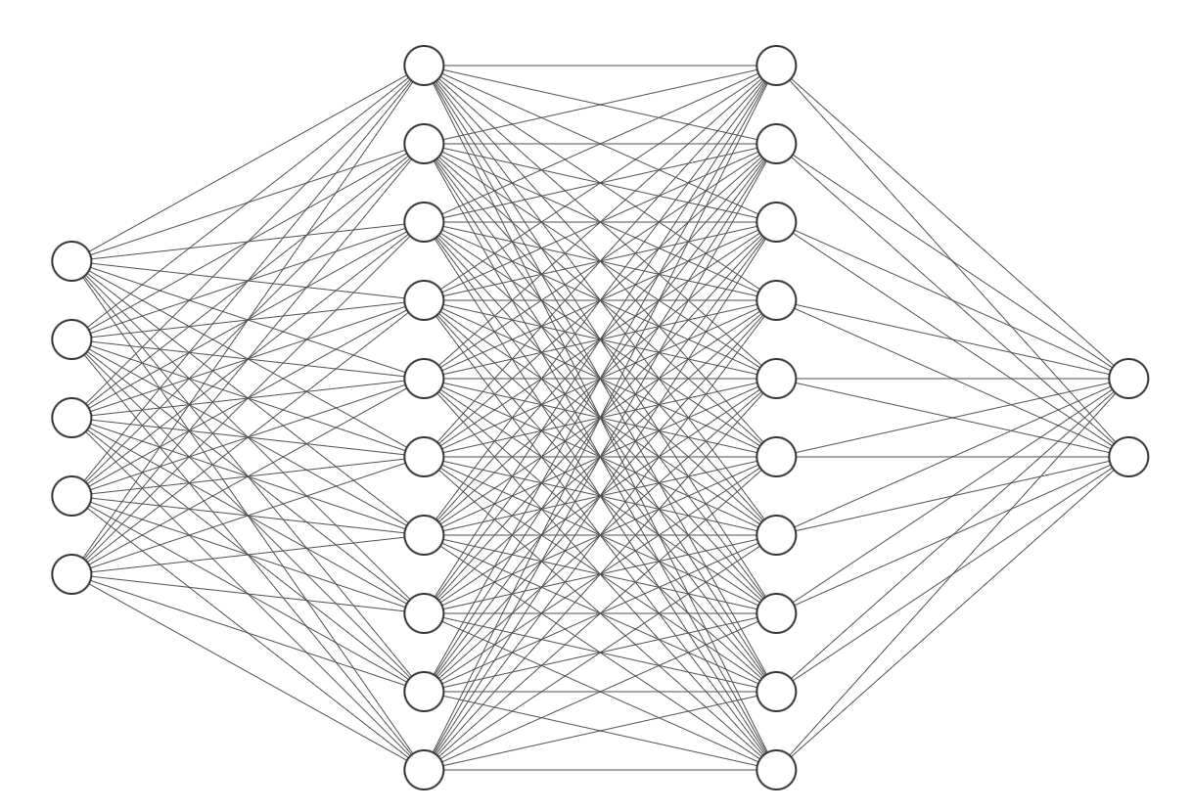
Overview
One-Slide Summary
MLP: Represents the 3d object
Volume rendering: Decide the color of a pixel and form image

Slide 3
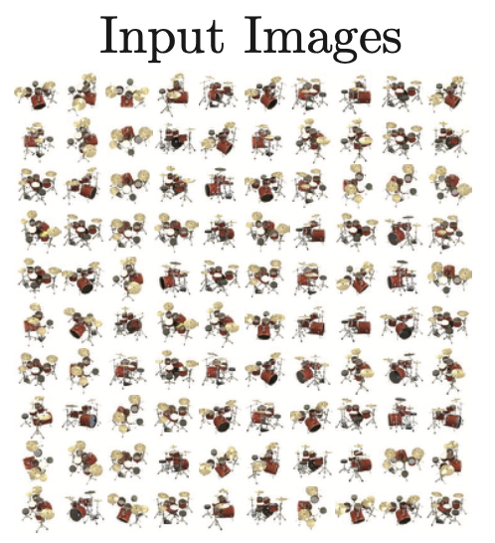
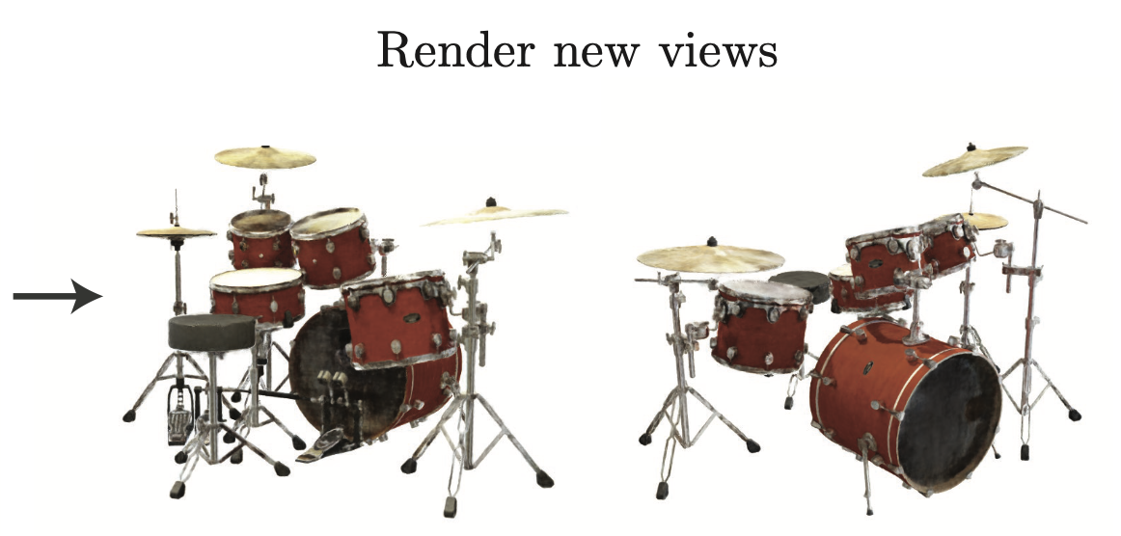
Introduction
Motive and approach
Goal: Using images of a 3d object, form novel view images

Slide 4
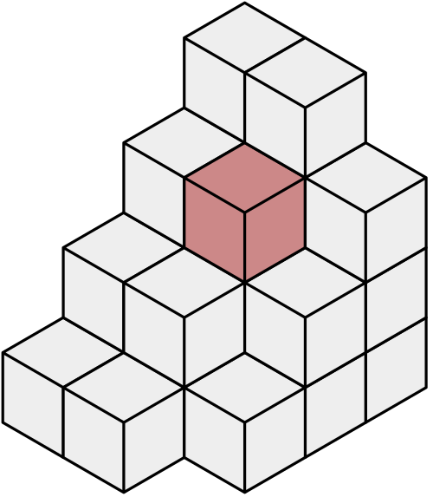
Introduction
Motive and approach
Previous approach: Use Voxel grids (3D version of image pixels)
..such as Neural Volume or Scene Representation Networks.
This is too heavy(e.g., 15GB per scene for LLFF)!
NeRF only requires 5MB per scene

Slide 5
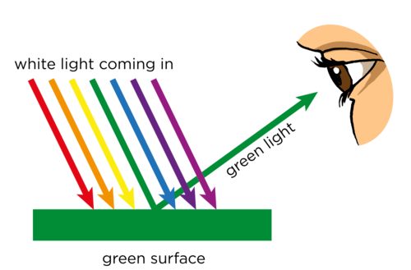
Prerequisites
About computer graphics - Ray
How can human see something?

Slide 6
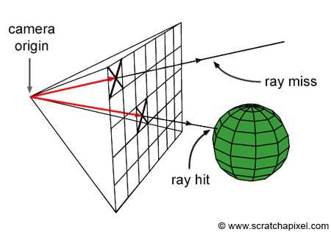
Prerequisites
About computer graphics - Ray
How can human see something?
Computer Graphic uses Ray-tracing

Slide 7
Prerequisites
About computer graphics
3D object should give color and opacity so that ray can decide the value of a pixel.
Each point(x, y, z) can have different values depending on the direction.
Goal: We want to represent a 3d object that gives color and opacity for every position and direction

Slide 8

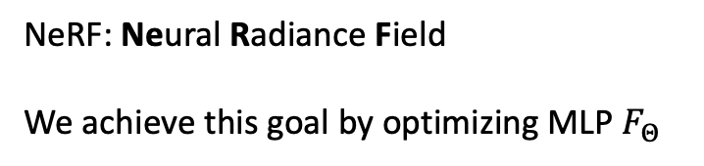
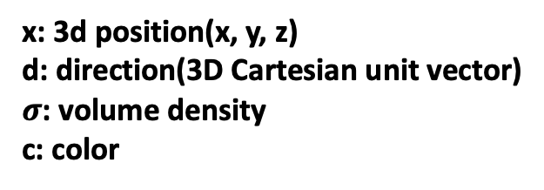
Methods
Neural Radiance Field Scene Representation
x: 3d position(x, y, z)
d: direction(3D Cartesian unit vector)
$σ$: volume density
c: color
NeRF: Neural Radiance Field
We achieve this goal by optimizing MLP $F_{Θ}$
8 fully- connected layers
$$σ$$
x
MLP
d
256-dim feature vector
concatenated feature vector
c

Slide 9
Methods
Neural Radiance Field Scene Representation
x: 3d position(x, y, z)
d: direction(3D Cartesian unit vector)
$σ$: volume density
c: color
NeRF: Neural Radiance Field
We achieve this goal by optimizing MLP $F_{Θ}$
8 fully- connected layers
$$σ$$
x
d
256-dim feature vector
concatenated feature vector
Single layer network
c

Slide 10
Methods
Neural Radiance Field Scene Representation
x: 3d position(x, y, z)
d: direction(3D Cartesian unit vector)
$σ$: volume density
c: color
NeRF: Neural Radiance Field
We achieve this goal by optimizing MLP $F_{Θ}$
8 fully- connected layers
$$σ$$
x
d
256-dim feature vector
concatenated feature vector
Single layer network
c

Slide 11
Methods
Neural Radiance Field Scene Representation
x: 3d position(x, y, z)
d: direction(3D Cartesian unit vector)
$σ$: volume density
c: color
NeRF: Neural Radiance Field
We achieve this goal by optimizing MLP $F_{Θ}$
8 fully- connected layers
$$σ$$
x
d
256-dim feature vector
concatenated feature vector
Single layer network
c

Slide 12
Methods
Neural Radiance Field Scene Representation
x: 3d position(x, y, z)
d: direction(3D Cartesian unit vector)
$σ$: volume density
c: color
NeRF: Neural Radiance Field
We achieve this goal by optimizing MLP $F_{Θ}$
8 fully- connected layers
$$σ$$
x
d
256-dim feature vector
concatenated feature vector
Single layer network
c

Slide 13
Methods
Neural Radiance Field Scene Representation
Why should we separate x and d as an input?
To achieve Multiview Consistency!
Volume density should not be affected by viewing direction(at least for most of the case).
8 fully- connected layers
$$σ$$
x
d
256-dim feature vector
concatenated feature vector
Single layer network
c

Slide 14
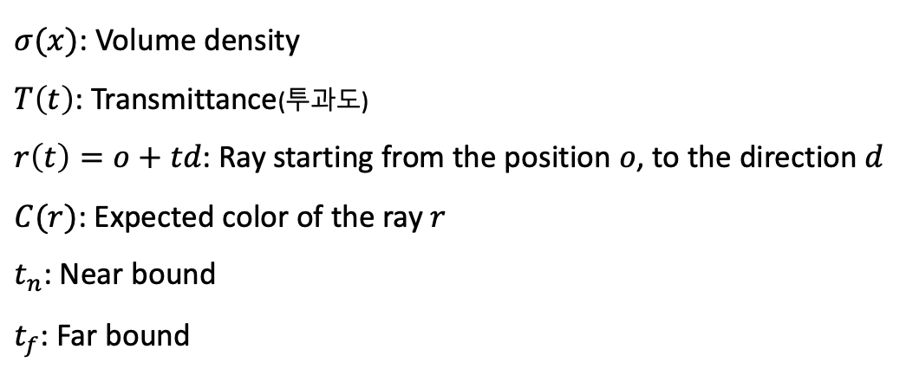
Methods
Volume Rendering with Radiance Fields
Now we have a representation of a 3d object.
→ Use it to decide a pixel value for the image.
$σ(x)$: Volume density
$T\left(t\right)$: Transmittance(투과도)
$r\left(t\right)=o+td$: Ray starting from the position $o$, to the direction $d$
$C(r)$: Expected color of the ray $r$
$t_{n}$: Near bound
$t_{f}$: Far bound

Slide 15
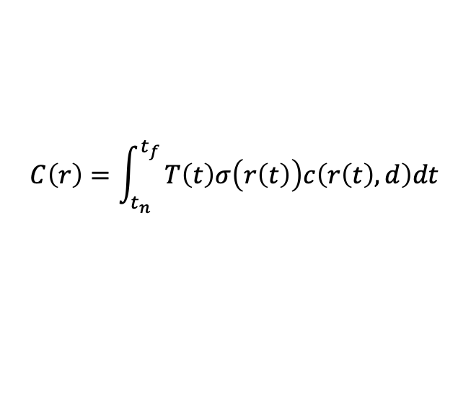
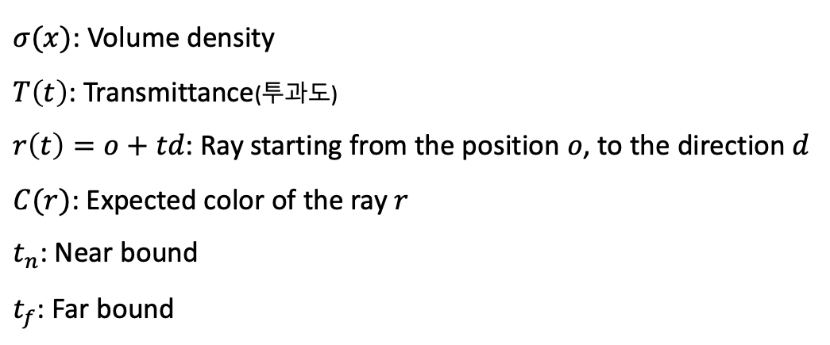
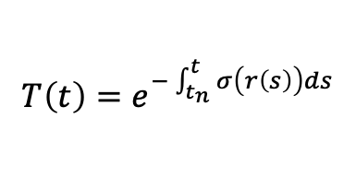
Methods
Volume Rendering with Radiance Fields
$σ(x)$: Volume density
$T\left(t\right)$: Transmittance(투과도)
$r\left(t\right)=o+td$: Ray starting from the position $o$, to the direction $d$
$C(r)$: Expected color of the ray $r$
$t_{n}$: Near bound
$t_{f}$: Far bound
$$C\left(r\right)=\int_{t_{n}}^{t_{f}}{T\left(t\right)σ\left(r\left(t\right)\right)c\left(r\left(t\right), d\right)dt}$$
$$T\left(t\right)=e^{−\int_{t_{n}}^{t}{σ\left(r\left(s\right)\right)ds}}$$

Slide 16
Methods
Volume Rendering with Radiance Fields
$σ(x)$: Volume density
$T\left(t\right)$: Transmittance(투과도)
$r\left(t\right)=o+td$: Ray starting from the position $o$, to the direction $d$
$C(r)$: Expected color of the ray $r$
$t_{n}$: Near bound
$t_{f}$: Far bound
$$C\left(r\right)=\int_{t_{n}}^{t_{f}}{T\left(t\right)σ\left(r\left(t\right)\right)c\left(r\left(t\right), d\right)dt}$$
$$T\left(t\right)=e^{−\int_{t_{n}}^{t}{σ\left(r\left(s\right)\right)ds}}$$
…But practically, we can’t compute in a continuous region

Slide 17
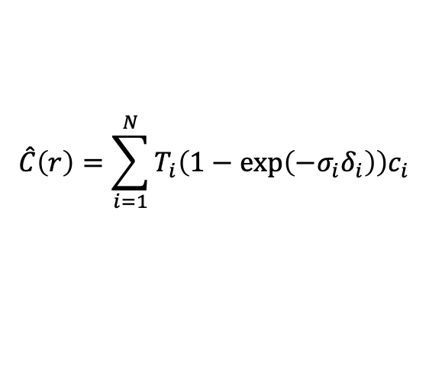
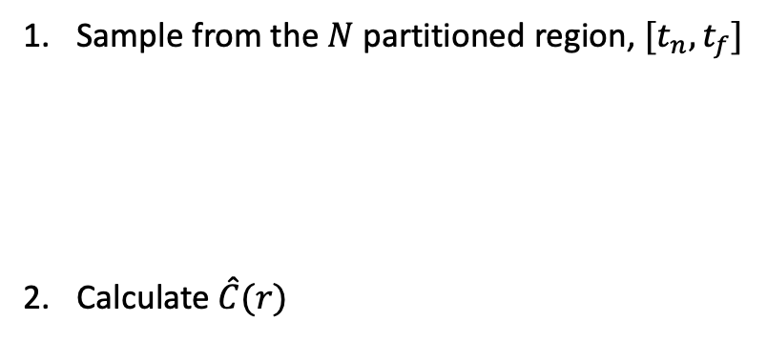
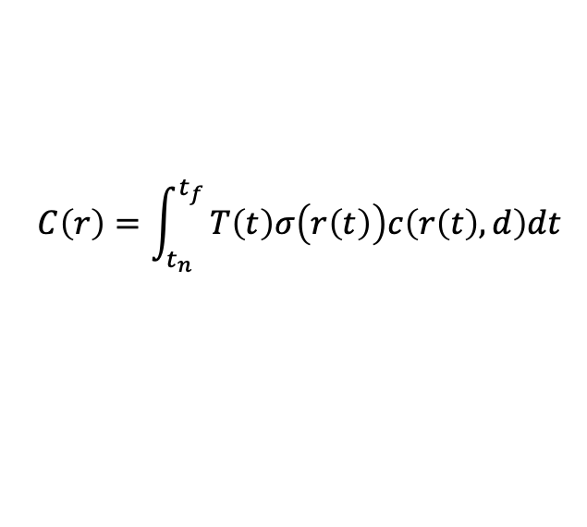



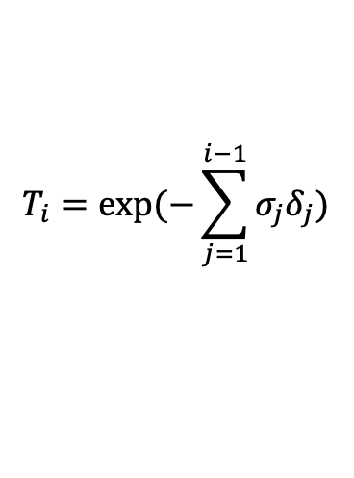

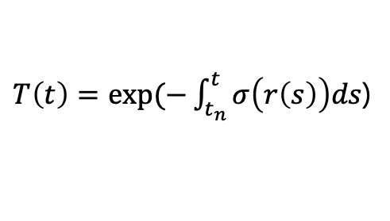
Methods
Volume Rendering with Radiance Fields
Sample from the $N$ partitioned region, $[t_{n},t_{f}]$
Calculate $\hat{C}(r)$
$$t_{3}$$
…
$$t_{n}$$
$$t_{f}$$
$$\hat{C}\left(r\right)=\sum_{i=1}^{N}{T_{i}\left(1−\exp\left(−σ_{i}δ_{i}\right)\right)c_{i}}$$
$$T_{i}=exp⁡(−\sum_{j=1}^{i−1}{σ_{j}δ_{j})}$$
$$(δ_{i}=t_{i+1}−t_{i})$$
$$C\left(r\right)=\int_{t_{n}}^{t_{f}}{T\left(t\right)σ\left(r\left(t\right)\right)c\left(r\left(t\right), d\right)dt}$$
$T\left(t\right)=exp⁡(−\int_{t_{n}}^{t}{σ\left(r\left(s\right)\right)ds}$)
Notes:
델타i 가 0에 가까워지면 빨간 줄로 표시한 부분이 거의 같아지게 됨(근사). 밑줄 친 부분은 둘 다 빛이 어떤 구간을 통과할 확률(투과도 개념).

Slide 18
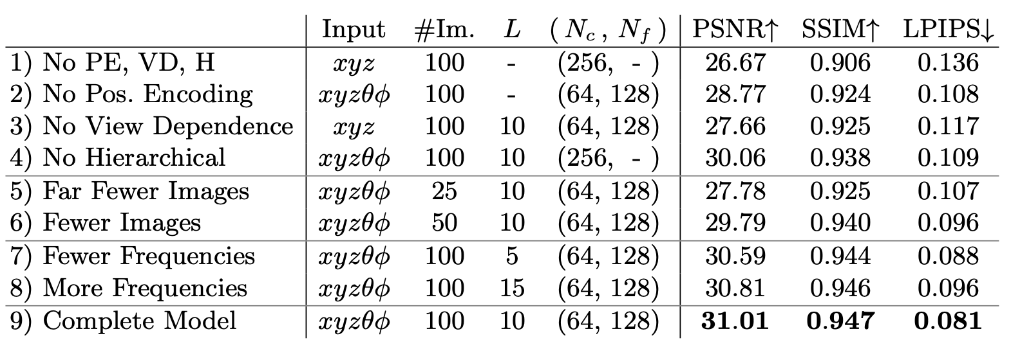
Methods
Optimizing a Neural Radiance Field

Slide 19
Methods
Optimizing a Neural Radiance Field
There are two problems;
1. MLP is weak at representing high-frequency functions
2. Sampling process is too naive

Slide 20

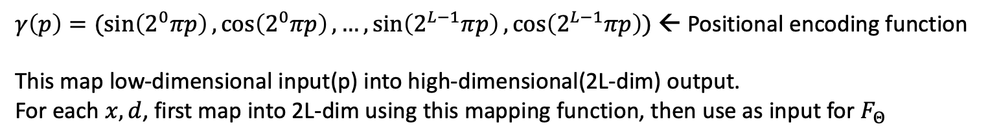

Methods
Optimizing a Neural Radiance Field – Positional Encoding
Positional encoding allows MLP to represent high-frequency changes
$γ\left(p\right)=(\sin\left(2^{0}πp\right),\cos\left(2^{0}πp\right),…, \sin\left(2^{L−1}πp\right),\cos\left(2^{L−1}πp\right))$ ← Positional encoding function
This map low-dimensional input(p) into high-dimensional(2L-dim) output.
For each $x,d$, first map into 2L-dim using this mapping function, then use as input for $F_{Θ}$
$$γ$$
8 fully- connected layers
$$σ$$
x
d
256-dim feature vector
concatenated feature vector
Single layer network
c

Slide 21
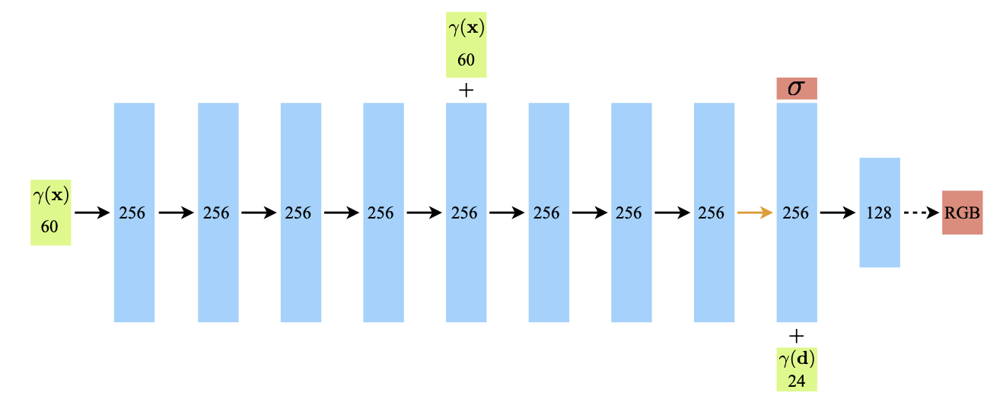
Methods
Optimizing a Neural Radiance Field – Positional Encoding
Positional encoding allows MLP to represent high-frequency changes
$γ\left(p\right)=(\sin\left(2^{0}πp\right),\cos\left(2^{0}πp\right),…, \sin\left(2^{L−1}πp\right),\cos\left(2^{L−1}πp\right))$ ← Positional encoding function
This map low-dimensional input(p) into high-dimensional(2L-dim) output.
For each $x,d$, first map into 2L-dim using this mapping function, then use as input for $F_{Θ}$

Slide 22
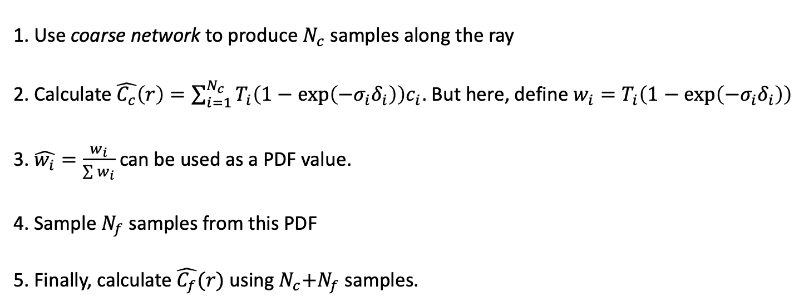
Methods
Optimizing a Neural Radiance Field – Hierarchical Volume Sampling
Idea: free space and occluded regions that do not contribute to the rendered image should be sampled less
How? → Use two distinct MLP networks to represent a 3d object!
1. Use coarse network to produce $N_{c}$ samples along the ray
2. Calculate $\hat{C_{c}}\left(r\right)=\sum_{i=1}^{N_{c}}{T_{i}\left(1−\exp\left(−σ_{i}δ_{i}\right)\right)c_{i}}$. But here, define $w_{i}=T_{i}\left(1−\exp\left(−σ_{i}δ_{i}\right)\right)$
3. $\hat{w_{i}}=\frac{w_{i}}{\sum{w_{i}}}$ can be used as a PDF value.
4. Sample $N_{f}$ samples from this PDF
5. Finally, calculate $\hat{C_{f}}(r)$ using${ N}_{c}+N_{f}$ samples.

Slide 23
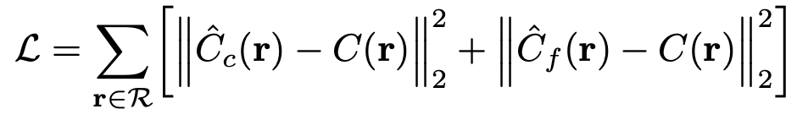
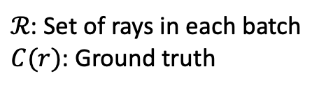
Methods
Optimizing a Neural Radiance Field – Hierarchical Volume Sampling
Loss function
$ℛ$: Set of rays in each batch
$C(r)$: Ground truth

Slide 24
Experiments
Results
Datasets | Diﬀuse Synthetic 360 | Realistic Synthetic 360 | Real Forward-Facing
Train images | 479 | 100 | 17~55
Test images | 1000 | 200 | 3~7
Resolution | 512 x 512 | 800 x 800 | 1008 x 756
 | /object | /object | /object

Slide 25
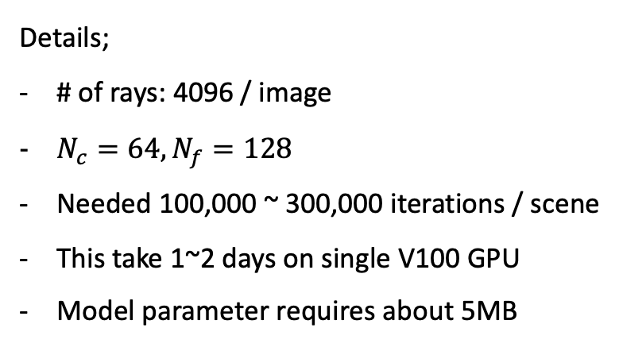
Experiments
Results
Details;
# of rays: 4096 / image
$N_{c}=64,N_{f}=128$
Needed 100,000 ~ 300,000 iterations / scene
This take 1~2 days on single V100 GPU
Model parameter requires about 5MB

Slide 26
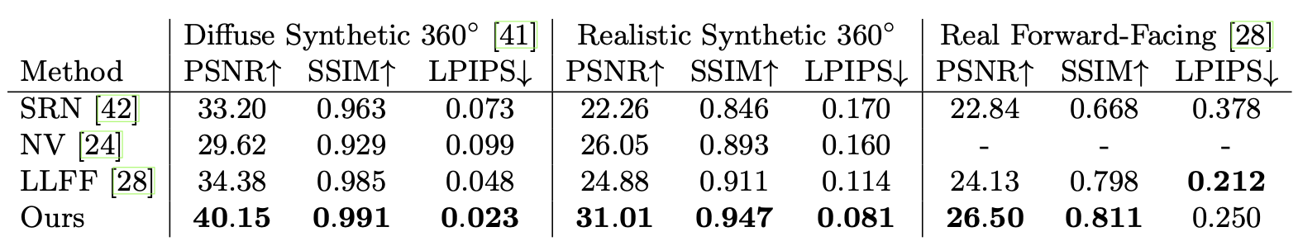
Experiments
Results - Comparisons

Slide 27
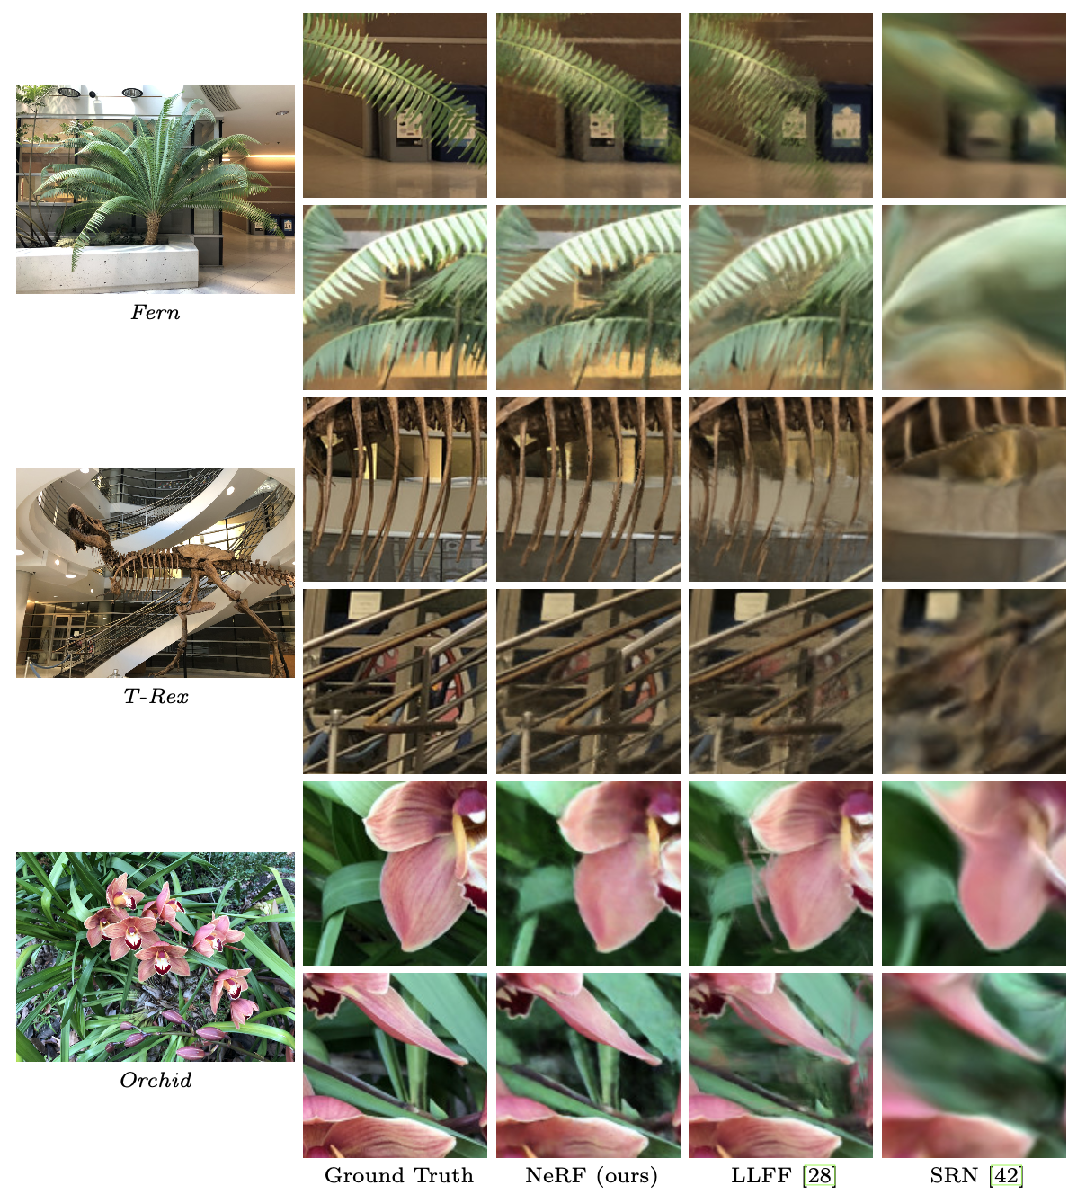
Experiments
Results - Comparisons

Slide 28
Experiments
Results - Comparisons

Slide 29
Experiments
Results - Comparisons

Slide 30
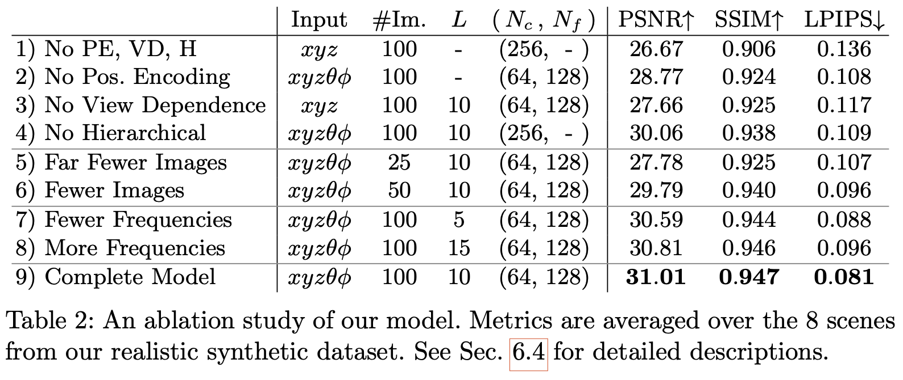
Experiments
Results – Ablation studies

Slide 31
Conclusions
Limitations
Time-space trade-off (1~2 days & 5MB vs 10-min & 15GB)
Interpretability (Quite low compared to voxel)

