Slide 1


WDI_ATL_3_Project 2
Tennis Gr up
Community Tennis Club
Mobile-Centric Website
June 15, 2015

Slide 2
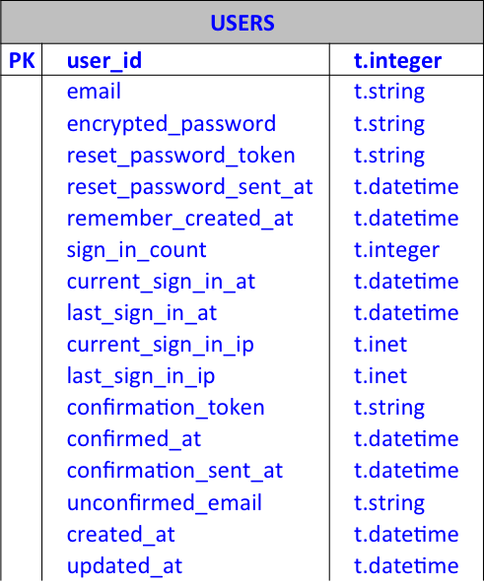
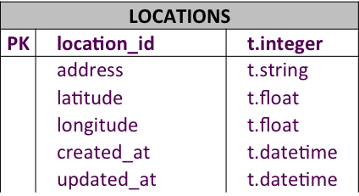
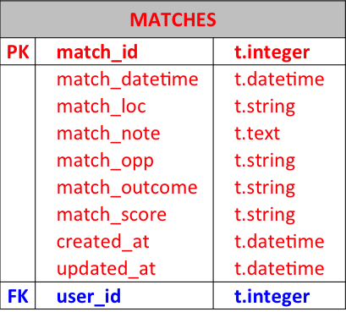
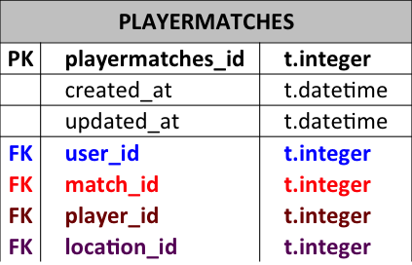
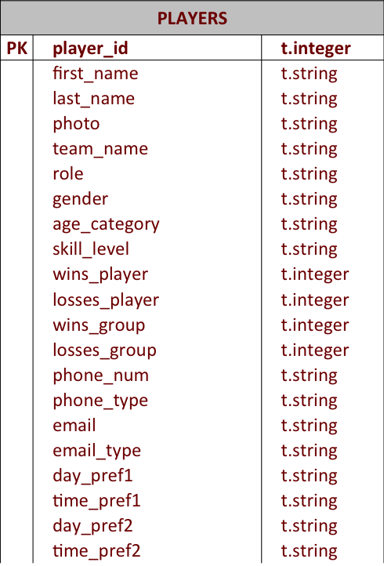
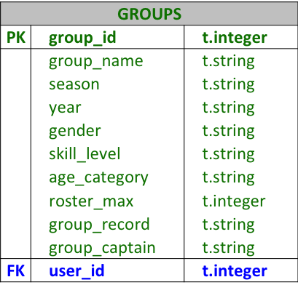
ERB Models

Slide 3

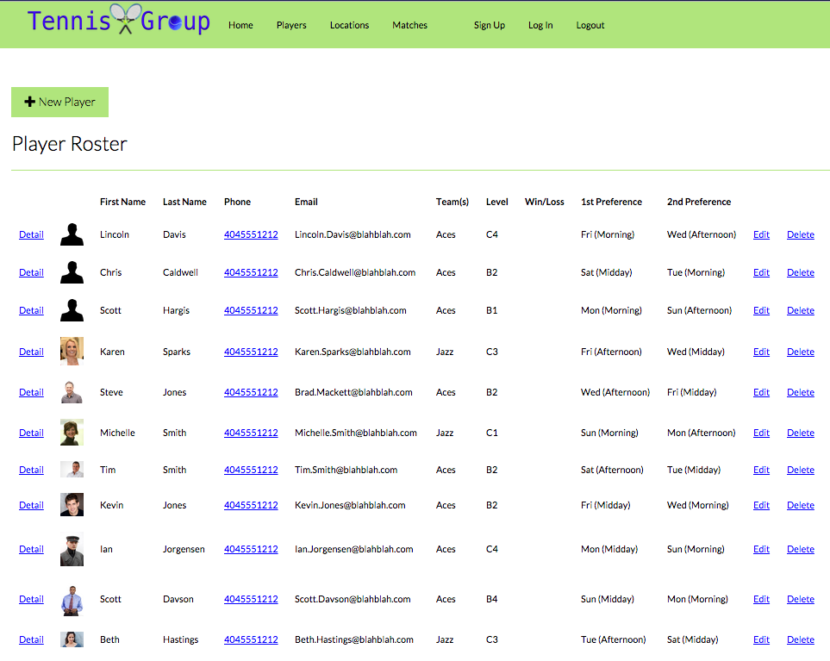

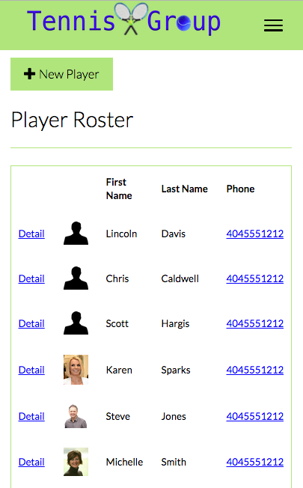
Group Roster

Slide 4
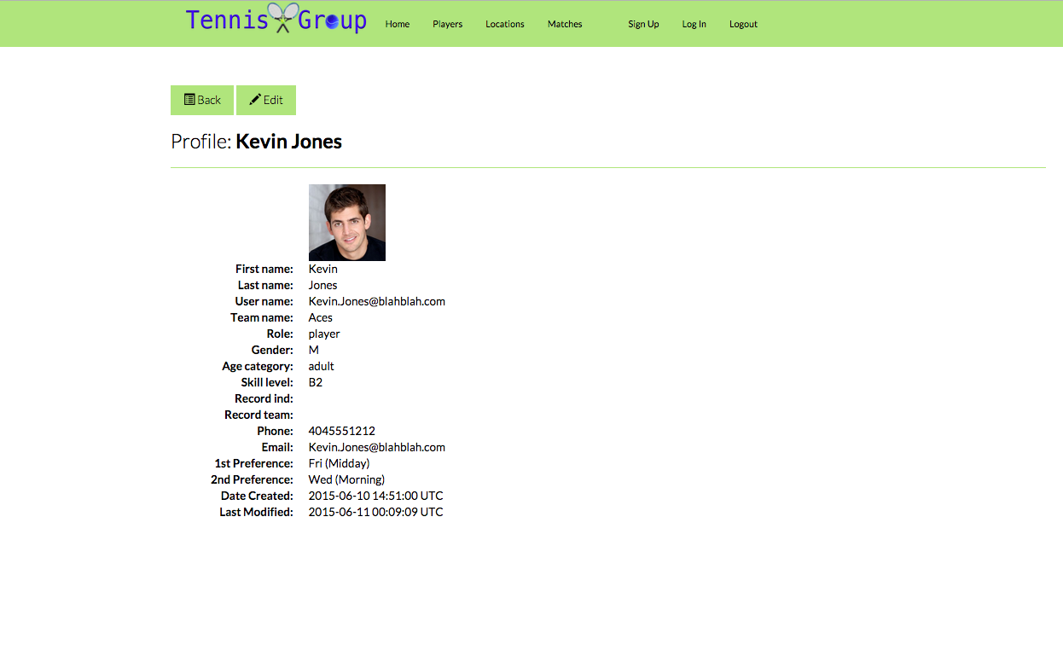
Profile View

Slide 5
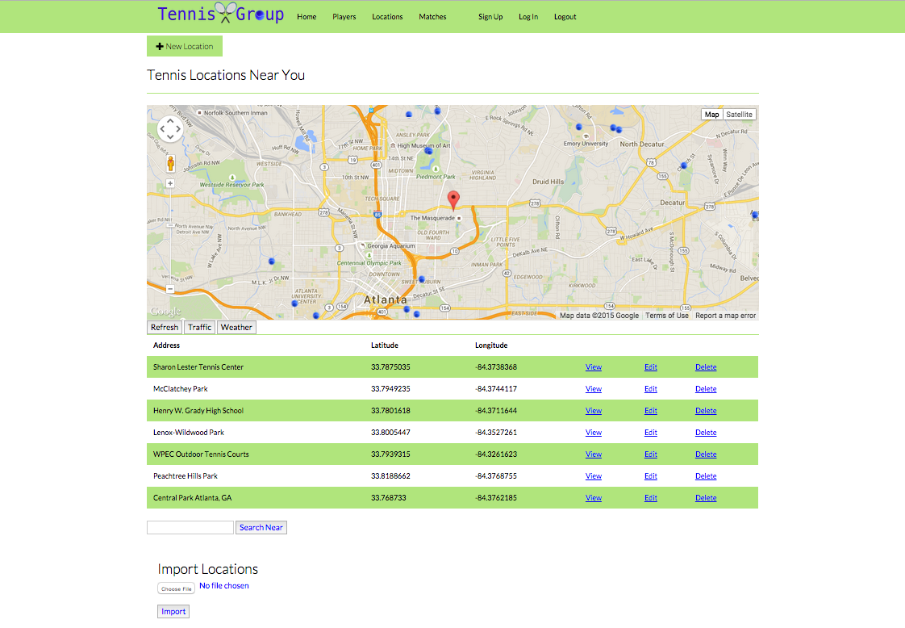
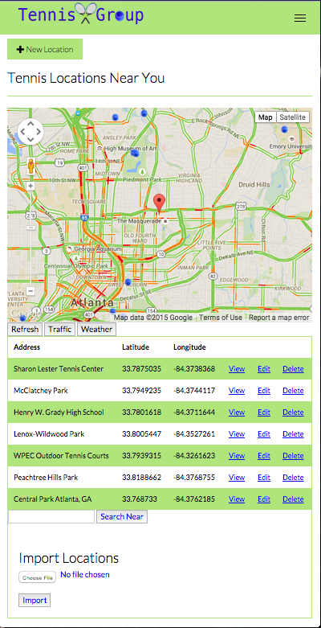
Match Location Search

Slide 6
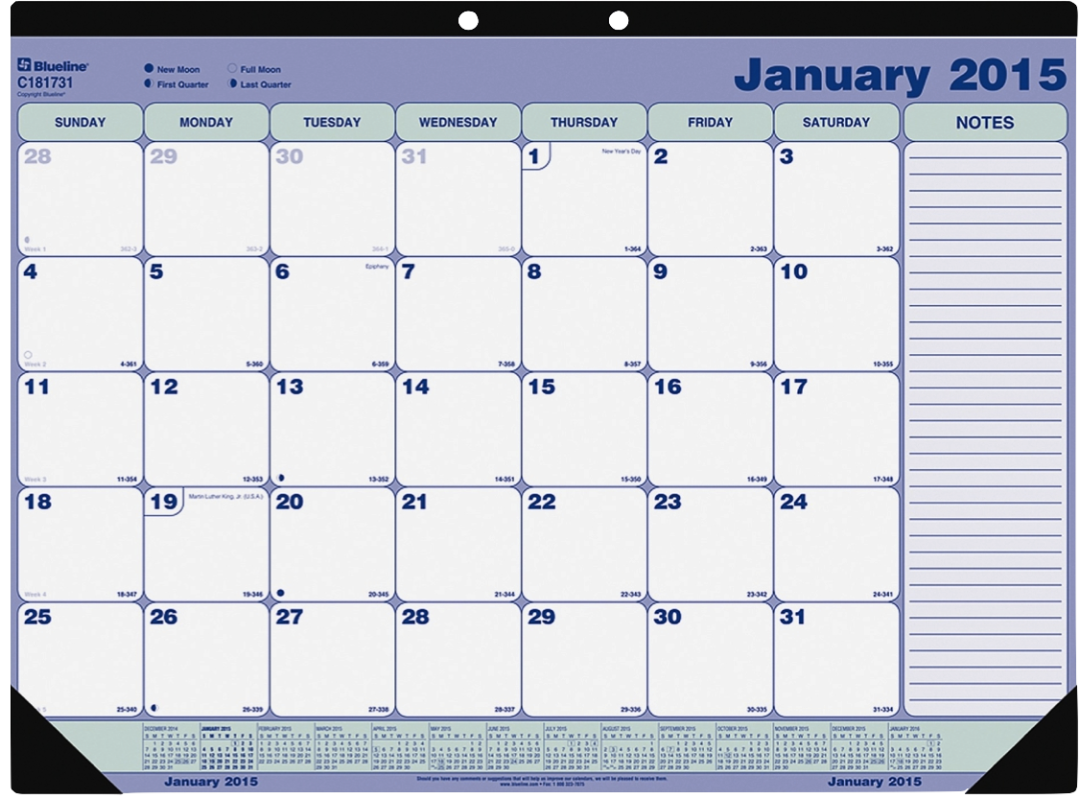
Calendar View

Slide 7
ERB Models
MATCHES
PK | match_id | t.integer
 | match_datetime | t.datetime
 | match_loc | t.string
 | match_note | t.text
 | match_opp | t.string
 | match_outcome | t.string
 | match_score | t.string
 | created_at | t.datetime
 | updated_at | t.datetime
FK | user_id | t.integer
GROUPS
PK | group_id | t.integer
 | group_name | t.string
 | season | t.string
 | year | t.string
 | gender | t.string
 | skill_level | t.string
 | age_category | t.string
 | roster_max | t.integer
 | group_record | t.string
 | group_captain | t.string
FK | user_id | t.integer
USERS
PK | user_id | t.integer
 | email | t.string
 | encrypted_password | t.string
 | reset_password_token | t.string
 | reset_password_sent_at | t.datetime
 | remember_created_at | t.datetime
 | sign_in_count | t.integer
 | current_sign_in_at | t.datetime
 | last_sign_in_at | t.datetime
 | current_sign_in_ip | t.inet
 | last_sign_in_ip | t.inet
 | confirmation_token | t.string
 | confirmed_at | t.datetime
 | confirmation_sent_at | t.datetime
 | unconfirmed_email | t.string
 | created_at | t.datetime
 | updated_at | t.datetime
PLAYERS
PK | player_id | t.integer
 | first_name | t.string
 | last_name | t.string
 | photo | t.string
 | team_name | t.string
 | role | t.string
 | gender | t.string
 | age_category | t.string
 | skill_level | t.string
 | wins_player | t.integer
 | losses_player | t.integer
 | wins_group | t.integer
 | losses_group | t.integer
 | phone_num | t.string
 | phone_type | t.string
 | email | t.string
 | email_type | t.string
 | day_pref1 | t.string
 | time_pref1 | t.string
 | day_pref2 | t.string
 | time_pref2 | t.string
PLAYERMATCHES
PK | playermatches_id | t.integer
 | created_at | t.datetime
 | updated_at | t.datetime
FK | user_id | t.integer
FK | match_id | t.integer
FK | player_id | t.integer
FK | location_id | t.integer
LOCATIONS
PK | location_id | t.integer
 | address | t.string
 | latitude | t.float
 | longitude | t.float
 | created_at | t.datetime
 | updated_at | t.datetime

Slide 9
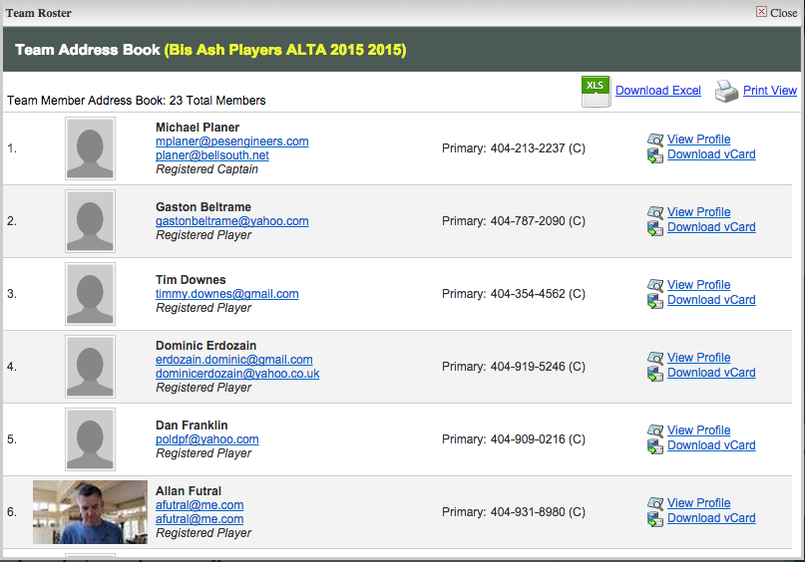

Player Dashboard
Team Address Book

Slide 10
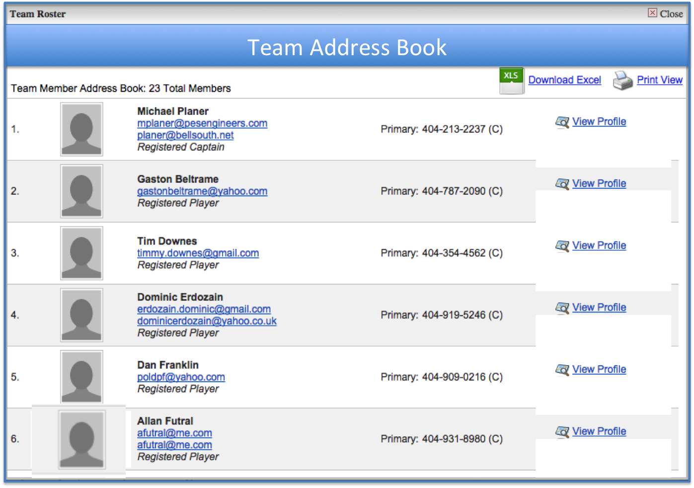
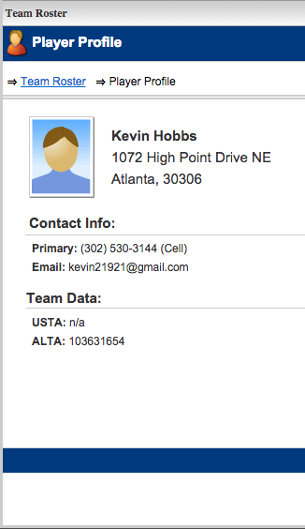
Player Profile

