Slide 1


WDI_ATL_3_Project 2
Tennis Gr up
Community Tennis Club
Mobile-Centric Website
June 15, 2015

Slide 2
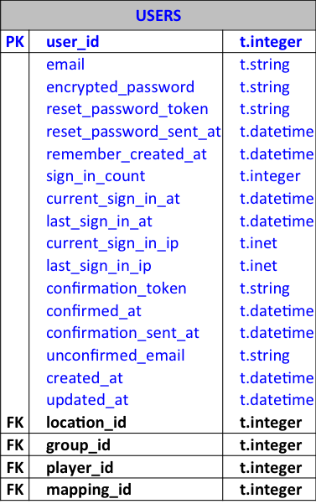
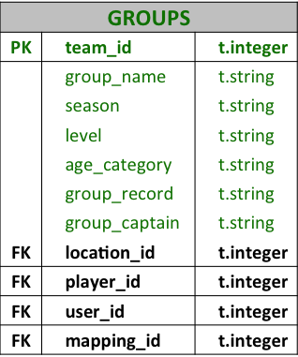
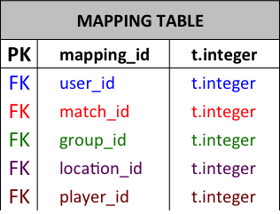
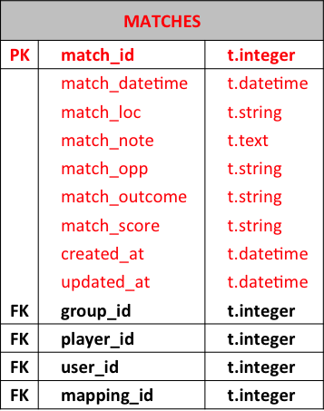
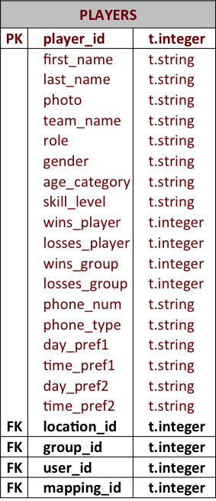
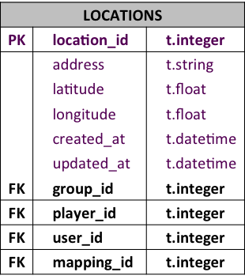
ERB Models

Slide 3

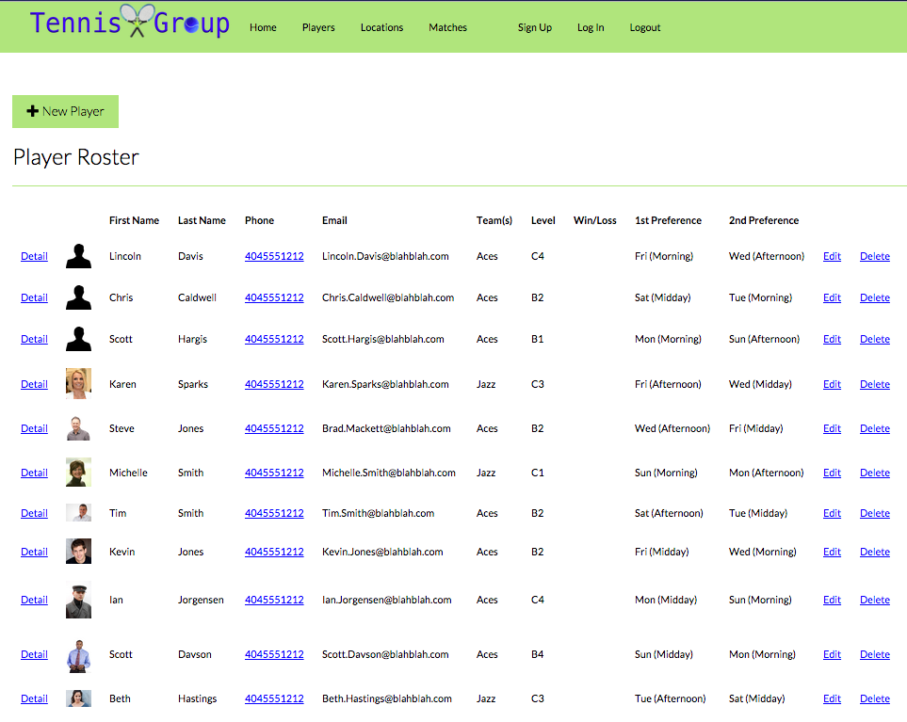

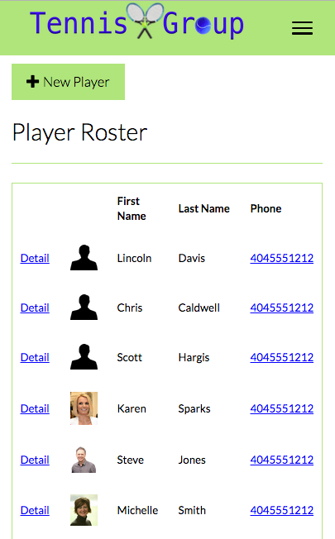
Group Roster

Slide 4
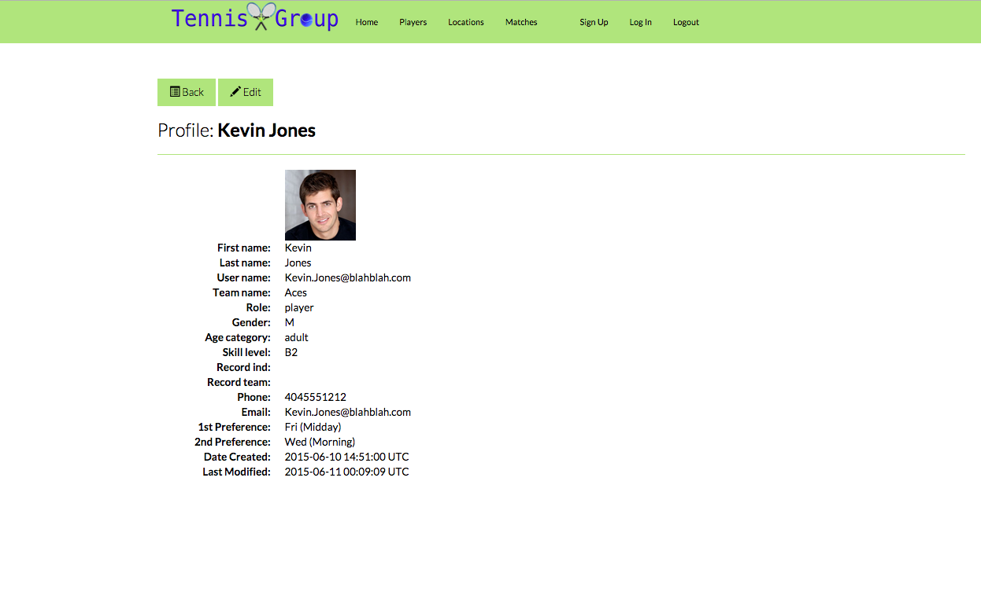
Profile View

Slide 5
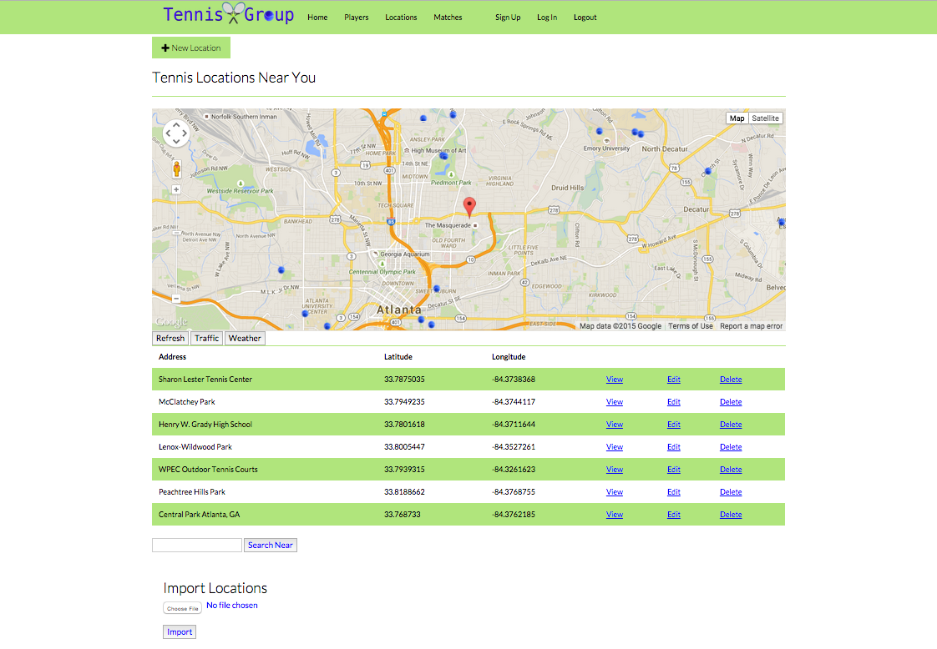
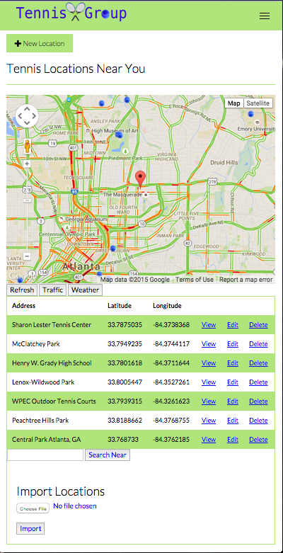
Match Location Search

Slide 6
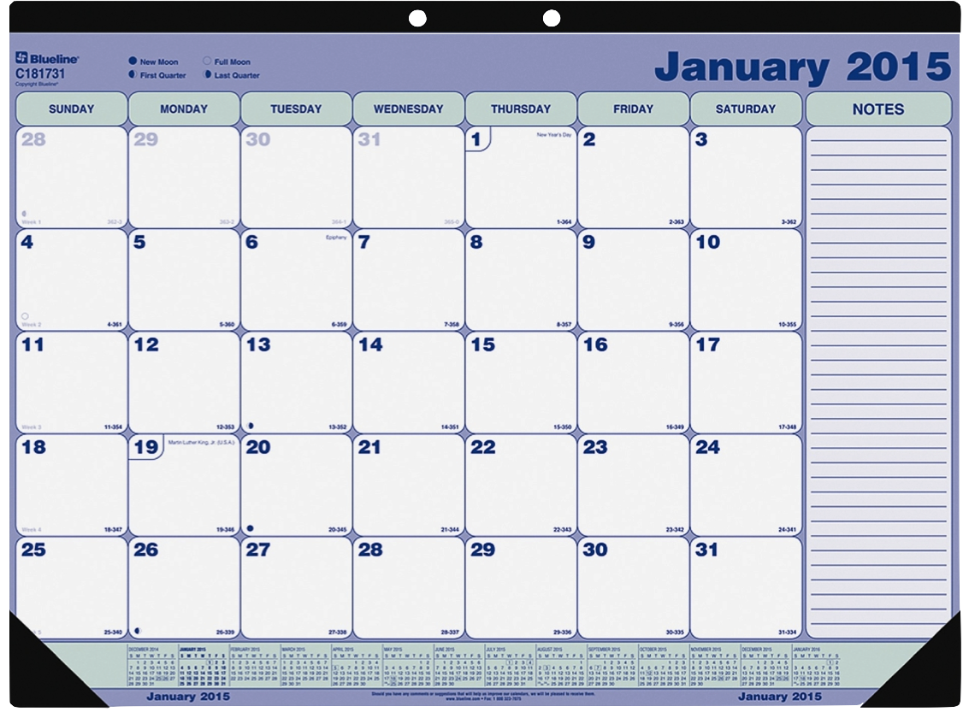
Calendar View

Slide 7
Database Models – ERB Diagram
PLAYERS
PK | player_id | t.integer
 | first_name | t.string
 | last_name | t.string
 | photo | t.string
 | team_name | t.string
 | role | t.string
 | gender | t.string
 | age_category | t.string
 | skill_level | t.string
 | wins_player | t.integer
 | losses_player | t.integer
 | wins_group | t.integer
 | losses_group | t.integer
 | phone_num | t.string
 | phone_type | t.string
 | day_pref1 | t.string
 | time_pref1 | t.string
 | day_pref2 | t.string
 | time_pref2 | t.string
FK | location_id | t.integer
FK | group_id | t.integer
FK | user_id | t.integer
FK | mapping_id | t.integer
LOCATIONS
PK | location_id | t.integer
 | address | t.string
 | latitude | t.float
 | longitude | t.float
 | created_at | t.datetime
 | updated_at | t.datetime
FK | group_id | t.integer
FK | player_id | t.integer
FK | user_id | t.integer
FK | mapping_id | t.integer
USERS
PK | user_id | t.integer
 | email | t.string
 | encrypted_password | t.string
 | reset_password_token | t.string
 | reset_password_sent_at | t.datetime
 | remember_created_at | t.datetime
 | sign_in_count | t.integer
 | current_sign_in_at | t.datetime
 | last_sign_in_at | t.datetime
 | current_sign_in_ip | t.inet
 | last_sign_in_ip | t.inet
 | confirmation_token | t.string
 | confirmed_at | t.datetime
 | confirmation_sent_at | t.datetime
 | unconfirmed_email | t.string
 | created_at | t.datetime
 | updated_at | t.datetime
FK | location_id | t.integer
FK | group_id | t.integer
FK | player_id | t.integer
FK | mapping_id | t.integer
MATCHES
PK | match_id | t.integer
 | match_datetime | t.datetime
 | match_loc | t.string
 | match_note | t.text
 | match_opp | t.string
 | match_outcome | t.string
 | match_score | t.string
 | created_at | t.datetime
 | updated_at | t.datetime
FK | group_id | t.integer
FK | player_id | t.integer
FK | user_id | t.integer
FK | mapping_id | t.integer
GROUPS
PK | team_id | t.integer
 | group_name | t.string
 | season | t.string
 | level | t.string
 | age_category | t.string
 | group_record | t.string
 | group_captain | t.string
FK | location_id | t.integer
FK | player_id | t.integer
FK | user_id | t.integer
FK | mapping_id | t.integer
MAPPING TABLE
PK | mapping_id | t.integer
FK | user_id | t.integer
FK | match_id | t.integer
FK | group_id | t.integer
FK | location_id | t.integer
FK | player_id | t.integer

Slide 9
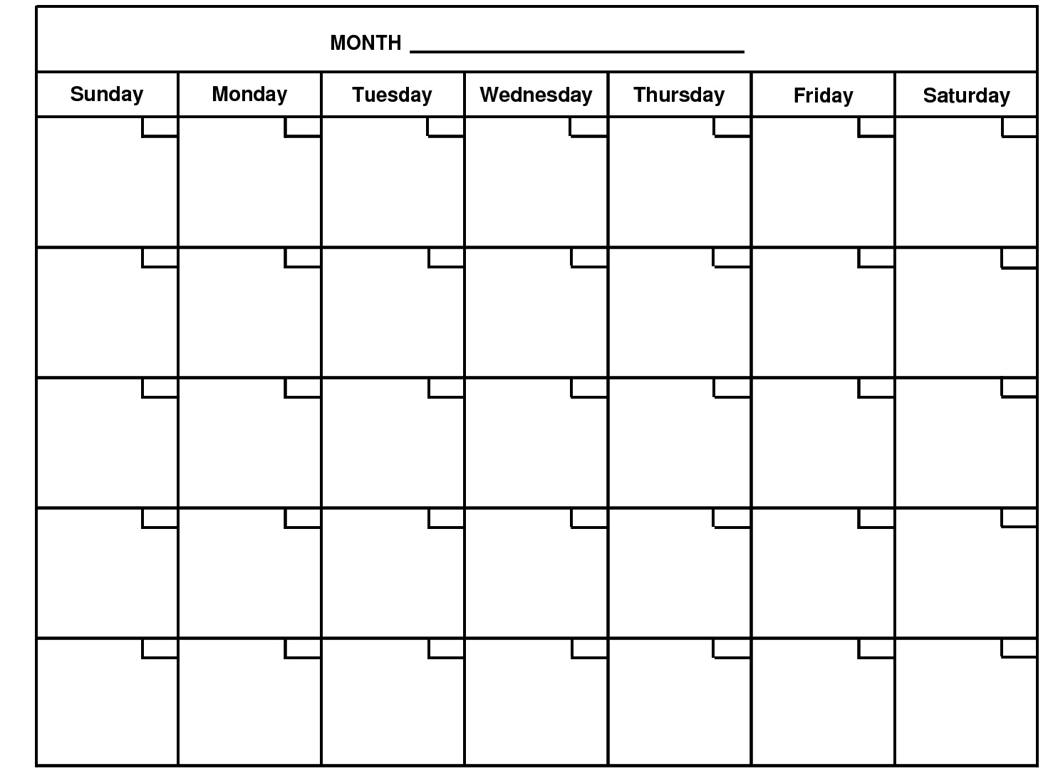
Calendar Scheduling
July
1
2
3
4
5
6
morning
morning
morning
morning
morning
morning
morning
☐
☐
☐
☐
☐
☐
☐
midday
midday
midday
midday
midday
midday
midday
☐
☐
☐
☐
☐
☐
☐
evening
evening
evening
evening
evening
evening
evening
☐
☐
☐
☐
☐
☐
☐
7
8
9
10
11
12
13
morning
morning
morning
morning
morning
morning
morning
☐
☐
☐
☐
☐
☐
☐
midday
midday
midday
midday
midday
midday
midday
☐
☐
☐
☐
☐
☐
☐
evening
evening
evening
evening
evening
evening
evening
☐
☐
☐
☐
☐
☐
☐
14
15
16
17
18
19
20
morning
morning
morning
morning
morning
morning
morning
☐
☐
☐
☐
☐
☐
☐
midday
midday
midday
midday
midday
midday
midday
☐
☐
☐
☐
☐
☐
☐
evening
evening
evening
evening
evening
evening
evening
☐
☐
☐
☐
☐
☐
☐
21
22
23
24
25
26
27
morning
morning
morning
morning
morning
morning
morning
☐
☐
☐
☐
☐
☐
☐
midday
midday
midday
midday
midday
midday
midday
☐
☐
☐
☐
☐
☐
☐
evening
evening
evening
evening
evening
evening
evening
☐
☐
☐
☐
☐
☐
☐
28
29
30
31
morning
morning
morning
morning
morning
morning
morning
☐
☐
☐
☐
☐
☐
☐
midday
midday
midday
midday
midday
midday
midday
☐
☐
☐
☐
☐
☐
☐
evening
evening
evening
evening
evening
evening
evening
☐
☐
☐
☐
☐
☐
☐

Slide 10
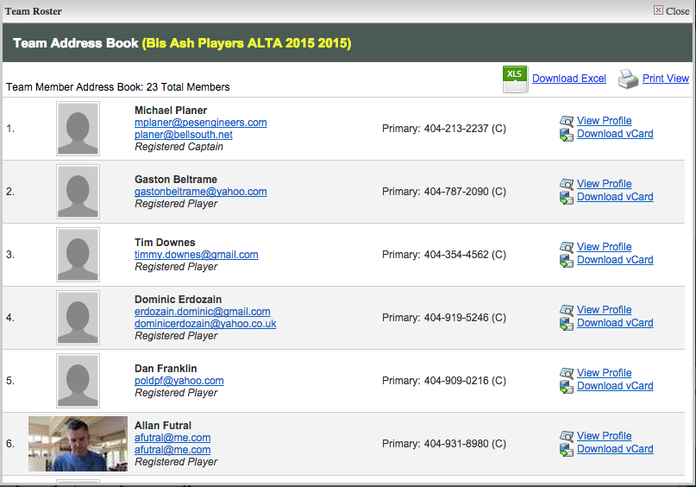

Player Dashboard
Team Address Book

Slide 11
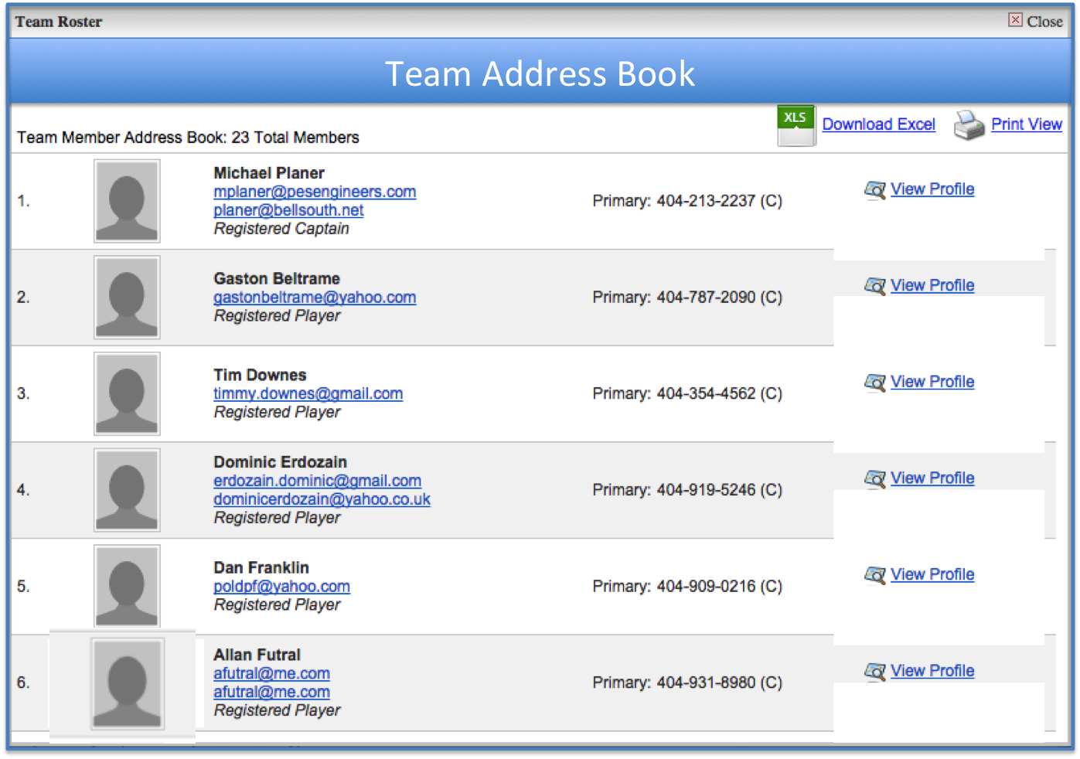

Slide 12
Calendar Scheduling
July
1
1
1
1
1
1
1
morning
morning
morning
morning
morning
morning
morning
☐
☐
☐
☐
☐
☐
☐
midday
midday
midday
midday
midday
midday
midday
☐
☐
☐
☐
☐
☐
☐
evening
evening
evening
evening
evening
evening
evening
☐
☐
☐
☐
☐
☐
☐
1
1
1
1
1
1
1
morning
morning
morning
morning
morning
morning
morning
☐
☐
☐
☐
☐
☐
☐
midday
midday
midday
midday
midday
midday
midday
☐
☐
☐
☐
☐
☐
☐
evening
evening
evening
evening
evening
evening
evening
☐
☐
☐
☐
☐
☐
☐
1
1
1
1
1
1
1
morning
morning
morning
morning
morning
morning
morning
☐
☐
☐
☐
☐
☐
☐
midday
midday
midday
midday
midday
midday
midday
☐
☐
☐
☐
☐
☐
☐
evening
evening
evening
evening
evening
evening
evening
☐
☐
☐
☐
☐
☐
☐
1
1
1
1
1
1
1
morning
morning
morning
morning
morning
morning
morning
☐
☐
☐
☐
☐
☐
☐
midday
midday
midday
midday
midday
midday
midday
☐
☐
☐
☐
☐
☐
☐
evening
evening
evening
evening
evening
evening
evening
☐
☐
☐
☐
☐
☐
☐
1
1
1
1
1
1
1
morning
morning
morning
morning
morning
morning
morning
☐
☐
☐
☐
☐
☐
☐
midday
midday
midday
midday
midday
midday
midday
☐
☐
☐
☐
☐
☐
☐
evening
evening
evening
evening
evening
evening
evening
☐
☐
☐
☐
☐
☐
☐

Slide 13
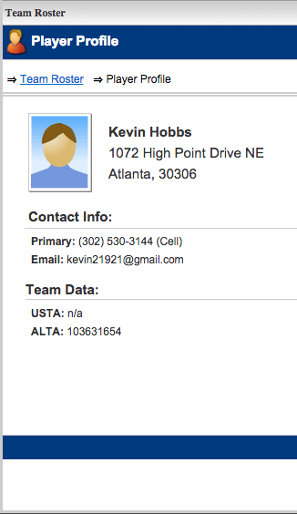
Player Profile

Slide 14
