Slide 1
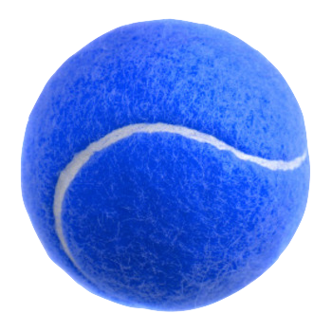
WDI_ATL_3_Project 2
TennisGr up
Tennis Club Mobile Responsive App

Slide 2
Database Models
PLAYERS
PK | player_id
 | first_name
 | last_name
 | user_name
 | password
 | photo
 | team_name
 | role
 | gender
 | age_category
 | skill_level
 | record_ind
 | record_team
 | phone_num
 | phone_type
 | email
 | dow_pref1
 | time_pref1
 | dow_pref2
 | time_pref2
 | password_digest
 | remember_token
 | created_at
 | updated_at
FK | match_id
MATCHES
PK | match_id
 | match_datetime
 | match_loc
 | match_note
 | match_opp
 | match_outcome
 | match_score
FK | player_id
TEAMS
PK | team_id
FK | match_id
FK | player_id

Slide 3

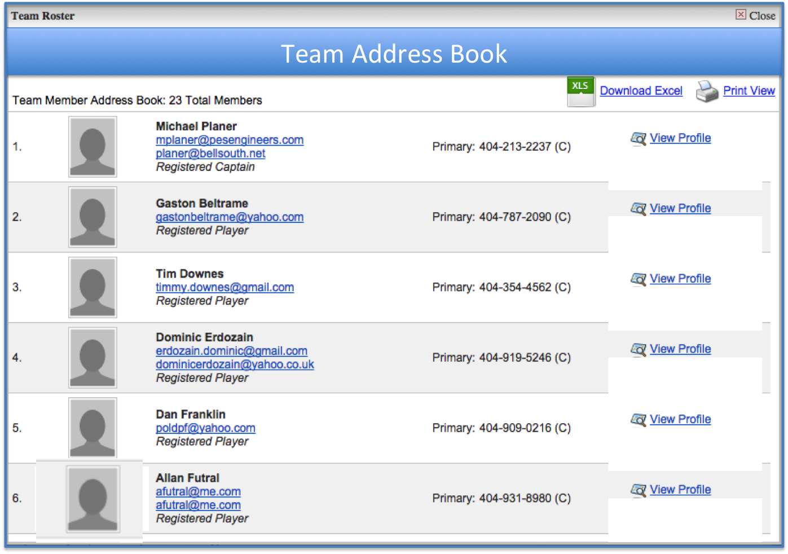

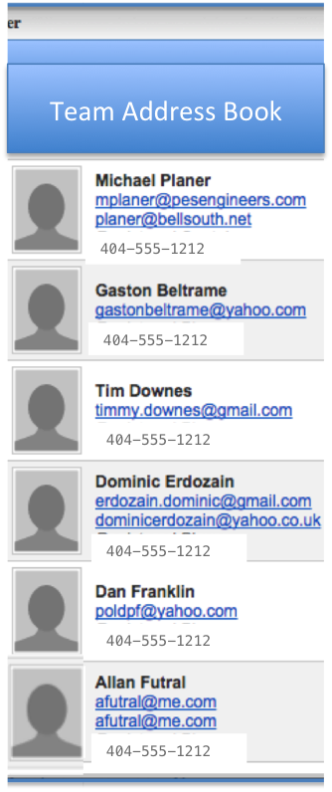
Address Book View

Slide 4
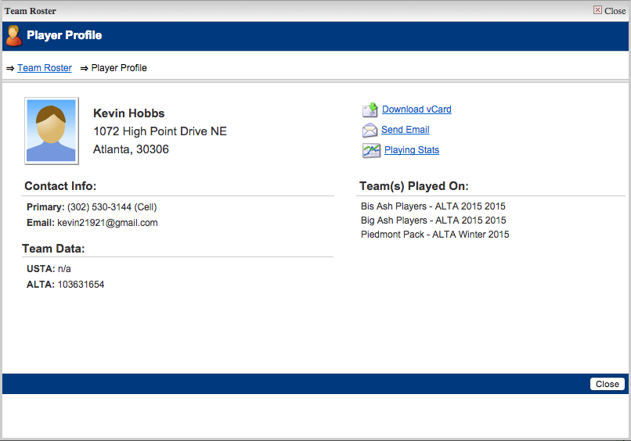
Profile View

Slide 5
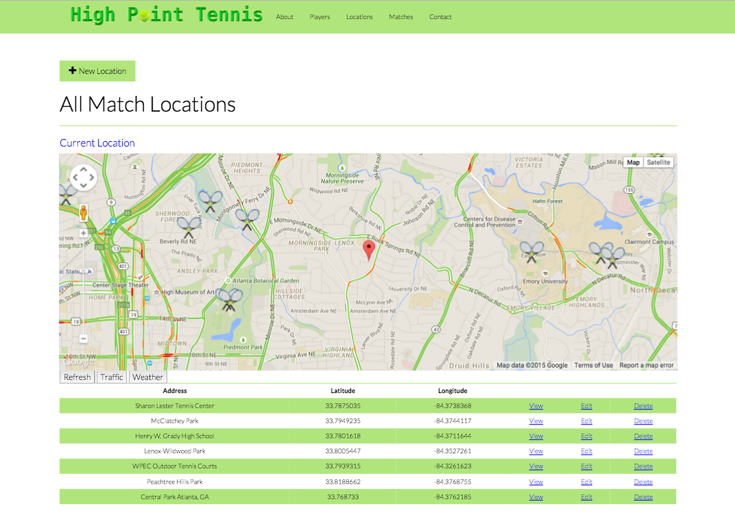
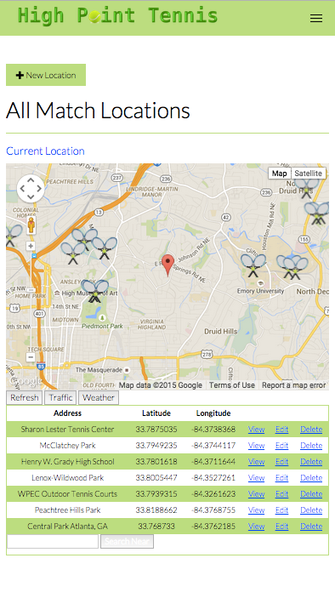
Match Location Search

Slide 6
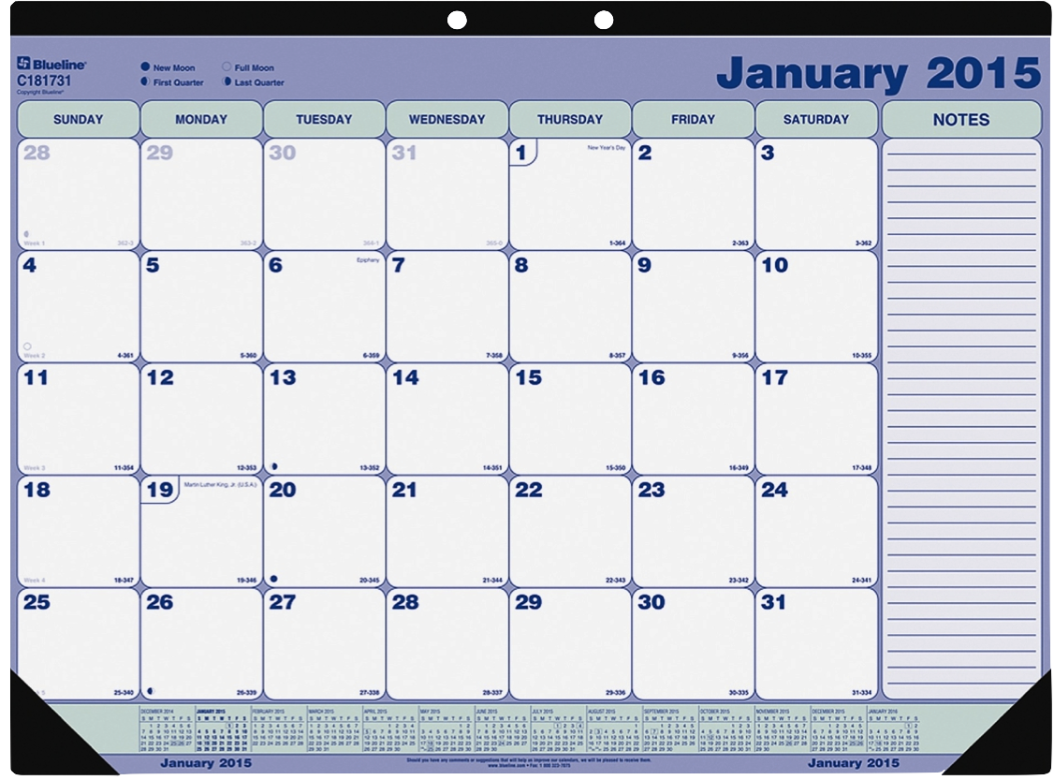
Calendar View

Slide 8
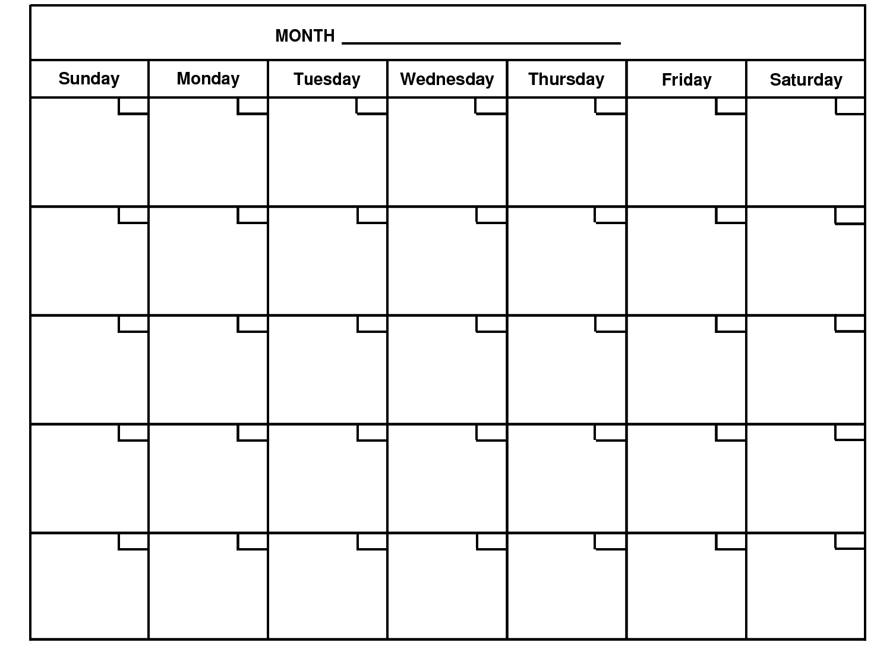
Calendar Scheduling
July
1
2
3
4
5
6
morning
morning
morning
morning
morning
morning
morning
☐
☐
☐
☐
☐
☐
☐
midday
midday
midday
midday
midday
midday
midday
☐
☐
☐
☐
☐
☐
☐
evening
evening
evening
evening
evening
evening
evening
☐
☐
☐
☐
☐
☐
☐
7
8
9
10
11
12
13
morning
morning
morning
morning
morning
morning
morning
☐
☐
☐
☐
☐
☐
☐
midday
midday
midday
midday
midday
midday
midday
☐
☐
☐
☐
☐
☐
☐
evening
evening
evening
evening
evening
evening
evening
☐
☐
☐
☐
☐
☐
☐
14
15
16
17
18
19
20
morning
morning
morning
morning
morning
morning
morning
☐
☐
☐
☐
☐
☐
☐
midday
midday
midday
midday
midday
midday
midday
☐
☐
☐
☐
☐
☐
☐
evening
evening
evening
evening
evening
evening
evening
☐
☐
☐
☐
☐
☐
☐
21
22
23
24
25
26
27
morning
morning
morning
morning
morning
morning
morning
☐
☐
☐
☐
☐
☐
☐
midday
midday
midday
midday
midday
midday
midday
☐
☐
☐
☐
☐
☐
☐
evening
evening
evening
evening
evening
evening
evening
☐
☐
☐
☐
☐
☐
☐
28
29
30
31
morning
morning
morning
morning
morning
morning
morning
☐
☐
☐
☐
☐
☐
☐
midday
midday
midday
midday
midday
midday
midday
☐
☐
☐
☐
☐
☐
☐
evening
evening
evening
evening
evening
evening
evening
☐
☐
☐
☐
☐
☐
☐

Slide 9
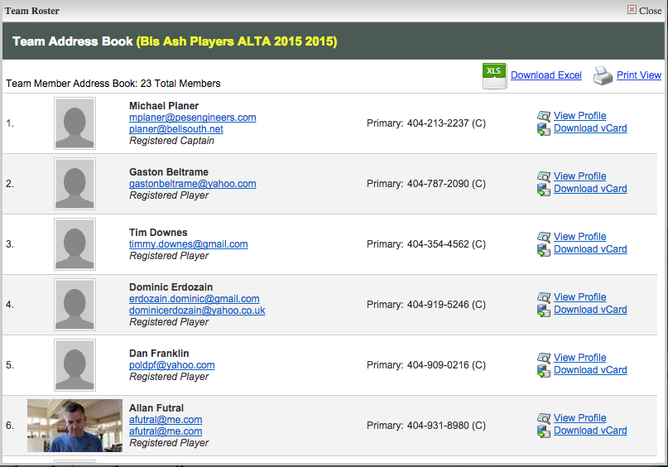

Player Dashboard
Team Address Book

Slide 11
Calendar Scheduling
July
1
1
1
1
1
1
1
morning
morning
morning
morning
morning
morning
morning
☐
☐
☐
☐
☐
☐
☐
midday
midday
midday
midday
midday
midday
midday
☐
☐
☐
☐
☐
☐
☐
evening
evening
evening
evening
evening
evening
evening
☐
☐
☐
☐
☐
☐
☐
1
1
1
1
1
1
1
morning
morning
morning
morning
morning
morning
morning
☐
☐
☐
☐
☐
☐
☐
midday
midday
midday
midday
midday
midday
midday
☐
☐
☐
☐
☐
☐
☐
evening
evening
evening
evening
evening
evening
evening
☐
☐
☐
☐
☐
☐
☐
1
1
1
1
1
1
1
morning
morning
morning
morning
morning
morning
morning
☐
☐
☐
☐
☐
☐
☐
midday
midday
midday
midday
midday
midday
midday
☐
☐
☐
☐
☐
☐
☐
evening
evening
evening
evening
evening
evening
evening
☐
☐
☐
☐
☐
☐
☐
1
1
1
1
1
1
1
morning
morning
morning
morning
morning
morning
morning
☐
☐
☐
☐
☐
☐
☐
midday
midday
midday
midday
midday
midday
midday
☐
☐
☐
☐
☐
☐
☐
evening
evening
evening
evening
evening
evening
evening
☐
☐
☐
☐
☐
☐
☐
1
1
1
1
1
1
1
morning
morning
morning
morning
morning
morning
morning
☐
☐
☐
☐
☐
☐
☐
midday
midday
midday
midday
midday
midday
midday
☐
☐
☐
☐
☐
☐
☐
evening
evening
evening
evening
evening
evening
evening
☐
☐
☐
☐
☐
☐
☐

Slide 12
Player Profile

Slide 13
