Slide 1
Electronics & Python
Hobby, Martin, ` Week 1 – Day 2

Slide 2
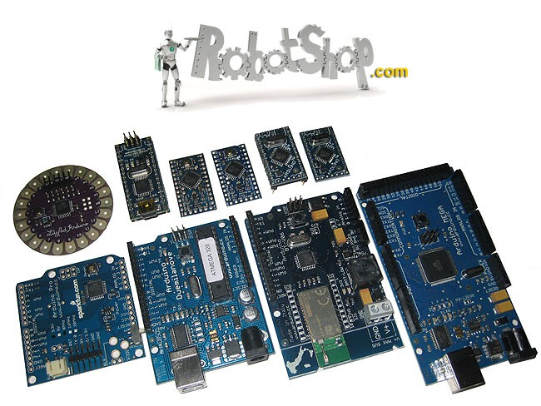
What Is a Microcontroller?
Small, programmable computer on a chip. Controls input/output devices. Examples: Raspberry Pi Pico, Arduino
Microcontrollers are the brains behind smart devices. affordable, powerful, and perfect for data logging.

Slide 3
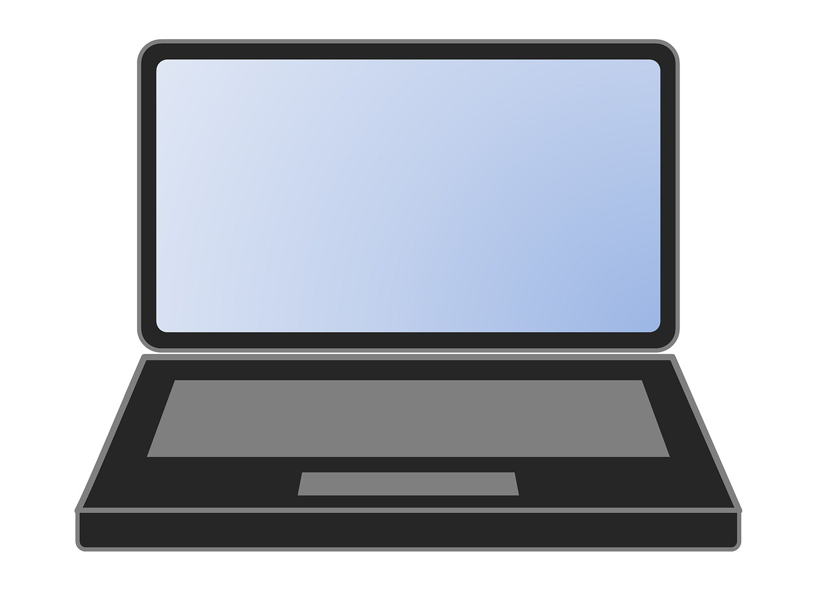
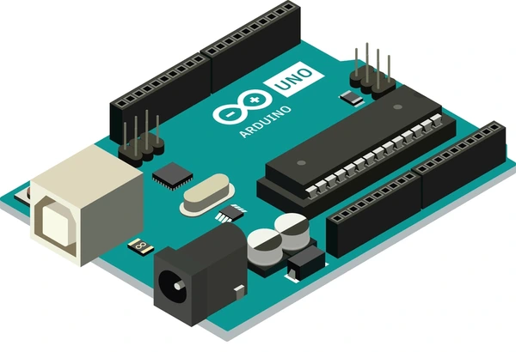
Laptop vs Microcontroller
Energy consuming
Expensive
powerful
larger memory
Energy efficient
Cheap
Not as powerful as big computers
Smaller memory

Slide 4
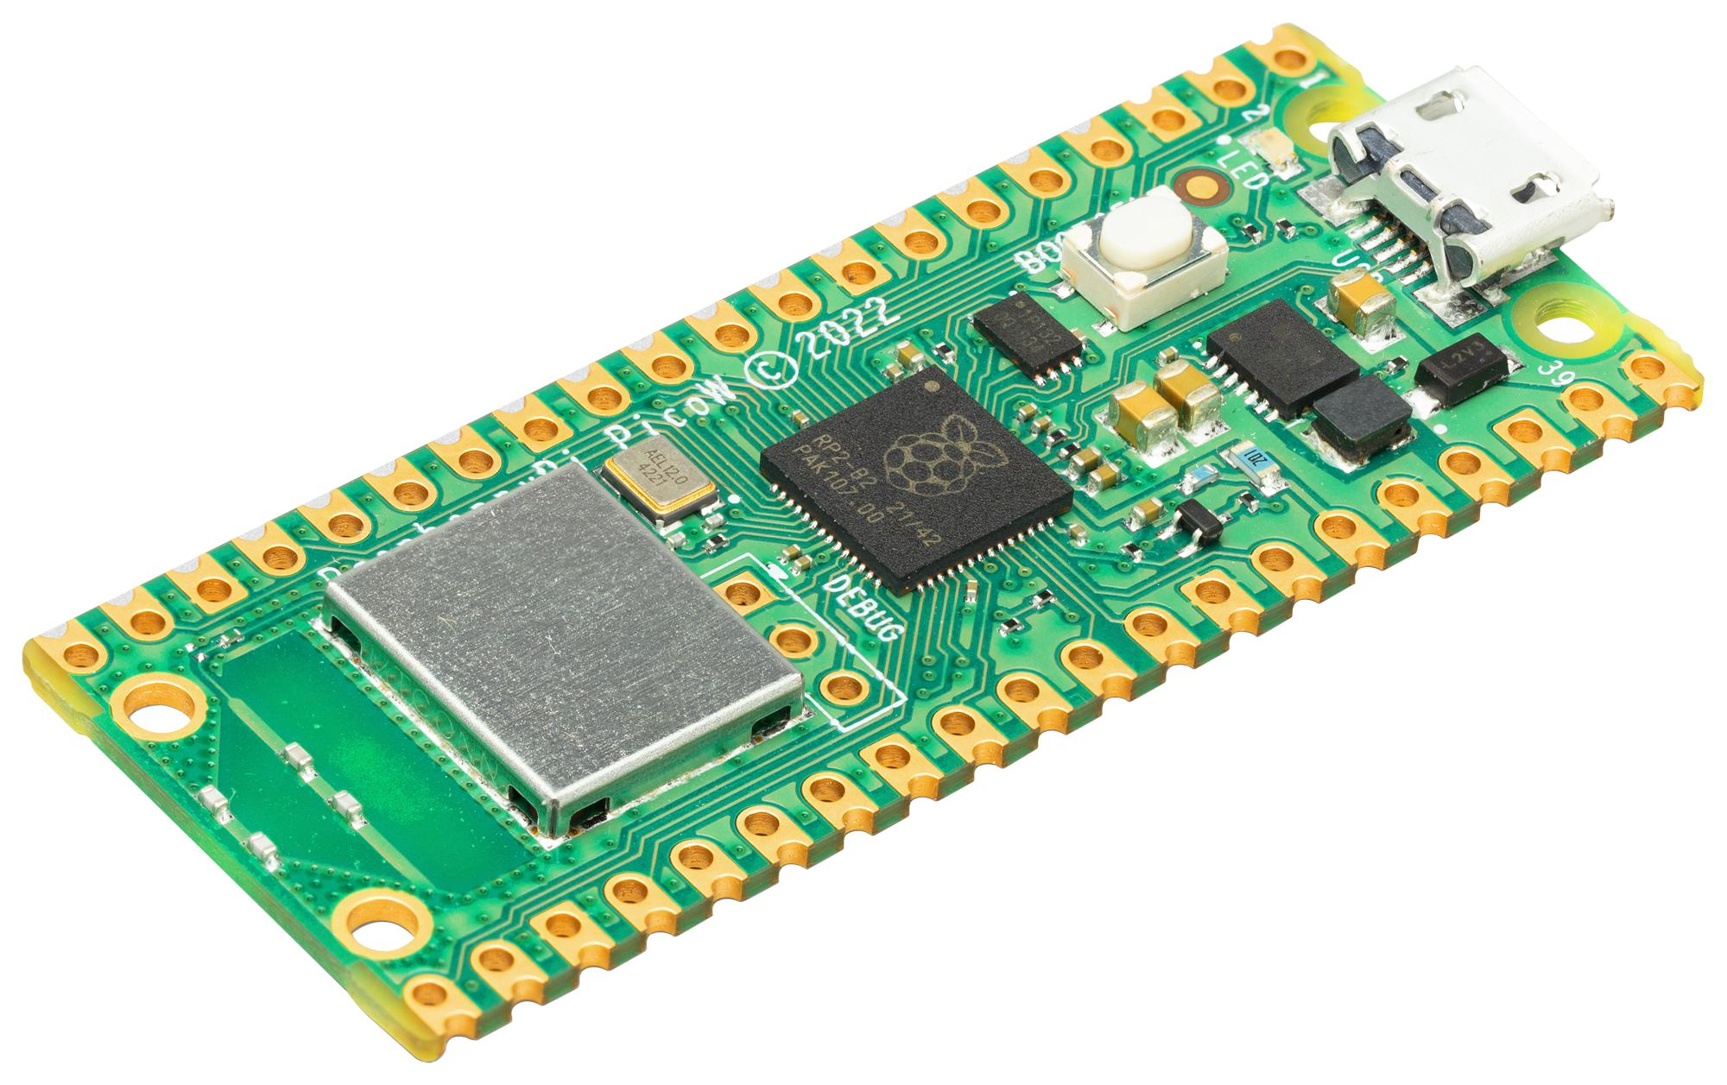
Raspberry Pi Pico Overview
Has GPIO pins
USB connectivity
Supports CircuitPython and MicroPython
The Pico is ideal for beginners as it uses python

Slide 5
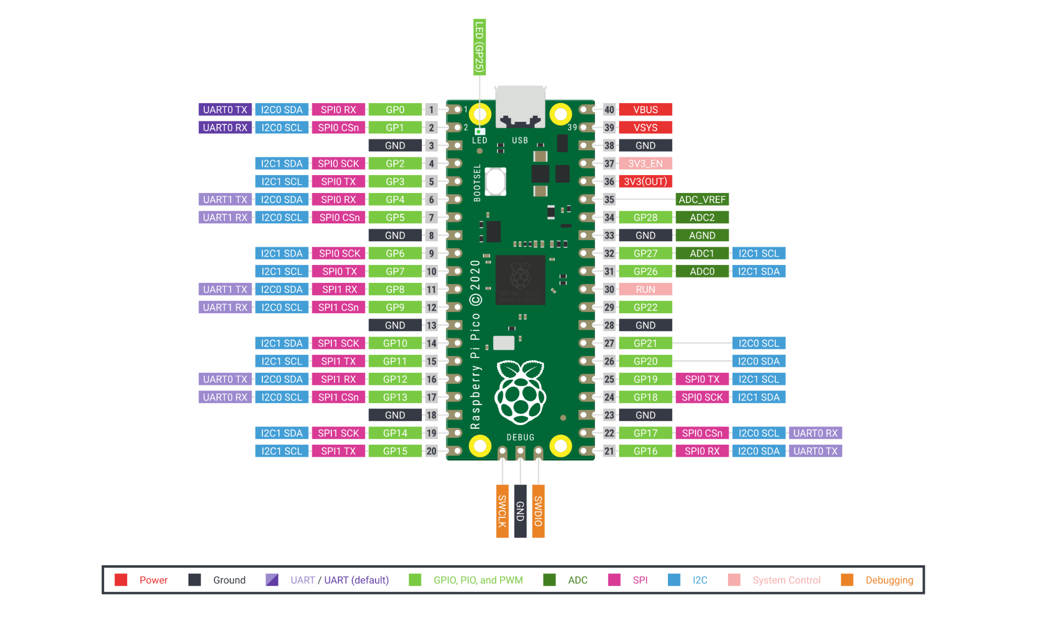
Pico pinout

Slide 6
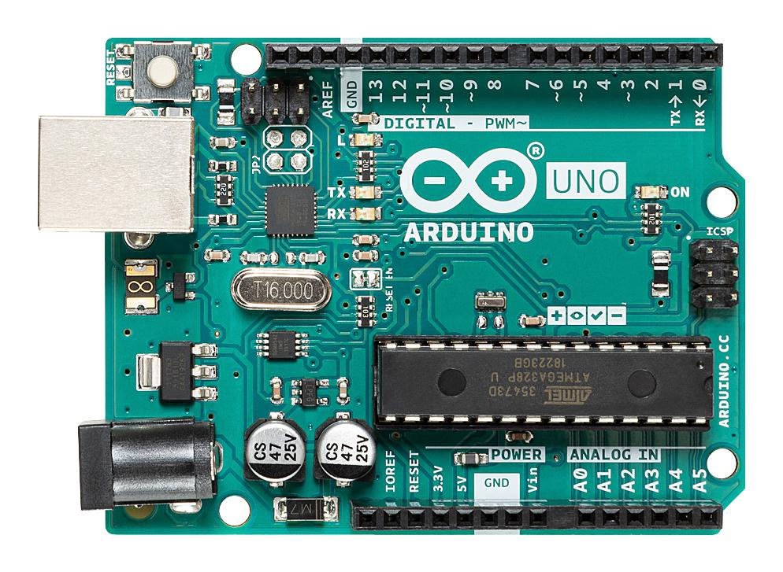
Arduino Overview
Faster and more compressed
USB connectivity
Supports C++

Slide 7
Components Basics

Slide 8
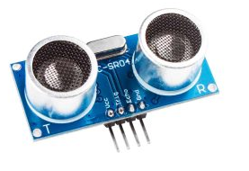
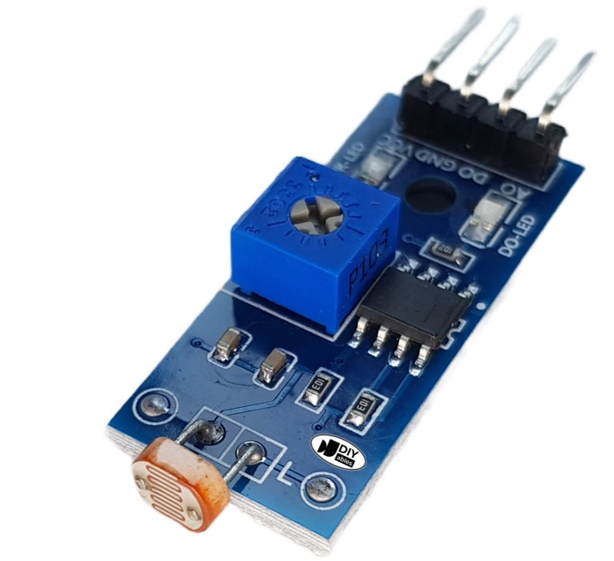
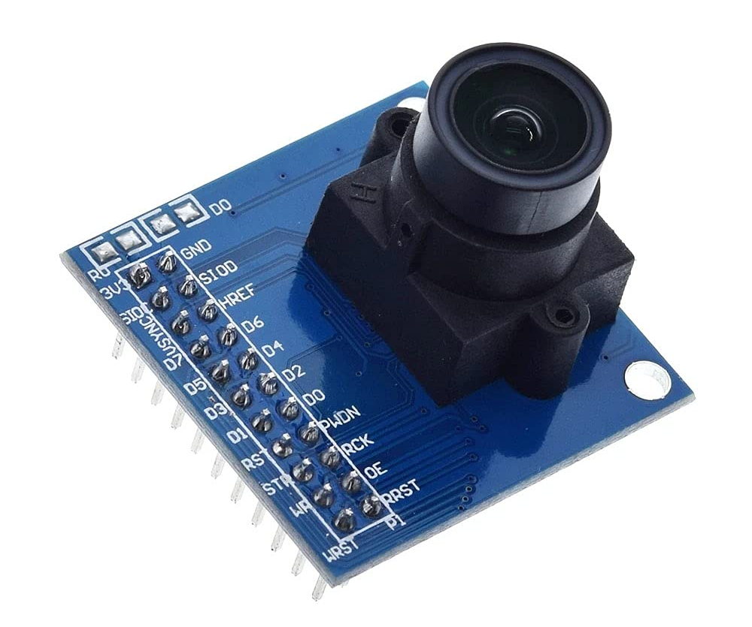
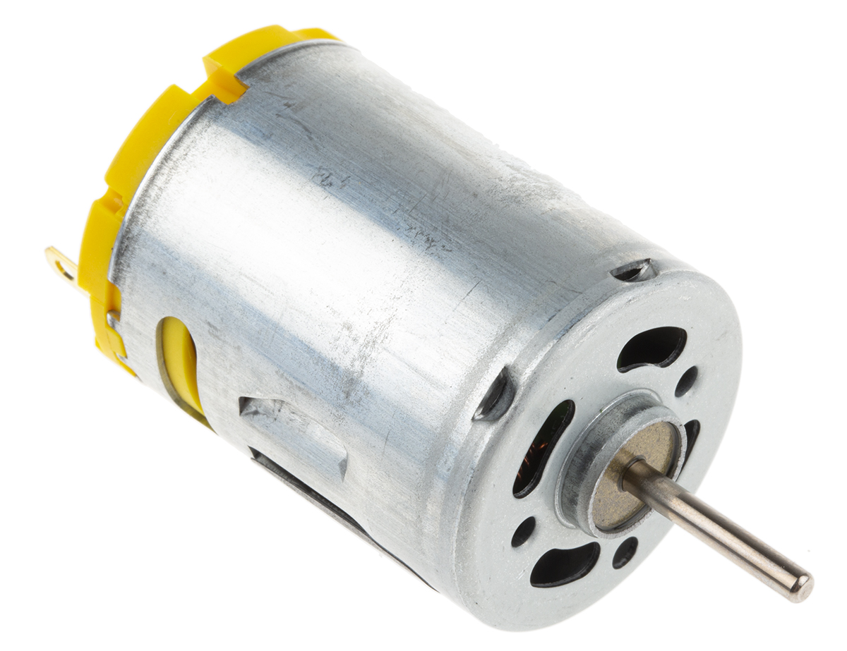
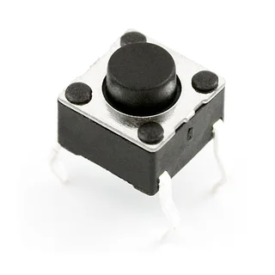
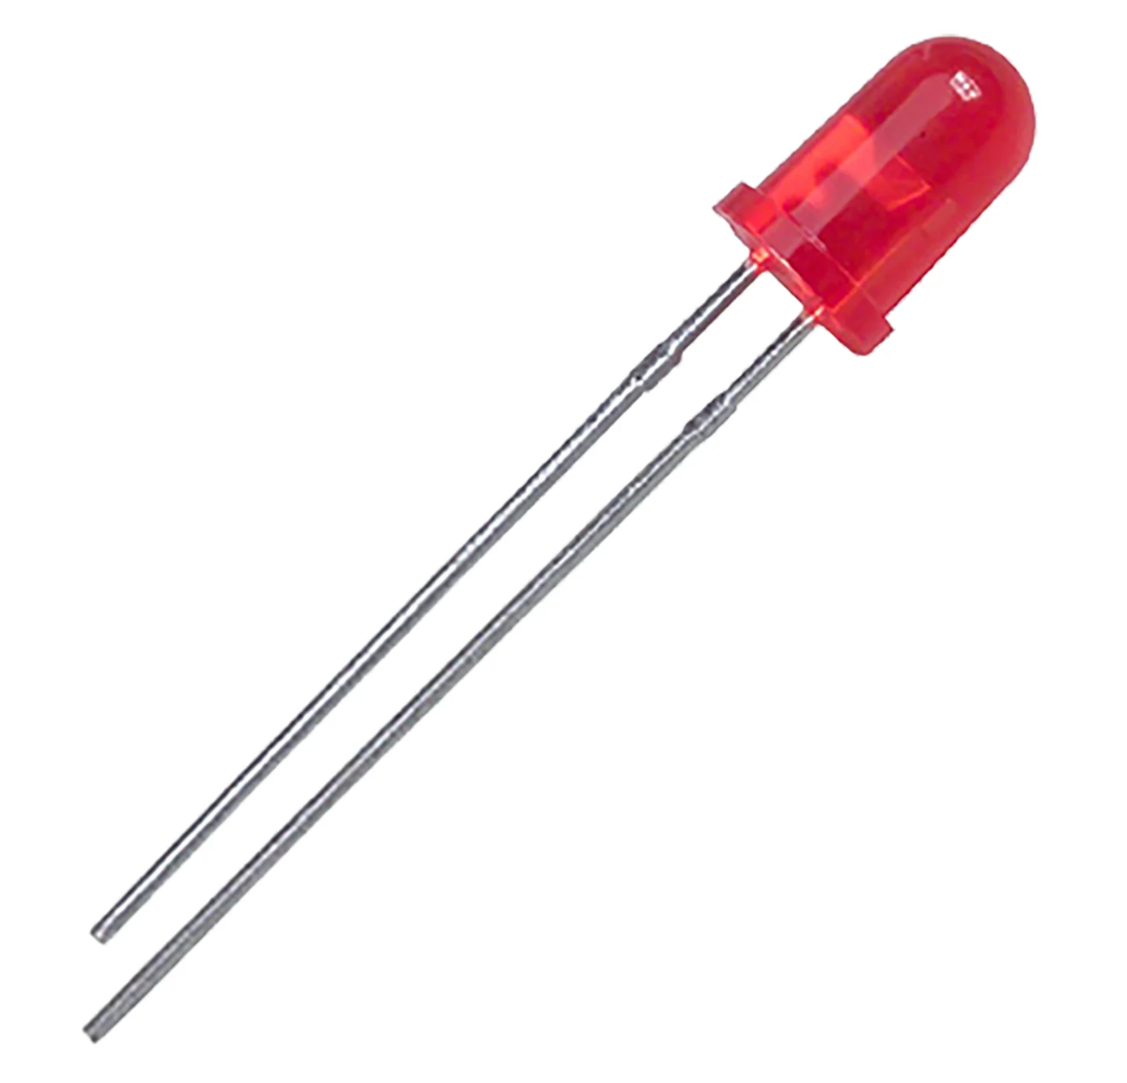
Input vs Output Devices
Type | Examples | Function
Input | Buttons, sensors | Send data to Pico
Output | LEDs, buzzers, motors | Receive commands from Pico

Slide 9
Sensors
Digital sensors: On/off signals (e.g., PIR motion sensor)
Analog sensors: Range of values (e.g., soil moisture sensor, microphones)
Common sensors: DHT11 (temp/humidity), CO2, ultrasonic (distance)
We’ll use them to collect environmental data for machine learning.

Slide 10
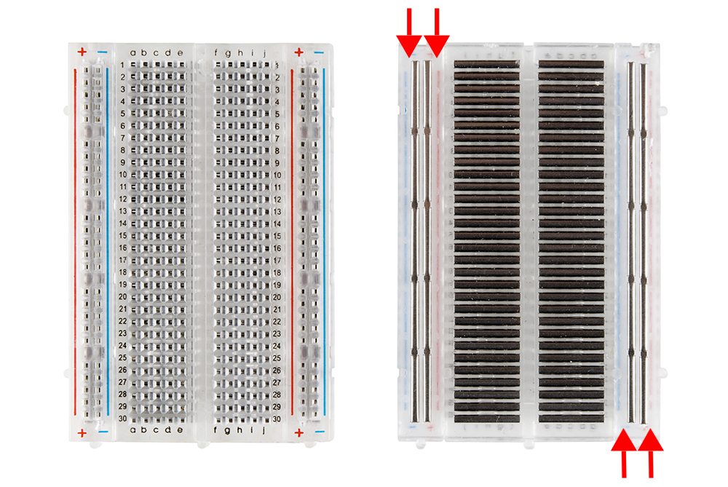
Breadboard
Breadboard: tool for prototyping circuits
Use jumper wires for connections
Check voltage limits (Pico: 3.3V logic)
Always double-check your wiring. Mistakes can damage components or give false readings

Slide 11
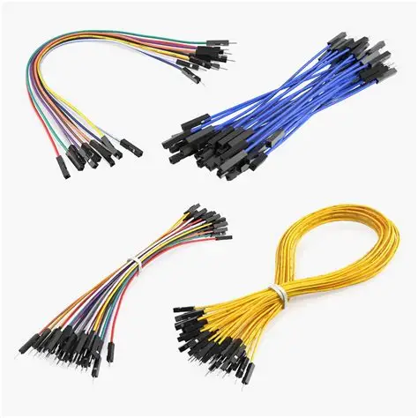
Jumper Wires
flexible, reusable wires used to connect components between a breadboard and a microcontroller
Types of Jumper Wires:
Male-to-Male: Pins on both ends.
Male-to-Female: One pin, one socket
Female-to-Female: Sockets on both ends
Use short wires to reduce clutter, Avoid crossing wires unnecessarily and Check connections before powering up

Slide 12
CircuitPython

Slide 13
About Circuit python
Python for Hardware / microcontrollers
Key libraries :
digitalio - for buttons/LEDs
analogio - for analog sensors
time - for delays
Checking Installed CircuitPython Modules
>> help("modules")

Slide 14
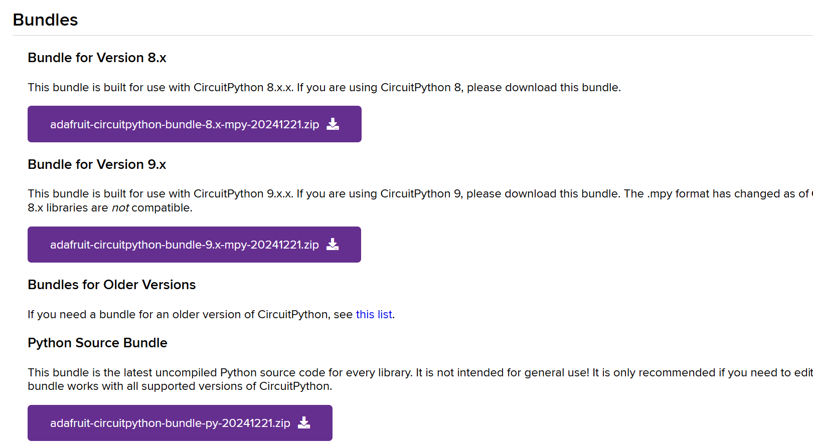
Libraries
https://circuitpython.org/libraries

Slide 15
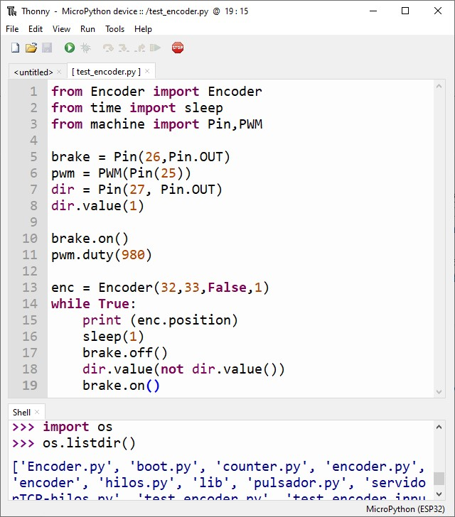
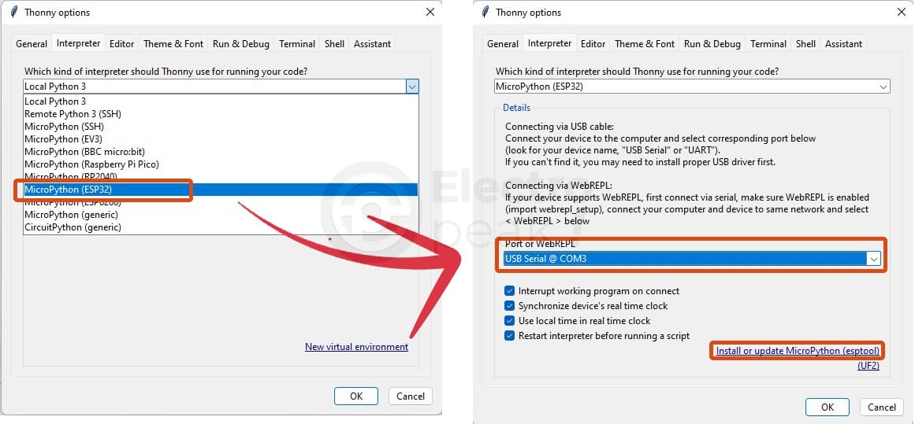
Installing
Download a software called thonny IDE
This will allow you to connect to the device

Slide 16
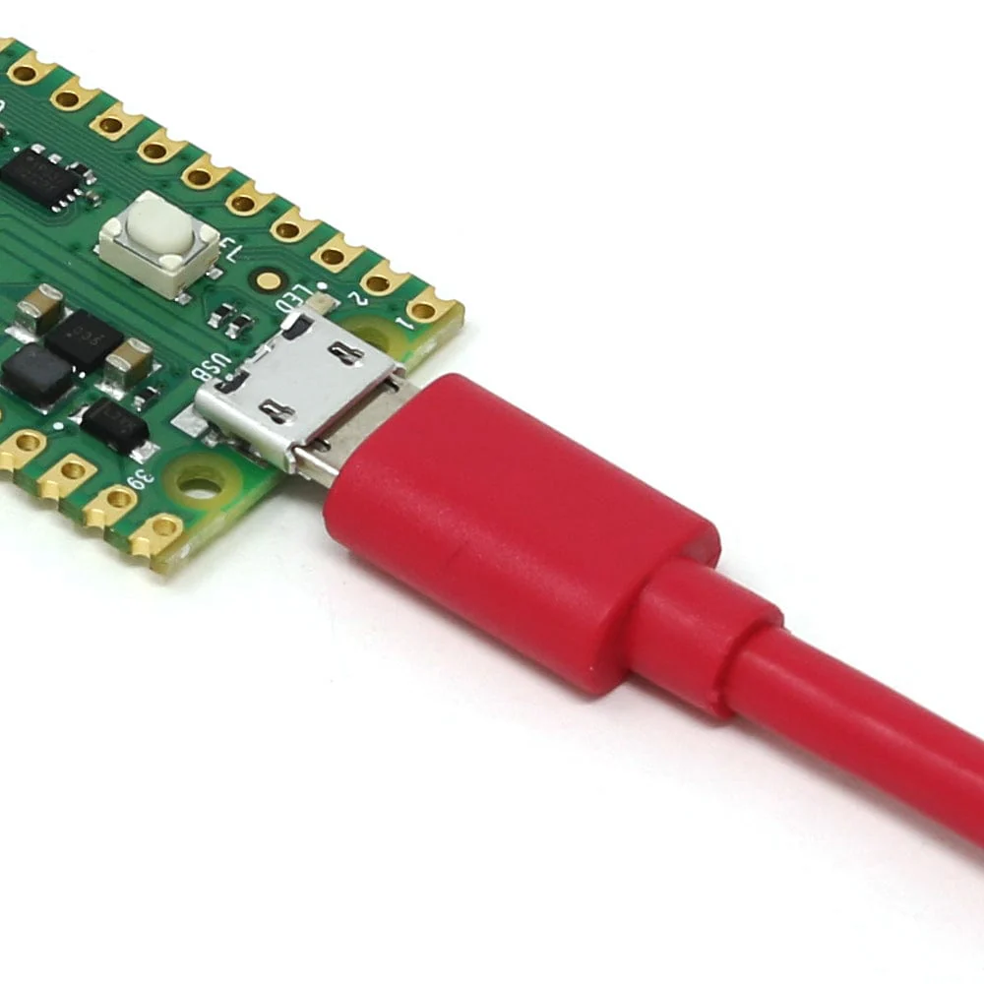
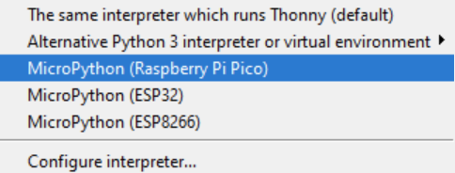
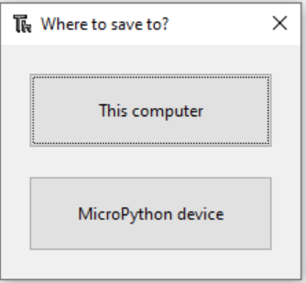
Booting
Download Thonny IDE: https://thonny.org/
Connect the robot via microUSB
Connect the device by changing the interpreter in the bottom right corner of the IDE
Once connected you can select where you wish to save code.
code.py (CircuitPython) will launch on boot

Slide 17
Getting CPU Temperature
import microcontroller
temperature = microcontroller.cpu.temperature
print("CPU Temperature:", temperature)
Reads the internal temperature of the Pico’s CPU
Can be logged like any other sensor data

Slide 18
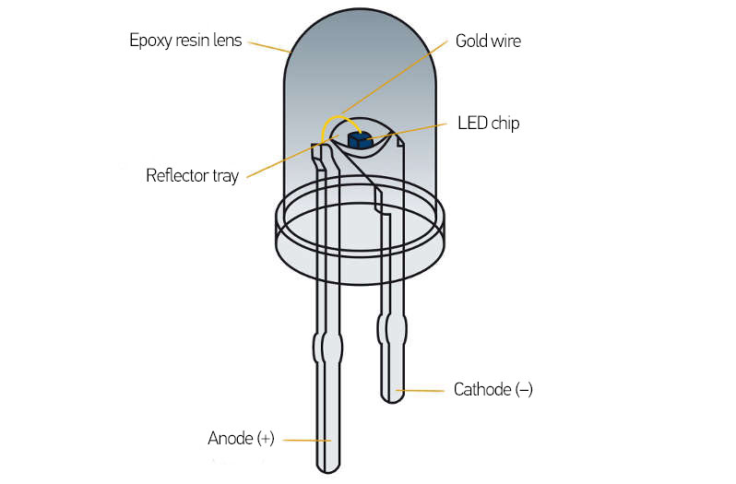
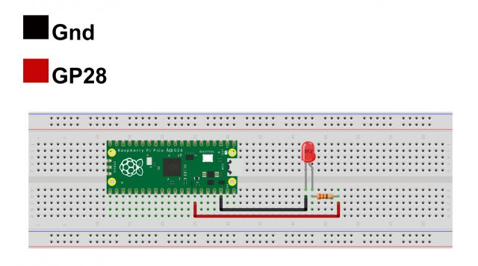
Controlling an LED with CircuitPython
import board
import digitalio
import time
led = digitalio.DigitalInOut(board.GP28)
led.direction = digitalio.Direction.OUTPUT
while True:
led.value = True # LED ON
time.sleep(1)
led.value = False # LED OFF
time.sleep(1)
Digital output
Turns an LED on and off every second

Slide 19
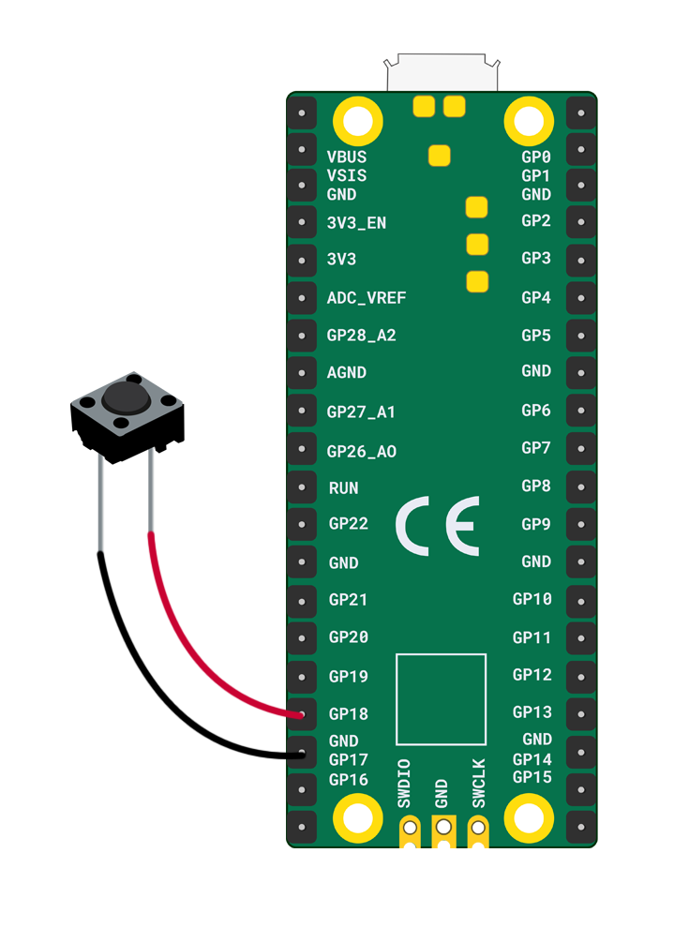
Detecting Button Presses
import board
import digitalio
button = digitalio.DigitalInOut(board.GP18)
button.direction = digitalio.Direction.INPUT
button.pull = digitalio.Pull.UP
while True:
if not button.value:
print("Button pressed!")
Digital input
Detects when a button connected to GP18 is pressed
Can be extended to trigger LEDs or log events

Slide 20
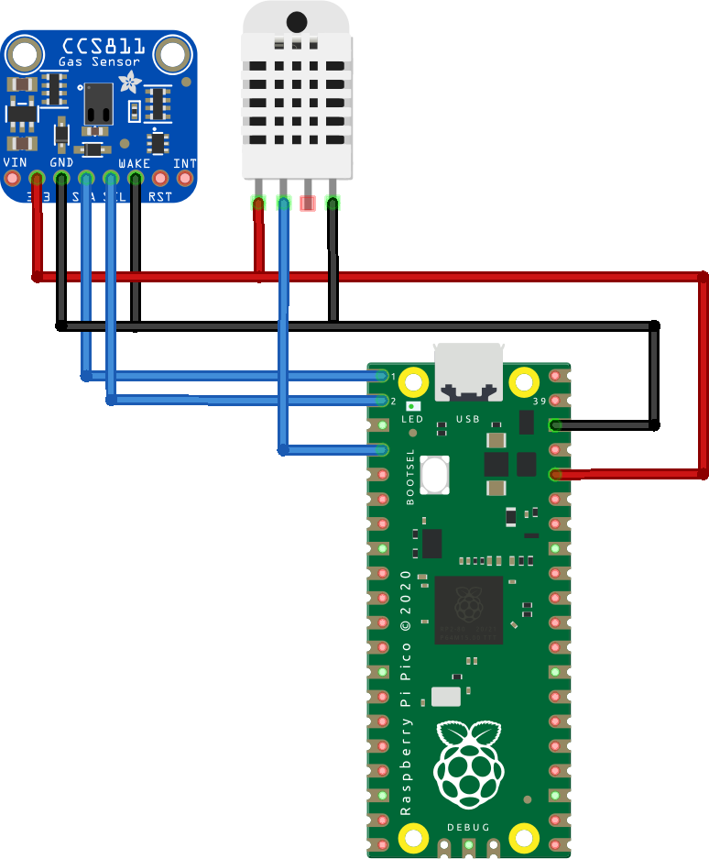
Temperature & Humidity Sensor
import board
import adafruit_dht
import time
dht_device = adafruit_dht.DHT11(board.GP15)
while True:
try:
temperature = dht_device.temperature
humidity = dht_device.humidity
print(f"Temp: {temperature}°C Humidity: {humidity}%")
except RuntimeError as error:
print(error.args[0])
time.sleep(2)
Uses the adafruit_dht library.
Reads temperature and humidity every 2 seconds

Slide 21
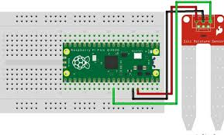
Soil Moisture Sensor (Analog)
import board
import analogio
import time
moisture = analogio.AnalogIn(board.A0)
def get_voltage(pin):
return (pin.value * 3.3) / 65536
while True:
voltage = get_voltage(moisture)
print("Soil moisture voltage:", voltage)
time.sleep(1)
Reads analog voltage from a soil moisture sensor.
Higher voltage = drier soil; lower voltage = wetter soil

Slide 22
Labs

Slide 23
Tasks
Get an LED blinking on and off with intervals of 1 second
Place in a button so the LED only lights up when the button is pressed
Now have it so the button toggles on and off the light instead of holding it down

Slide 24
Make a game
The game should have three buttons and 3 LEDs, plus a green and red LED.
The game will flash the LEDs in a different random order, then wait for the user to press the buttons in that order. As soon as a mistake is made the red LED blinks and the game restarts. If the user enters the correct sequence the green LED blinks and another random sequence will play.
EXTENSION: have the sequences get longer and longer as the game goes on
Further EXTENSION: Use other sensors for your game rather than just buttons

Slide 25
Wrap-Up & Preview of Day 2
Tomorrow: Electronics & sensor basics
Lab: Build a memory game with buttons and LEDs
Great start today! Tomorrow, we dive into hardware and sensors get ready to build.

Slide 26
Timetable | Mon | Tue | Wed | Thu | Fri | Sat | Sun | Mon | Tue | Wed | Thu | Fri
Lecture (1.5 hours) | 11:00am | 10:30am | 10:30am | 10:30am | 10:30am |  |  | 10:30am | 10:30am | 10:30am | 10:30am | 10:30am
Practical (2 hours) | 13:00pm | 13:00pm | 13:00pm | 13:00pm | 13:00pm |  |  | 13:00pm | 13:00pm | 13:00pm | 13:00pm | 13:00pm
Time table

