Slide 1
Building Electronics for ML Data
Hobby, Martin ` Week 1 – Day 5

Slide 2
Goals
Explore ML on microcontrollers
Learn how to power and maintain devices in the field
Explore memory and storage limits
Plan sensor setups for ML ready data
This session connects everything we’ve done so far electronics, sensors, and data with ML and IOT.

Slide 3
The need for ML powered devices
Farmers need smart irrigation systems
Schools need air quality monitors
Cities need traffic and pollution sensors
Communities need affordable, local tech solutions

Slide 4
Real-World ML application

Slide 5
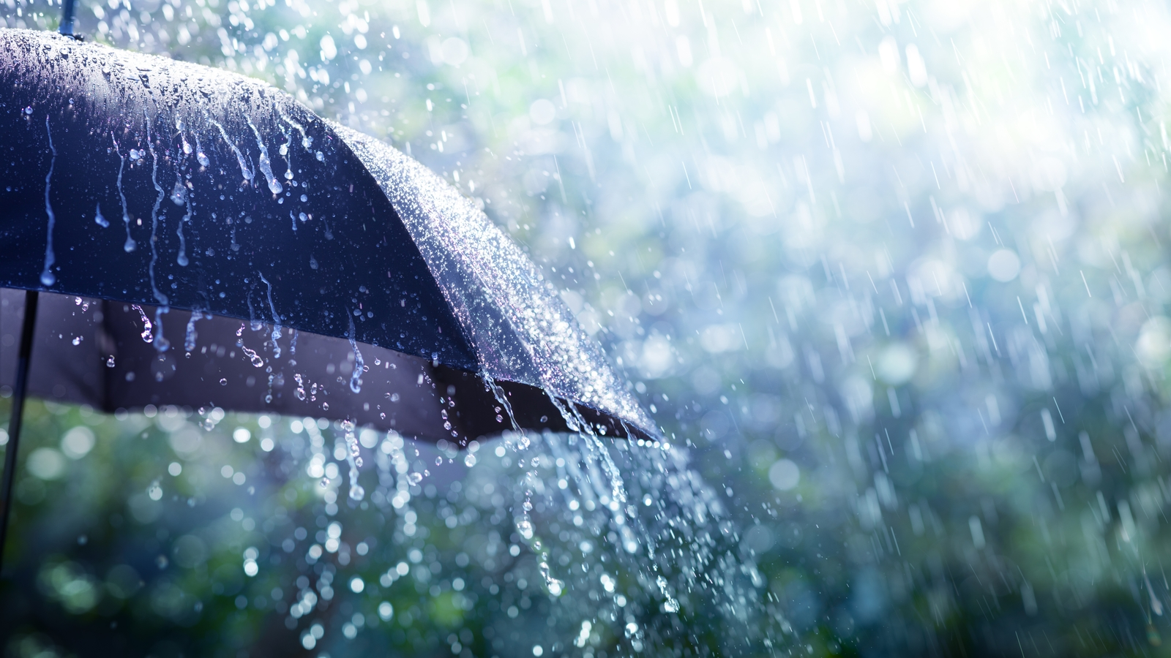
Predicting rainfall from humidity and pressure

Slide 6
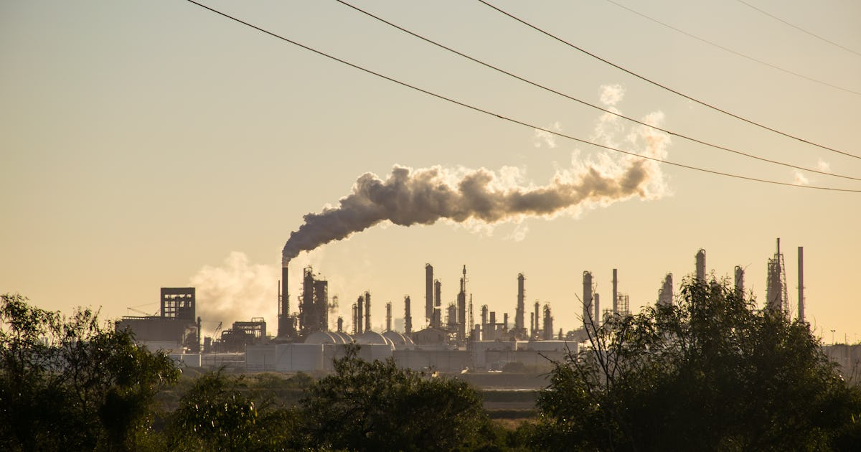
Estimating CO₂ levels in an area

Slide 7
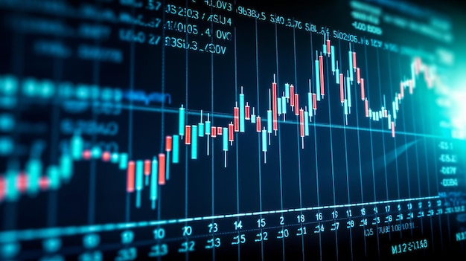
Forecast currency exchange rates

Slide 8
IoT systems

Slide 9
What Is IoT (Internet of Things)?
It’s a network of physical devices like sensors, microcontrollers, and appliances that collect and exchange data over the internet.
Smart irrigation systems
Weather stations
Home automation (lights, alarms)
Think of IoT as giving your devices the ability to talk to each other and to you

Slide 10
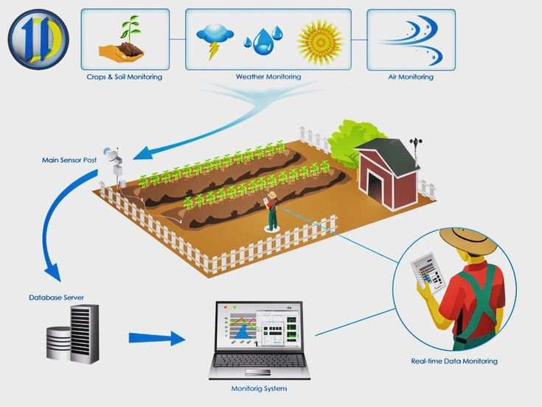
IoT Architecture
Sensor >> Microcontroller >> Network >> Cloud >> User Interface
Add Wi-Fi or LoRa to your Raspberry Pi Pico, and it becomes part of a smart network

Slide 11
IoT Communication Options
Method | Range | Power Use | Use Case
WiFi | Medium | High | Home/office networks
LoRa | Long | Low | Rural field sensors
Bluetooth | Short | Low | indoor use
LoRa is great for agriculture. Wi-Fi works well in schools or homes

Slide 12
Preparing Devices for Field work

Slide 13
Making Good Electronics
Sensors must be accurate and reliable
Data must be clean and consistent
Devices must run continuously in the field
Power and memory must be managed carefully

Slide 14
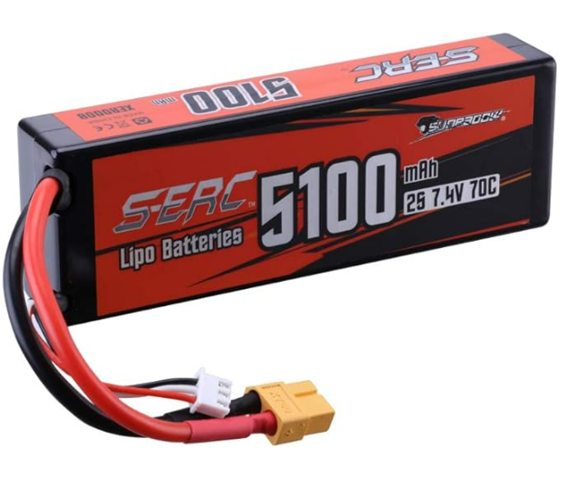
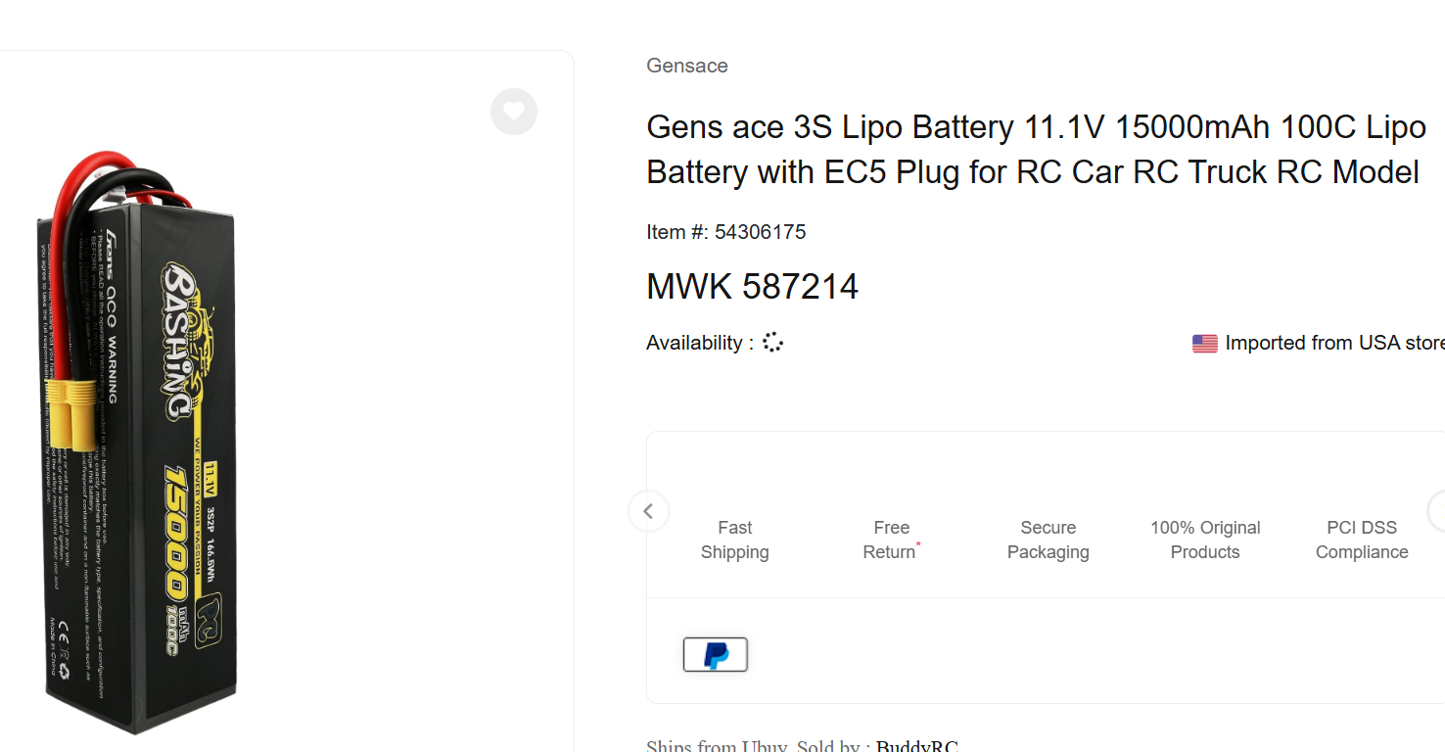
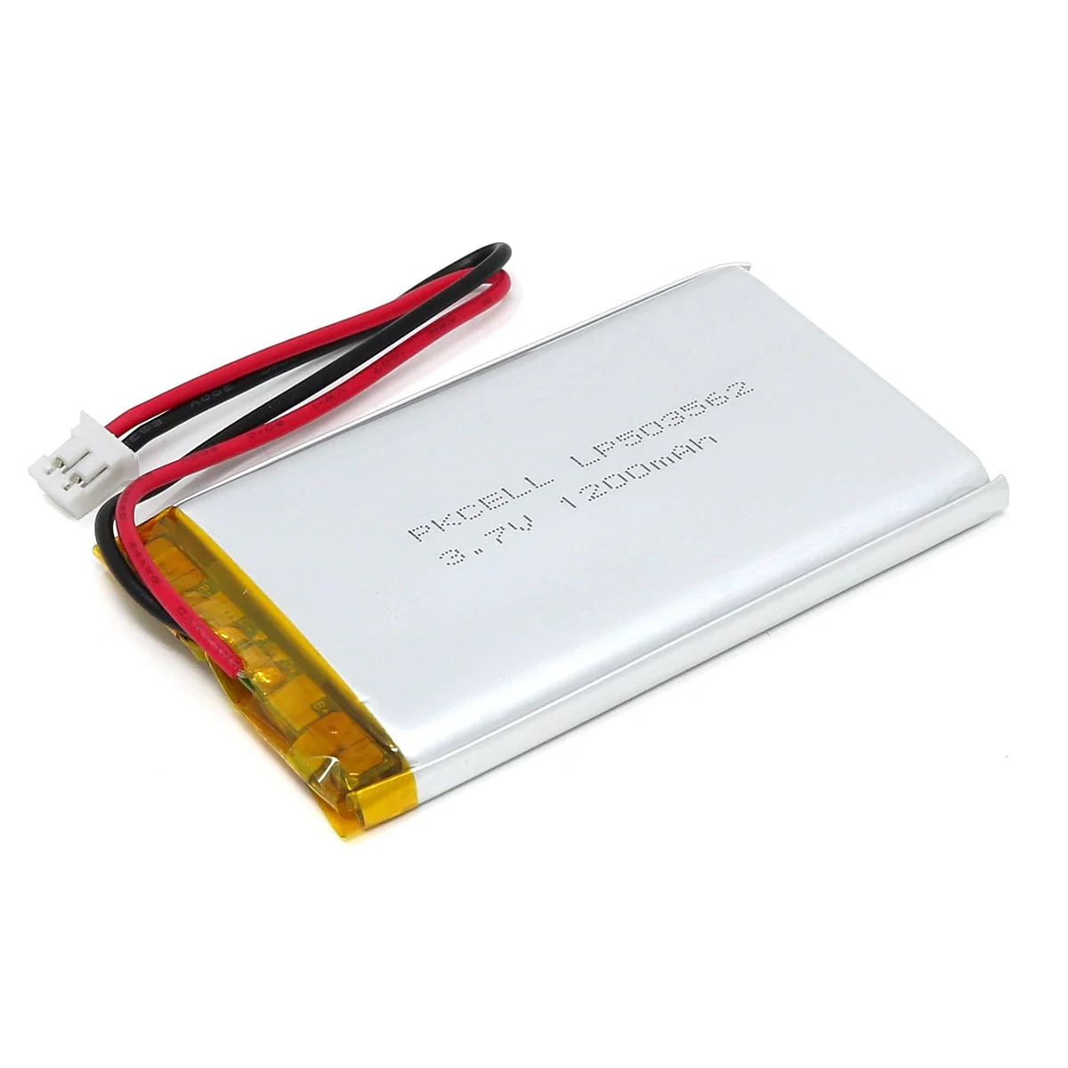
Options for powering data loggers
USB power banks
Rechargeable Li-ion batteries
Solar panels + charge controller
AA battery packs

Slide 15
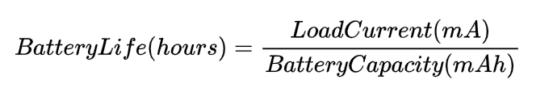
Battery technology
We can calculate how long a battery will last
The battery capacity is on the datasheet for your battery
Equally we can calculate the current draw using a multimeter

Slide 16
Example – calculating the required battery size & life span
Raspberry Pi Pico <- 50–100 mA
Humidity Sensor <- 2.5 mA
SD Card write <- 50–100 mA
Worst case scenario 100+2.5+100 = 202.5 mA
Battery = 1200 mAh
Total_time = 1200/202 = 5.94 hours
Best case scenario 50+2.5+50=102.5mA -> 11.7 hours

Slide 17
Example
Lets say we want to leave it there for 3 days
3*24 = 72 hours
72 = battery / 202.5mA
Battery = 72 * 202.5 = 14580 mAh

Slide 18
Planning ML Tasks with Electronics

Slide 19
Questions you must have
What do I want to predict?
What sensors give me that data?
How often / frequent should I log?
How will I power and store it?

Slide 20
Example Task – Soil Moisture Prediction
Goal | Predict moisture from temp/humidity
Sensors | DHT11/22 + moisture sensor
Power | Power bank
Storage | SD card

Slide 21
Gathering good data

Slide 22
Choose appropriate sensors and tools
Select sensors or instruments that match the range, resolution, and accuracy required for your application.
Will your sensors actually influence the research question?
Using vibration sensors has nothing to do with soil moisture…. Or does it?

Slide 23
Optimize Data Sampling
Determine the correct sampling rate:
High enough to capture relevant details
Low enough to avoid unnecessary data and save storage/memory.
Consider averaging multiple readings to reduce noise if precision is more critical than time resolution.
You can always experiment the other side how much data is needed

Slide 24
Validate the Data Pipeline
Test your data logging setup with trial runs to check for:
Missing data points.
Unexpected noise or artifacts.
Sensor or logger failures.
You can also log errors in your datalogging as well as the data
if len(sensor_reads)!=5:
logger.log(“error too many”+str(sensor_reads))

Slide 25
Minimize Noise and Interference
Shield your sensors and cables from electromagnetic interference (EMI).
Avoid environmental factors that can skew data (e.g., vibrations, temperature changes, or lighting variations).
Or on the other hand, make sure to gather data across lots of different environmental factors if your model is going to be robust

Slide 26
Calibrate sensors
Perform proper calibration before starting. Uncalibrated sensors can lead to systematic errors.
Regularly re-calibrate if you’re collecting data over long periods or in harsh conditions.
For example, how do you know what moisture levels correspond to in analogue reading? Set up a control experiment and regression model to interpret this data

Slide 27
Debugging in the Field
Will the device you have made be able to endure its location?
Use LEDs for status indicators
Log errors to SD card
Test sensors before deployment
if sensor.value is None:
log_error("Sensor failed")

Slide 28
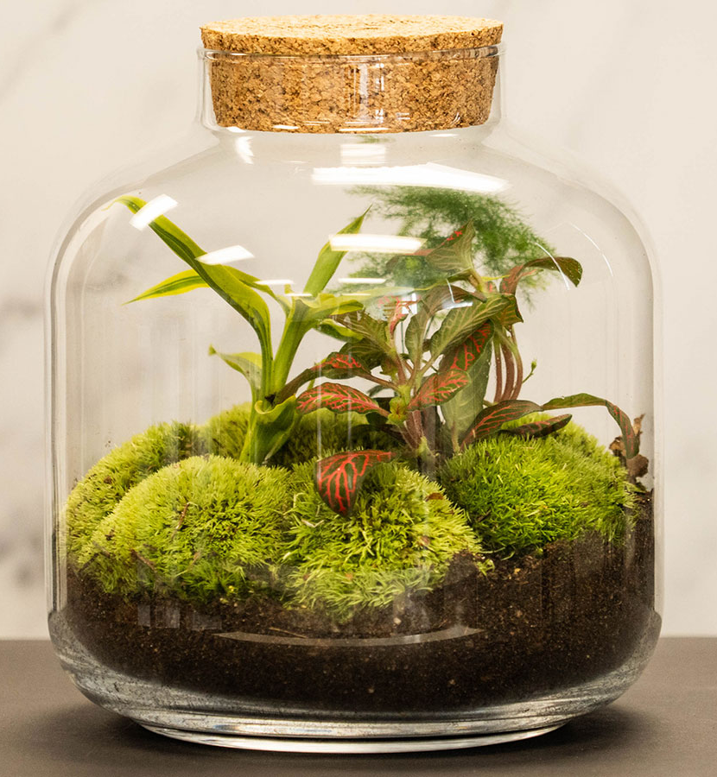
Maintaining Devices in the Field
Protect from dust and rain (use enclosures), check battery levels if using a power bank, and replace faulty sensors
A simple enclosure design may include plastic containers with labeled holes for sensor, ports and power switches.

Slide 29
Labs

Slide 30
Today’s tasks:
Build a multi-sensor data logger
Power it with battery or USB
Format data for ML
Deploy it in the field for data collection
Notes:
How they gathered data, what type of data, do you understand the complexity…

Slide 31
What to do now
Get an electronics kit and construct your device
Use at least two sensors in your datalogger (or use your phones for making image datasets)
Remember to remember which recording is which - label your data!

Slide 32
Where we will be going
We will be going out and taking our breadboard assembled dataloggers. We will then gather data that is appropriate to our experiment, but try stick together so we can help.

Slide 33
Preview of next session
Day 6: Regression & Prediction models
Great work today! 😎

Slide 34
Timetable | Mon | Tue | Wed | Thu | Fri | Sat | Sun | Mon | Tue | Wed | Thu | Fri
Lecture (1.5 hours) | 11:00am | 10:30am | 10:30am | 10:30am | 10:30am |  |  | 10:30am | 10:30am | 10:30am | 10:30am | 10:30am
Practical (2 hours) | 13:00pm | 13:00pm | 13:00pm | 13:00pm | 13:00pm |  |  | 13:00pm | 13:00pm | 13:00pm | 13:00pm | 13:00pm
Time table

