Slide 1
Data Logging Essentials
Hobby, Martin ` Week 1 – Day 3

Slide 2

What Is Data Logging?
The process of recording data from sensors or devices. The data is stored for later analysis, visualization, or machine learning.
Example:
A temperature sensor records the room temperature every 10 seconds and saves it to a file.

Slide 3
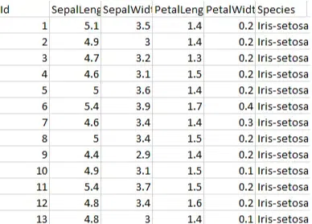
Why Log Data?
Track temperature, humidity, or rainfall over time
Monitor soil moisture to optimize irrigation
Detect air pollution or CO₂ levels
Log system performance or energy usage
💡 Logging rainfall or soil moisture can help farmers decide when to irrigate

Slide 4
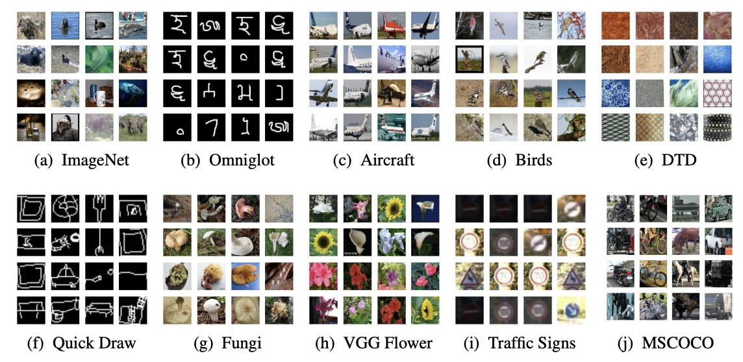
How about Online datasets?
A dataset is collection of data which can be used for making models
There might not be a dataset doing what you want or the existing datasets might not be well documented
https://www.kaggle.com/datasets
https://huggingface.co/

Slide 5
What Does a Data Logger Do?
Reads data from a sensor
Formats the data (e.g., adds a timestamp)
Saves it to storage (e.g., SD card)
Repeats this process at regular intervals
Example data:
2025-10-16 10:00:00, 24.5°C, 60% humidity

Slide 6
File Formats for Logging

Slide 7
File formats
CSV: Easy to work with in Excel or Python and Less memory is used
JSON: Structured, readable, good for web apps
TXT: Simple logs, less structured
💡 CSV is clean, simple, and works well with Machine Learning tools.

Slide 8
CSV Format Example
timestamp,temp,humidity
2025-10-16 10:00:00,24.5,60
Each row is a data entry
Columns represent features
Easy to visualize and analyze

Slide 9
JSON Format Example
{
"time": "2025-10-16 10:00:00",
"temp": 24.5,
"humidity": 60
}
Key-value pairs
Good for APIs and structured storage
Great for web-based systems

Slide 10
Storage Options

Slide 11
Where to log data?
We want to gather as much data and metadata to avoid repeating an experiment
Storage Type | Pros | Cons
SD Card | Large capacity, portable | Requires wiring and setup
Internal Flash | Easy to use, built-in | Limited space
Cloud | Remote access, scalable | Needs internet and setup
SD cards are great for fieldwork

Slide 12
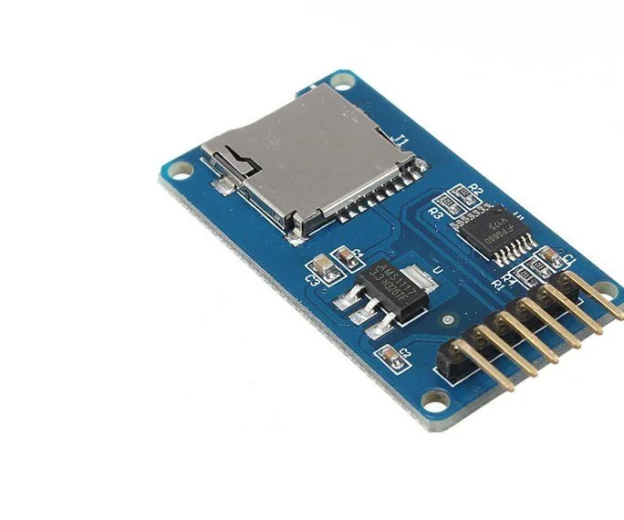
SD Card Setup
To use an SD card with Raspberry Pi Pico:
Connect via SPI pins (MISO, MOSI, SCK, CS)
Use adafruit_sdcard and storage libraries
Mount the card and write files
Always double-check your wiring. Mistakes can damage components or give false readings

Slide 13
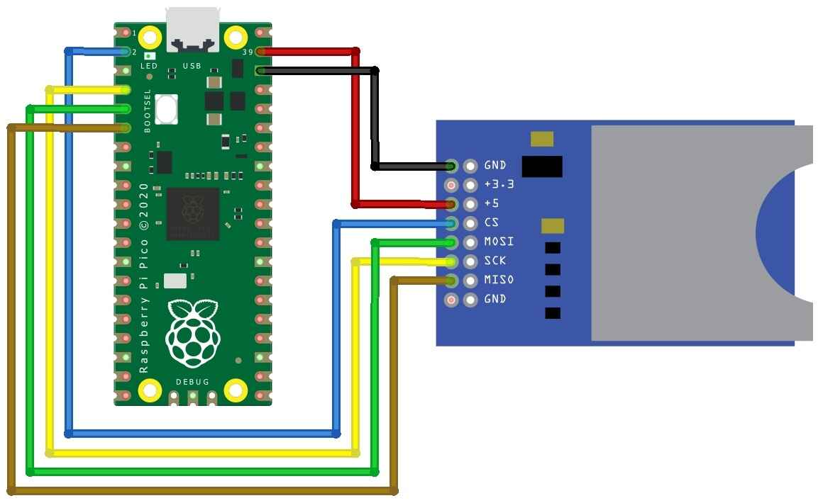
SD Card wiring
This setup lets your Pico talk to the SD card
import storage, sdcard, busio, digitalio, board
spi = busio.SPI(board.GP10, board.GP11, board.GP12)
cs = digitalio.DigitalInOut(board.GP13)
sd = sdcard.SDCard(spi, cs)
vfs = storage.VfsFat(sd)
storage.mount(vfs, "/sd")

Slide 14
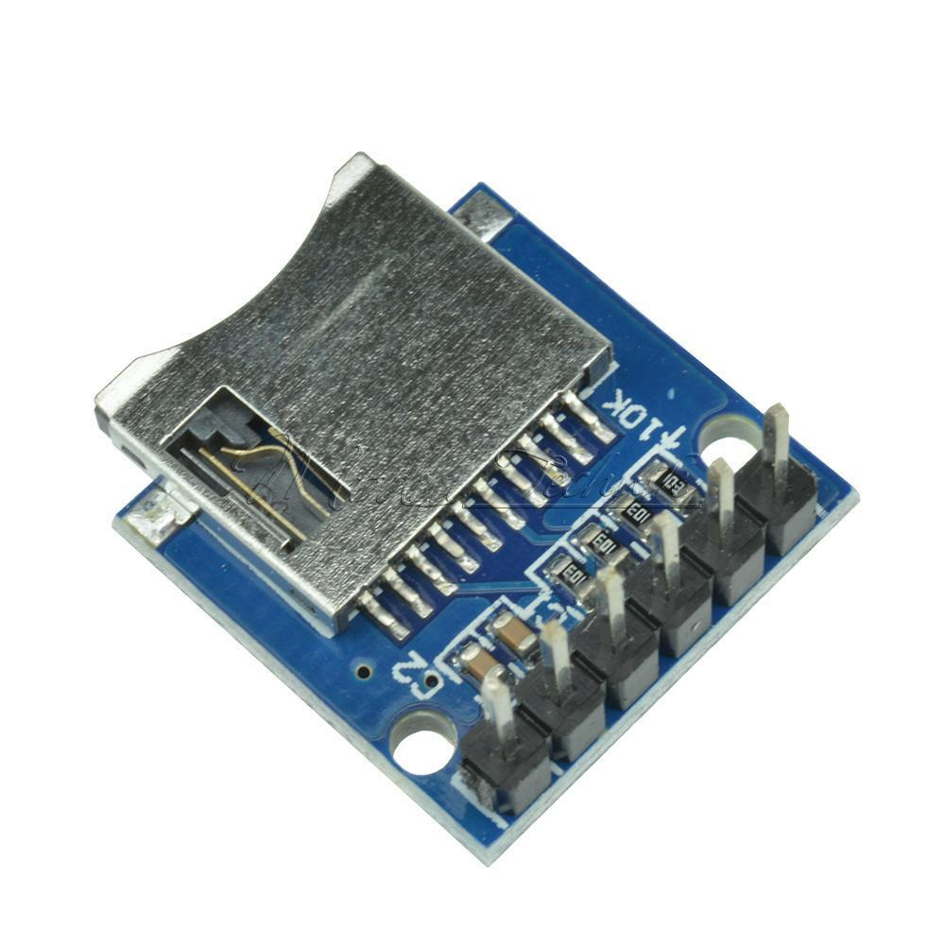
Different SD Card holders
One of the SD card holders requires 3v and the other 5v.
If you have this holder then you can use the 3v3out on the Pico
For 5v connect to VBUS on the Pico

Slide 15
Logging to device

Slide 16
Logging Code Example (CSV)
with open("/sd/log.csv", "a") as file:
file.write(f"{formatted},{temp},{humidity}\n")
Appends new data to the file
Uses formatting technique’s
Safe and efficient

Slide 17
Logging Temperature & Humidity
import adafruit_dht, board
dht = adafruit_dht.DHT11(board.GP15)
temp = dht.temperature
humidity = dht.humidity
with open("/sd/log.csv", "a") as file:
file.write(f"{temp},{humidity}\n")
Uses DHT11 sensor with CircuitPython

Slide 18
Logging to Serial Console
print(f"{formatted},{temp},{humidity}")
No SD card needed
Useful for debugging
Quick way to test sensors

Slide 19
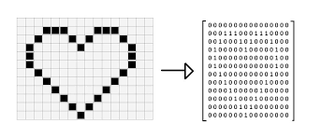
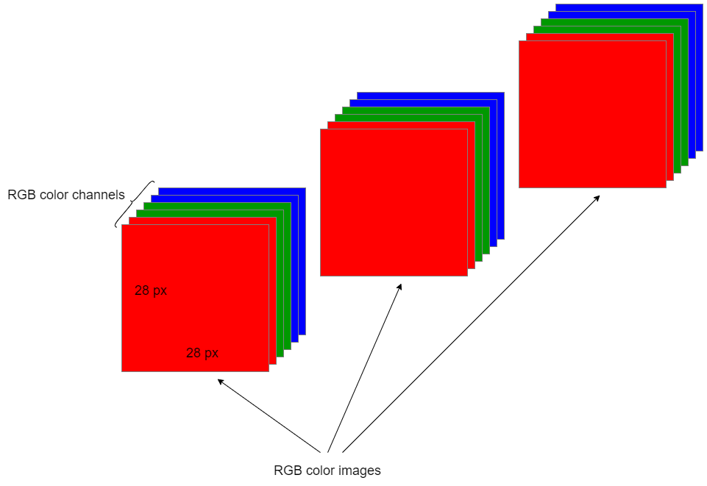
Image data
Images are matrices
Pixels are represented by tuples (R,G,B) where a numeric values are an integer between 0 and 255 representing how much colour of each R G B.
A grayscale image is simply one value of 0-255
Colour image: H x W x 3
Grey scale: H x W x 1

Slide 20
Compression (saving image data)
Saving an image as a jpeg will naturally compress it, The lazy but computationally quick option is to save the raw data on the device, then convert it later
If we do not compress the files will be too big
numpy.savez_compressed()
Think about the dtype
x = np.array([1, 2, 2.5])
x = x.astype(np.uint8)

Slide 21
Catching errors
It is good practice to catch errors of all sorts in your program
This can be done through assertions, but also through if statements
assert memory < 10000, “Memory too big”
if memory < 1000: print(“Memory too big”)

Slide 22
Data Logging Challenges
Power interruptions
Sensor error or calibration errors
File corruption
Environmental noise

Slide 23
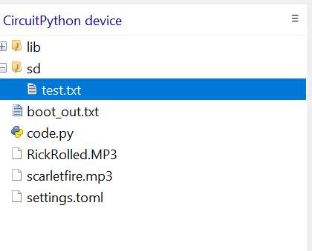
Viewing file
You can take the SD out and put it in your PC
Or you can use Thonny’s inbuilt file directory
Thonny>View>Files

Slide 24
Labs

Slide 25
Data logging task
Connect different sensors to your Pico, Log the sensor data to SD card. Format the collected data as CSV or Json and view logs in Excel

Slide 26
Split off into your groups (ideally of size 3)
Discuss a project that you want to research, with the resources provided…
This could be
Looking at soil moisture from different areas
Making an image dataset of different plants (or something specific about those plants
Relationship of humidity, temperature and soil moisture
Try not all to do the same thing so we can use eachothers datasets

Slide 27
Assemble the tools
Start putting together a device that can be used in the field to achieve the goals of your research project
Questions:
What sensors are relevant?
What format of data should be used?
Is this transportable to the field

Slide 28
Wrap-Up & Preview of Day 4
Tomorrow: data visualization and sharing
Lab: we’ll turn your data into graphs and shareable datasets
Great work today! 😎

Slide 29
Timetable | Mon | Tue | Wed | Thu | Fri | Sat | Sun | Mon | Tue | Wed | Thu | Fri
Lecture (1.5 hours) | 11:00am | 10:30am | 10:30am | 10:30am | 10:30am |  |  | 10:30am | 10:30am | 10:30am | 10:30am | 10:30am
Practical (2 hours) | 13:00pm | 13:00pm | 13:00pm | 13:00pm | 13:00pm |  |  | 13:00pm | 13:00pm | 13:00pm | 13:00pm | 13:00pm
Time table

