Slide 1
Data collection & Machine Learning Training
LUANAR - Week 1 – Day 1

Slide 2
Course Objectives
Learn to work with micro controllers
Understand how to log and store sensor data
Build datasets for machine learning
Train and deploy ML models
Apply skills to real-world challenges (e.g., rainfall prediction, irrigation)

Slide 3

Course Structure
Duration: 10 days
Format: Daily lectures + hands-on labs
Week 1: Electronics, data logging, visualization
Week 2: ML models, deployment, presentations
Fieldwork: Collect real datasets
Final Day: Present your project

Slide 4
Tools & Materials
Raspberry Pi Pico microcontroller
Sensors & components: temperature, humidity, SD cards, breadboards, jumper wires
CircuitPython
Integrated Development Environments (VS Code, Thonny)

Slide 5
What’s Machine Learning (ML)?
Machine Learning is a method of teaching computers to learn patterns from data and make predictions or decisions without being explicitly programmed.
e.g.: Predicting soil moisture levels based on temperature and humidity

Slide 6
ML or Traditional Programming
Traditional Programming
Rules are coded manually
Output is predictable
Good for fixed logic
Machine Learning
Learns rules from data
Output adapts to patterns
Good for complex decisions
vs

Slide 7
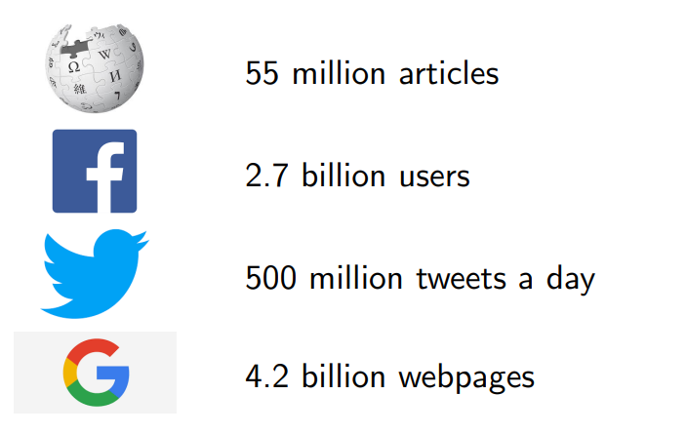
Why is machine learning interesting/relevant
There is so much data to be handled! Too much to be processed manually. Every second about 24,000 gigabytes is uploaded to the internet

Slide 8
Background

Slide 9

How It All Began
The training was first conducted in 2024 at LUANAR Bunda Campus,
facilitated by a team of PhD students from the University of Sussex (UK).
Focused on empowering students with practical skills in AI, machine learning, electronics, Python programming, and real-world applications

Slide 10
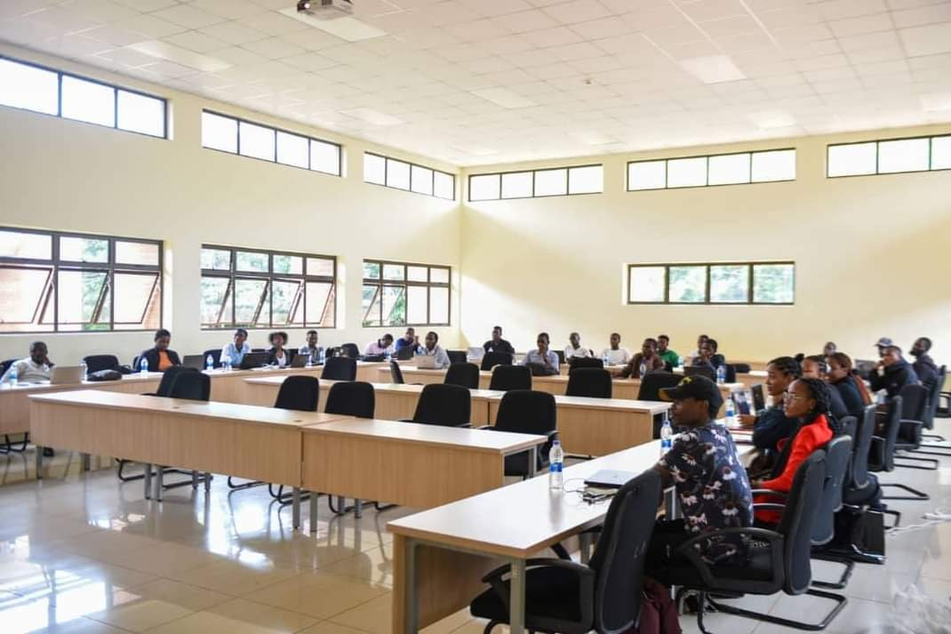
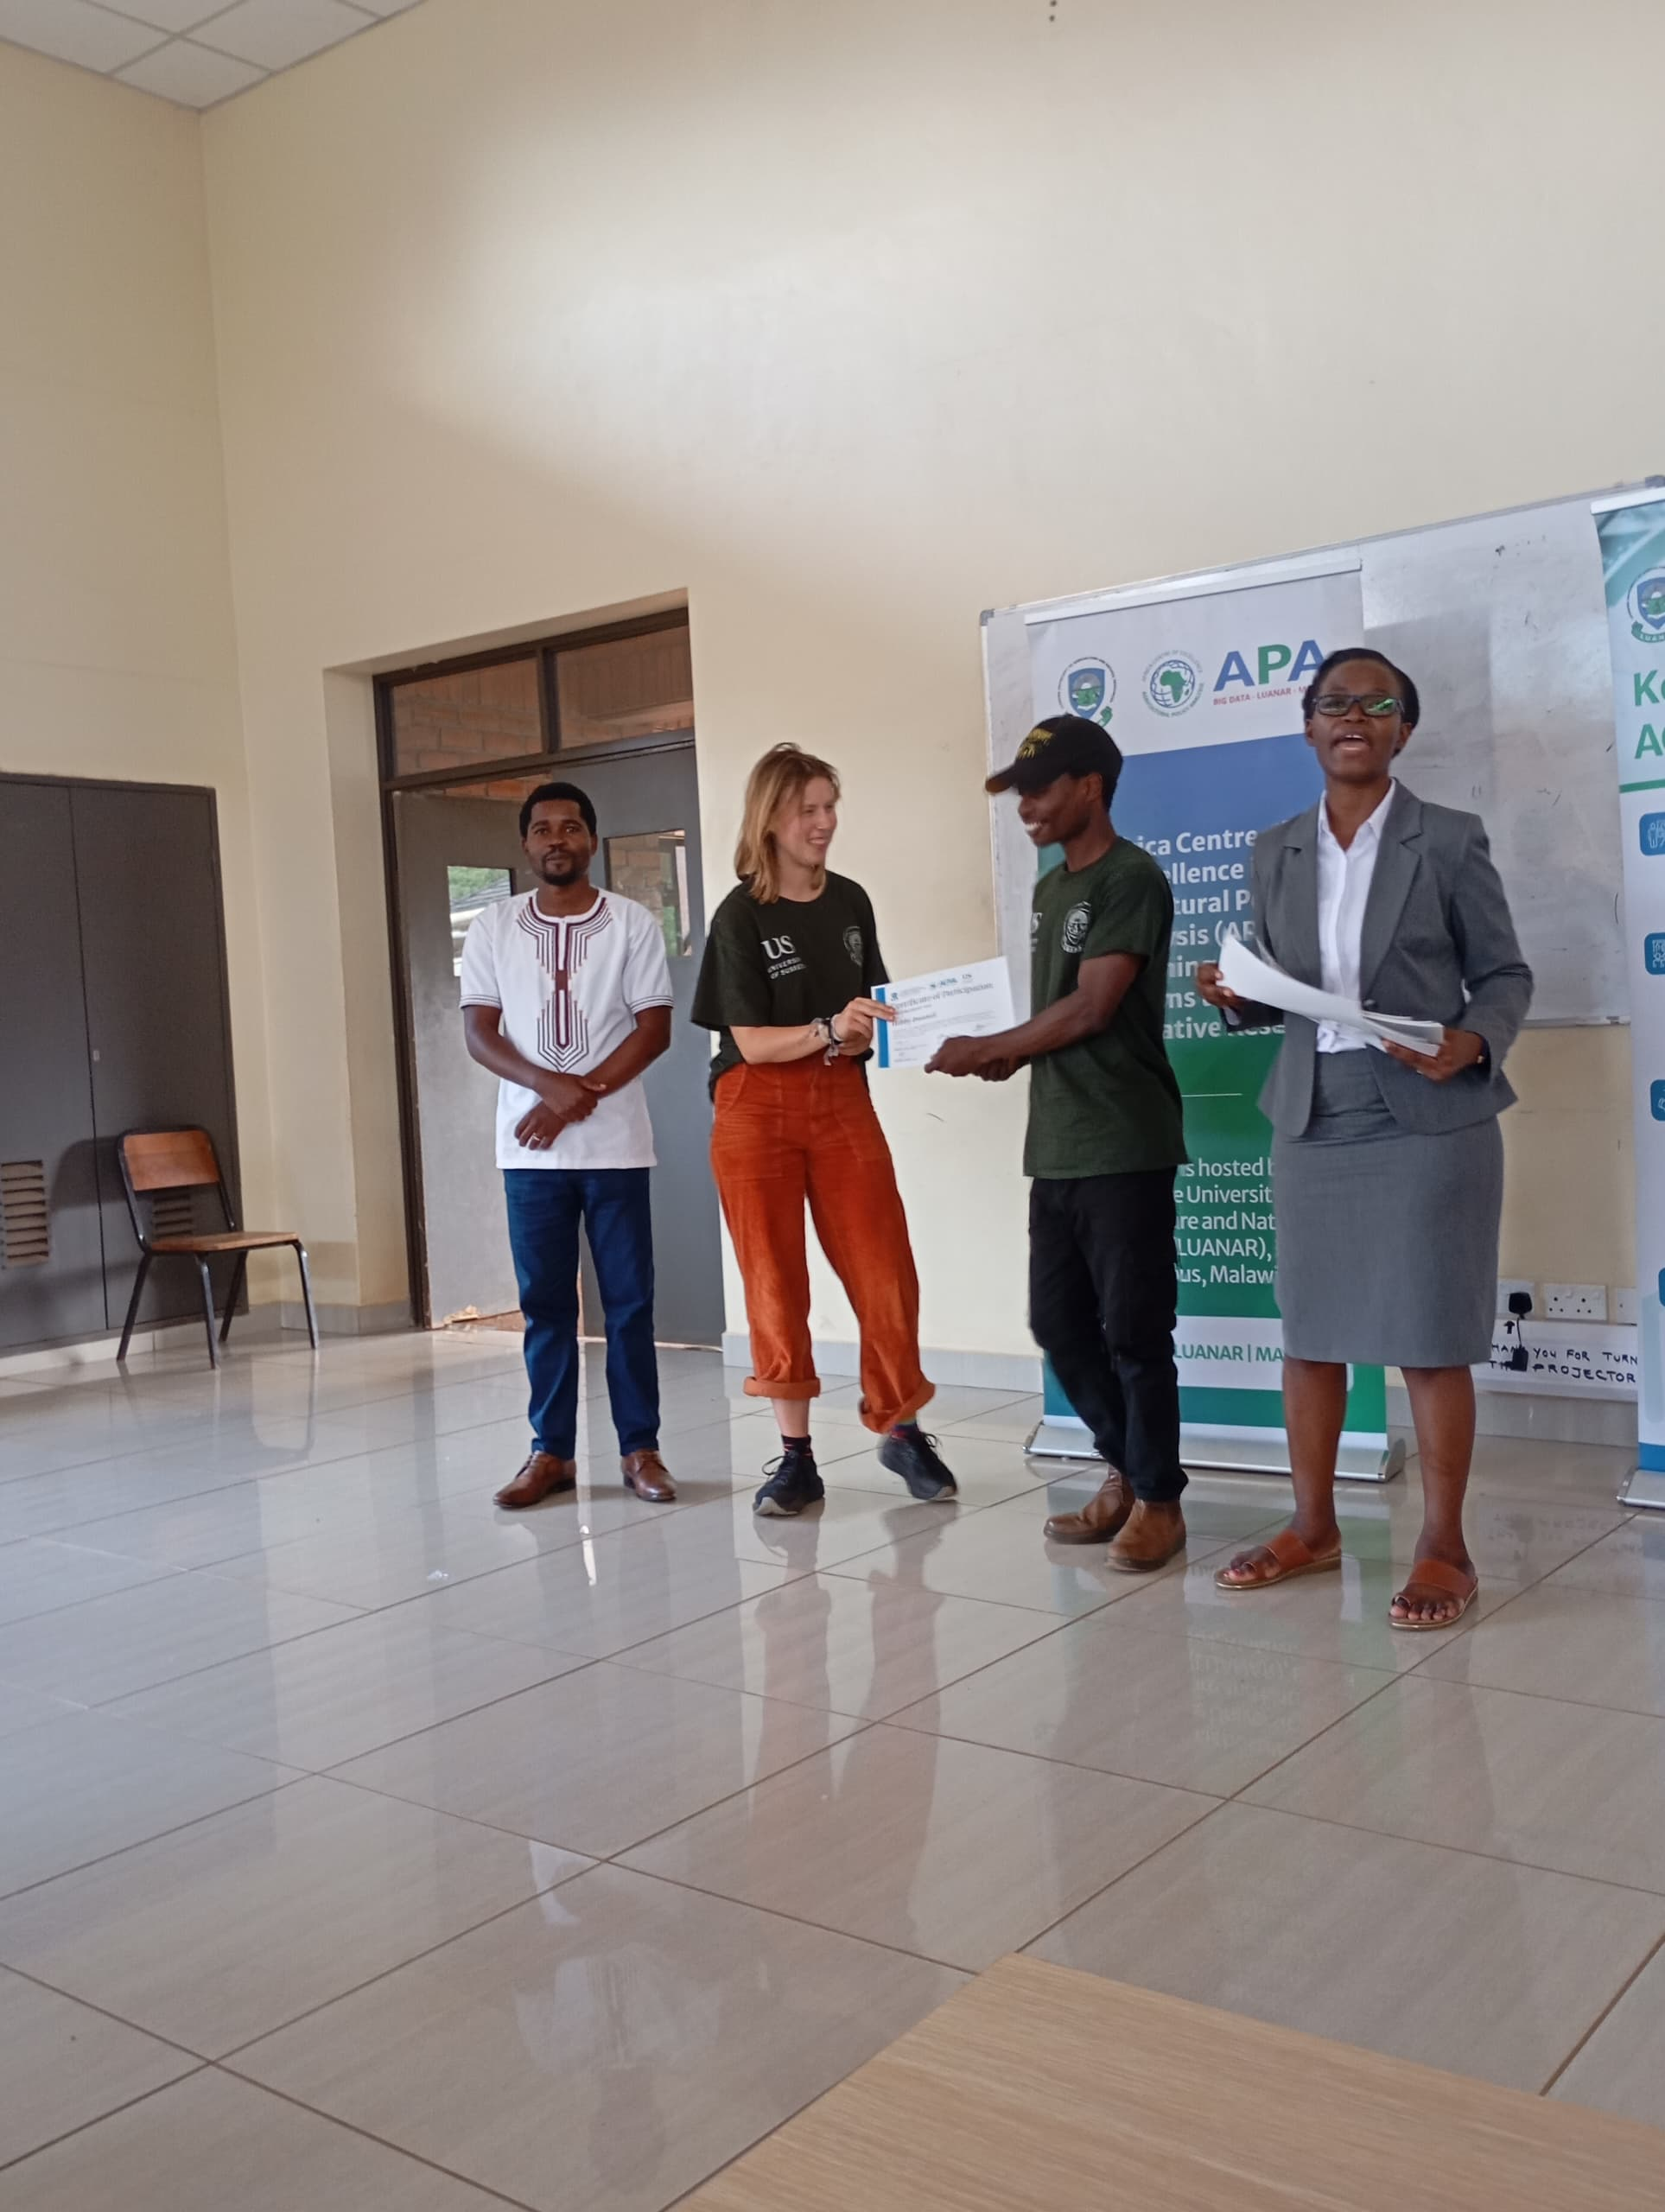
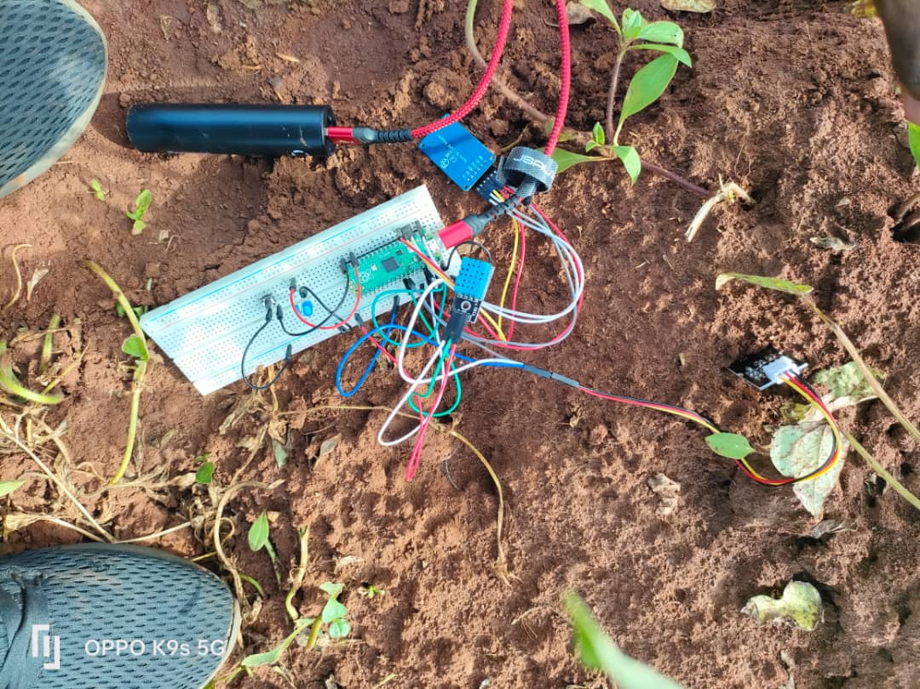
How It All Began

Slide 11
The volunteers

Slide 12
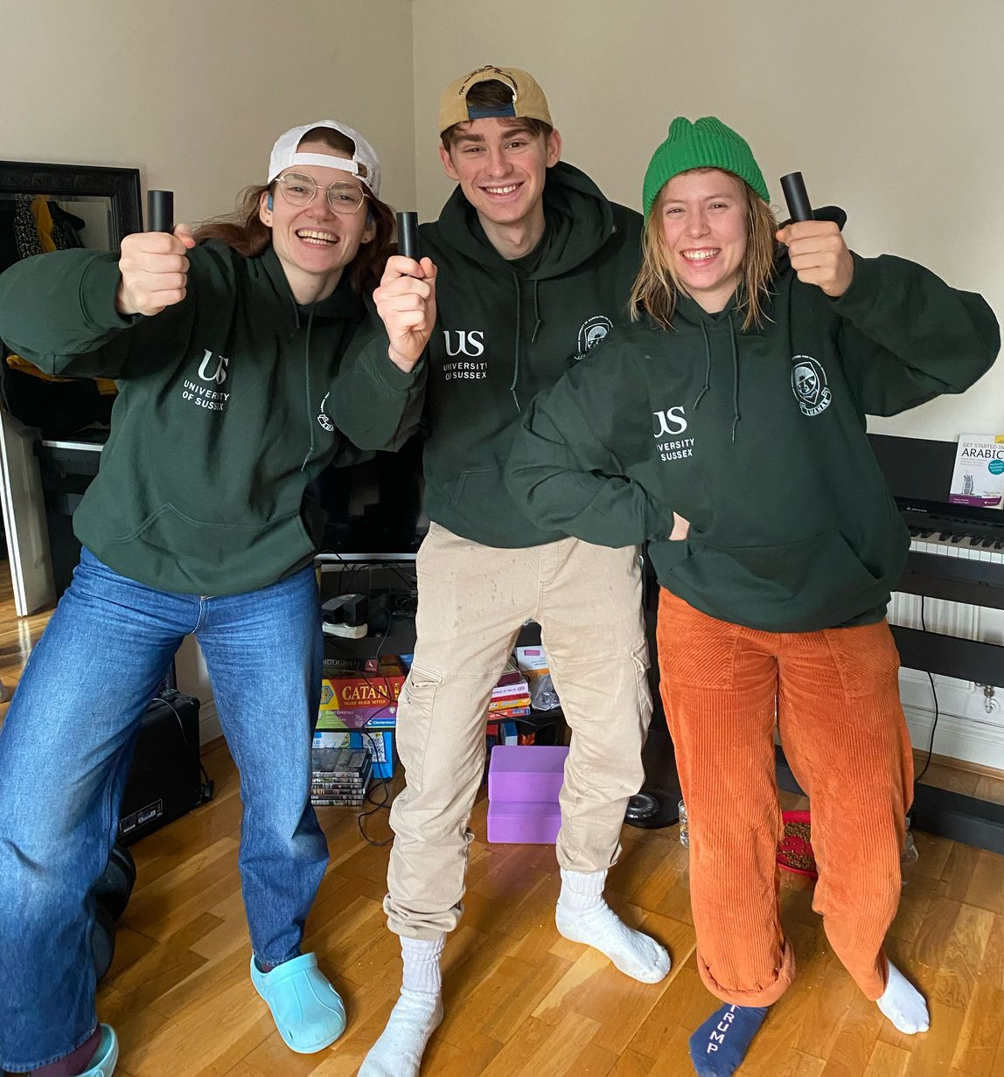
Mentors & Directors From the University of Sussex
Dexter Shepherd
PhD in AI and Robotics
Paula Seidler
PhD in AI and Computer Vision
Alejandra Carriero
PhD in Neuroscience and AI

Slide 13
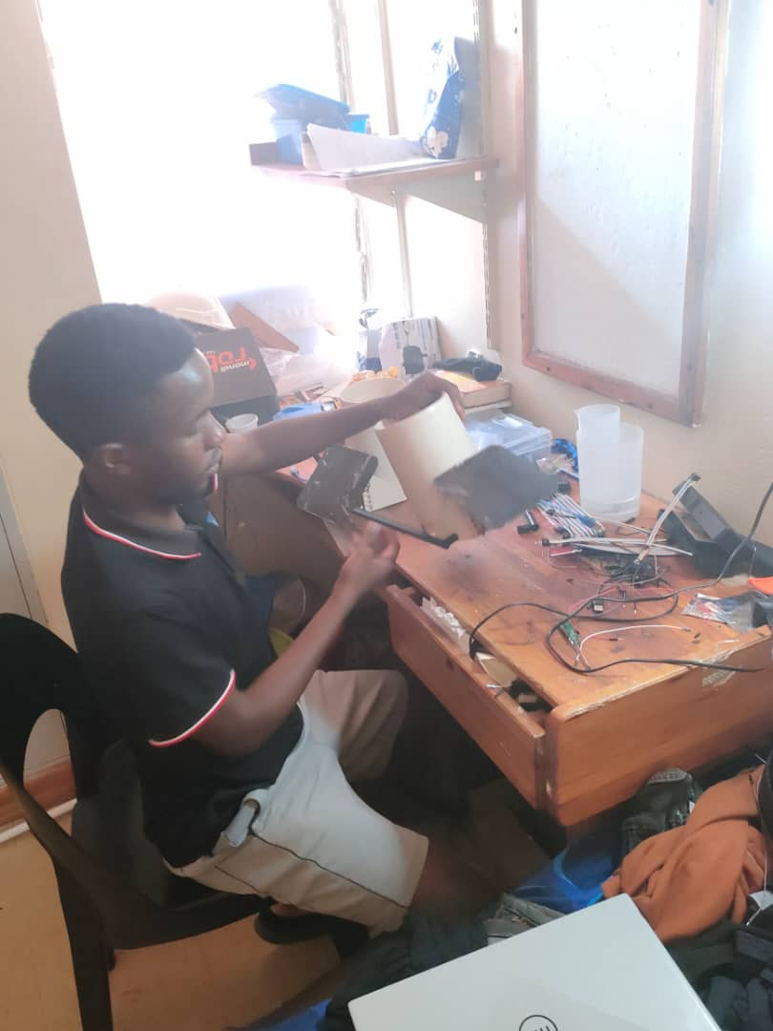
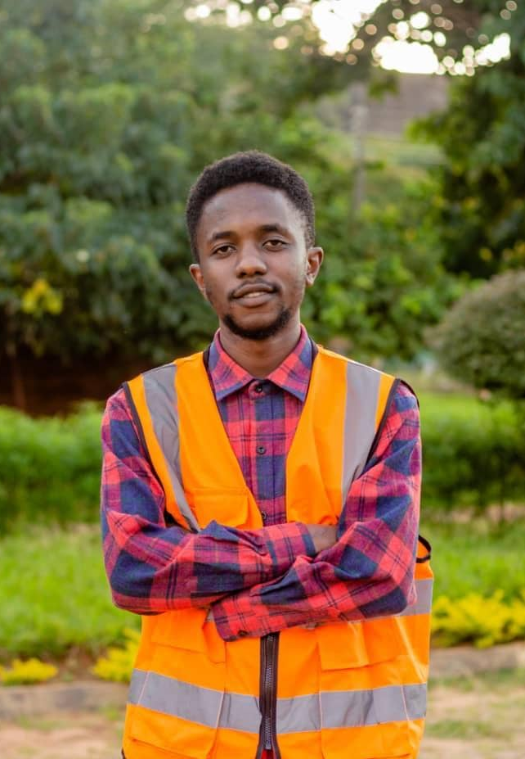
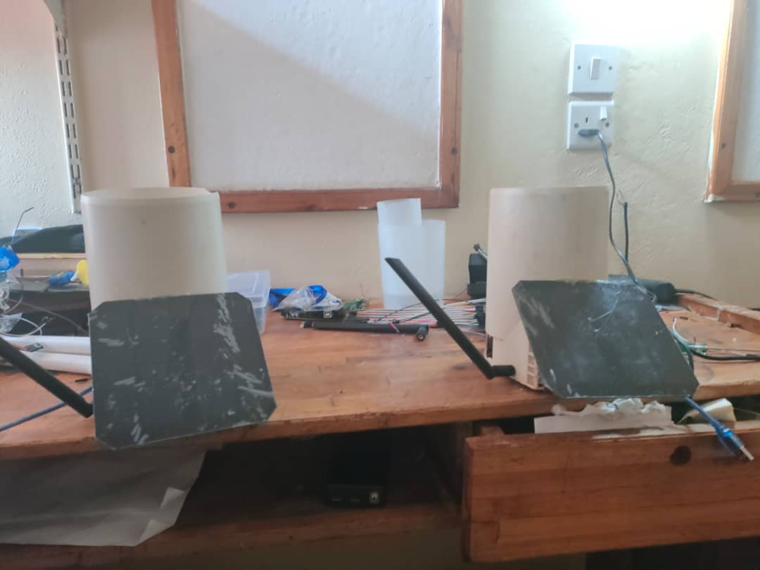
Martin Chirwa
5th yr BSc Irrigation engineering, LUANAR
Research:
Design and Implementation of an IoT-Based Low Power Wide Area Network (LPWAN) Rain Gauge System for Agricultural Monitoring

Slide 14
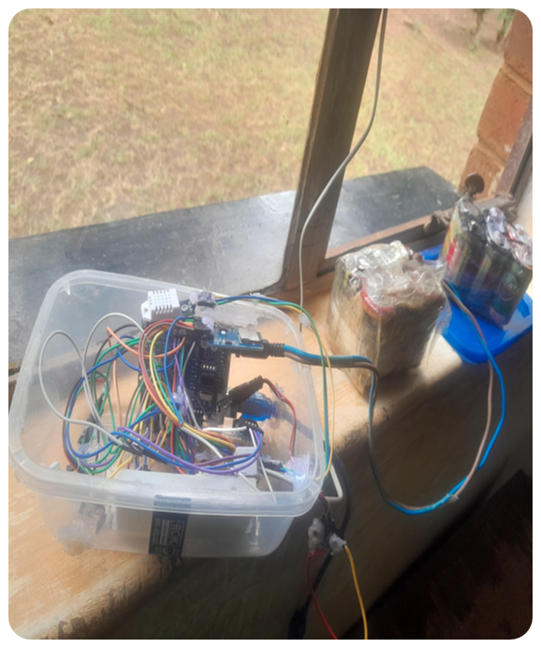
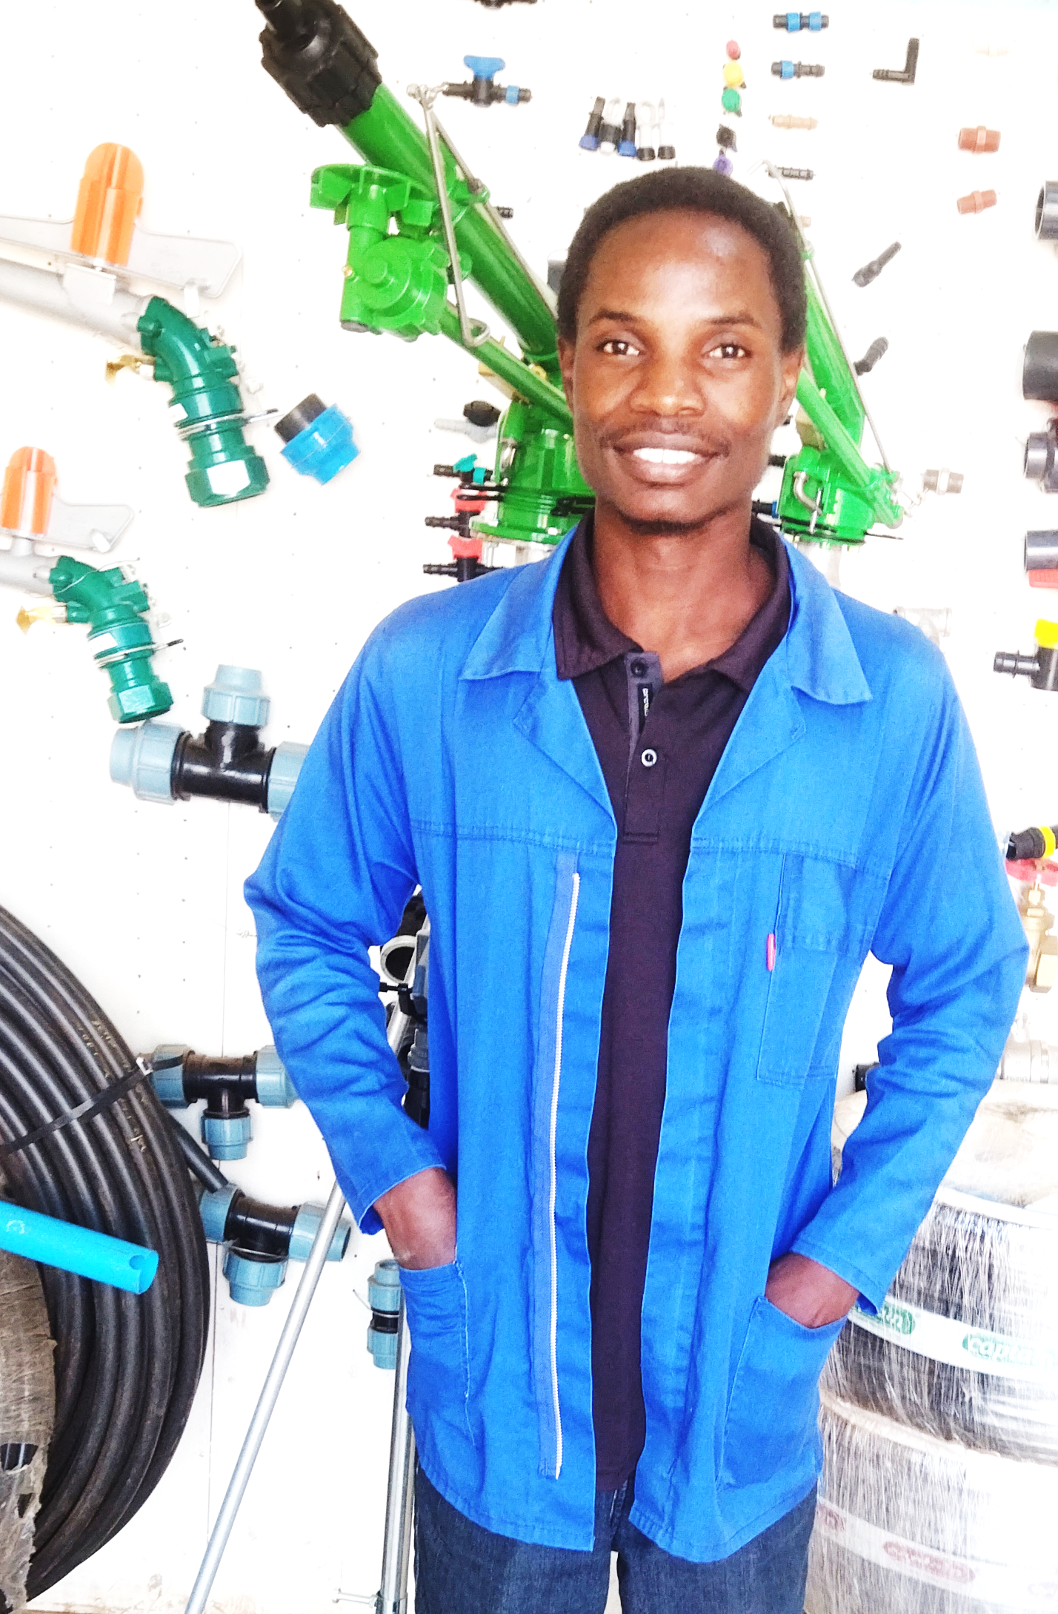
Hobby M. Bwanali
1st yr MSc Irrigation engineering, LUANAR
Research:
Performance Comparison of Machine Learning Models in Rainfall Prediction

Slide 15
This course

Slide 16
What You’ll Build
Data loggers
Sensor-based prototypes
Machine learning models
Final project: real-world application

Slide 17
What not to expect
We are providing the foundations, rather than making experts in 2 weeks
The datasets we make will not be the finished product!

Slide 18
Program
Day 1 | Introduction & Team Building
Day 2 | Electronics & Python for Hardware
Day 3 | Data Logging Essentials
Day 4 | Data Visualization & Sharing
Day 5 | Building Electronics for ML Data
Day 6 | Regression & Prediction Models
Day 7 | Classification Models
Day 8 | Neural Networks & Deep Learning
Day 9 | Data Augmentation & Scaling
Day 10 | Final projects presentations

Slide 19
Labs

Slide 20
Installations and setups
Vscode - https://code.visualstudio.com/
Thonny IDE - https://thonny.org/
GitHub Desktop- https://github.com/apps/desktop
Best resources
Use the internet! online documentation, adafruit learn
Talk to each other and work together!

Slide 21
What to do next
Python coding practice
Karel game
OPEN Lab_day1.pynb in the worksheets folder and practice working with python

Slide 22
Schedule

Slide 23
Wrap-Up & Preview of Day 2
Tomorrow: Electronics & sensor basics
Lab: working with buttons and LEDs and other components
Great start today! Tomorrow, we dive into hardware and sensors get ready to build.

Slide 24
Timetable | Mon | Tue | Wed | Thu | Fri | Sat | Sun | Mon | Tue | Wed | Thu | Fri
Lecture (1.5 hours) | 11:00am | 10:30am | 10:30am | 10:30am | 10:30am |  |  | 10:30am | 10:30am | 10:30am | 10:30am | 10:30am
Practical (2 hours) | 13:00pm | 13:00pm | 13:00pm | 13:00pm | 13:00pm |  |  | 13:00pm | 13:00pm | 13:00pm | 13:00pm | 13:00pm
Time table

