Slide 1

Module 2 – Basic Probability and Statistics
Module 2.A: Basic Probability and Statistics for Univariate Random Variables
Author: Drs. Huy Vo, Ania Baetica, Brian Munsky
Instructor: Prof. Brian Munsky
e-mail: munsky@colostate.edu

Slide 2
Module 2A – Distributions, Sampling, and Expectations
Learning Objectives for this Notebook
Upon completing this notebook, you should be able to:
Mathematically define Random Variables and their Probability Distributions.
Recognize and generate common Discrete Random Variables, including:
    Bernoulli, Binomial, Poisson, Geometric
Recognize and generate common Continuous Random Variables, including:
    Uniform, Gaussian, Exponential
Generate Random Variable Samples from arbitrary distributions.
Define Expectations of Random Variables (mean, variance, etc.) and compute these from distributions
Define Summary Statistics and numerically estimate these from sample data.

Slide 3
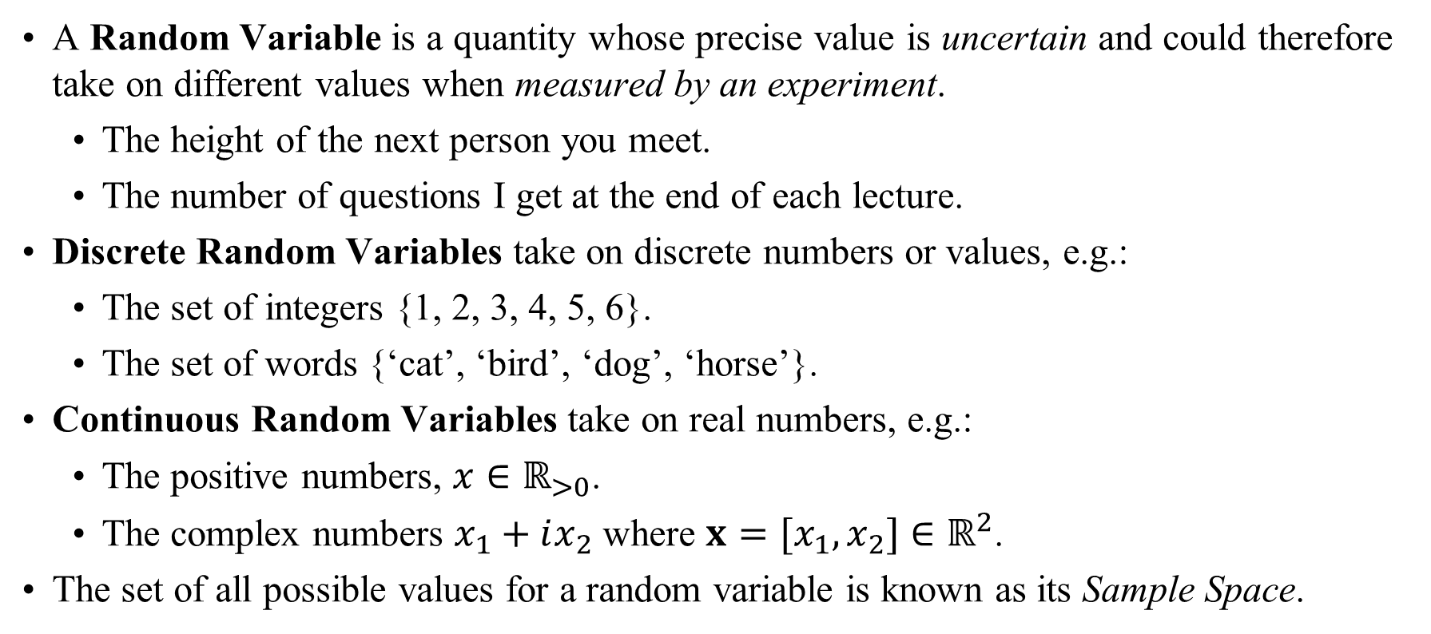
Module 2A – Distributions, Sampling, and Expectations
What are Random Variables?
A Random Variable is a quantity whose precise value is uncertain and could therefore take on different values when measured by an experiment.
  The height of the next person you meet.
  The number of questions I get at the end of each lecture.
Discrete Random Variables take on discrete numbers or values, e.g.:
  The set of integers {1, 2, 3, 4, 5, 6}.
  The set of words {‘cat’, ‘bird’, ‘dog’, ‘horse’}.
Continuous Random Variables take on real numbers, e.g.:
  The positive numbers, $x∈ℝ_{>0}$.
  The complex numbers $x_{1}+ix_{2}$ where $x=[x_{1},x_{2}]∈ℝ^{2}$.
The set of all possible values for a random variable is known as its Sample Space.

Slide 4



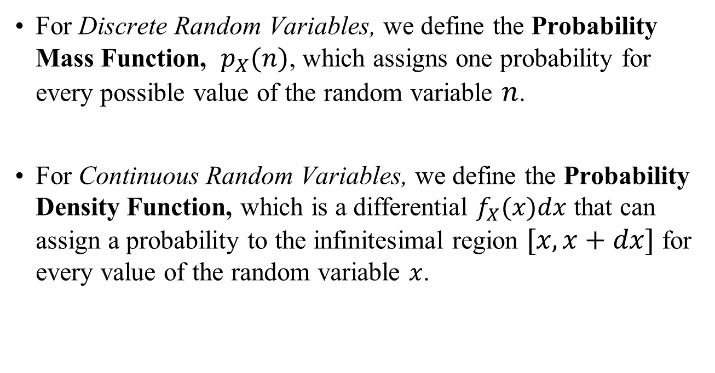

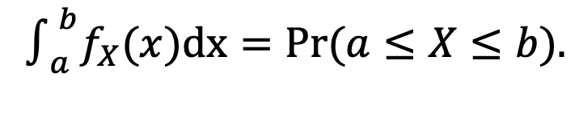

Module 2A – Distributions, Sampling, and Expectations
Probability Distributions
A Probability Distribution quantifies the probability that a random variable will take for every possible value in its sample space.
For Discrete Random Variables, we define the Probability Mass Function, $p_{X}(n)$, which assigns one probability for every possible value of the random variable $n$.
For Continuous Random Variables, we define the Probability Density Function, which is a differential $f_{X}(x)dx$ that can assign a probability to the infinitesimal region $[x,x+dx]$ for every value of the random variable $x$.
$$p_{X}(n)$$
$$p_{X}(n)=Pr\left(X=n\right)$$
$$n$$
$$f_{X}(n)$$
$$∫_{a}^{b}f_{X}(x)dx=Pr(a≤X≤b).$$
$$x$$
All PMFs (PDFs) are always non-negative and sum (integrate) to one.

Slide 5


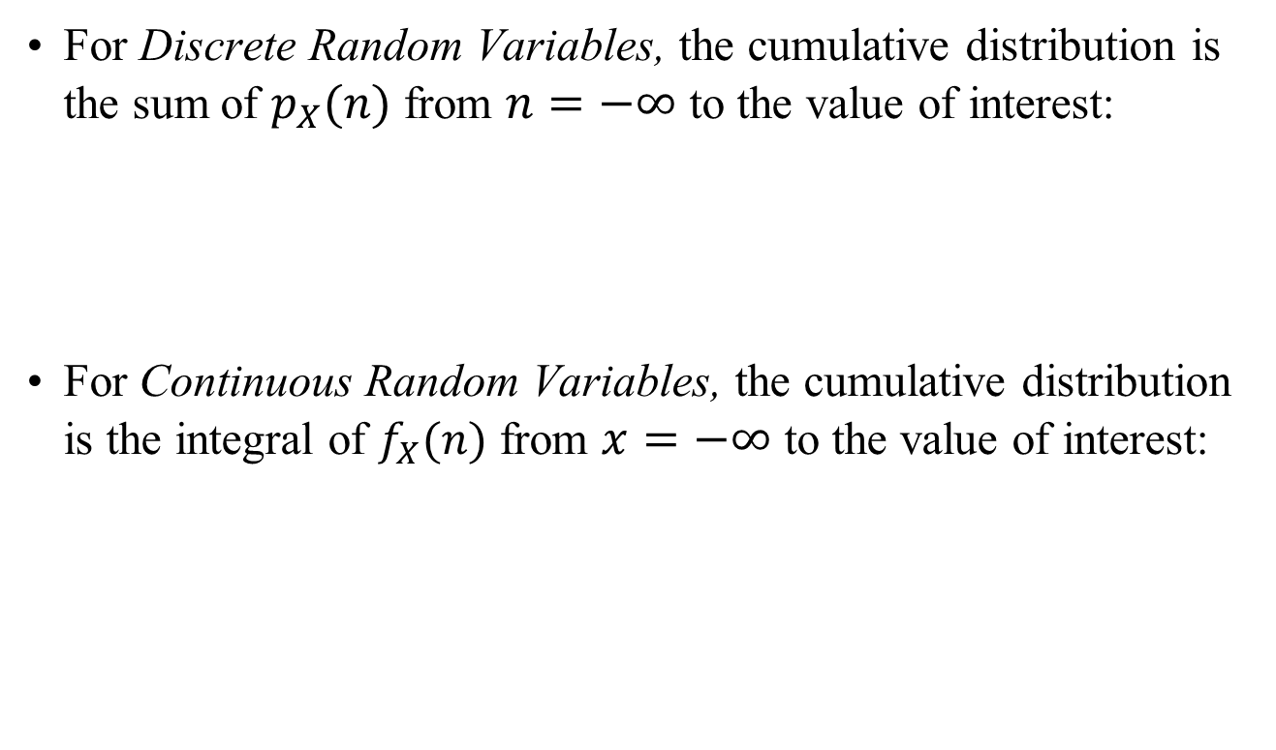

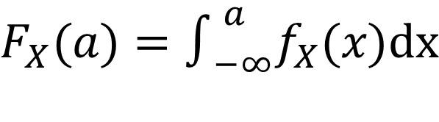
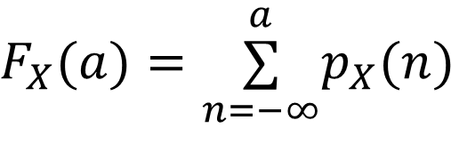

Module 2A – Distributions, Sampling, and Expectations
Cumulative Probability Distributions
A Cumulative Probability Distribution quantifies the probability that a random variable will take a value less than or equal to a given amount.
For Discrete Random Variables, the cumulative distribution is the sum of $p_{X}(n)$ from $n=−∞$ to the value of interest:
For Continuous Random Variables, the cumulative distribution is the integral of $f_{X}(n)$ from $x=−∞$ to the value of interest:
1
$$F_{X}(a)=\overset{a}{\underset{n=−∞}{∑}}p_{X}(n)$$
$$F_{X}(n)$$
0
$$a$$
1
$$F_{X}(a)=∫_{−∞}^{a}f_{X}(x)dx$$
$$F_{X}(n)$$
0
$$a$$
Cumulative distributions increase monotonically from zero as $a→−∞$ to one as $a→∞$.

Slide 6
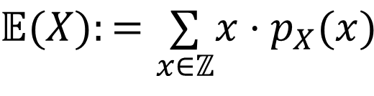
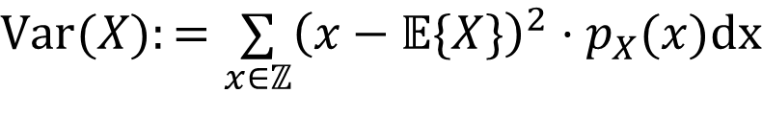
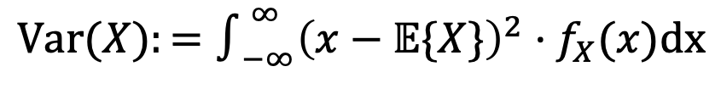
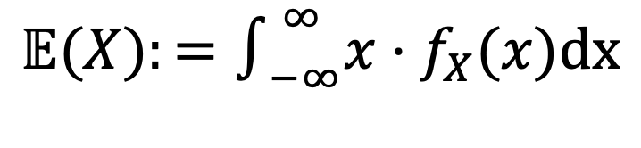
Module 2A – Distributions, Sampling, and Expectations
Expected Values of Random Variables
The term Expected Value refers to the theoretical average of a random variable (or some function of random variables).
$$𝔼(X):=\underset{x∈ℤ}{∑}x⋅p_{X}(x)$$
The expected value (mean) of a discrete random variable is:
The expected value (mean) of a continuous random variable is:
We can also take the expected value of the squared variance from the mean:
$$𝔼(X):=∫_{−∞}^{∞}x⋅f_{X}(x)dx$$
$$Var(X):=\underset{x∈ℤ}{∑}{\left(x−𝔼\{X\}\right)}^{2}⋅p_{X}(x)dx$$
$$Var(X):=∫_{−∞}^{∞}{\left(x−𝔼\{X\}\right)}^{2}⋅f_{X}(x)dx$$

Slide 7
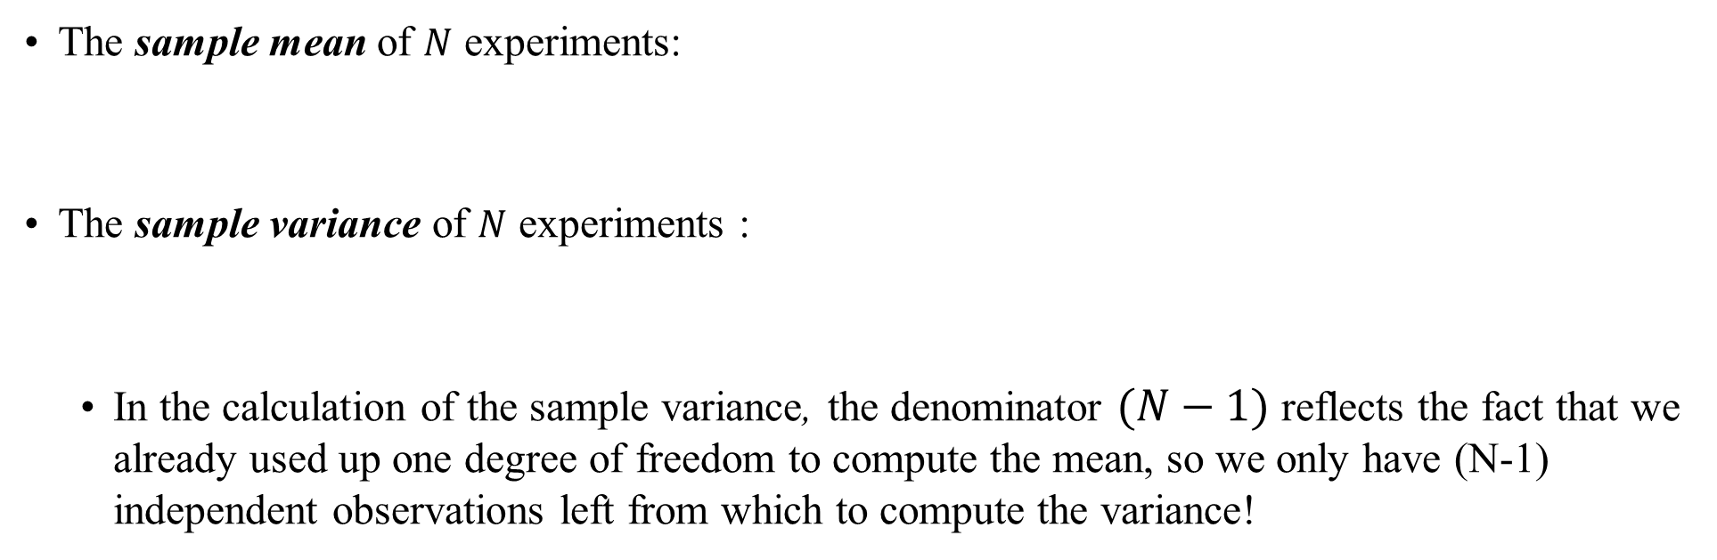
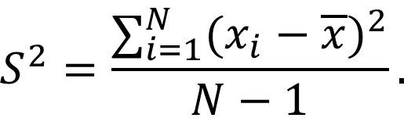
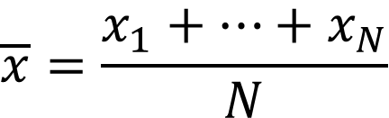
Module 2A – Distributions, Sampling, and Expectations
Sample Statistics
When we do an experiment, we collect samples of random variables. From these we can compute summary statistics:
$$\overline{x}=\frac{x_{1}+…+x_{N}}{N}$$
The sample mean of $N$ experiments:
The sample variance of $N$ experiments :
  In the calculation of the sample variance, the denominator $(N−1)$ reflects the fact that we already used up one degree of freedom to compute the mean, so we only have (N-1) independent observations left from which to compute the variance!
$$S^{2}=\frac{∑_{i=1}^{N}(x_{i}−\overline{x})^{2}}{N−1}.$$

Slide 8
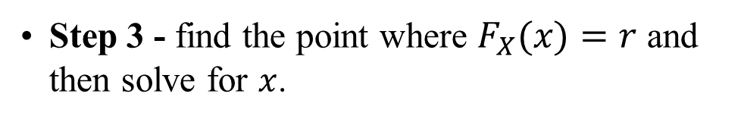

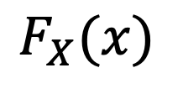
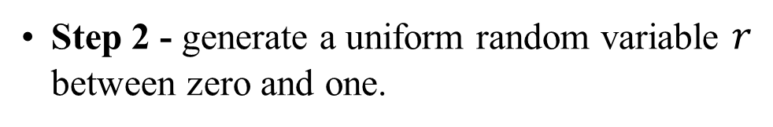

Module 2A – Distributions, Sampling, and Expectations
Drawing Samples from Probability Distributions
For many simulations, we wish to generate realistic samples from a known probability distribution.
Fortunately, there is a simple recipe for this if you can compute the cumulative probability distribution.
Step 1 - define the cumulative distribution function (this can be discrete or continuous)
1
$$F_{X}(x)$$
Step 2 - generate a uniform random variable $r$ between zero and one.
$$r$$
Step 3 - find the point where $F_{X}(x)=r$ and then solve for $x$.
0
$$x$$

Slide 9
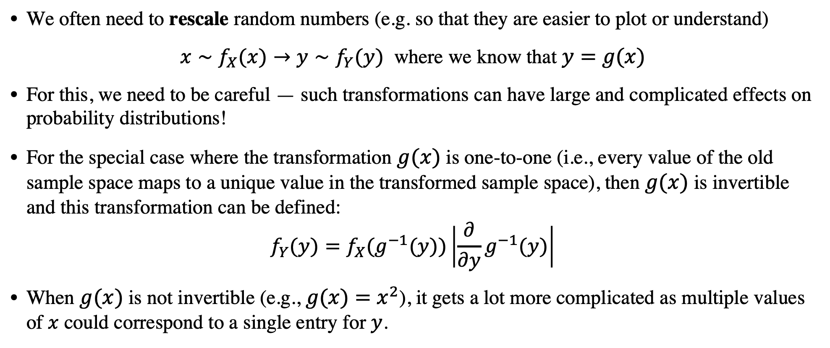
Module 2A – Distributions, Sampling, and Expectations
Changing the units or scales for probability distributions.
We often need to rescale random numbers (e.g. so that they are easier to plot or understand)
$x∼f_{X}(x)→y∼f_{Y}(y)$ where we know that $y=g(x)$
For this, we need to be careful — such transformations can have large and complicated effects on probability distributions!
For the special case where the transformation $g(x)$ is one-to-one (i.e., every value of the old sample space maps to a unique value in the transformed sample space), then $g(x)$ is invertible and this transformation can be defined:
$$f_{Y}(y)=f_{X}(g^{−1}(y))\left|\frac{∂}{∂y}g^{−1}(y)\right|$$
When $g(x)$ is not invertible (e.g., $g(x)=x^{2}$), it gets a lot more complicated as multiple values of $x$ could correspond to a single entry for $y$.

Slide 10

Module 2A – Distributions, Sampling, and Expectations
Central Limit Theorem – what happens if I flip hundreds of coins?
It is often interesting to deal with the summation of many observations.
  For example, that was an important step in computing the sample mean or the sample variance for some experiments.

Slide 11
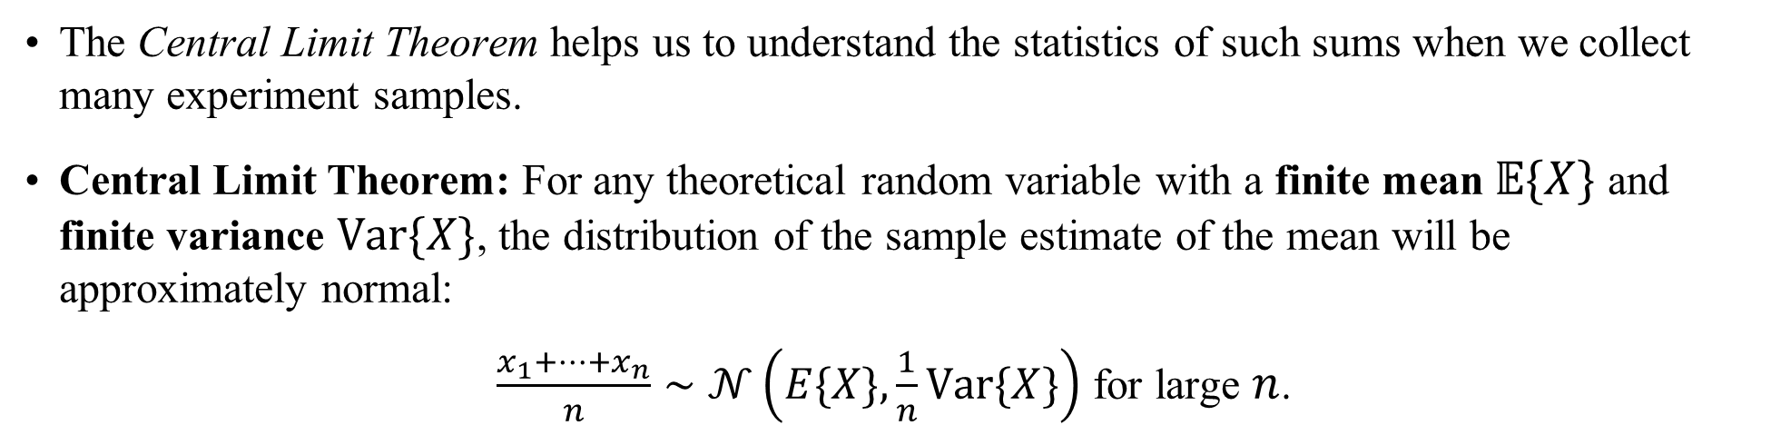
Module 2A – Distributions, Sampling, and Expectations
Central Limit Theorem
The Central Limit Theorem helps us to understand the statistics of such sums when we collect many experiment samples.
Central Limit Theorem: For any theoretical random variable with a finite mean $𝔼\{X\}$ and finite variance $Var\{X\}$, the distribution of the sample estimate of the mean will be approximately normal:
$\frac{x_{1}+…+x_{n}}{n}∼𝒩\left(E\{X\},\frac{1}{n}Var\{X\}\right)$ for large $n$.

Slide 12

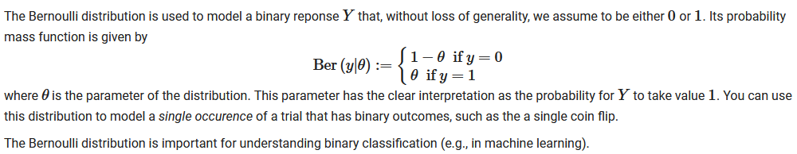
Module 2A – Distributions, Sampling, and Expectations
Basic Discrete Distributions
Bernoulli:
What is the probability of heads during a coin toss?
What is the probability that a drug will reach market?
What is the probability that a student will get an A in the course?

Slide 13
Module 2A – Distributions, Sampling, and Expectations
Basic Discrete Distributions
What is the probability of getting 2 heads out of 3 coin tosses?
What is the probability that 5 out of 6 nucleotides will be an ‘G’?
What is the probability that 20 out of 25 students in the class will get an ‘A’.
What is the probability that 10 out of 12 patients will recover?
Binomial:

Slide 14
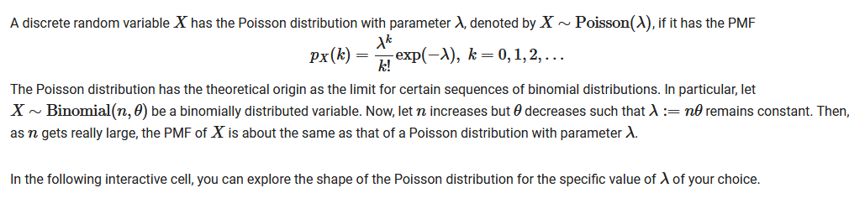
Module 2A – Distributions, Sampling, and Expectations
Basic Discrete Distributions
Poisson
What is the number of calls received in a minute at a call center?
How many mRNA will be created in half an hour from an active gene?
How many photons will reach a fluorescence sensor in a 50 milliseconds?

Slide 15


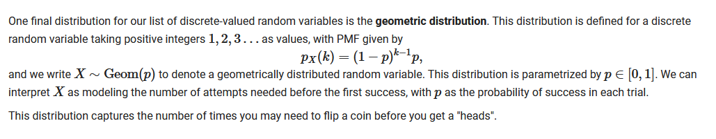
Module 2A – Distributions, Sampling, and Expectations
Basic Discrete Distributions
Meow
Meow
Meow!!
How many times do you need to flip a coin before you get a heads?
How many cats before you see white kitty appear?
How many tries would it take to to make a 3-point throw from half court.
Geometric

Slide 16
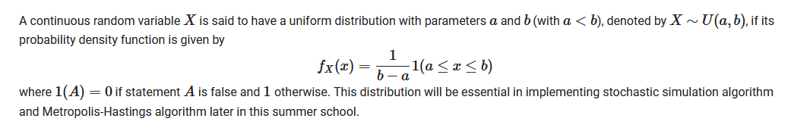
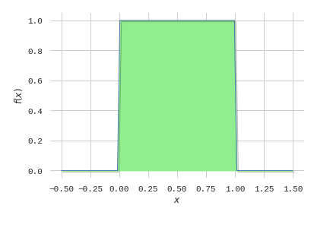
Module 2A – Distributions, Sampling, and Expectations
Basic Continuous Distributions
Uniform:
The probability is the same across interval [a, b]

Slide 17
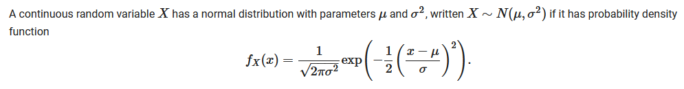
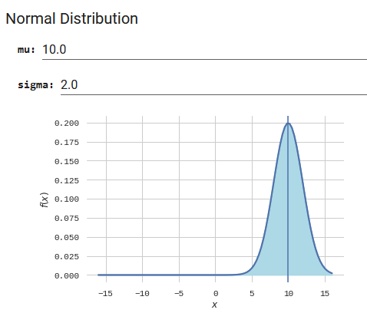
Module 2A – Distributions, Sampling, and Expectations
Basic Continuous Distributions
Gaussian

Slide 18
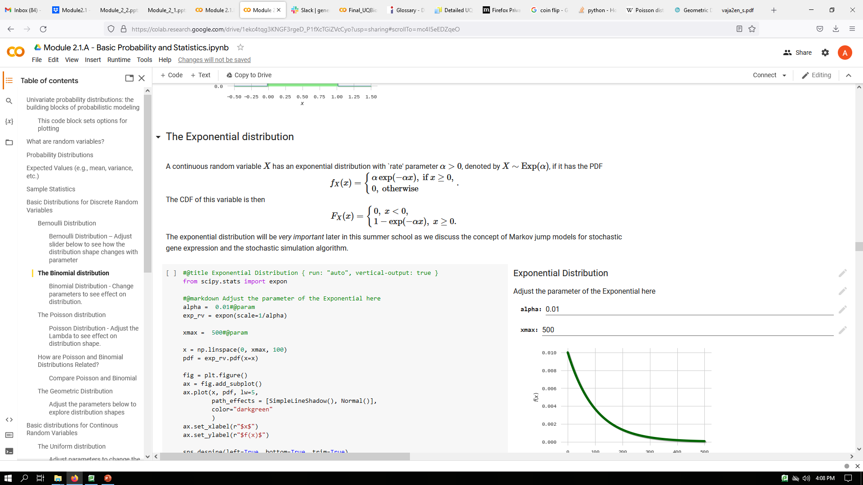
Module 2A – Distributions, Sampling, and Expectations
Basic Continuous Distributions
Exponential:
What is the time until a gene will turn on at random?

