Slide 1
Lab 2: Build Your Own Blocks (BYOB), Variables & Loops
Jan. 13 – Jan. 15

Slide 2
BYOB…Draw square
Review
Created our own motion block called “draw square”
Used script to create a square with side lengths of 100 steps

Slide 3
Improving Draw square
Created a motion block, that allows us to move a sprite in a 100 step square whenever this block is applied to the script
We will edit the block to accept an argument (or input), which tells it the length of the square it has to draw.
Right-click on the block and open block editor.

Slide 4
Improving Draw Square
Notice the “+” surrounding the draw square text on the block
Allows us to enter
another component
Create size input and
copy by dragging

Slide 5
Draw Triangle
Using knowledge of “draw square” motion block…create a “draw triangle”
How many repeats?
What angle?
Edit block to have size argument

Slide 6
Draw Shape
Create a motion block that will draw any shape
Name block “draw shape sides size”
Have two arguments
Side
Size
Use operator block for angle

Slide 7
Max Block
Reporter block – reports a value
We will make a block called “max” that takes two numbers as input and reports the bigger value (the maximum)
Notice the shape of this block, it has smooth edges and differs from the puzzle piece look of command blocks

Slide 8
Max Block
How could we compute the max of 3 values?

Slide 9
Useful tips in Snap
You can create inputs in blocks by clicking on the plus signs to add an input; however, you can also type the names of the input by incorporating a %.
The percent signs (%) indicate that the word should be an input.
Practice doing this both manually and with a %

Slide 10
Predicates
A predicate is a block that reports either true or false.
Notice the difference in shape of a predicate block, it is neither smooth or puzzle piece shaped, but has pointed sides.
Lets create our own predicate block, “Greater than or equal to”

Slide 11
Review of Variables
Normal/Global Variables: Can be used anywhere and by any in block, script, and sprite
Ex. “score” variable
Sprite Specific Variables: Normal variables that are applied to sprites individually, not good for block use
Script Variables: For use inside a script

Slide 12
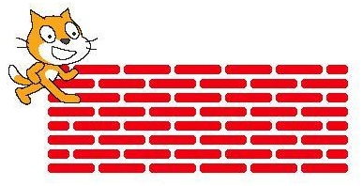
Activity 2: Brick Wall
In this activity you will draw this brick wall
See Moodle link for full description

