Slide 1

Scalable Heat engine using Convergence
Anant Patil (Hewlett Packard Enterprise)
Kanagaraj Manickam (Huawei Technologies India Pvt. Ltd.)
Kiran Kumar Vaddi (Hewlett Packard Enterprise)

Slide 2



About Presenters
Anant Patil
Software Engineer @ HPE, Bangalore, India
OpenStack Heat contributor
Having 8+ years of experience in Network Management Software (HP NNMi).
And Having 3+ years of experience in OpenStack Cloud.
IRC: ananta
Kanagaraj Manickam
Sr. System Architect @ Huawei, Bangalore, India
Core-reviewer @ Heat, Openstack.
Having 8+ years of experience in HP data-center Server, Storage management and automation products. And Having 3+ years of experience in OpenStack Cloud.
Establishing new service namos – OpenStack Manager)
Kiran Kumar Vaddi
Architect @ Hewlett Packard Enterprise, Bangalore, India
Having 14 years of experience in System management software and having 3+ years of experience in building private cloud solution using OpenStack.

Slide 3
Agenda
Convergence: The New architecture
Convergence Design Evolution
Convergence Design Comparison
Convergence Observer
Convergence Progress
Q & A
Brief Overview of Heat & Mitaka Updates

Slide 4




Cloud application
Sample Word-press application
Load-balancer
Wordpress
Web-server
Wordpress
Web-server
Wordpress
Web-server
Db-server
Configuration
Storage

Slide 5


Introduction
An orchestration service to create and manage the lifecycle of cloud application
How to model the cloud application deployment (in YAML/JSON)?
Heat provides Template (HOT & AWS CFN)
How to model the cloud application element like instances, volumes,?
Heat provides Resource (as resource plug-in)
How to create and manage the cloud application?
Heat provides Stack
How to manage the cloud application scalability?
Heat provides Auto-scaling
How to deploy the cloud application?
Heat provides Software-Deployment
How to configure the cloud application?
Heat provides Software-Configuration
How to track the progress of life-cycle operations ?
Heat provides Events

Slide 6

Template and resources
Capture the declarative model of cloud application
my_instance:
type: OS::Nova::Server
properties:
key_name: kp1
image: cirros-0.3.3
flavor: m1.small
networks: [private]
heat_template_version: 2015-04-15
description: >
Cirros instance created with 10 GB volume
parameters:
key_name:
type: string
description: Name of an existing key pair for instance
constraints:
- custom_constraint: nova.keypair
description: Must name a public key (pair) known to Nova
flavor:
image:
network:
vol_size:
resources:
my_instance:
….
my_vol:
….
vol_att:
….
outputs:
instance_networks:
description: The IP addresses of the deployed instance
value: { get_attr: [my_instance, networks] }
my_vol:
type: OS::Cinder::Volume
properties:
size: 10 GB
/dev/vdb
10 GB
vol_att:
type: OS::Cinder::VolumeAttachment
properties:
instance_uuid: { get_resource: my_instance }
volume_id: { get_resource: my_vol }
mountpoint: /dev/vdb

Slide 7
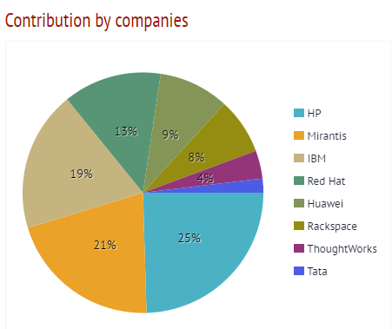
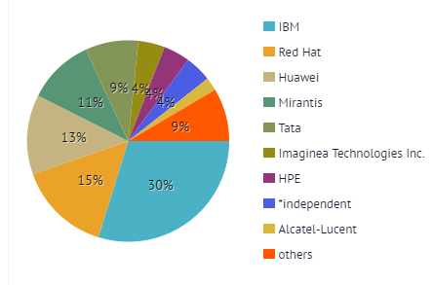
Liberty vs Mitaka Blueprints
Liberty: 53 Completed Blueprints
Mitaka: 47 Completed Blueprints

Slide 8
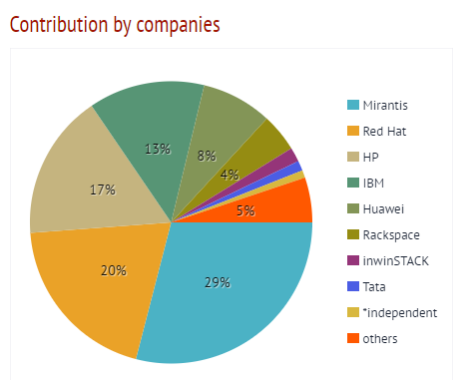
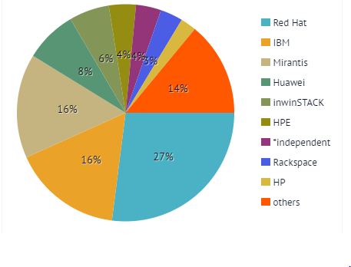
Liberty vs Mitaka Commits
Liberty: 1399 Commits
Mitaka: 1070 Commits

Slide 9
Convergence
“The new architecture”

Slide 10
Motivation
Robustness
Clouds are noisy
Build capacity in Heat to deal with failures in physical work
Heat engine restarts/failures fail stack
Convergence
Scale
Stack provisioned in singe heat-engine process
Large stacks can exceed heat engine‘s capacity
Stacks should scale to the limits of external components
Availability/
Usability
Take right action when user intervention not needed
Users should be able to update stack at any time
Existing stacks should keep working
Efforts to address all these concerns started under name “convergence”
Notes:
Hardware and software failures are a reality
Example: hypervisor failure when spawning a VM, user deletes a VM, network port disappearing, disk failures
Heat engines restart upon system upgrades/reboots
Operators don’t have to wait for the stack to be in right state to carry out maintenance activities
Heat should scale as much as the messaging or DB can scale
VM deleted, heat can re-create it
Backward compatibility for existing stacks

Slide 11
Convergence phases
Phase 1
Phase 2
Phase 3
Design changes in engine
Persist graph in DB
Workers in each engine
RPC cast resource task
Resources propagate on their own
Observer
Observe before update
Fault tolerant heat engines?
Engine restarts
Engine processes crashing
Continous observer
Act based on changes in reality
Poll or use notification system
In process polling to observe-and-notify
User‘s choice to enable it

Slide 12
Phase 1: Design evolution
Legacy engine
Stack-1
Heat-Engine-1
Template
Heat-API
AMQP
Stack-2
DB
Heat-Engine-2
Heat-Engine-3
Stack-3
Z
D
D
W
X
Y
Stacks are distributed across available engines
C
C
G
H
I
J
K
A
B
A
B
A
B
C
D
E
F
Stack-1
Stack-2
Stack-3

Slide 13

Phase 1: Design evolution
Legacy engine
Stack-1
Heat-Engine-1
Template
Heat-API
AMQP
Stack-2
DB
Heat-Engine-2
Heat-Engine
G
H
A
B
C
D
E
F
Stack-3
Z
D
D
W
X
Y
Stacks are distributed across available engines
C
C
G
H
I
J
K
Entire stack is handled by one engine
A
B
A
B
A
B
C
D
E
F
Even when other engines are available they will not be utilized for stacks that are in progress
Stack-1
Stack-2
Stack-3
Legacy engine: Large stacks can exceed capacity of one engine process

Slide 14


Phase 1: Design evolution
Convergence engine
A
B
C
F
Heat-Engine-1
“worker”
B
A
D
DB
Template
Heat-API
AMQP
“worker”
Heat-Engine-2
A
B
E
Heat-Engine-3
“worker”
Schedule A, B
Stack-1
Z
D
D
X
Y
C
C
G
H
I
J
K
1. Engine processes start listening on “worker” topic
A
B
A
B
A
B
C
D
E
F
2. Parse the template and store graph, resources
Stack-1
Stack-2
Stack-3
3. Resources are distributed among heat engine processes
4. Resources acquire resource lock and proceed
Notes:
Components are same
Number engines
Workers in each heat engine

Slide 15
Phase 1: Design evolution
Convergence engine
A
B
C
F
Heat-Engine-1
Schedule C
“worker”
B
A
D
DB
Template
Heat-API
AMQP
“worker”
Heat-Engine-2
A
B
E
Heat-Engine-3
“worker”
Z
D
D
X
Y
C
C
G
H
I
J
K
1. A is done, cannot propagate C
A
B
A
B
A
B
C
D
E
F
2. B is done, propagates C
Stack-1
Stack-2
Stack-3

Slide 16
Phase 1: Design evolution
Convergence engine
C
I
Heat-Engine-1
“worker”
G
J
DB
Template
Heat-API
AMQP
“worker”
Heat-Engine-2
C
H
K
Heat-Engine-3
“worker”
Z
A
B
A
B
D
D
W
X
Y
C
C
G
H
I
J
K
A
B
A
B
A
B
C
D
E
F
Stack-1
Stack-2
Stack-3
A
B
C
D
E
F
Stacks
Done Resources

Slide 17
Phase 1: Design evolution
Convergence engine
I
Heat-Engine-1
“worker”
D
W
DB
Template
Heat-API
AMQP
“worker”
Heat-Engine-2
D
K
Heat-Engine-3
“worker”
C
C
Z
A
B
A
B
D
D
W
X
Y
C
C
G
H
I
J
K
A
B
A
B
A
B
C
D
E
F
Stack-1
Stack-2
Stack-3
G
H
J
A
B
C
D
E
F
Stacks
Done Resources

Slide 18
Phase 1: Design evolution
Convergence engine
W
Heat-Engine-1
“worker”
X
DB
Template
Heat-API
AMQP
“worker”
Heat-Engine-2
Y
Heat-Engine-3
“worker”
D
D
C
C
Z
A
B
A
B
D
D
W
X
Y
C
C
G
H
I
J
K
A
B
A
B
A
B
C
D
E
F
Stack-1
Stack-2
Stack-3
G
H
I
J
K
A
B
C
D
E
F
Stacks
Done Resources

Slide 19
Phase 1: Design evolution
Convergence engine
Heat-Engine-1
“worker”
DB
Template
Heat-API
AMQP
“worker”
Heat-Engine-2
Z
Heat-Engine-3
“worker”
D
D
C
C
Z
A
B
A
B
D
D
W
X
Y
C
C
G
H
I
J
K
A
B
A
B
A
B
C
D
E
F
W
X
Y
Stack-1
Stack-2
Stack-3
G
H
I
J
K
A
B
C
D
E
F
Stacks
Done Resources

Slide 20
Phase 1: Design evolution
Convergence engine
Heat-Engine-1
“worker”
DB
Template
Heat-API
AMQP
“worker”
Heat-Engine-2
Heat-Engine-3
“worker”
D
D
C
C
Z
A
B
A
B
D
D
W
X
Y
C
C
G
H
I
J
K
Z
A
B
A
B
A
B
C
D
E
F
W
X
Y
Stack-1
Stack-2
Stack-3
G
H
I
J
K
A
B
C
D
E
F
Stacks
Done Resources

Slide 21
Phase 1: Design Comparison
Legacy
Convergence
Locking
Stack wide
More granular resource locks
Graph/Progress Info
In memory
In DB
Load distribution
Stack runs on one engine process
Stack resource tasks distributed among heat engine processes
Concurrent Update
No
Yes

Slide 22
Why Observer is required?
Phase 2: Observer
After successful deployment of a stack, the following problem exist if any resource fails
No mechanism to know current state of stack resources and notify user
If a resource in the stack is unavailable there is no way to sync the resource back to normal
Any updates to such a stack can fail

Slide 23
Phase 2: Observer
Stack update <stack id> <template with new resource>
Template
Heat-API
AMPQ
D
n
needs update ?
C
DB state matches template data, no update required
C
A
B
Stack
Heat-Engine
1. Get resource inform DB
DB
Heat-Engine
Heat-Engine
D
C
A
B
Stack

Slide 24
Phase 2: Observer
Stack update <stack id> <template with new resource>
Template
Heat-API
AMPQ
D
n
Creation of resource ‘n’ will fail
since dependent resource ‘C’
is not available
C
n
A
B
Stack
Heat-Engine
DB
Heat-Engine
Heat-Engine
D
C
A
B
Stack

Slide 25
Phase 2: Observer
Stack update <stack id> <template with new resource>
Template
Heat-API
AMPQ
D
n
needs update ?
C
2. Get live state of the resource
C
DB state matches template data, no update required
A
B
Stack
1. Get resource inform DB
Heat-Engine
Observer
DB
Heat-Engine
Heat-Engine
3. Merge DB data with live state
4. Compare merged data with template data
D
C
A
B
5. Bring resource in sync
Stack

Slide 26
Convergence progress
5
Newton
4
Make default in newton -1
Stack-cancel-update & esoteric features
Address performance issues
Complete observe-on-update
Convergence Functional tests
Phase 3
HA using DLM
Continous observer?
Mitaka
3
Phase 2 BP for observe-on-update
Gate job for convergence made mandatory
Patch to keep testing TripleO
Testing and bug fixing
Fixing all intermittently failing functional tests
Lot of patches for observe-on-update
Liberty
2
Implement phase 1 BPs
Convergence graph computaion
Light weight stack
Workers, RPC cast
Resource level locks and retries
Concurrent workflow
Scenario tests
Experimental convergence gate job
Kilo
PoCs and evaluations in Mid Kilo
Decided to do in phases
Phase 1 BPs submitted
Implement DB changes
Implement Convergence message bus
1
Juno
Convergence initial BPs
(filed towards the end)
Notes:
Load levelling
Scale out
Concurrent update
Observe on update
HA
Continues observer
Migrate stacks
Gate jobs mandatory
TripleO gate jobs
Phase 1 BPs
Phase 2 BPs

Slide 27
Convergence Vs Legacy
(Time taken)
Time taken (secs)
32 Heat engine processes
48 CPU
256 GB RAM
1 TB HDD
Stack Size
https://github.com/asalkeld/convergence-rally
Notes:
* Tested with patches still in review
With convergence we had to increase the max DB connections size from default 1024
For smaller stacks legacy was better
Doing performance improvements on convergence, need to test with super big size (100K?)

Slide 28
Convergence comparison (Number of engine processes vs Time Taken)
Time taken (secs)
Stack Size

Slide 29
Legacy Engine comparison (Number of engine processes vs Time Taken)
Time taken (secs)
Stack Size

Slide 30
Convergence Blueprints
Activity | Release | Owners
Blueprint convergence | Juno | Clint Byrum & Mike Spreitzer
Blueprint convergence-engine | Juno | Clint Byrum
Blueprint convergence-continuous-observer | Juno | Clint Byrum
Blueprint convergence-observer | Juno | Clint Byrum
Convergence-engine PoC on top of upstream heat codebase | Juno, Kilo | Anant Patil, Rakesh HS, Sirushti Murugesan, Ishant Tyahi, Unmesh Gurjar, Vishnusaran Murugan, Kanagaraj Manickam
Convergence-engine PoC | Kilo | Zane Bitter
Convergence-engine blueprint is converted into small blueprints based on above PoC | Kilo | Zane Bitter
Blueprint convergence-config-option | Kilo | Peter Razumovsky
Blueprint convergence-resource-table | Kilo | Sergey Kraynev
Blueprint convergence-message-bus | Kilo | Kanagaraj Manickam
Blueprint convergence-push-data | Kilo | Sergey Kraynev
Blueprint convergence-stack-data | Kilo | Anant Patil
Blueprint convergence-concurrent-workflow | Liberty | Angus Salkeld
Blueprint convergence-graph-progress | Liberty | Rakesh H S
Blueprint convergence-lightweight-stack | Liberty | Sirushti Murugesan
Blueprint convergence-prepare-traversal | Liberty | Rakesh H S
Blueprint convergence-check-workflow | Liberty | Sirushti Murugesan
Blueprint convergence-resource-locking | Liberty | Ishant Tyagi
Blueprint convergence-rollback | Liberty | Anant Patil
Blueprint convergence-resource-replacement | Liberty | Angus Salkeld
Blueprint convergence-resource-operations | Liberty | Kanagaraj Manickam
Enable Convergence-engine-functional testing in zuul gate | Liberty | Heat Community
Convergence-engine Functional-testing and bug fixing | Liberty | Heat Community

Slide 31
Get involved
IRC
The developers use IRC in #heat on Freenode for development discussion.
Meetings
Meetings are held on IRC in #openstack-meeting on Freenode. See the Heat agenda page for times and details.
Mailing list
Discussions about Heat happens on the openstack-dev mailing list. Please use the tag [Heat] in the subject line for new threads
https://wiki.openstack.org/wiki/Heat

Slide 32
Q & A

Slide 33
Thank you

